Slide 1

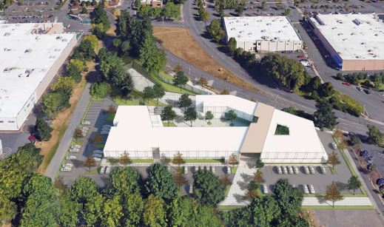
City of Portland
Design Commission
Design Advice Request
EA 19-115255 DA
SE 102nd + SE Cherry Blossom
March 21, 2019
Staff Presentation

Slide 2
Staff Introduction
Applicant Presentation
Staff Discussion Topics
Public Comments
Commission Discussion

Slide 3
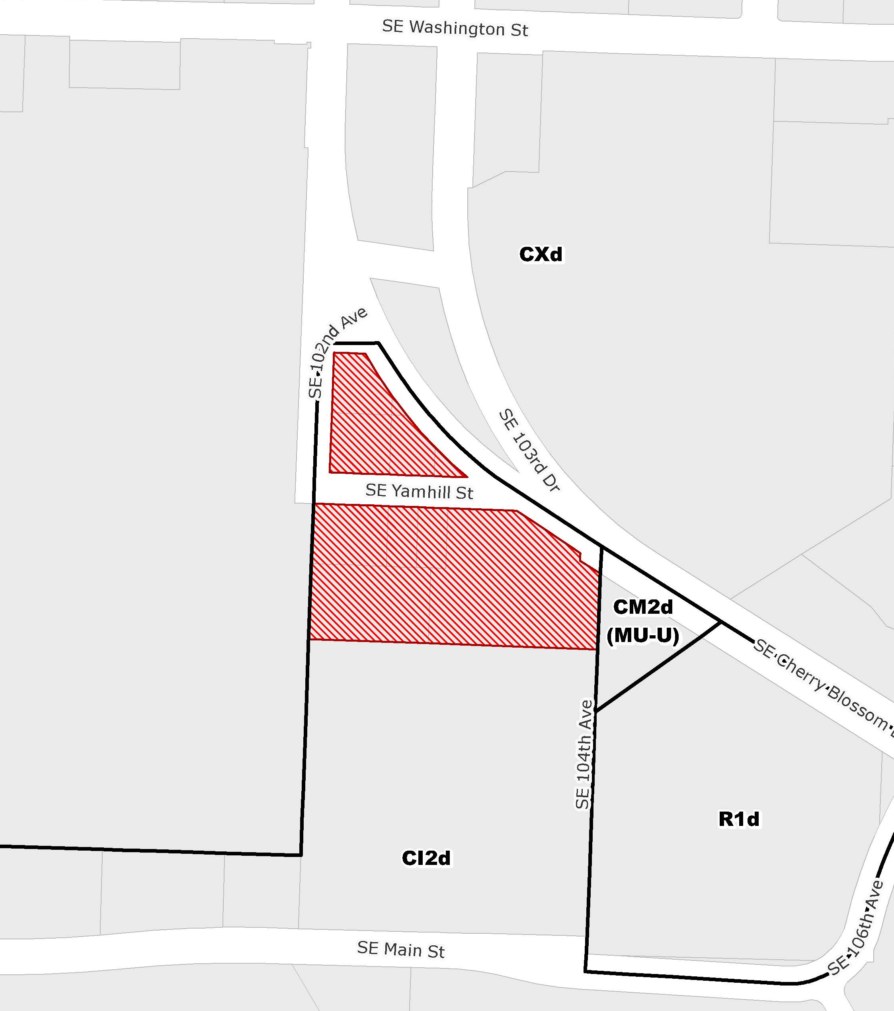
Location:
Gateway Plan District
Gateway Ped. District
Gateway Bicycle District
Base Zone:
CI2d, Campus Institutional 2, Design Overlay
Approval Criteria:
Gateway Regional Center Design Guidelines
Height:
120’ max base
Floor Area Ratio:
4:1 base, 6:1 bonus with residential units
Site Challenges:
BES Easement through SE Yamhill
Public street/easement on all sides
Modifications
Grade change (slopes up to the north)
Zoning

Slide 4
SE Cherry Blossom:
City Bikeway
Local Service Walkway
Major Transit Priority
District Collector
Bus line
Major Emergency Response
SE 102nd:
Local Service Walkway
Local Service Bikeway
Minor Emergency Response
SE Yamhill:
To be vacated, but BES easement remains. An east-west pedestrian connection is required.
Zoning

Slide 5
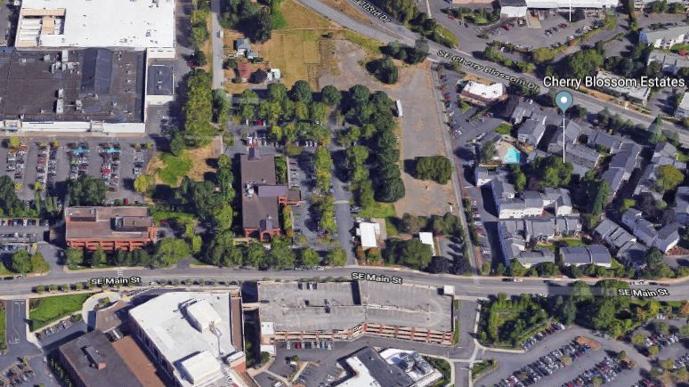
SE 102nd Ave
SITE
retail
SE Cherry Blossom Drive
retail
residential
medical
medical
Surrounding Context

Slide 6
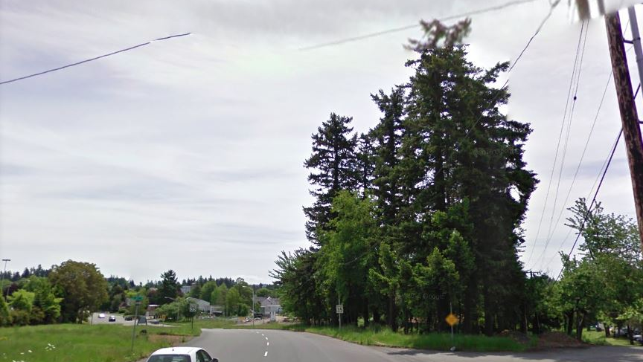
SITE
View of site from SE Cherry Blossom, looking south

Slide 7
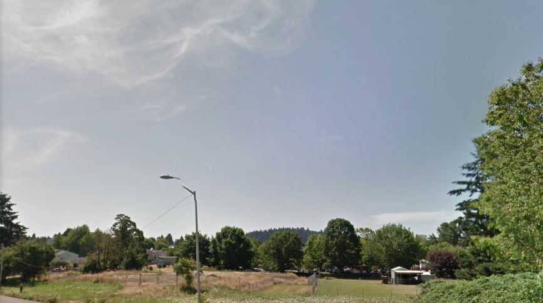
SITE
Slopes down to the south

Slide 8
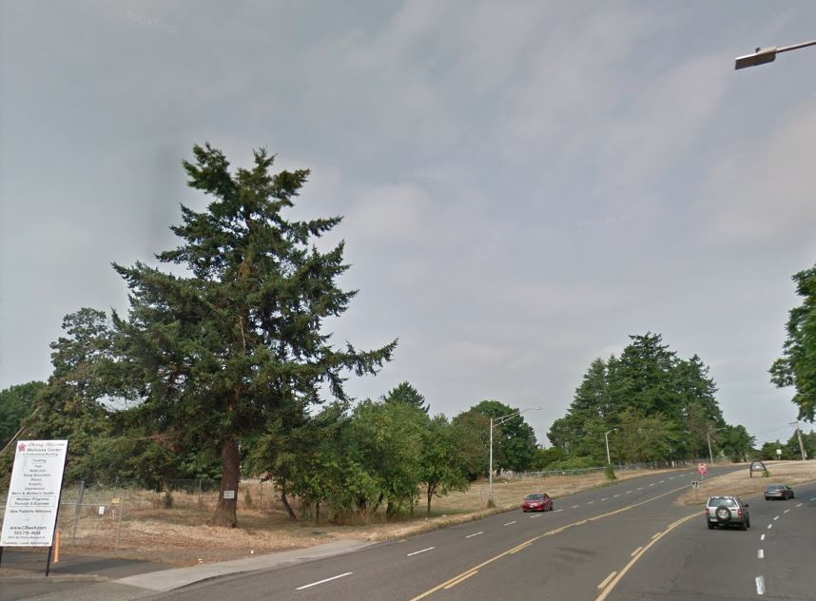
SITE
View of site from SE Cherry Blossom, looking north

Slide 9
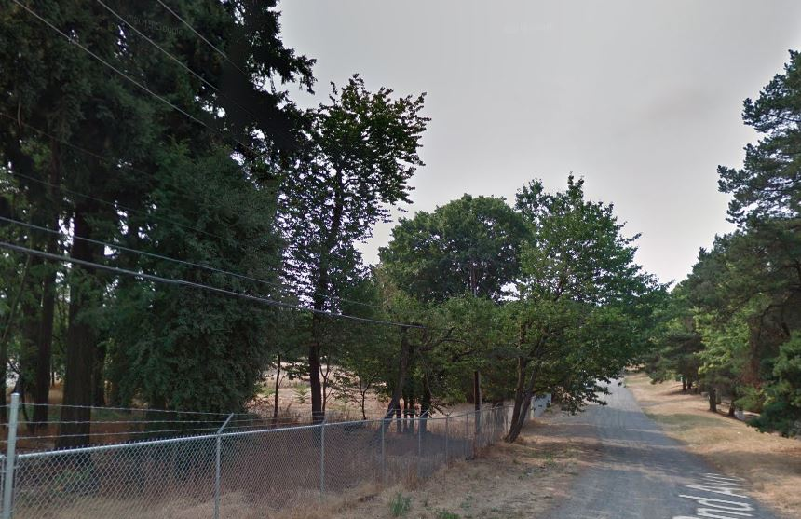
SITE
View of site from SE 102nd Ave, looking south

Slide 10
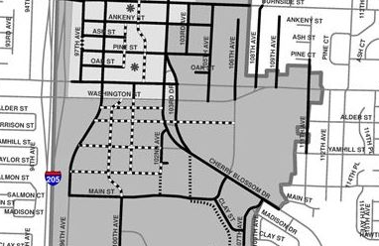
Gateway Master Street Plan

Slide 11
Staff Introduction
Applicant Presentation
Staff Discussion Topics
Public Comments
Commission Discussion

Slide 12
Staff Introduction
Applicant Presentation
Staff Discussion Topics
Public Comments
Commission Discussion

Slide 13
Context:
Site Plan
Entry/Egress
Public Realm
Transit Street Main Entrance Modification
Ground Floor Windows Modification
Fence Height and Visibility Modification
Maximum Setback Modification
Vehicles Between a Building and a Street

Slide 14
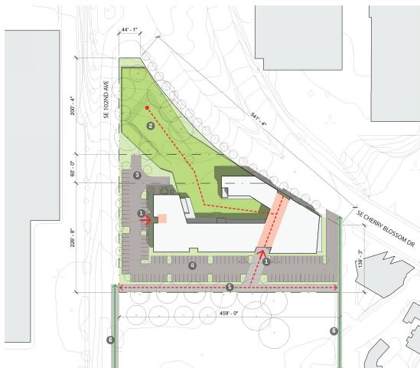
Context:
Site Plan
Entrances
Open Space
Pedestrian Easement

Slide 15
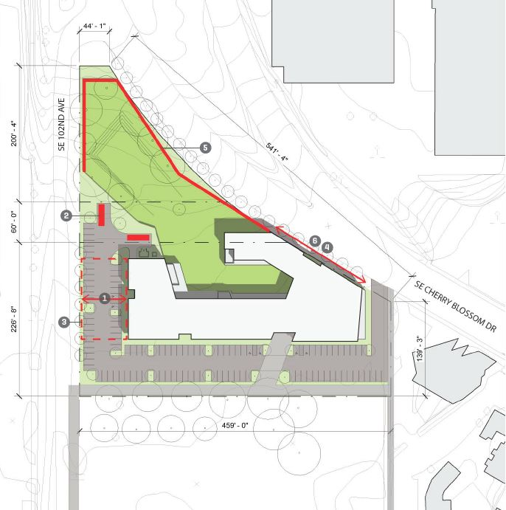
Context:
Site Entry/Egress
SE Cherry Blossom or
  SE 102nd?
Loading - Modification

Slide 16
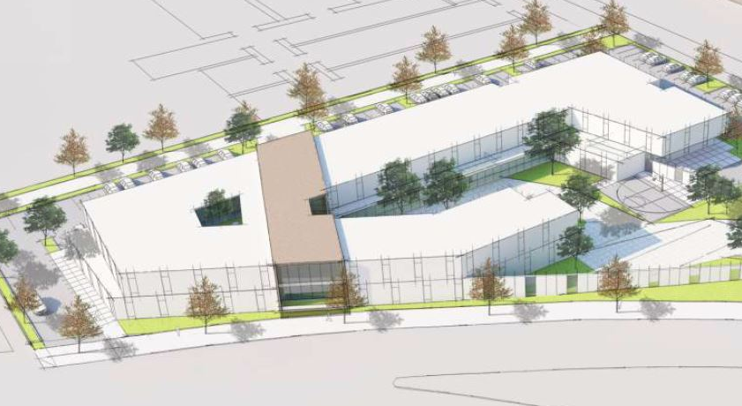
Public Realm:
Transit Street Main Entrance
Modification requested to not have an entrance from SE Cherry Blossom

Slide 17
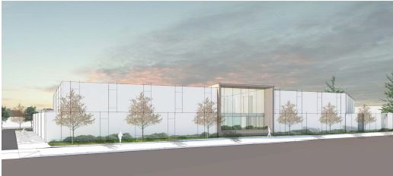
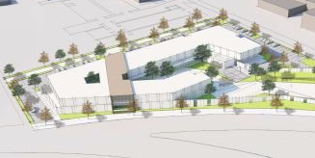
Public Realm:
Ground Floor Windows
Modification requested to reduce Ground Floor Windows on SE Cherry Blossom from 40% to 27%.

Slide 18
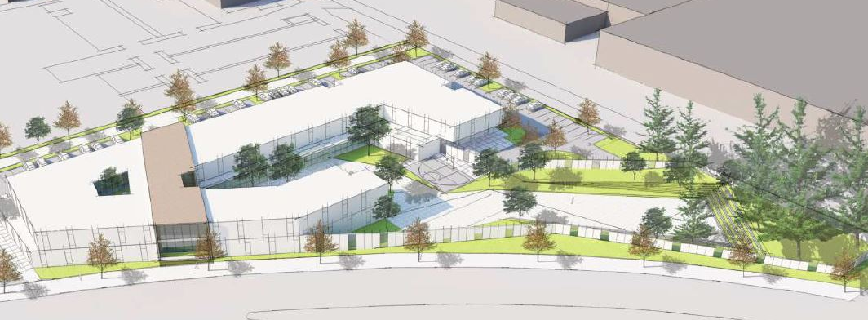
Public Realm:
Fence Height
Modification requested to allow a tall fence that is less than 50% open.
Standard says: Fences that are more than 50% sight-obscuring may be up to 3 ½ feet high.

Slide 19
Public Realm:
Maximum Setback
Modification requested to increase the allowed setback from 10’ to 72’ on SE 102nd Ave .

Slide 20
Public Realm:
Vehicles Between a Building and a Street
Modification requested to allow parking between the building and SE 102nd Ave.

Slide 21
Staff Introduction
Applicant Presentation
Staff Discussion Topics
Public Comments
Commission Discussion

Slide 22
Staff Introduction
Applicant Presentation
Staff Discussion Topics
Public Comments
Commission Discussion

Slide 23
