Slide 1
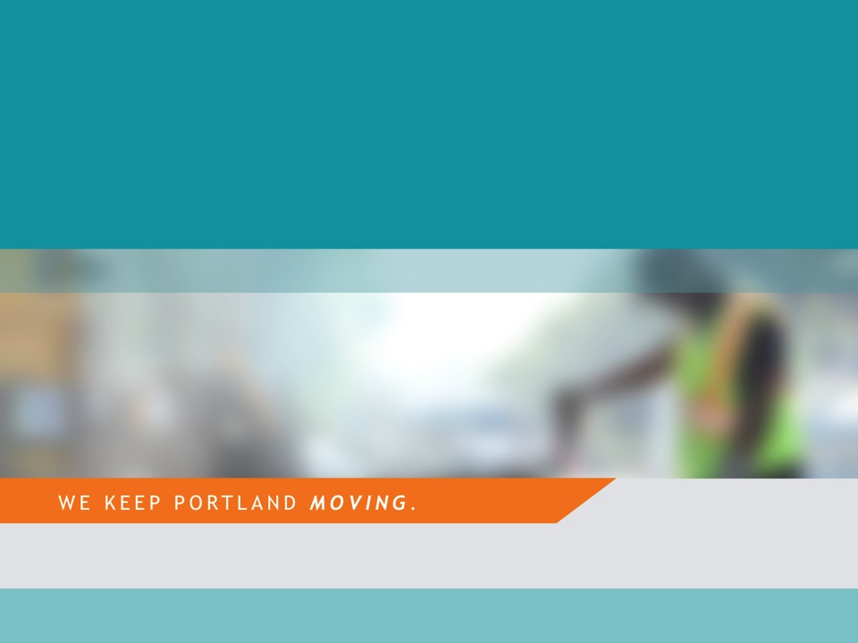


NE 97th Avenue Phase II
Local Improvement District
Resolution of Intent Hearing
March 13, 2019 – Agenda Item #221
Staff presenting: Andrew Aebi, Local Improvement District Administrator
Slide #1-8 photos taken on 2/14/19 and slides #9-10 photos on 3/09/19 by Andrew Aebi

Slide 2
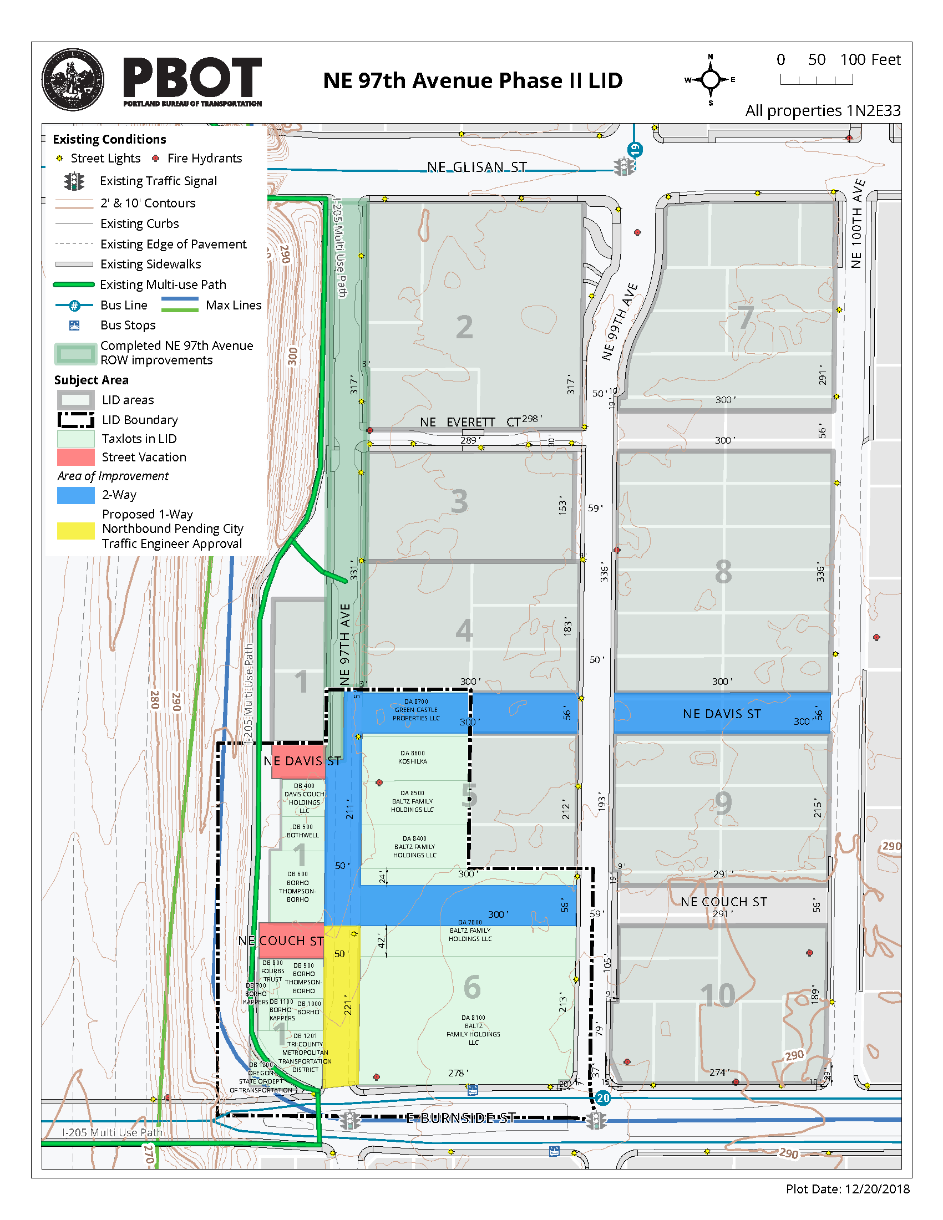
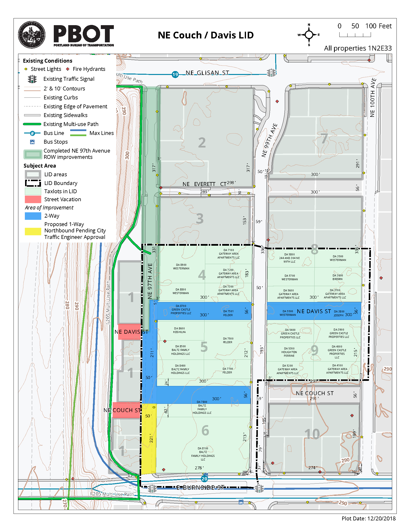
NE 97th Avenue Phase II LID (left) &
planned NE Couch/Davis LID (right)

Slide 3
Project Goals
Coordinated New Multiagency Infrastructure
1) Break up Burnside / Glisan / I-205 / 102nd Avenue “superblock”
2) Build 1,500 to 2,000 new housing units, 40% affordable
Achieve potential of Gateway URA before June 2022 expiration
4) Add to ridership of 3 nearby MAX lines, new 24-hour bus line
5) Improve pedestrian and bicyclist safety at light rail track crossing
6) Replace “cattle chute” I-205 Multiuse Path, add drainage, lighting
Limit urban sprawl; target growth in Gateway Regional Center
Transit-oriented placemaking in East Portland; equity score of 10

Slide 4
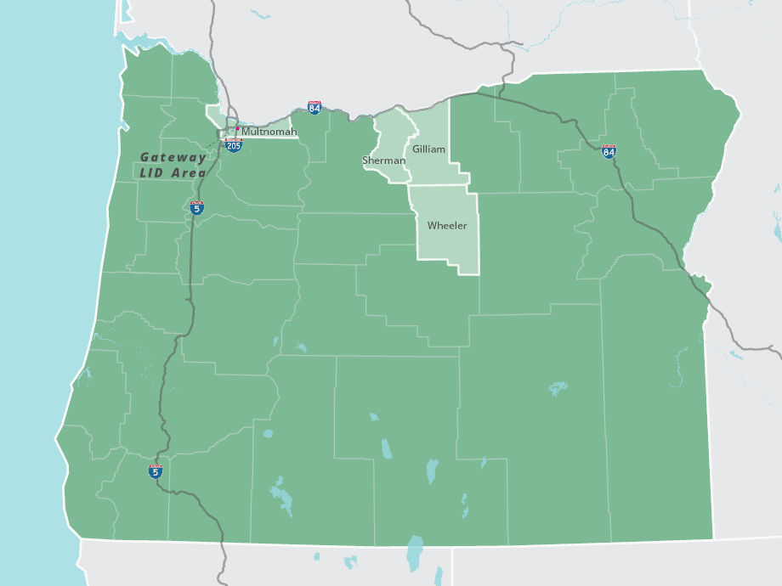
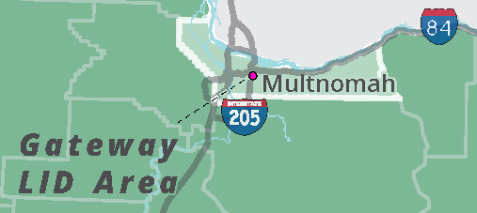
Hypothetical Gateway County
If it were to become the 37th Oregon county, newly housed population to exceed 3 existing counties

Slide 5
4th Largest LID in City History
Outside Central City
Financial Overview
$ 3,018,000 LID: Private Property Owners (53.6%)
$ 2,298,000 LID: TriMet (40.8%)
$ 319,000 PBOT: Overhead Funding (5.6%)
$ 5,635,000 Total Project Funding (100.0%)
Planned additional LIDs for NE Couch / Davis and NE Everett Ct.
Combined Gateway LIDs would become largest in City …
… surpassing recently-formed NE 46th & Bryant LID ($11,634K),
N. Suttle Rd. LID ($8,525K) and NW 20th Ave. LID ($7,565K)

Slide 6

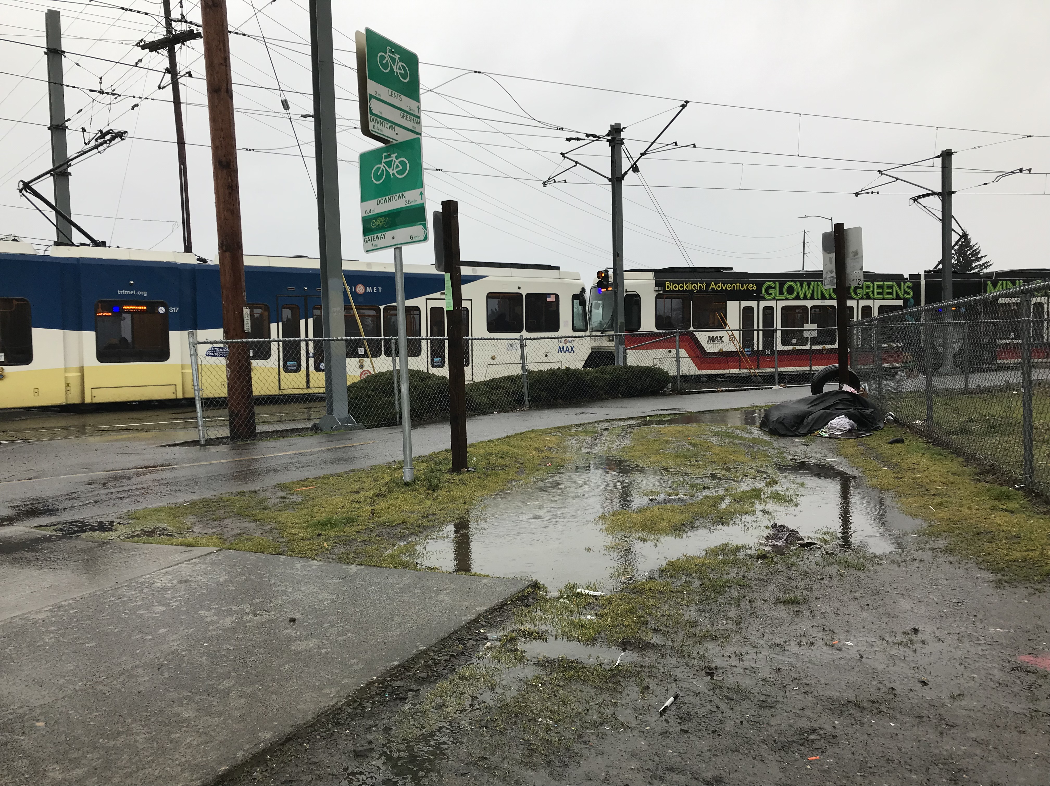
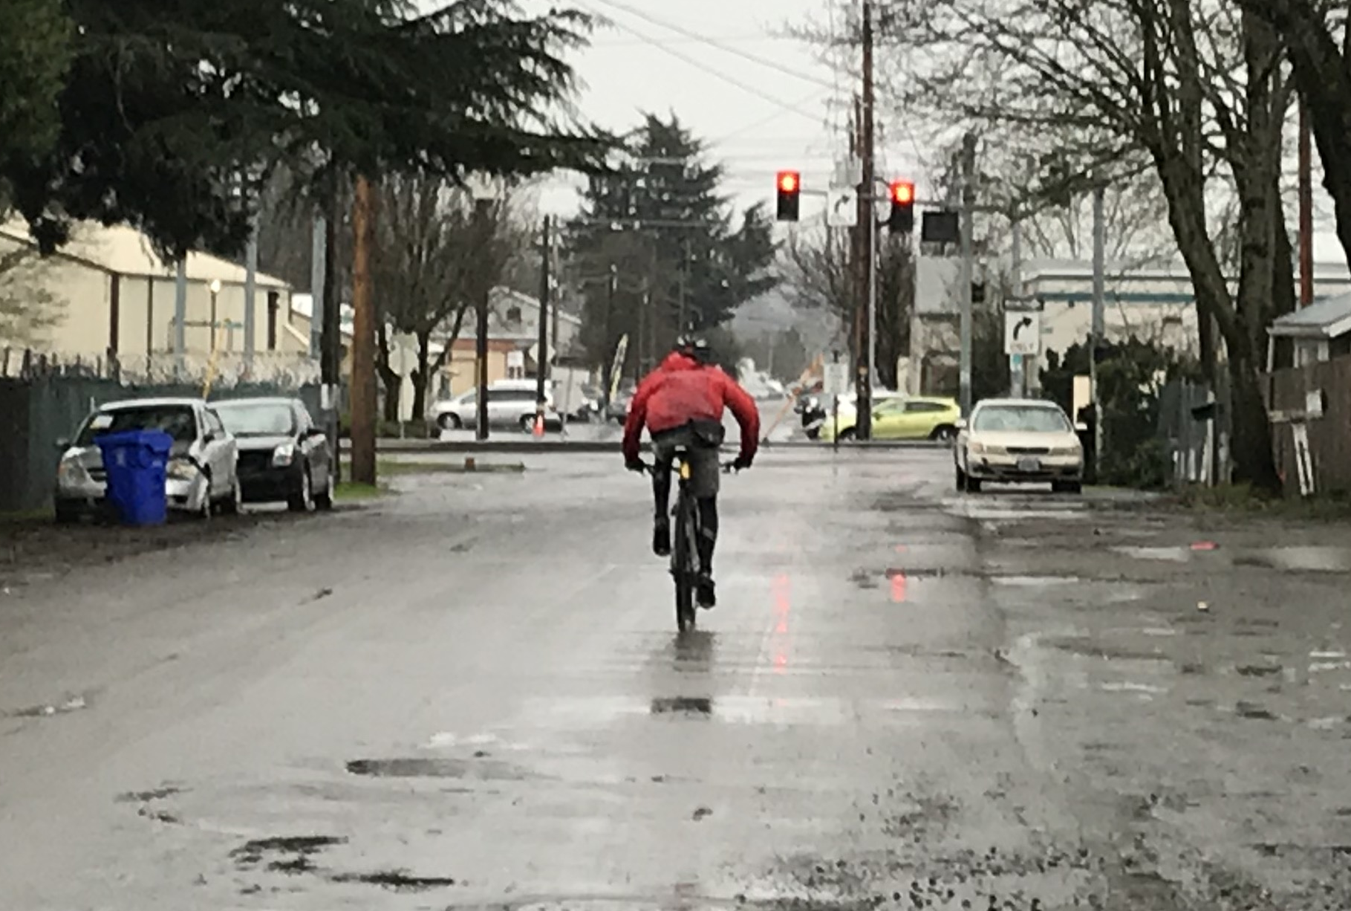
Improve safety at light rail crossing
MAX Blue Line at NE / SE 97th Ave. & E. Burnside St.

Slide 7
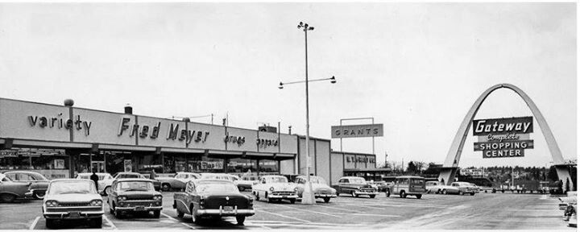
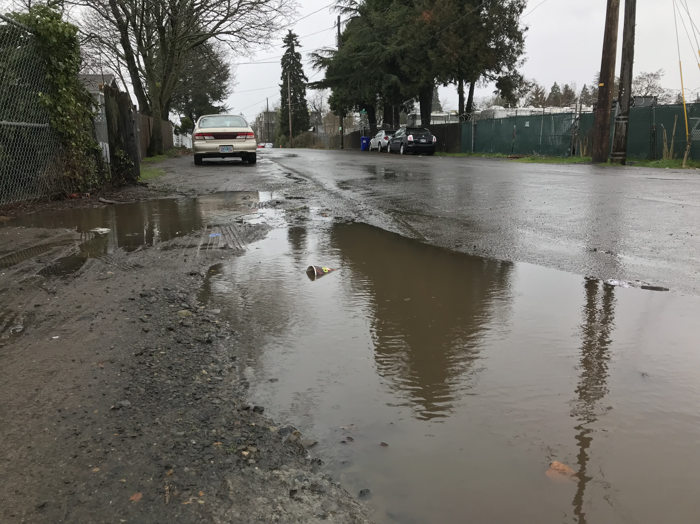
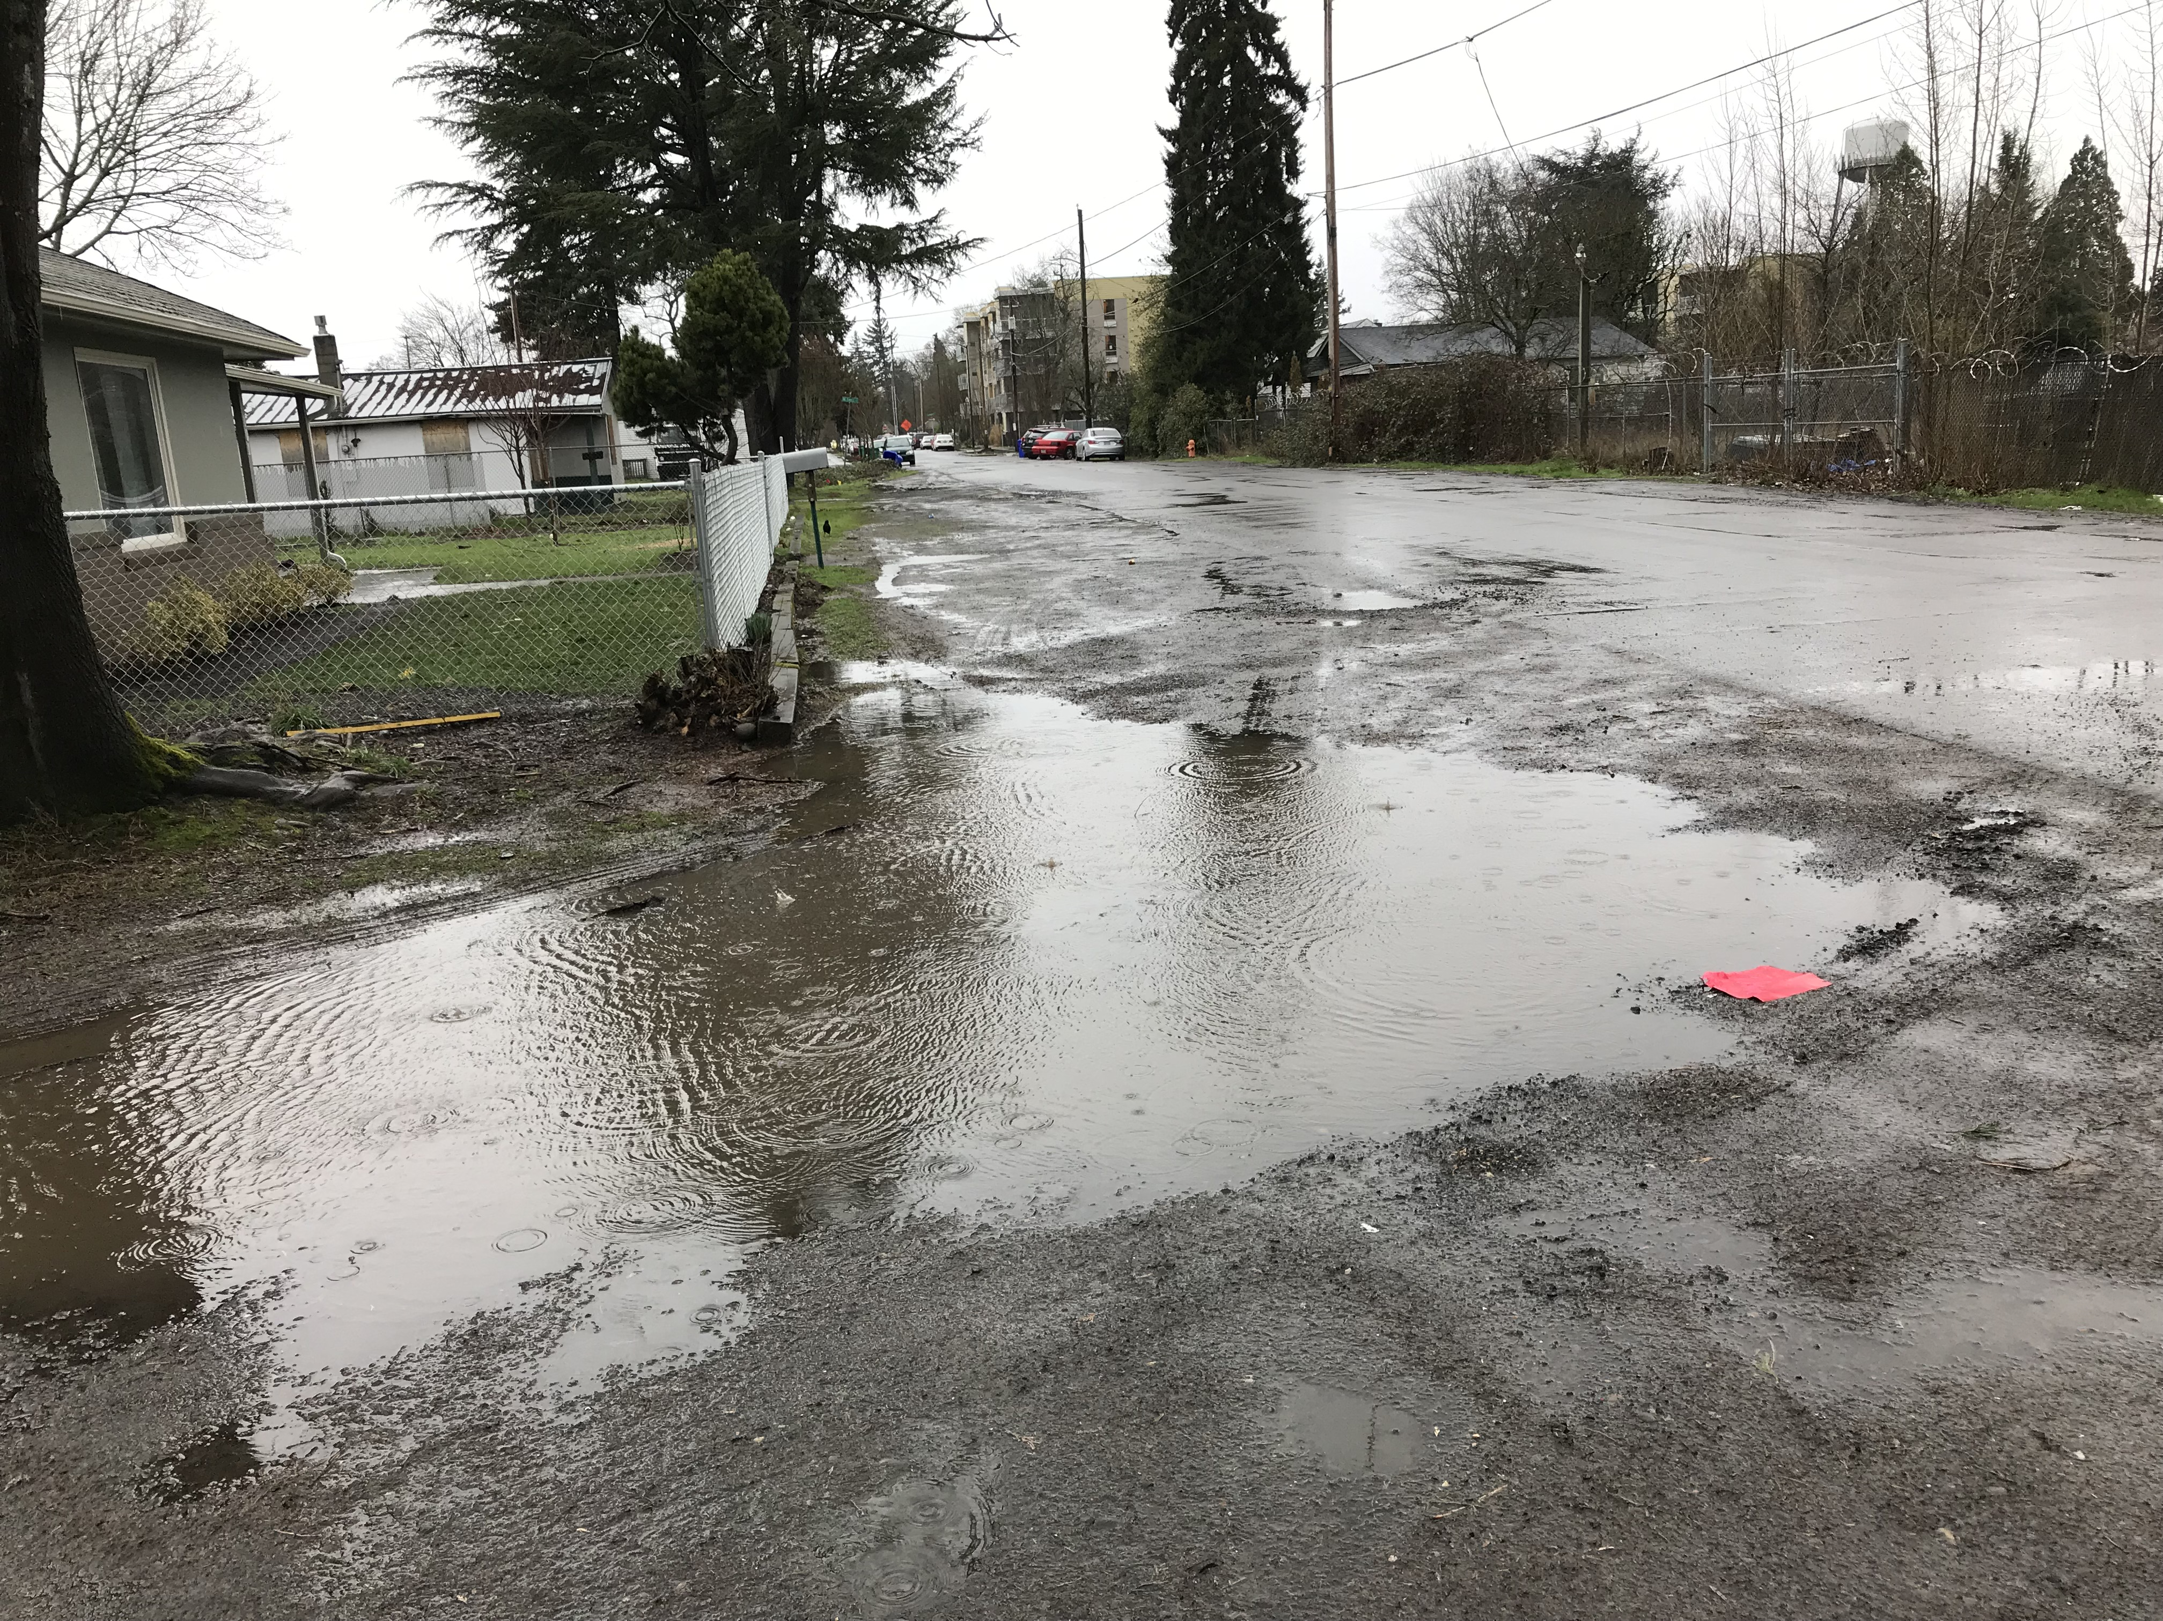
Gateway District: 1954 and 2019
Hazelwood Neighborhood sidewalk coverage still less than Citywide average (58.9% vs. 62.5%) after 65 years

Slide 8
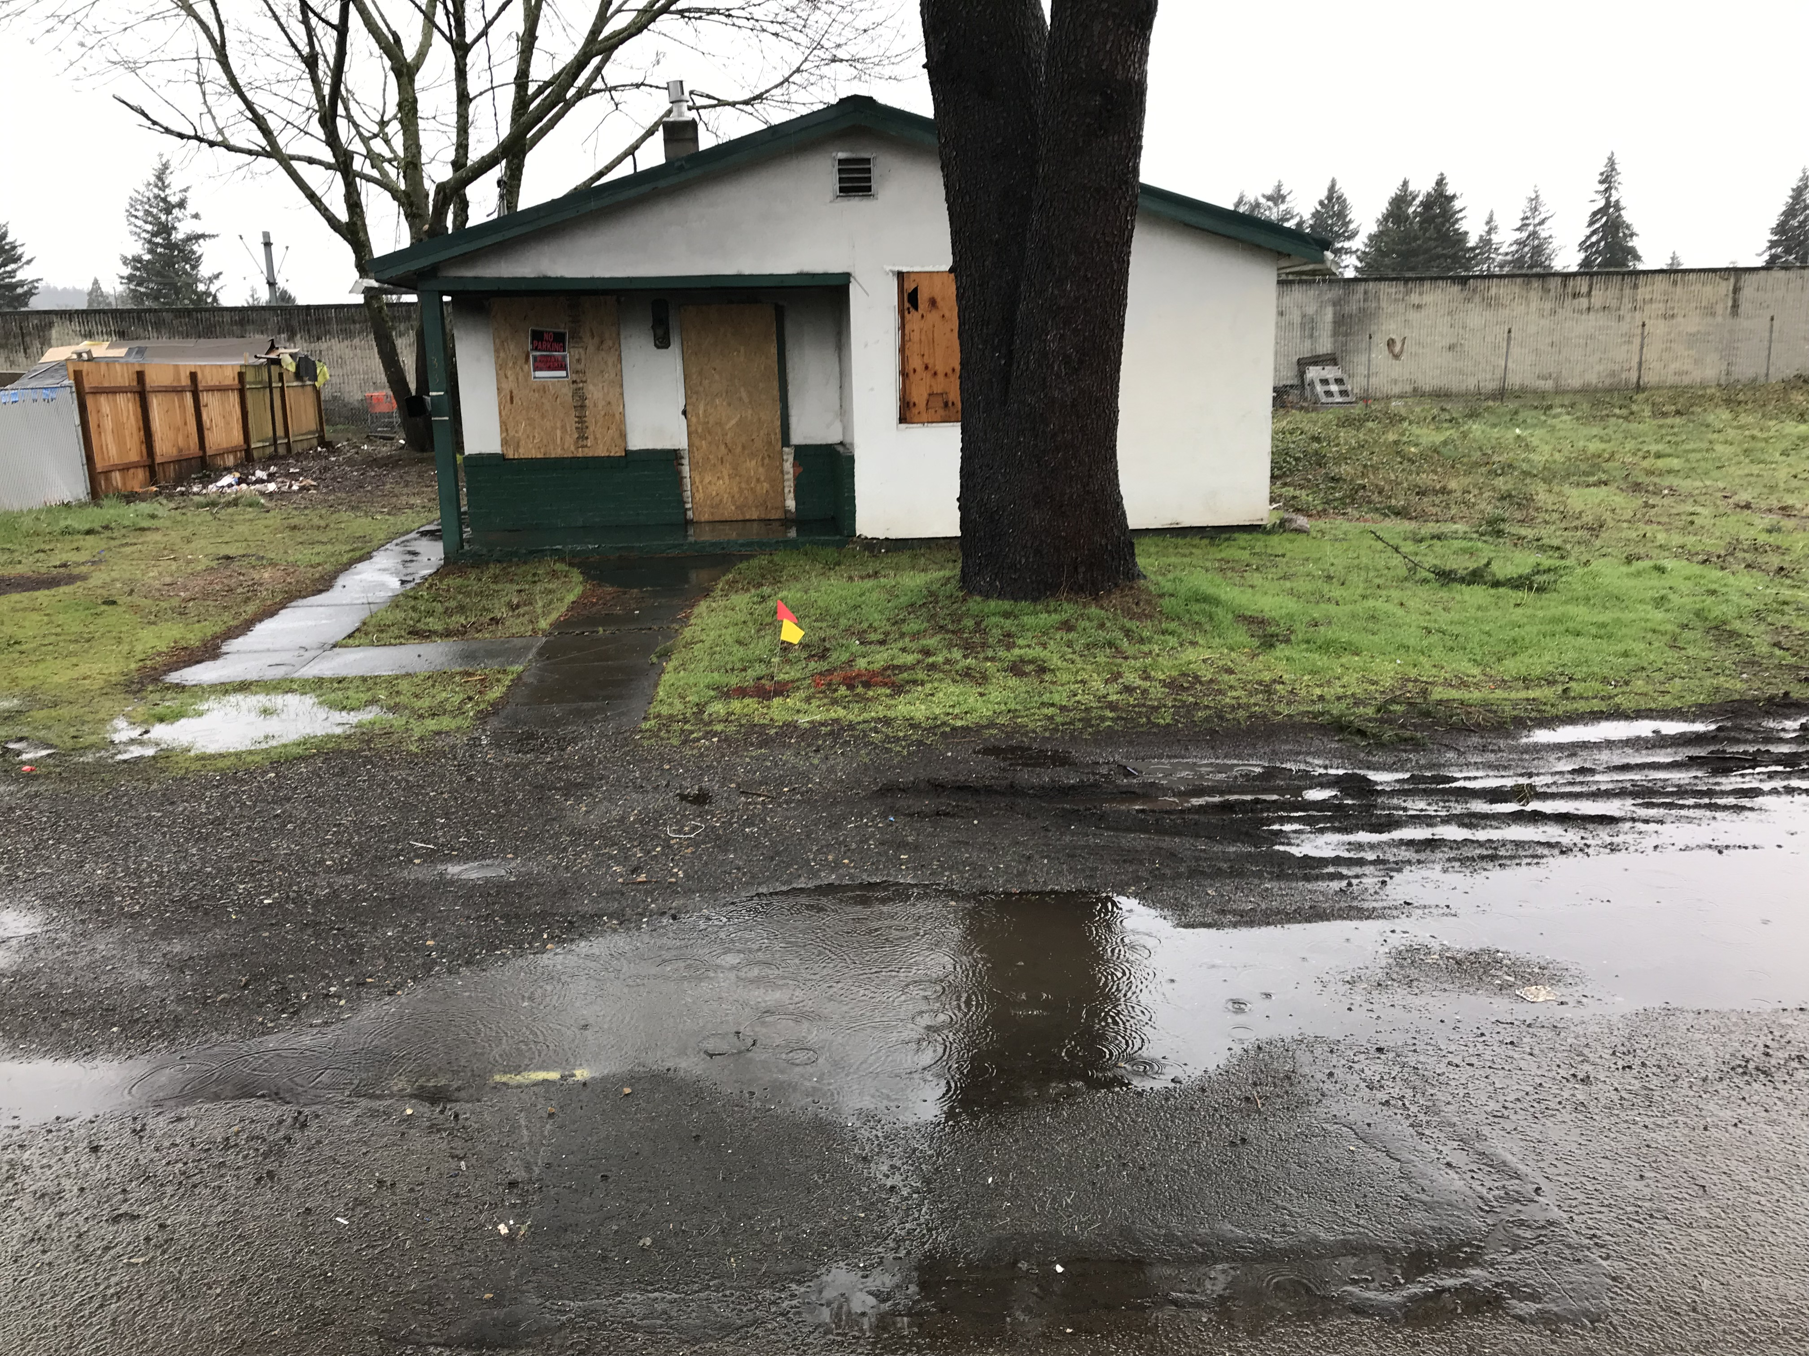
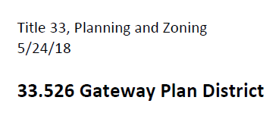
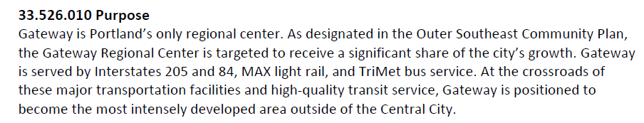
Second LID in Gateway URA since 2001
NE 97th & Couch (left) and 133 NE 97th Avenue (right)

Slide 9
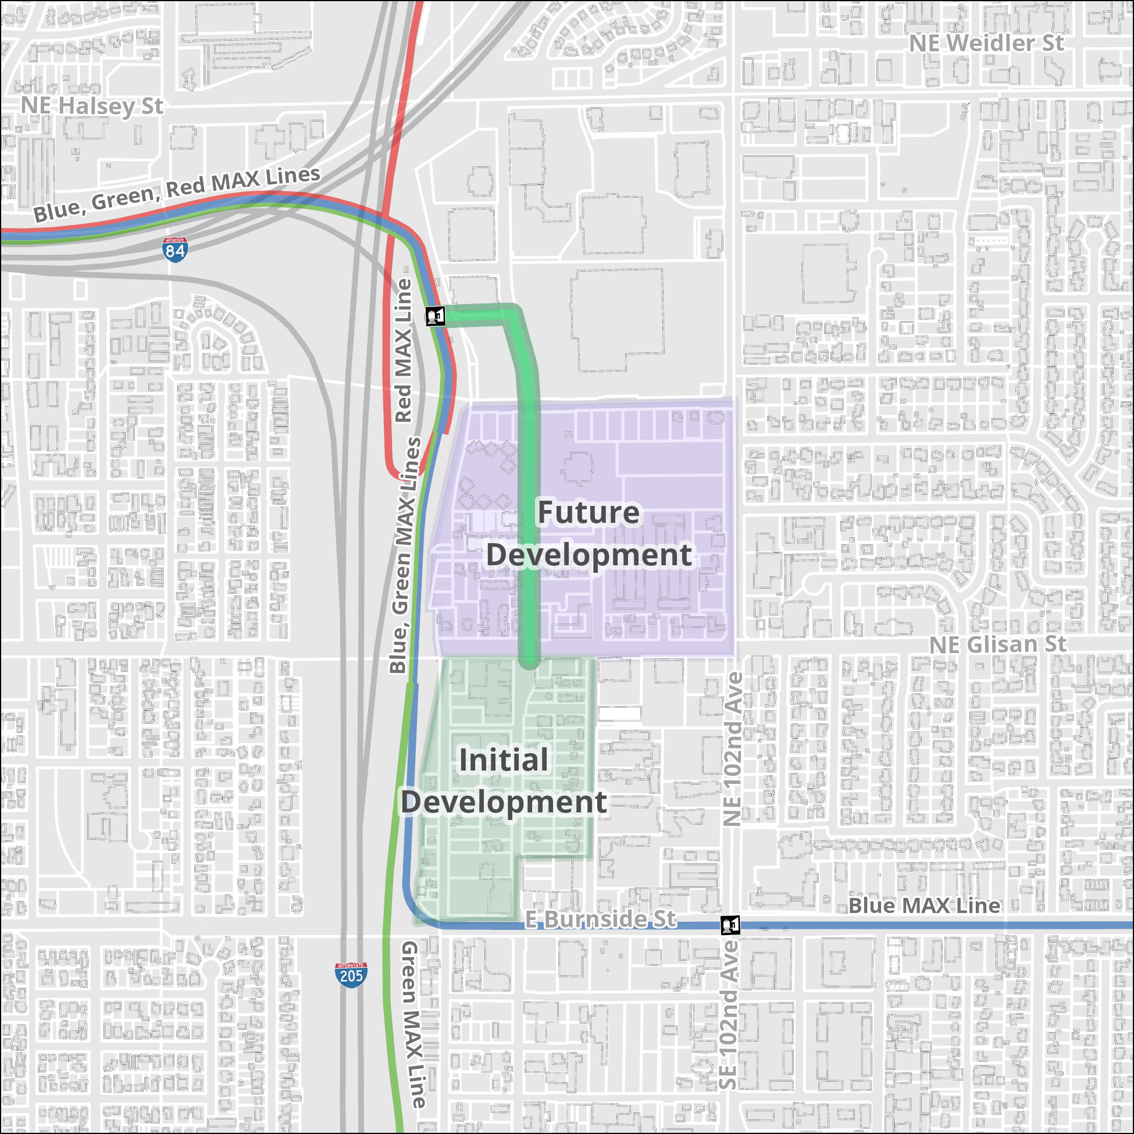
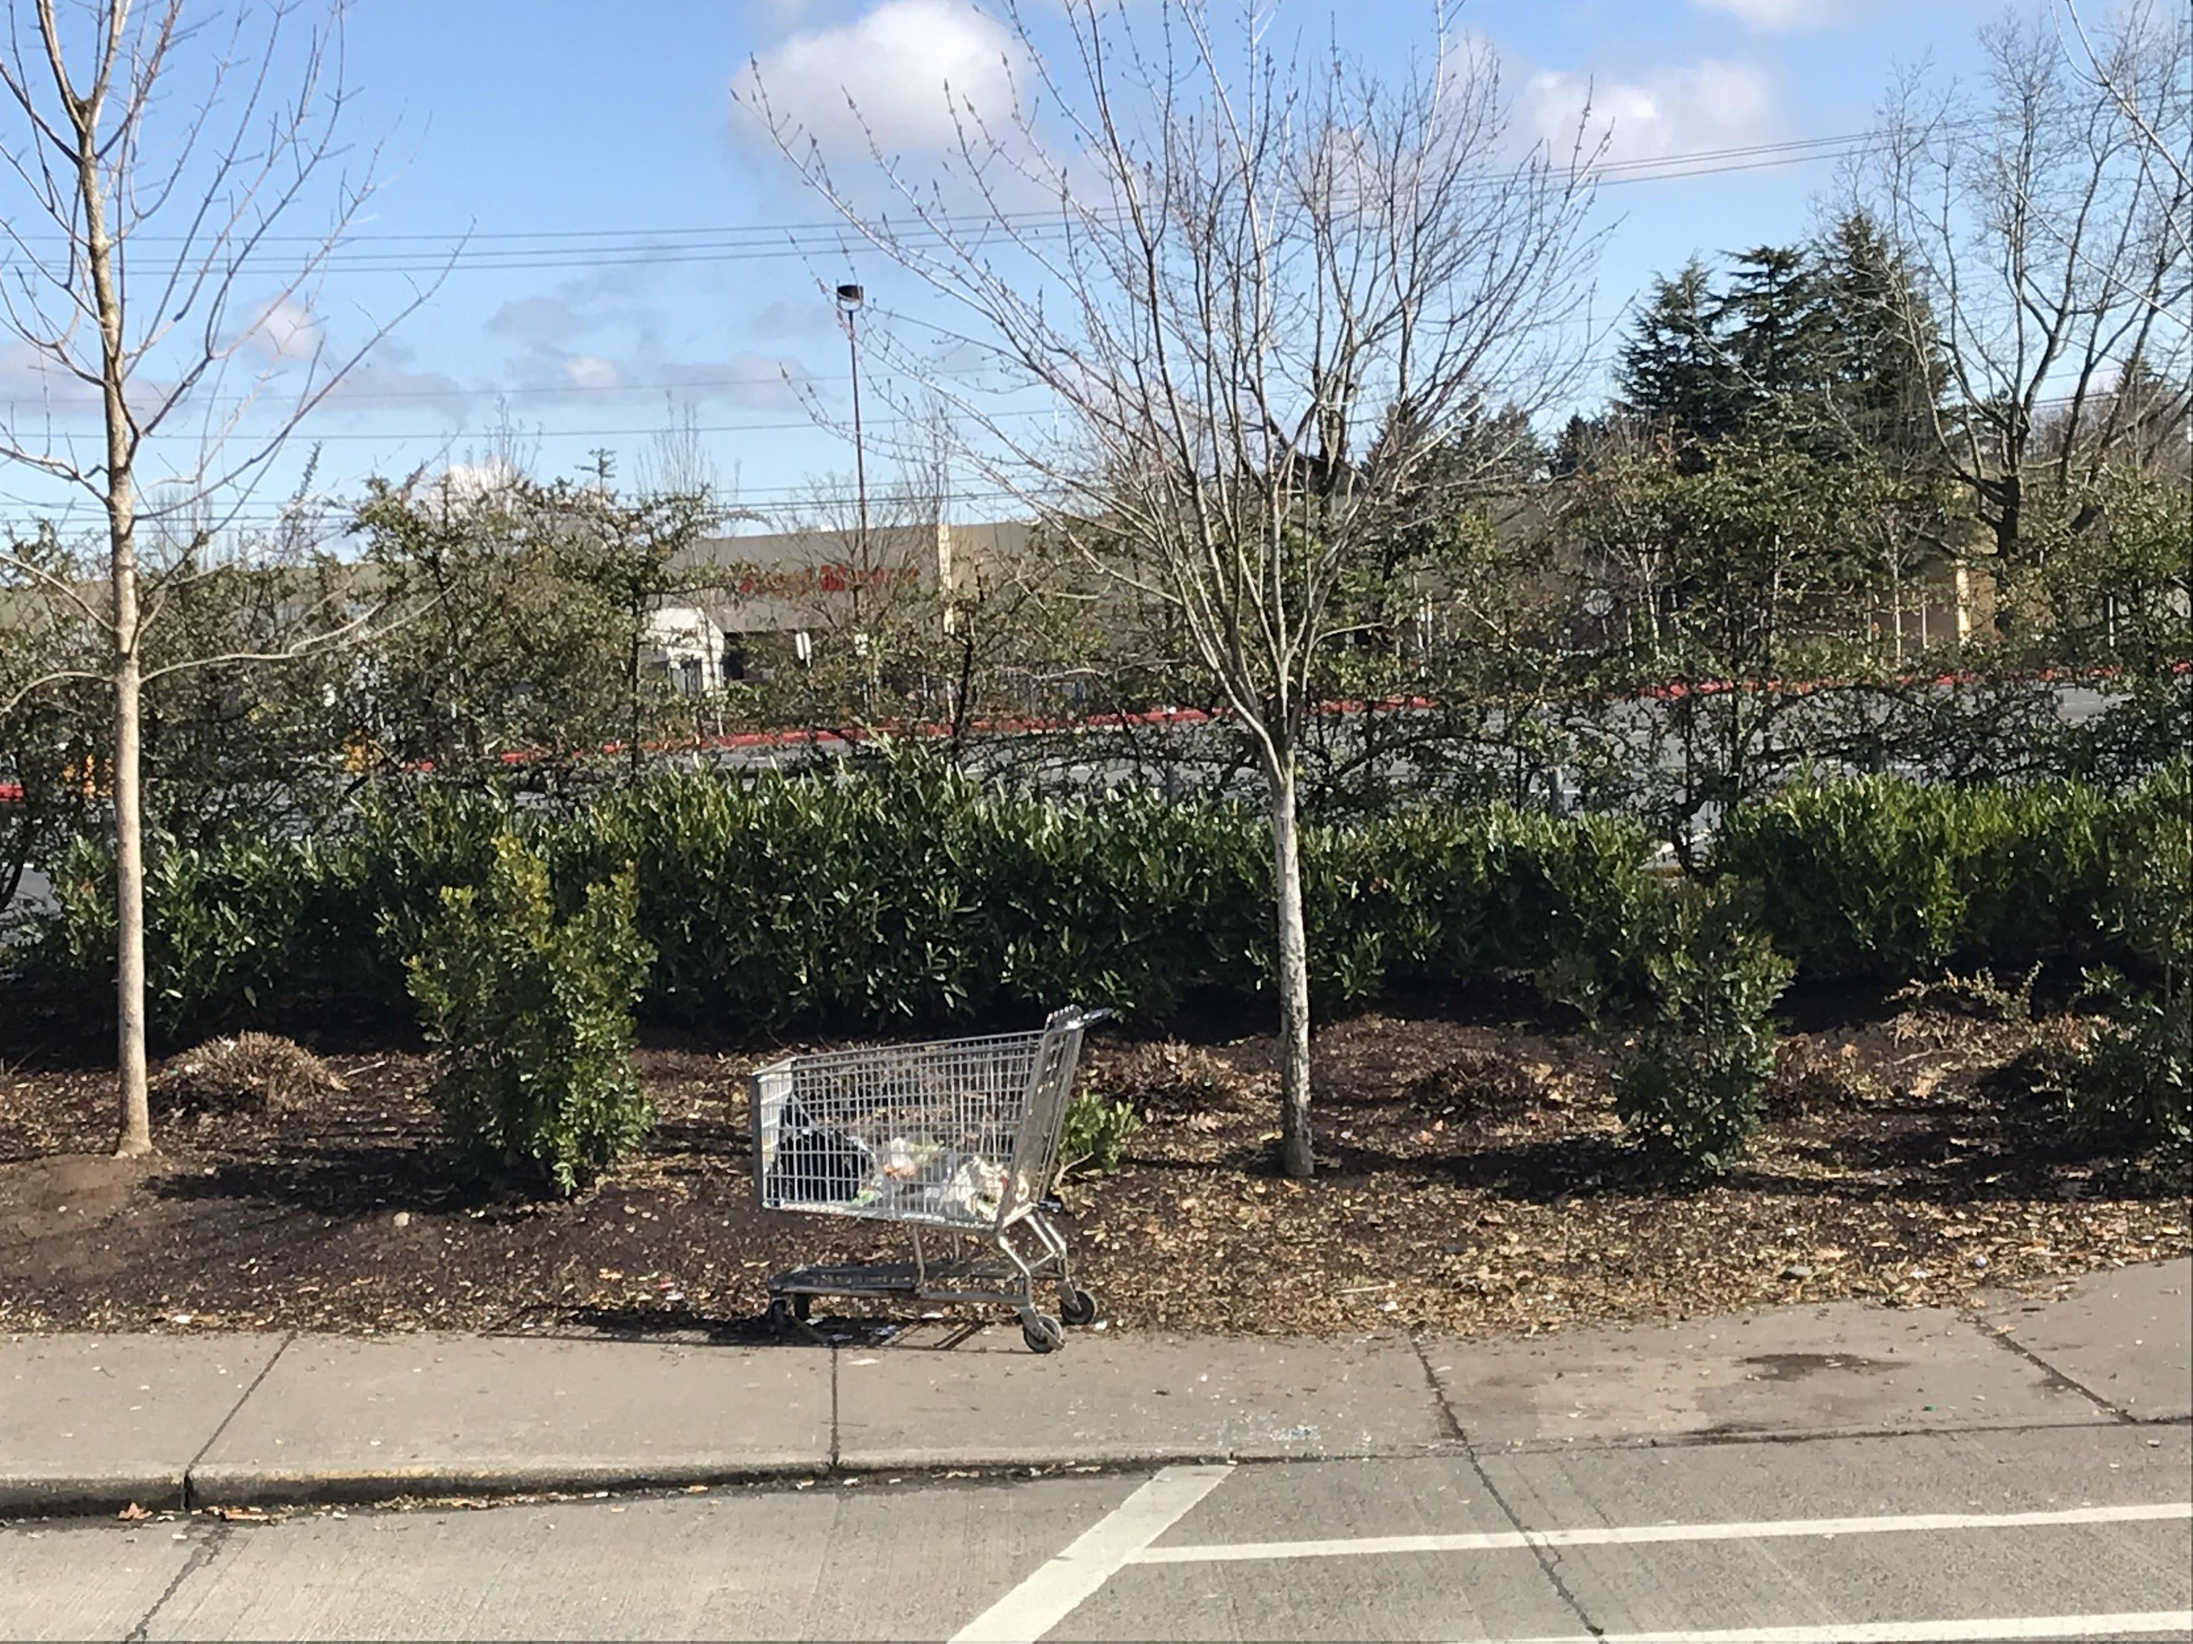

Phasing of Gateway Development
1/3 Mile Walk to 3 MAX Lines and 7 Bus Lines
“The transit center is next to the interchange of Interstate 84 and Interstate 205, and behind a Fred Meyer Store.”

Slide 10
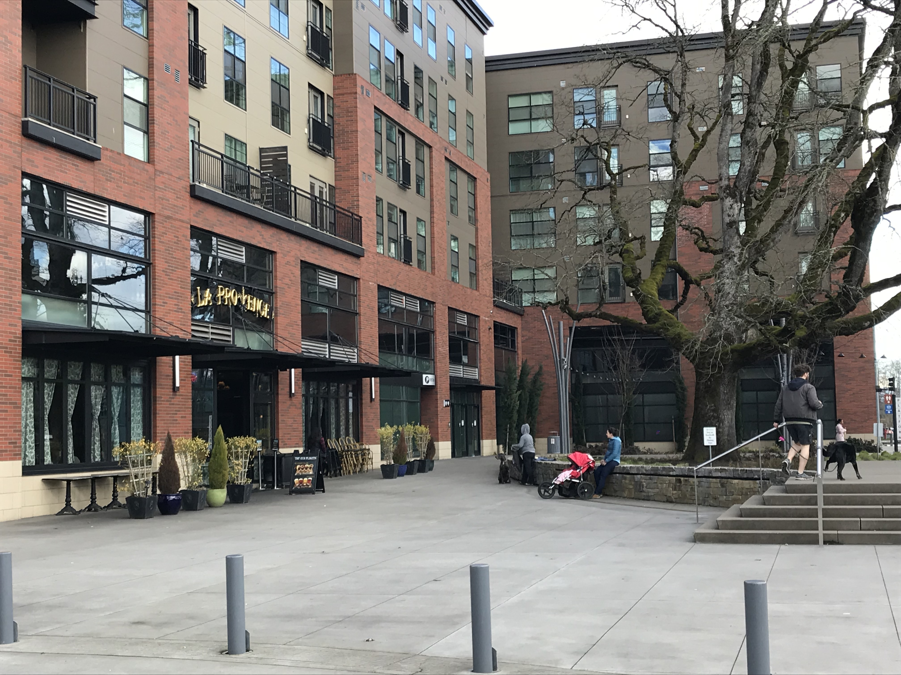
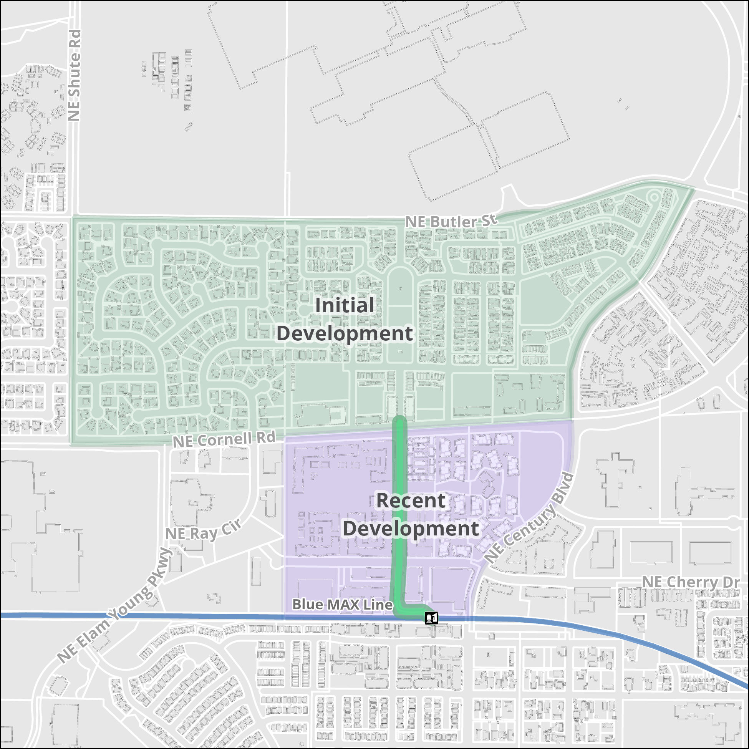
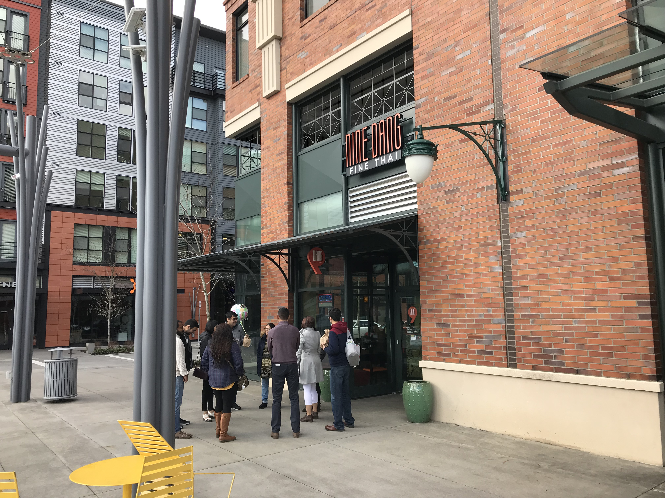
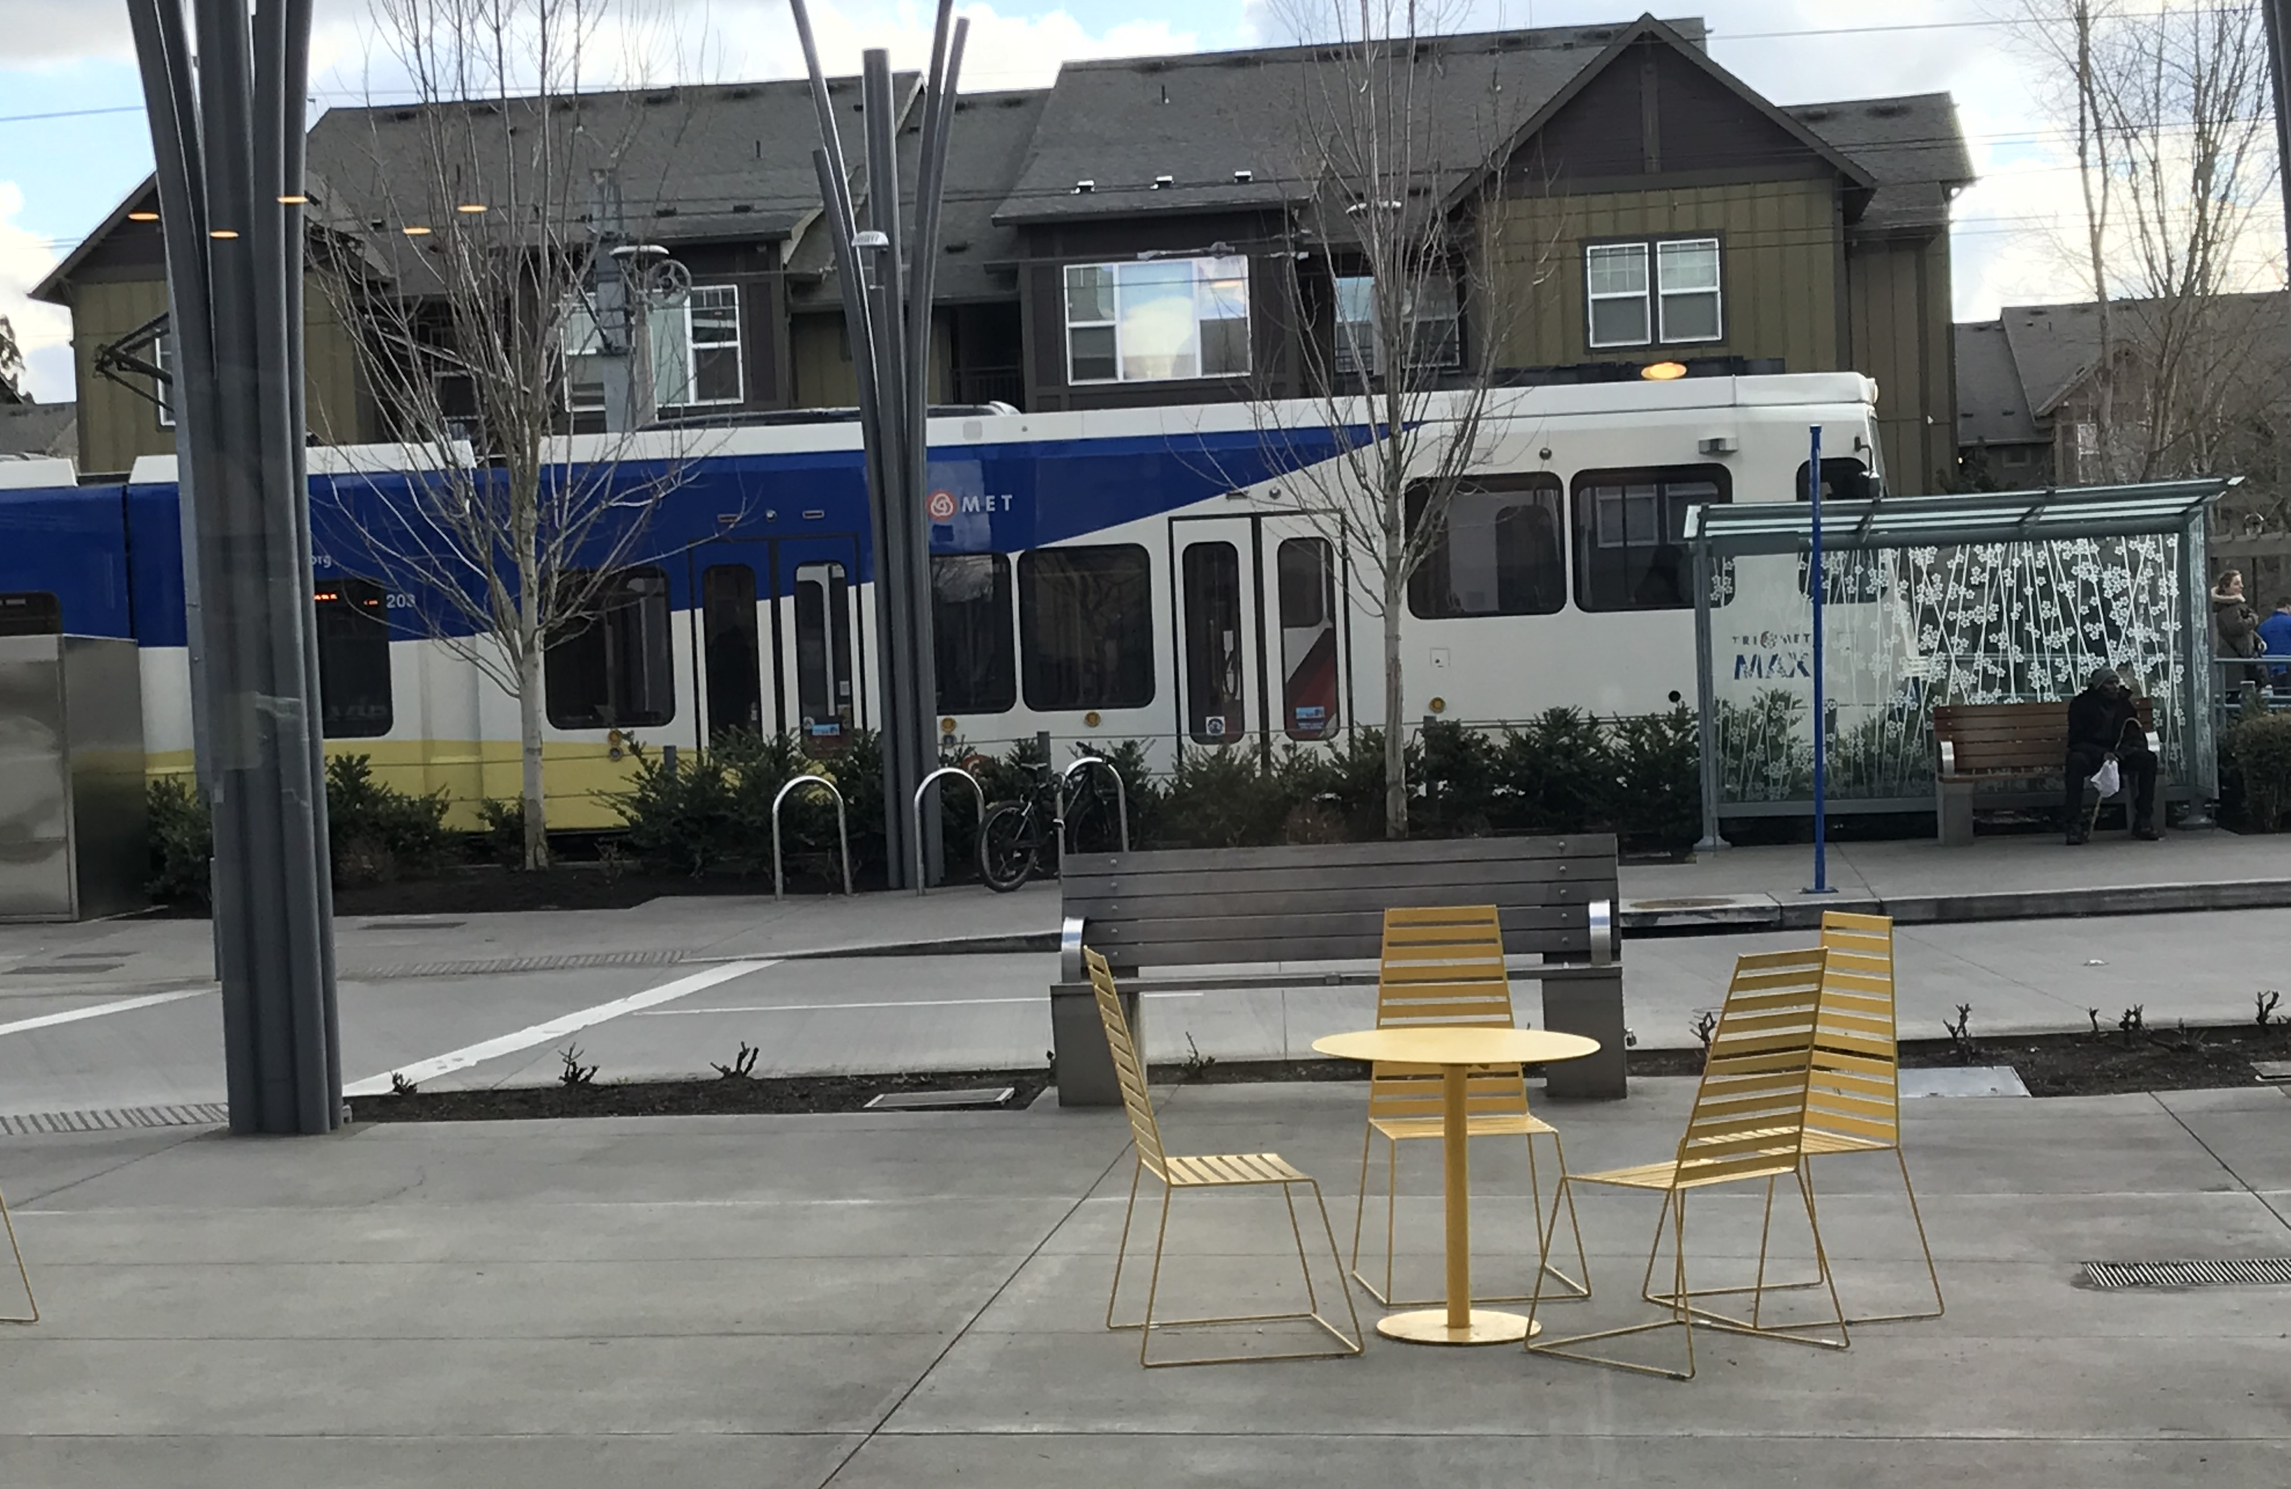
Phasing of Orenco Station Development
1/3 Mile Walk to MAX Blue Line and 1 Bus Line

Slide 11
Gateway URA Formed in 2001
Future View of I-205 & E. Burnside St. at LID Completion
Artistic renderings of slides #11 and #12 provided by HDR and Quatrefoil, respectively

Slide 12
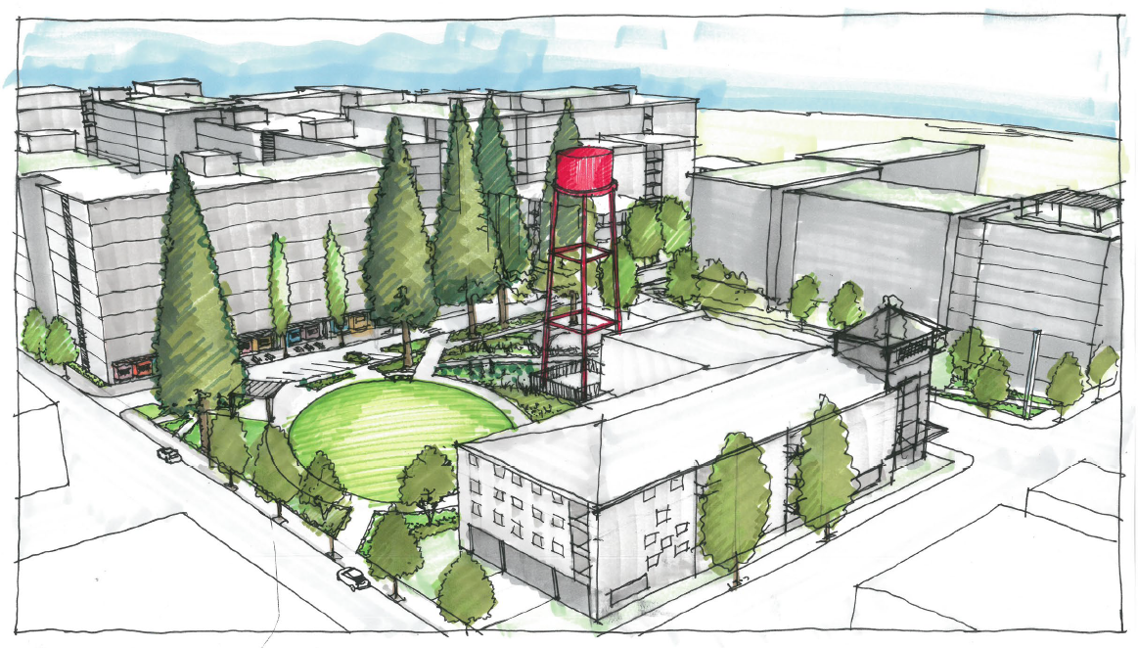
Gateway URA Expires in 2022
Future View of Park at NE 99th & Everett – Additional LID

