Slide 2
Experience PDX
Expanding intergenerational connections across cultures
Notes:
Is a project that aligns with Portland’s Age Friendly City initiative by asking the question: How can we tailor our local AARP Experience Corps model in a way that better engages the perspective and direct engagement of our culturally diverse elders in service to youth?

Slide 3
Portland was one of the first five pilots for Experience Corp
Circa 1995
Evidence based for third grade literacy
and older adult health and wellness
Notes:
John Hopkins/ and Wash University proved this, and about 10 years ago, Portland program received a Gates grant that showed similar outcomes
Program has always had high numbers of students whose first language is other than English, and mentors have been able to help students improve, while also assisting them with other needs. Great support, engagement with schools, principals are happy to have teams of people aged 50 + in their high need schools; there is a shift in the way the school feels, I have heard, as well as in the outcomes for the children at schools like Woodlawn, Sacramento Elementary, Alder and Mill Park … “

Slide 4
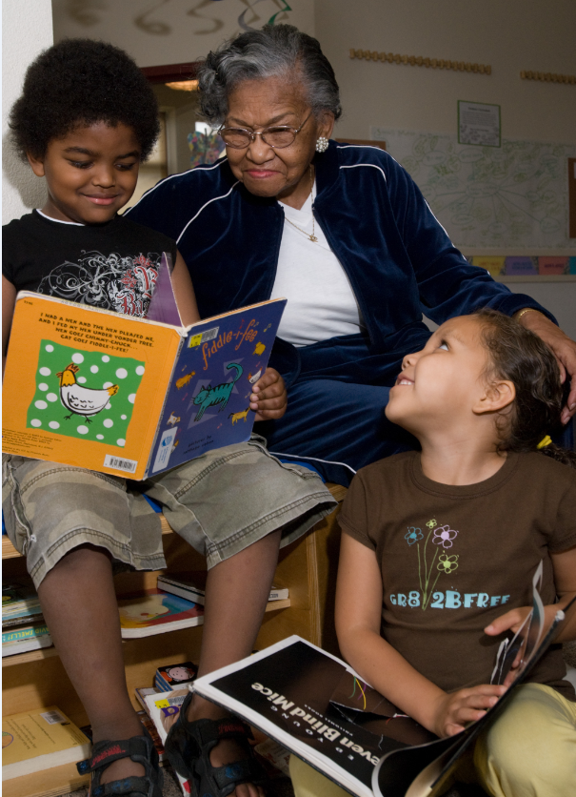
Numbers
Benefits all 11 sites via training/consultation
(over 300 children/52 mentors)
4 PDX Sites – training time 21 hours/mentor
72 children in one on one mentoring
768 through classroom support
4,550 hours of individual group and classroom
academic support and mentoring
Notes:
John Hopkins/ and Wash University proved this, and about 10 years ago, Portland program received a Gates grant that showed similar outcomes
Program has always had high numbers of students whose first language is other than English, and mentors have been able to help students improve, while also assisting them with other needs. Great support, engagement with schools, principals are happy to have teams of people aged 50 + in their high need schools; there is a shift in the way the school feels, I have heard, as well as in the outcomes for the children at schools like Woodlawn, Sacramento Elementary, Alder and Mill Park … “

Slide 5
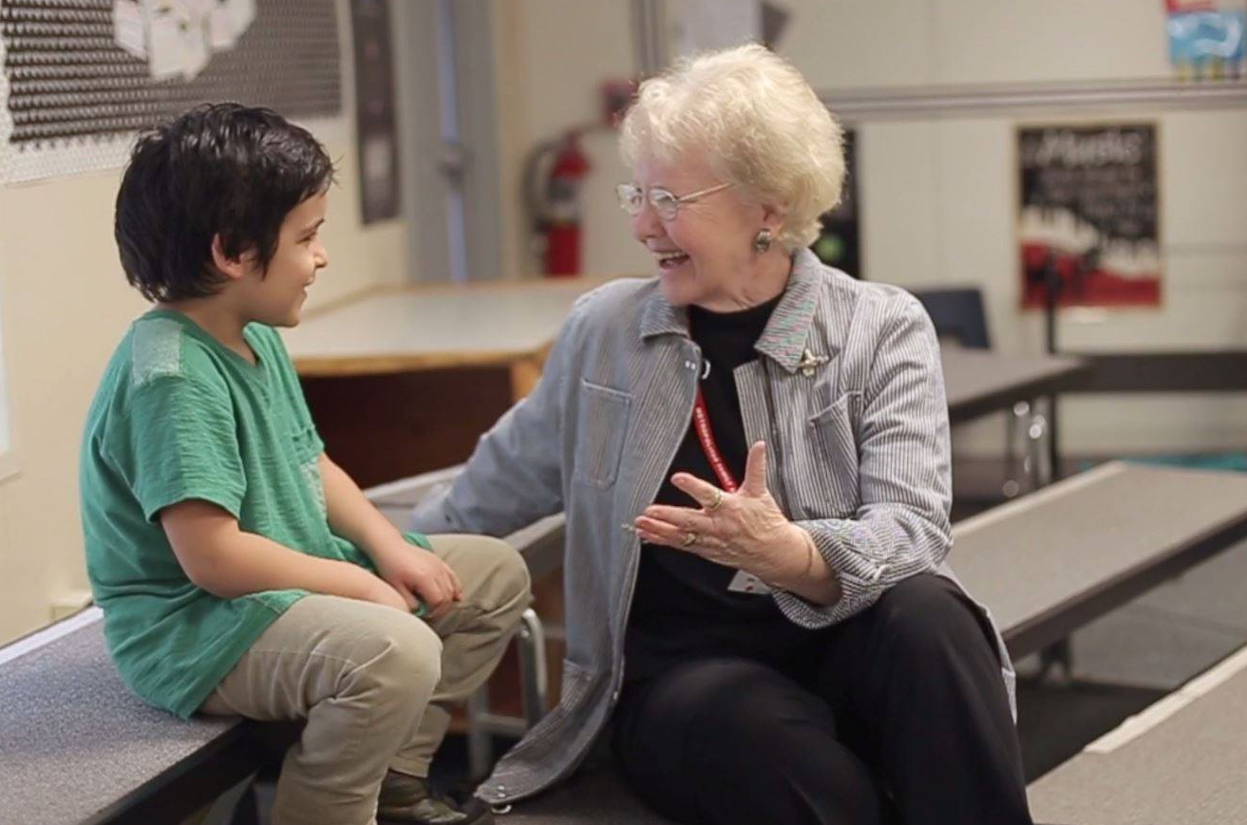
Results
74% of the youth improved in overall reading/literacy
58.9% of youth demonstrated increase in confidence and motivation to learn
97% of mentors indicated improved health and wellbeing

Slide 6
Growing partnerships with culturally specific organizations
Learning process
Process of listening to the elders
Consultation and Training from IRCO staff
Led us to outside of “model” thinking
Notes:
Invitation to full spectrum of elders in communities where they live, where children are in local school – to create informal contact – story telling, singing, food related and family events – “I would not “volunteer” – I will help the children if they need my help. I would not teach them to read; would tell stories and perhaps read a book in my language to them with their whole family – not 1 ; 1 “ example – and the training done by IRCO staff – SEI now interested in helping us do outreach and activities – and other culturally specific partners, through our Successful Families model, have met with the mentors to share their connections and services to better serve mentees.

Slide 7
Awareness of Inequities
Major shift in response to:
“I observe that educational opportunity is not equitable for all students” (17% increase)
Notes:
Judy outlines above - “I take steps to learn about the context and background of the children”
“I can adapt my approach to respond to my mentee’s unique needs, strengths and background”
“ I observe that education opportunity is not equitable for all students”
“ I recognize that social and cultural factors can impact learning and school success”

Slide 8
Effort to understand
Major shift in response to:
“I take steps to learn about the context and background of the children I work with” (20% increase in strongly agree – and 10% increase in agree)
Notes:
Judy outlines above - “I take steps to learn about the context and background of the children”
“I can adapt my approach to respond to my mentee’s unique needs, strengths and background”
“ I observe that education opportunity is not equitable for all students”
“ I recognize that social and cultural factors can impact learning and school success”

Slide 9
Ability Shift
Major shift in response to:
“I can adapt my approach to respond to my mentees’ unique needs, strength and backgrounds.”
(before: strongly disagree/neutral – for a few, after: 100% agree or strongly agree)
Notes:
Judy outlines above - “I take steps to learn about the context and background of the children”
“I can adapt my approach to respond to my mentee’s unique needs, strengths and background”
“ I observe that education opportunity is not equitable for all students”
“ I recognize that social and cultural factors can impact learning and school success”

Slide 10
IRCO perspective

