Slide 1
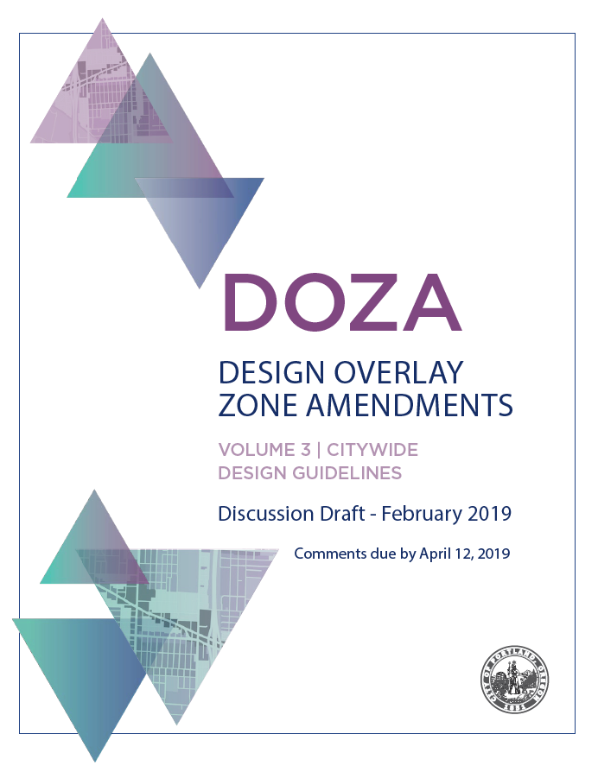
Design Commission Briefing Bureau of Planning and Sustainability March 14, 2019

Slide 2
DOZA Proposals
Public Review
Feb 2019
Summer 2019
Winter 19/20
Spring 2020

Slide 3
DOZA Proposals
Purpose of the Design overlay zone
Map of where the Design overlay zone applies
Process for reviewing projects
Tools for evaluating projects*:
Standards
Guidelines
Additional Improvements
*Design Standards will be focus of discussion at Design Commission briefing (4/4/19).
Citywide Design Guidelines will come to Design Commission for recommendation during the hearings (Summer 2019).

Slide 4
1. Purpose of the Design overlay zone
Revise the purpose statement
33.420.010 Purpose
The Design overlay zone strengthens Portland as a city designed for people. The Design overlay zone supports the city’s evolution within current and emerging centers of civic life.
The overlay promotes design excellence in the built environment through the application of additional design guidelines and standards that:
Build on context by enhancing the distinctive physical, natural, historic and cultural qualities of the location while accommodating growth and change;
Contribute to a public realm that encourages social interaction and fosters inclusivity in people’s daily experience; and
Promotes quality and long-term resilience in the face of changing demographics, climate and economy.

Slide 5
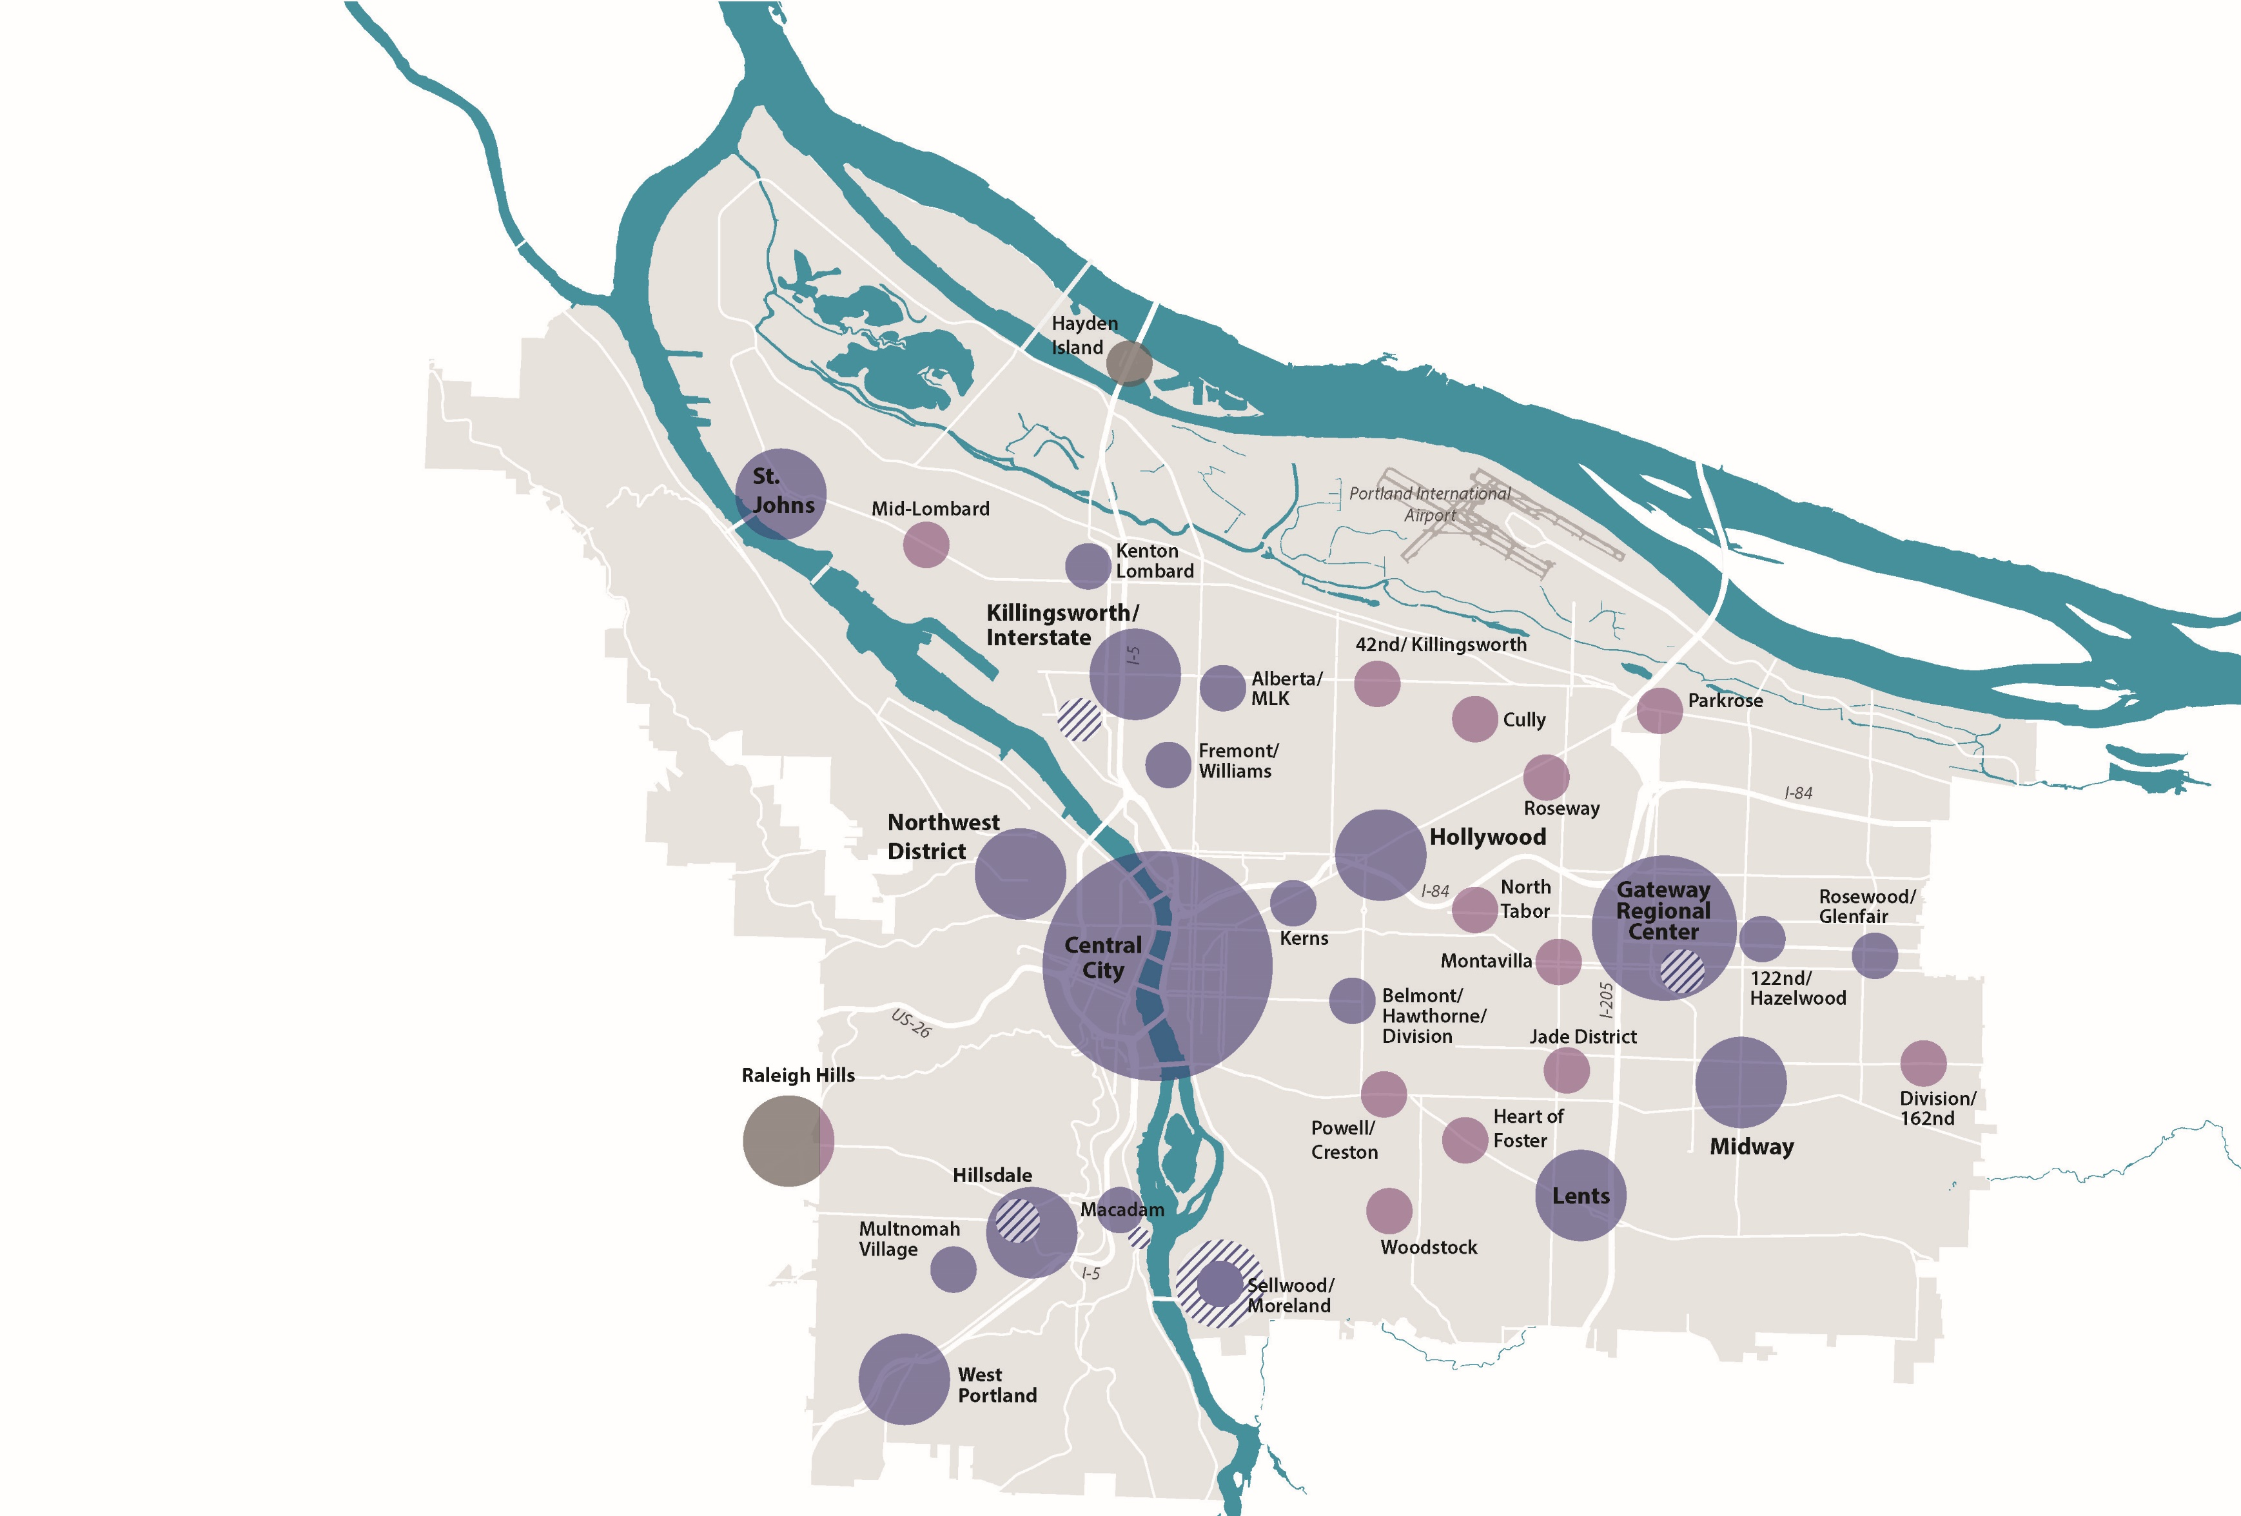
2. Map of where the Design overlay zone applies
Expand Design overlay zone to commercial properties in all Neighborhood Centers
Remove the Design overlay zone from single-dwelling-zoned properties outside of the Terwilliger Design District
Notes:
Three points
Purpose Statement
Low-rise storefront commercial study/Comp Plan Process
Peer research – Seattle – doesn’t map it – has thresholds within certain zones to trigger.
Context (adjacent to R)/Scale (>43,000 sf lot) → lower thresholds 8K/35K bulding sf
No Context/Scale → higher thresholds for smaller projects - /35K still triggers full review

Slide 6
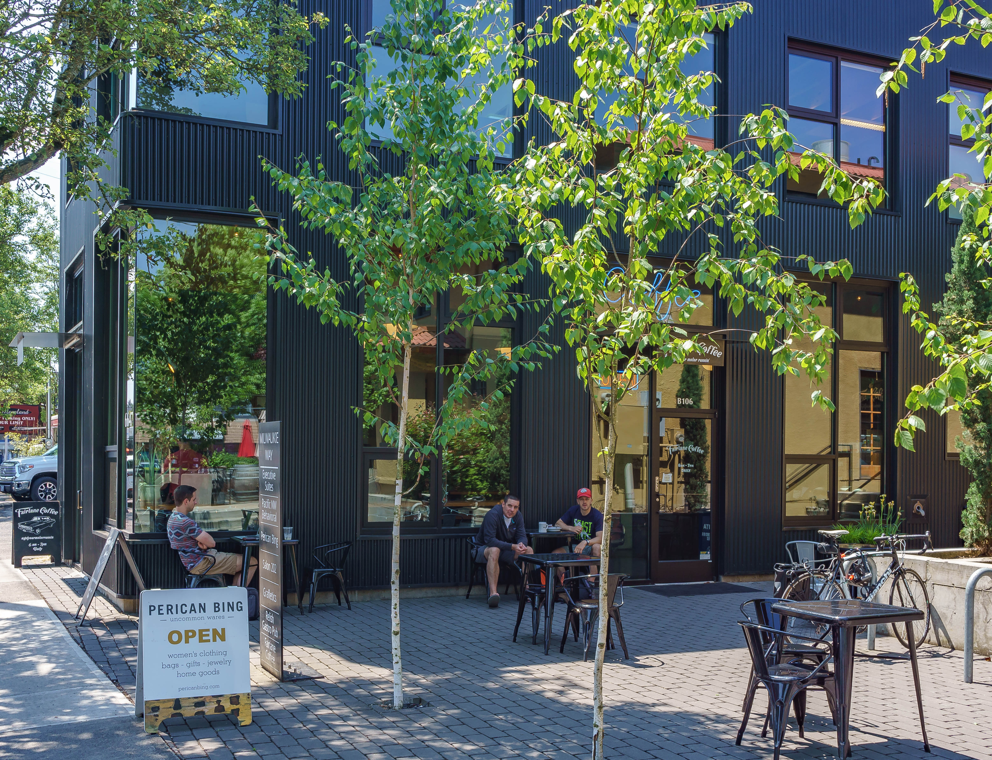
3. Process for reviewing projects
Establish review thresholds based on size and scale
Allow Gateway to use Design Plan Check
Goals of proposal
Simplify list of exemptions and review table
Right-size/standardize Procedure Type (added Type I)
Facilitate review of alterations & Gateway development

Slide 7
3. Process for reviewing projects
Establish review thresholds based on size and scale
Allow Gateway to use Design Plan Check
Design overlay zone ‘d’ outside of Central City
33.420.045
Exempt
Not Exempt
Up to 3 dwelling units
Some façade alterations (awnings, louvers, small façade changes …)
Some rooftop alterations (skylights, ecoroofs, mechanical equipment…)
Non-conforming upgrades
33.420.050
Design Plan Check
Design Standards
Design Review Citywide Design Guidelines
Residential or mixed-use development < 55 ft
Commercial (< 40k sf)
Façade alterations (<50% area)
Buildings or additions in Gateway (< 35’ tall)
33.825.025
Type I
Type II
Type III
Staff
Staff
Design Commission
Façade alterations < 500 sf
Alterations not covered by Type I
Buildings not covered by Type III
Buildings > 80k sf
Buildings > 65 ft tall

Slide 8
3. Process for reviewing projects
Establish review thresholds based on size and scale
Design overlay zone ‘d’ in of Central City
33.420.045
Exempt
Not Exempt
Fewer façade alterations (awnings, louvers…)
Some rooftop alterations (skylights, ecoroofs, mechanical equipment…)
Non-conforming upgrades
33.420.050
Design Plan Check
Design Standards
Design Review
Central City Fundamental Design Guidelines
Design Standards not applicable in the Central City plan district
33.825.025
Type I
Type II
Type III
Staff
Staff
Design Commission
Façade alterations < 500 sf
Alterations not covered by Type I or Type III
Buildings not covered by Type III
Buildings > 25k sf
Buildings > 45 ft tall
Alteration > 50% façade, or 200 linear ft ground floor

Slide 9
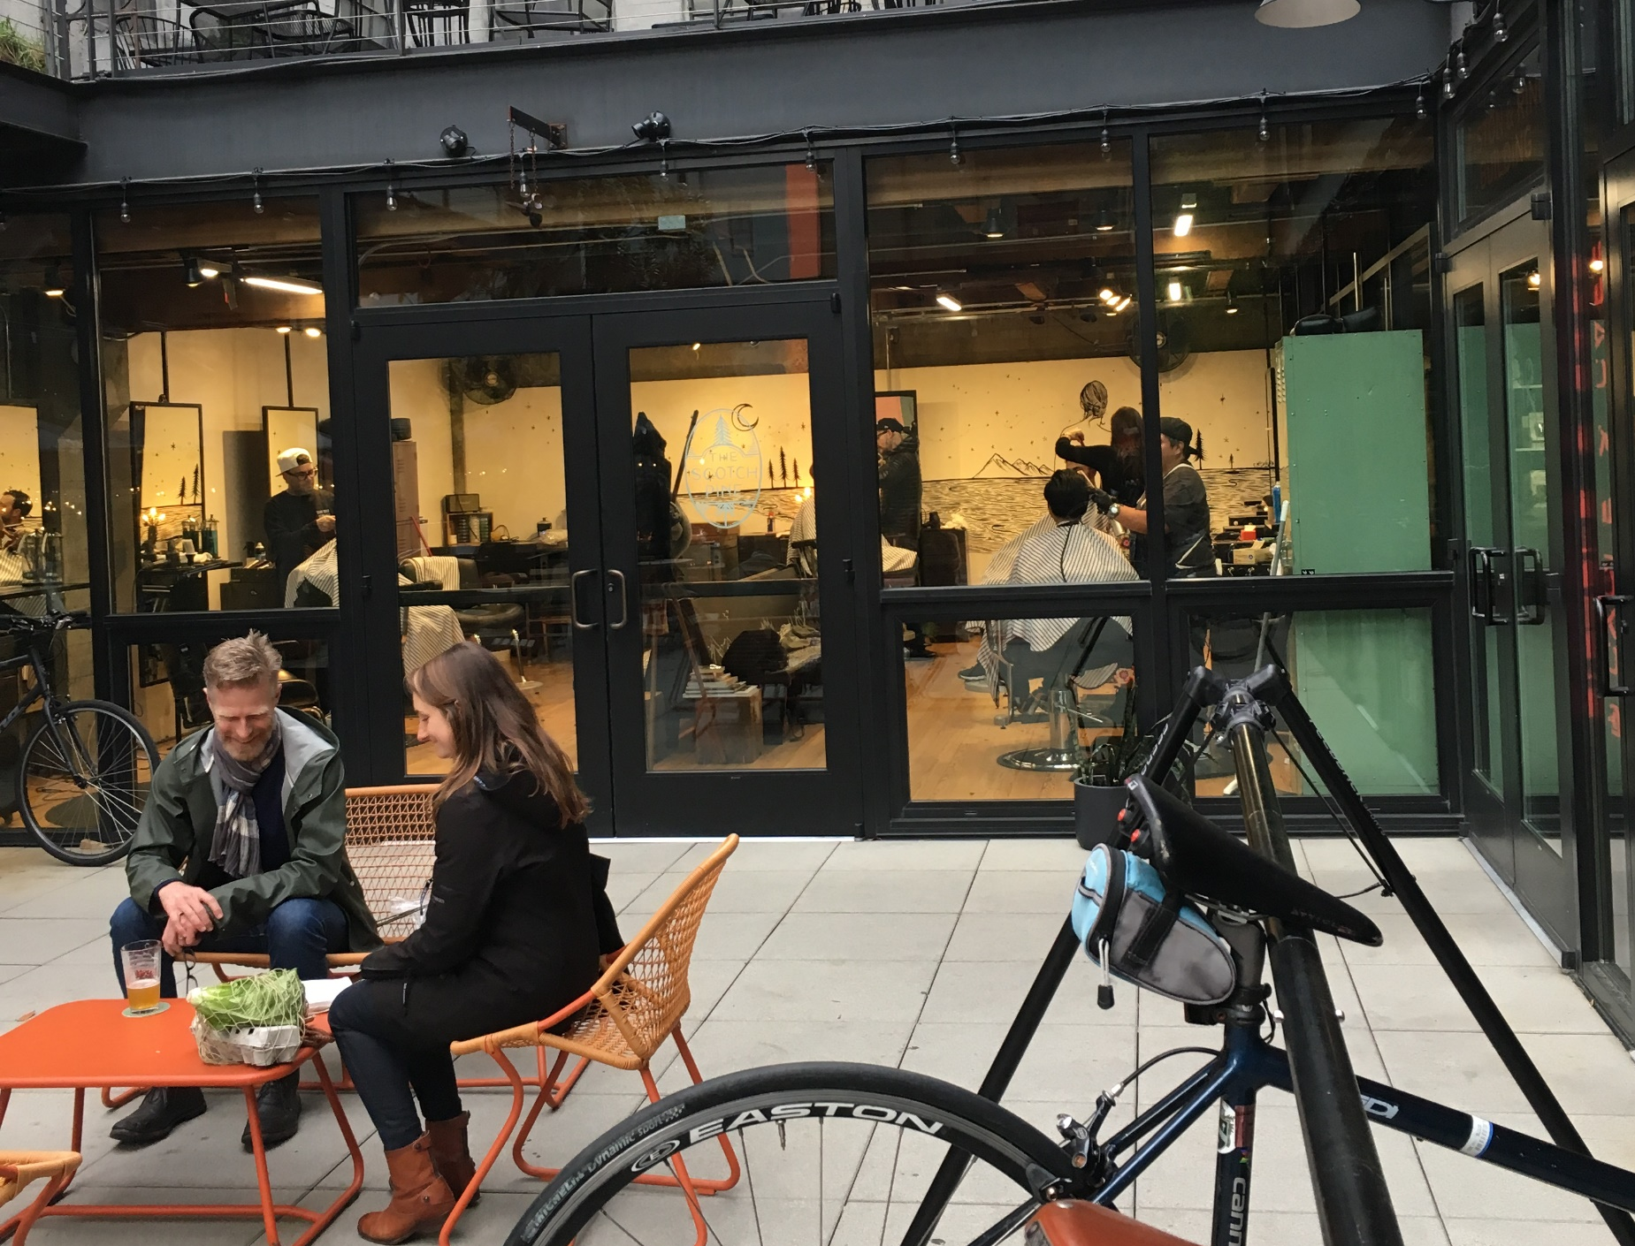
3. Process for reviewing projects
Align Type III design review/ historic resource review with applicant’s design process
Goals of proposal
Provide the applicant with early direction
Respect the public’s time
Provide decision-makers with timely information and materials

Slide 10
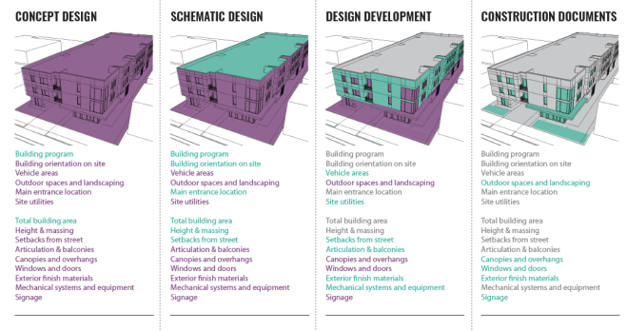
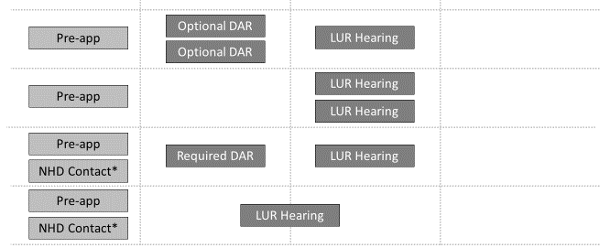
3. Process for reviewing projects
OPPORTUNITY FOR CHANGE:
EASY
DIFFICULT
NOT FEASIBLE
Building program
Building orientation on site
Vehicle areas
Outdoor spaces and landscaping
Main entrance location
Site utilities
Total building area
Height & massing
Setbacks from street
Articulation & balconies
Canopies & overhangs
Windows & doors
Exterior finish materials
Mechanical systems &equipment
Signage
Building program
Building orientation on site
Vehicle areas
Outdoor spaces and landscaping
Main entrance location
Site utilities
Total building area
Height & massing
Setbacks from street
Articulation & balconies
Canopies & overhangs
Windows & doors
Exterior finish materials
Mechanical systems &equipment
Signage
Vehicle areas
Outdoor spaces and landscaping
Site utilities
Setbacks from street
Articulation & balconies
Canopies & overhangs
Windows & doors
Exterior finish materials
Mechanical systems &equipment
Signage
Outdoor spaces and landscaping
Canopies & overhangs
Windows & doors
Exterior finish materials
Signage
Current practice, applicant chose DAR
Current practice,
applicant did not choose DAR
ALTERNATIVE 1
ALTERNATIVE 2

Slide 11
3. Process for reviewing projects
OPPORTUNITY FOR CHANGE:
EASY
DIFFICULT
NOT FEASIBLE
Building program
Building orientation on site
Vehicle areas
Outdoor spaces and landscaping
Main entrance location
Site utilities
Total building area
Height & massing
Setbacks from street
Articulation & balconies
Canopies & overhangs
Windows & doors
Exterior finish materials
Mechanical systems &equipment
Signage
Building program
Building orientation on site
Vehicle areas
Outdoor spaces and landscaping
Main entrance location
Site utilities
Total building area
Height & massing
Setbacks from street
Articulation & balconies
Canopies & overhangs
Windows & doors
Exterior finish materials
Mechanical systems &equipment
Signage
Vehicle areas
Outdoor spaces and landscaping
Site utilities
Setbacks from street
Articulation & balconies
Canopies & overhangs
Windows & doors
Exterior finish materials
Mechanical systems &equipment
Signage
Outdoor spaces and landscaping
Canopies & overhangs
Windows & doors
Exterior finish materials
Signage
Current practice, applicant chose DAR
Current practice,
applicant did not choose DAR
ALTERNATIVE 1
ALTERNATIVE 2

Slide 12
3. Process for reviewing projects
OPPORTUNITY FOR CHANGE:
EASY
DIFFICULT
NOT FEASIBLE
Building program
Building orientation on site
Vehicle areas
Outdoor spaces and landscaping
Main entrance location
Site utilities
Total building area
Height & massing
Setbacks from street
Articulation & balconies
Canopies & overhangs
Windows & doors
Exterior finish materials
Mechanical systems &equipment
Signage
Building program
Building orientation on site
Vehicle areas
Outdoor spaces and landscaping
Main entrance location
Site utilities
Total building area
Height & massing
Setbacks from street
Articulation & balconies
Canopies & overhangs
Windows & doors
Exterior finish materials
Mechanical systems &equipment
Signage
Vehicle areas
Outdoor spaces and landscaping
Site utilities
Setbacks from street
Articulation & balconies
Canopies & overhangs
Windows & doors
Exterior finish materials
Mechanical systems &equipment
Signage
Outdoor spaces and landscaping
Canopies & overhangs
Windows & doors
Exterior finish materials
Signage
Current practice, applicant chose DAR
Current practice,
applicant did not choose DAR
ALTERNATIVE 1
ALTERNATIVE 2

Slide 13
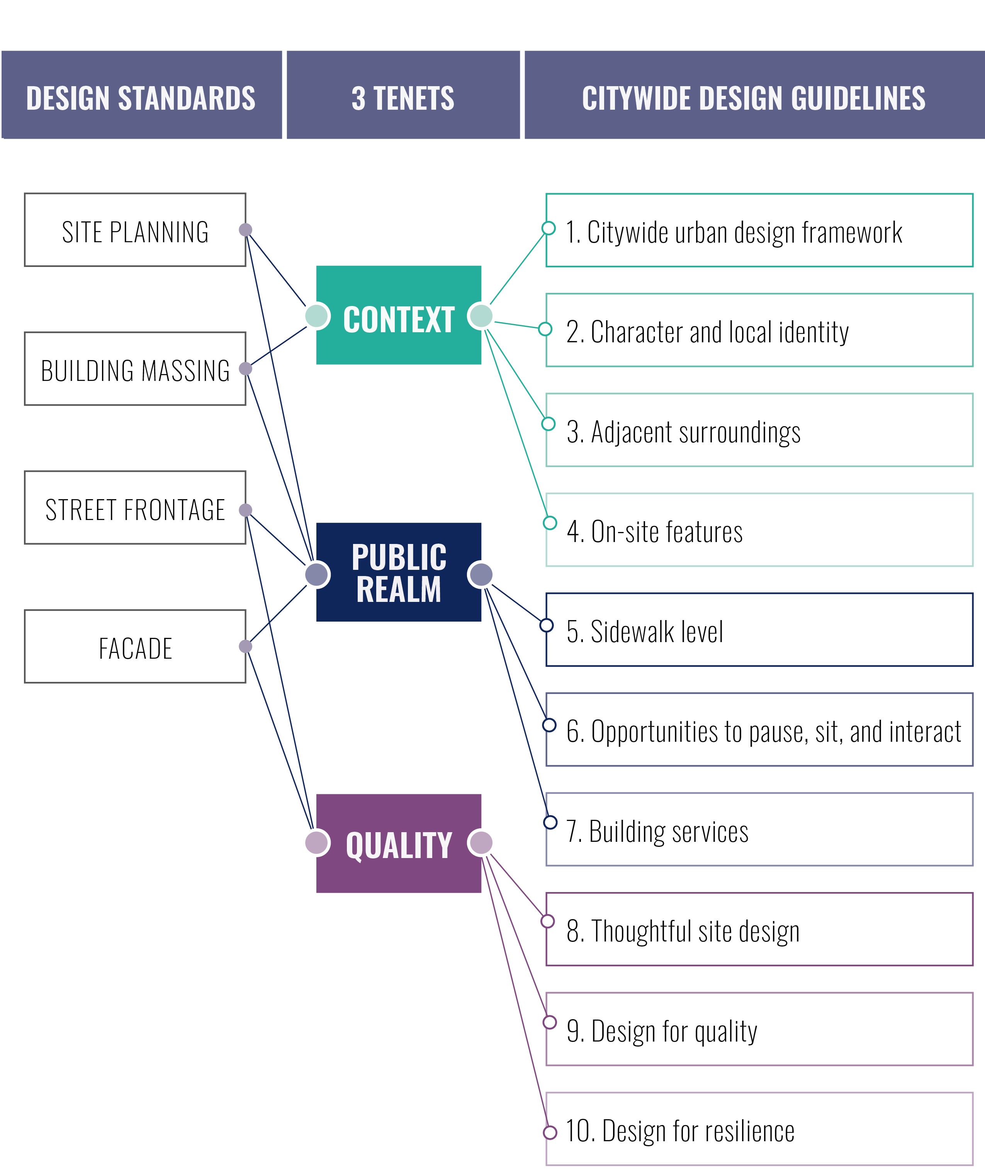
4. Tools for reviewing projects

Slide 14
5. Additional Improvements
Update the Design Commission membership rules:
Landscape architects
Public-at-large member
Clarify that design review cannot require a reduction of proposed FAR (except in limited cases in the Central City)
Clarify that mitigation may be required to lessen cumulative impacts of modifications
Make administrative improvements for transparency and efficiency of design review process

Slide 15
DOZA Proposals
Public Review
Feb 2019
Summer 2019
Winter 19/20
Spring 2020

Slide 16
Next Steps…
Recommending Bodies (joint hearing)
Decision-making Body hearing
DOZA
PROPOSED DRAFT
DOZA
RECOMMENDED DRAFT
Zoning Code Proposals
Purpose Statement
Design Overlay Map
Process Improvements
Design Standards
Code Clarifications
Zoning Code Proposals
Purpose Statement
Design Overlay Map
Process Improvements
Design Standards
Code Clarifications
Design Guidelines
Planning & Sustainability Commission
City Council
Design Guidelines
Design Commission

