Slide 1
Vertical Infrastructure in the ROW: March 2019 Update
3/14/19 Design Commission & Historic Landmarks Commission Briefing

Slide 2
Agenda
Background
Recap of Small Cells
FCC Developments
City Pole & Equipment Design Standards
Pole Design Standards
Vertical Infrastructure (VI) Program
City Code Update- Underground Wiring District
New Street Light Pole RFI/RFP Process
Next Steps
Questions

Slide 3
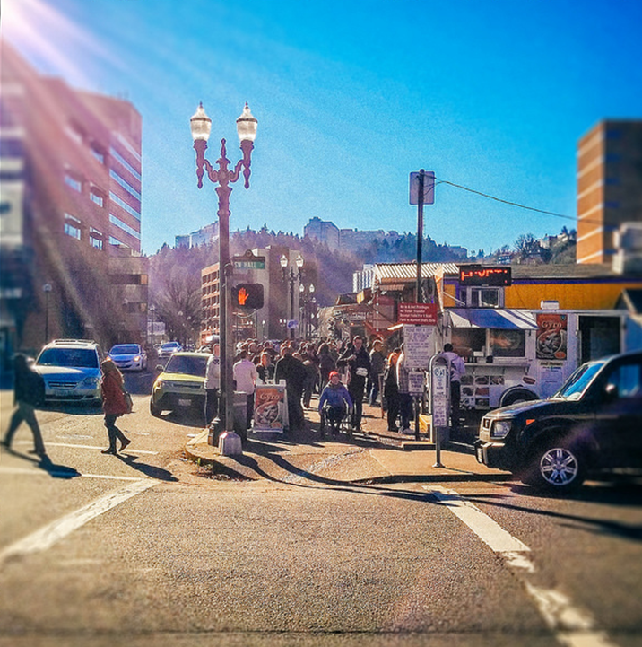
Background
In Spring 2018, PBOT staff briefed the Design Commission and Historic Landmarks Commission on the potential impacts that vertical infrastructure (VI) deployments could have on Portland
Since then, the City of Portland has established directives on how we will govern this emerging technology:
  Ensure digital inclusion across communities
  Manage the public right-of-way (ROW) to support the well-being of residents
  Secure fair and reasonable compensation for use of the ROW
  Ensure VI deployments support the Digital Equity Action Plan (DEAP), as adopted by City Council
  Ensure that the City protects the public health, safety, and welfare of its citizens

Slide 4
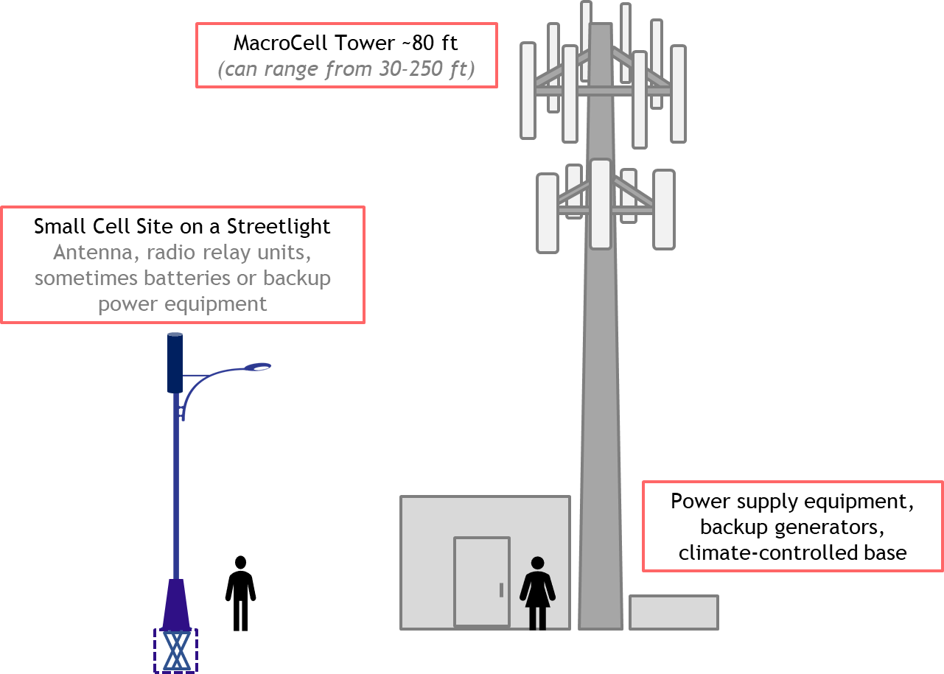
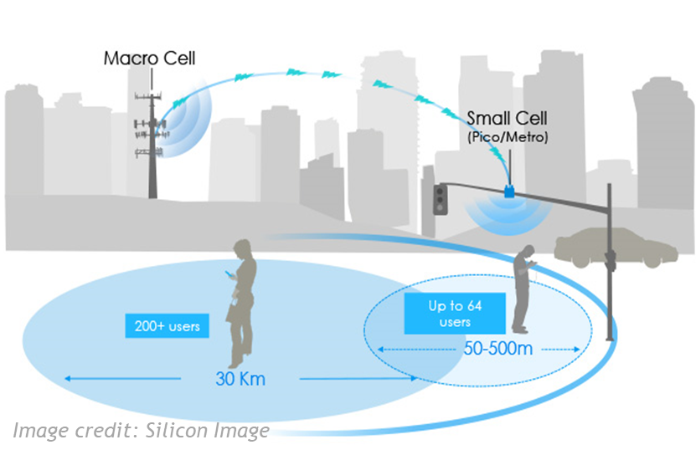
Recap of Small Cells
Small cells or distributed antenna systems (DAS) — short range, low‐powered cellular radio access
Small because these mobile phone base stations have:
  Shorter range and handle fewer calls/sessions
  Not because of physical size
Notes:
Note: Macro towers are usually taller than 80’, this example is around 80’ to be to scale with the 40’ cobra head

Slide 5


Federal Communications Commission (FCC) Developments
The Federal Communications Commission (FCC) adopted two administrative acts that significantly impact wireless infrastructure deployment in the City of Portland.
The FCC adopted the Moratoria Ruling on August 2, 2018, interpreting Section 253(a) of the Federal Communications Act to prohibit express de facto moratoria on application and permits to deploy wireless infrastructure. The City challenged the Ruling in the Ninth Circuit on October 2, 2018.
The FCC issued a Small Cell Order on September 26, 2018 becoming effective January 11, 2019. The Order significantly limits local authority to manage wireless infrastructure deployments in the public ROW. The City, as part of a national collation, challenged the Order in the Ninth Circuit on October 25, 2018.

Slide 6
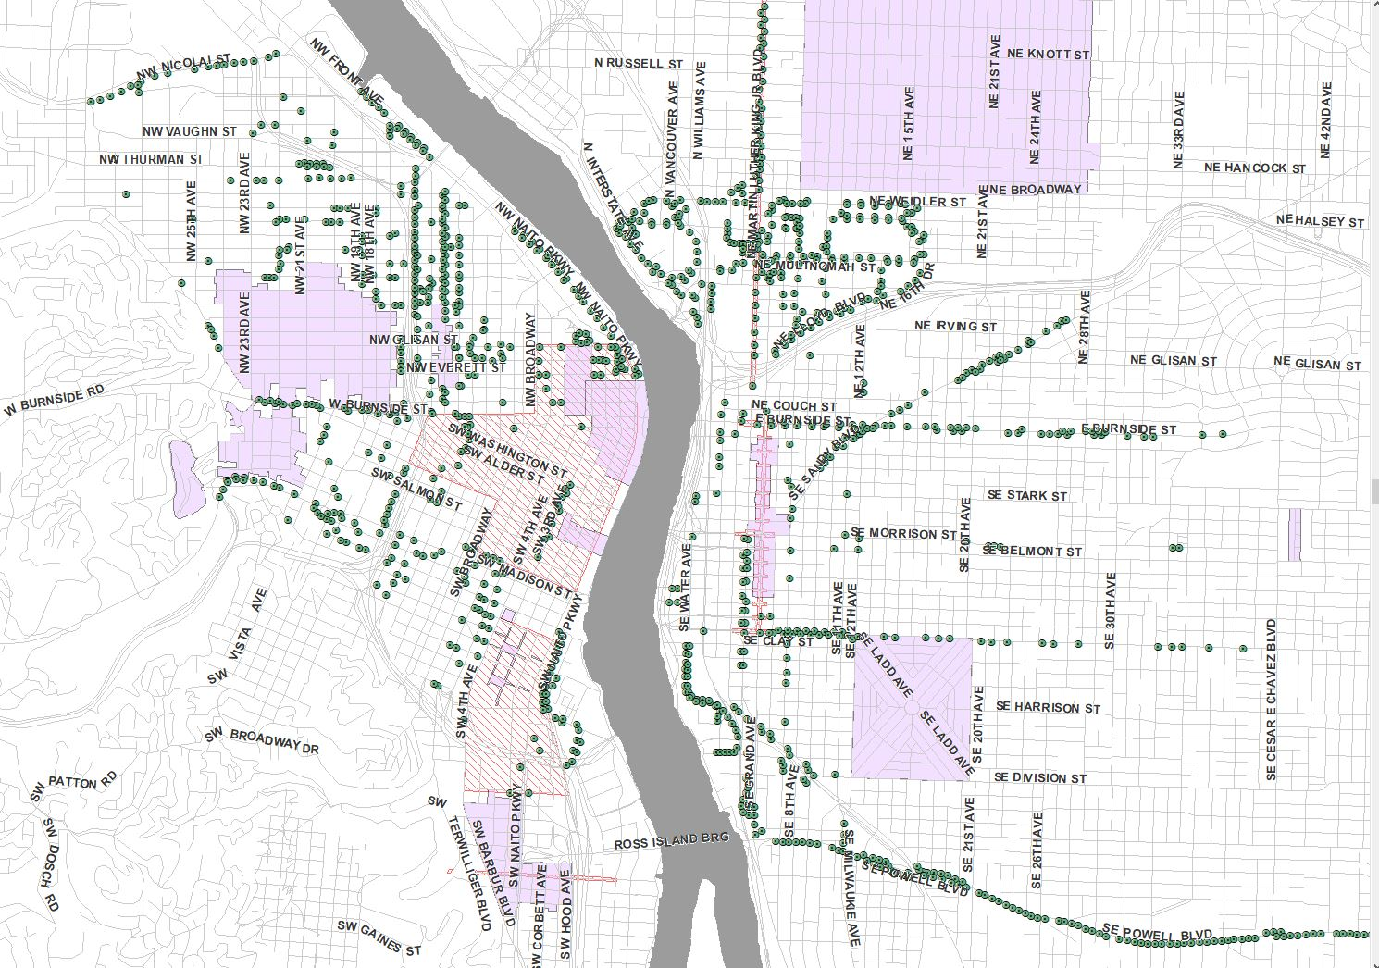
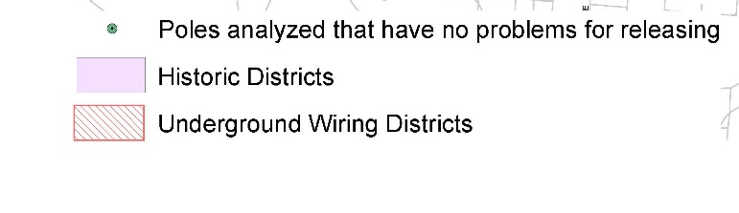
City Owned Street Lights Inventory
PBOT staff have completed an inventory of street light poles in the underground wiring district
All inventoried street lights are cobra head or davit light poles
Pole hierarchy update:
  Non-decorative street light poles (cobra head and davit)
  Signal lights
  Catenary poles
  Mid block ornamentals (underground wiring district)
Notes:
Non decorative poles include poles outside of the downtown core, mostly concentrated on SE Powell, NE Airport Way, NE MLK
Signal poles are expensive and because an entire intersection has to be replaced and time consuming.
Catenary pole replacement would mean closing a streetcar line for a period of time (foundations could take up to 4 days to cure)

Slide 7
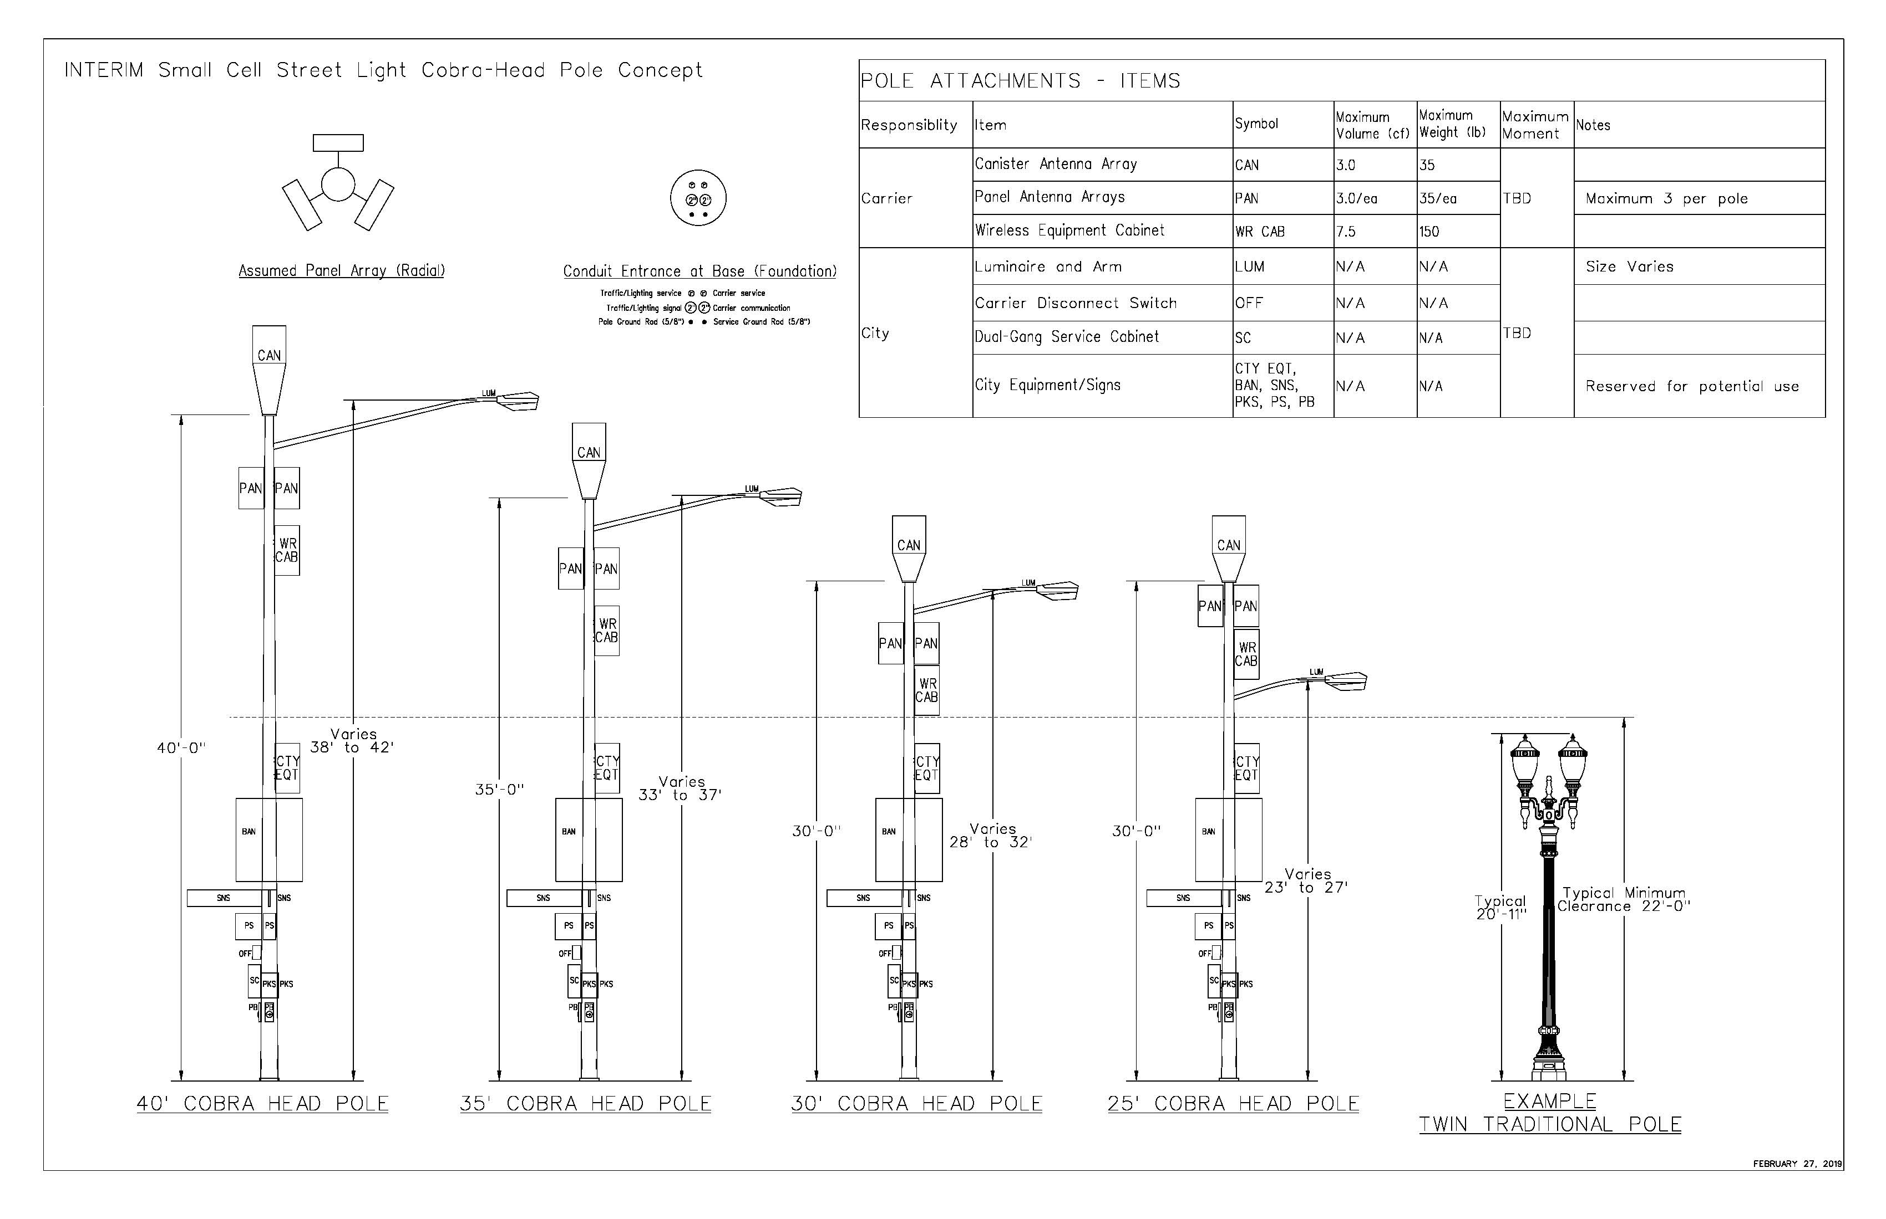
City Pole & Equipment Design Standards
Notes:
PBOT has contracted an engineering consultant to develop design standards for street light and signal poles
A standardized design for street light and signal poles will ensure that there is no need for monopoles
All attachments and wiring will be shrouded
Cabinets will be installed on poles due to a lack of space in the Underground Wiring District
There will be no above ground cabinets in the ROW

Slide 8
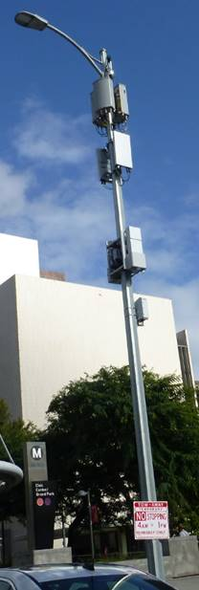
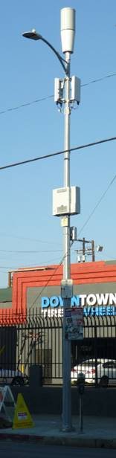
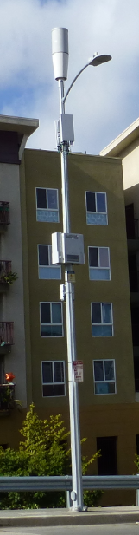
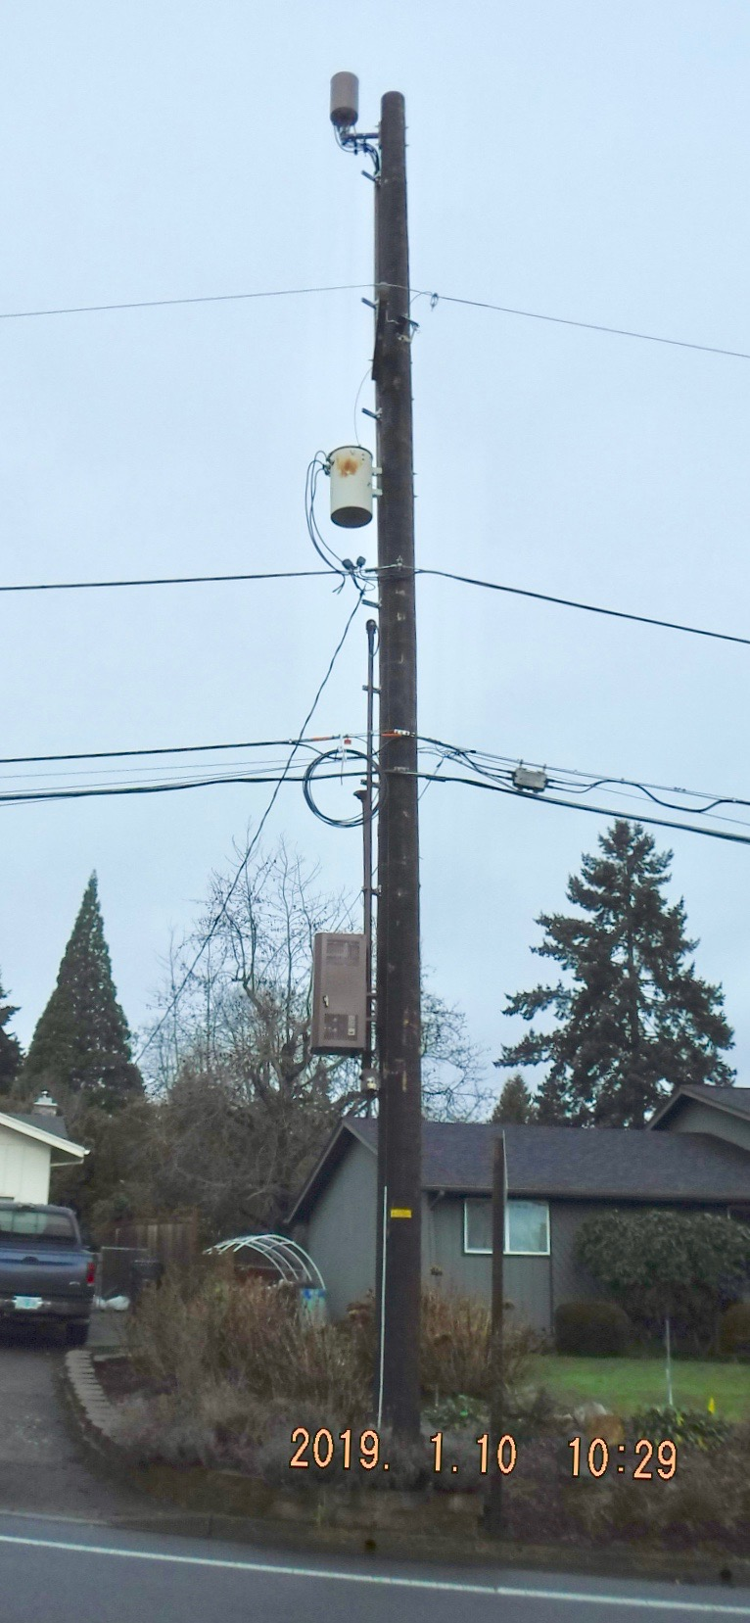
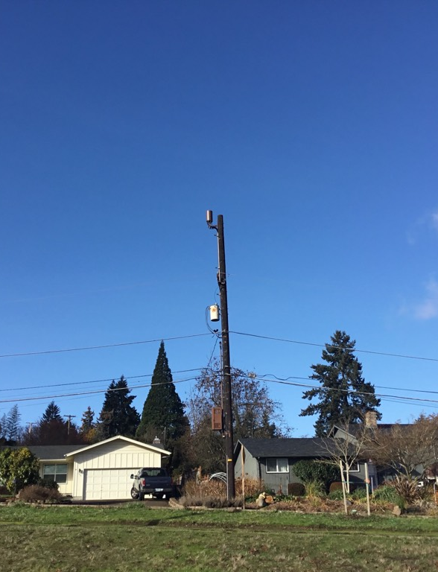
Pole Design Standards (Street Light) – Examples
Sector Antennas
Cantenna
Cantenna
Panel Antennas
Transformer
Cabinet
Cabinet
Notes:
Left side are metal poles near/in Los Angeles
Right side are EWEB wood poles in Eugene

Slide 9







Vertical Infrastructure (VI) Program
PBOT will manage all aspects of the Vertical Infrastructure Program
Vertical Infrastructure Program
Leasing
Permitting
In partnership with BPS, BDS, OCT and City Attorney’s Office
Installation
Enforcement

Slide 10
City Code Update – Underground Wiring District
Currently there are no attachments allowed on any poles in the ROW in Underground Wiring Districts. This code change update will allow for small cell attachments on city-owned poles in the ROW.
Proposed changes to City Code Chapter 17.60.110 Exceptions
Addition of the following language:
F. Appliances or appurtenances on, through or by means of which telecommunications data is wirelessly collected or transmitted, as defined by the City of Portland Wireless Master Plan and Transportation Administrative Rules. This exemption does not include attachments to transit and/or transit supporting infrastructure not owned and maintained by the City.

Slide 11
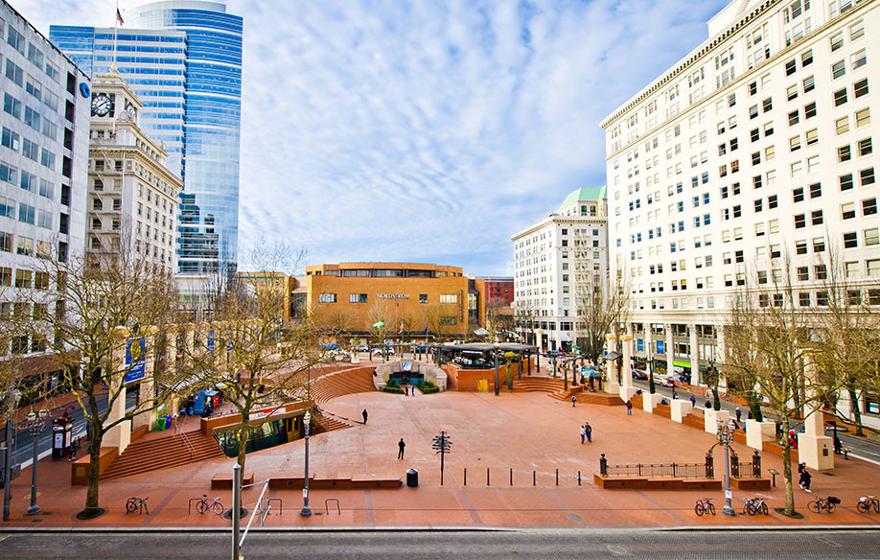
New Street Light Pole RFI/RFP Process
PBOT will lead a RFI/RFP process to design a new street light pole standard to be used when replacing midblock ornamentals and other city owned street light poles
Beginning in April 2019, PBOT will kickoff the RFI process
A volunteer liaison from each of the Historic Landmarks and Design Commissions requested to join the review team
Notes:
City-owned design that can be provided to many manufacturers for fabrication. This is like the current twin ornamental pole procurement
Less desirable outcome: Sole source justification for the purchase of a specific pole from a specific manufacturer. This is like the current South Waterfront poles that must be purchased from Valmont

Slide 12

Next Steps
PBOT requests of the Design Commission and Historic Landmarks Commission:
  A volunteer liaison from each commission to participate in the new design for streetlight replacement RFI
  Letter of Support for the Underground Wiring District code update
  Support for city pole and equipment design standards
Special thanks to BPS, BDS, OCT and the City Attorney’s Office for their continuing support throughout this process

Slide 13
Questions?
Contact: Anne Hill
Anne.Hill@portlandoregon.gov
503-823-7239

