Slide 1
SW Multnomah/Garden Home Intersection Project
City Council February 20, 2019

Slide 2
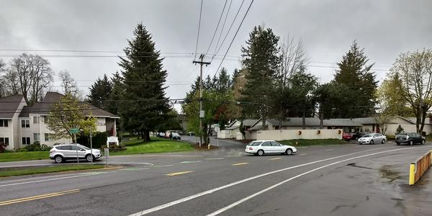
Background
Address intersection safety issues

Slide 3
Timeline
Alternatives Analysis & Online open house: December 2018- Spring 2019
Design: Summer 2019- Summer 2020
Right-of-Way: Spring 2020 – Summer 2020
Construction: Spring 2021 – Fall 2021

Slide 4
Multi-jurisdictional partnership & coordination
Washington County
City of Beaverton
Beaverton School District
Portland Fire & Rescue
Tualatin Valley Fire & Rescue
TriMet
Bureau of Environmental Services

Slide 5
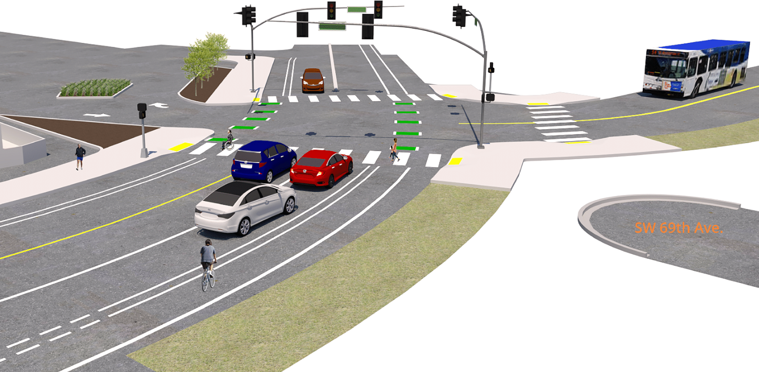
Signal Option

Slide 6
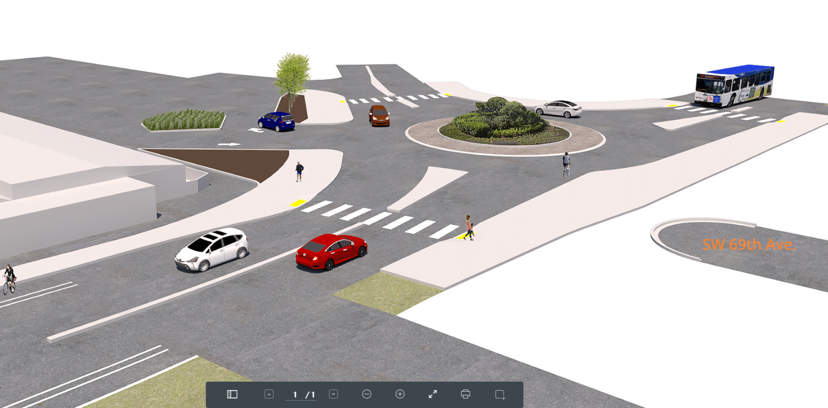
Roundabout Option

Slide 7
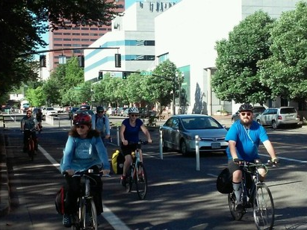
Potential two-way walking/biking space
Enhanced biking/walking space on Multnomah between Garden Home & Multnomah Village

Slide 8
Public Engagement
12/20/18- Online Survey launched
1/7/19- Mailer to 8,000 residents
1/8/19- Bike Advisory Cmte
1/9/19- Door to Door outreach
1/17/19- Open House at Garden Home Rec Center
(130 attendees)
1/22 & 1/25 – Office Hours at Garden Home Growlers (open to all ages)

Slide 9
Online Survey Results
860 respondents
Cost NOT being a factor, 70% supported roundabout
Cost & Time as factors, 64% supported roundabout
Top 3 safety concerns
  Too many cars (51%)
  Right-of-way ambiguity (49%)
  Drivers travel too fast (48%)

Slide 10
Requested Council Action
Accept $1M in funding from Washington County
Authorize IGA with Washington County

Slide 11
Public Involvement
Office hours
Online survey
Email List
https://www.portlandoregon.gov/transportation/GH
Contact us
Timur Ender
Timur.Ender@PortlandOregon.gov
Capital Project Manager
Portland Bureau of Transportation
Brad Taylor
Brad@BradTaylorGroup.com
Multnomah/Garden Home Project
Public Involvement Consultant

