Slide 1
NE Halsey Safety and Access to Transit Project
City Council - February 27, 2019

Slide 2
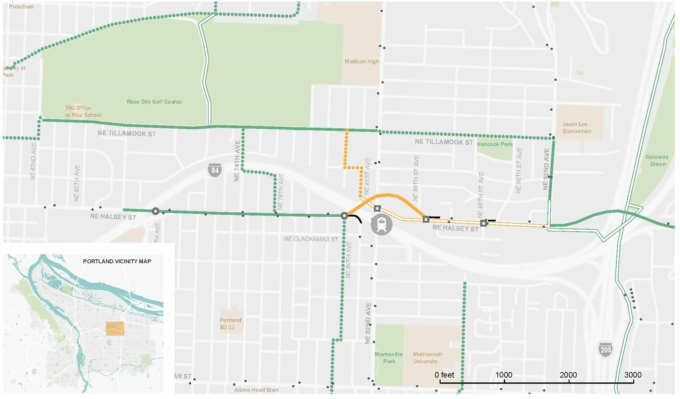
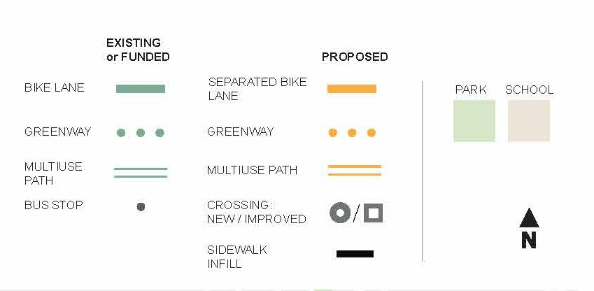
NE Halsey Safety and Access to Transit Project

Slide 3
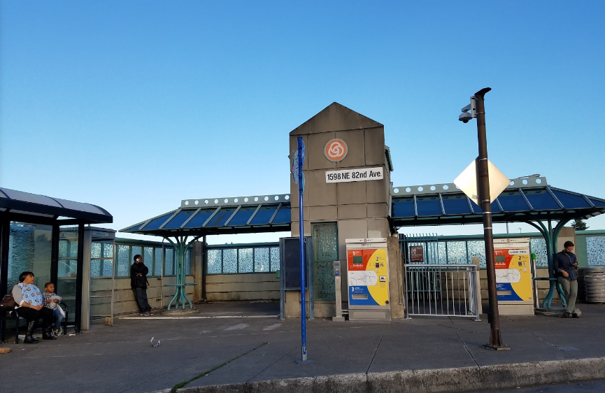
NE Halsey Safety and Access to Transit Project
82nd Ave MAX Station
SE OGDEN
SE FLAVEL

Slide 4
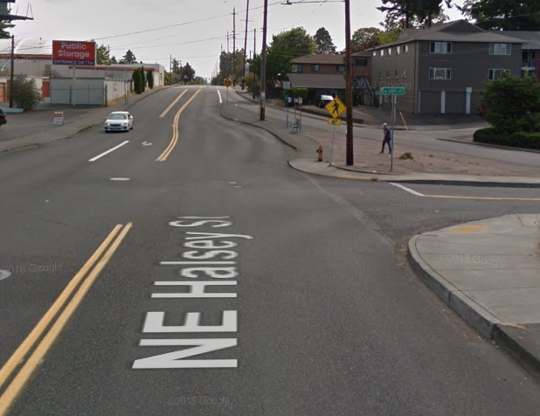
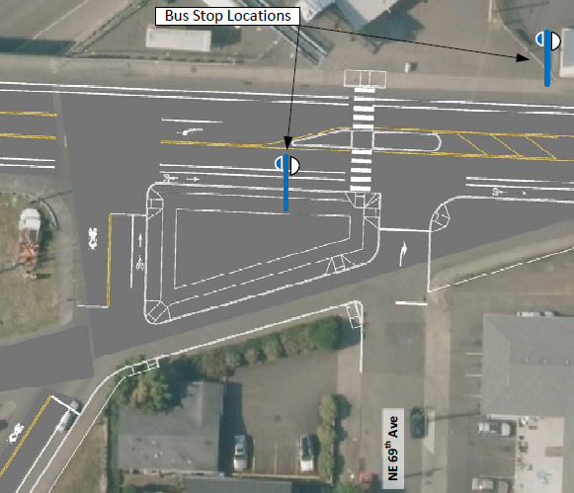
NE Halsey Safety and Access to Transit Project
Halsey at 68th Ave.
Draft concept
SE DUKE
SE OGDEN
SE FLAVEL
Looking east on NE Halsey

Slide 5
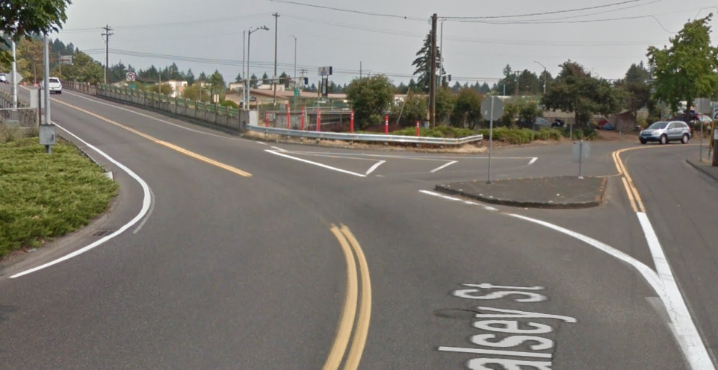
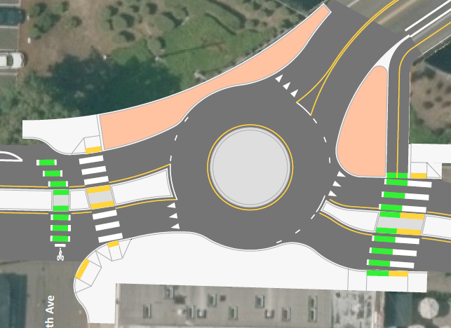
NE Halsey Safety and Access to Transit Project
Halsey at 80th Ave.
SE DUKE
Draft concept
SE OGDEN
SE FLAVEL
Looking east on NE Halsey

Slide 6
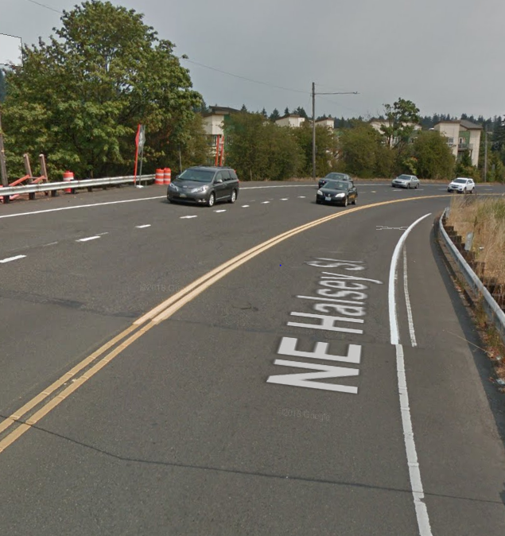
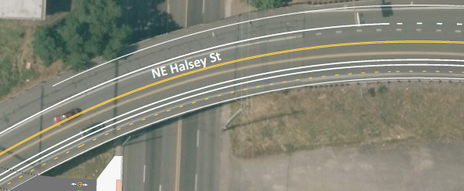
NE Halsey Safety and Access to Transit Project
Halsey structure over NE 82nd Ave.
SE DUKE
Draft concept
Looking east on NE Halsey

Slide 7
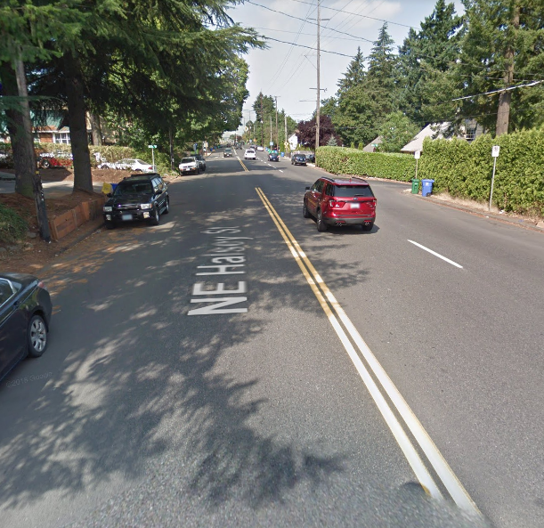
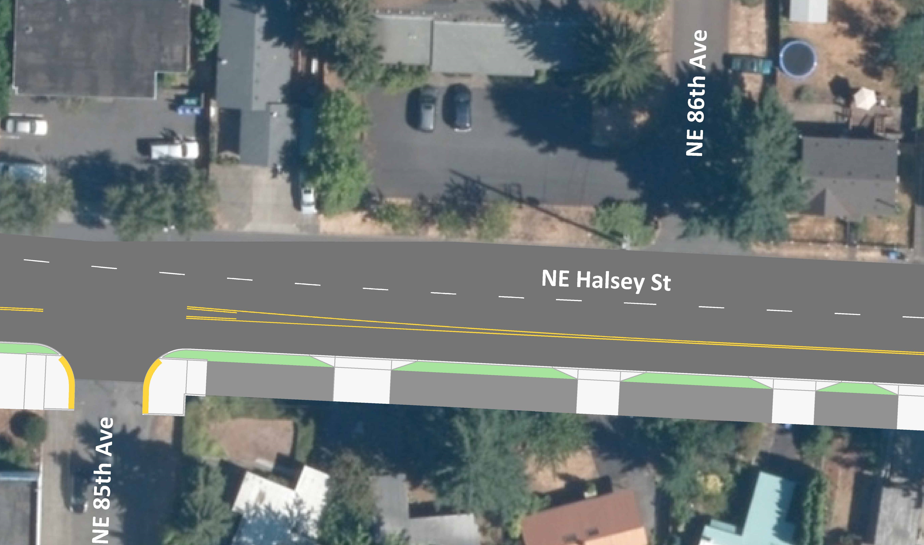
NE Halsey Safety and Access to Transit Project
Halsey between NE 82nd and 92nd Ave.
SE DUKE
Draft concept
SE OGDEN
SE FLAVEL
Looking west on NE Halsey

