Slide 1

City Council Item #151: Acquire riparian parcels along the Columbia Slough
Nancy Hendrickson
Columbia Watersheds Management
February 20, 2019

Slide 2
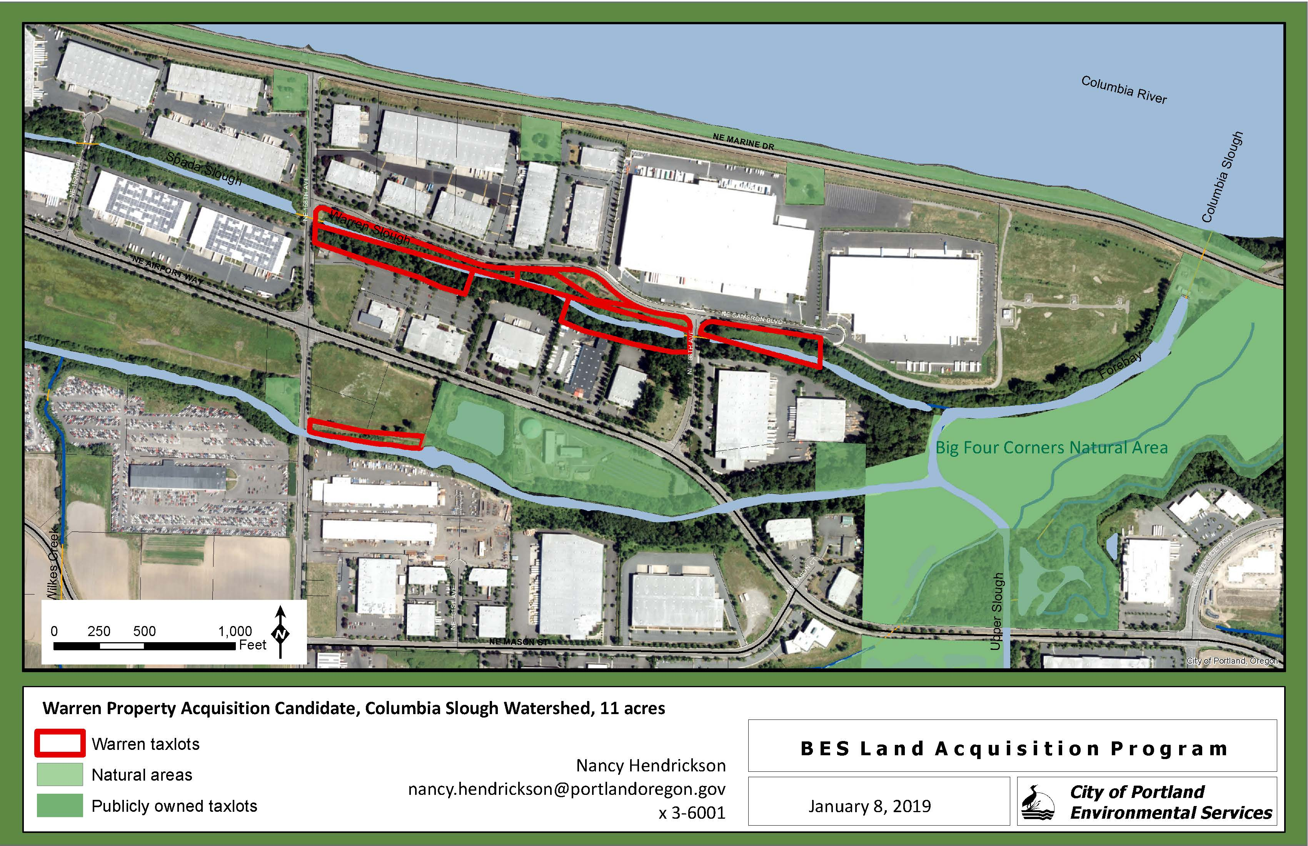
Title Here
Notes:
The example is the straw pipe.
It’s called the straw pipe because it connects one slough to another, like a straw.
This 60” pipe is Located under business park.
The Roads are NE 82nd, NE Alderwood and NE 79th Court
I’m going to show you some cool pictures that illustrate what we have found out about its history
This pipe connects two sloughs: McBride Slough on the north to the main channel of the Columbia Slough – essentially the water flows from McBride Slough to the main Slough
(McBride Slough used to drain to the Columbia River, but can no longer do so because of the Columbia River Levee)
The documentation we have uncovered is absolutely fascinating

Slide 3
Riparian Parcels along the Columbia Slough
11 acres near Big Four Corners Natural Area
Restoration and protection
Riparian canopy for temperature reduction

Slide 4
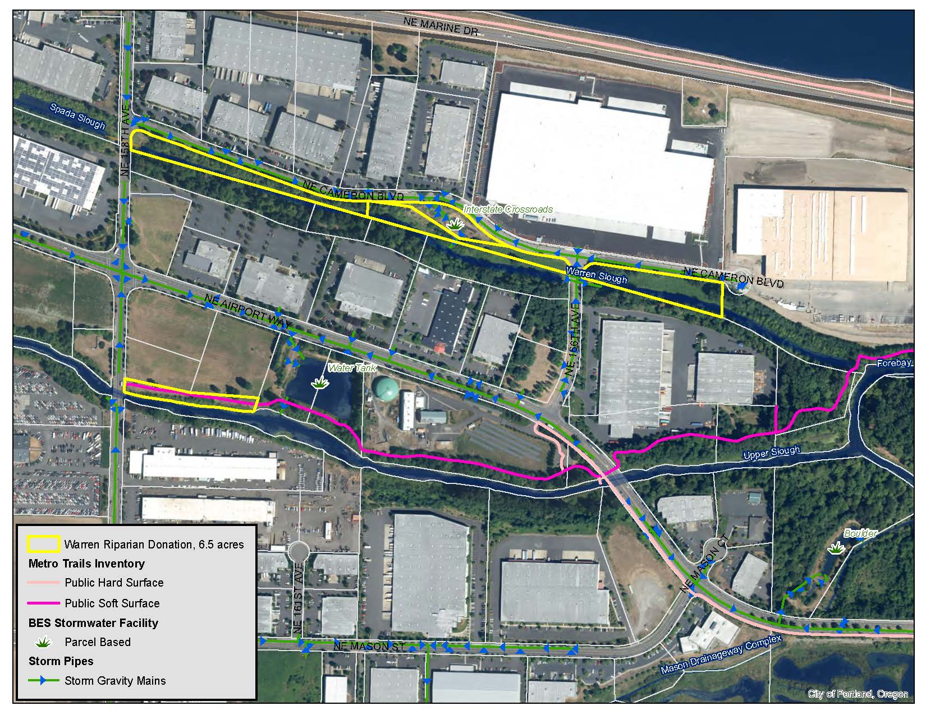
Title Here
Notes:
The example is the straw pipe.
It’s called the straw pipe because it connects one slough to another, like a straw.
This 60” pipe is Located under business park.
The Roads are NE 82nd, NE Alderwood and NE 79th Court
I’m going to show you some cool pictures that illustrate what we have found out about its history
This pipe connects two sloughs: McBride Slough on the north to the main channel of the Columbia Slough – essentially the water flows from McBride Slough to the main Slough
(McBride Slough used to drain to the Columbia River, but can no longer do so because of the Columbia River Levee)
The documentation we have uncovered is absolutely fascinating

