Slide 1
Portland Streetcar 2018 Annual Report
Presentation to City Council
Dan Bower, PSI Executive Director
February 27, 2019

Slide 2
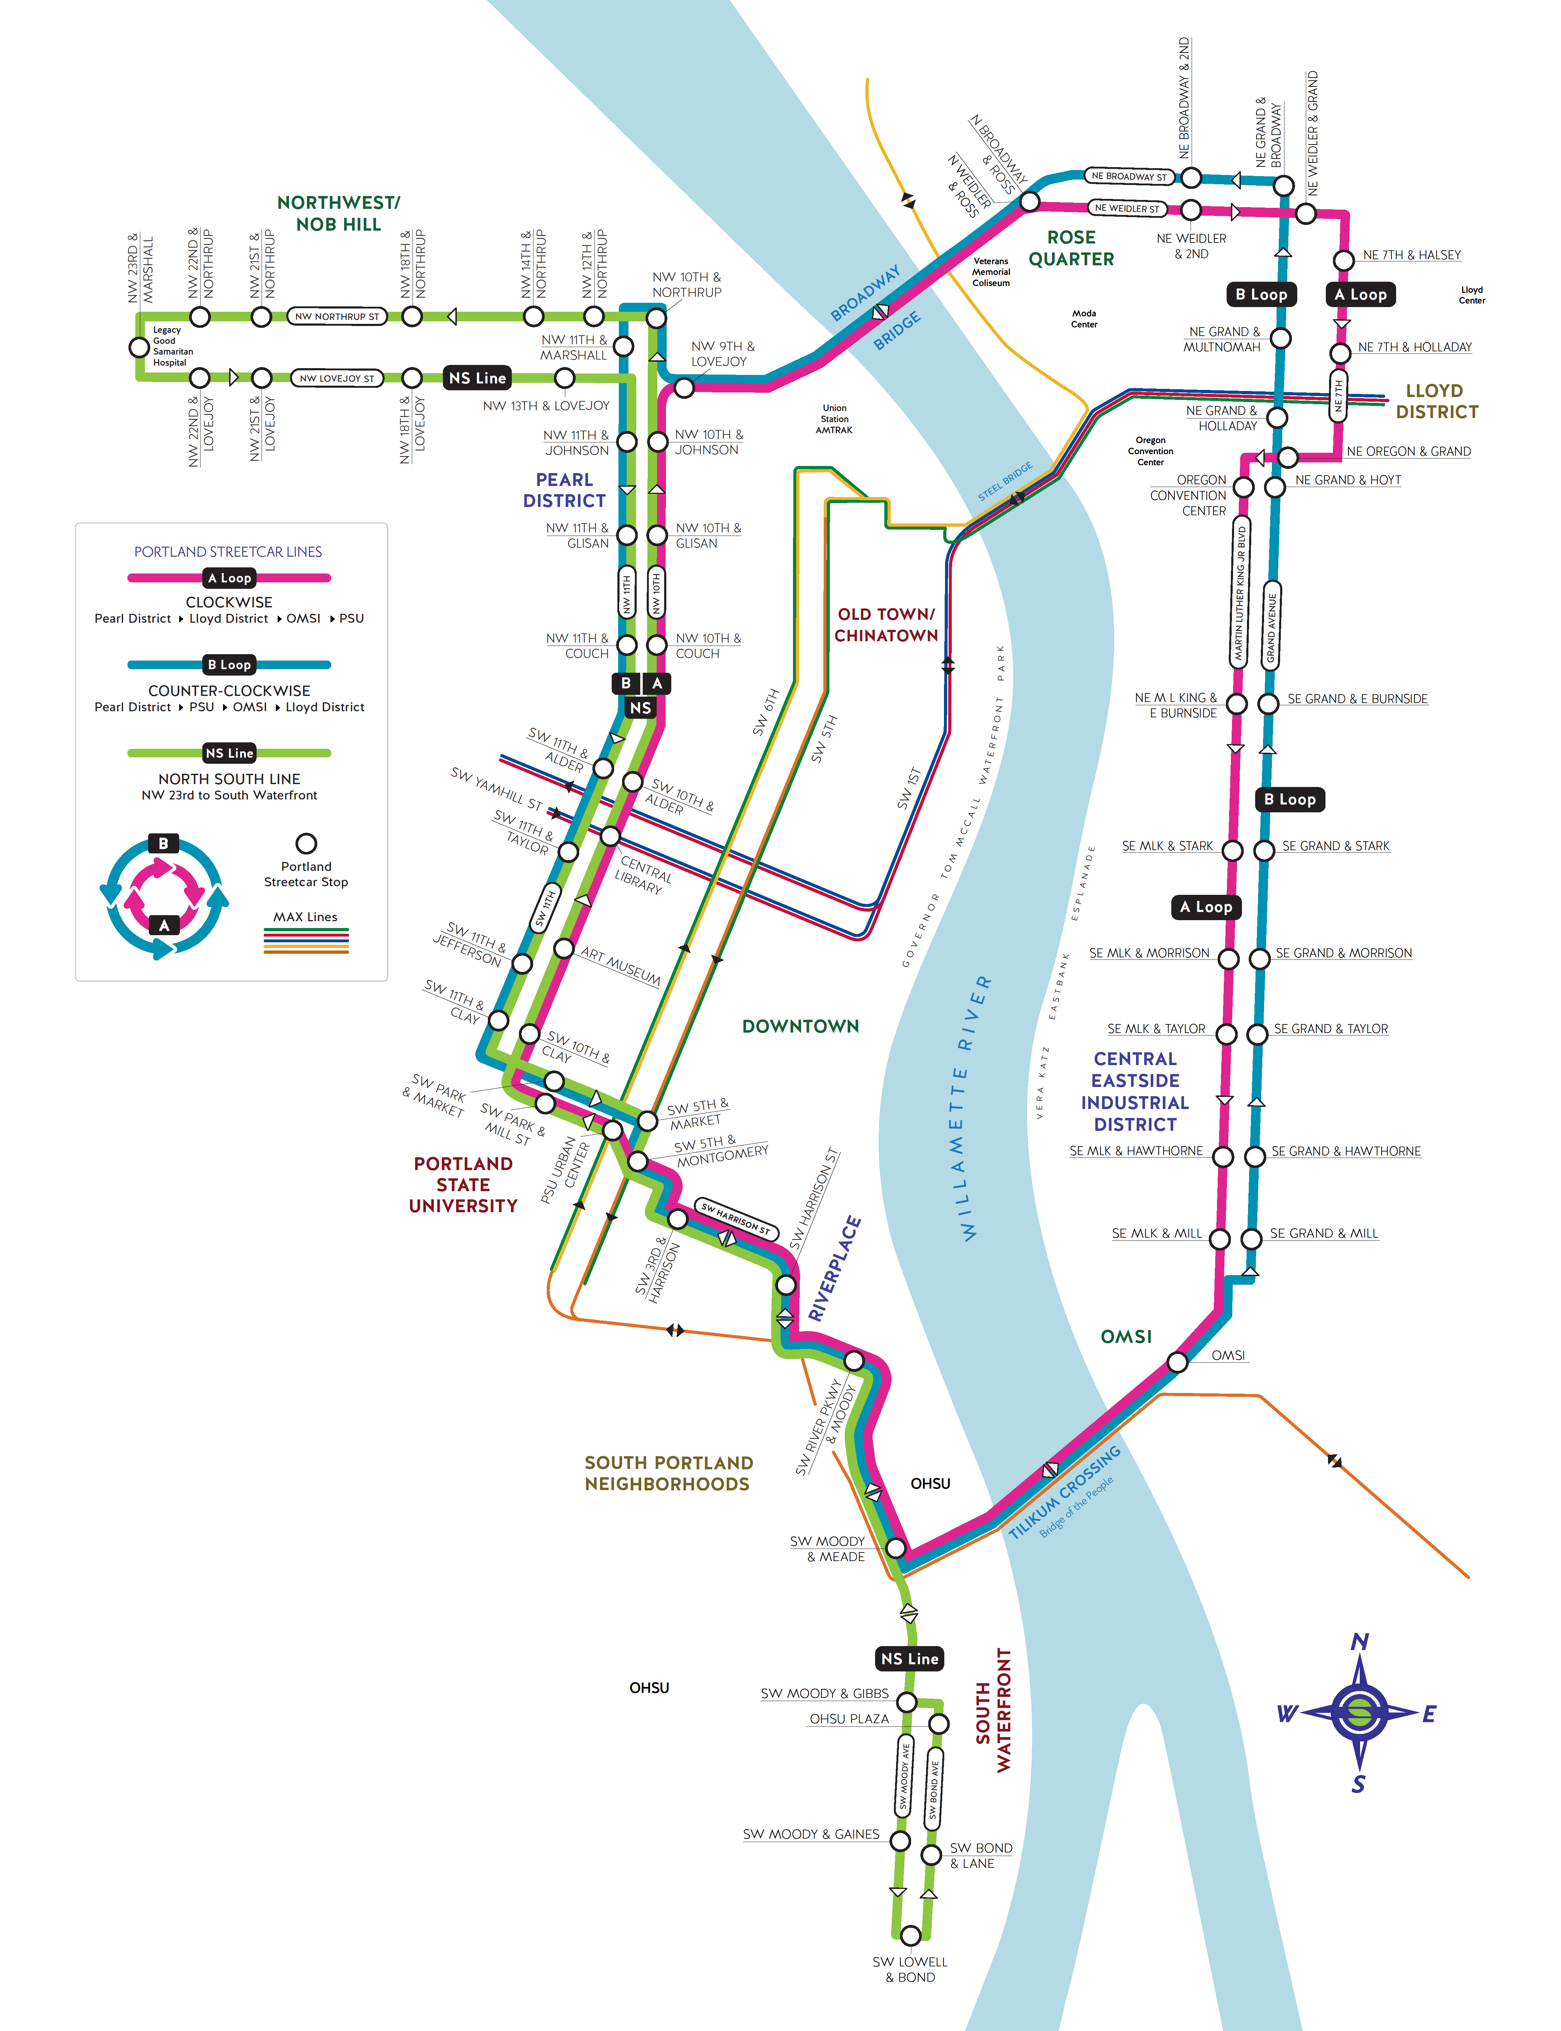
Ridership & Service
Approximately 15,000 riders per day
82% on-time performance (up from 80% in 2017)
Wheelchair ramp deployed 35+ times per hour
12 streetcars at peak service

Slide 3
Improving Performance
Business Access and Transit lane on NE Grand Avenue
Pilot project for Enhanced Transit Corridors/Central City in Motion plan
Will be implemented by end of April 2019

Slide 4
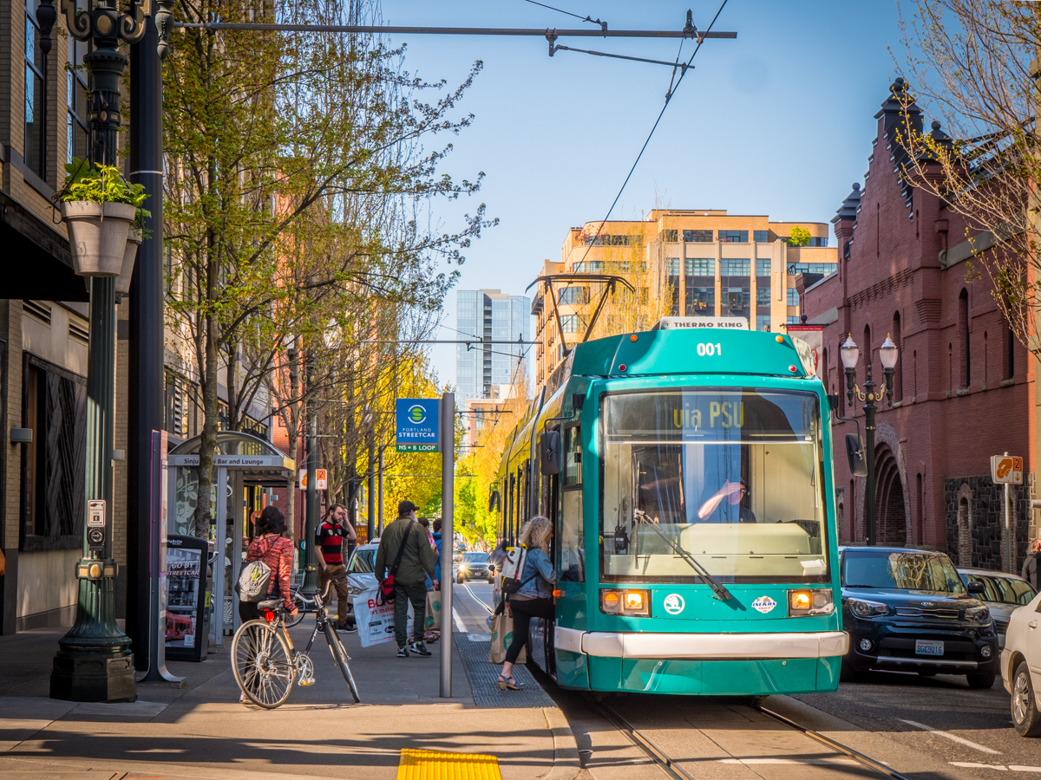
Walkable Development
2,936 new housing units built along the route in 2018
49% of all housing units built in last 20 years are on the streetcar line
11,282 units planned or under construction
32% of Portland’s jobs are along the route

Slide 5
A System That Serves Everyone

Slide 6
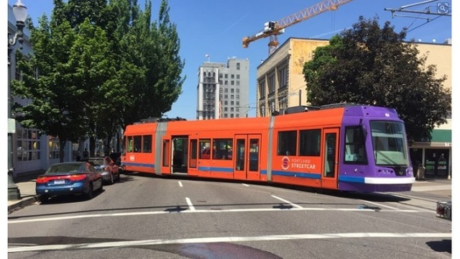
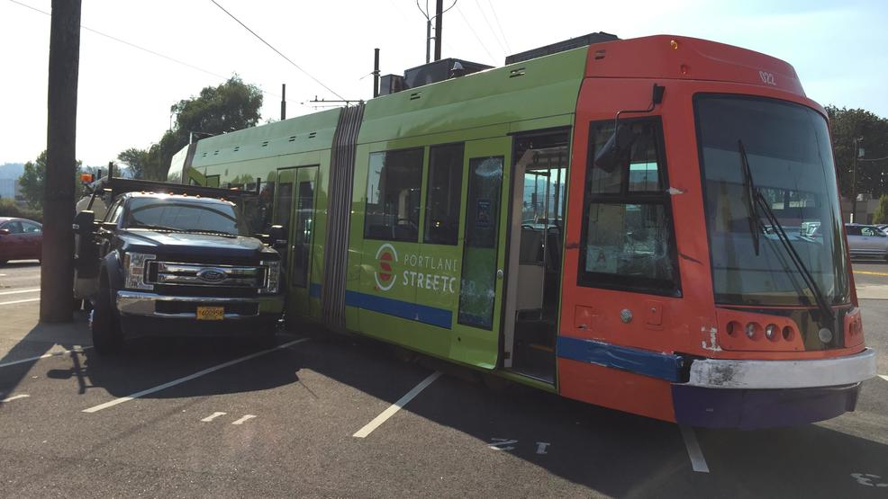
Vehicle Maintenance
Three derailments in 2018
Reduced peak service to 12 streetcars to maintain available spare vehicles

Slide 7
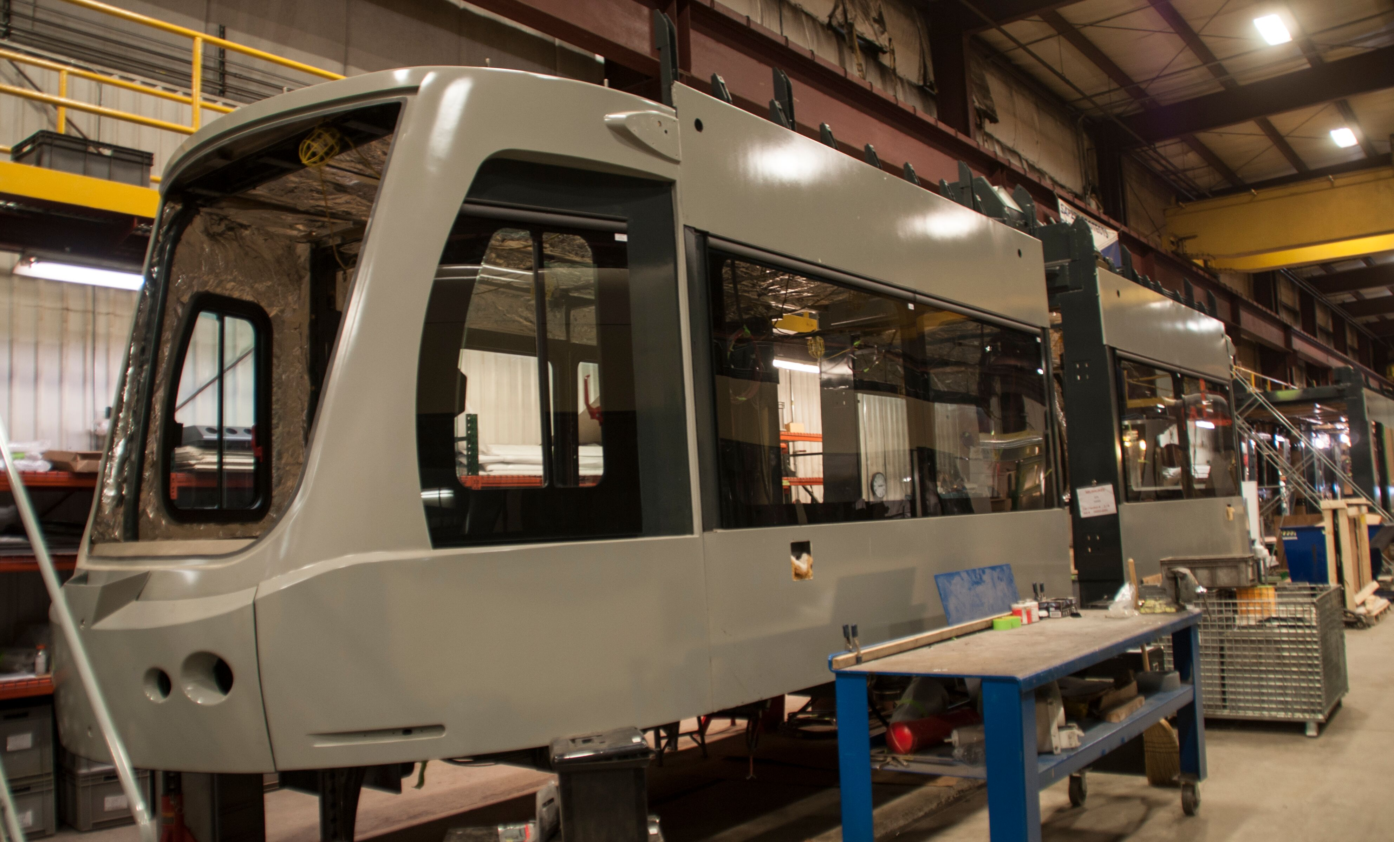
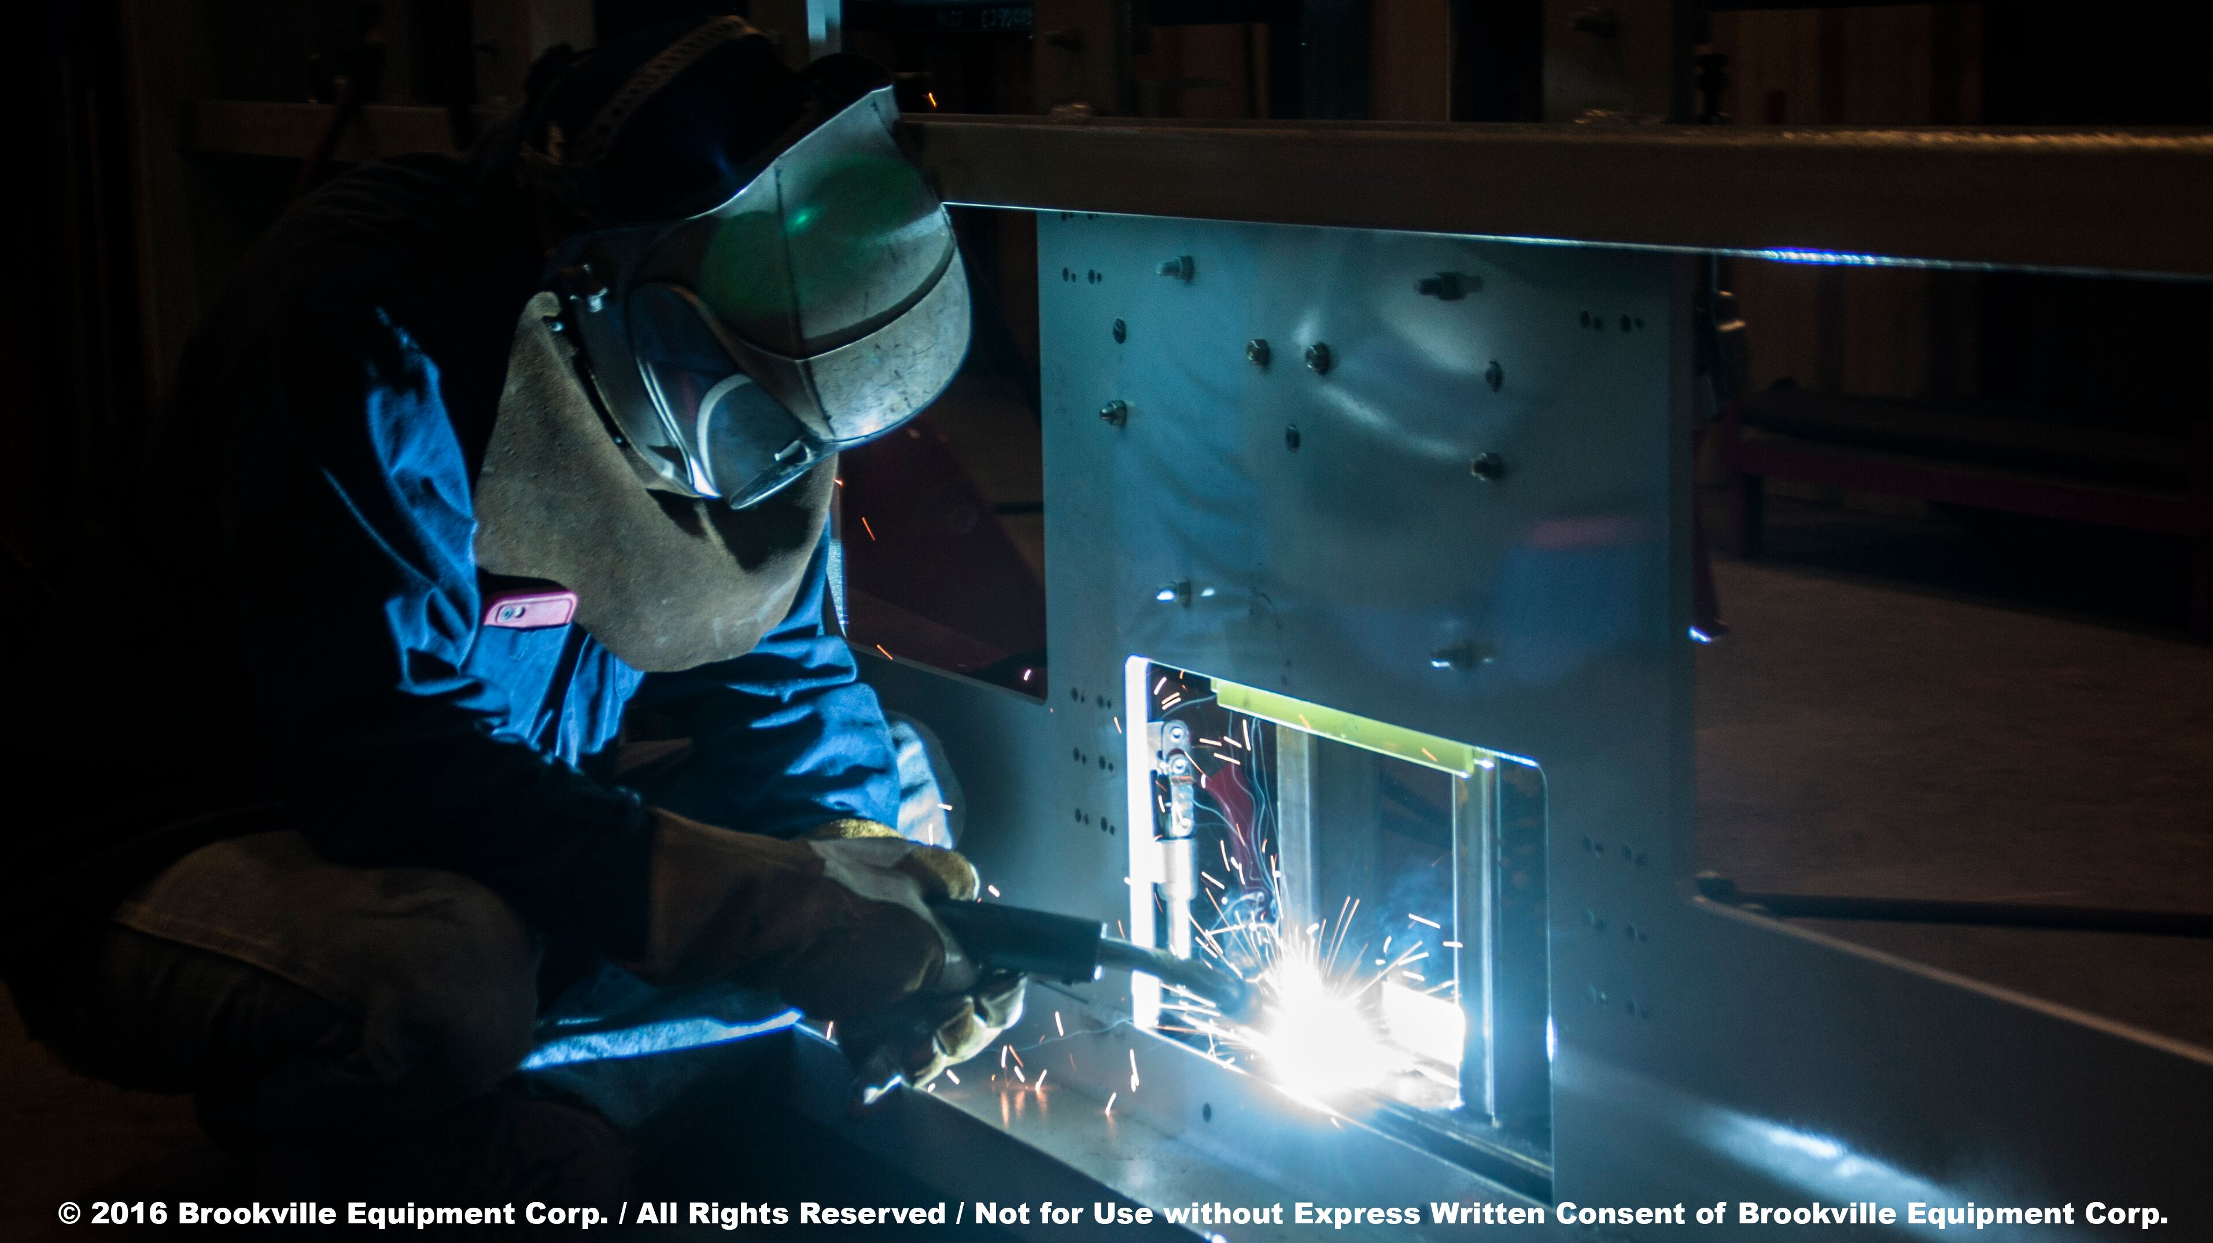
3 New Streetcars in Service Fall 2020
3 New Cars in Service Fall 2020
Brookville Equipment Corp.,
Brookville, Pennsylvania

Slide 8
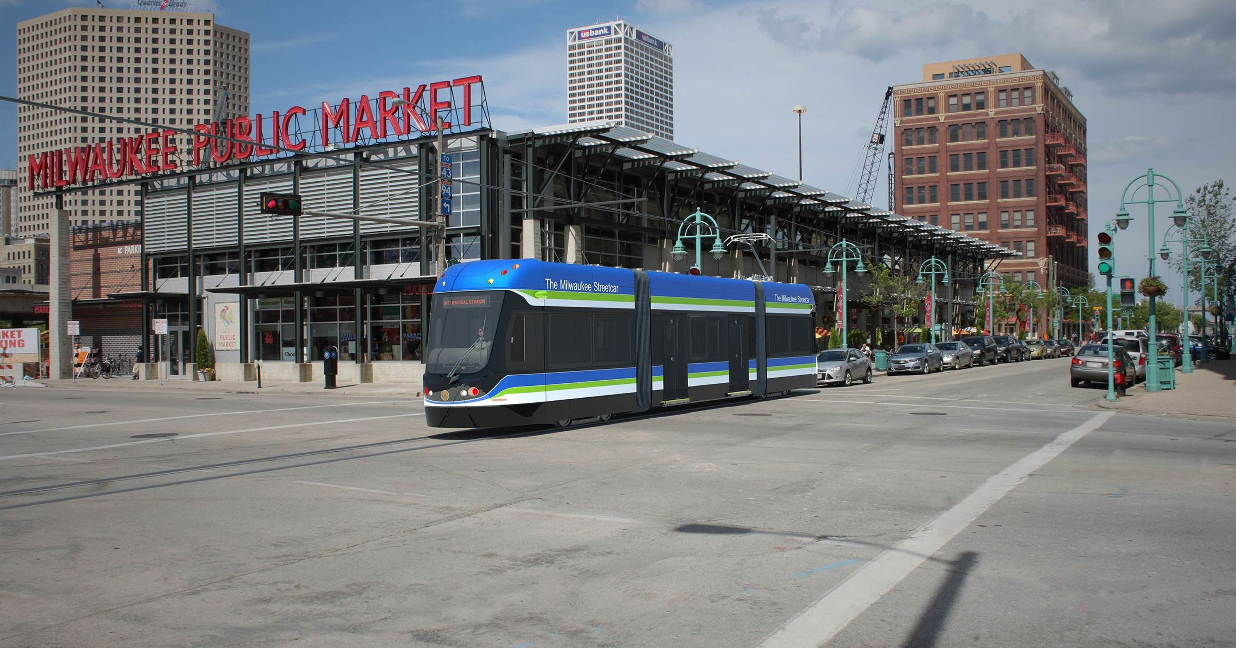
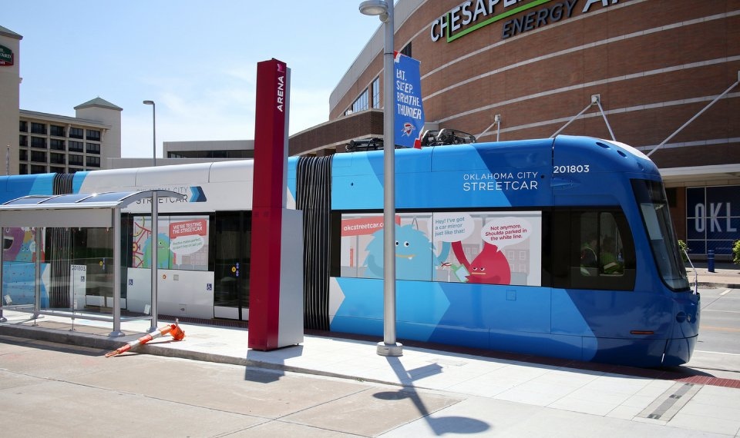
New Streetcar Systems in 2018
Milwaukee, WI
Oklahoma City, OK
El Paso, TX

Slide 9
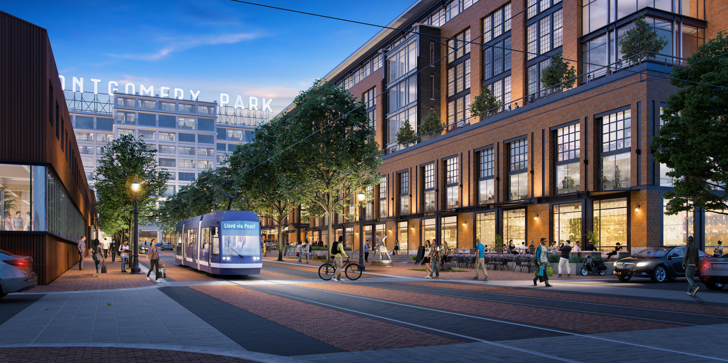
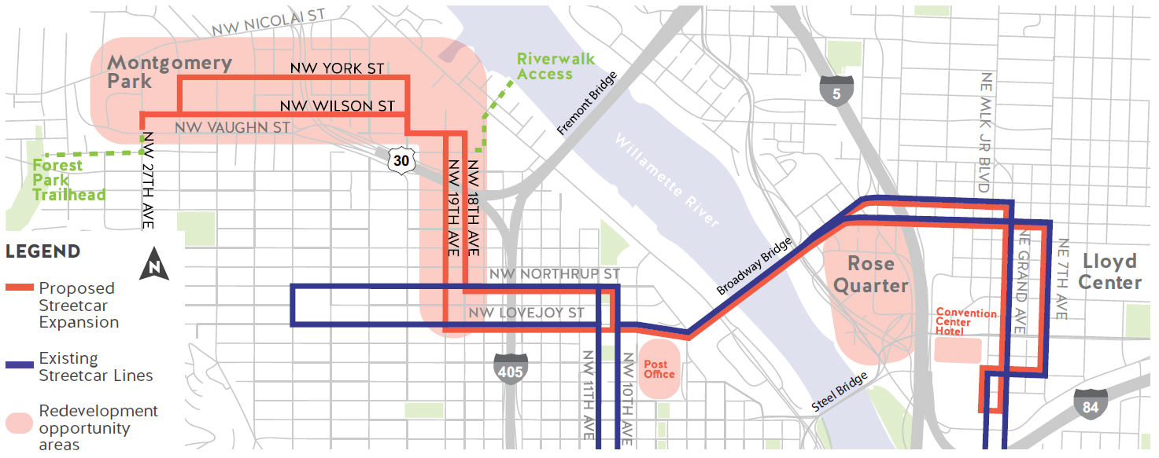
Moving Forward
Planned extension to Montgomery Park
Connects to Albina and Broadway Corridor
45+ acres of land for redevelopment
Access to Forest Park and the Willamette
Coalition of property owners pursuing Local Improvement District

Slide 10
City Funds and Federal Planning Grant
Project management and oversight
Funding, operations planning and partnerships
Project need and alternatives analysis/network planning
$120,000
Project management and oversight
Funding, operations planning and partnerships
Project need and alternatives analysis
$370,000
Land use evaluation
Jobs/housing analysis
Equity analysis
Streetcar engineering
$1.3M
Land use planning and development assistance
Transportation/traffic planning
Includes full corridor connection to Hollywood Town Center

Slide 11
Dan Bower, PSI Executive Director
February 27, 2019

