Slide 1
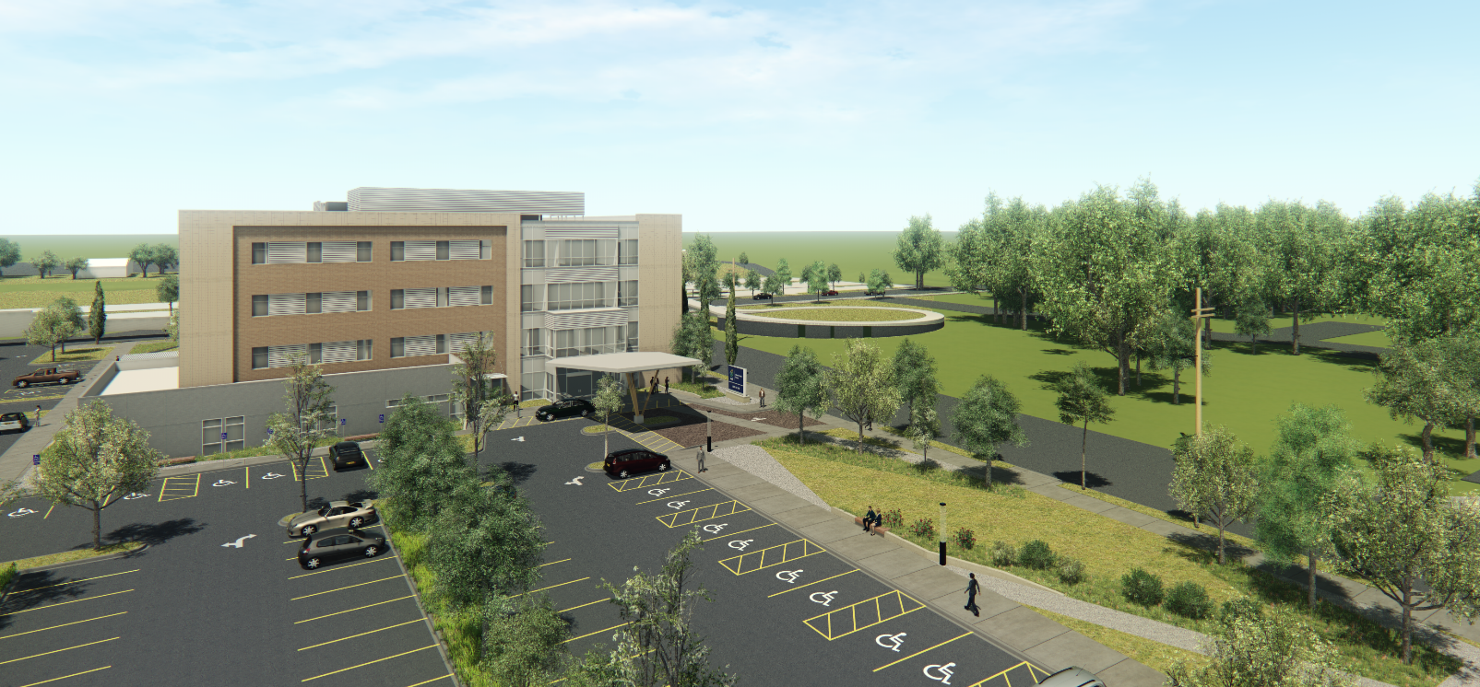
MedCraft / Adventist Health Medical Office Building EA 18-281680
Design Advice Review
Clark/Kjos Architects
March 7, 2018
Page 1

Slide 2
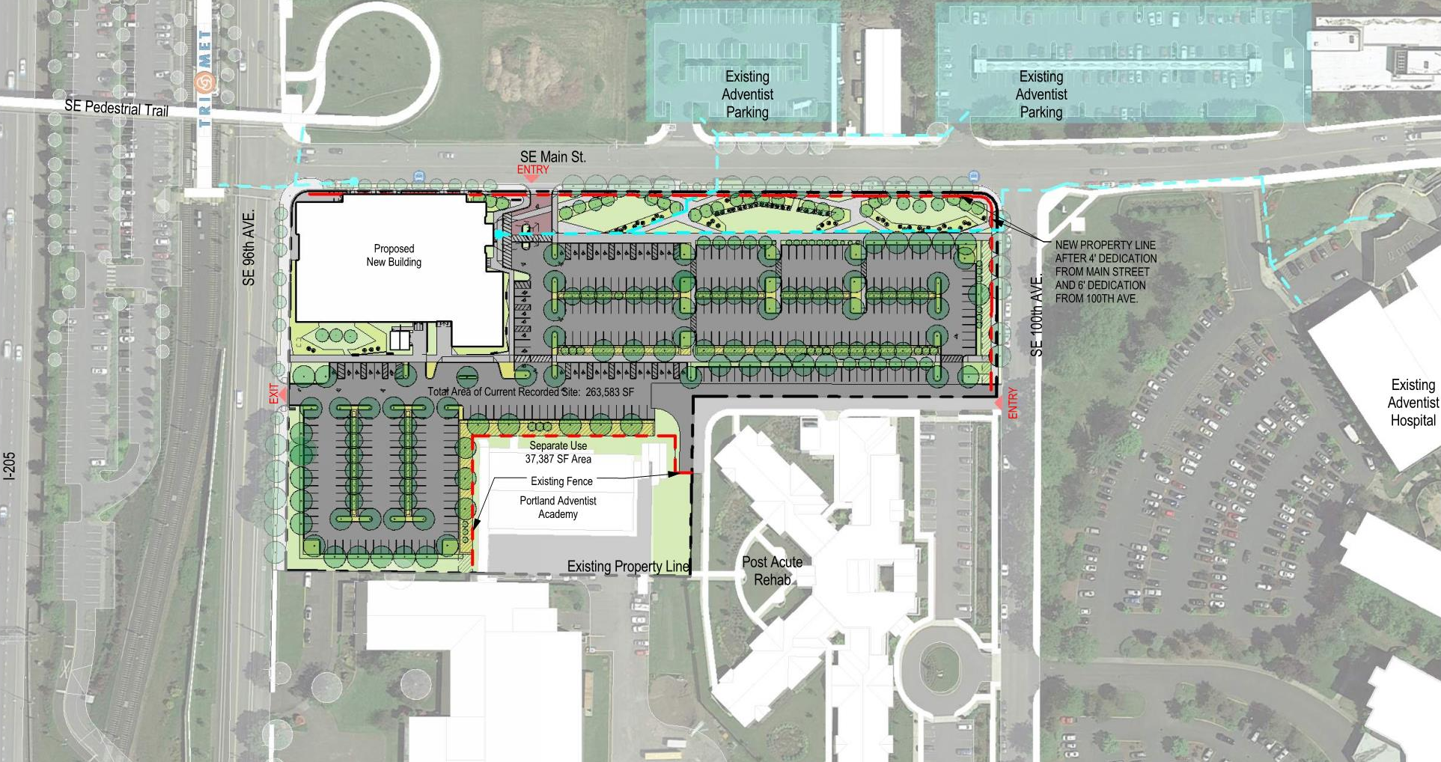
Vicinity Plan
Page 2
Notes:
City Maximum: 92,600-13,500 sf / 204 = 454 stalls
Potential need:
Clinics : 74,600 sf / 250 = 298 stalls (min)
ASC: 4 OR x 15 = 60 stalls (approx.)
Total 358

Slide 3
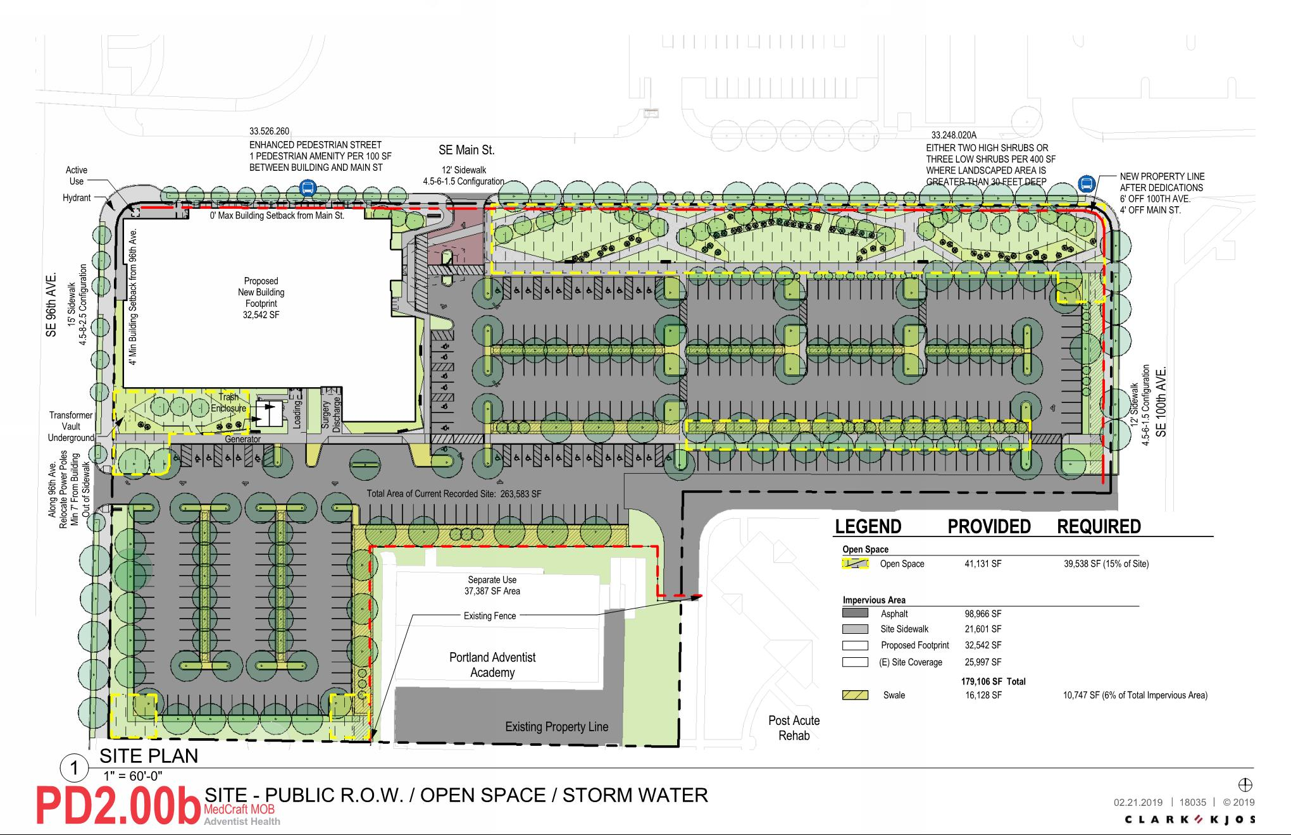
Site
Page 2
Notes:
City Maximum: 92,600-13,500 sf / 204 = 454 stalls
Potential need:
Clinics : 74,600 sf / 250 = 298 stalls (min)
ASC: 4 OR x 15 = 60 stalls (approx.)
Total 358

Slide 4
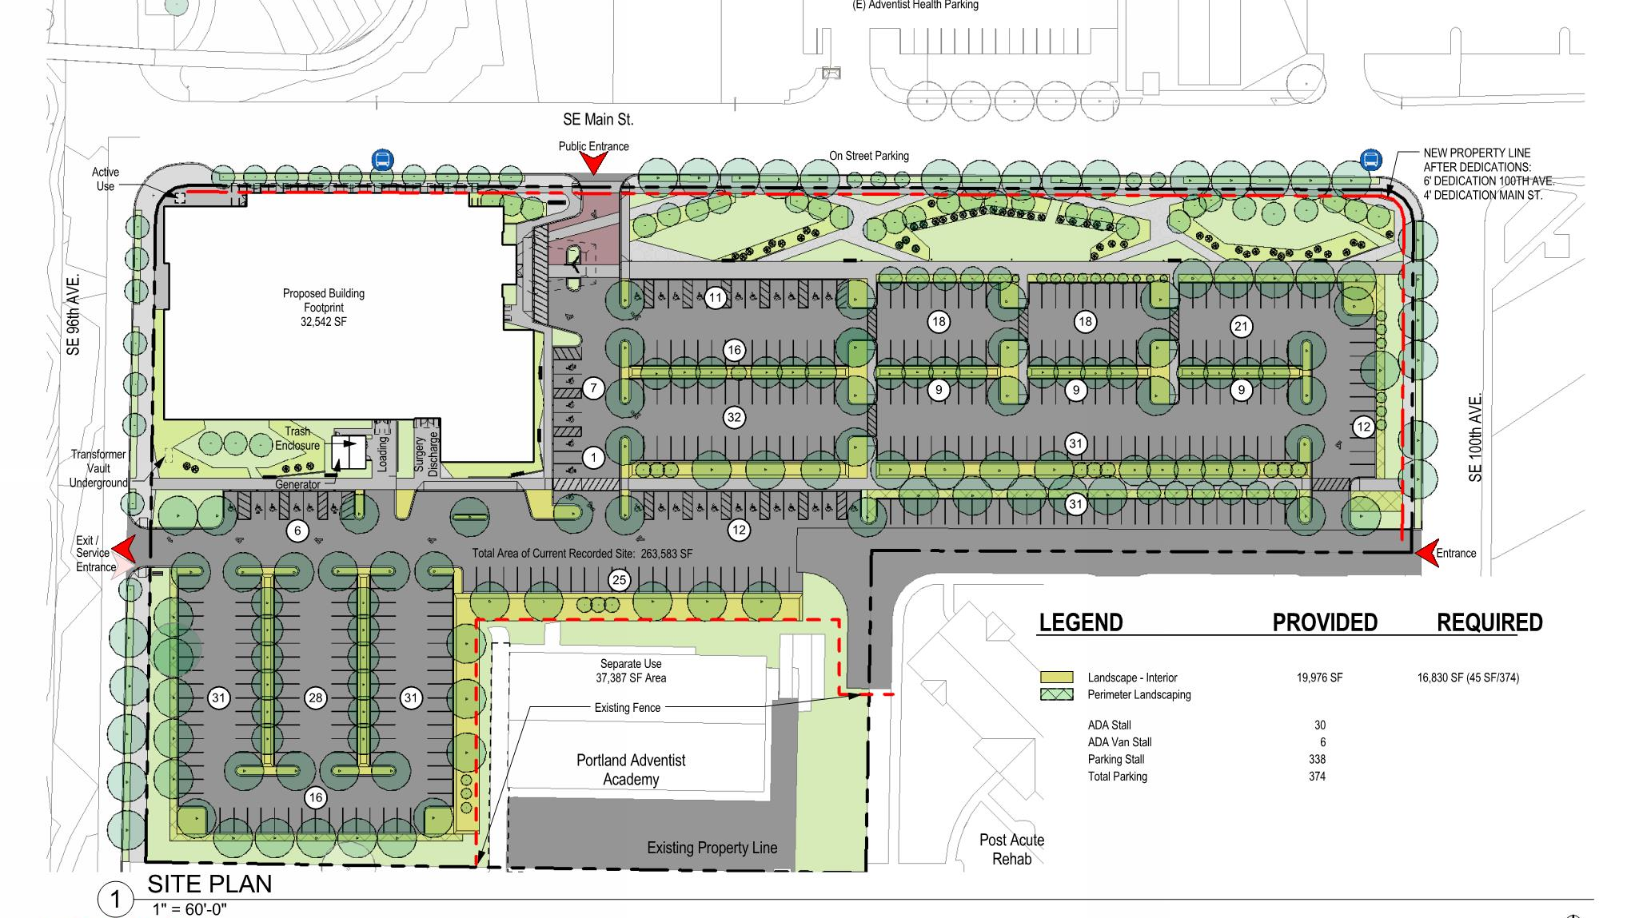
Site - Parking
Page 2
Notes:
City Maximum: 92,600-13,500 sf / 204 = 454 stalls
Potential need:
Clinics : 74,600 sf / 250 = 298 stalls (min)
ASC: 4 OR x 15 = 60 stalls (approx.)
Total 358

Slide 5
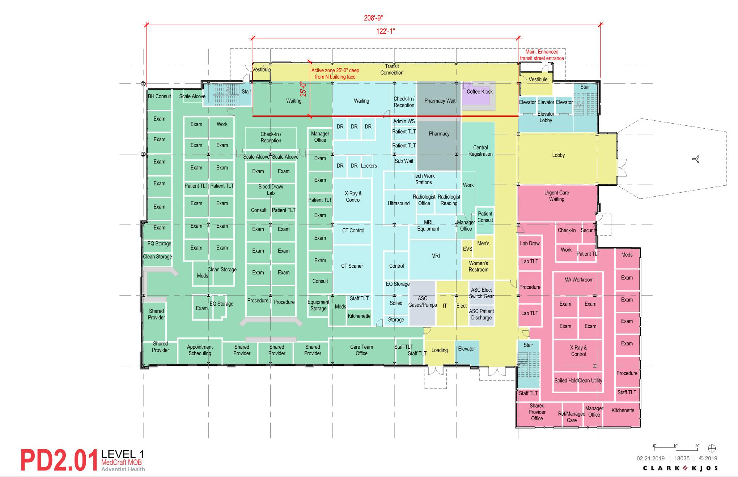
Level 1
Page 2
Notes:
City Maximum: 92,600-13,500 sf / 204 = 454 stalls
Potential need:
Clinics : 74,600 sf / 250 = 298 stalls (min)
ASC: 4 OR x 15 = 60 stalls (approx.)
Total 358

Slide 6
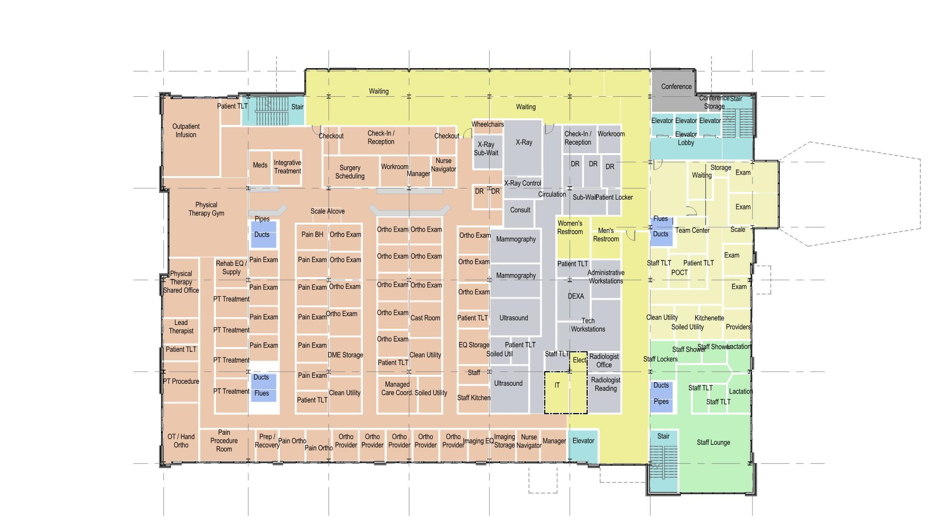
Level 2
Page 2
Notes:
City Maximum: 92,600-13,500 sf / 204 = 454 stalls
Potential need:
Clinics : 74,600 sf / 250 = 298 stalls (min)
ASC: 4 OR x 15 = 60 stalls (approx.)
Total 358

Slide 7
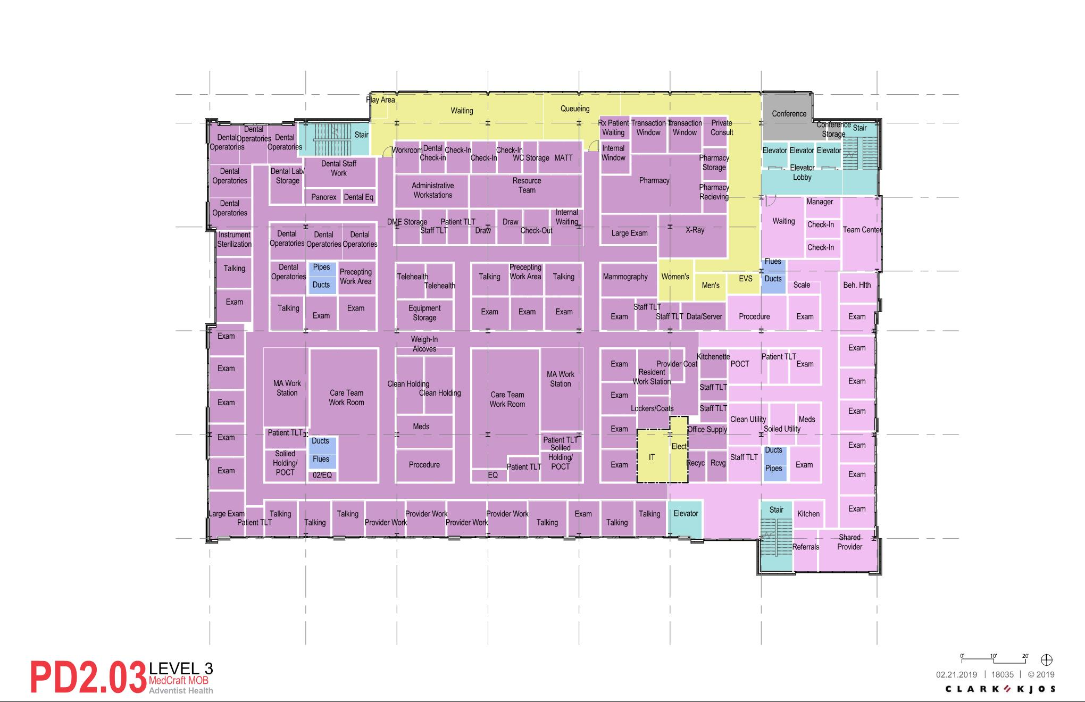
Level 3
Page 2
Notes:
City Maximum: 92,600-13,500 sf / 204 = 454 stalls
Potential need:
Clinics : 74,600 sf / 250 = 298 stalls (min)
ASC: 4 OR x 15 = 60 stalls (approx.)
Total 358

Slide 8
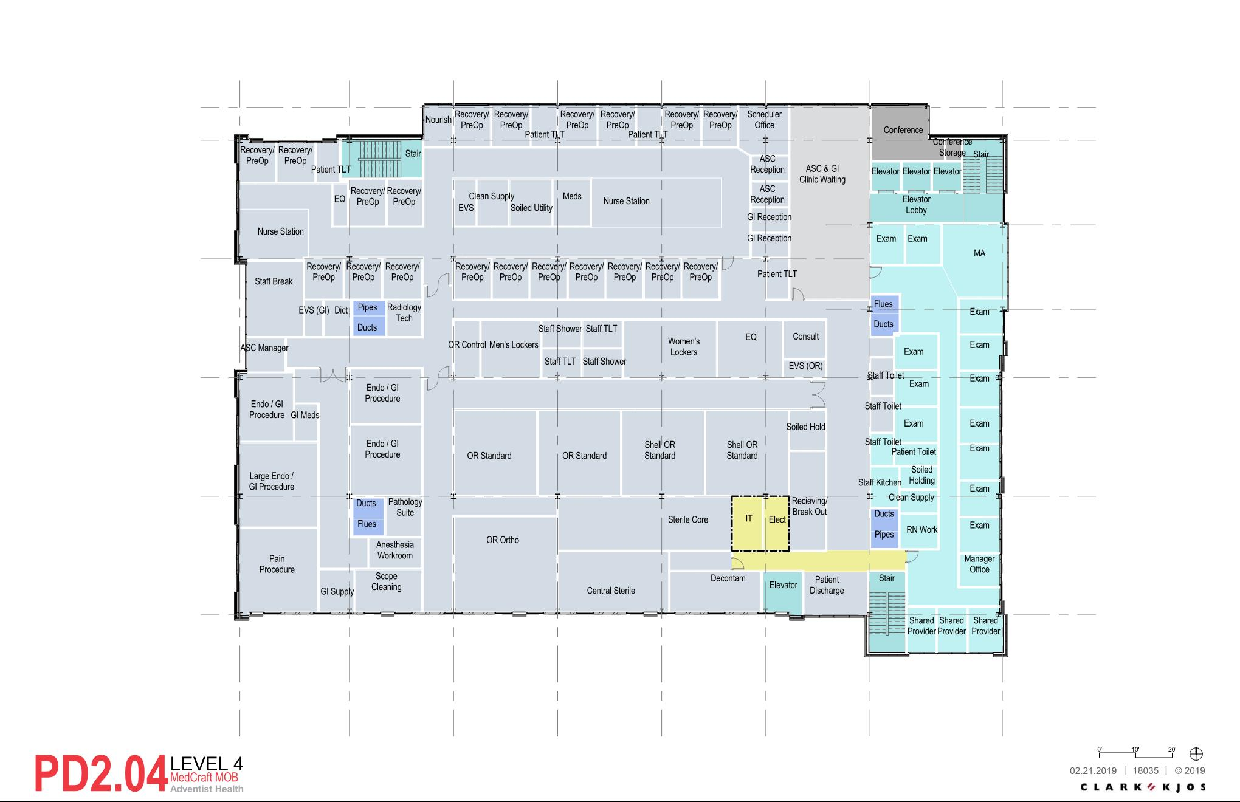
Level 4
Page 2
Notes:
City Maximum: 92,600-13,500 sf / 204 = 454 stalls
Potential need:
Clinics : 74,600 sf / 250 = 298 stalls (min)
ASC: 4 OR x 15 = 60 stalls (approx.)
Total 358

Slide 9
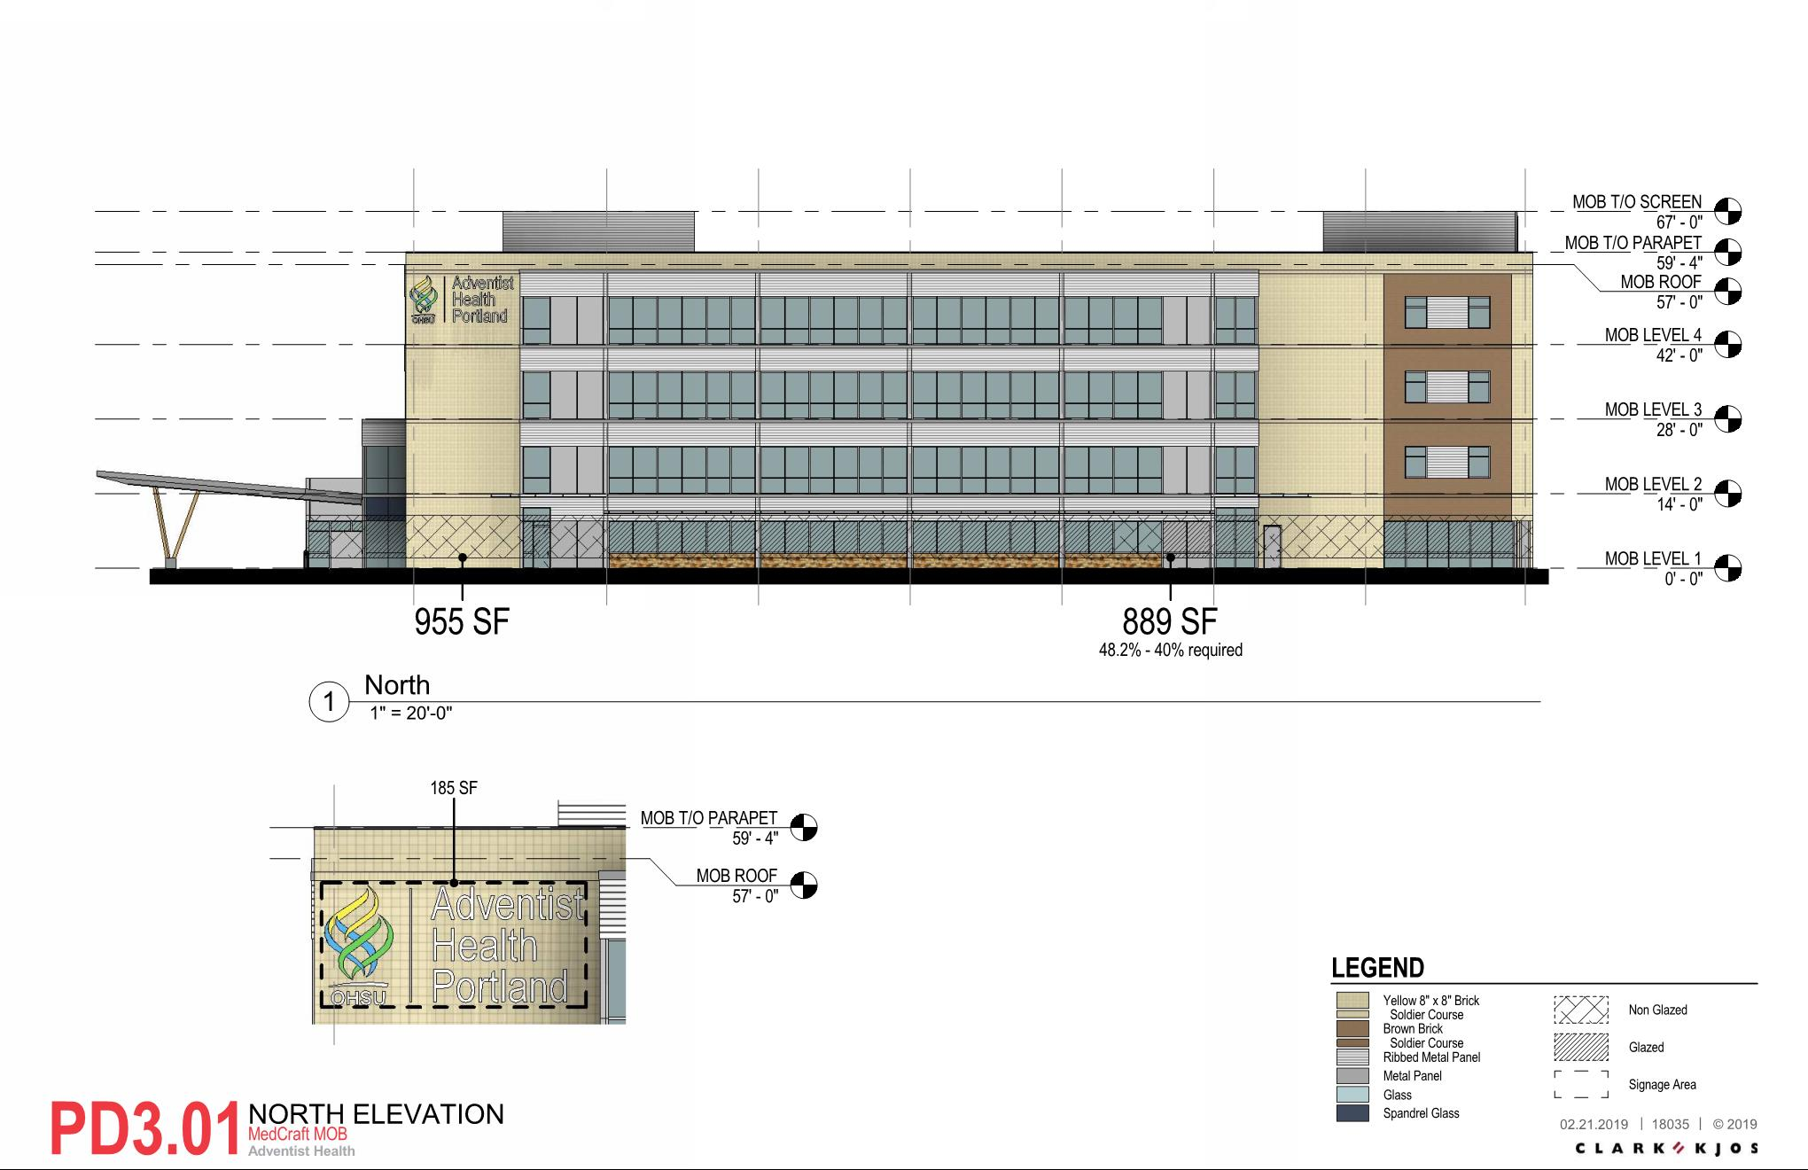
North Elevation
Page 2
Notes:
City Maximum: 92,600-13,500 sf / 204 = 454 stalls
Potential need:
Clinics : 74,600 sf / 250 = 298 stalls (min)
ASC: 4 OR x 15 = 60 stalls (approx.)
Total 358

Slide 10
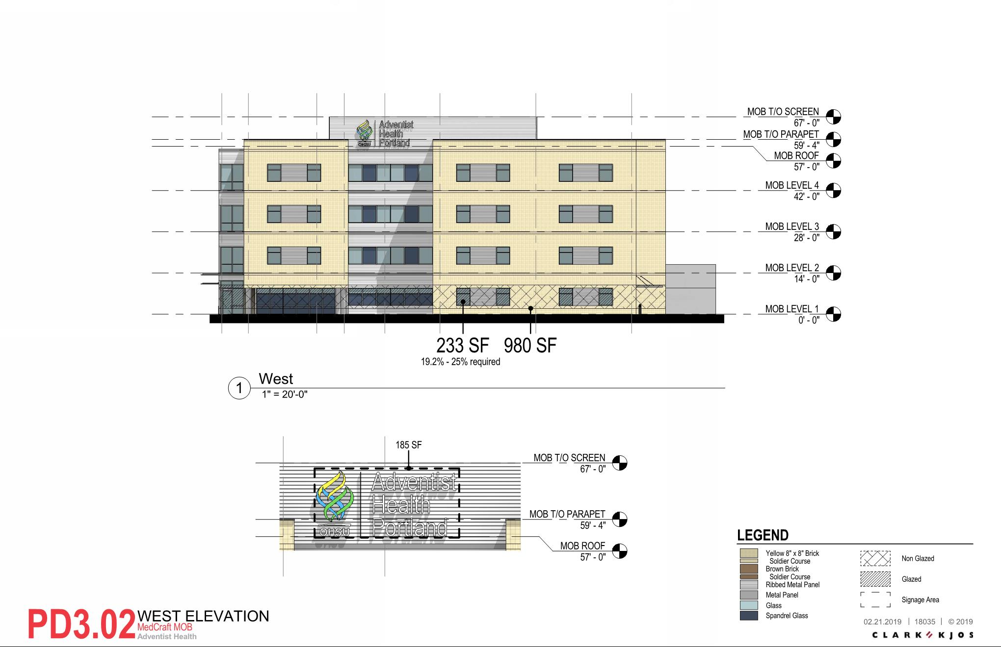
East Elevation
Page 2
Notes:
City Maximum: 92,600-13,500 sf / 204 = 454 stalls
Potential need:
Clinics : 74,600 sf / 250 = 298 stalls (min)
ASC: 4 OR x 15 = 60 stalls (approx.)
Total 358

Slide 11
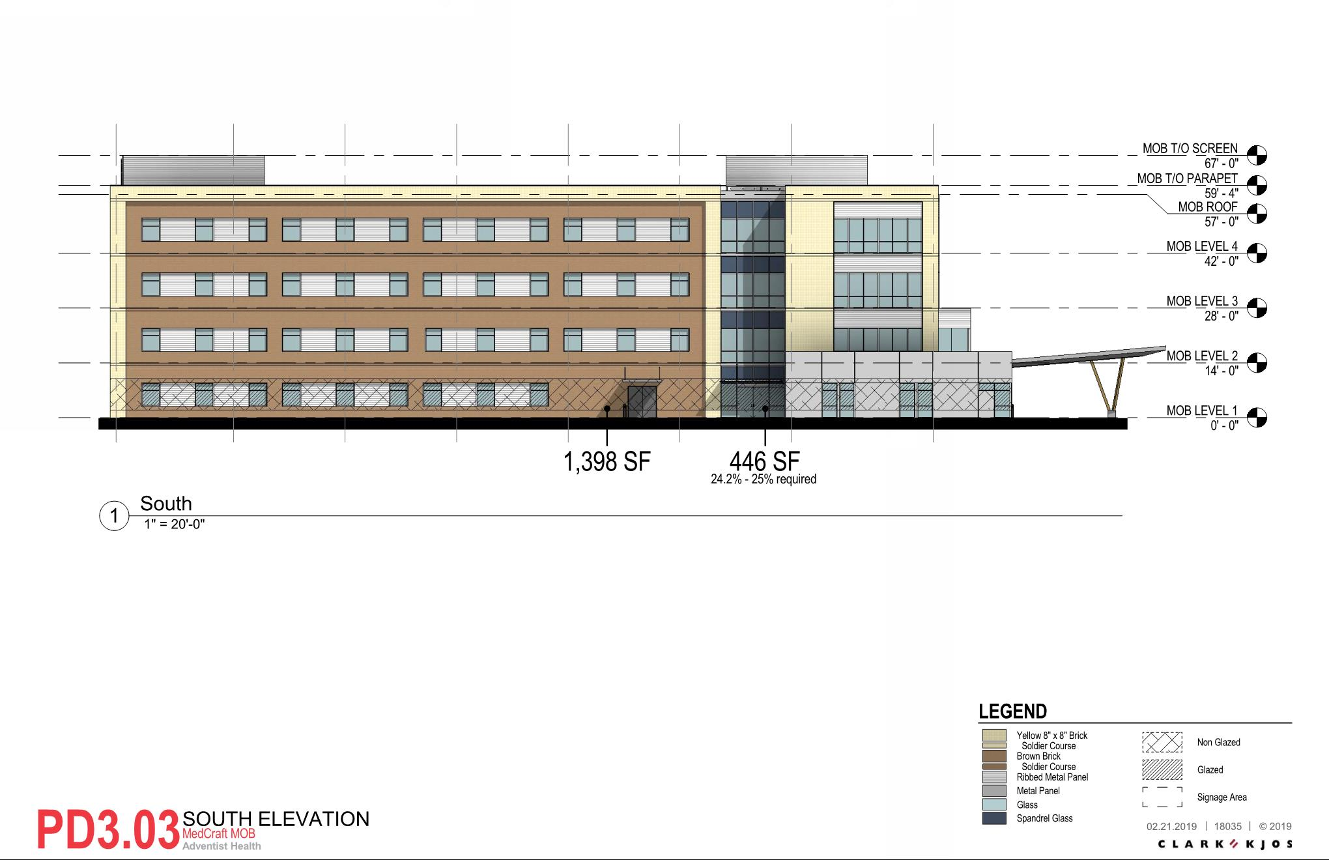
South Elevation
40%
Page 2
Notes:
City Maximum: 92,600-13,500 sf / 204 = 454 stalls
Potential need:
Clinics : 74,600 sf / 250 = 298 stalls (min)
ASC: 4 OR x 15 = 60 stalls (approx.)
Total 358

Slide 12
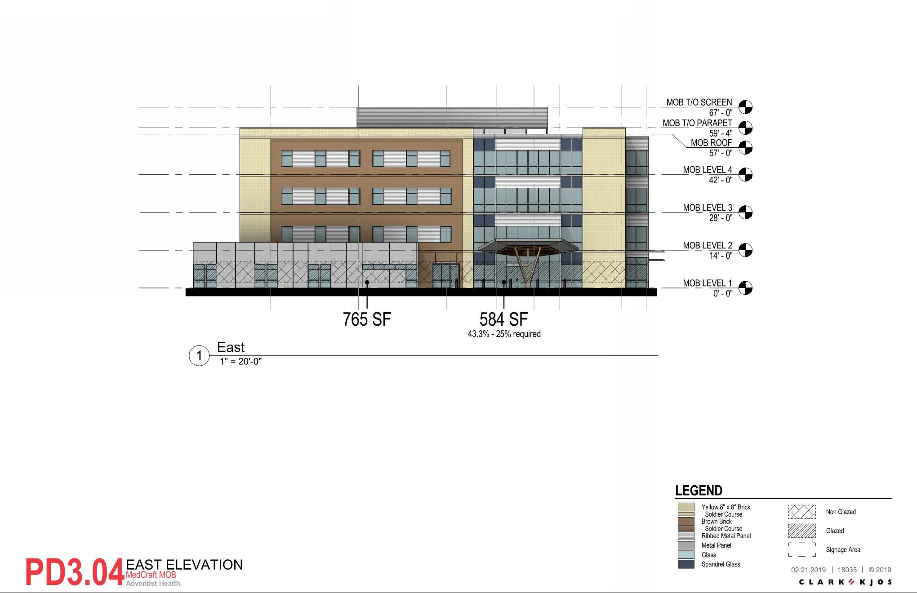
West Elevation
Page 2
Notes:
City Maximum: 92,600-13,500 sf / 204 = 454 stalls
Potential need:
Clinics : 74,600 sf / 250 = 298 stalls (min)
ASC: 4 OR x 15 = 60 stalls (approx.)
Total 358

Slide 13
Renderings
Page 2
Notes:
City Maximum: 92,600-13,500 sf / 204 = 454 stalls
Potential need:
Clinics : 74,600 sf / 250 = 298 stalls (min)
ASC: 4 OR x 15 = 60 stalls (approx.)
Total 358

Slide 14
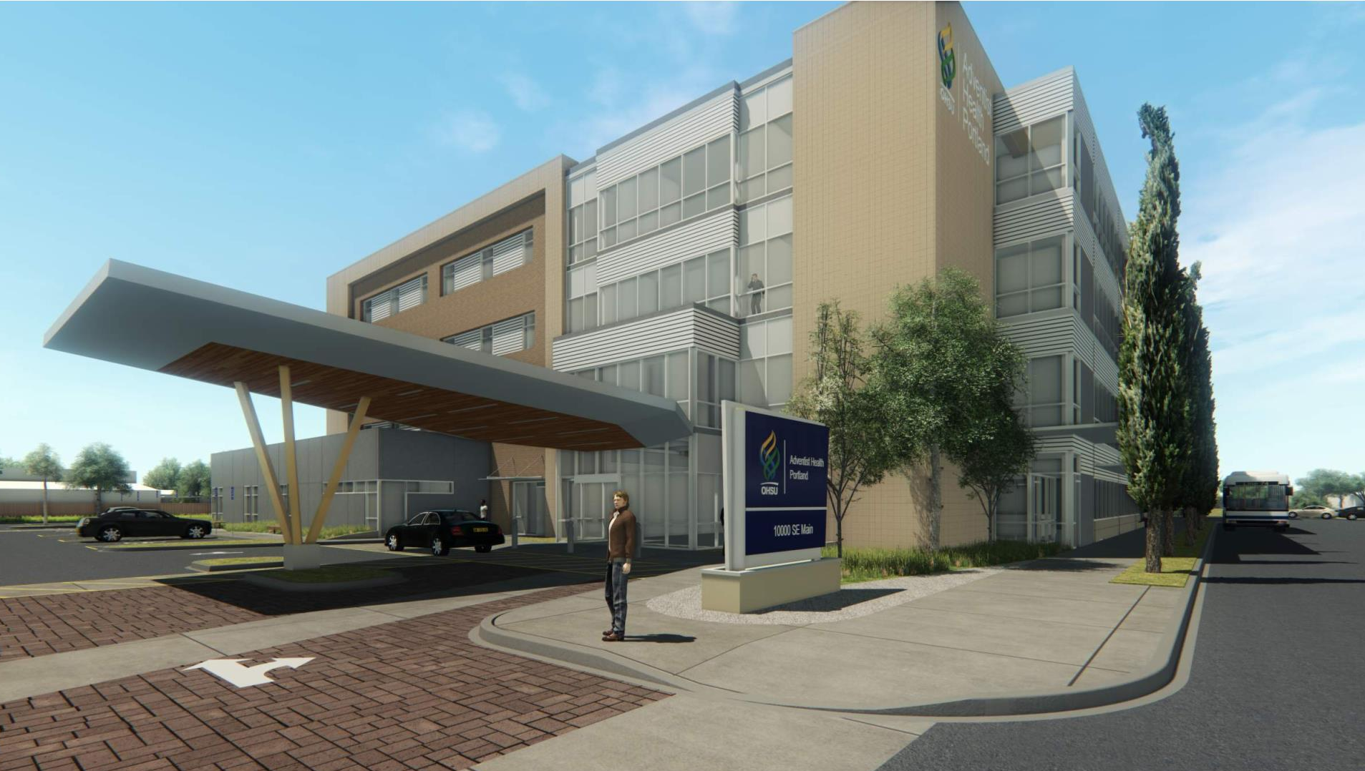
Notes:
City Maximum: 92,600-13,500 sf / 204 = 454 stalls
Potential need:
Clinics : 74,600 sf / 250 = 298 stalls (min)
ASC: 4 OR x 15 = 60 stalls (approx.)
Total 358

Slide 15
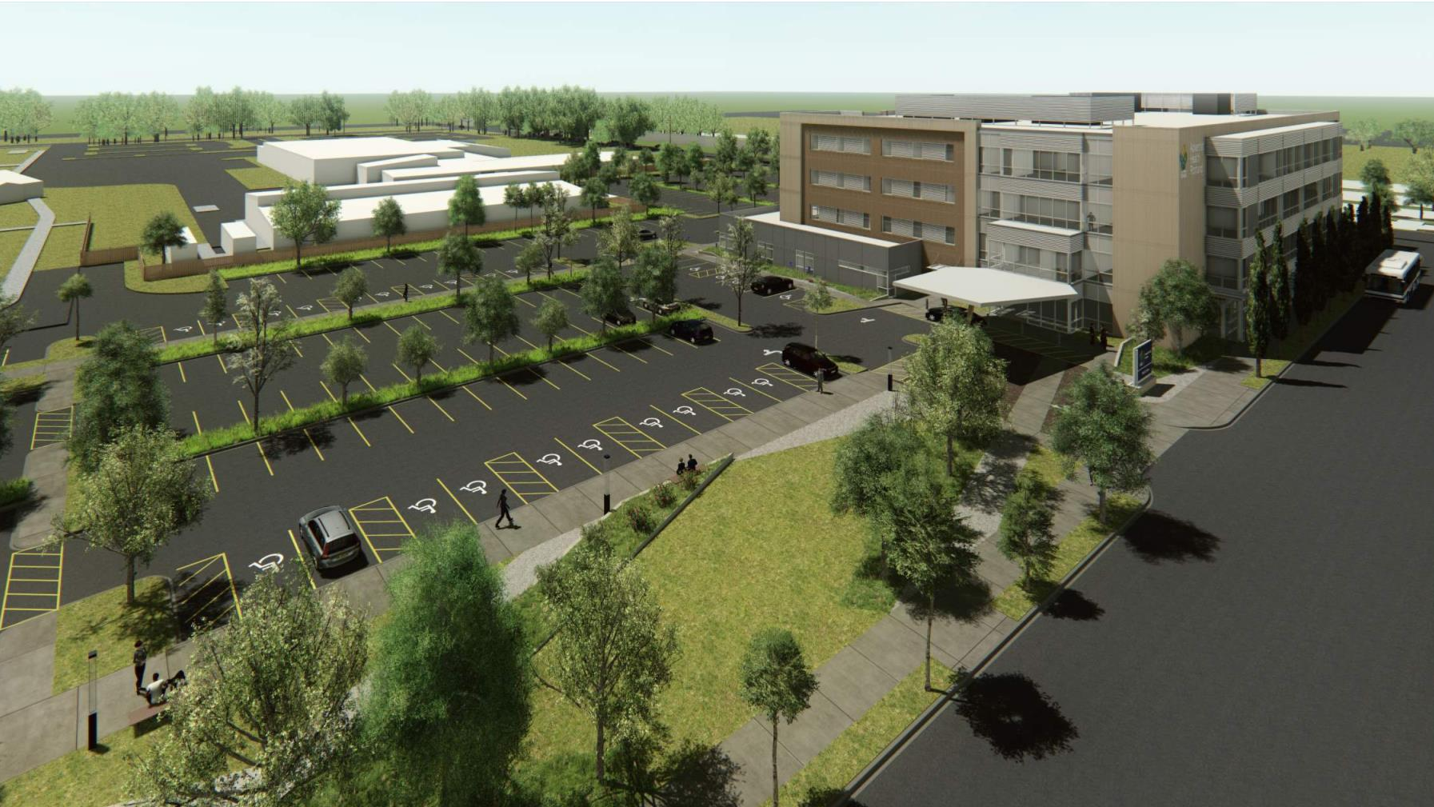
Notes:
City Maximum: 92,600-13,500 sf / 204 = 454 stalls
Potential need:
Clinics : 74,600 sf / 250 = 298 stalls (min)
ASC: 4 OR x 15 = 60 stalls (approx.)
Total 358

Slide 16
Modification - Enhanced Pedestrian Street Frontage
Goal: Create “Exceptional Pedestrian Environment”
Enhanced Pedestrian Connections
  Improve the campus connections between proposed MOB and existing Adventist Health campus and neighborhood MAX station
Health and Wellness
  Connect to Clinic uses
  Healing Gardens
  Promotion of Walking
Future Property Development Alignment
  Open Space located and suited future site development
Page 2
Notes:
City Maximum: 92,600-13,500 sf / 204 = 454 stalls
Potential need:
Clinics : 74,600 sf / 250 = 298 stalls (min)
ASC: 4 OR x 15 = 60 stalls (approx.)
Total 358

Slide 17
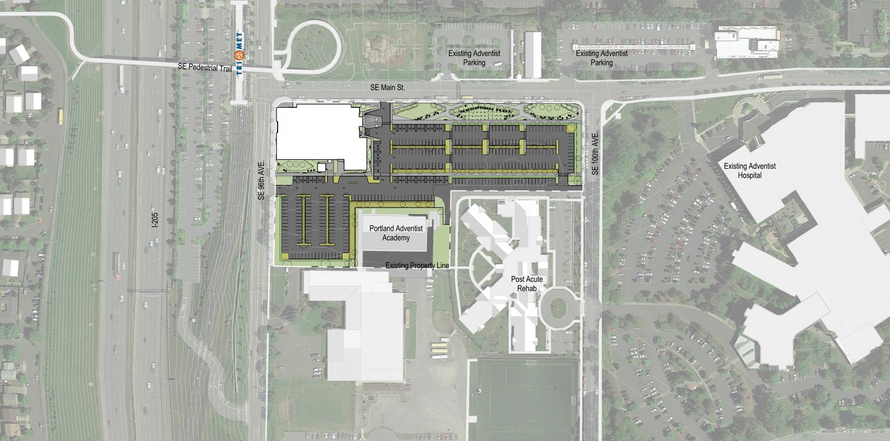


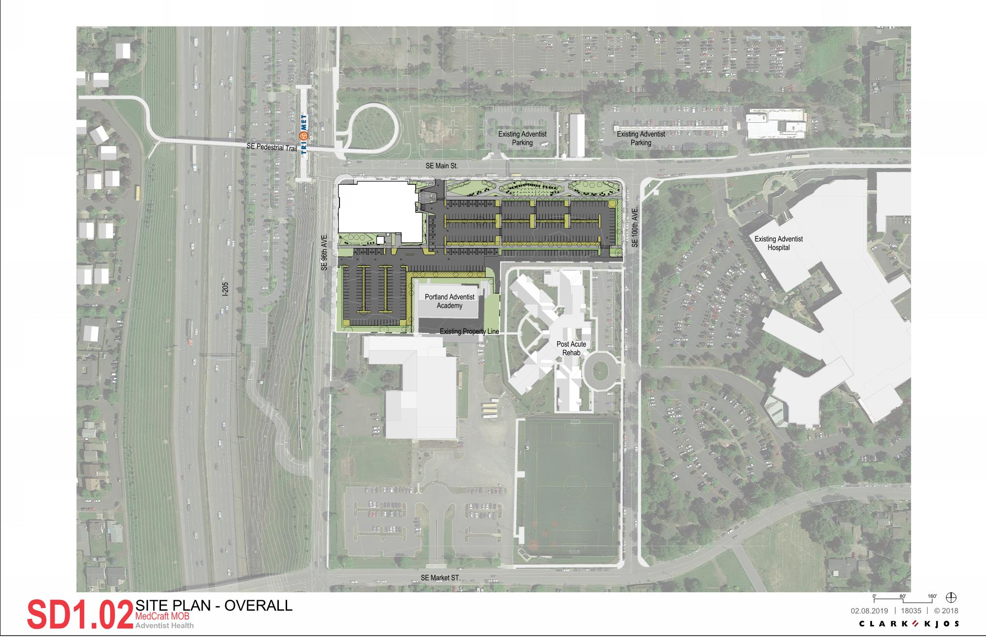
Extended Pedestrian Connections
Page 3
Notes:
City Maximum: 92,600-13,500 sf / 204 = 454 stalls
Potential need:
Clinics : 74,600 sf / 250 = 298 stalls (min)
ASC: 4 OR x 15 = 60 stalls (approx.)
Total 358

Slide 18
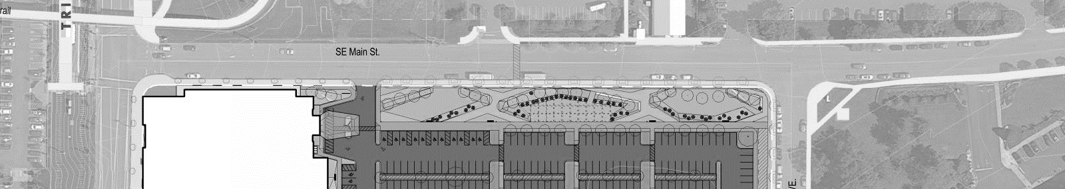
SE Main Street Frontage
10%
65%
=75%
OF BUILDING FACE AT LOT LINE FOR BUILDING AND ACTIVE USE
22’-0” ACTIVE USE
AT SETBACK
31%
1%
17%
= 49%
VISIBLE VEHICLE AREA
`
54’-0” Open Area
`
`
`
`
Poss. Food
Trucks
  Vehicle Area Location (33.266.130.C.3.b)
    No more than 50% of the frontage on a transit street can be used as vehicle area.
  Pedestrian Enhanced Street (33.526.280)
    75% of the building must extend to the lot line or within 12 feet with Active uses
    Enhance the continuity of the pedestrian environment
    Maintain an urban character by pedestrian oriented, active ground level uses
    Strengthen the relationship between the active uses and the pedestrian environment
  Remediation
    Locate Open Area to provide exceptional pedestrian experience
Page 5
Notes:
City Maximum: 92,600-13,500 sf / 204 = 454 stalls
Potential need:
Clinics : 74,600 sf / 250 = 298 stalls (min)
ASC: 4 OR x 15 = 60 stalls (approx.)
Total 358

Slide 19
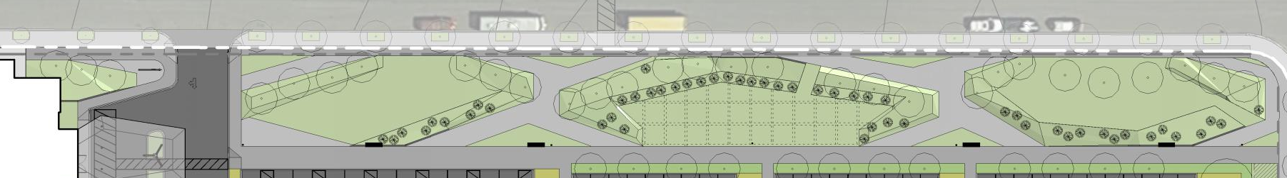
Enhanced Open Area
BUILDING PLAZA
PUBLIC
ACTIVITY
ZONE
RESPITE
GARDEN
MARKET / SEATING
BUFFER
BUFFER
BUFFER
BUFFER
Traffic calming
Campus connections
Activated Space
Connection to Retail / Café
Bus stop
Activated Hard Space
Extended Building Gatherings
Private and group activities
Staff and Patient Respite
Destination for patients and staff
Private and group seating options
Vendor market
Food truck access at parking lot
Central location for Adventist Hospital campus and MOB
Healing path
Increased landscape density and berms to provide visual buffer to parking along SE Main)
Seasonal interest throughout all gardens
Adaptive plantings for ease of maintenance
Page 6
Notes:
City Maximum: 92,600-13,500 sf / 204 = 454 stalls
Potential need:
Clinics : 74,600 sf / 250 = 298 stalls (min)
ASC: 4 OR x 15 = 60 stalls (approx.)
Total 358

Slide 20
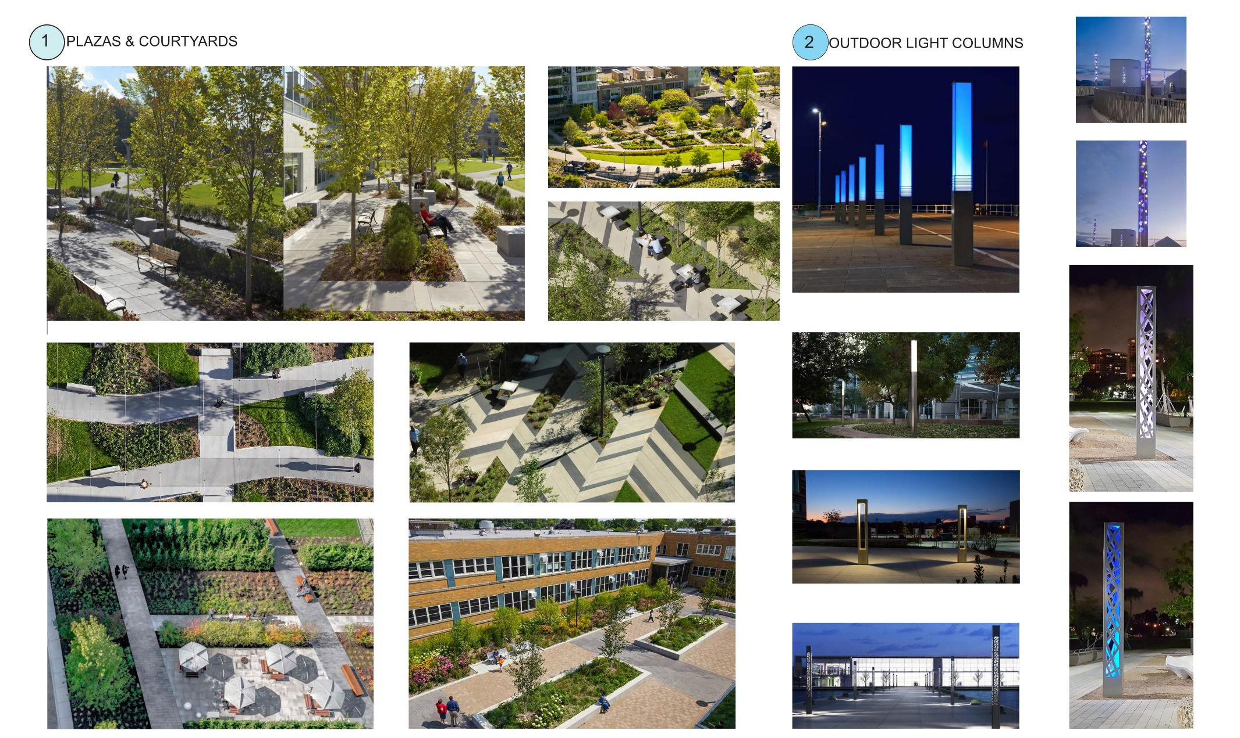
Open Area Qualities
Page 7
Notes:
City Maximum: 92,600-13,500 sf / 204 = 454 stalls
Potential need:
Clinics : 74,600 sf / 250 = 298 stalls (min)
ASC: 4 OR x 15 = 60 stalls (approx.)
Total 358

Slide 21
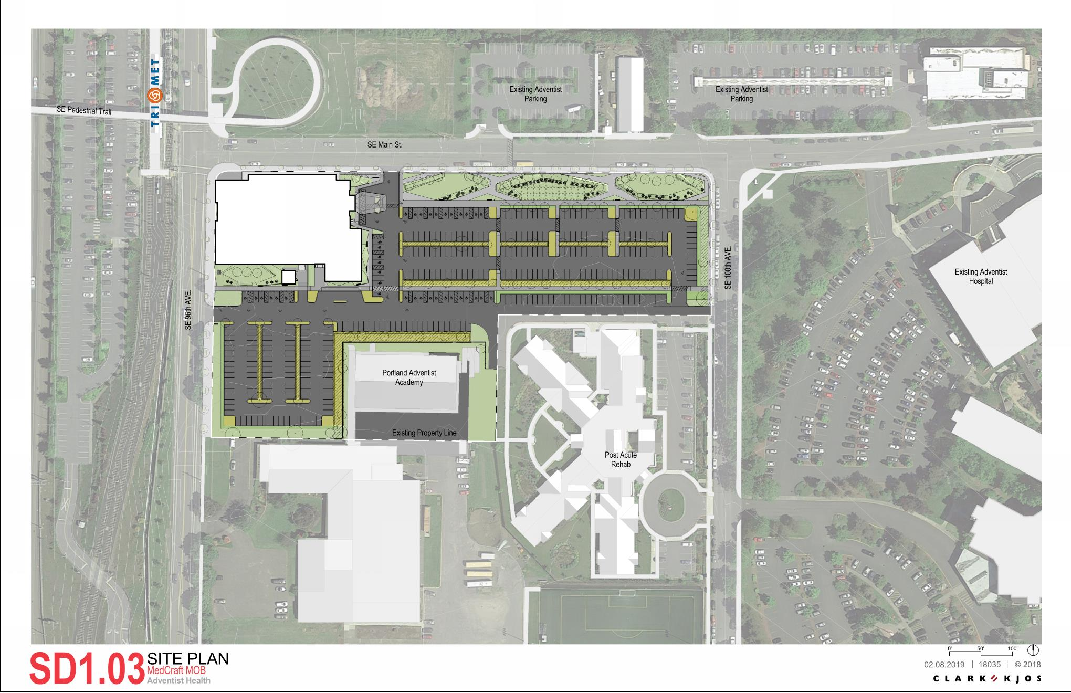
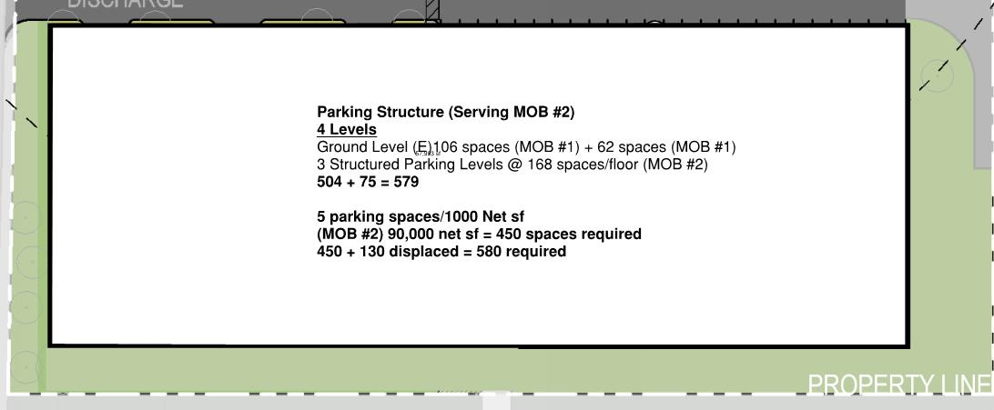
Future Vision – 536 housing units
Proposed M.O.B.
Future
14 Story Housing
(536 Units)
Future
4 Story Structured Parking
Page 9

Slide 22
Modification – Sign Area in a Pedestrian District
West Elevation
  Elevation Faces I-205
40%
Notes:
City Maximum: 92,600-13,500 sf / 204 = 454 stalls
Potential need:
Clinics : 74,600 sf / 250 = 298 stalls (min)
ASC: 4 OR x 15 = 60 stalls (approx.)
Total 358

Slide 23
Modification – Sign Area in a Pedestrian District
North Elevation
  Elevation faces Main St. Pedestrian Enhanced Street
Page 2
Notes:
City Maximum: 92,600-13,500 sf / 204 = 454 stalls
Potential need:
Clinics : 74,600 sf / 250 = 298 stalls (min)
ASC: 4 OR x 15 = 60 stalls (approx.)
Total 358

Slide 24
Open Space Studies
Notes:
City Maximum: 92,600-13,500 sf / 204 = 454 stalls
Potential need:
Clinics : 74,600 sf / 250 = 298 stalls (min)
ASC: 4 OR x 15 = 60 stalls (approx.)
Total 358

Slide 25
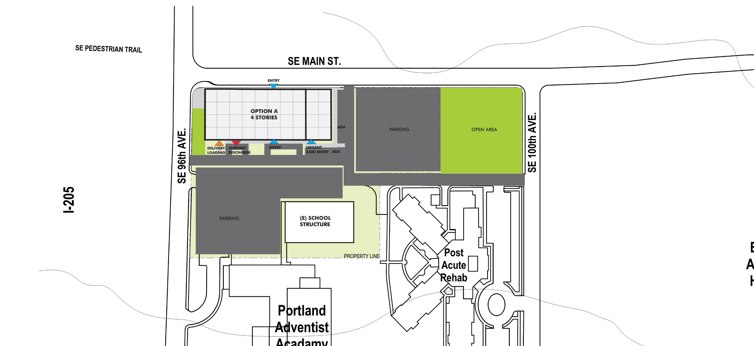
Open Area Study - Option A
Page 9

Slide 26
Open Area Study - Option A
29%
50%
21%
Proposed M.O.B.
Open Area
Parking Frontage Limitation (City of Portland 33.266.130.C.3.b)
  Solution meets vehicle 50% frontage limitation
  Parking must be adjacent to building
  Code drives remote Open Area location
Page 8

Slide 27
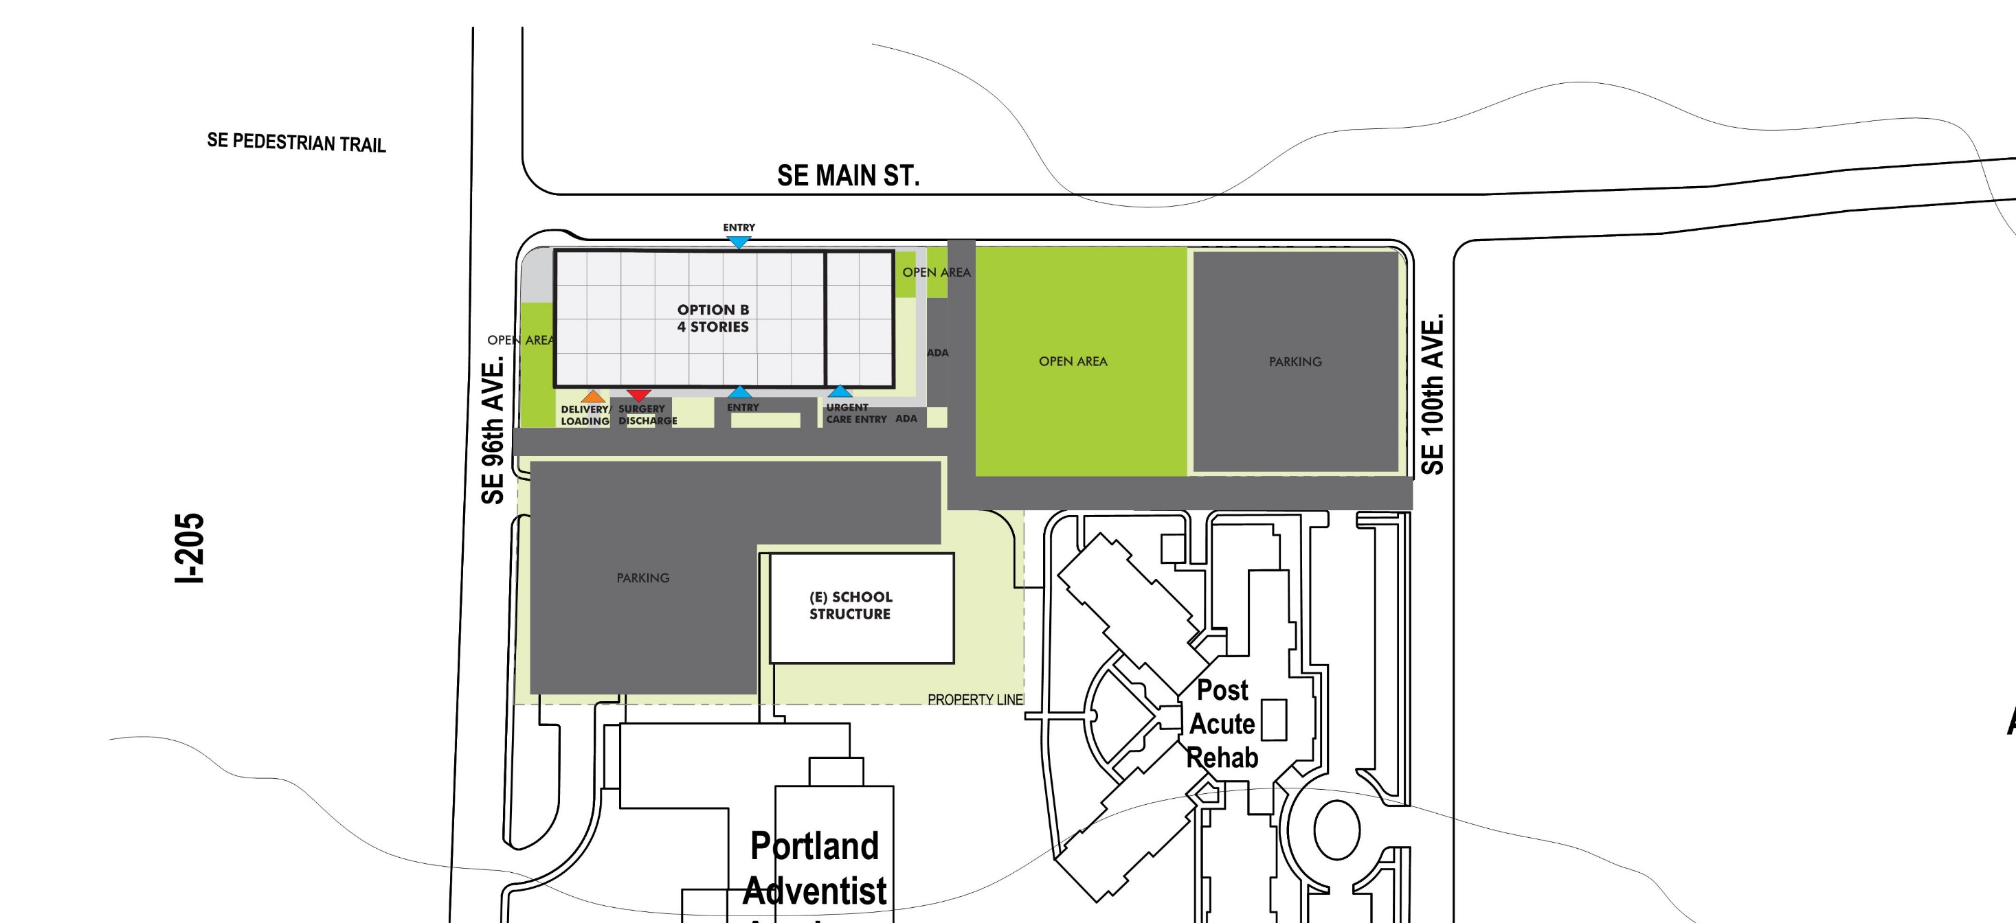
Open Area Study – Option B
Page 9

Slide 28
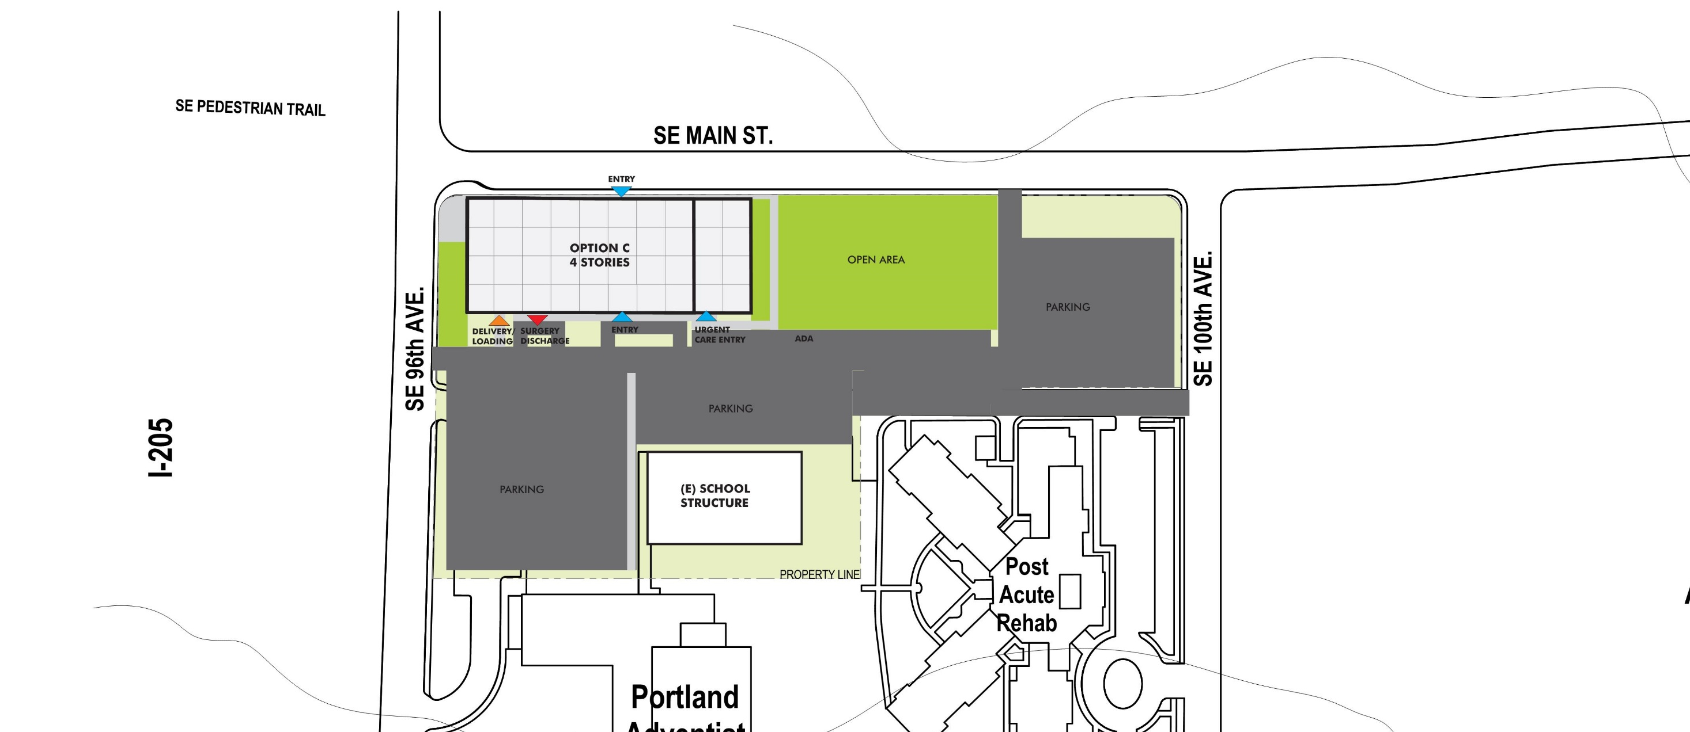
Open Area Study – Option C
Page 9

Slide 29
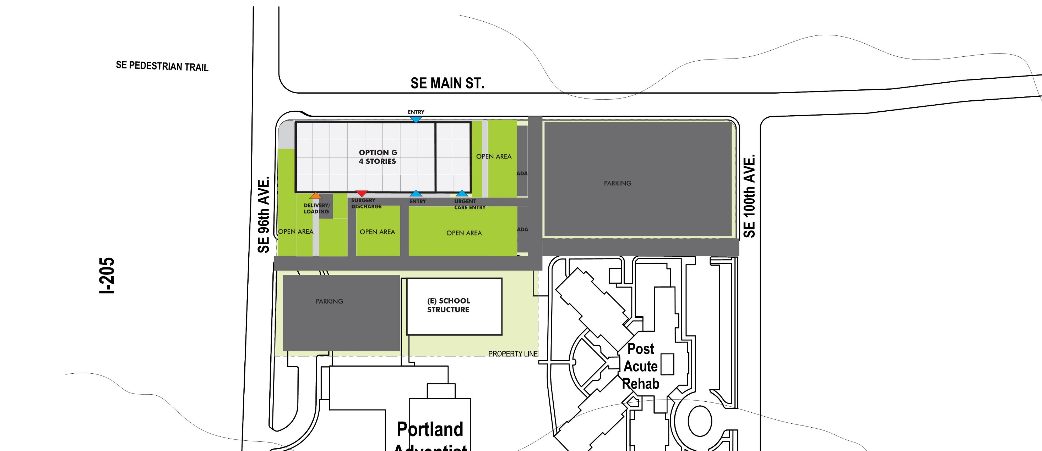
Open Area Study – Option G
Page 9

Slide 30
Building Orientation Studies
Page 2
Notes:
City Maximum: 92,600-13,500 sf / 204 = 454 stalls
Potential need:
Clinics : 74,600 sf / 250 = 298 stalls (min)
ASC: 4 OR x 15 = 60 stalls (approx.)
Total 358

Slide 31
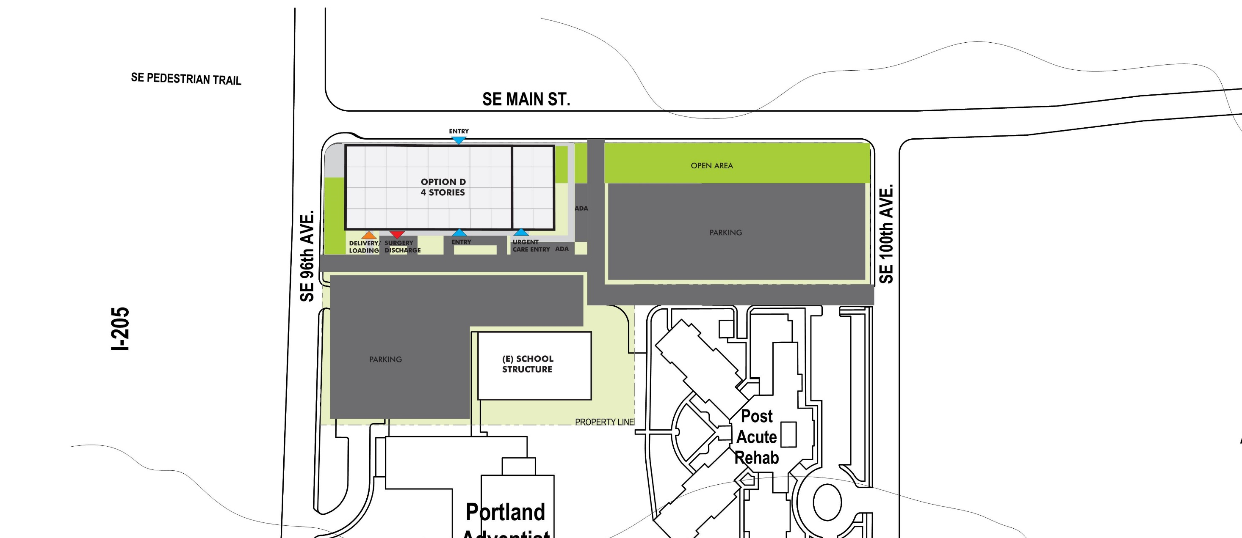
Building Studies – Option D
Page 9

Slide 32
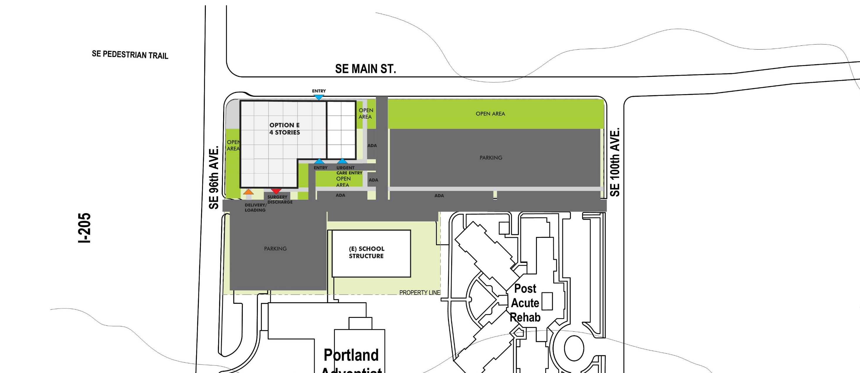
Building Studies – Option E
Page 9

Slide 33
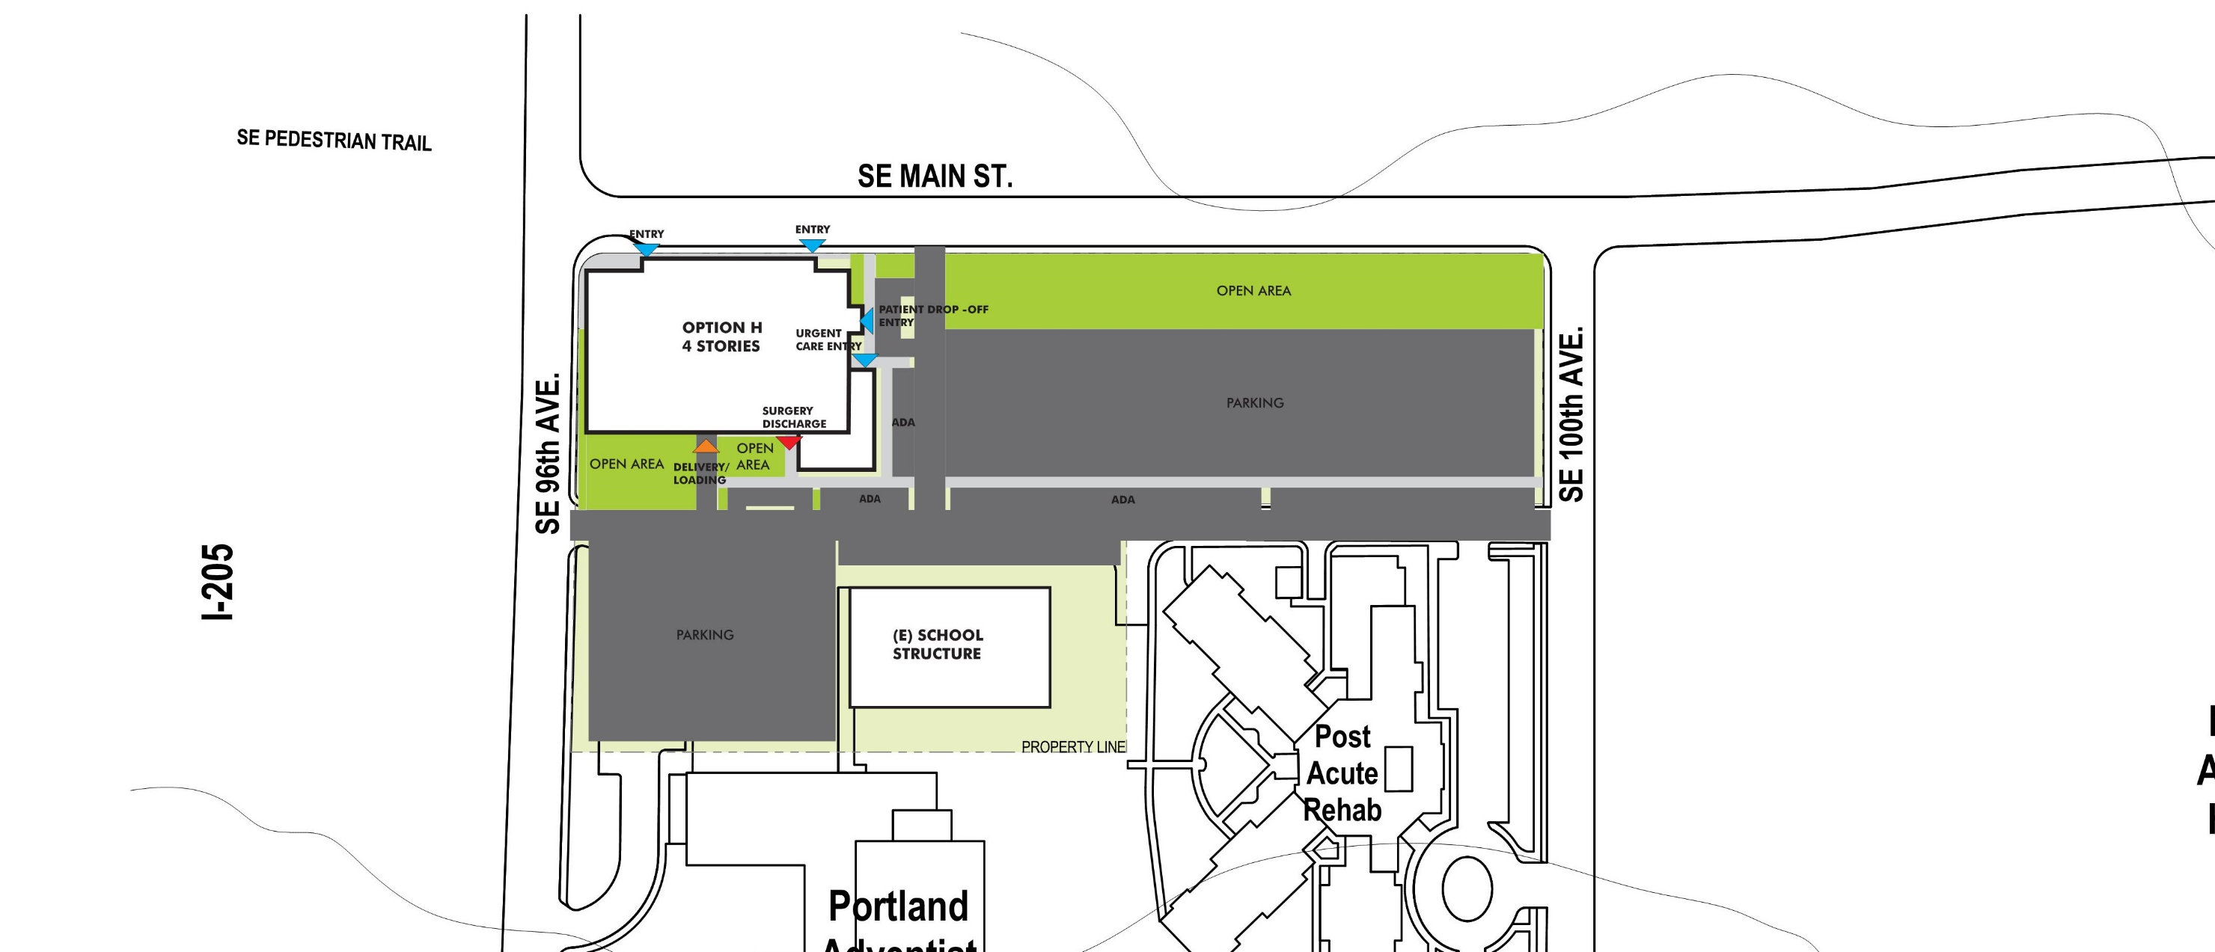
Building Studies – Option H
Page 9

Slide 34
Survey
Page 2
Notes:
City Maximum: 92,600-13,500 sf / 204 = 454 stalls
Potential need:
Clinics : 74,600 sf / 250 = 298 stalls (min)
ASC: 4 OR x 15 = 60 stalls (approx.)
Total 358

Slide 35
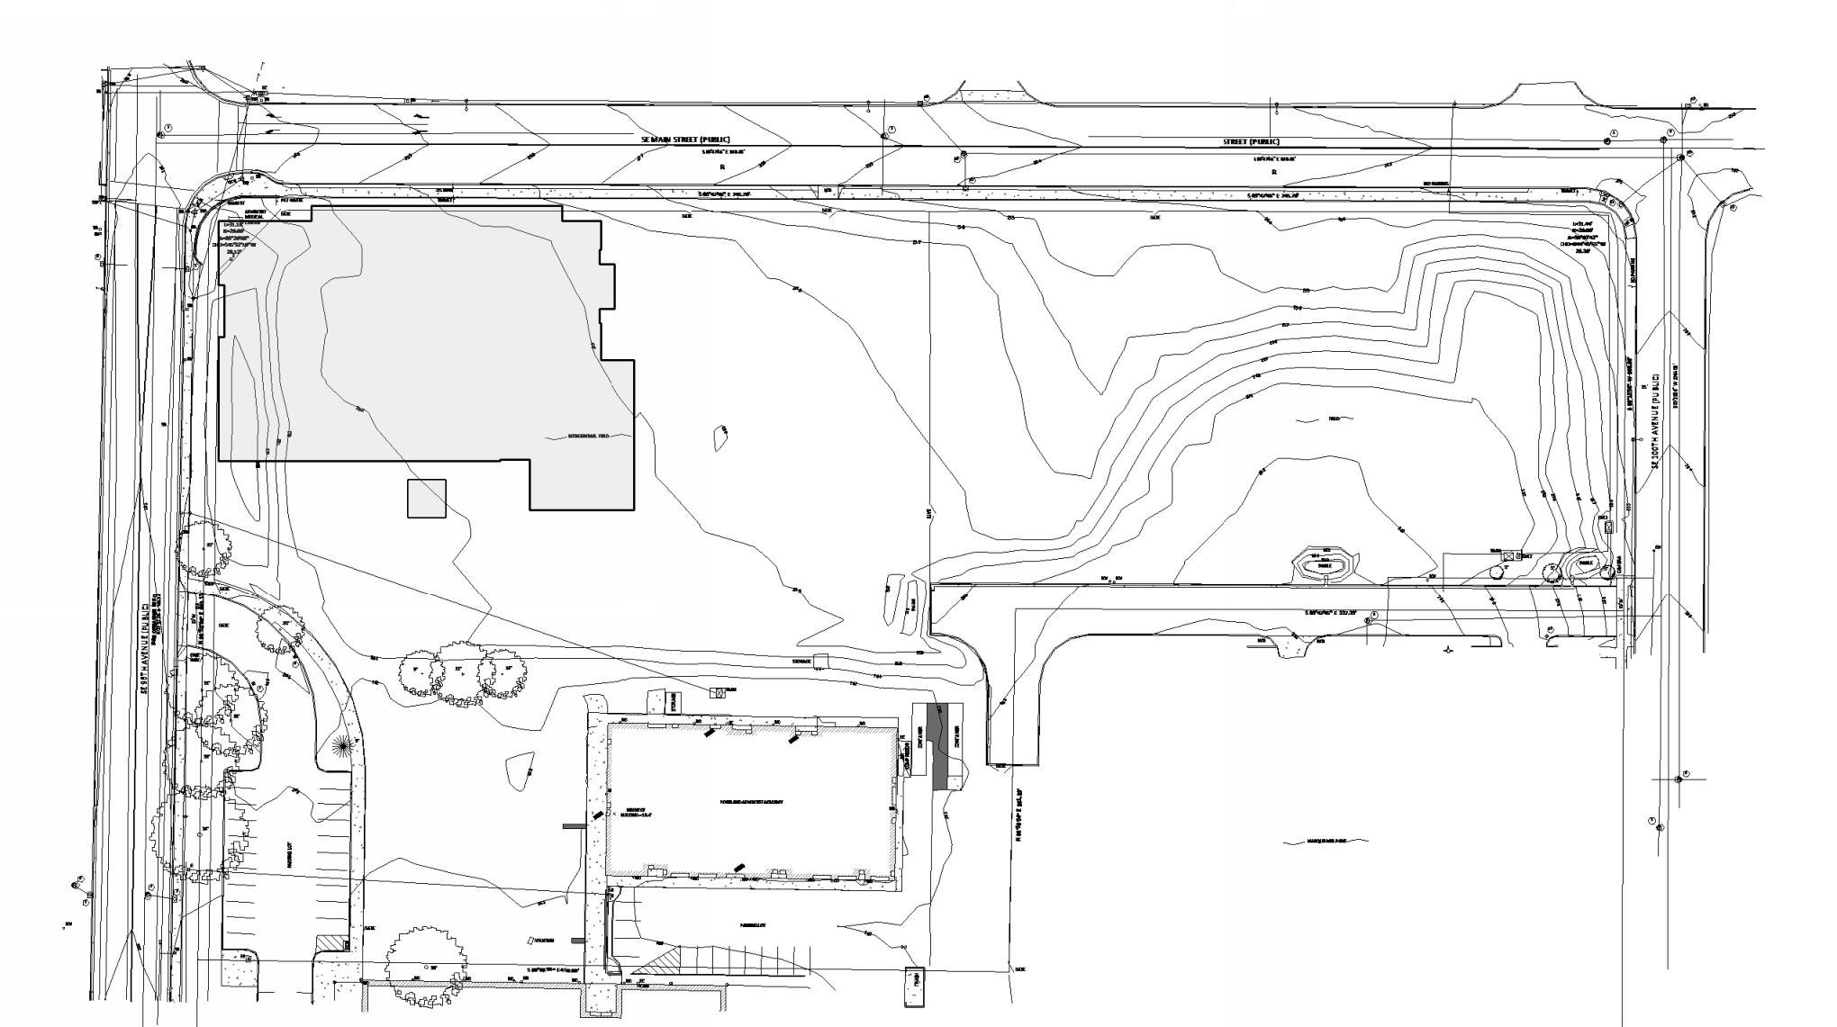
Survey
Page 2
Notes:
City Maximum: 92,600-13,500 sf / 204 = 454 stalls
Potential need:
Clinics : 74,600 sf / 250 = 298 stalls (min)
ASC: 4 OR x 15 = 60 stalls (approx.)
Total 358

Slide 36
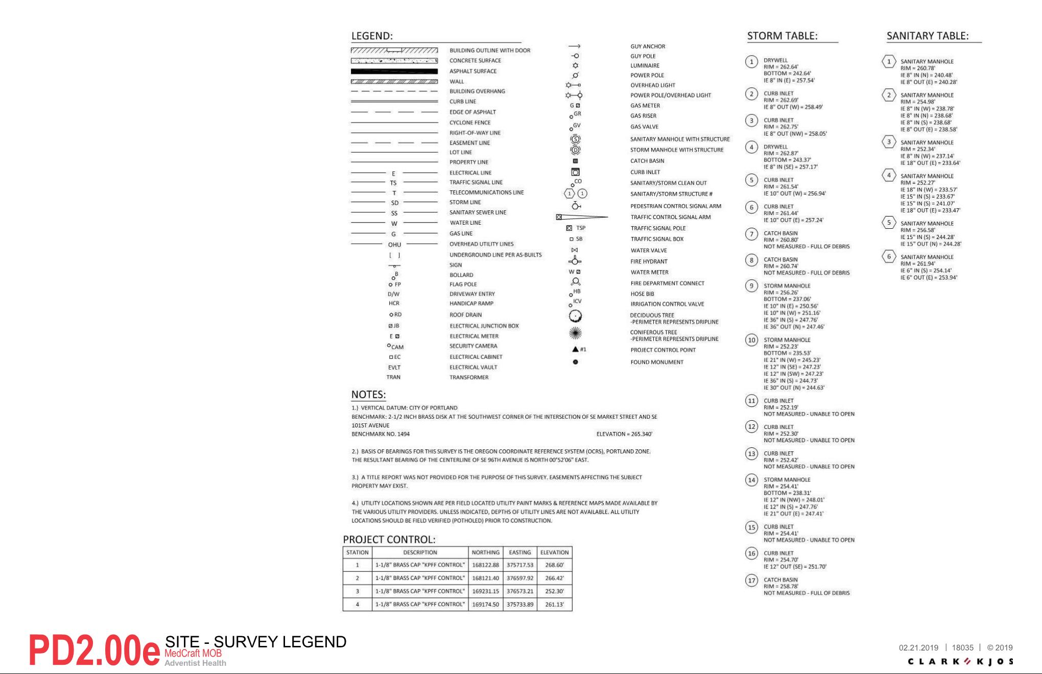
Survey Key
Page 2
Notes:
City Maximum: 92,600-13,500 sf / 204 = 454 stalls
Potential need:
Clinics : 74,600 sf / 250 = 298 stalls (min)
ASC: 4 OR x 15 = 60 stalls (approx.)
Total 358

