Slide 1

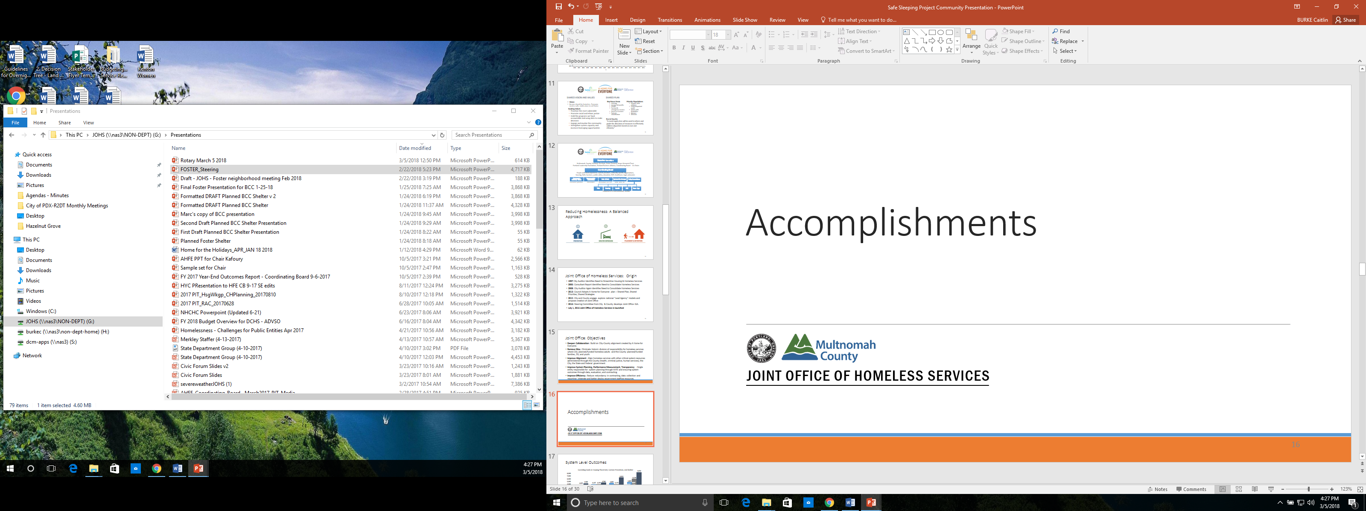
State of Housing Emergency Recap
Notes:
SHANNON
The presentation is intended to cover four aspects:
Recap of state of housing emergency
Mitigating efforts during this emergency period-investments, programs, pilots
Plans for the emergency period

Slide 2
Timeline of State of Housing Emergency
October 7, 2015
Original Declaration of State of Housing Emergency
September 7, 2016
One Year Extension of State of Housing Emergency
October 4, 2017
Further 18-Month Extension of Housing Emergency
2
Notes:
SHANNON
2015- original declaration of housing emergency; extended twice first yearlong and then for a period of 18 months

Slide 3
Housing Conditions that Characterized Emergency
One of the highest rent increases in the nation
    Average rent growth of 8 to 9 percent
Among the lowest vacancy rates in the nation
    Citywide vacancy rates between 2 to 3 percent
Increasing number of people experiencing unsheltered homelessness and/or accessing emergency shelters
3
Notes:
SHANNON

Slide 4
Mitigating Actions:
Investments, Programs,
& Pilots
Notes:
SHANNON

Slide 5
Investments:
City’s Funding for Homeless Services Tripled
    An estimated $103 million since FY15
Record Investments in Affordable Housing
    An estimated $288 million spent on affordable multifamily housing programs since FY 15
5
Notes:
SHANNON

Slide 6
Programs: Implementation of Inclusionary Housing
6
Notes:
SHANNON
Inclusionary Zoning adopted by Council in December of 2016, as a result of actions taken under the State of Emergency.

Slide 7
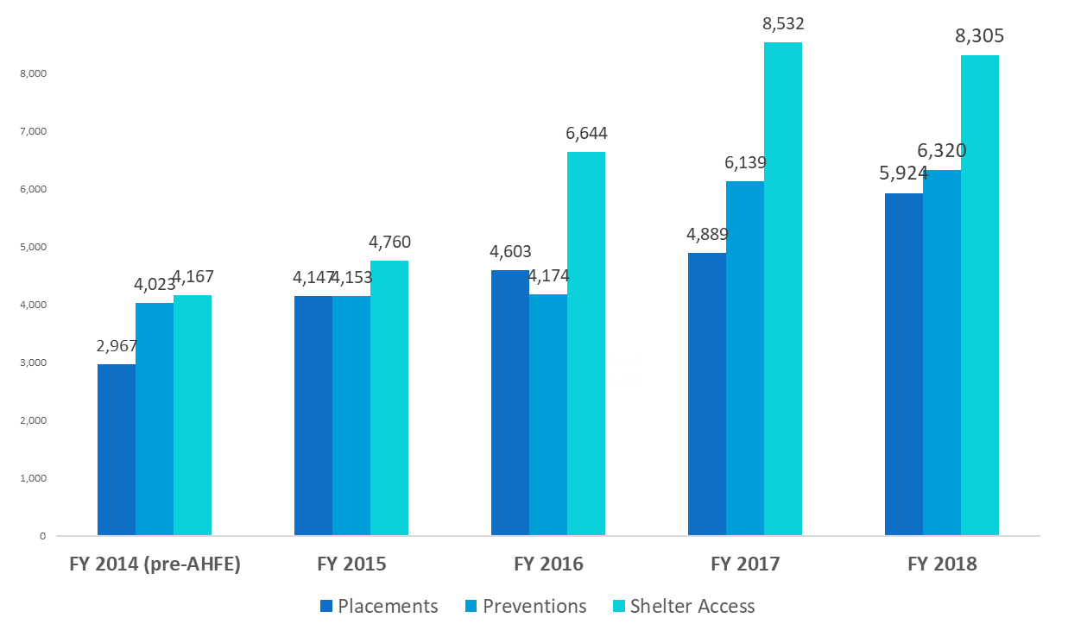
Programs: Prevention, Placement, Shelter Expansion
Notes:
When Slide 7 - AHFE Outcomes - Comes Up, Introduction:
Mayor, Council members, my name is Joshua Bates. I am the recently hired Equity Manager in the Joint Office of Homeless Services.
I am here today on behalf of our Director, Marc Jolin, and Deputy Director, Patricia Rojas, both of whom unfortunately were previously scheduled to be out of town.
The JOHS is very supportive of the proposal before you to extend the State of Emergency for an additional two years.
Referring Specifically to Slide 7
As Shannon pointed out, under the State of Emergency, the City, and the County, have significantly increased investments in homeless services.
And with these investments, we’ve been able to respond to the crisis in unprecedented ways. As tens of thousands of people have lost their housing, we’ve been able to respond by dramatically increasing our prevention, housing placement, and sheltering efforts.
As you can see here, since 2015, we’ve nearly doubled - from just under 3000 to nearly 6000 people per year who we are helping escape homelessness through placement into permanent housing.
During the same period of time, we’ve more than doubled - from 4000 to over 8000 - the number of people served in emergency shelter each year.
And over the last two years, we’ve started to see real increases in the number of people we’re able to help keep the housing they are already in through prevention investments - over 6300 people last year, a more than 30% increase over 2016.
These increases have allowed us to respond to the emergency, but they haven’t ended it. We continue to have more than 2000 highly vulnerable people on our waiting list for permanent supportive housing, and more 1300 families with children on the waiting list for help finding permanent housing.

Slide 8

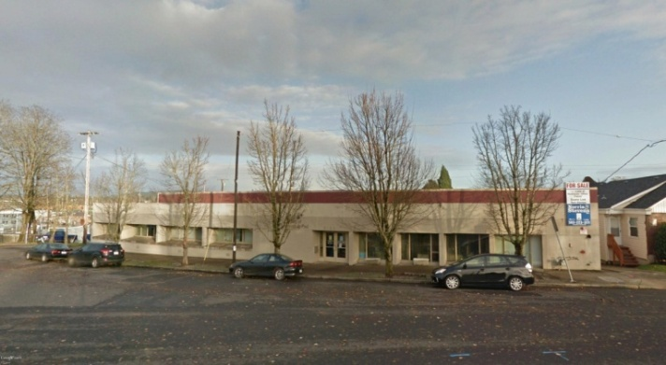
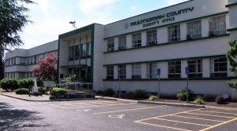
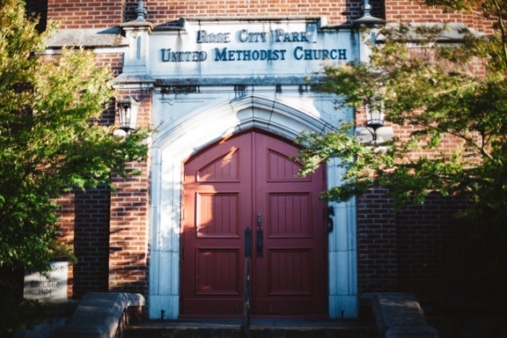
Programs: Rapid Shelter Expansion
Notes:
Referring to Slide 8
Shelters (pictures of Willamette Center (120 bed, women, couples; Veterans Shelter at Rose City Park; 200 bed Hansen Shelter, now closed and replaced with 125 bed WyEast (SE 122nd) and 75 bed Mead (downtown); and Kenton Women’s Village (20 women)
In addition to expanding investments in over-all system capacity, the JOHS has used the State of Emergency to expand the number of emergency shelters in our community at the fastest rate in decades.
We have used the declaration of the state of emergency to help us open more than 650 new beds of year-round shelter for men, women, couples, families with children, veterans, and domestic violence survivors.
We’ve distributed those shelters geographically, and we’ve removed the barriers that traditionally kept many of the most vulnerable people out of our shelters.
We’ve also used the state of emergency to launch new alternative shelter, the Kenton Women’s Village, to help relocate Right to Dream Too, and to begin the process of relocating Hazelnut Grove.
That work has led to more than doubling the number of people who have access to shelter each year in our community, and it helped lead to a reduction in un-sheltered homelessness, and a reduction in unsheltered chronic homelessness, between 2015 and 2017.
That work has also led to national recognition for the transformation of how we provide shelter in our community.
But our shelter system expansion and transformation is not complete. A number of shelters have not yet transitioned from temporary to permanent facilities. We are in the midst of creating new, service-enriched shelters in east and downtown Portland. We are working to create a specialized mental health shelter, and are in discussions about creating shelter capacity specifically for trans women. And, importantly, we continue to work to stabilize our alternative shelters; to put them on sound legal footing and create the possibility for additional community-led alternative shelter sites.
Continuing the State of Emergency allows us to complete this work - to partner with our partners at BPS and BDS to modernize the shelter and temporary housing codes to ensure that they are well aligned with what we are learning about the best, most cost-effective, practices in the provision emergency shelter, in terms of shelter types, locations, sizes, and programming.

Slide 9
Supportive Housing Goal – 2,000 units by 2028
2018-2021
9
Notes:
Making sure that we are transitioning folks out of shelter into housing is critical – which is where the City’s and County’s shared goal of Supportive Housing is so critical.

Slide 10
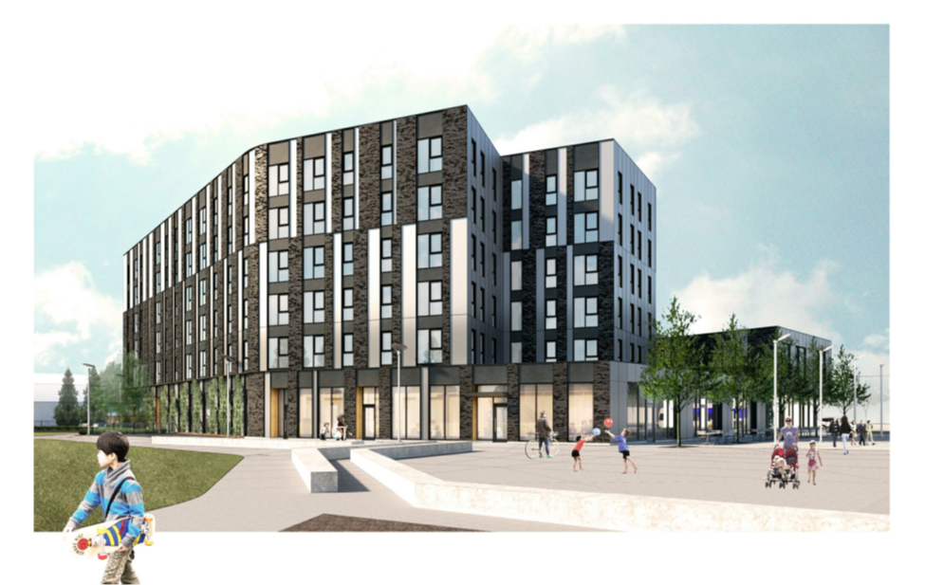
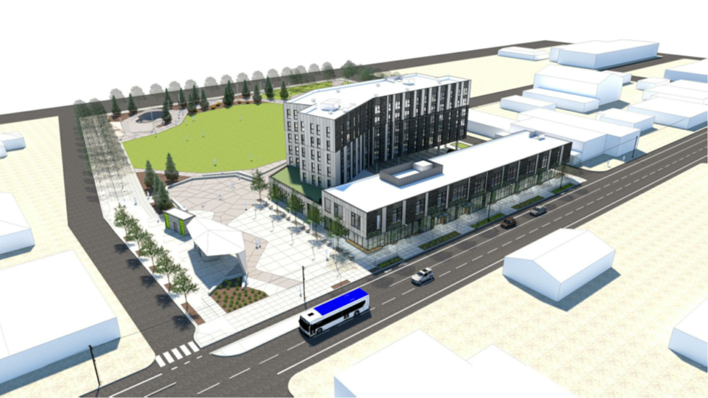
Expedited Review - Gateway Park
10
Notes:
An example of the accelerated Gateway Park in Gateway District was able to use Type IIx Design review instead of Type III that will expediate the production of 40 regulated units

Slide 11
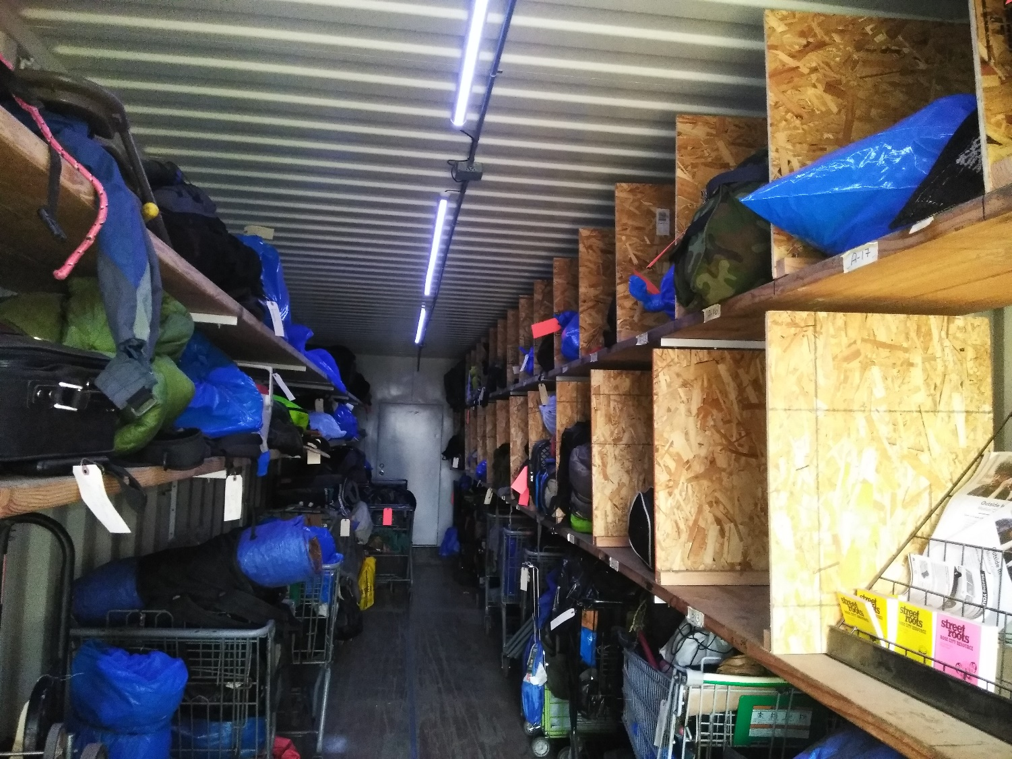
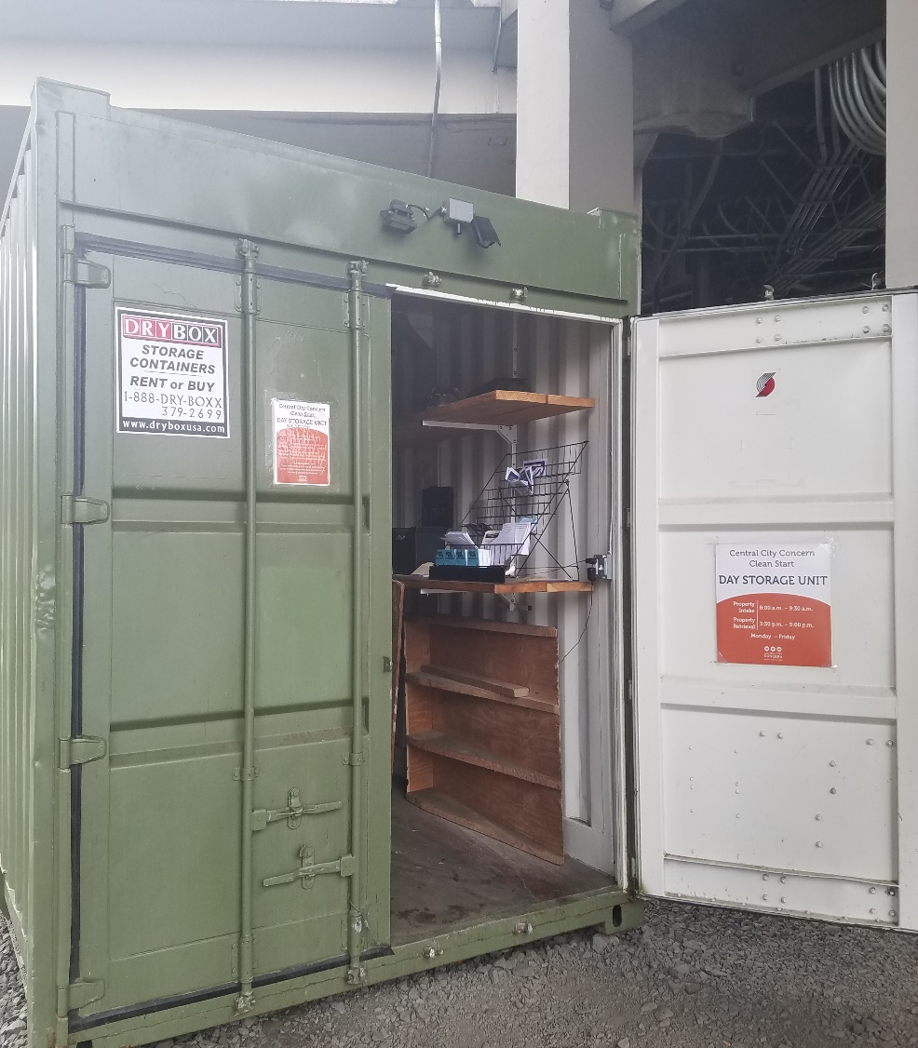
Pilot: Day Storage Unit
11
Notes:
Two day storage units are in operation that provide users secure, dry storage facilities for personal belongings during daytime hours to people experiencing homelessness. The facilities include portable toilets and facilities for safe disposal of biohazardous used needles

Slide 12
Plans for the Extension Period
Allow for permanent siting the day storage units
Changes for temporary housing, shelters and alternative shelter siting
Continue to accelerate affordable housing permitting & review process
12
Notes:
Note: Intent is to Modernize Shelter Code and make sure that as we develop more knowledge as to alternative shelters that our code is reflective of

