Slide 1
Brentwood-Darlington
Safe Routes to School Project
City Council, February 6, 2019

Slide 2
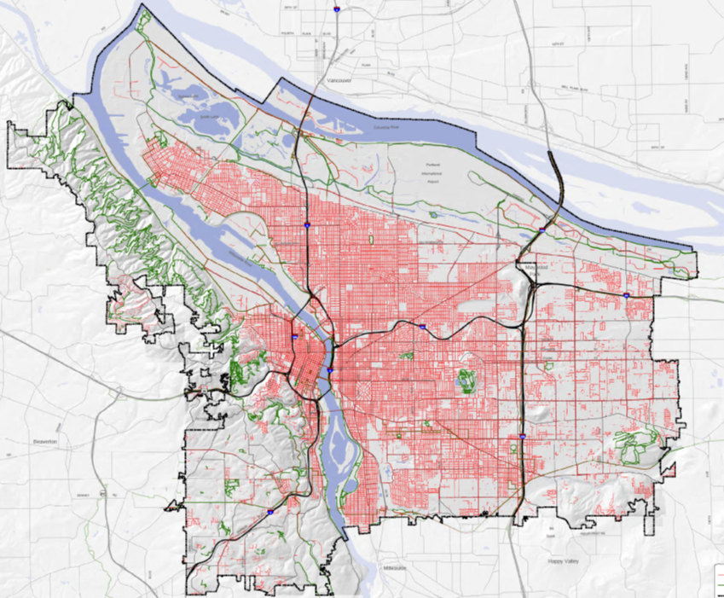
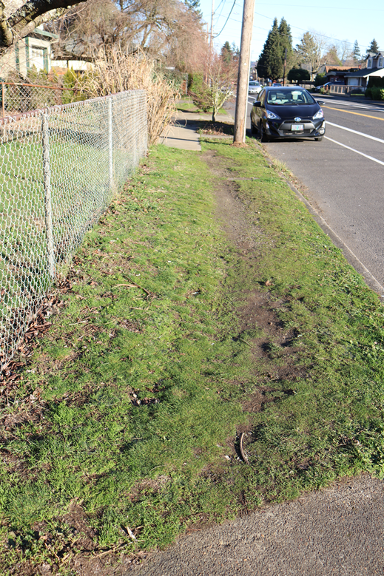
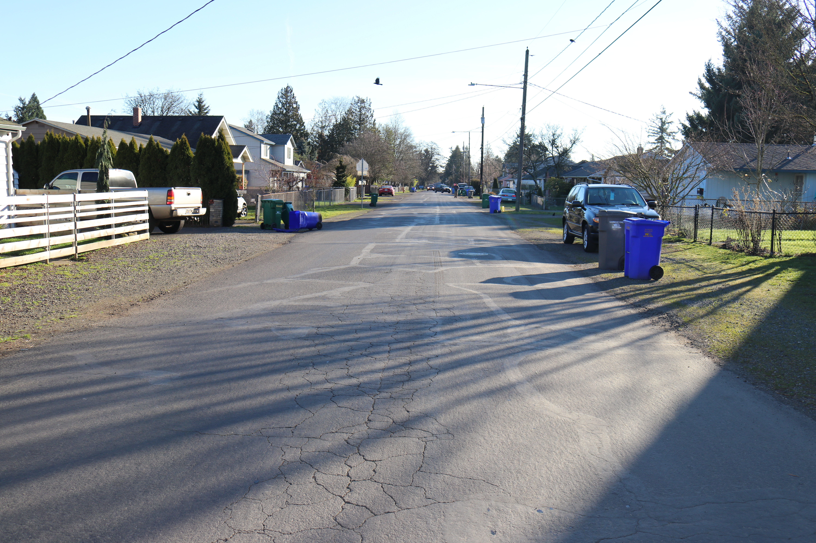
Brentwood-Darlington Safe Routes to School
Pedestrian Network
 | % all streets with sidewalks | % arterials with sidewalks
City wide | 63% | 65%
SE Uplift Neighborhood Coalition | 78% | 89%
Brentwood- Darlington | 28% | 59%
Brentwood-Darlington

Slide 3
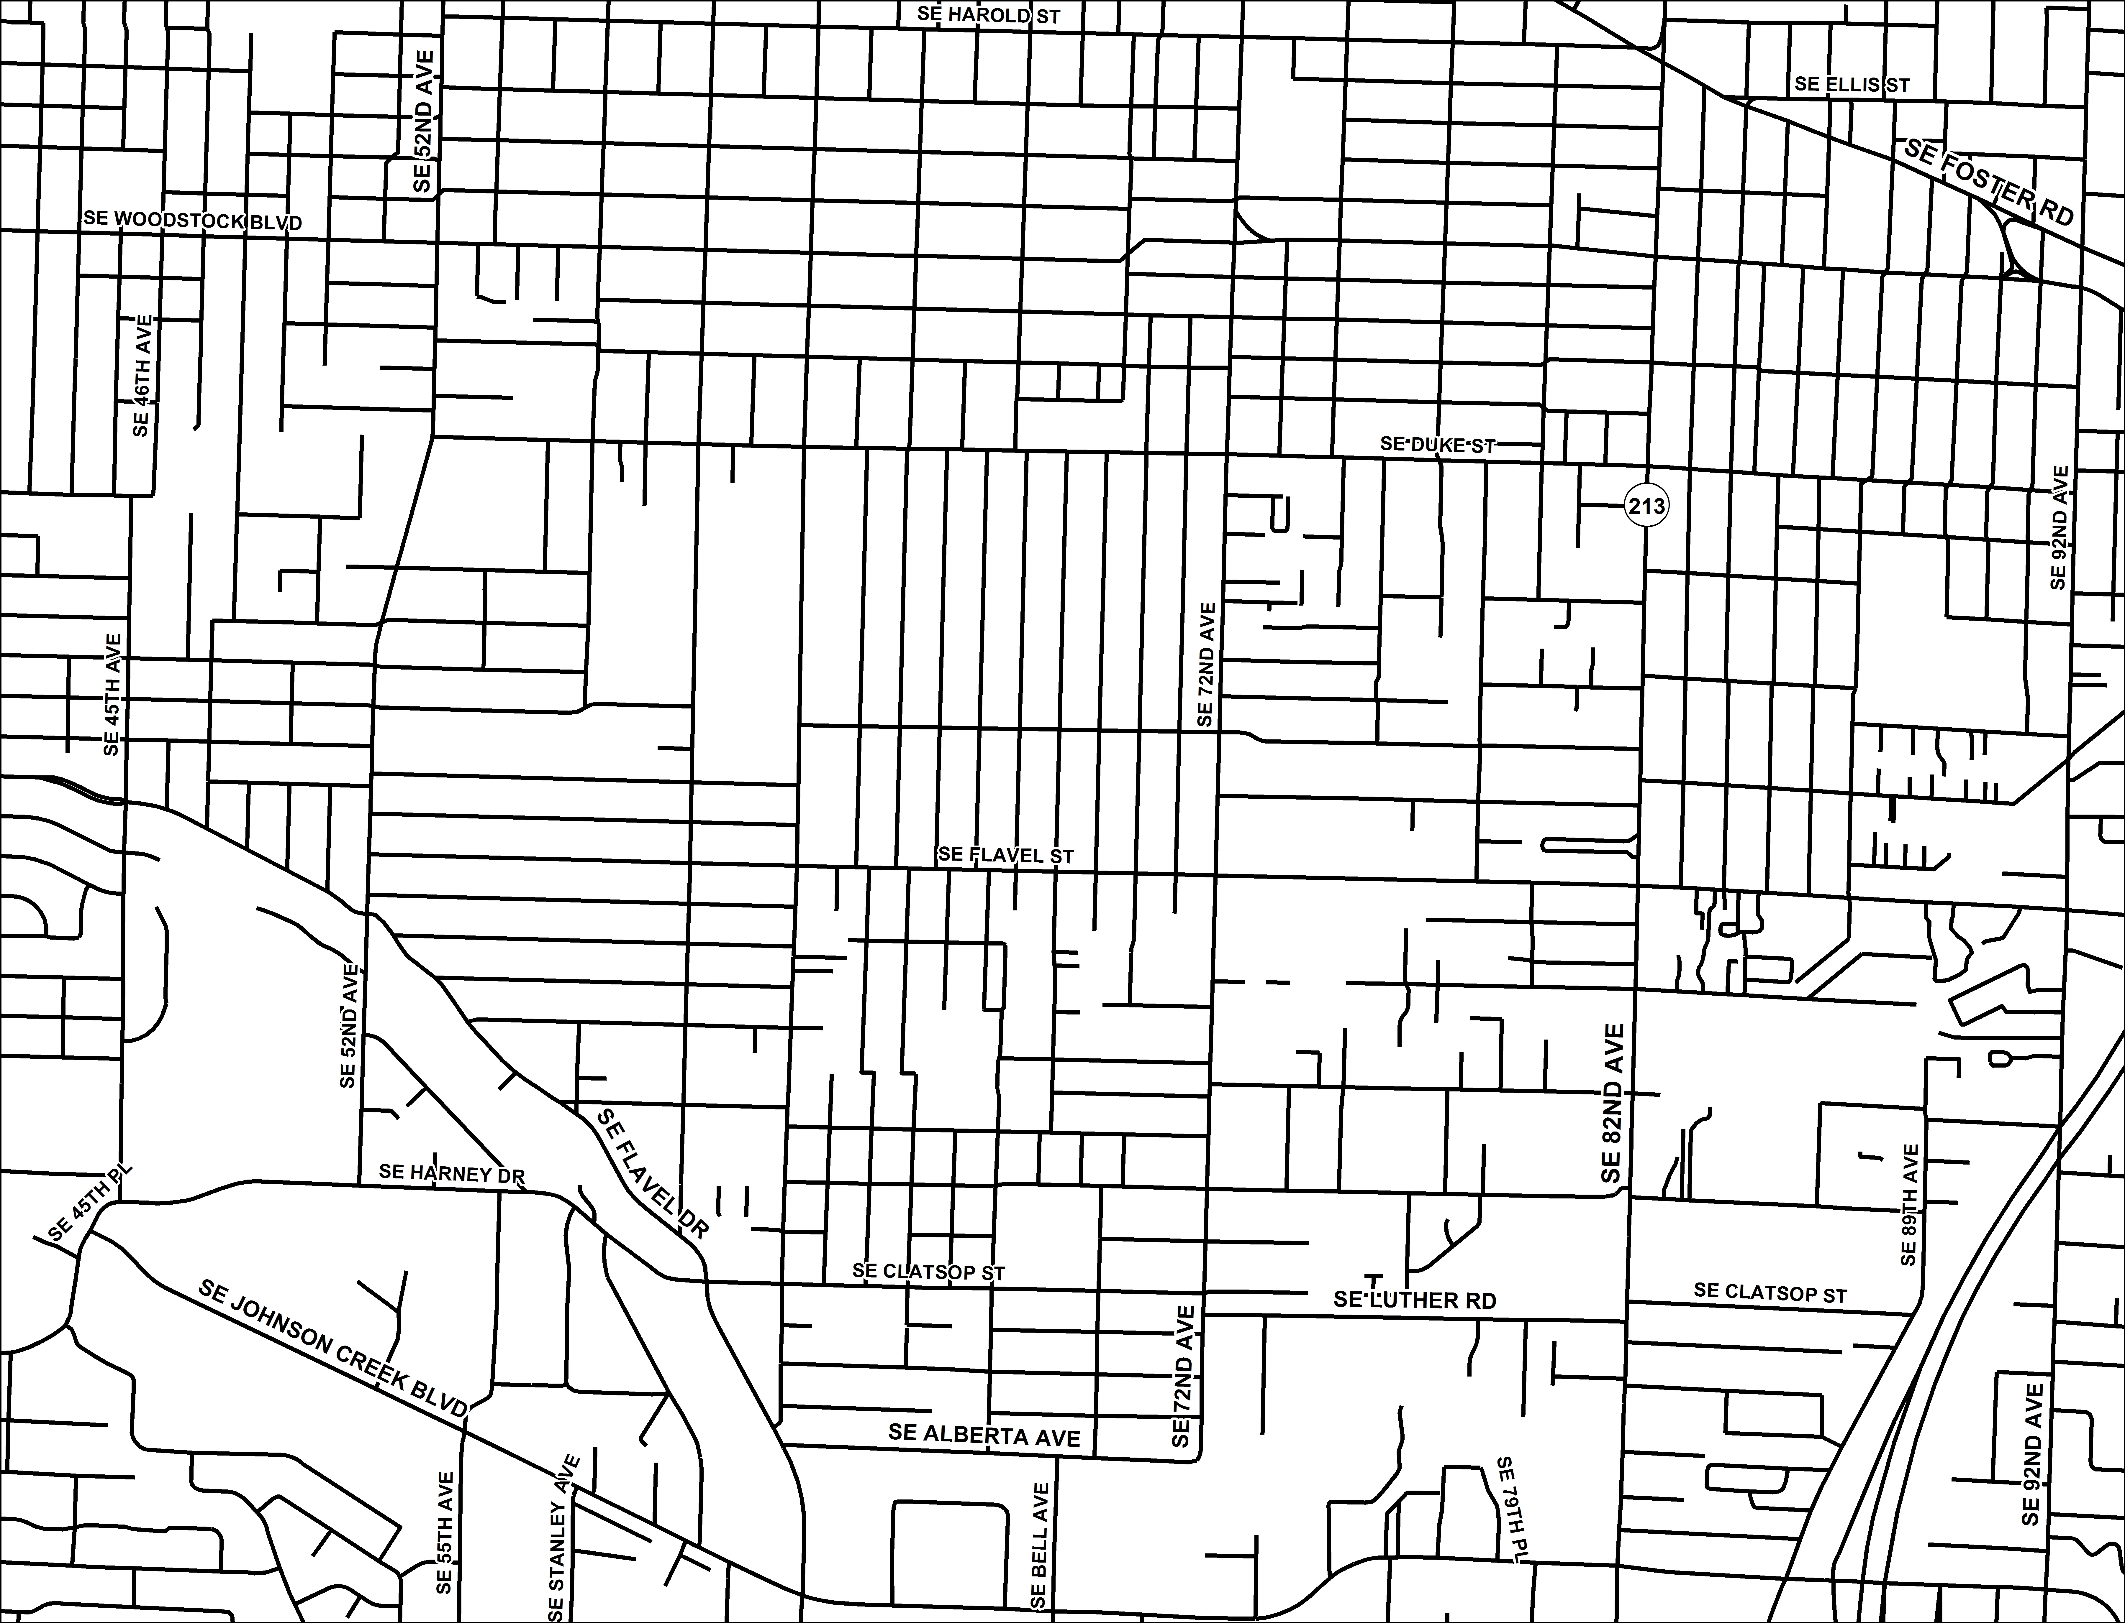
Brentwood-Darlington Safe Routes to School
Project Summary
Sidewalk Infill
SE Duke
SE Flavel
Neighborhood
Greenway
SE Knapp/ Ogden
Crossing
Improvements
SE 52nd Ave/ Knapp
SE 72nd Ave/ Ogden
SE 82nd Ave/ Ogden
SE 60^{th/} Flavel
SE DUKE
SE OGDEN
SE FLAVEL

Slide 4

Brentwood-Darlington Safe Routes to School
Connections
Schools
Lane Middle School
Whitman Elementary
Kelly Elementary
Woodmere Elementary
Access Academy Middle
SE DUKE
SE OGDEN
SE FLAVEL

Slide 5

Brentwood-Darlington Safe Routes to School
Connections
Parks
Mt Scott
Brentwood
Glenwood
Flavel
West Lents Floodplain
Harney
Hazeltine
Errol Heights
SE DUKE
SE OGDEN
SE FLAVEL

Slide 6

Brentwood-Darlington Safe Routes to School
Connections
Bicycle Network
SE WOODSTOCK BLVD
SE DUKE
80S BIKEWAY
SE OGDEN
50S BIKEWAY
SE FLAVEL
40S BIKEWAY
SPRINGWATER CORRIDOR
SE 92ND AVE

Slide 7
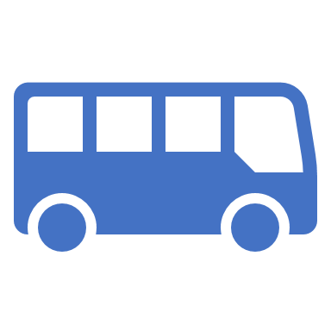
Brentwood-Darlington Safe Routes to School
Connections
Transit Network
SE DUKE
SE OGDEN
SE FLAVEL

Slide 8
Brentwood-Darlington Safe Routes to School
Community Support
Grass roots petition collected over 1,000 signatures in support of the grant

