Slide 1
Culinary Corridor
Design Commission Briefing

Slide 2
Agenda
Introductions
Context and why are we here
Considerations
Locations and preliminary concepts
Discussion

Slide 3
Context

Slide 4
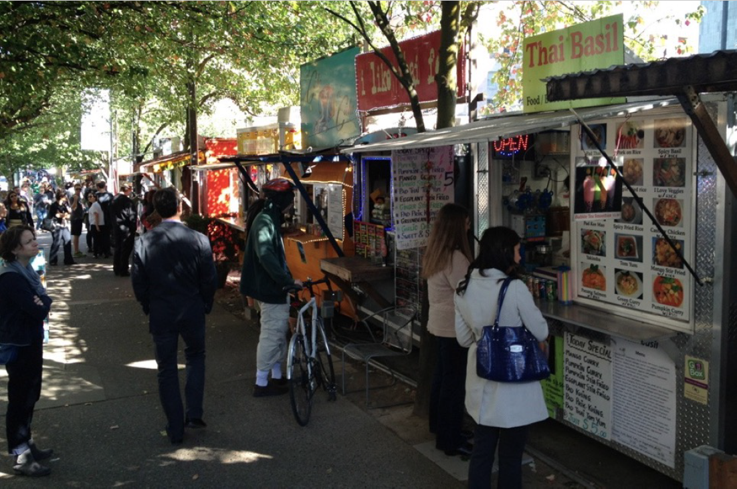
Context
Source: Burmeister, Huerta and Gragg presentation of Culinary Corridor concept to City Council

Slide 5
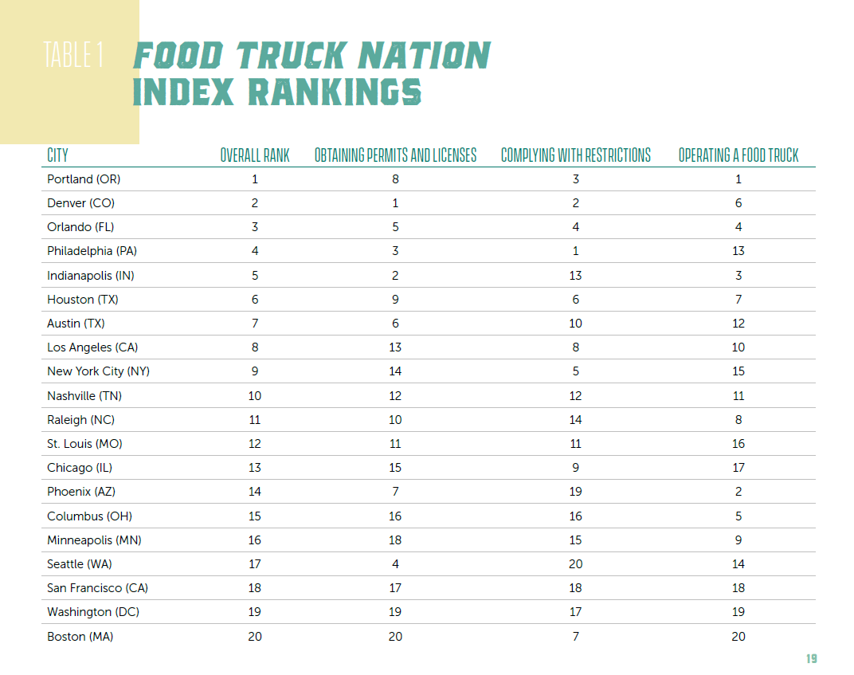
Context

Slide 6
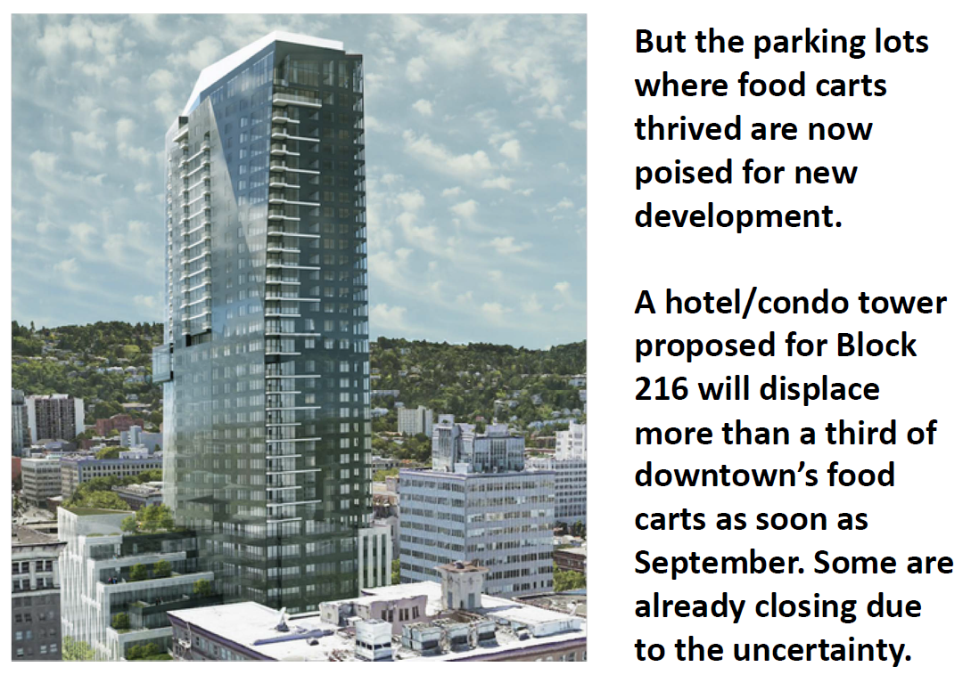
Context – images from Council PPT
Source: Burmeister, Huerta and Gragg presentation of Culinary Corridor concept to City Council

Slide 7
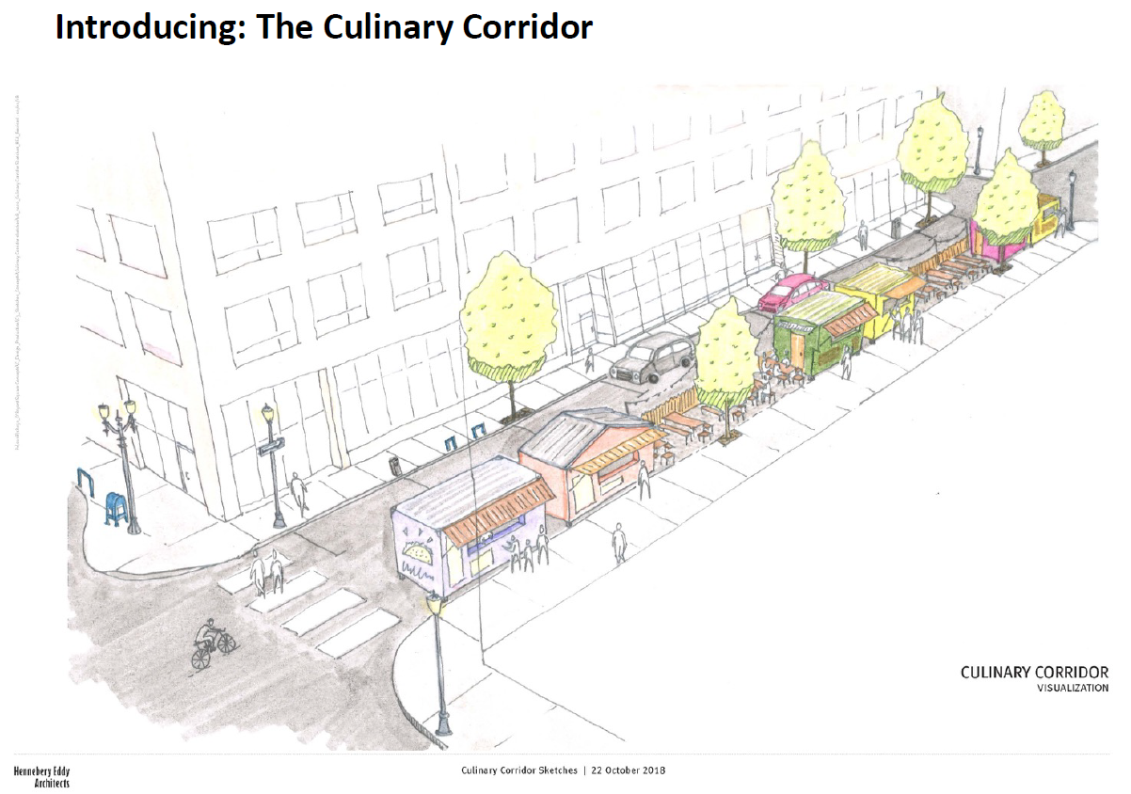
Context – images from Council PPT
Source: Burmeister, Huerta and Gragg presentation of Culinary Corridor concept to City Council

Slide 8
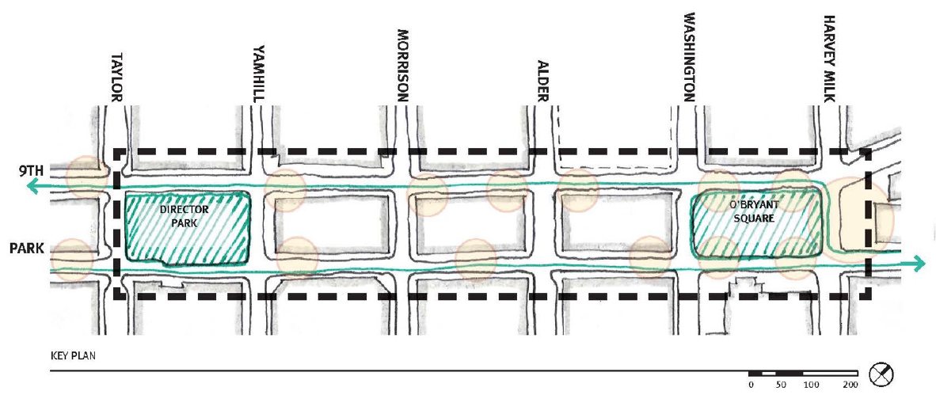
Context – images from Council PPT
Source: Burmeister, Huerta and Gragg presentation of Culinary Corridor concept to City Council

Slide 9
Context

Slide 10
Where we are
Listening session with Randy Gragg Dec 2018
Work Group Meetings
Design sub-group
Mayor’s office briefing
Design review advice from Design Commission
Prepare recommendations to stakeholders and Mayor’s office Spring 2019

Slide 11
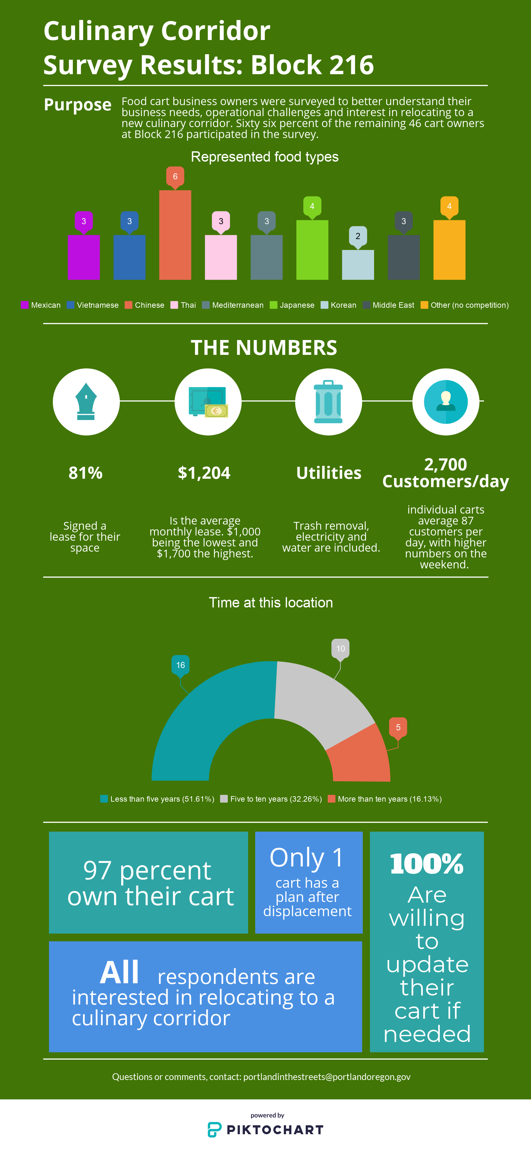
Block 216 Survey

Slide 12
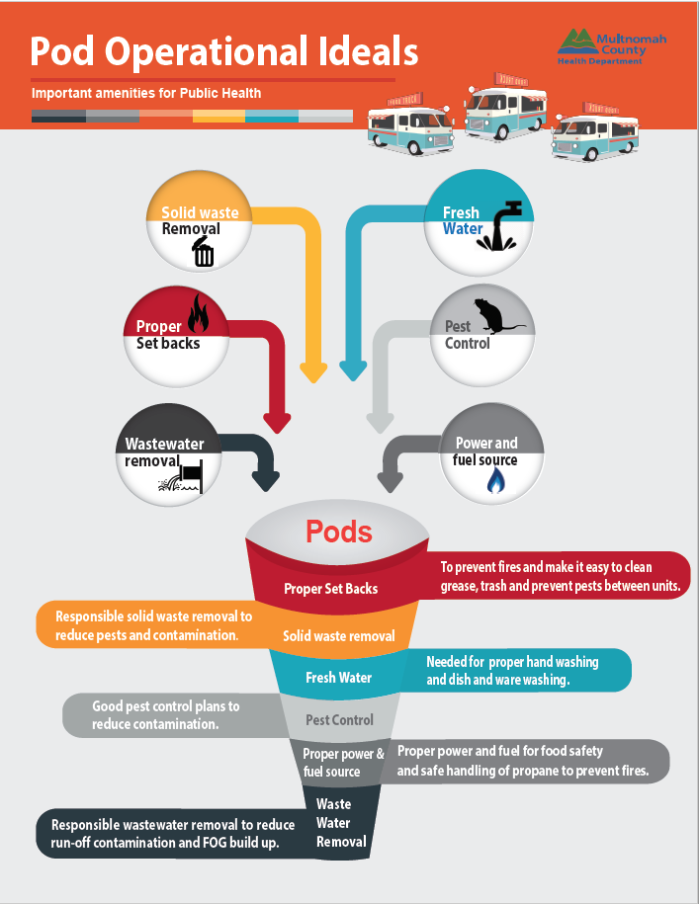
Regulations

Slide 13
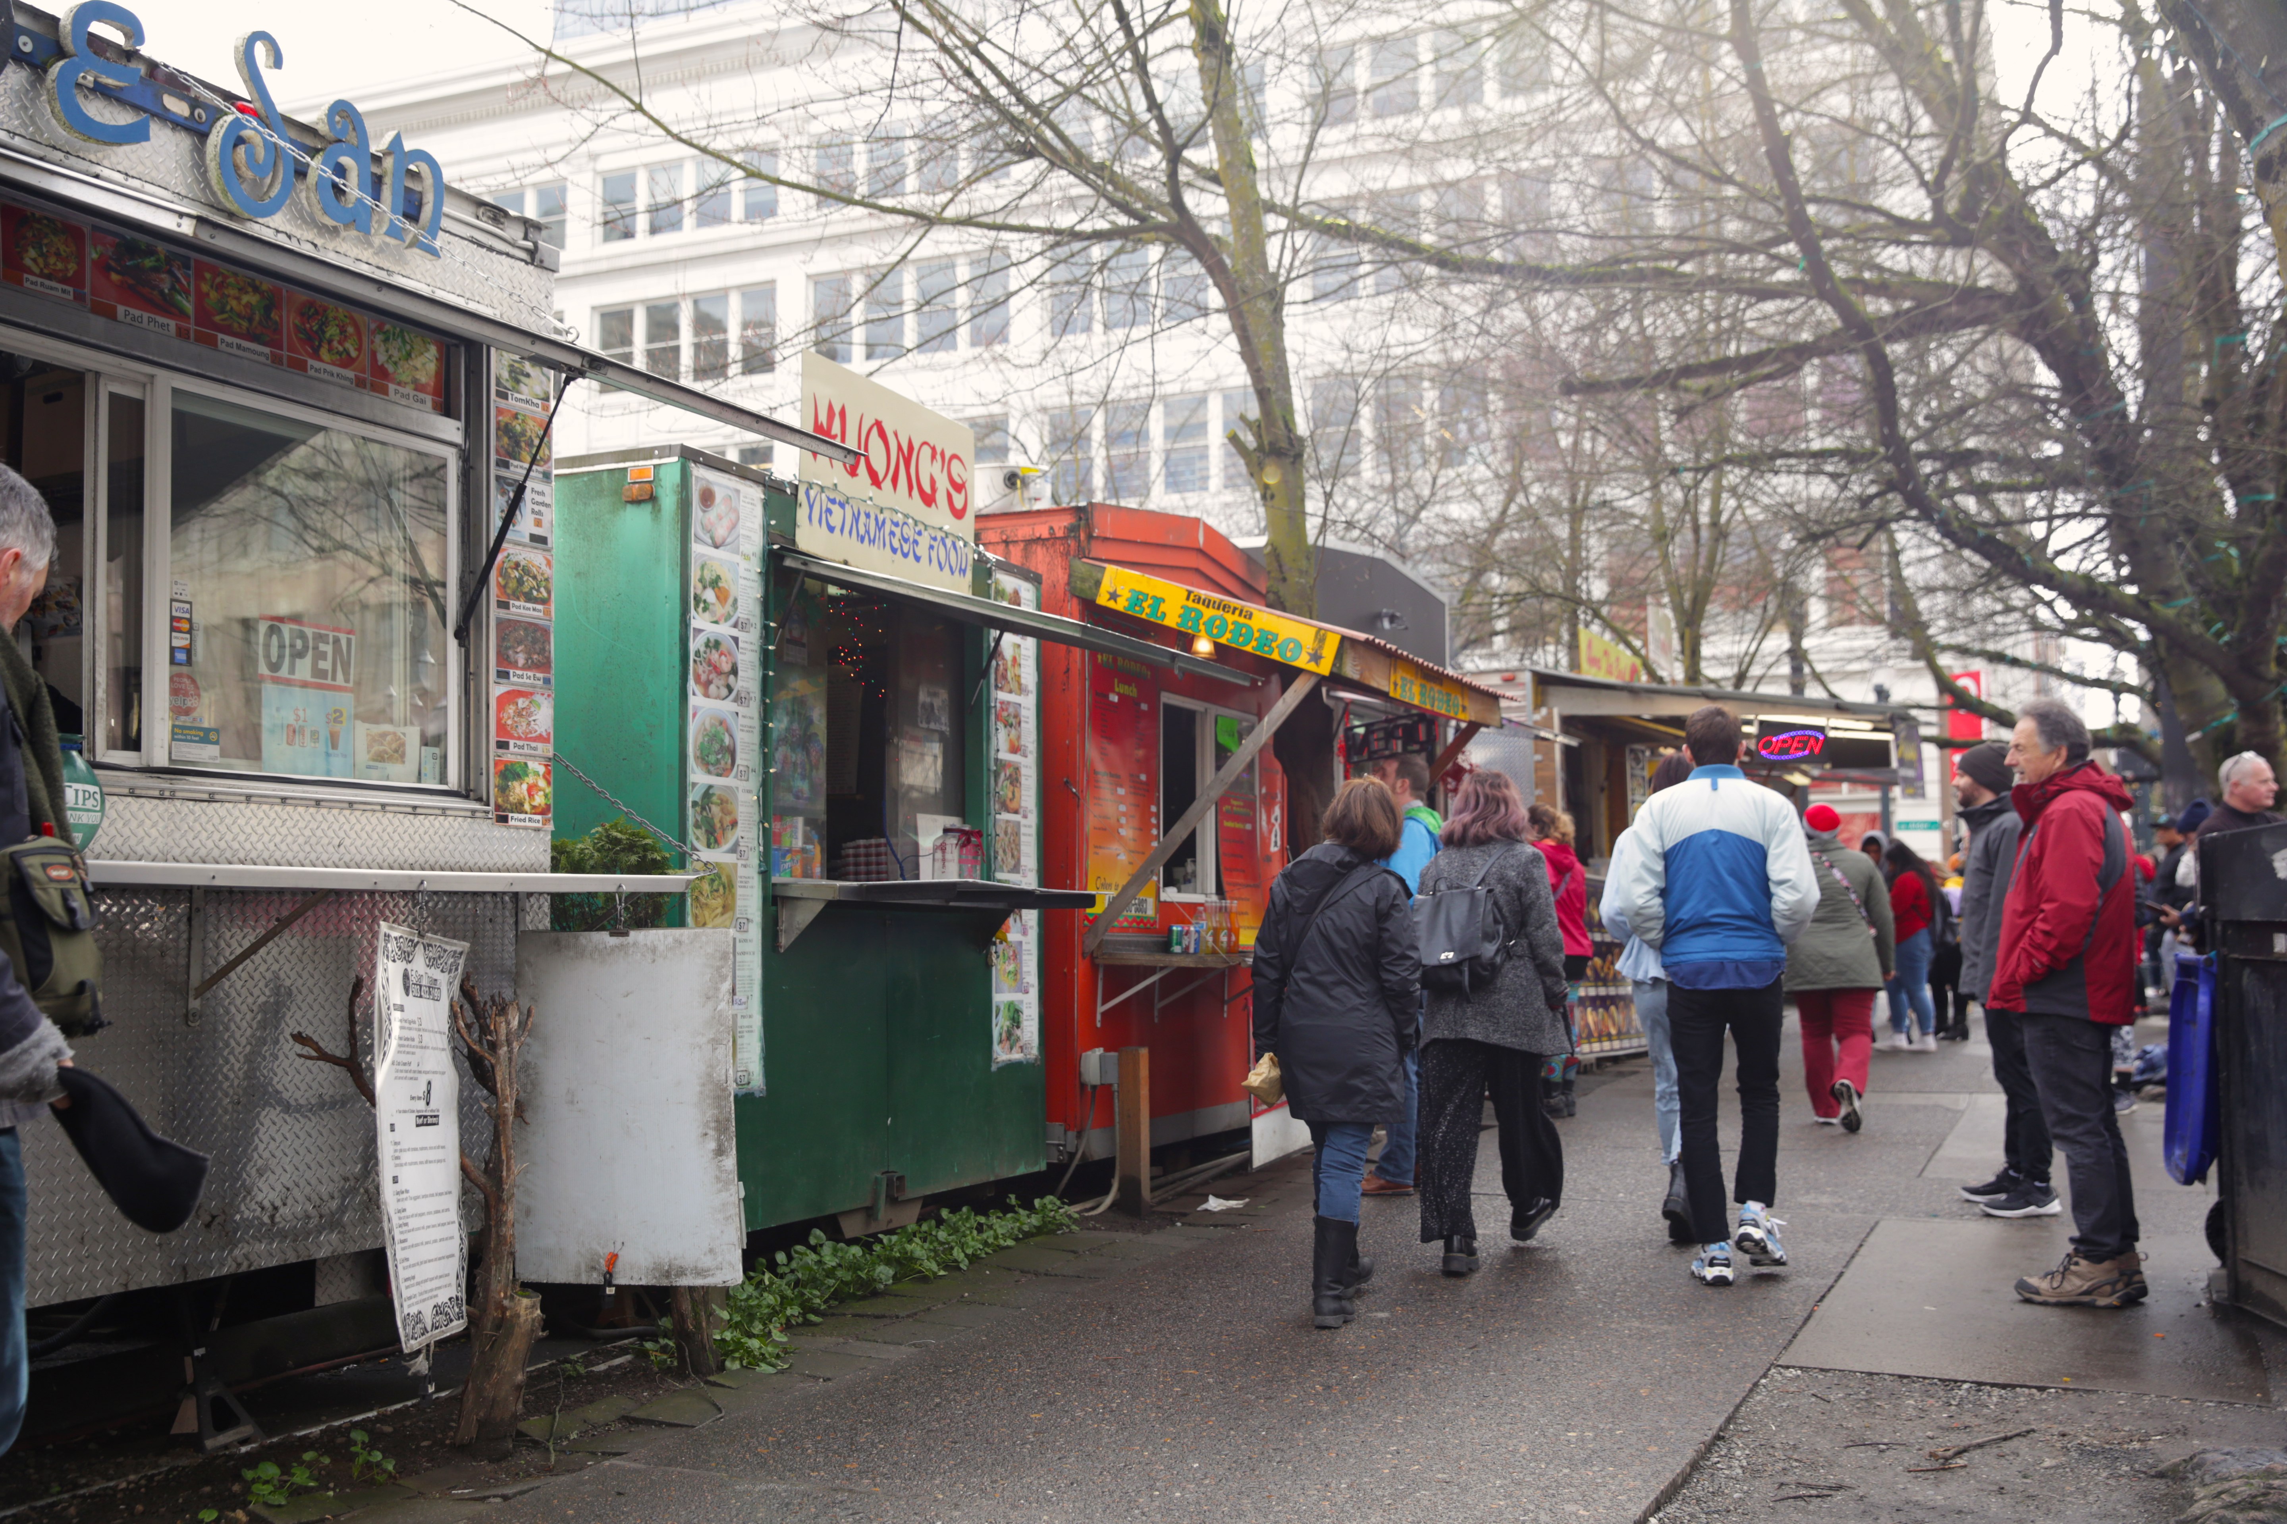
Considerations
Affordability and equity of opportunity
Program management
Parks infrastructure
Evaluating changes to parking or circulation
Funding for hard connections
Stakeholder outreach

Slide 14
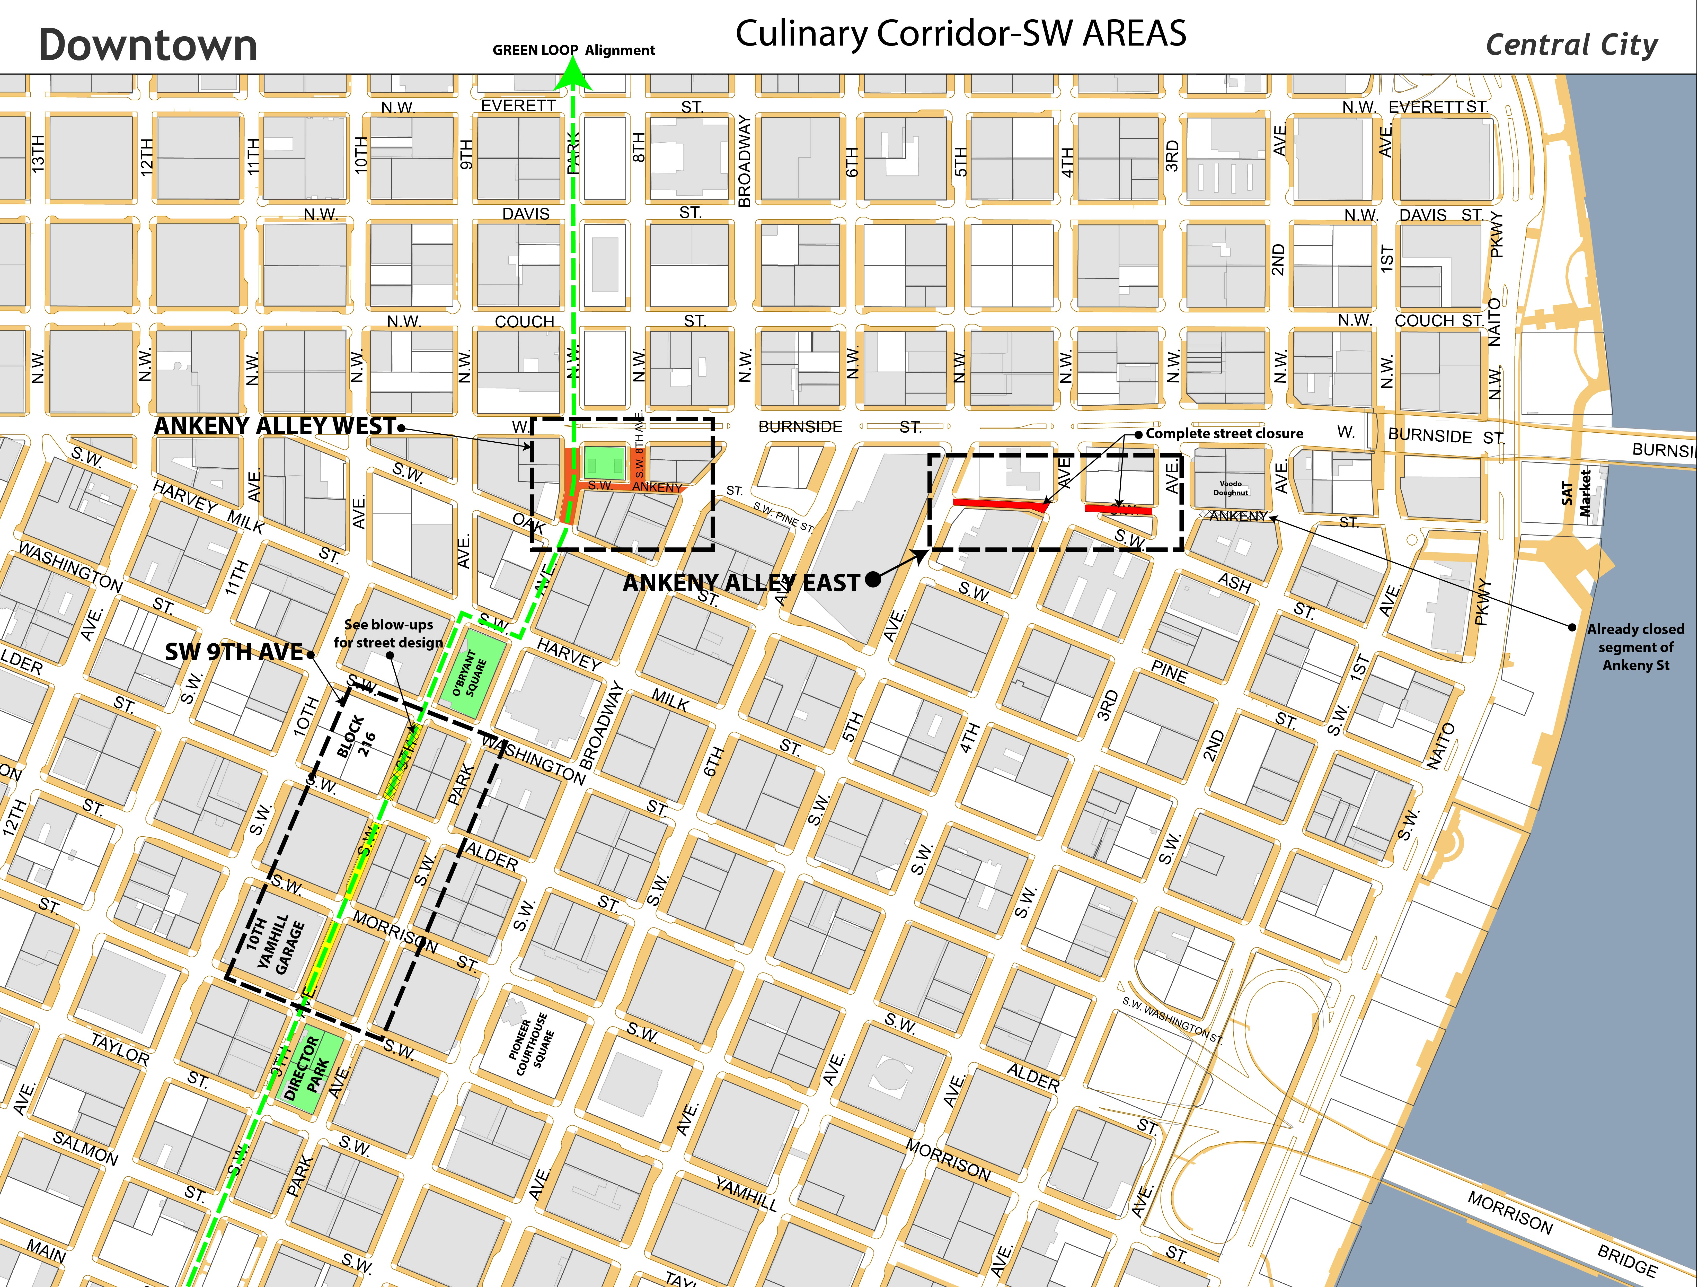
Design

Slide 15
Design

Slide 16
Design – 9th Avenue (Yamhill to Alder)

Slide 17
Design – 9th Avenue (Yamhill to Alder)

Slide 18
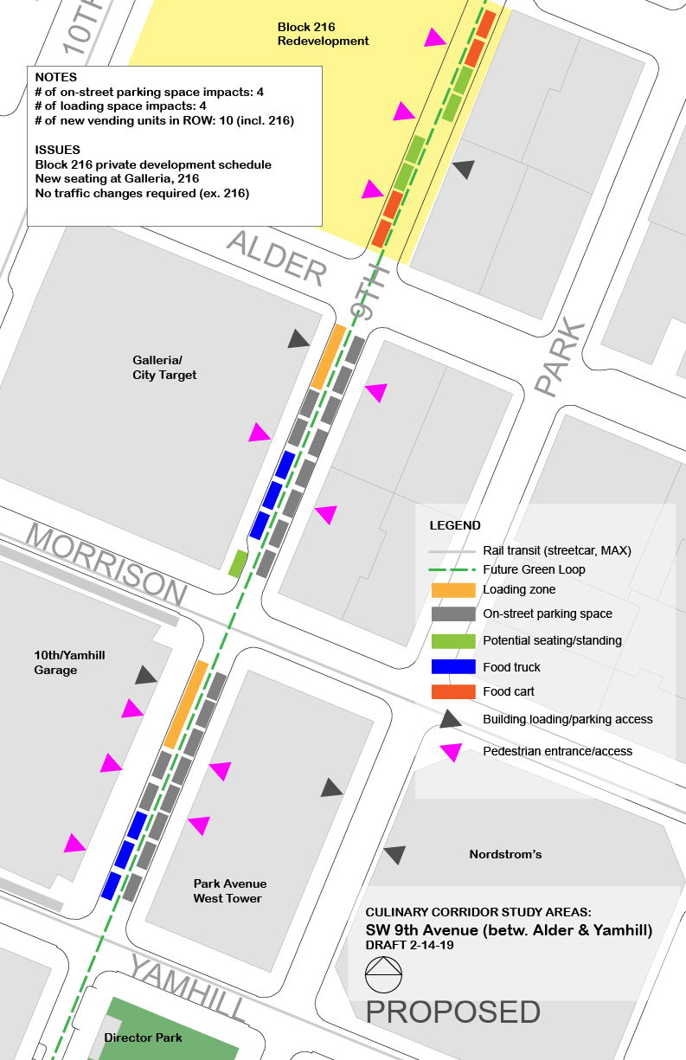
Design – 9th Avenue (Yamhill to Alder)

Slide 19
Design – Ankeny Corridor West

Slide 20
Design – Ankeny Corridor West

Slide 21
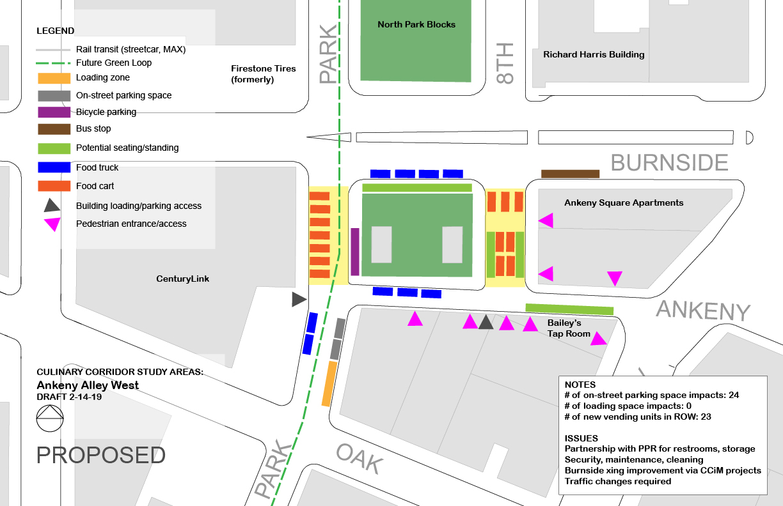
Design – Ankeny Corridor West

Slide 22
Design – Ankeny Corridor East

Slide 23
Design – Ankeny Corridor East

Slide 24
Design – Ankeny Corridor East

Slide 25
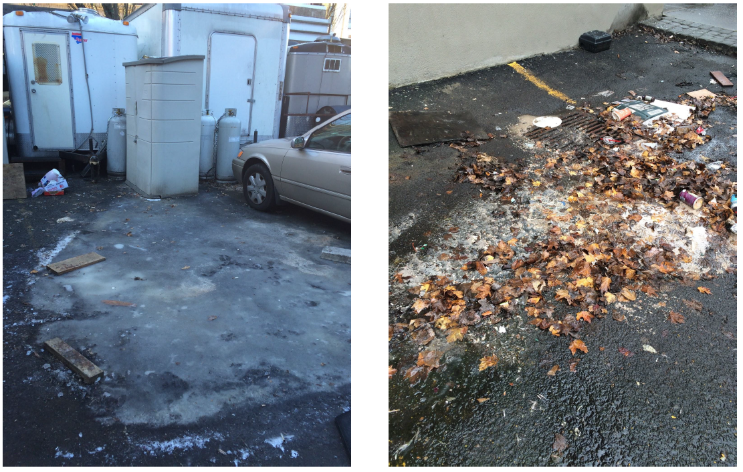
Discussion
Affordability and equity of opportunity
Program management
Parks infrastructure
Evaluating changes to parking or circulation
Funding for hard connections
Stakeholder outreach

Slide 26
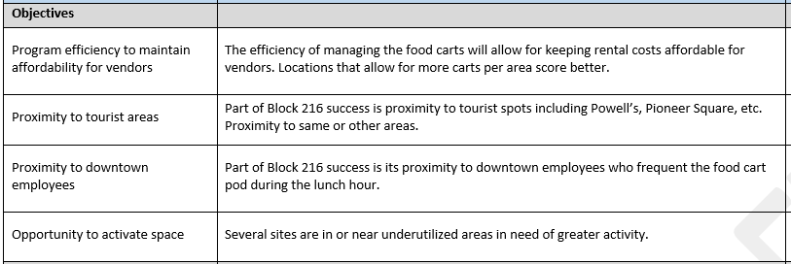
Discussion

Slide 27
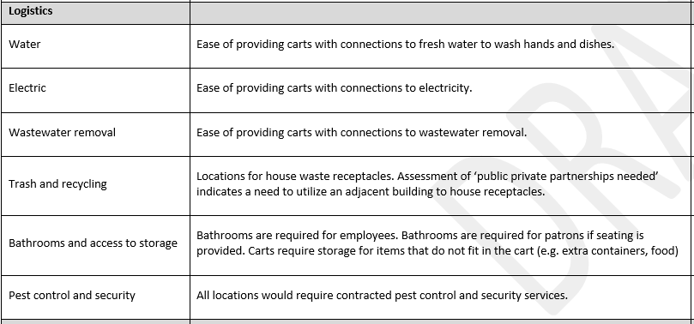
Discussion

Slide 28
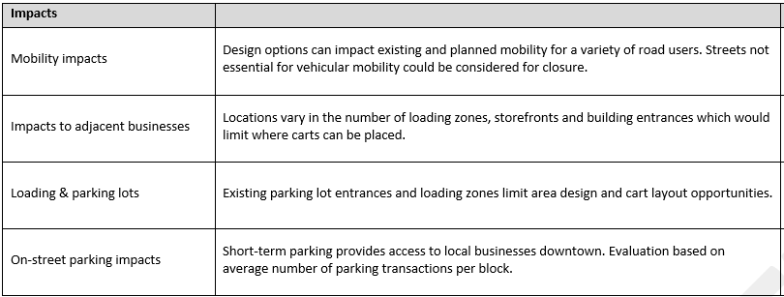
Discussion

Slide 29
Discussion

