Slide 1
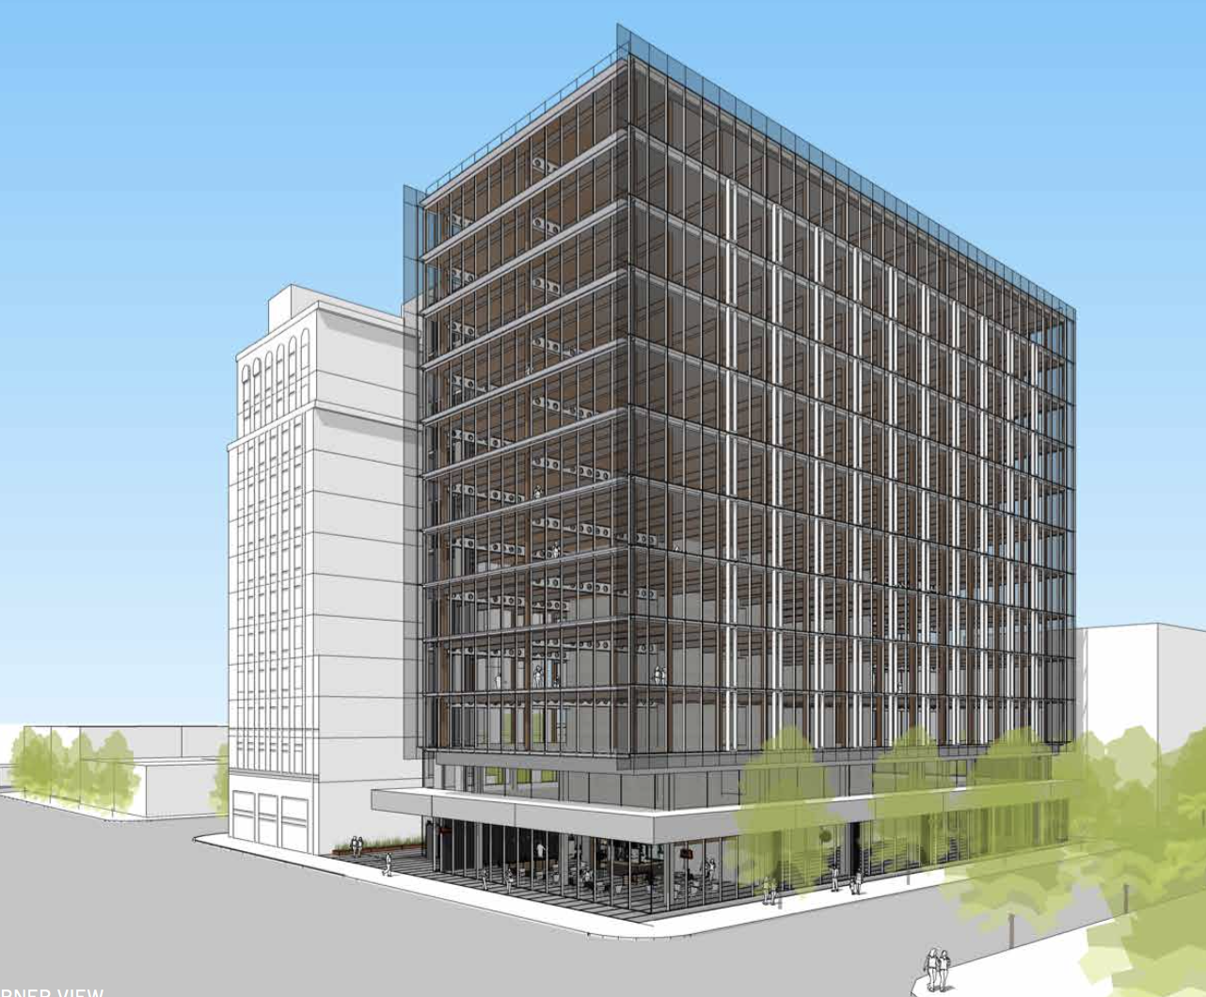
City of Portland
Historic Landmarks Commission
Design Advice Request
EA 18-272873 DA
510 SE Morrison Street
February 11, 2019
Staff Presentation

Slide 2
Staff Introduction
Applicant Presentation
Staff Discussion Topics
Public Comments
Commission Conversation

Slide 3
Location:
Central City Plan District
Central Eastside Subdistrict
Base Zone:
EXd, Central Employment Design and Historic Resource Protection Overlays
Approval Criteria:
Central City Fundamental Design Guidelines
Adopted Design Guidelines East Portland/Grand Avenue Historic Design Zone
Height:
160’ max base w/minor projections
Not eligible to bonus height
160’ proposed w/ minor projections (4’ parapet, 16’ elevator, 10’ mechanical equipment)
Floor Area Ratio:
9:1 base, 3:1 bonus with bonus or transfer
Scheme A: 6.5:1 proposed
Scheme B: 7.53:1 proposed
Site Challenges:
Historic District
(2) Type A Loading Spaces required and proposed
Vehicular Access to Pedestrian Alley from Grand Avenue prohibited
3.5’ Dedication on SE Belmont taken into consideration
No Modifications or Adjustments requested
Zoning

Slide 4
East Portland/Grand Avenue Historic District

Slide 5
View of Site: Bridgehead Location

Slide 6
View of Site: Bridgehead Location

Slide 7
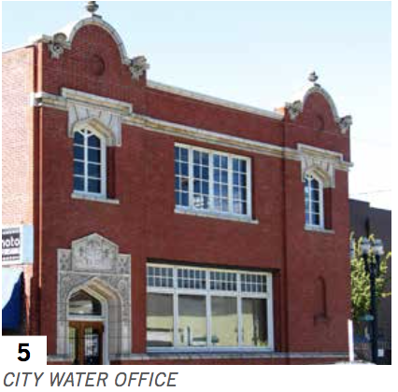
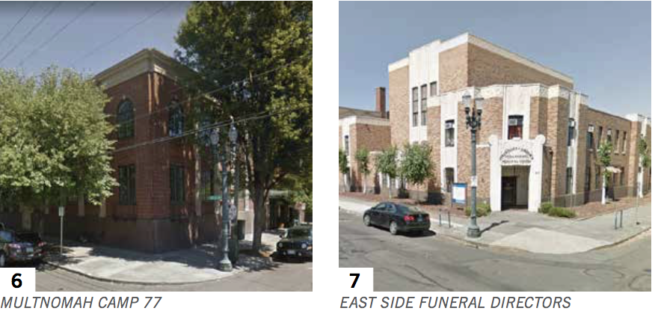
East Portland/Grand Avenue Historic District

Slide 8
Looking North on Grand Ave Grand Belmont & the Weatherly

Slide 9
The Site & the Weatherly Building

Slide 10
Southwest Corner – Pour Sports Non-contributing Structure

Slide 11
Looking East at the Site from SE Grand

Slide 12
Existing Parking Access from SE Grand Ave

Slide 13
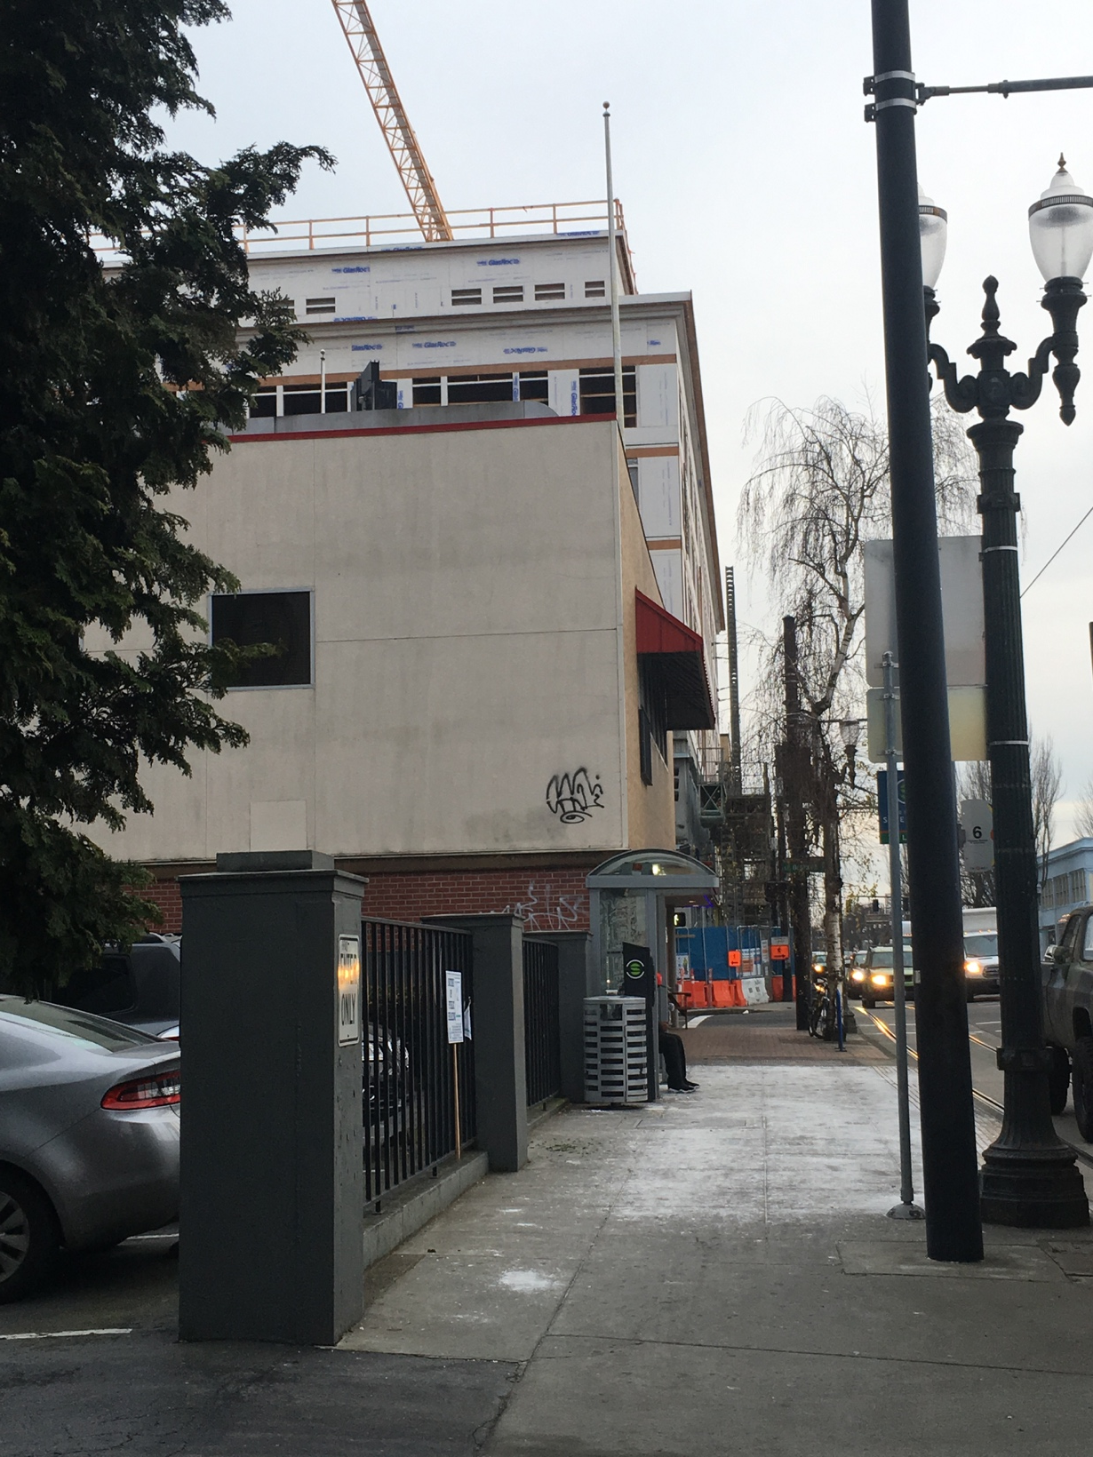
SE Grand Ave. Looking North
SE Grand Ave. Looking South

Slide 14
Looking West toward Downtown

Slide 15
Looking West toward Downtown

Slide 16
Looking East on SE Belmont St. Modera Belmont Apartments

Slide 17
Looking East on SE Belmont St. South Edge of the Site

Slide 18
Looking East on Belmont at the Site & Modera Belmont Apartments

Slide 19
Looking North at the Site From SE Belmont St.

Slide 20
SE Belmont St. & Grand Belmont

Slide 21
Existing Parking Access from SE 6th Avenue

Slide 22
Looking East on SE Morrison St.

Slide 23
Looking North on SE Grand

Slide 24
Looking South on SE Grand at the Weatherly Building

Slide 25
Staff Introduction
Applicant Presentation
Staff Discussion Topics
Public Comments
Commission Conversation

Slide 26
Staff Introduction
Applicant Presentation
Staff Discussion Topics
Public Comments
Commission Conversation

Slide 27
Macro Level
Compatibility of Design
Siting and Building Orientation
Height, Scale, Form, & Proportion
Architectural Character
Parking & Loading Location and Access
Mid Level
Building Entrance
Building Materials and Details
Micro Level
Building Details
Datums
Other Design Comments

Slide 28
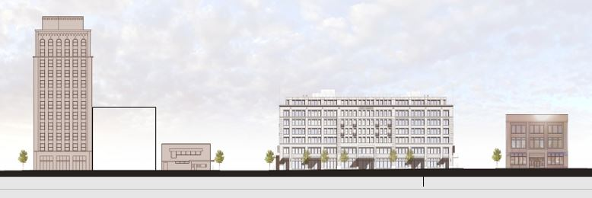
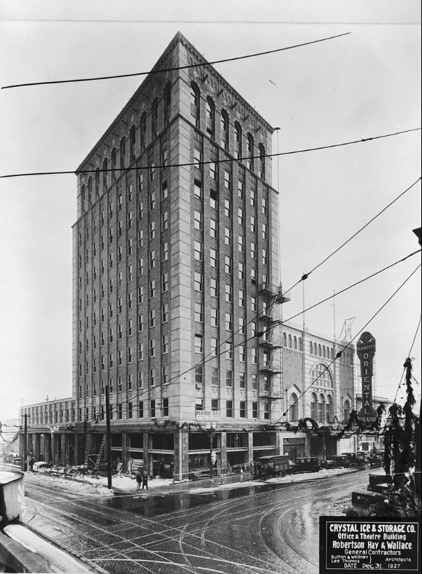
Compatibility of Design:
Siting & Building Orientation

Slide 29
Compatibility of Design:
Siting & Building Orientation

Slide 30
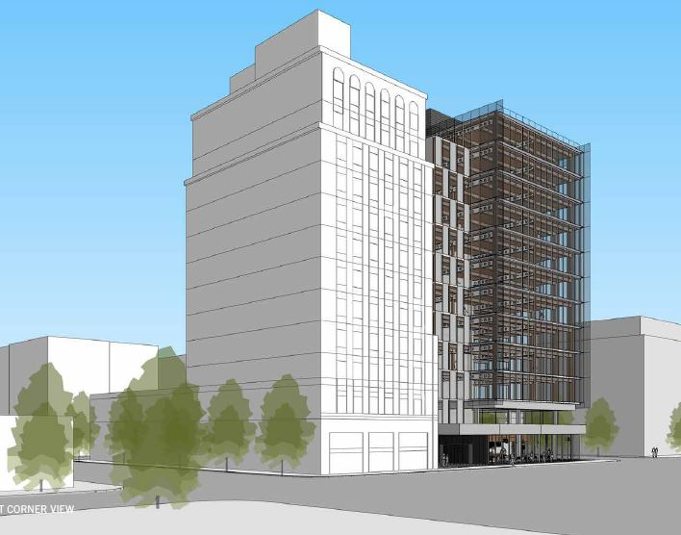
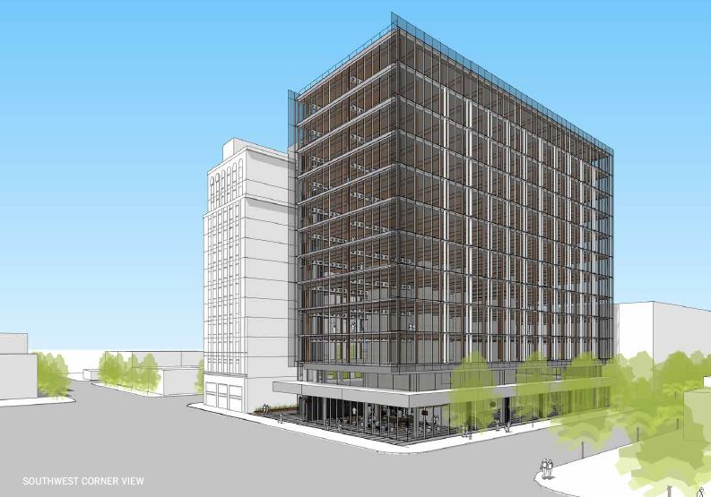
Compatibility of Design:
Height, Scale, Form & Proportion

Slide 31
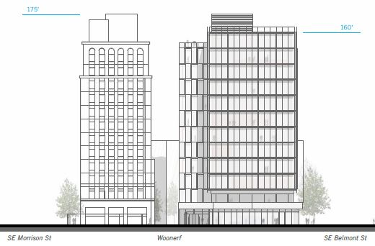
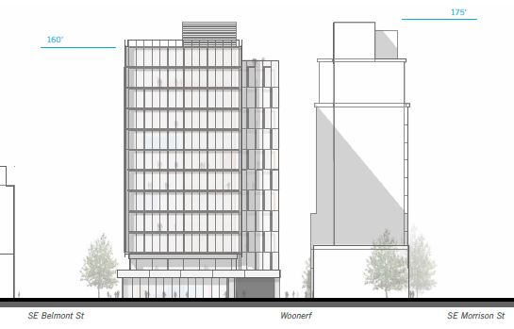
Compatibility of Design:
Height, Scale, Form & Proportion

Slide 32
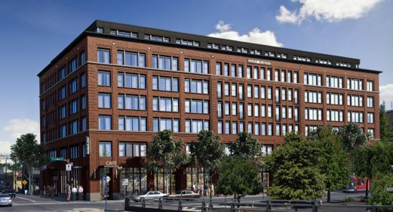
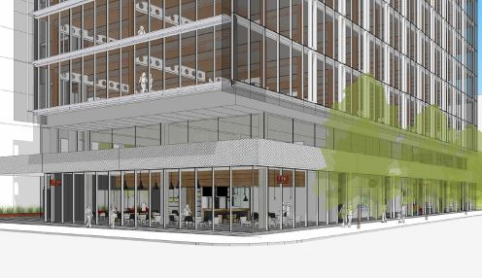
Compatibility of Design:
Architectural Character

Slide 33
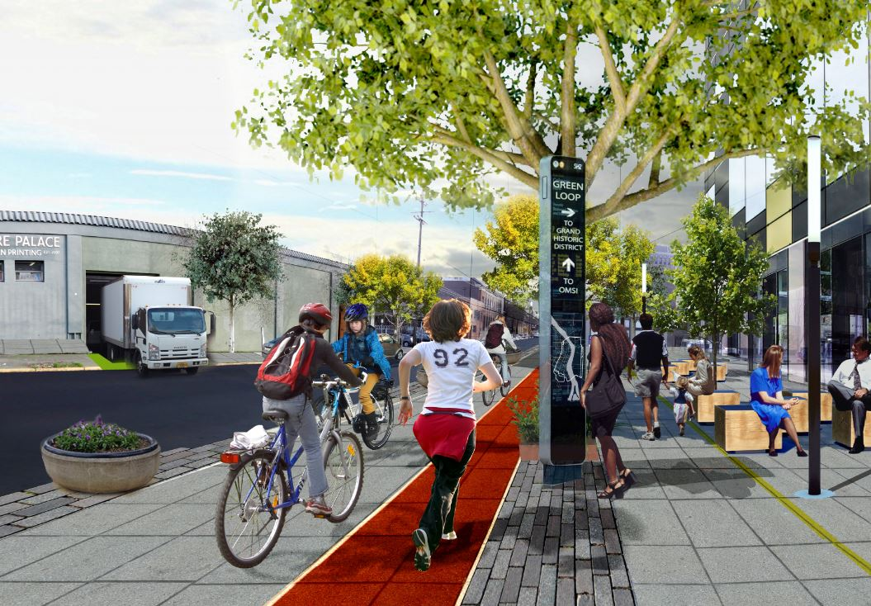
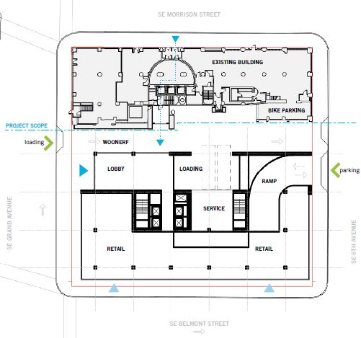
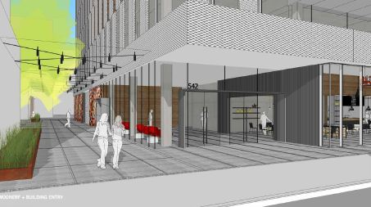
Compatibility of Design:
Parking, Loading versus Pedestrian Alley

Slide 34
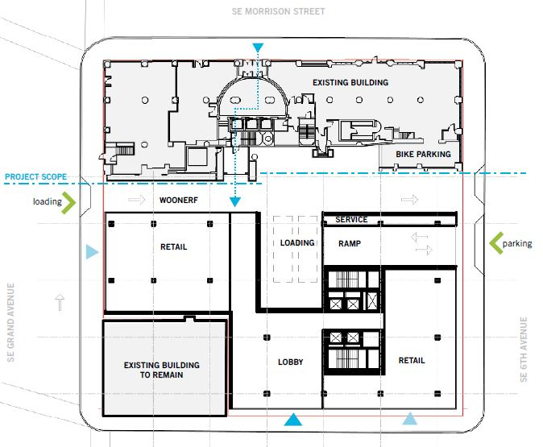
Mid Level Issues
Building Entrance

Slide 35
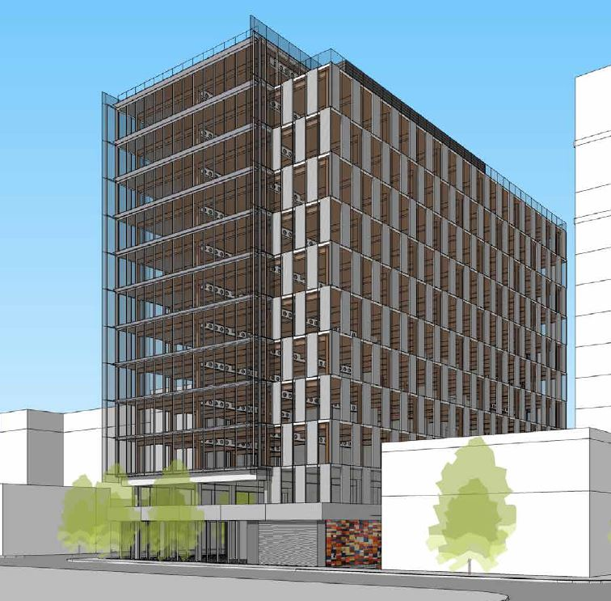
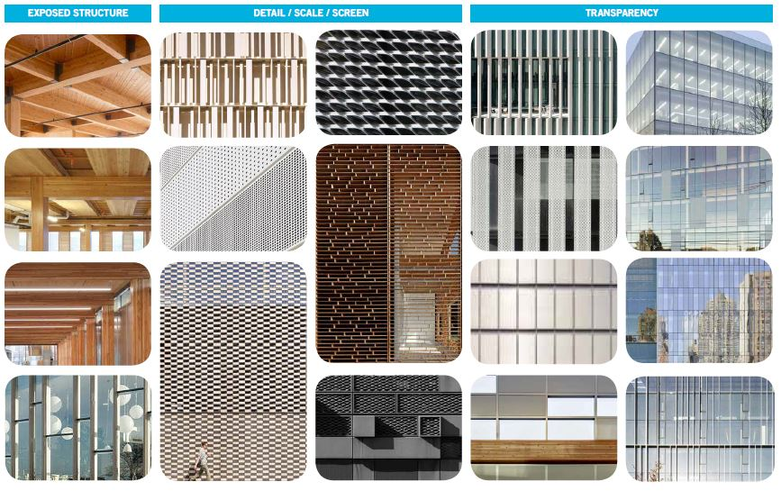
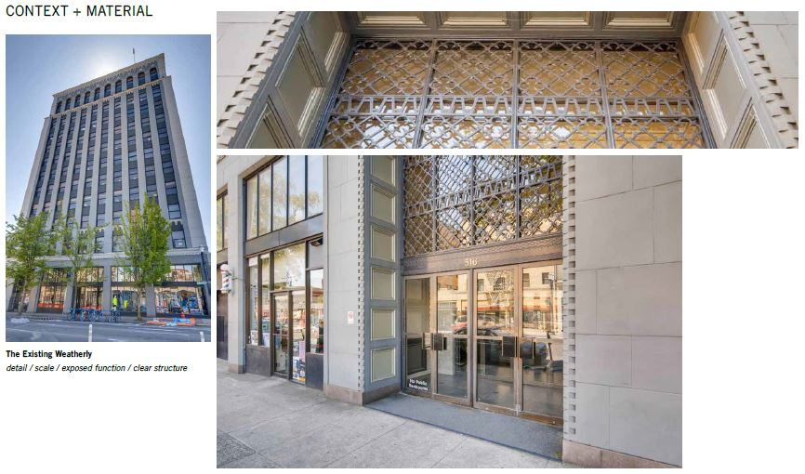
Mid Level Issues
Materials, Colors, and Textures

Slide 36
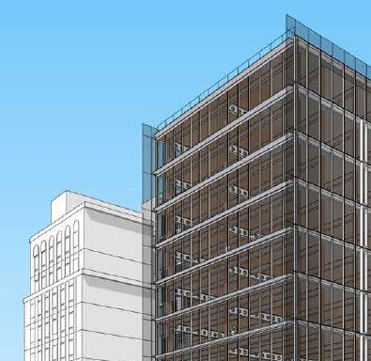
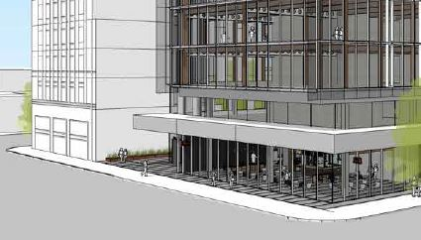
Micro Level Issues
Building Details

Slide 37
Staff Introduction
Applicant Presentation
Staff Discussion Topics
Public Comments
Commission Conversation

Slide 38
Staff Introduction
Applicant Presentation
Staff Discussion Topics
Public Comments
Commission Conversation

