Slide 1



FUTURE CONNECT – UPDATE CITY OF PORTLAND 2018 -19
Susie Lashene
Portland Community College Foundation Board President
Kelly Love
Future Connect Program Manager
Margarita Hernandez Trujillo
Future Connect Transfer Specialist
Rachel Hartford
Future Connect Graduate, 2015 Future Connect Cohort

Slide 2

5137
high school students received information about college through Future Connect
1070
students applied for Future Connect
506
waitlisted students supported via Summer Connect workshops and text-based advising and enrollment coaching
2018-19
Future Connect
New Student Outcomes
Core Service still exist
345
students receive wrap around coaching, scholarship, and classes
215
students received transfer coaching to attend universities
115
students received internship support
40 emergency supports given

Slide 3
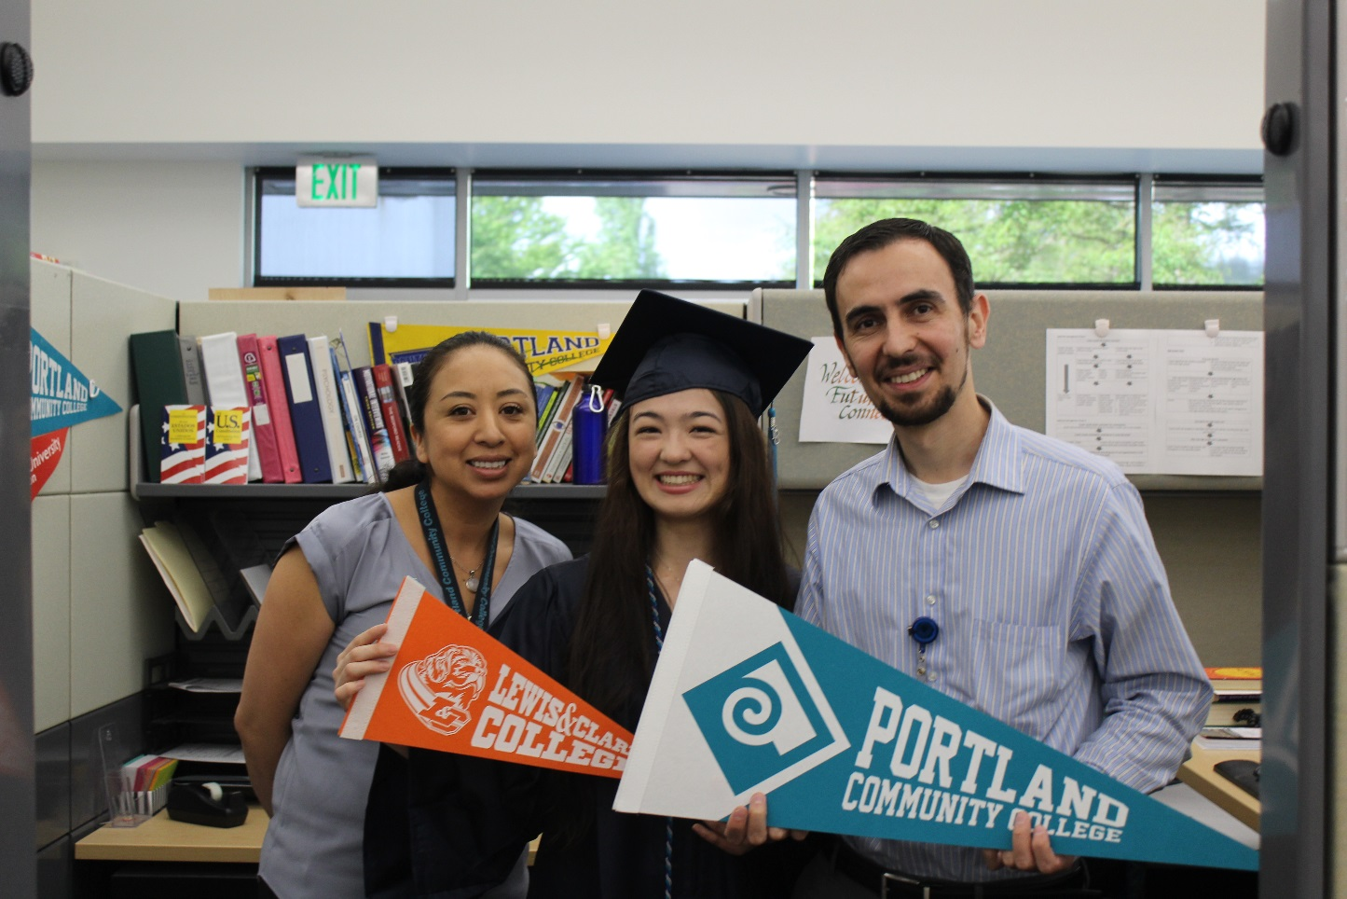
Rachel Hartford
2015 Grant High School Graduate
2015 Future Connect group
Graduate of PCC in 2018
Lewis and Clark College Full ride Scholarship recipient

Slide 4
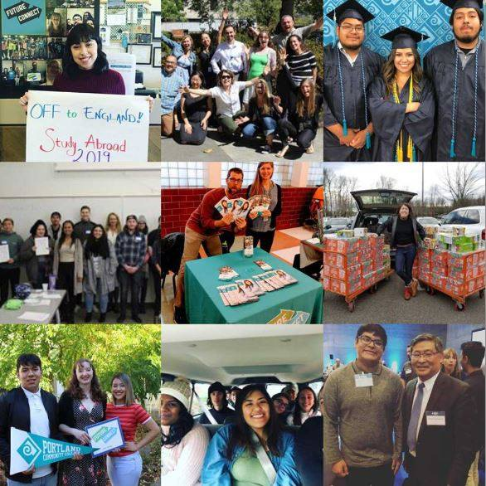
Thank you
City of Portland
for your support and investment in the students in
our city!

