Slide 1
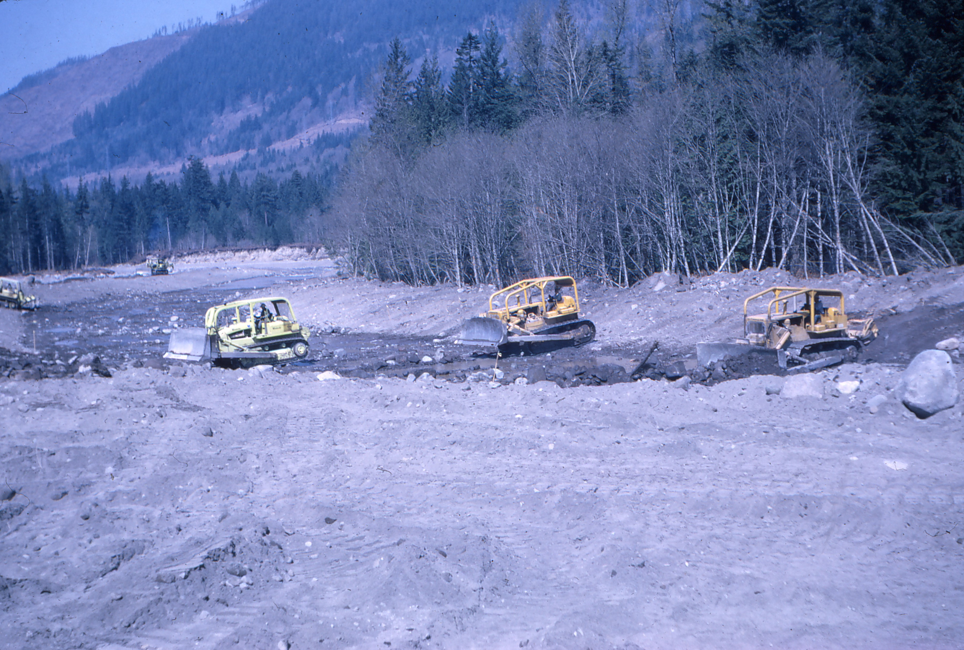
Bulldozers in River, 1965
Arrigotti

Slide 2
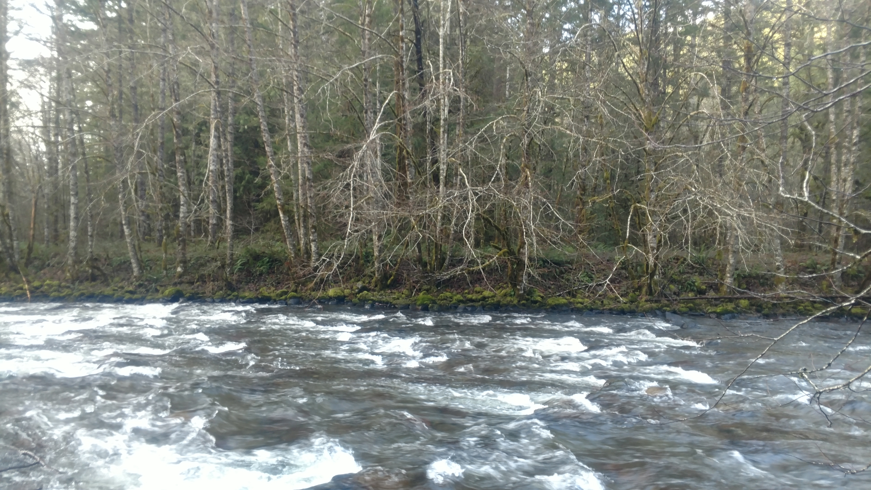
Zigzag River: Face of Right Bank Berm

Slide 3
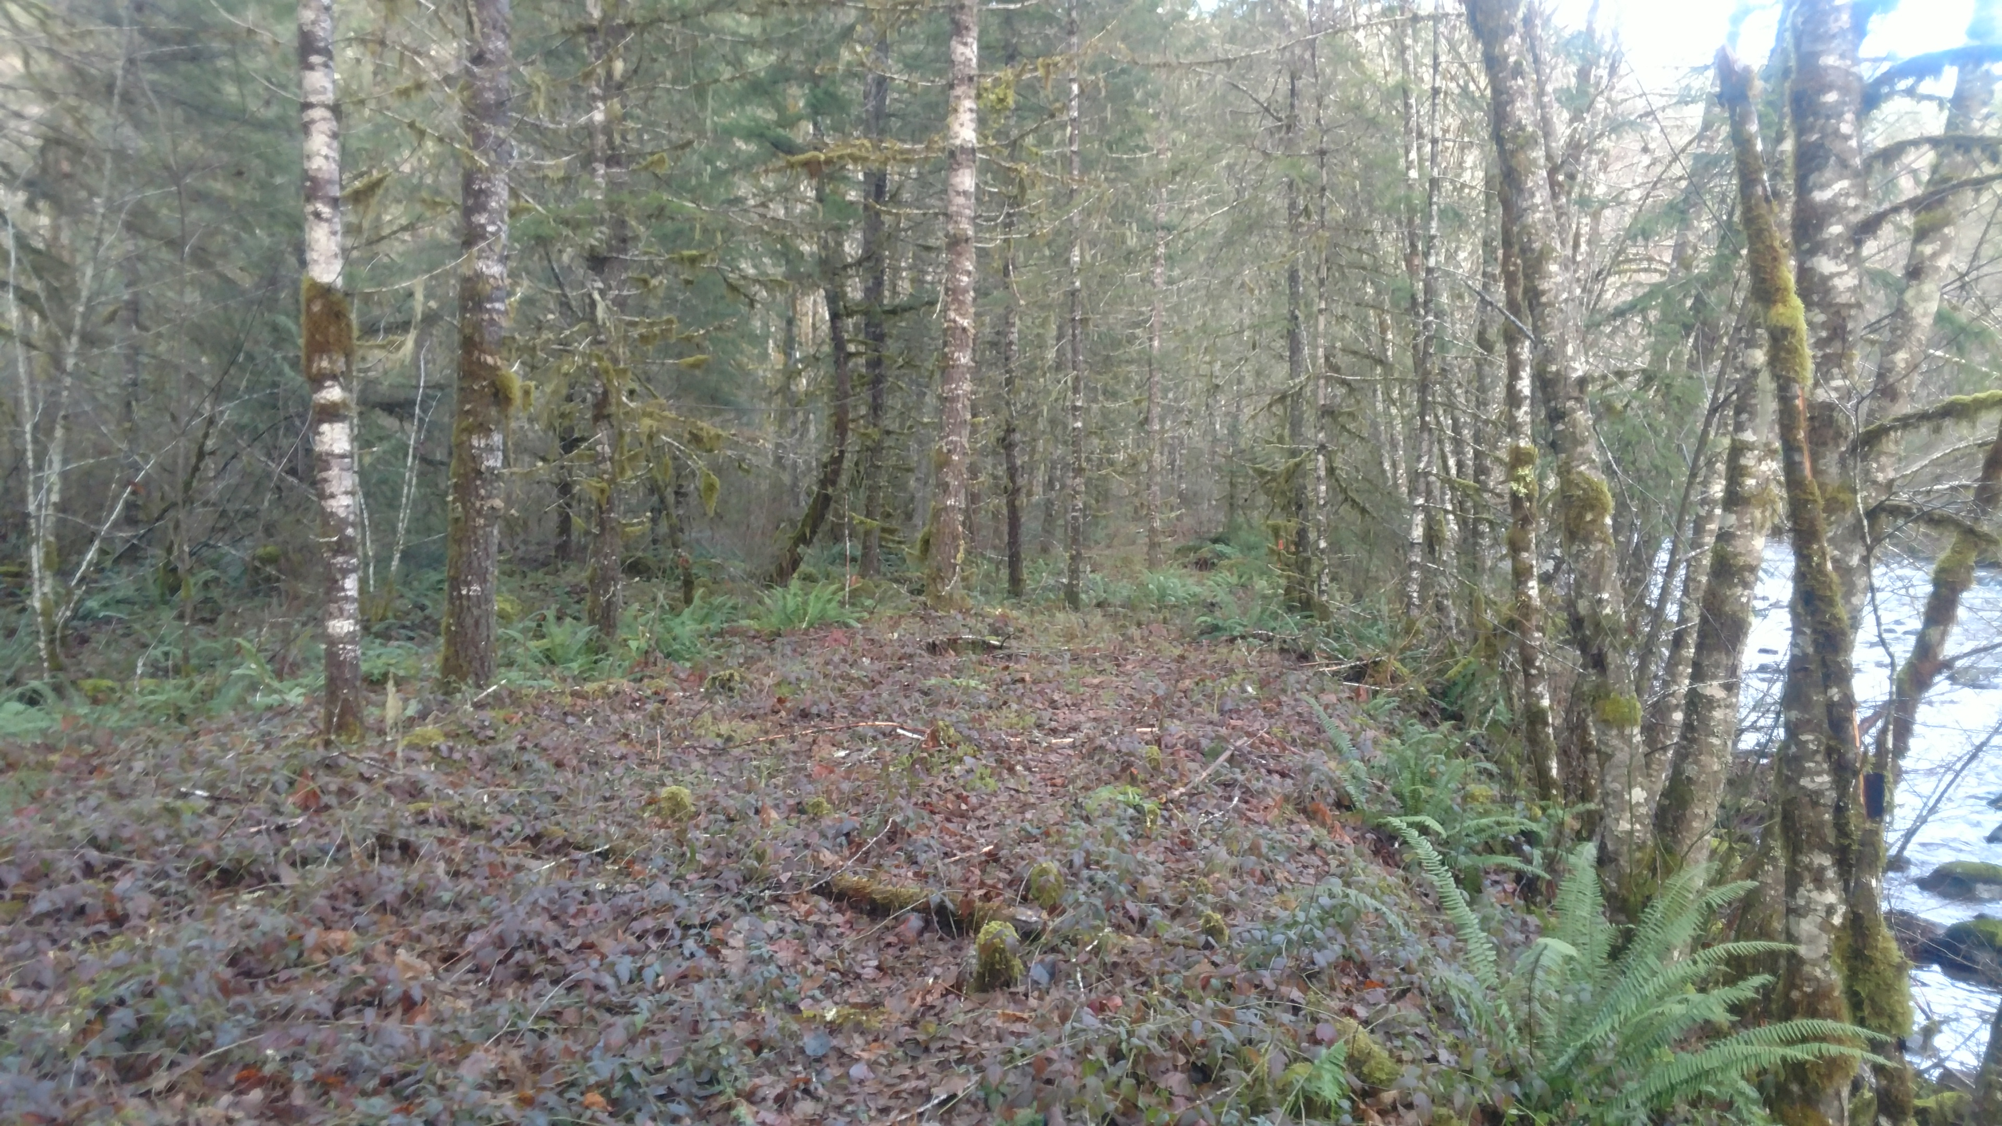
Zigzag River: Top of Right Bank Berm Looking Upstream

Slide 4
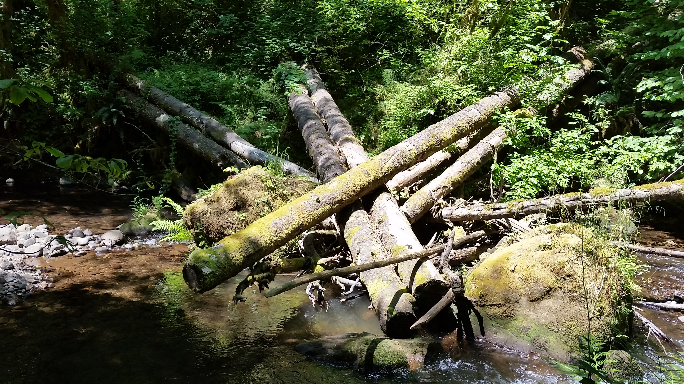
Engineered Log Jam

Slide 5
