Slide 1
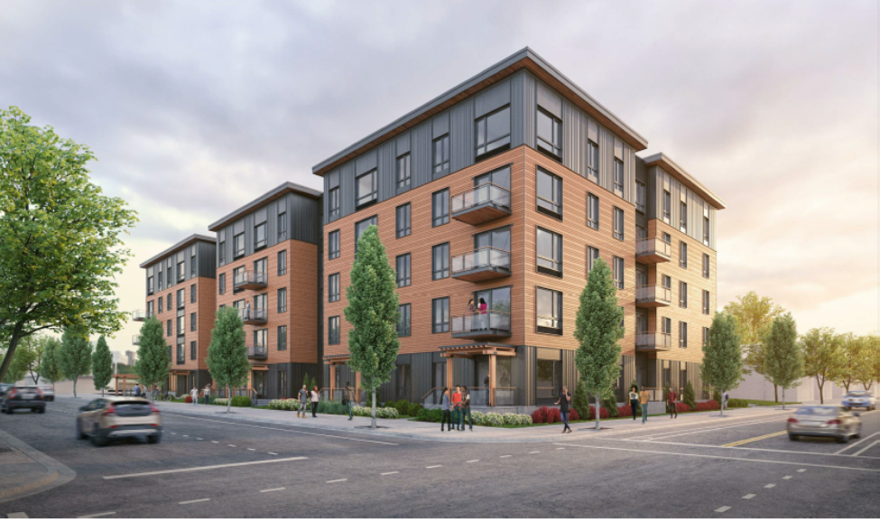


North Williams Center
Shannon Callahan, PHB Director
January 16, 2019

Slide 2
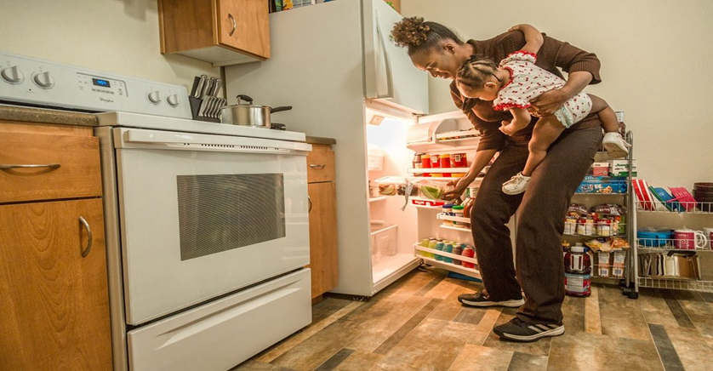
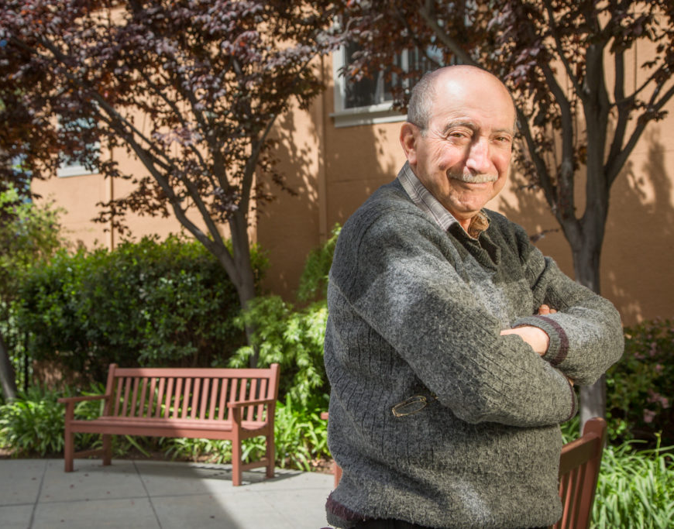
North Williams Center
60
194
new affordable units at N. Williams and NE Tillamook
Residents
Housed
1

Slide 3
North Williams Center
Focused on households with very low incomes: 2/3 of the units are 0-30%
N/NE Preference
10
N/NE Preference
10 Permanent Supportive Housing units
Permanent Supportive
Housing units

Slide 4
Construction Start: March 2019
Construction Complete: May 2020

