Slide 1
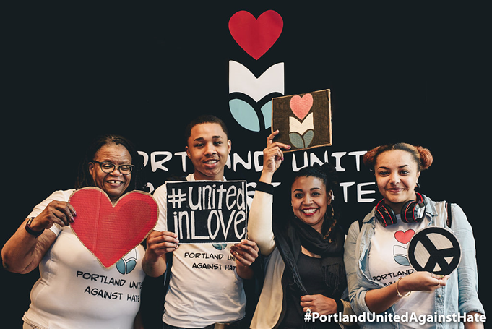
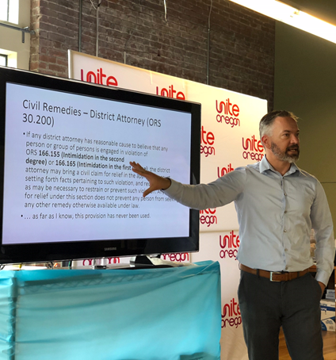
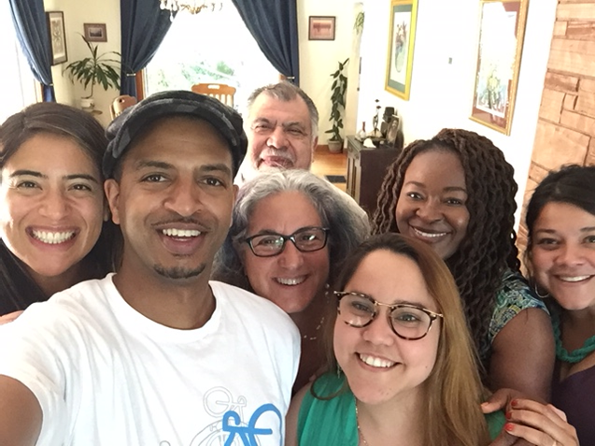
2017-18 Special Appropriations
Portland United Against Hate
Grant Report

Slide 2
JANUARY 2019
Portland United Against Hate
2017-18 Special Appropriations Grant Report

Slide 3
Jan 2019 – PUAH Grant Report
Portland United Against Hate
Overview
In the FY2017-18 budget City Council set aside $350,000 in Special Appropriations funding for competitive grants to do capacity building, training, and data collection and analysis to support the work of the Portland United Against Hate Coalition.
Thank you for your support!

Slide 4
Jan 2019 – PUAH Grant Report
Portland United Against Hate
Grant Outcomes
Launch of ReportHatePdx pilot
Creation of tools and resources
Increased capacity within community to respond to, interrupt, and be prepared for hate incidents

Slide 5
Jan 2019 – PUAH Grant Report
Portland United Against Hate
1. ReportHatePdx

Slide 6
Jan 2019 – PUAH Grant Report
Portland United Against Hate
1. ReportHatePdx
Through community points of contact and the ReportHatePdx website, 138 hate incidents were reported during the grant cycle.
Community garden volunteer showing hate signs
Harassment of transgender woman by non-profit worker
Woman in hijab harassed with a car on public street
Islamophobic flyers around East Portland neighborhood
Anti-Semitic graffiti on elementary schools

Slide 7
Jan 2019 – PUAH Grant Report
Portland United Against Hate
2. Creation of tools and resources
Rapid Response toolkit
No Hate in Our Neighborhood how-to guide
Interrupting Hate action cards
Culturally and language-specific printed materials
Youth-led, peer-to-peer video

Slide 8
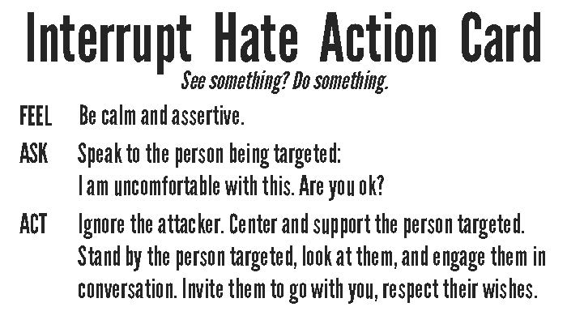
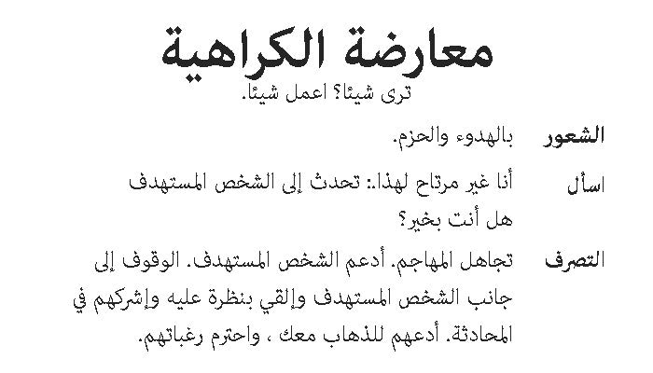
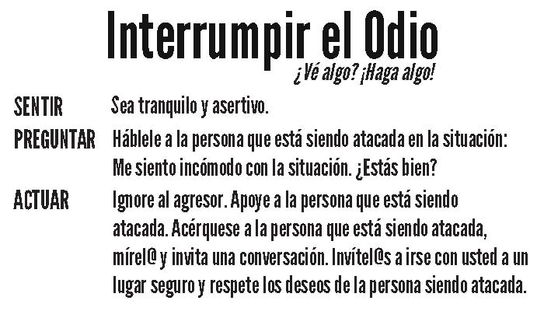
Jan 2019 – PUAH Grant Report
Portland United Against Hate
2. Creation of tools and resources

Slide 9
Jan 2019 – PUAH Grant Report
Portland United Against Hate
3. Increased capacity within community to respond to, interrupt, and be prepared for hate incidents
Together, the PUAH grant partners:
Held 152 trainings for 2,667 people to respond, interrupt, track, understand, and promote solutions to hate violence;
Provided outreach and engagement to 9,429 people in 11 languages;
Supported 38 youth in leading anti-hate programming, including creation of a video.

Slide 10
Jan 2019 – PUAH Grant Report
Portland United Against Hate
3. Increased capacity within community to respond to, interrupt, and be prepared for hate incidents
“This workshop series has had an incredible impact on me and through me, in my workplace and community. I’m so grateful for the grant that was provided to make these trainings available – it has been one of the highest impact programs I’ve participated in and I’m excited to see it continue and expand!”
--feedback from Friend, Neighbor, Ally: Community Response and Supportive Engagement with Those Targeted by Hate & Bias workshop by Lewis & Clark

Slide 11
Jan 2019 – PUAH Grant Report
Portland United Against Hate
The Coalition
As the climate of hate, fear, and violence continues to be felt in the Portland community, the PUAH Coalition has set strategic directions for 2019-20 to contribute to a safe and livable Portland. The three primary focus areas are:
Community Capacity Building
Rapid Response
Policy and Data

Slide 12
Jan 2019 – PUAH Grant Report
Portland United Against Hate
Next Steps
Public launch of ReportHatePdx including an upgrade of the tool to make it more mobile friendly and to add multi-lingual capability;
Expansion of capacity building through 60 trainings with 910 people and outreach to an additional 1,808 about a variety of topics and skills related to hate violence;
Deeper community engagement work, including 20 specially trained leaders doing de-escalation work on public transit, advocacy for 38 people targeted by hate violence, three faith leader meetings to map out upstream approaches to addressing hate, and leadership development of more than 40 youth in the African immigrant communities.

Slide 13
Jan 2019 – PUAH Grant Report
Portland United Against Hate
X: Structures for Inclusion
PUAH was created by the community advocating structural change for a community-centered approach to hate response.
Y: Adaptive Governance
PUAH created and is holding shared space for solving challenges, we are rooted in coming together across City and Community to identify needs, opportunities, and solutions. This partnership is model of community engagement that is based in community need and City responsibility.
Z: Fulfilled and Empowered Portlanders
PUAH is building capacity, leveraging funds, and setting up systems that are both connected to local government and situated within the community.
Notes:
With Deb’s testimony

Slide 14
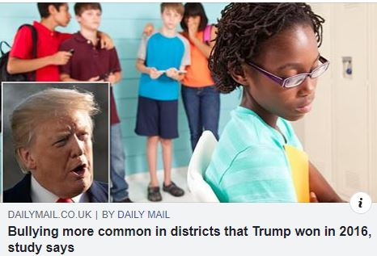
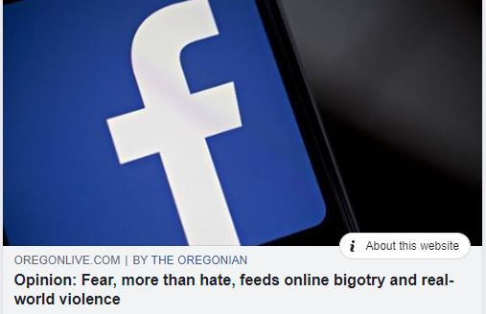
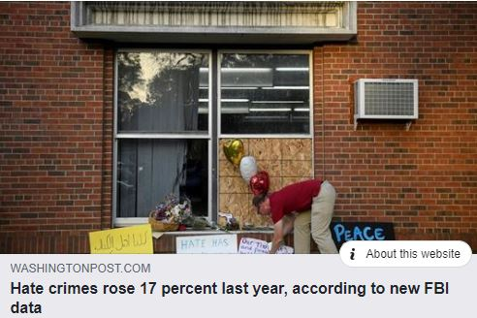
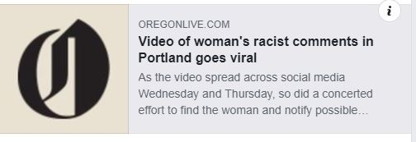
Jan 2019 – PUAH Grant Report
Notes:
With Kayse’s testimony

Slide 15
Jan 2019 – PUAH Grant Report
ReportHatePDX.com Goals
Document what is happening in our communities
Provide resources and support from culturally-specific communities within the tracking tool
Collect relevant data for informed decision making & policy

Slide 16
Jan 2019 – PUAH Grant Report
ReportHatePDX.com Features
Community-vetted survey instrument
Report various types of incidents
Report various types of perpetrators
Multiple avenues to report hate crimes and incidents
Anonymous online
Through trusted community organizations and leaders
Resource guide indexed by type of services and by geography

Slide 17
Jan 2019 – PUAH Grant Report
ReportHatePDX.com Analysis
138 incidents in June 2017- November 2018
33% of the incidents that reported the type of incident involved “discrimination”, “unfair treatment”, and “actions or speech that made me feel unwelcome” such as being spit on and sexual harassment.
22% of incidents used the word “harassment” to describe the incident.
16% of incidents relate to physical assault or intimidation or threat of physical assault.
12% were reported as motivated by the target’s race/ethnicity; 7% of incidents referred to nationality and/or immigration status; 4% of incidents were reported as motivated by the target’s disability.

Slide 18
Jan 2019 – PUAH Grant Report
ReportHatePDX.com Lessons
Any online tool must have a trusted organizational interface;
New tools take time to integrate into communities;
Combining the tool with education and outreach not only increases use of the tool but also validates experiences of harm;
The power of this tool is in the broad definition of ‘hate incident’ and a target-centered approach to recording the incident.

Slide 19
Jan 2019 – PUAH Grant Report
ReportHatePDX.com Next Steps
Public launch January 31
Platform available in English and Spanish
The platform’s features will continue to be strengthened, including a mobile-ready public website for individuals to report hate incidents and find available resources by location, communities served and service type
Communications campaign to increase the use of the platform
Notes:
Marcus – At the end of your testimony, click to the next slide. Wait until the end of Shala’s testimony to click through the link.

Slide 20
Jan 2019 – PUAH Grant Report
Portland United Against Hate
Notes:
Marcus – at the end of Shala’s testimony, click the black box or video image above. It should start to play automatically. When video is over. Click through to last slide.

Slide 21
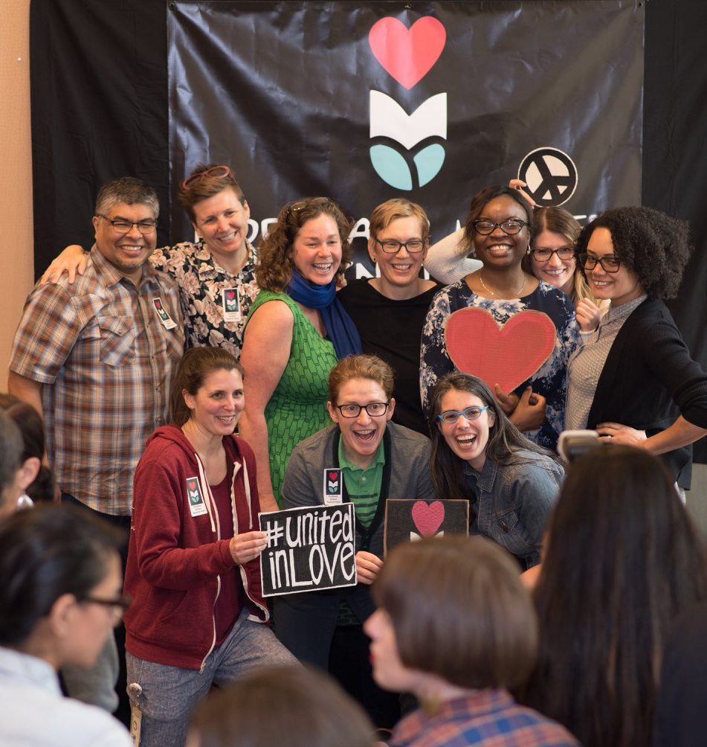
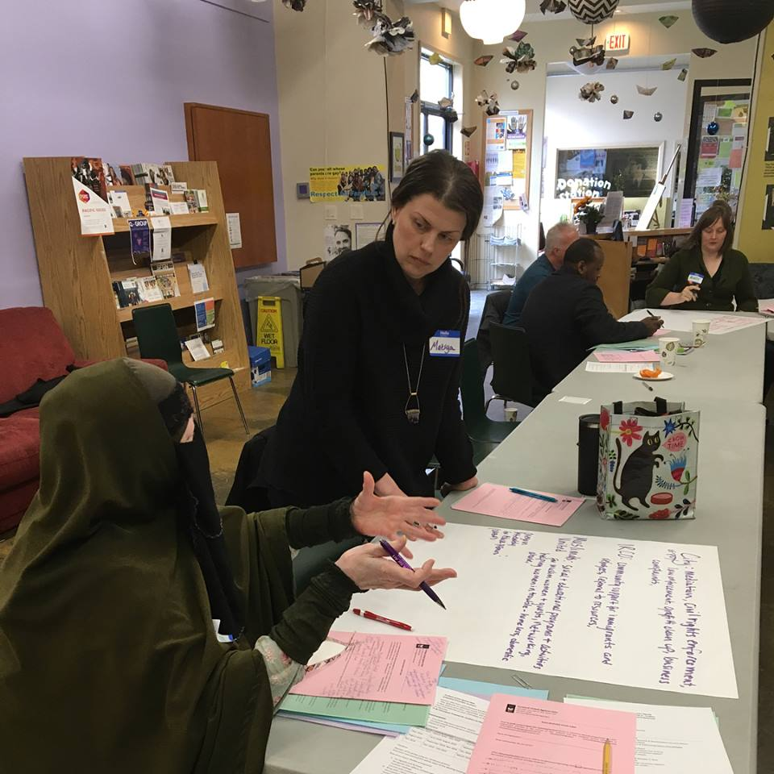
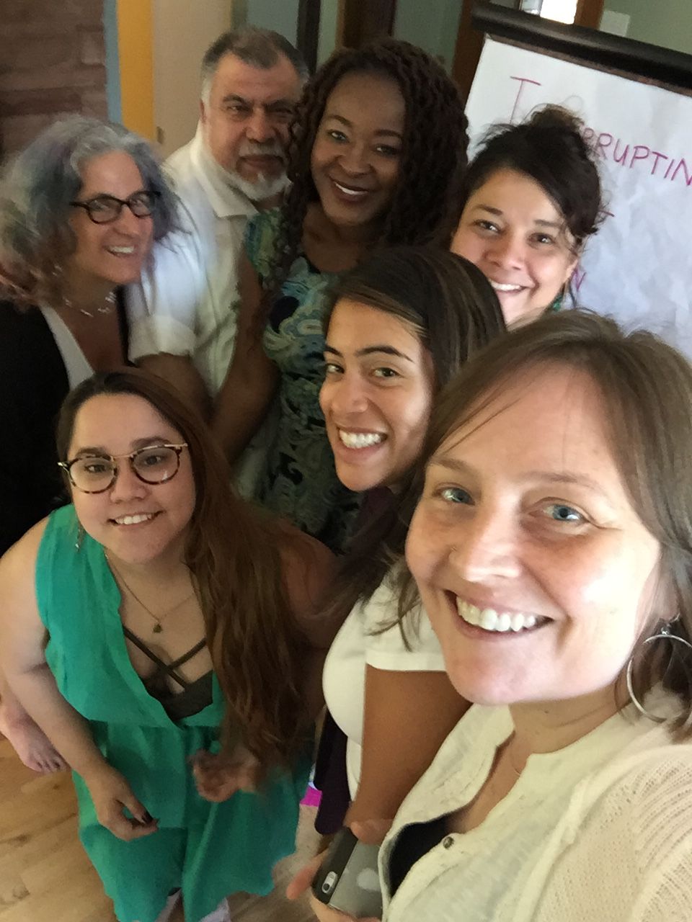
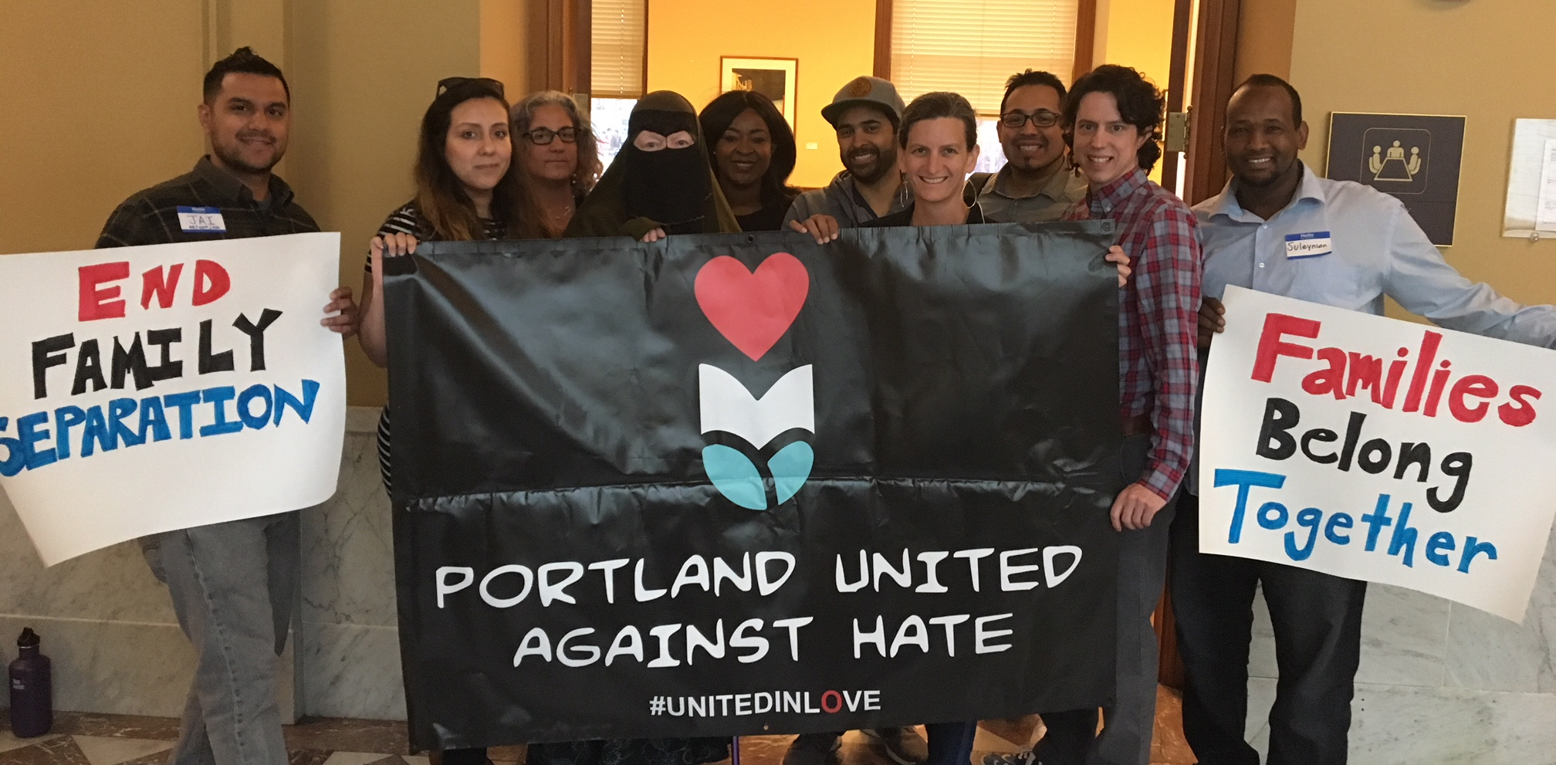
Jan 2019 – PUAH Grant Report
Thank you for your support!
Notes:
Leave this slide up for all remaining speakers.

