Slide 1
January 16, District Coalitions Budget Note
District Coalition Offices
North Portland Neighborhood Services (NPNS)
Northeast Coalition of Neighborhoods (NECN)
Southeast Uplift Neighborhood Coalition (SEUL)
Central Northeast Neighbors (CNN)
Neighbors West/Northwest (NWNW)
East Portland Community Office (EPCO)
Southwest Neighborhoods (SWNI)

Slide 2
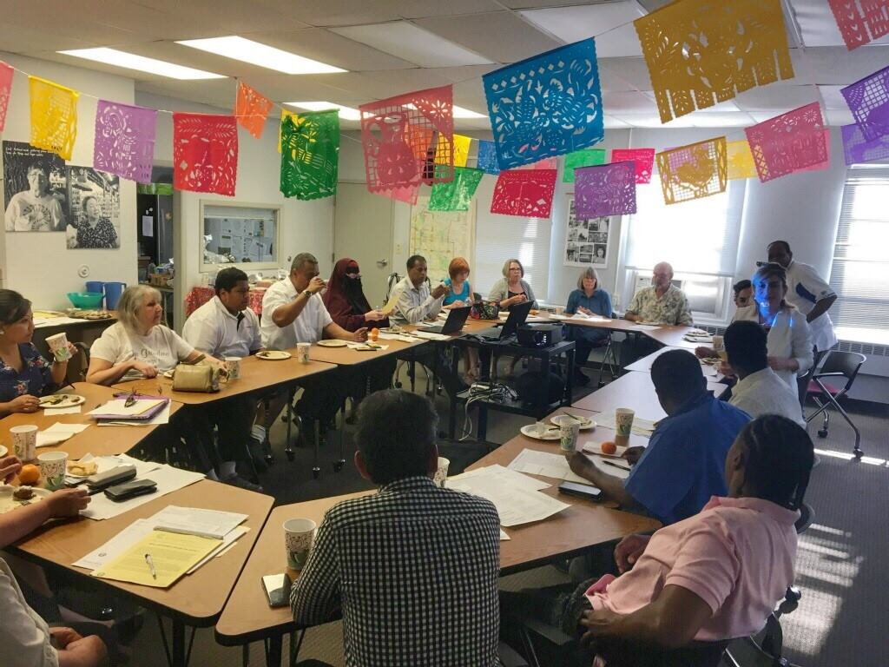
January 16, District Coalitions Budget Note
EPCO Place based, people centered
• Limited staff 2.275 FTE and funding capacity
• Leveraged resources to work with all Portlanders though not sustainable
• Advocacy for increased funding for EPCO

Slide 3
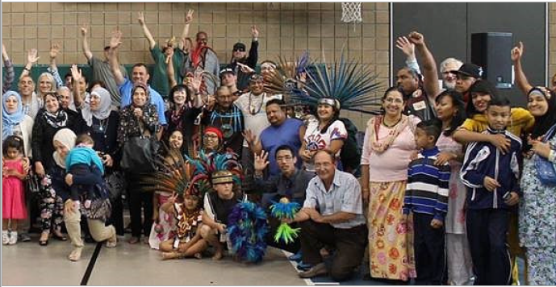
January 16, District Coalitions Budget Note
EPCO Place based, people centered
• Additional funding to go from 2.275 FTE to 3.7 FTE
• Increased funding helps EPCO recruit highly competent multi-lingual staff.
• Increased staff FTE helps EPCO better meet Civic Life’s goal of supporting healthy, connected and equitable communities.

Slide 4
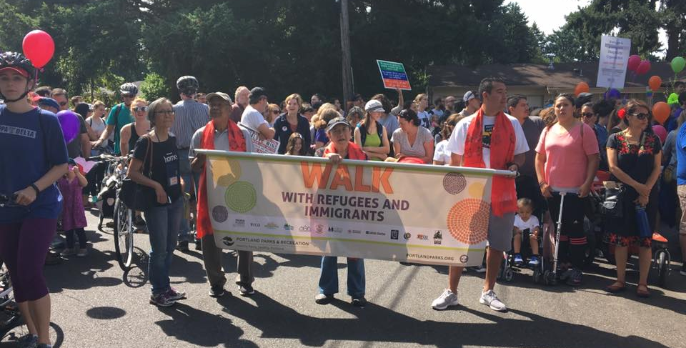
January 16, District Coalitions Budget Note
EPCO Place based, people centered
• Glenfair Neighborhood Association: supporting inclusive, multicultural, multilingual civic engagement
• Somali Women’s Coalition of Portland: leveraging resources across district coalition offices to support under-served and under-resourced community groups

Slide 5
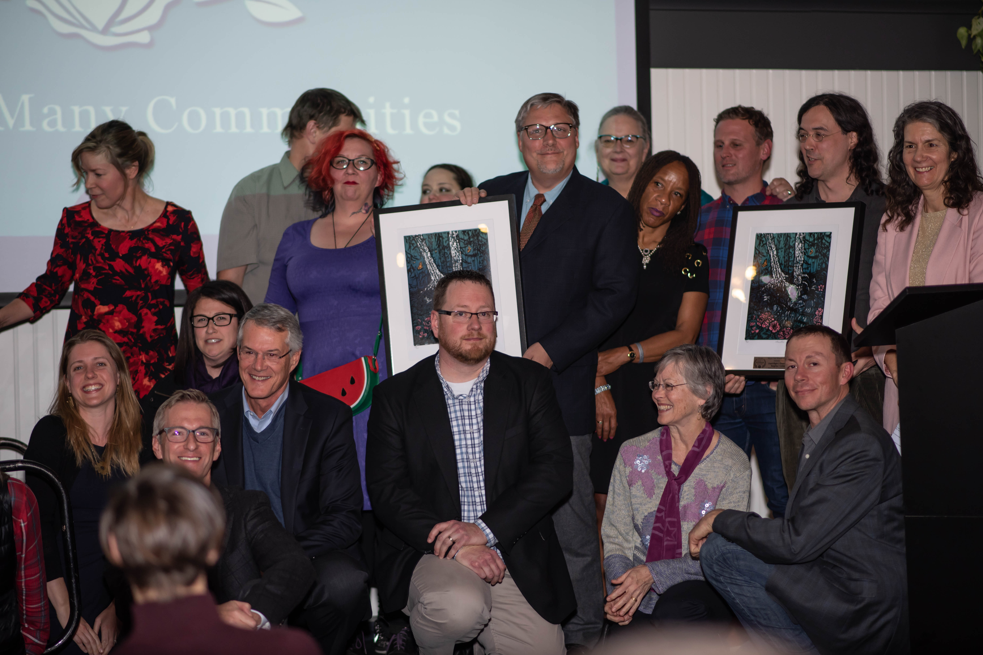
January 16, District Coalitions Budget Note
District Coalition Offices Houselessness and Affordable Housing
2016 Community development strategy to identify sleep areas within districts.
SEUL and NECN: R2D2 (Right to Dream too) Project.
Partnership with Central City Concern’s Clean Start PDX.
Houselessness Crisis community meetings, materials and videos.

