Slide 1



NW Parking Pilot Report
Innovative Parking Management

Slide 2
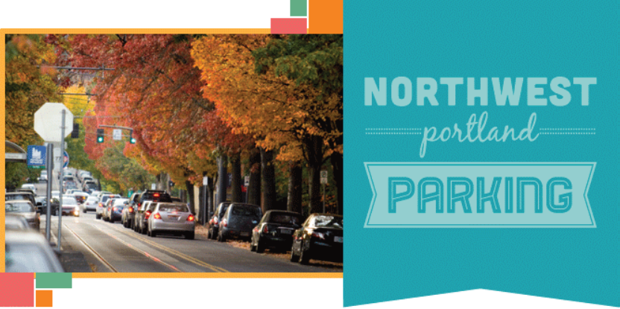
Today’s Items
NW Parking District Management Pilot Report
Resolution to change NW Parking Hours of Operation
Ordinance to adopt Parking Permit Surcharge

Slide 3
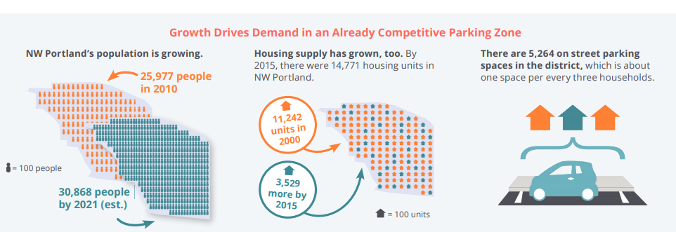
Parking in NW
Parking in NW has historically been challenging. Increased growth in NW requires focused parking management.
Notes:
Parking in NW has historically been challenging, with many different users needing to park on-street, historic buildings built before cars were prominent, and with the growth in housing and employment in the area, the parking crunch has gotten worse.
Since we started implementation of this plan in 2015, more than 1,000 new residential units have been built and we know there are 1,000 or more in the pipeline. Couple that with the growth of jobs, stores and restaurants and we know the parking demand will continue to increase.
With only 5,264 on-street spaces in NW, or 1 space for every 3 households, there is a great need for focused and innovative parking management.

Slide 4
Parking Management
Timeline
NW Parking Plan Adopted
2012
NW Permit Pilot Adopted
2016
Permit Pilot Begins
2017
Zone M Permits Issued
2015
Meters Installed 2016
NW Parking SAC formed
2014
Notes:
After a multi-year planning process with intense public and community involvement, the NW Parking Management Plan was adopted in 2012. The NW Parking Stakeholder Advisory Committee was formed in 2014 to guide the implementation of the plan.
The permit program was rolled out in 2015
Meters installed in 2016
Then new tools were requested in order to manage parking more effectively in the NW Pilot. In

Slide 5
Advisory committee
& public involvement
The SAC meets 18 times a year to deliberate on parking
management
There are two open houses per year
Residents are surveyed twice a year
Visitors and employees are surveyed once a year or more as needed
Door to door outreach is conducted regularly
Notes:
The SAC Advises the City on transportation and parking issues in NW and Evaluates district transportation needs and priorities to support and facilitate more efficient transportation access.
They meet monthly in an open forum
Members appointed by Commissioner in charge of Transportation and charter states the SAC should have 13 members-
4 reps from Northwest District Association (NWDA)
4 reps from Nob Hill Business Association (NHBA)
5 At-large members

Slide 6
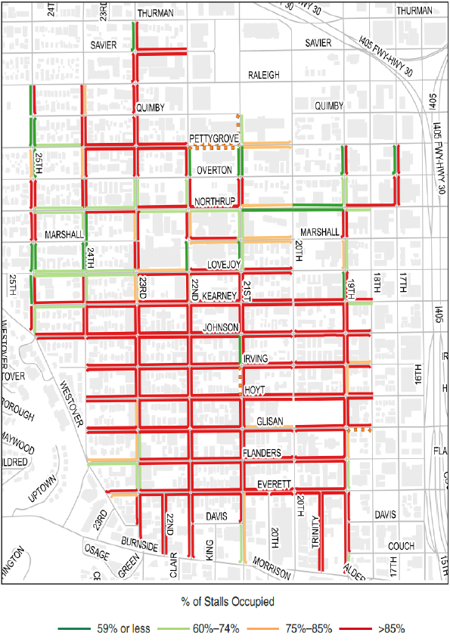
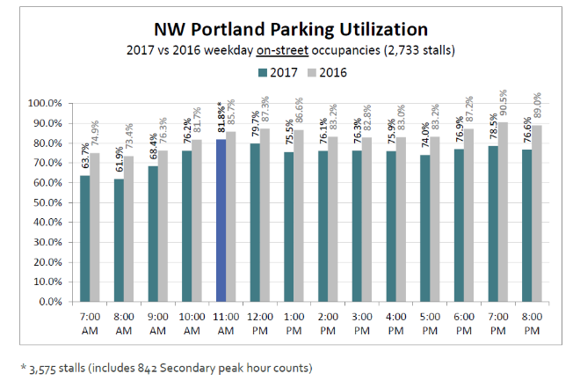
Data driven
decision-making
Notes:
The cornerstone of good parking management is regular data collection and evaluation.
Each year we actively manage parking using industry best practices and annual data collection to ensure the system is operating as efficiently as possible.
A parking study is conducted annually in NW in order to help guide parking management decisions using good data.
Pbot staff work with consultants and share recommendations with the NW SAC for deliberation.

Slide 7
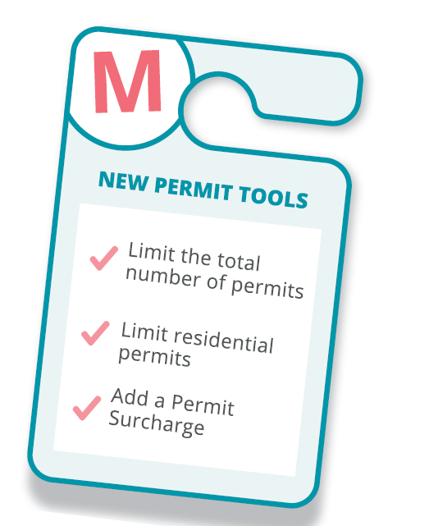
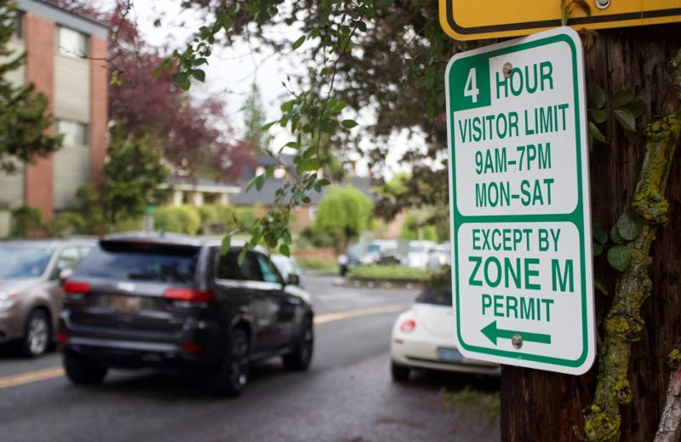
New Tools in NW
Image courtesy of: Portlanders for Parking Reform
Notes:
In 2016, PBOT asked City Council for parking requirements with new development to try and address the parking demand and remedy the situation.
City Council did not approve of that and instead directed PBOT to try new strategies instead.
With the ordinance passed in December 2016, the NW Parking Management Pilot was authorized and new tools such as limiting the number of permits and using price as a mechanism were then able to be used.
In response to having new parking tools available the SAC recommended, and PBOT staff supported, placing a surcharge on Area Parking Permits for permit year 2017-2018.
The SAC recommended adding a surcharge of $120, with waivers for low-income residents, to the cost of a Zone M Parking Permit – raising the total cost to $180 annually. The $120 surcharge on the parking permits funds SAC transportation programs and projects supporting mode shift and efforts to reduce parking demand in the district.

Slide 8
Year 1 Pilot Changes
Employee Permits-- Limit to .80 FTE
Residential Permits
Existing buildings with 30 units or more:
  Eligible to receive permits at 60% of units.
New buildings with 30 units or more that do not have certificate of occupancy by September 1, 2017
  Eligible for permits at 40% per units/addresses for the upcoming permit year and beyond.
Guest Permits
Eliminated annual guest permits.
Major Changes to Permit Program
Limited the number of permits sold based on the occupancy goal (84%) this was previously not allowed.
Added a Permit Surcharge of $120 to the base price of $60 for both residential and business permits.
Notes:
In the first year of the pilot, we changed the permit program by limiting the number of permits based on building size and opening date.
We also limited the number of employee permits and eliminated the annual guest permits.
The Permit surcharge also helped to limit the number of permits sold and revenue raised went toward programs that introduce people to new transportation options such as the Transportation Wallet.

Slide 9
Year 1 Results
Net Reduction of 1,600 permits
700 business permit decrease
Eliminated guest permits- 1,100
200 residential permit increase
Parking Permits sold
Year | 2017 | 2016 | Change | percent Change
Business | 3,386 (Goal 3,200) | 4,054 | -668 | -16%
Guest | 0 | 1,094 | -1,094 | -100 %
Resident | 3,600 (Goal 2,850) | 3,412 | 188 | +6%
Total Allocated | 6,986 | 8,560 | -1,574

Slide 10
Year 1 Results
Average 4.5% reduction in parking occupancy
Peak 82% (2017) 86% (2016)
Notes:
Parking occupancies were lower after implementing meters and the new permit program.

Slide 11
Year 1
Recommendations
Expand meter coverage in NW parking district.
Reduce and redistribute the number of 30 Minute stalls
Convert 1 Hour stalls to 2 Hour
Consider changing enforcement hours to 10 AM – 8 PM (currently 9 AM – 7 PM)
Change wrap-around 2 Hour and 4 Hour Metered to 4 Hours Metered OBP (change based on occupancy analysis)
Notes:
Each year changes are made based on the parking study data and industry best practices, here are some of the recommendations made after the year 1 study.

Slide 12

Transportation Wallet
In the first year we served:
Over 100 employers and 1,000 employees and residents engaged in the program
Notes:
The parking permit surcharge revenue supported the Transportation Wallet, a suite of passes and memberships for people to use active transportation.
In 2018 the Wallet included:
1 Free annual BIKETOWN Membership
1 Free annual Portland Streetcar Pass
$100 on TriMet Hopcard (equivalent to a month pass).
The Transportation Wallet was offered for free to all residents and employees in NW Zone M who gave up their parking permit. It was available to any other Zone M employee or resident for $99.

Slide 13
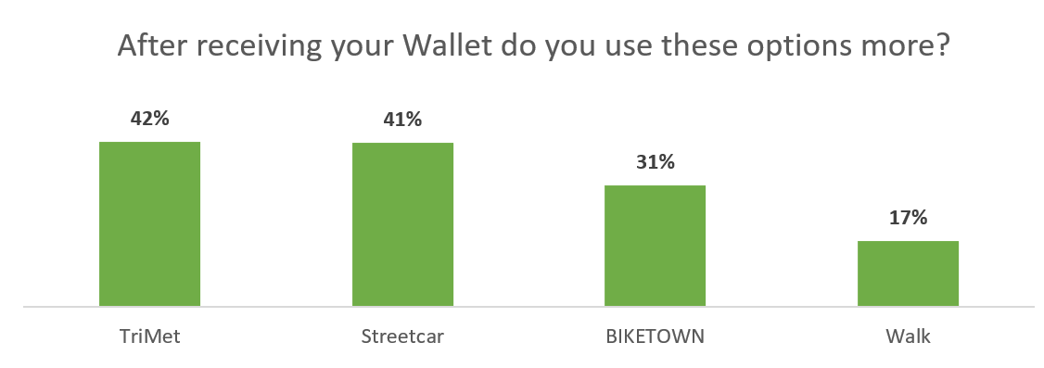
Changing behavior
Notes:
In addition to parking studies, we survey businesses, residents and visitors regularly. From a survey of people with a Transportation wallet, we learned that the wallet was successful in helping people take Transit and BIKETOWN more often.
While encouraging people to drive less helps the city reach our overall transportation and climate goals, it is not yet clear if the Transportation Wallet is helping reduce parking demand. Many people report needing or wanting a car for work, family errands, or to get out of town on the weekends.
There may be an opportunity to do more outreach and encouragement for carsharing services to help those who don’t need a car to further reduce the parking demand in NW.
We are using the survey data to improve the transportation wallet, the next version of the wallet will include more TriMet value and credits with Car2go to help people try car sharing services.

Slide 14
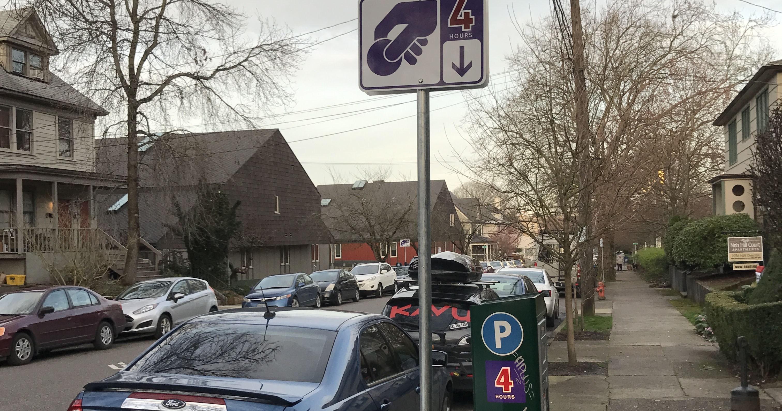
What we learned
Restrict permits based on housing age, not on type of housing (multi-family versus single family).
Cap on permits for older buildings dropped, thought to be unfair
No hard cap on permit allocation
Permit reduction goals do not account for growth in housing or jobs
Notes:
After year one (2017-2018) of the permit pilot, the approach to managing parking and permit demand was modified.
Extensive discussions within the SAC, using data and recommendations from consultants, lessons learned from other cities, and listening to residents and community members, helped inform the recommended changes to further manage parking demand.
The continued high parking occupancy, coupled with interest from the neighborhood and the Parking SAC to encourage new building tenants and owners to use off-street parking, spurred the Parking SAC and PBOT staff to find additional approaches to manage parking demand.

Slide 15
Next Steps
Continue to collect data and survey residents
Change on-street time limits, reduce number of 30 minute stays, etc.
Continue to adjust permit program
Change meter hours of operation to meet demand
Notes:
Parking management requires constant monitoring and in NW we will continue to-
to collect data on parking utilization
and survey residents, businesses and visitors on how to manage parking better using data

Slide 16
Resolution to change hours of operation

Slide 17
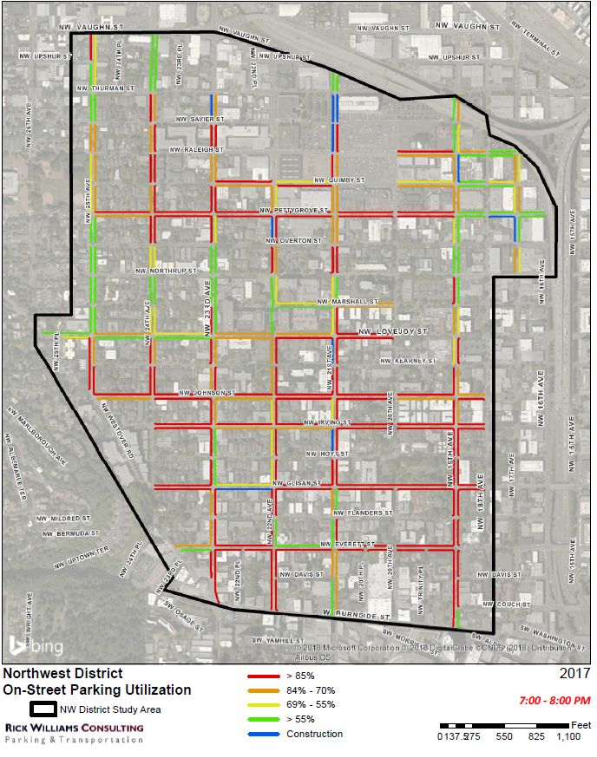
Meter when there is demand
Current hours of operation: 9am-7pm Monday-Saturday
Proposed new hours:
10am-8pm Monday- Saturday
1 hour later
Meter when there is high demand
Notes:
Based on the last two years’ on-street parking studies, consultants recommend changing the hours of enforcement to match the demand.
PBOT Parking Operations staff and the NW Parking SAC both agree that changing the hours of enforcement from 9am-7pm to 10am-8pm, would result in more effective parking demand management.
The occupancy graph on the following page, shows parking stall utilization still ramping up in the early morning hours 9 AM when enforcement is needed less, whereas occupancies remain steady up through 8 PM when enforcement efforts can encourage turnover when the need is greater.
Moving one hour later, on a typical enforcement day would be more productive volume wise as more vehicles are on street later.
Revised enforcement hours are more consistent with the current cross-section (majority) of business hours on major commercial corridors (NW 21st & 23rd).
Most retail establishments open at 10 AM and most restaurants are open until 10 PM or later, which could allow them to get another ‘table turn’ for dinner service.
Revised enforcement hours are also supportive of the city’s Vision Zero policy, allowing visitors who may have had too much to drink, to leave their car on-street with more time the next morning to get their car.

Slide 18

Adopt Resolution
Proposed meter operating hours in NW Parking District:
10am-8pm Monday- Saturday
Notes:
Revised enforcement hours are also supportive of the city’s Vision Zero policy, allowing visitors who may have had too much to drink, to leave their car on-street with more time the next morning to get their car.
Equity- we do not anticipate any impacts to low-income residents or employees since there are employee permits that the business purchases for the employees and a low-income permit price for residents. This change should also help everyone find it easier to find a parking space in a timely fashion.

Slide 19
Permit Surcharge Guidelines

Slide 20
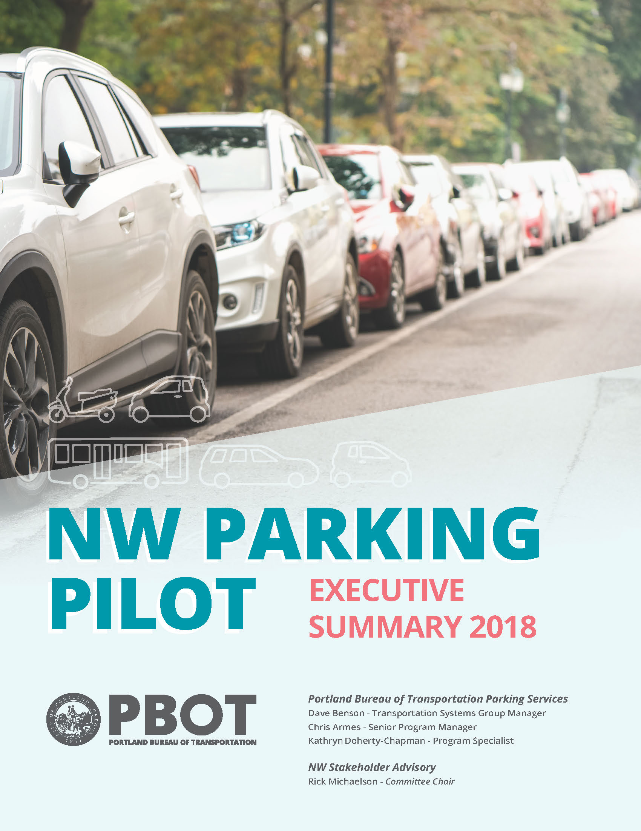
Future Parking Pilots
Notes:
Currently NW and CEID are the only parking districts that are allowed to have a permit surcharge.
In January 2018 Council directed PBOT to initiate two additional parking management pilot areas.
In February PBOT asked for letters of interest from areas that wanted to participate in the pilots. We received 9 letters.
PBOT then collected occupancy data in April and May to evaluate the parking issue in each area
N Mississippi and SE Hawthorne had the highest occupancy so PBOT contacted these areas and held informational open houses in June.
In June and July ballots were sent out to evaluate support for the pilots. Unfortunately the ballots did not come back in support
Since that balloting process staff has met with representative from both Mississippi and Hawthorne for feedback on the process and what changes could be made and how they would like to move forward. The Boise Neighborhood has asked PBOT to undertake a neighborhood-wide parking management plan and the Hawthorne representatives said they would like to wait and not move forward with a pilot at this time. We have now initiated conversations with the community around SE Division Street.
Before we start working with the community on new pilots, guidelines are needed to outline appropriate use of funds if an area elects to add a surcharge to their permit fee.

Slide 21
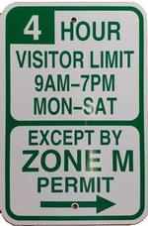
Permit Surcharge
Purpose:
• Manage parking demand using price
• Surcharge funds go back to the community where they are collected for Transportation Demand Management (TDM) programs
Guidelines are necessary to ensure funds are spent appropriately
Notes:
Surcharge is added to the base cost of an area permit with the purpose of
Using price as a tool to manage parking and to fund Transportation Demand Management programs in the district they are collected
The purpose of the guidelines is to provide clarity on appropriate use of funds.
Based on these guidelines funds will be focused on transportation demand management programs and projects
Examples include:
The Transportation Wallet
Free transit passes to low income residents and employees
Carshare memberships
Added bike parking
Curb extensions and rapid flash beacons

Slide 22
Surcharge Guidelines
Examples of projects/programs:
Free transit passes to low income residents and employees
TriMet Universal Pass program
Transit tracker kiosks
Crosswalk improvements
Bike parking
And more depending on that
neighborhood’s needs
Notes:
All programs and projects funded by permit surcharge will be evaluated against the Citywide Equity Goals and Strategies with the goal of alleviating transportation burdens on low income and underserved communities
A Stakeholder Advisory Committee will help develop programs and select projects
Stakeholder Advisory Committee members will be identified with input from the PBOT Equity & Inclusion Manager and the Public Outreach Coordinator
----------------------------------------------------------------- OR -----------------------------------------------------------
Based on Council input from the Parking Management Manual hearing this summer members of the Advisory Committee will follow the same composition as outlined in the Manual.
Business owners, residents and employees who may not live within the district. All members will be identified with input from the PBOT Equity & Inclusion Manager and the Public Outreach Coordinator
We would like to be able to take what we have learned from NW and Central Eastside and apply this in other areas of the city.
It is important for any new parking districts to understand appropriate use of surcharge funds so they can evaluate the benefit to their community before assessing a surcharge. We would like Council to support these guidelines currently being used in the NW District and for any new parking districts that may be formed.
Thank you, we are happy to answer any questions.

Slide 23
Thank you!

Slide 24
If needed

Slide 25
Night-time parking survey
Notes:
In 2015 as a part of the considerations for a rate adjustment, There was a concern that the rate adjustment would place an undue burden on low-income night workers who parked on-street at night.
PBOT staff conducted an intercept survey of people parking on-street downtown over the course of several days in different parts of Downtown.
We found from the survey that only 25% of the people parking on –street were there to work. Of that 25 % less then 1/3 of that 25% was there to work in a service industry like cleaning or restaurant work.
This led us to develop the low-income evening parking rate for Smart Park garages
We manage on-street parking primarily for visitors and not for employee parking

Slide 26
Night workers

Slide 27
Low-income permit
Notes:
The low income permit price is $75 per year, or $6.25 a month. A TriMet annual pass is $100 a month.

Slide 28
NW Permit Revenue
$720,000 in 2017-2018
Estimated $600,000 in 2018-2019

Slide 29
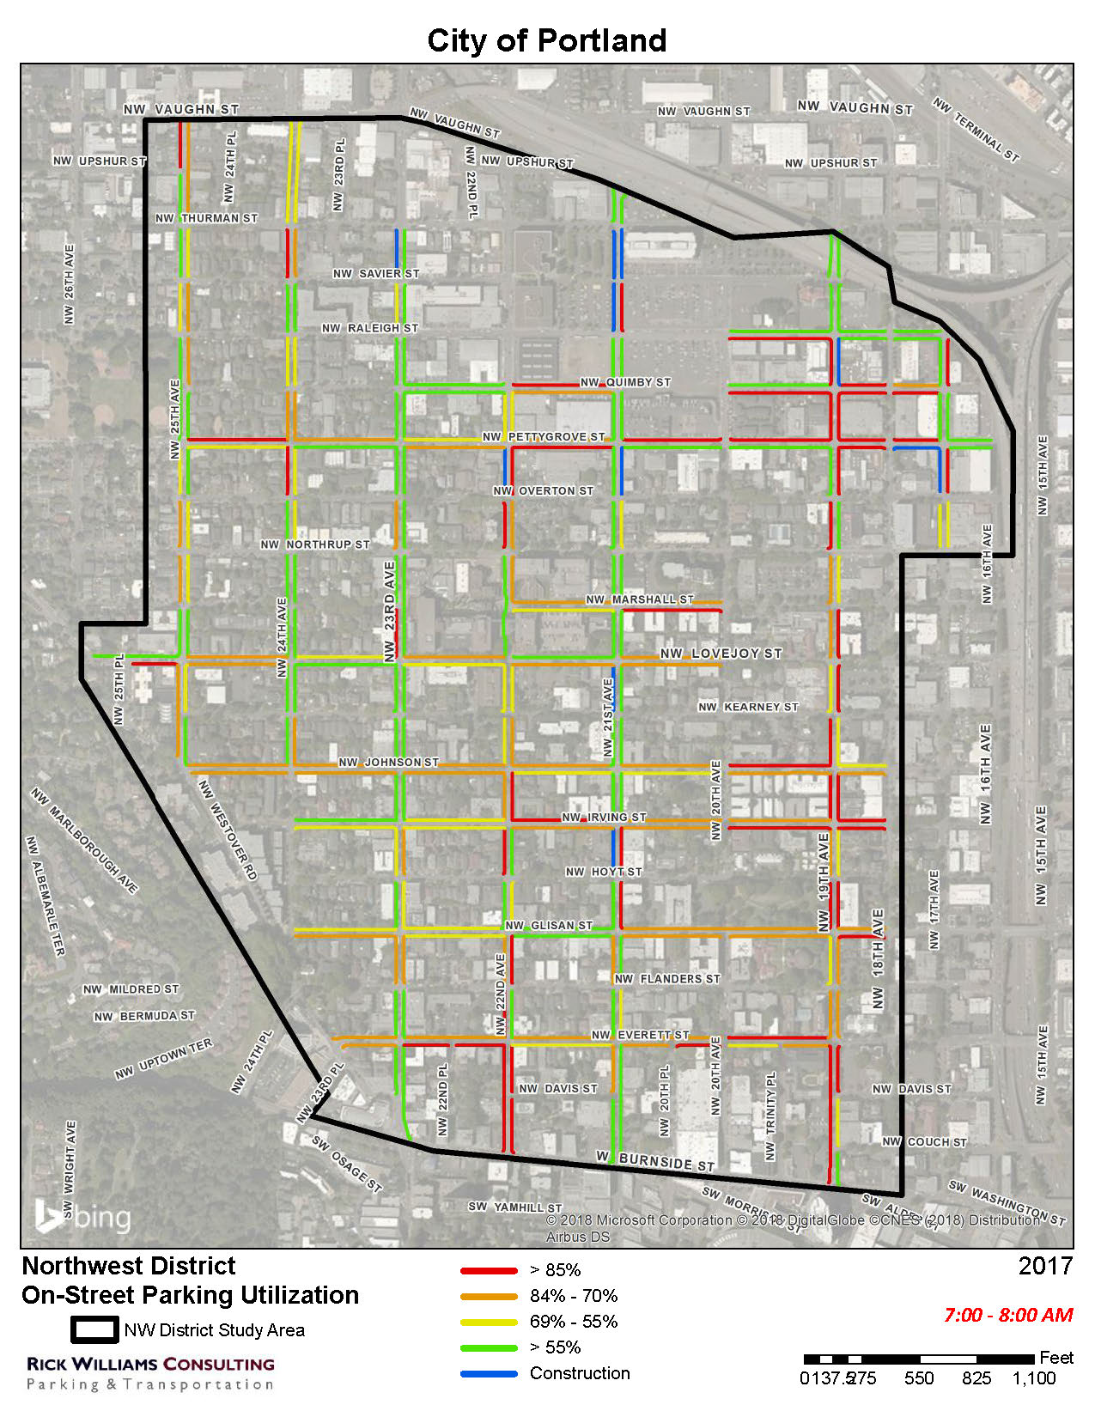
Occupancy
7-8 am

Slide 30
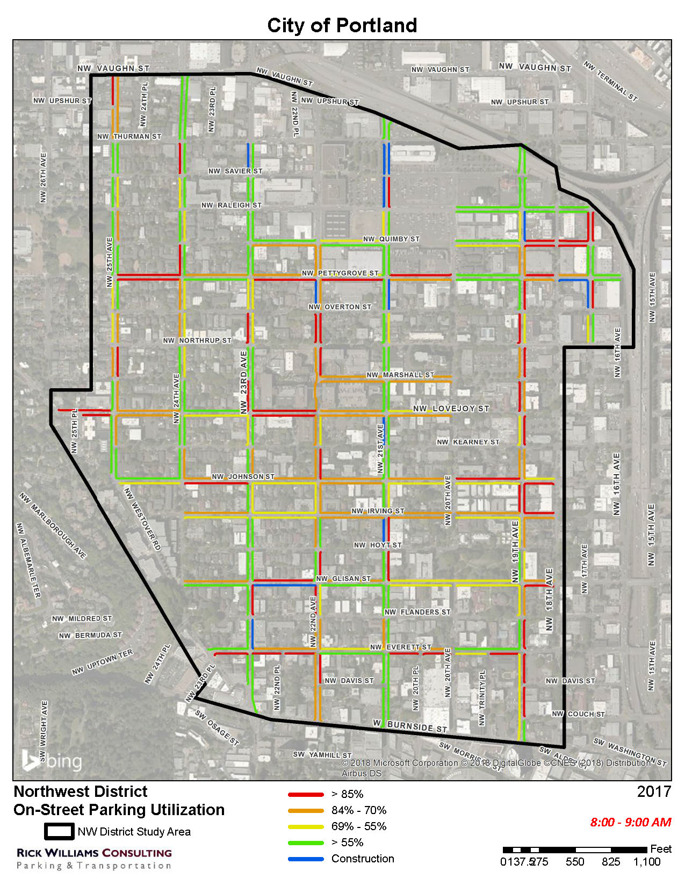
Occupancy
8-9 am

Slide 31
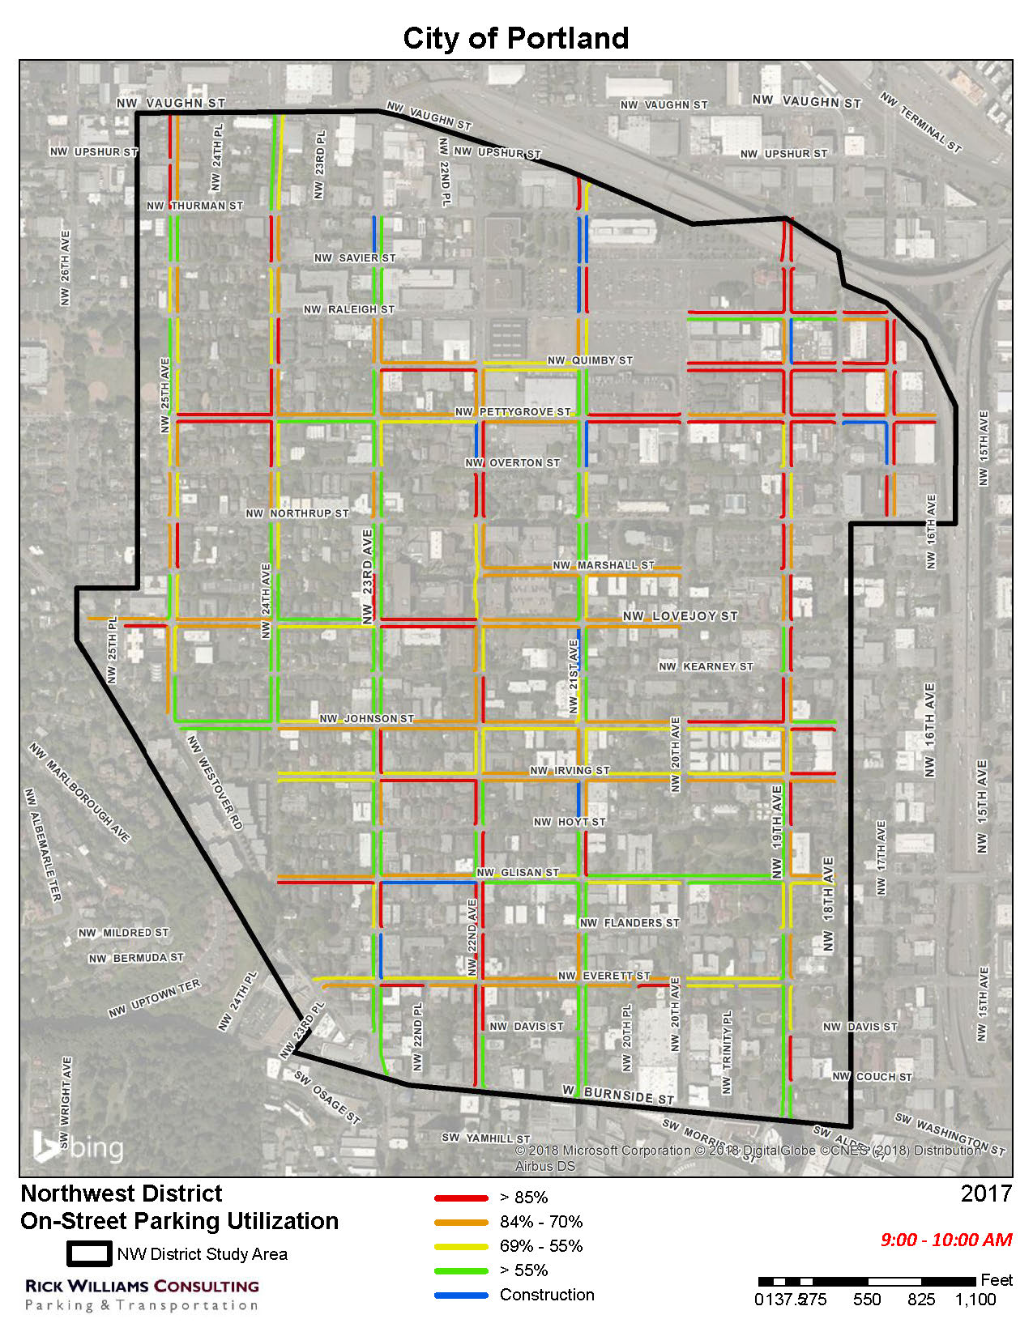
Occupancy
9-10 am

Slide 32
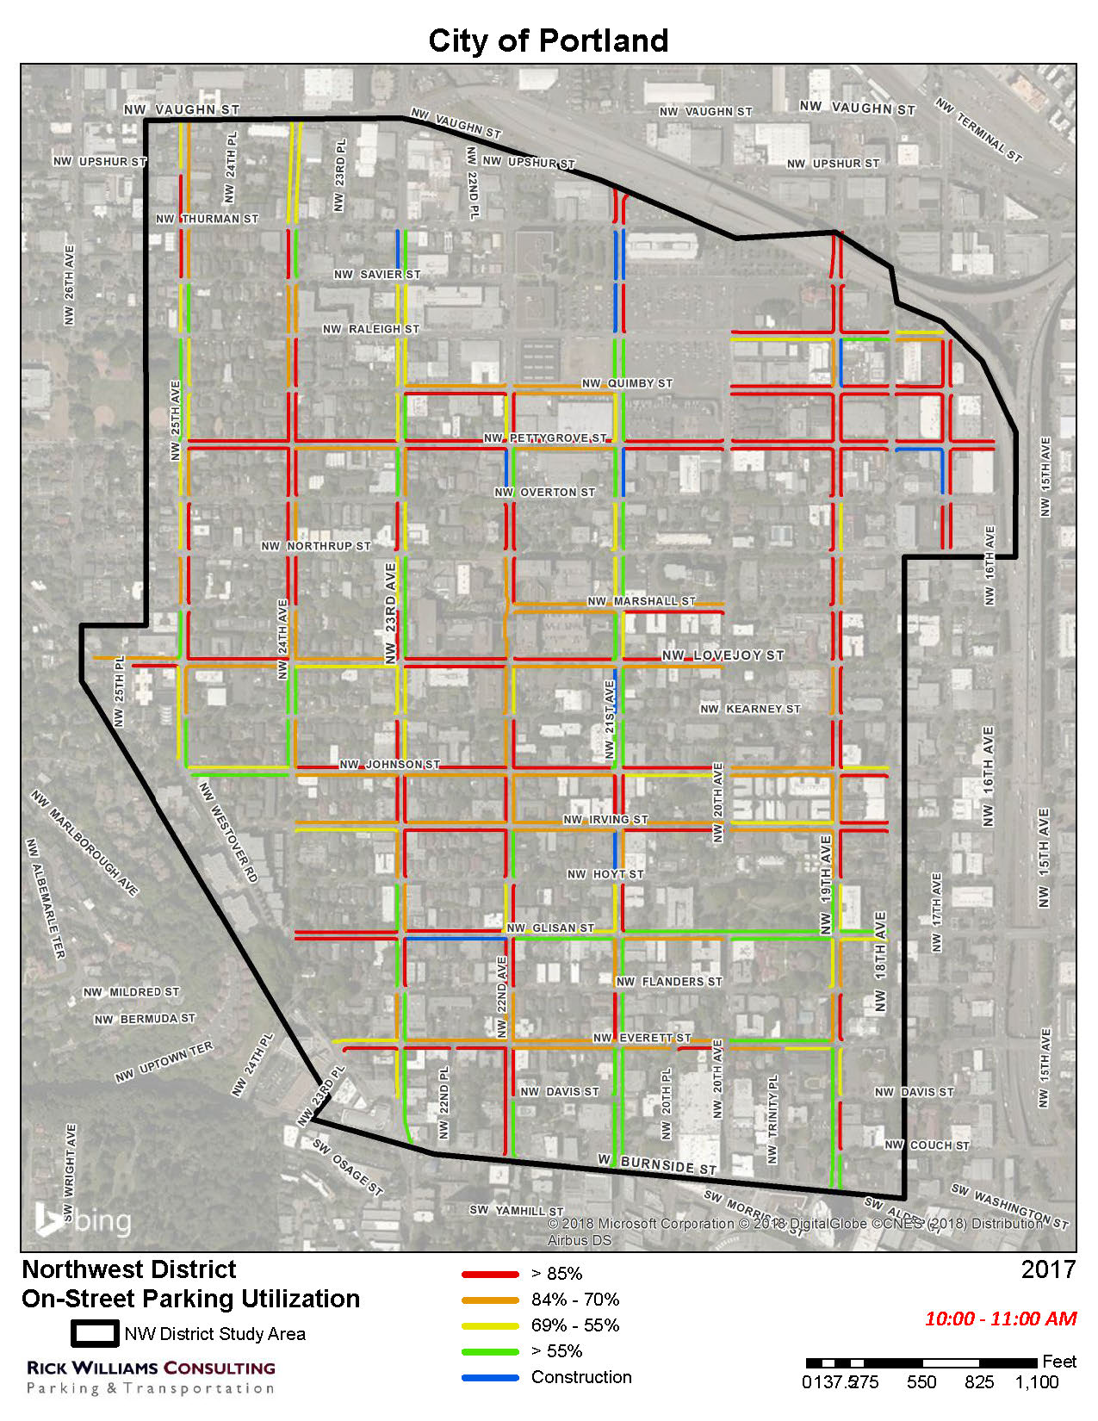
Occupancy
10-11 am

Slide 33
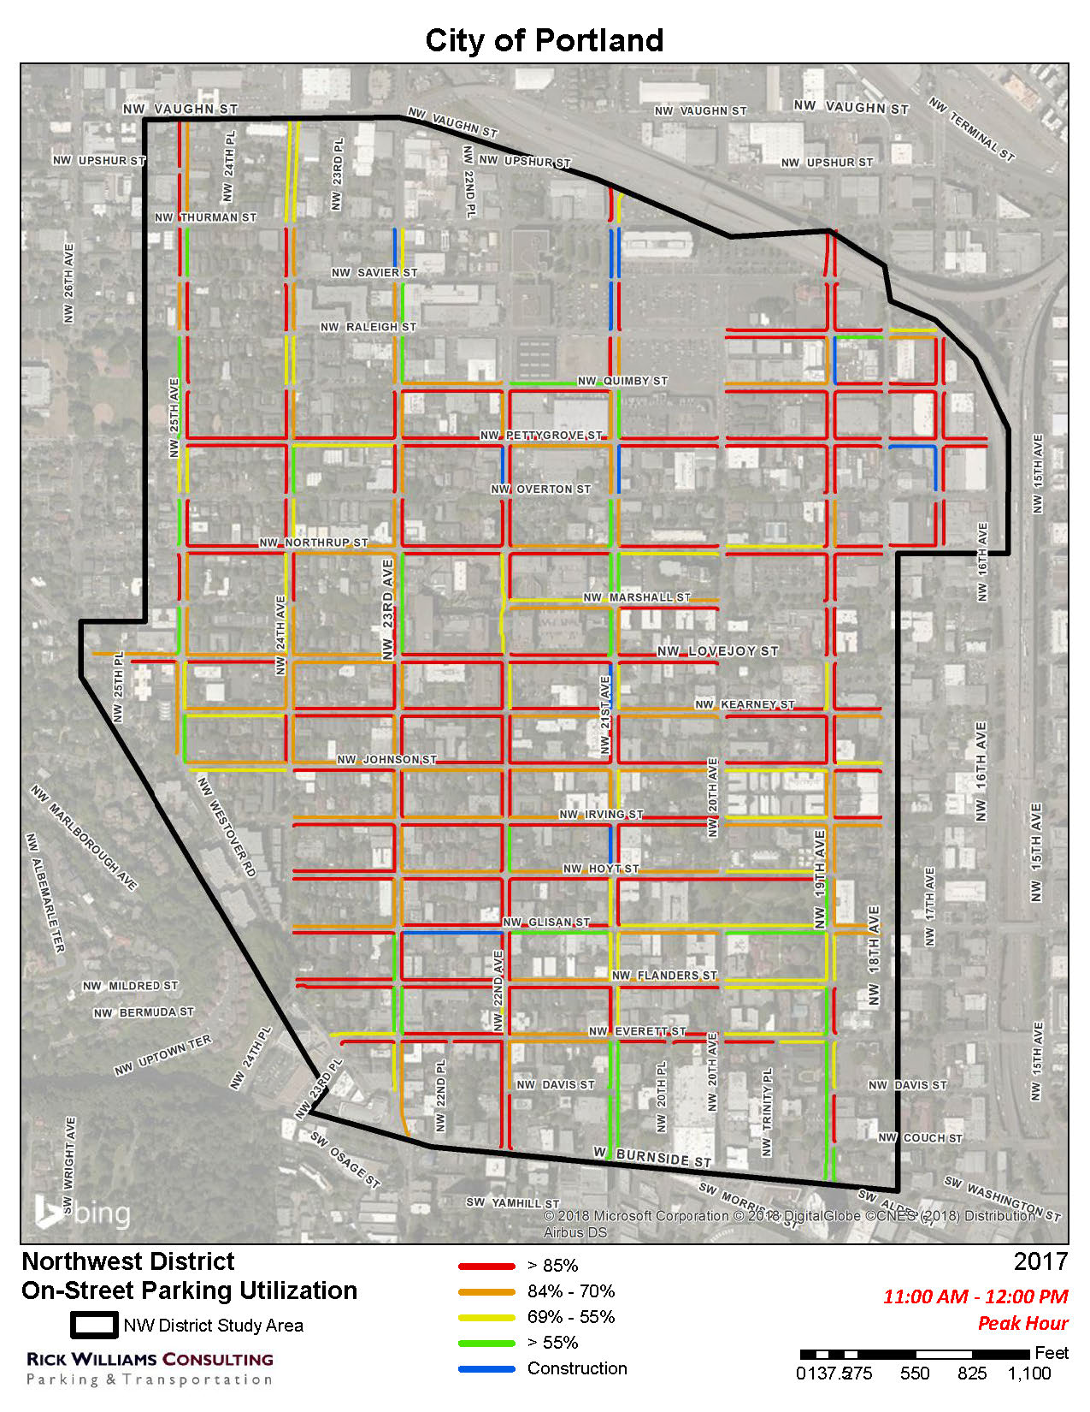
Occupancy
11-12 am

Slide 34
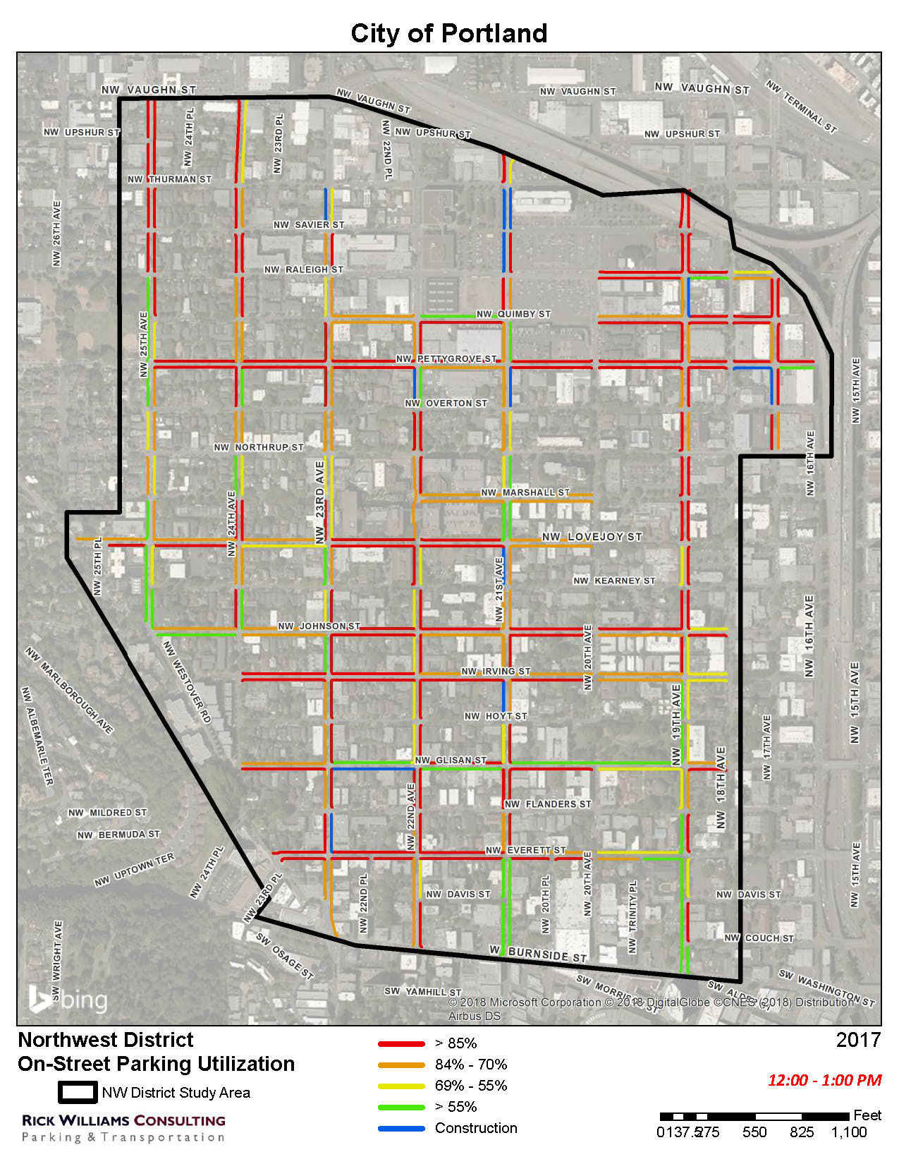
Occupancy
12-1 pm

Slide 35
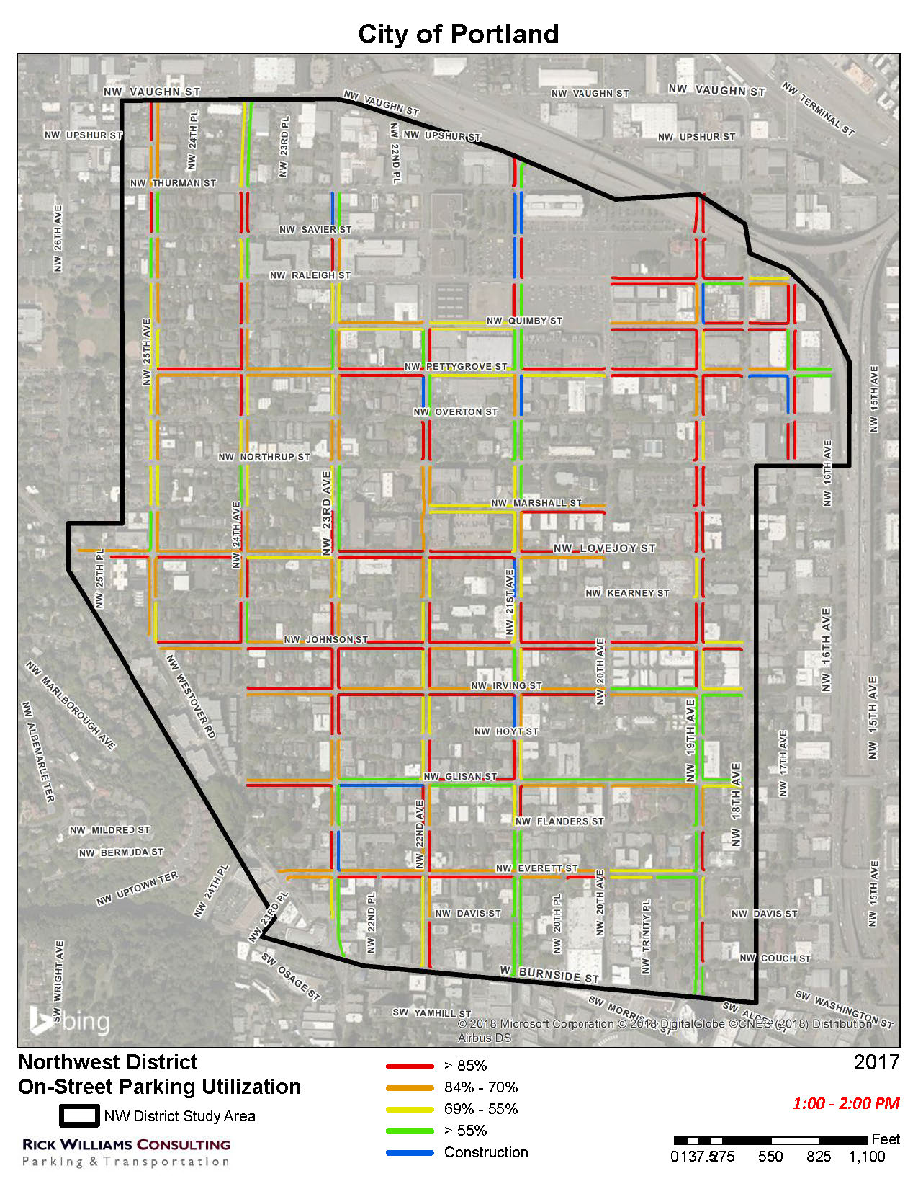
Occupancy
1-2 pm

Slide 36
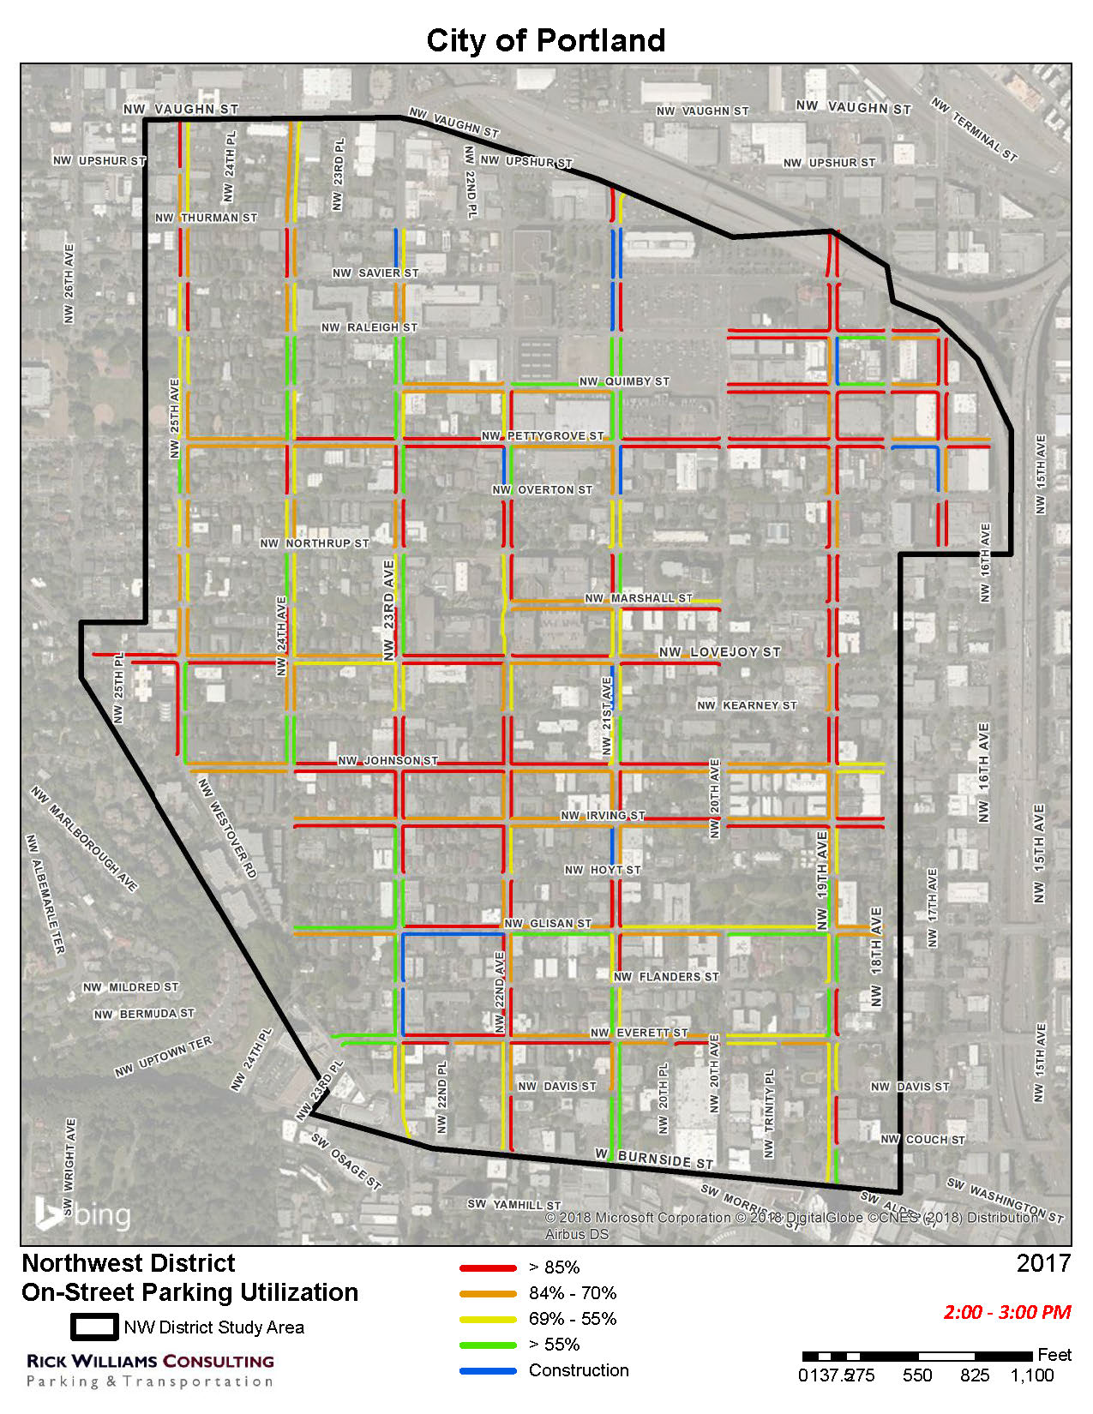
Occupancy
2-3 pm

Slide 37
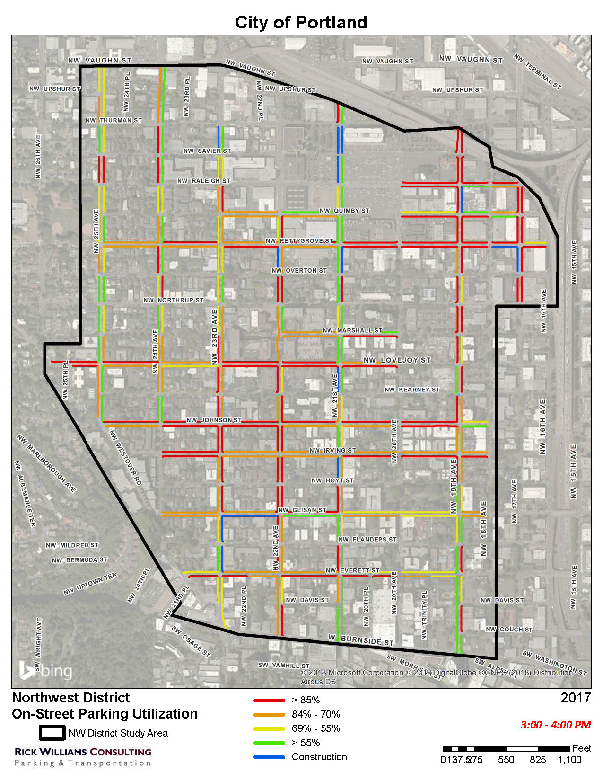
Occupancy
3-4 pm

Slide 38
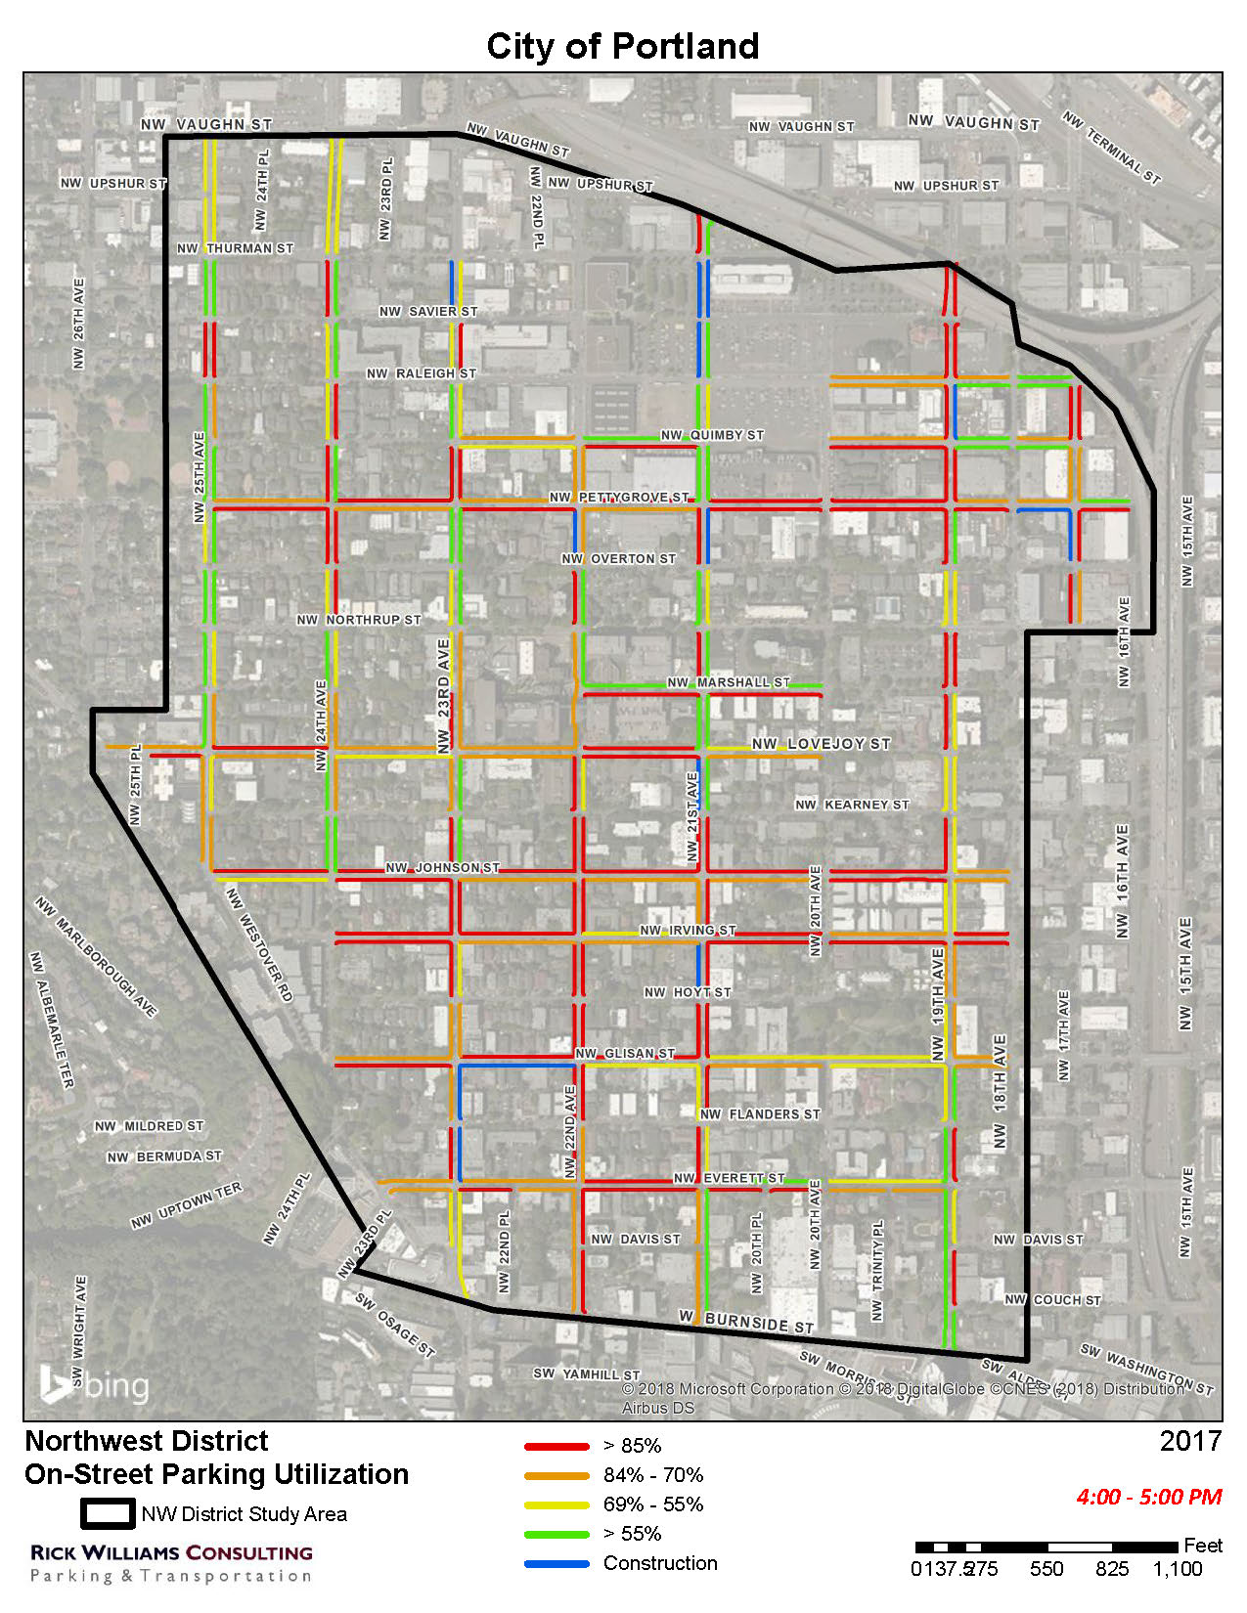
Occupancy
4-5 pm

Slide 39
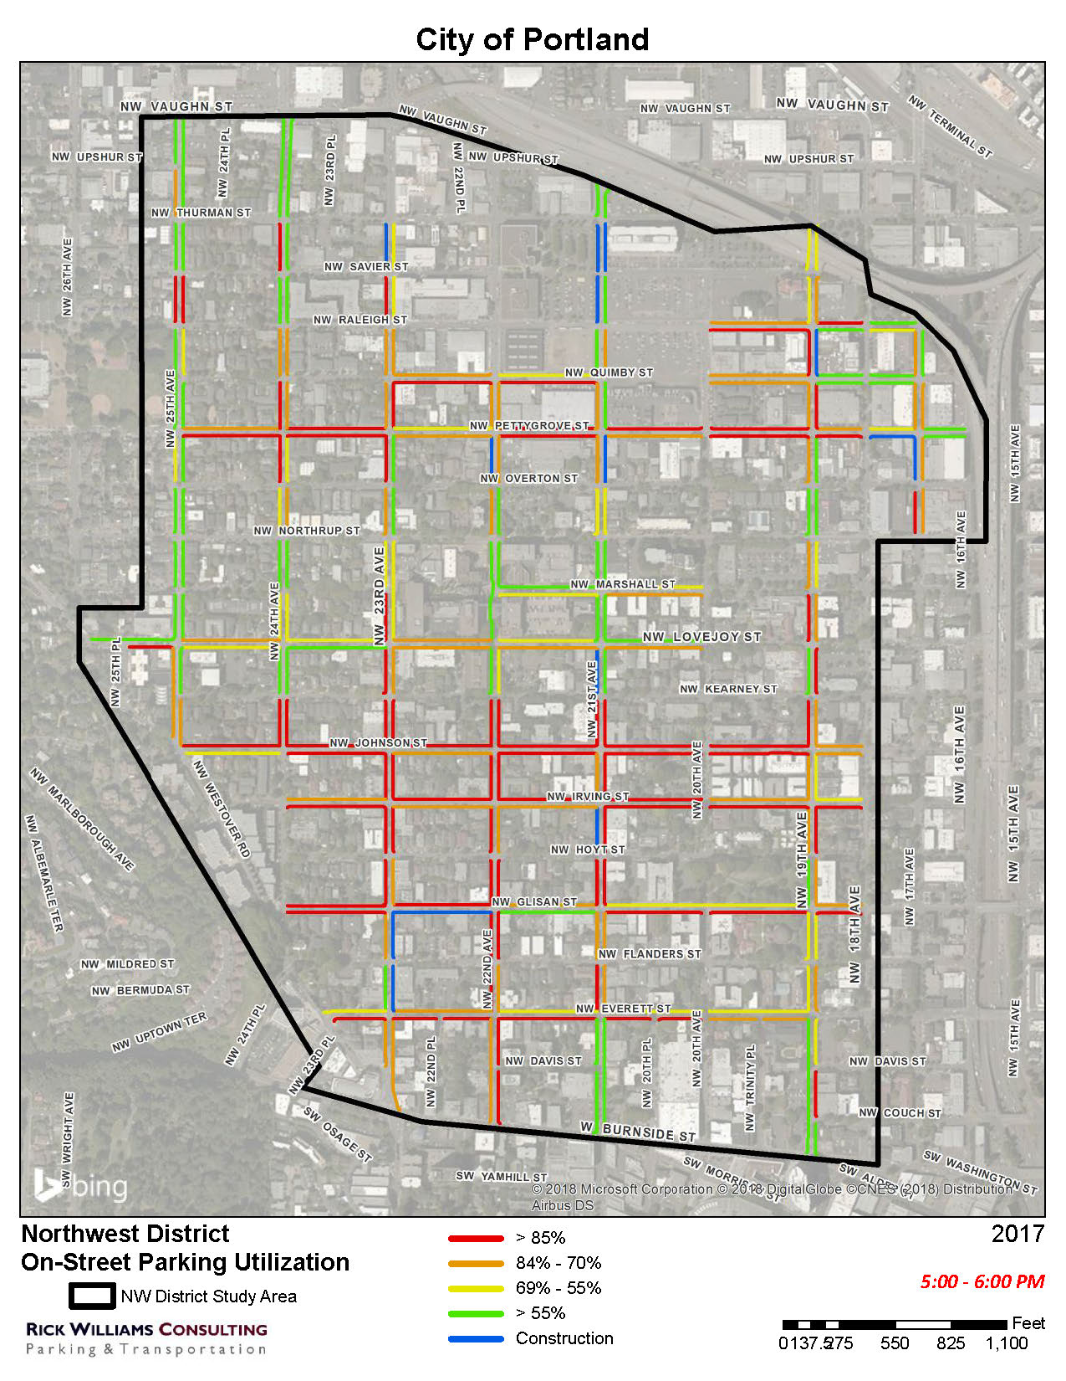
Occupancy
5-6 pm

Slide 40
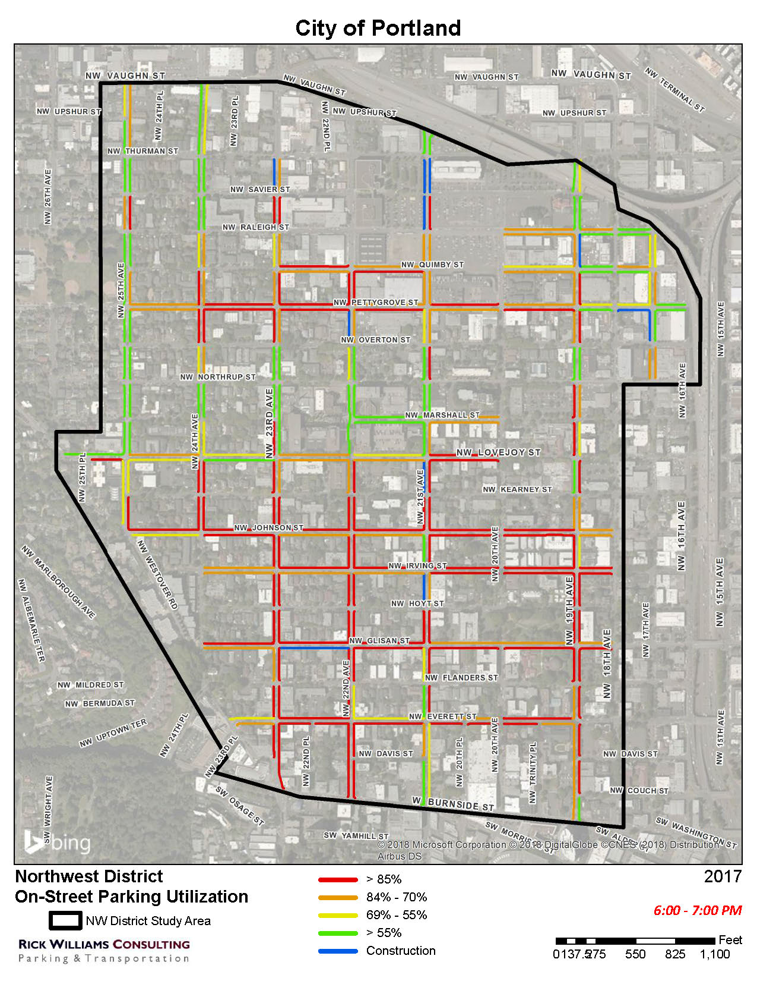
Occupancy
6-7 pm

Slide 41
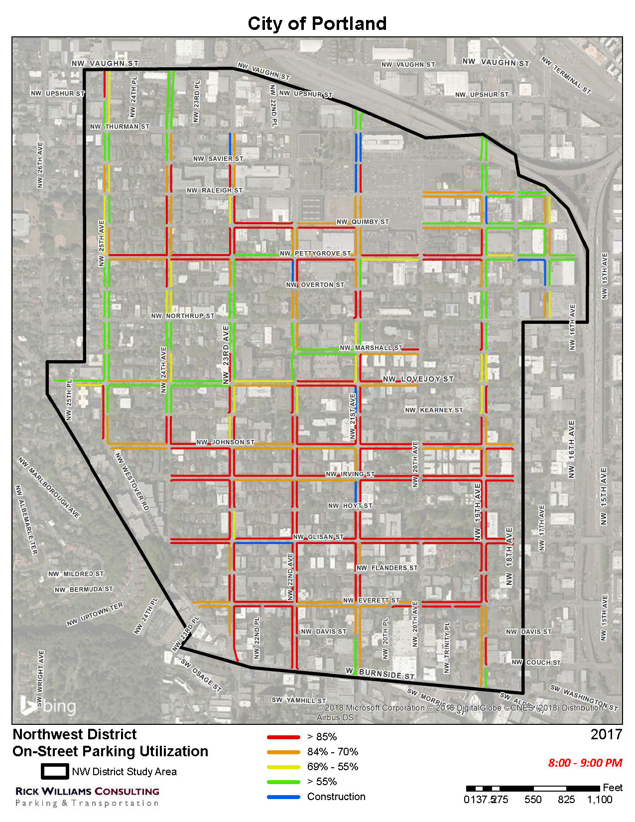
Occupancy
7-8 pm

