Slide 1
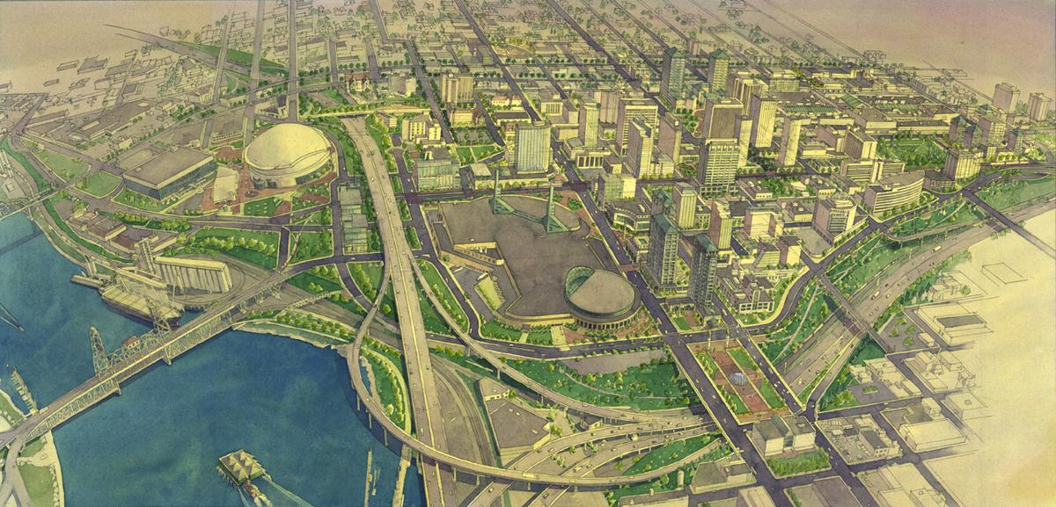
Lloyd Enhanced Services District
Partnering in Lloyd’s Evolution
2014 – 2024

Slide 2
Lloyd ESD Board of Directors
Hank Ashforth The Ashforth Company
Scott Bolton PacifiCorp
Peter Cogswell Bonneville Power Admin.
Scott Cruickshank Oregon Convention Center
Bob Dye Lloyd Center
Ann Grimmer Lloyd Community Association
Lisa Klein Colliers International
Wade Lange American Assets Trust
Chris Oxley Portland Trail Blazers
David Slawson East West College
John Sullivan Kaiser Permanente
Notes:
SLIDE: HANK

Slide 3
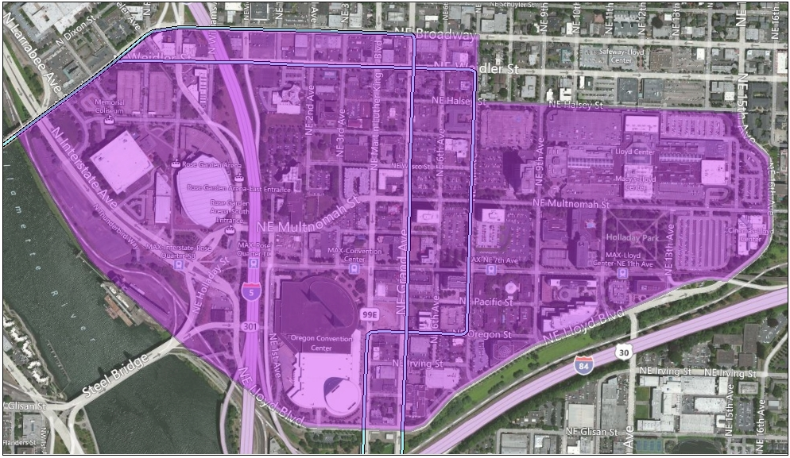
Lloyd ESD Boundary
Willamette River, NE Lloyd Blvd, NE 16th/15th Ave, Halsey (at 7th), Martin Luther King, Jr. Blvd, NE Broadway to the Willamette River
Notes:
SLIDE: HANK

Slide 4
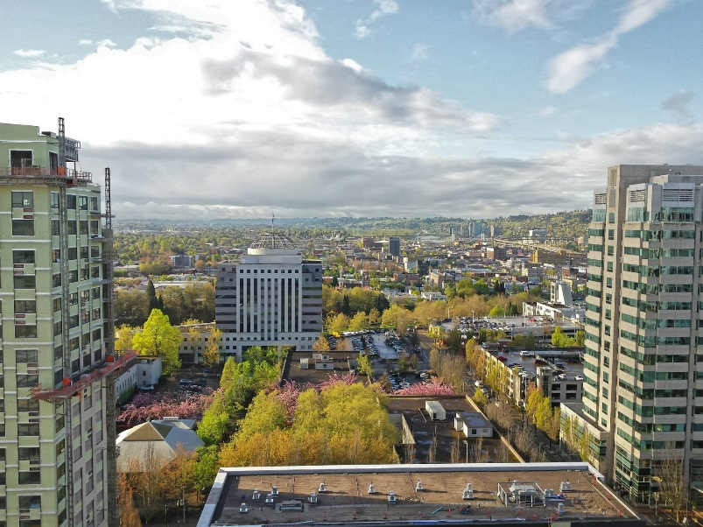
Lloyd ESD Overview
Started in 2001
125 affected properties
99% assessment compliance
Generates $475,000 annually
$5.5 Million reinvested in the neighborhood
Public sector partners
Metro
Oregon Convention Center
TriMet
City of Portland
Bonneville Power Administration
Notes:
SLIDE: HANK
$5.5 million in ESD revenues reinvested in Lloyd over 18 years of operation
Around $1 Million in private investment in Holladay Park – programming (events, activities, music, games)
Economic Development Initiatives
4,000 + new jobs
2,500 new housing units
8:1 jobs housing ratio (currently 20:1)
500,000 SF additional built space w/ no net energy increase

Slide 5
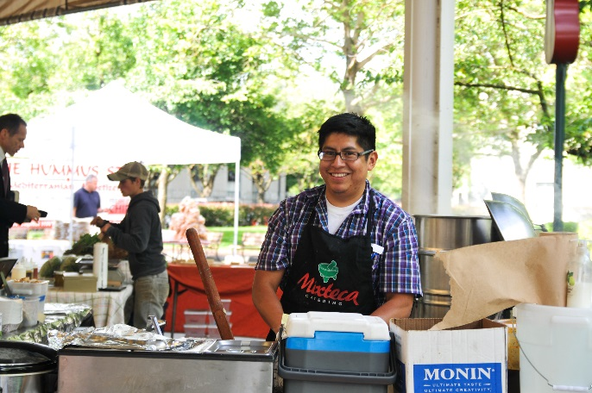
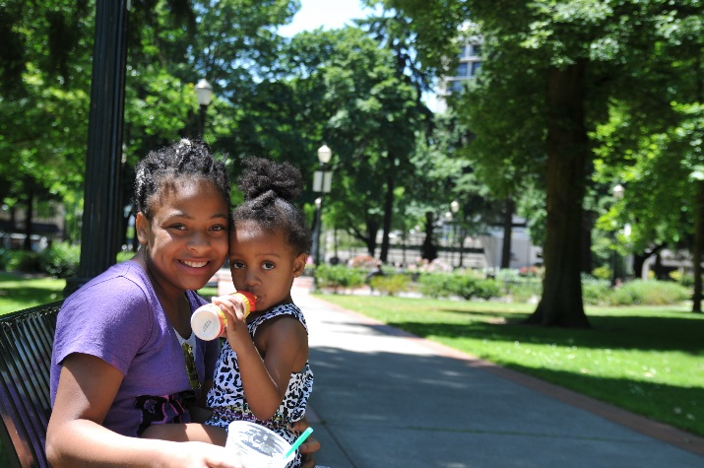
Lloyd ESD Overview
Long track record of successful public/private partnerships
2018 Spirit of Portland Award
The Lloyd ESD builds community and political support for innovative, catalytic Lloyd initiatives by:
Engaging and building diverse neighborhood partnerships
Facilitating investment in Lloyd
Being a champion for Lloyd
Notes:
SLIDE: HANK
Public/private partnerships:
Lloyd public safety – neighborhood policing program dates back to 1990 (Lloyd, MCDA, PPB)
Go Lloyd (Lloyd, City, TriMet)
Holladay Park Partnership (Lloyd, Parks Bureau)
Right 2 Dream Too (Lloyd, City, EcoDistrict)
Honored to receive Spirit of Portland Award (Mayor Wheeler & Commissioner Fritz Award) for the neighborhood’s work with Right 2 Dream Too

Slide 6
Lloyd ESD Services Funding
Lloyd ESD
Special Projects Economic Development Advocacy
Go Lloyd
Mult. Co. District Attorney/ Portland Police Bureau
Lloyd Community Association
Lloyd EcoDistrict
Holladay Street Maintenance
Holladay Park Programming
Notes:
SLIDE: HANK

Slide 7
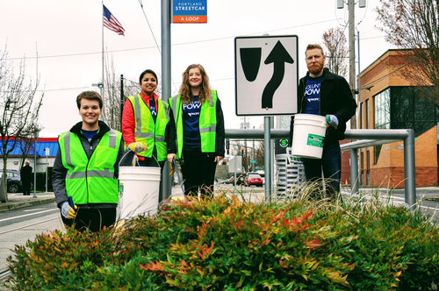
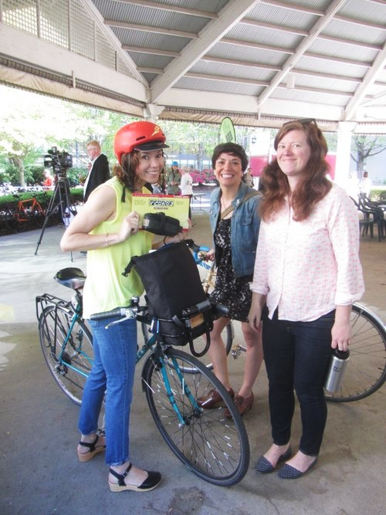
Lloyd ESD Programs
The Lloyd ESD funds programs and services that enhance the economic vitality and livability of Lloyd:
Go Lloyd – transportation management
Focused Promotions – neighborhood marketing resources/campaign
Holladay Street landscape maintenance
Lloyd EcoDistrict – district-based sustainability
Lloyd Community Association – community building and engagement
Neighborhood District Attorney – public safety
Notes:
SLIDE: HANK
Focused Promotions – focus groups with residents and business owners suggested dropping district from name
Lloyd District Community Associated, in cooperation with Northeast Coalition of Neighborhoods, rebranded itself as Lloyd Community Association

Slide 8
Value of Lloyd ESD
Assessments = $475,000 annually
District Prosecutor
Go Lloyd
Lloyd EcoDistrict
Leverages = $605,000 annually ($1.27 match for every $1.00 ESD)
Go Lloyd ($150K annual match to LESD contribution)
Go Lloyd/City ($275K annual transportation projects)
County ($100K of D.A. program services)
City/Police Bureau ($80K match to D.A. program)
Lloyd employer savings on Go Lloyd Universal Pass = $3.9 million annually
Lloyd Community Association
Holladay Street Landscaping
Branding – Focused Promotions
Notes:
SLIDE: HANK

Slide 9
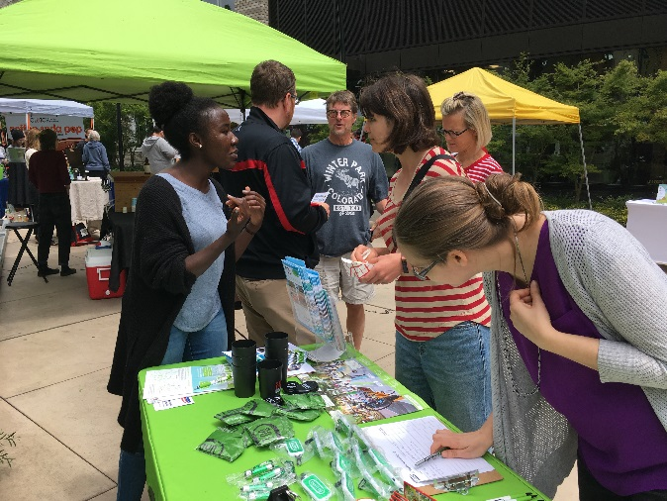
Program Highlights
Go Lloyd
Connects people and places by creating partnerships and transportation solutions to make Lloyd extraordinary.
Improved access for employees, customers, visitors, and residents
Transportation Store and resource center
Programs for transit, bike, walk and employee assistance – 50+ events per year
$275K annually in transportation projects
$395 annual Universal Transit Pass price vs. $1,200
Notes:
SLIDE: WADE

Slide 10
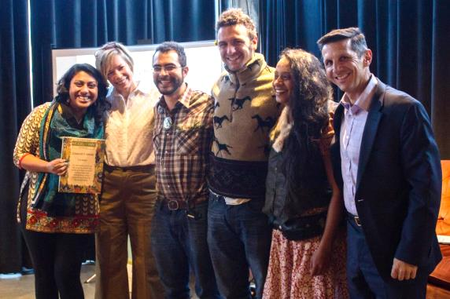
Program Highlights
Lloyd EcoDistrict
Facilitates collaboration between its businesses, residents and public agencies to support prosperity, environmental quality, and social welfare.
Direct assistance on sustainable business practices
Developed comprehensive baseline measurements for solid waste, energy and water consumption
Installed pollinator planters in the nation’s first Pollinator Bikeway Corridor
Worked with Right2DreamToo on sleeping pod build-out
Notes:
SLIDE: WADE
Energy Star – (neighborhood) collective participation in energy conservation

Slide 11
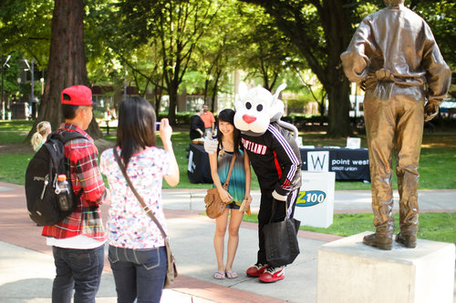
Program Highlights
Lloyd Community Association
Is committed to growing economic prosperity and livability by bringing together businesses and residents to make the Lloyd neighborhood a vibrant community to live, work, or visit.
Enhance sense of community by promoting shared sense of responsibility and open communication
Organize and improve crime prevention efforts through coordination with business and residents
Open process for all members to involve themselves in affairs/issues affecting the neighborhood
Notes:
SLIDE: WADE
Conduct regular outreach and neighborhood engagement through Resident’s Committee

Slide 12
Program Highlights
Focused Promotions – Lloyd Brand & Visibility
Lloyd brand toolkit for all Lloyd businesses/organizations: www.lloydpdx.org
Mission
Logo/photo gallery
Style guidelines
Letter to Lloyd businesses introducing brand concept, included window clings for storefronts
Streetlight banners showcase Lloyd
Leverage ongoing neighborhood development for positive earned media
Notes:
Campbell DeLong Resources looked at data on residents, businesses, and employees on what makes Lloyd special
Watson Creative (Lloyd-based design firm) created a visual and narrative brand for Lloyd

Slide 13
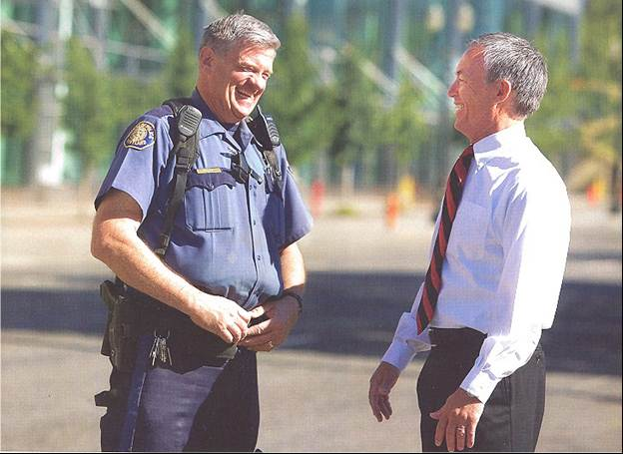
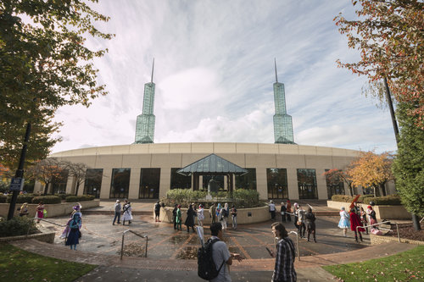
Program Highlights
Neighborhood District Attorney
Long-time partnership between Lloyd community, Multnomah County DA, and Portland Police Bureau – a national model for community policing.
Lloyd Public Safety Committee – neighborhood coordination, cooperation, and proactive approach to public safety
Monthly meetings w/ Multnomah Co. DA, Police Bureau, TriMet Transit Police, Lloyd Center, private security providers, property managers, & tenants
Quick response to issues and problems (crimes, property damage, graffiti)
Notes:
SLIDE: WADE

Slide 14
Offense Count By Neighborhood
Lloyd | Inner SE to SE 12th & Hawthorne | Outer NW | Pearl District | Old Town | Downtown Ent. District & N. Waterfront
160 | 180 | 157 | 94 | 170 | 175 | 2016
209 | 205 | 213 | 123 | 220 | 180 | 2017
171 (228) | 157 (209) | 200 (267) | 136 (181) | 175 (233) | 78 (104) | Jan – Sept ’18 (‘18 forecast)
*includes aggravated assault, bike theft, forcible sex offense, homicide, motor vehicle theft
Notes:
SLIDE: WADE
Need more officers; officers trained in neighborhood policing
2016-2017 YOY – increases across the board: 31% (Lloyd), 14% (Inner SE), 36% (Outer NW), 31% (Pearl), 29% (Old Town), 3% (Downtown) 2017-2018 YOY – forecast increases across the board (except for Downtown) - Forecast: 9% (Lloyd), 2% (Inner SE), 25% (Outer NW), 250% (Pearl), 6% (Old Town), -42% (Downtown)

Slide 15
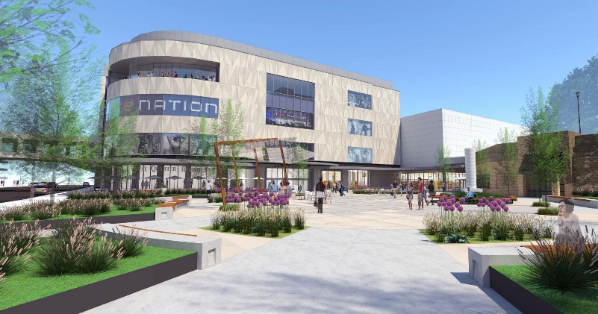
Member Perspective
Future Lloyd Center Projects
Lloyd Local
Live Nation venue
NE Multnomah / 9th Avenue plaza remodel
Regal Cinemas build out / relocation
Challenges Facing Lloyd
Perception of safety consequences
Portland Resident/Police ratio
Notes:
SLIDE: BOB
Lloyd Local initiative to bring in local tenants in Lloyd Center
Police-to-population ratios from similar sized cities around the country
How many officers Portland should have comparatively
HPP – partnership between Lloyd Center, neighborhood stakeholders, & Parks Bureau

Slide 16
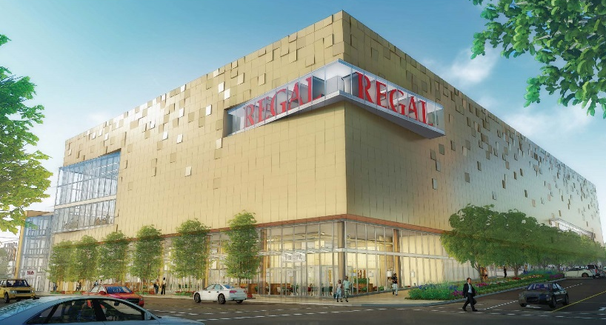
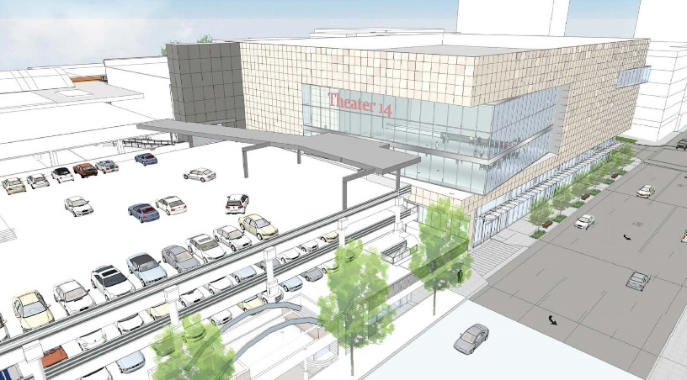
Member Perspective
Challenges Facing Lloyd
Organized retail shoplifting
Cooperative Solutions
Community policing
Neighborhood District Attorney program
Coordination with NAACP on education efforts
Portland Police Bureau support
Notes:
SLIDE: BOB
Police-to-population ratios from similar sized cities around the country
How many officers Portland should have comparatively
HPP – partnership between Lloyd Center, neighborhood stakeholders, & Parks Bureau

Slide 17
ESD Mgt. Services Agmt. Renewal
Efficient – significant accomplishments across multiple programs with a modest budget
Effective – provide needed services to local stakeholders and build value in the Lloyd neighborhood
Innovative – fostering a unique approach to economic vitality through sustainable business practices and environmental stewardship
Responsive – proactive efforts in the areas of transportation, public safety, sustainability, building community
Engaged – Lloyd is an active participant in the broader Portland community and recognizes its responsibility to collectively develop solutions that benefit the whole city
Notes:
SLIDE: HANK

