Slide 1
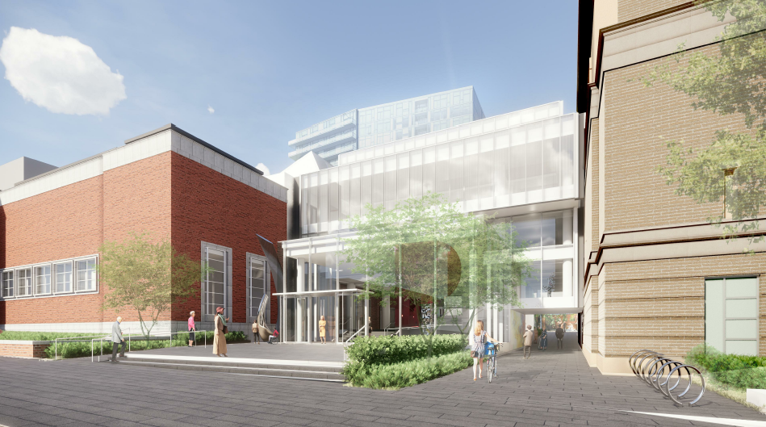
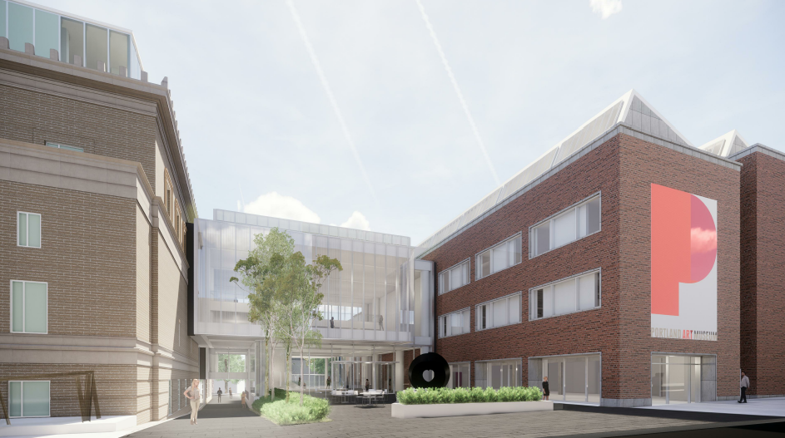
City of Portland
Historic Landmarks Commission
3rd Design Advice Request
EA 18-124279 DA
Rothko Pavilion
January 14, 2019
Staff Presentation

Slide 2
Staff Introduction
Applicant Presentation
Staff Discussion Topics
Public Comments
Commission Conversation

Slide 3
Location:
Central City Plan District
West End Subdistrict
Base Zone:
RXd, Central Residential, Historic Resource Protection overlay,
Design overlay
Approval Criteria:
Central City Fundamental Design Guidelines
33.846.060.G Other approval criteria
33.846.070 (Modifications)
33.805.040 (Adjustments)
Height:
100’ max on E ½, 150’ max on W 1/2
Eligible for Open Space performance bonus
63’ proposed
Floor Area Ratio:
8:1 base, 3:1 bonus with bonus or transfer
2.54:1 proposed
Site Challenges:
Landmarks
Streetcar, Access Restricts Streets
Pedestrian Accessway Requirement
Zoning

Slide 4
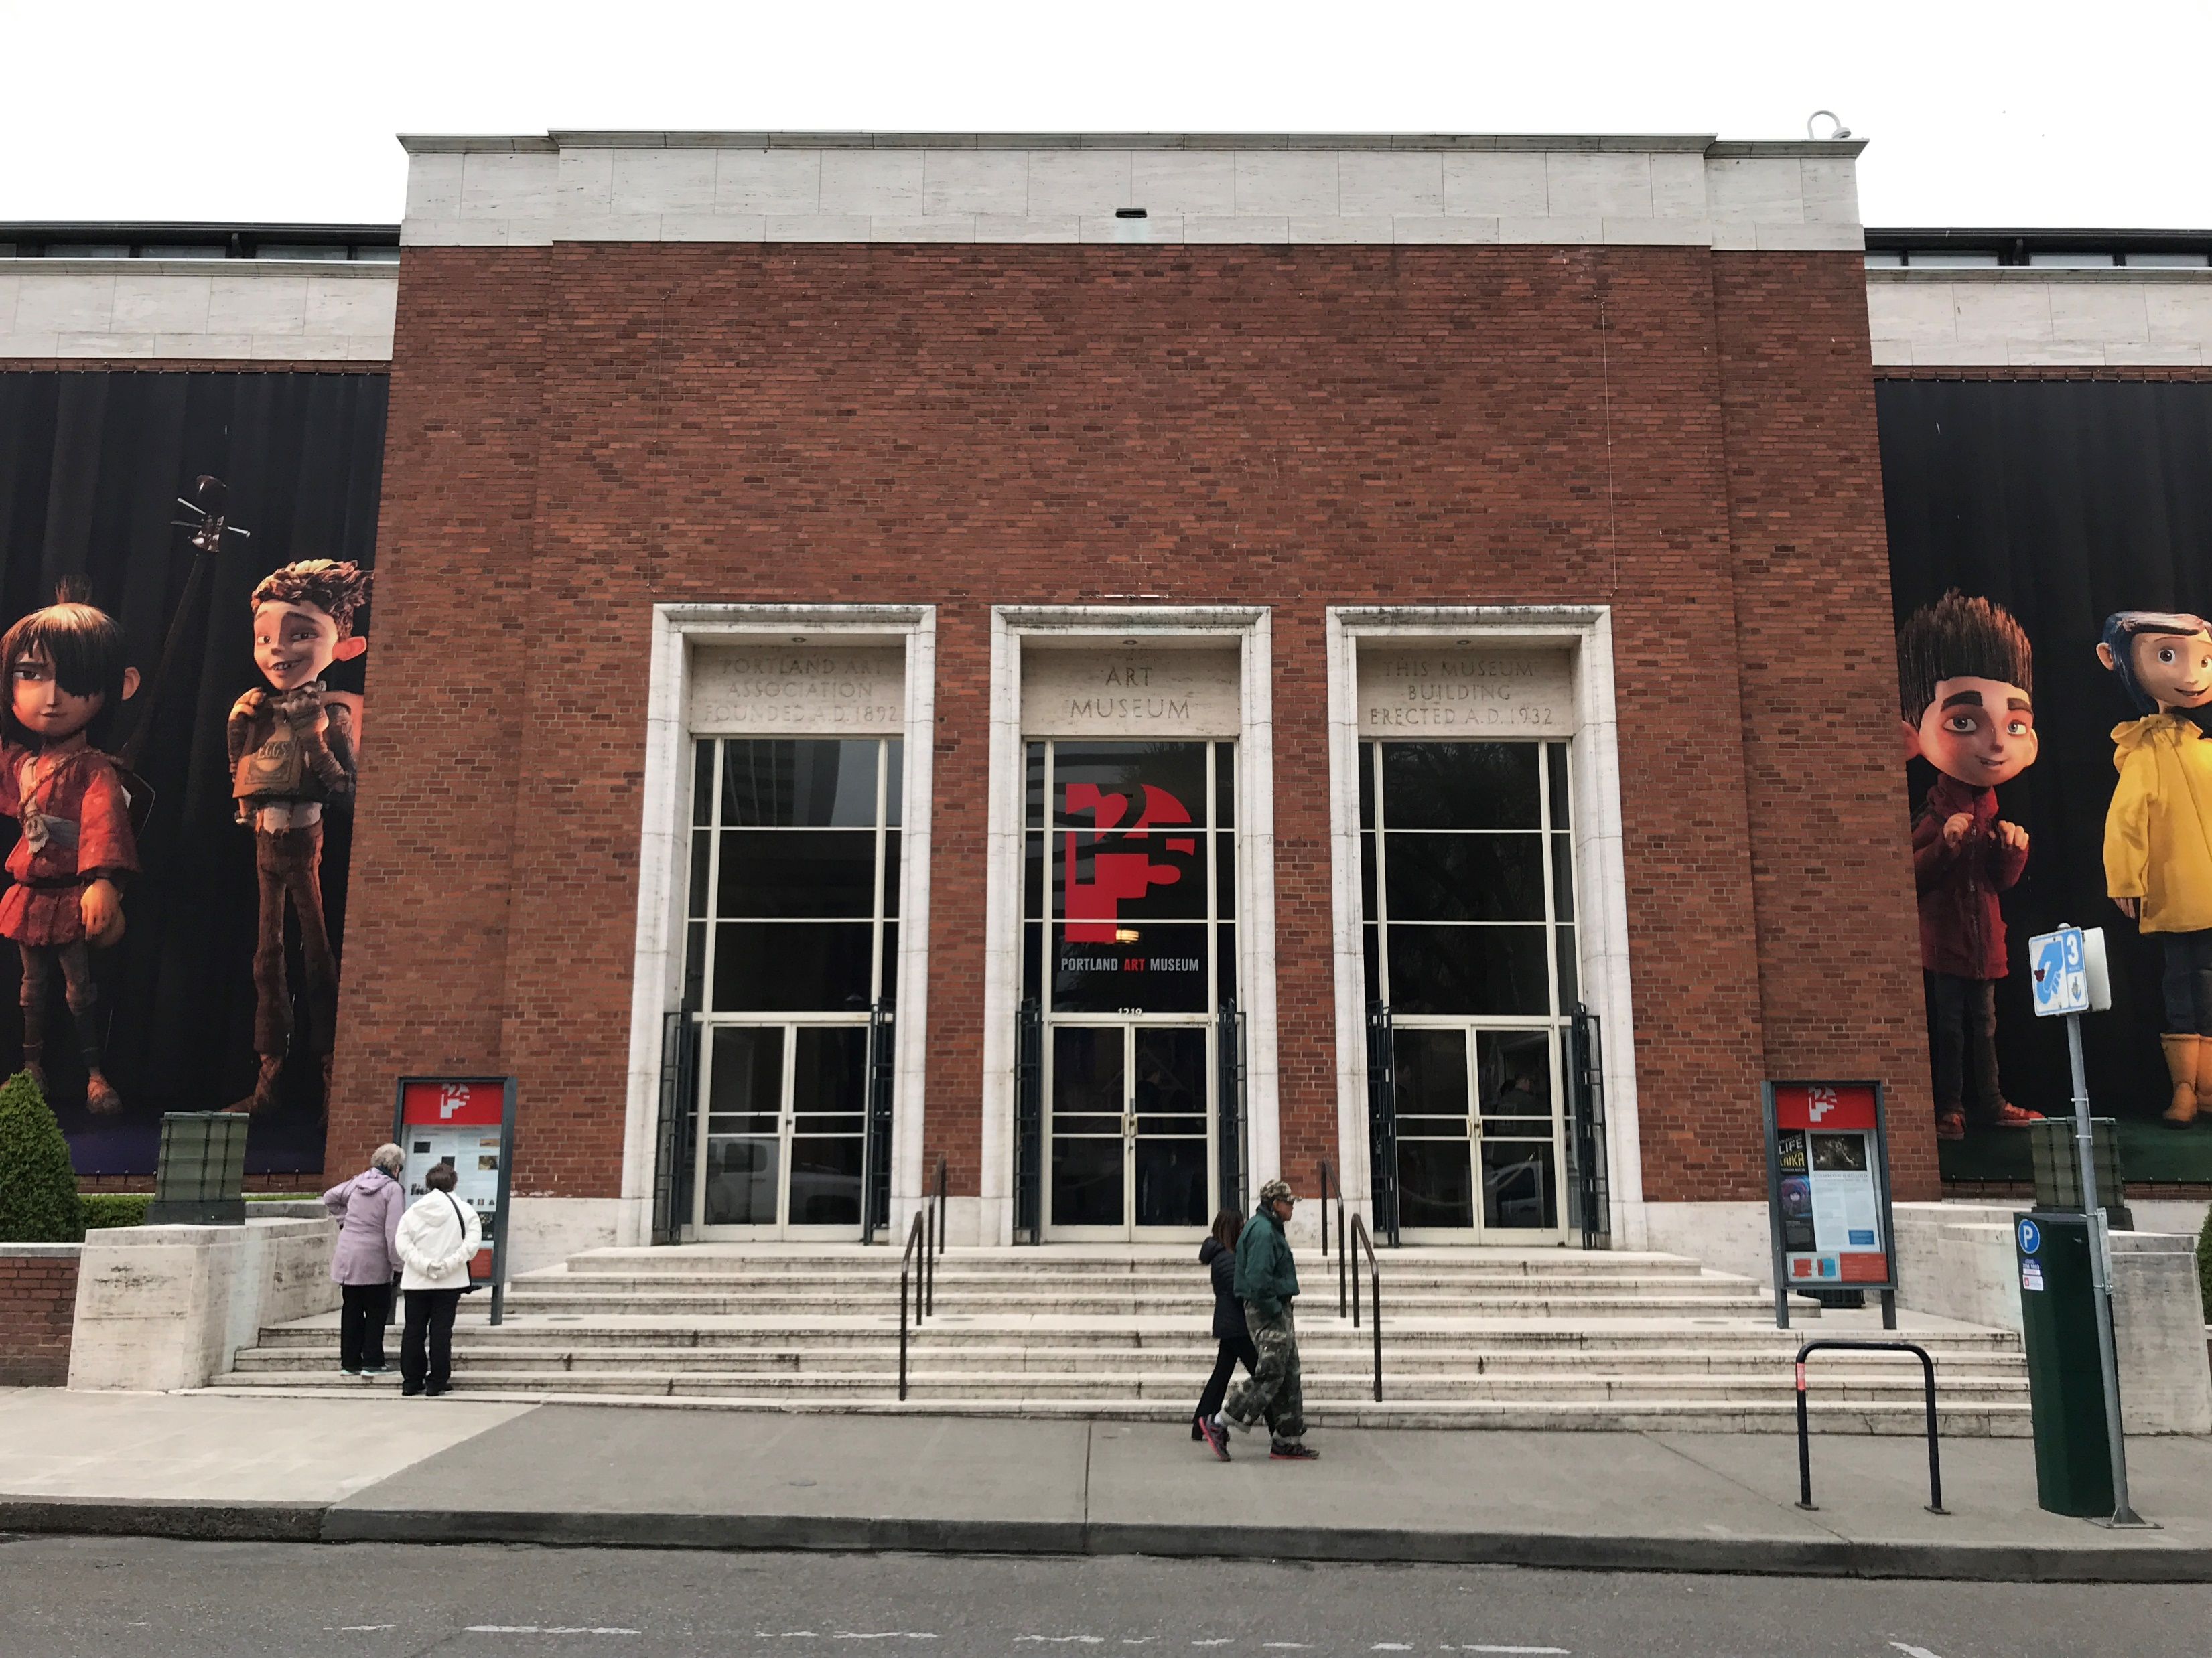
Looking west toward original Belluschi entrance

Slide 5
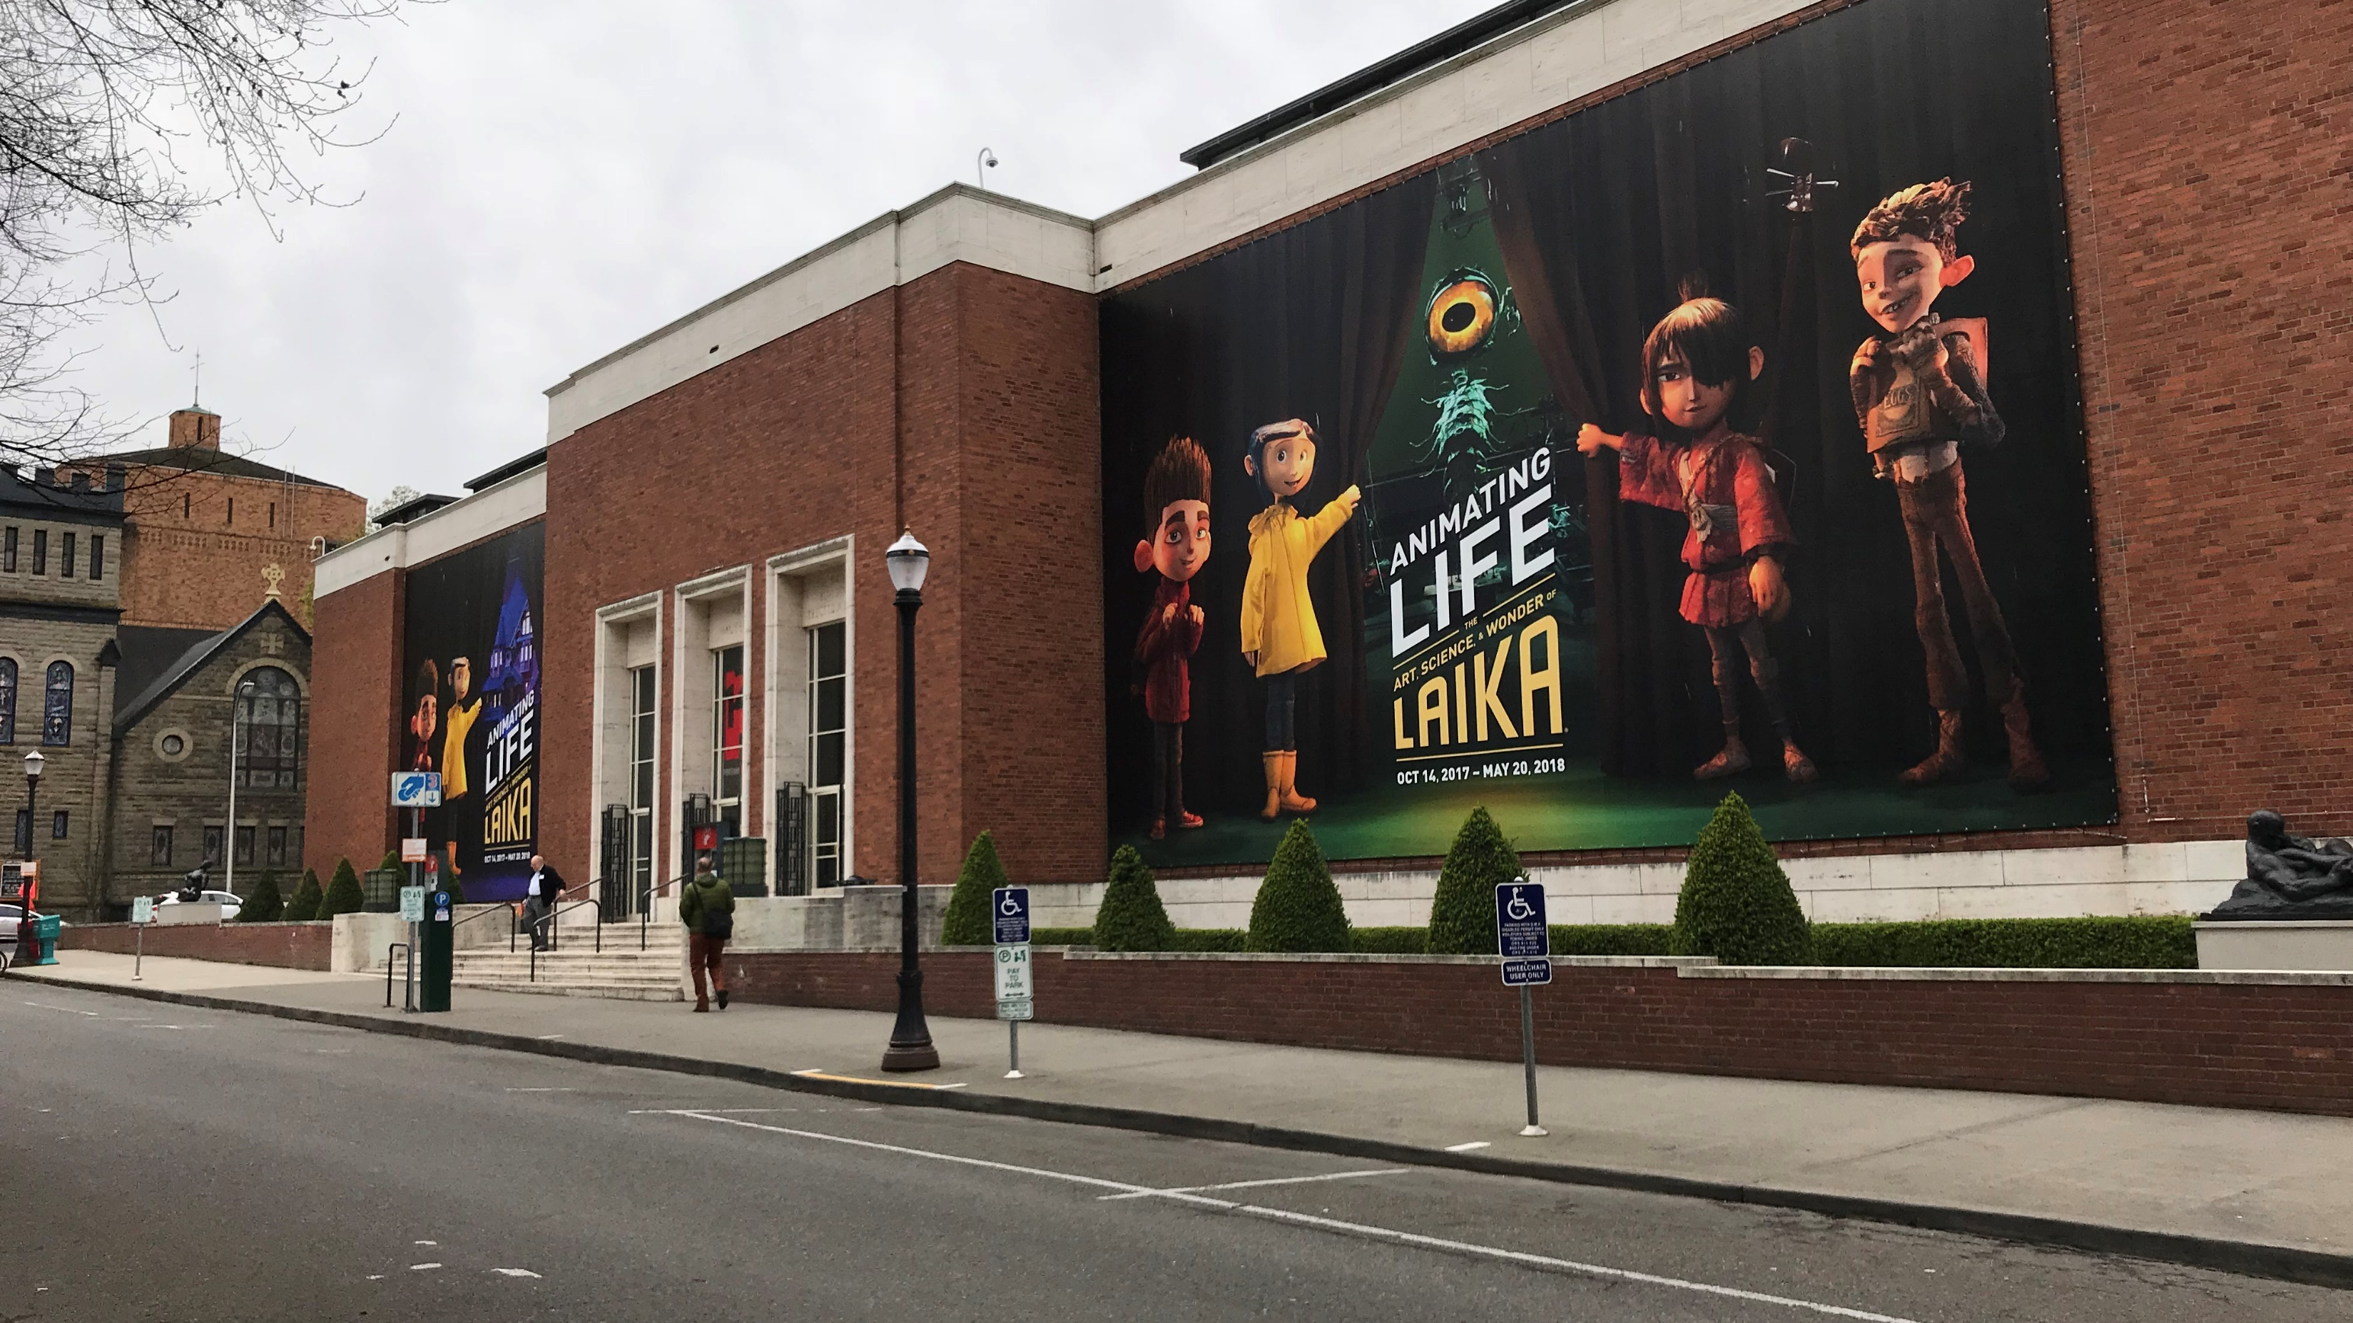
Looking southwest toward original Belluschi wing

Slide 6
Looking south toward existing loading bay

Slide 7
Looking west toward existing plaza

Slide 8
Looking west through pedestrian accessway

Slide 9
Looking west across SW 10th Avenue toward Heritage tree and Eliot accessway

Slide 10
Looking east toward existing Sculpture Garden and future west plaza area

Slide 11
Looking southeast toward north façade of Mark Building

Slide 12
Looking east toward proposed loading area

Slide 13
Staff Introduction
Applicant Presentation
Staff Discussion Topics
Public Comments
Commission Conversation

Slide 14
Staff Introduction
Applicant Presentation
Staff Discussion Topics
Public Comments
Commission Conversation

Slide 15
Macro Level
Compatibility of Design
Response to City and Neighborhood Context
Park Blocks
Transportation System
Cultural District
Loading and Public Realm
Mid Level
Site Organization
Major Remodel
Micro Level
Additional Details

Slide 16
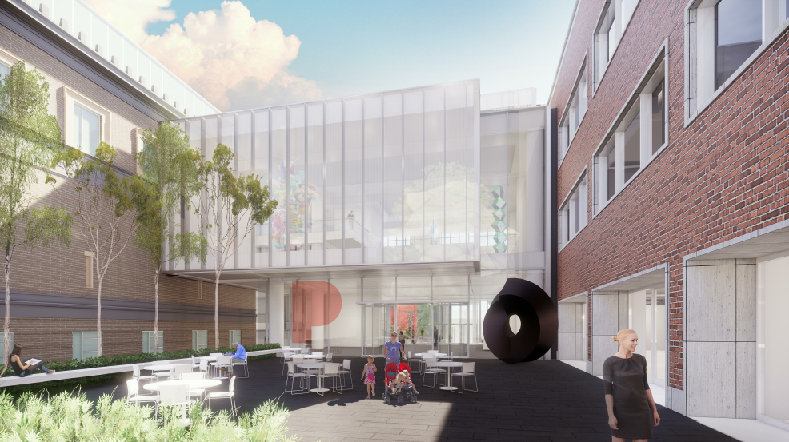
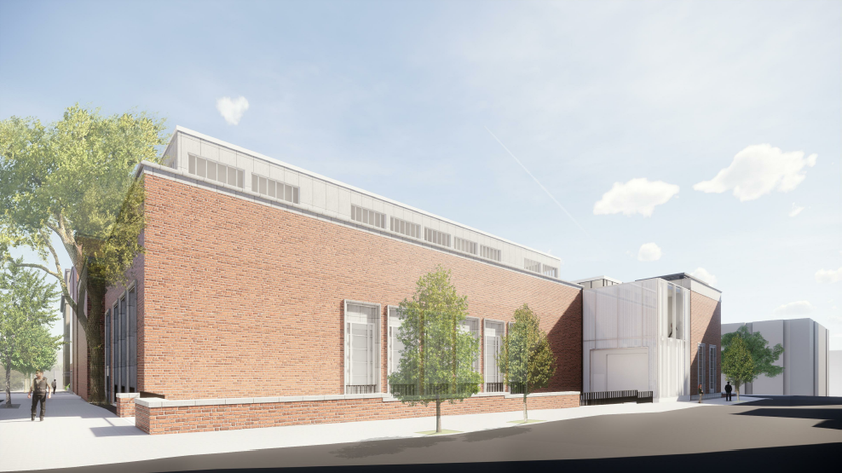
Compatibility of Design

Slide 17
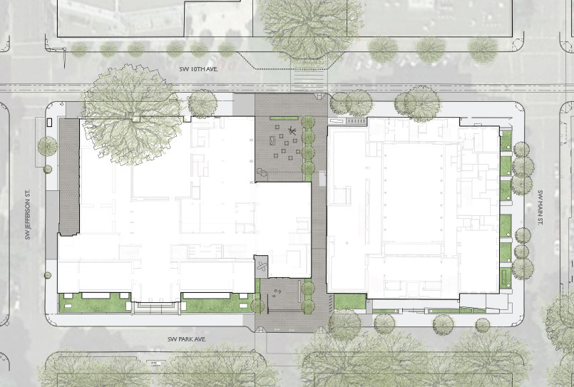
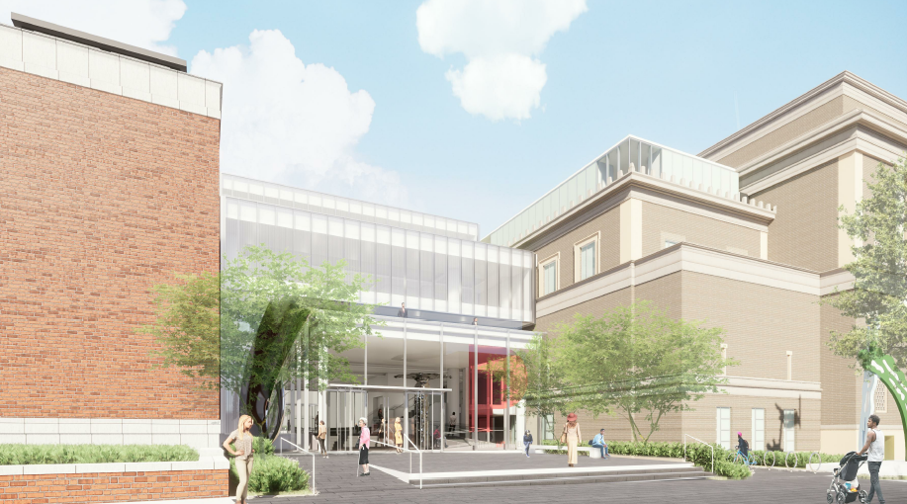
Response to City and Neighborhood Context
Park Blocks

Slide 18
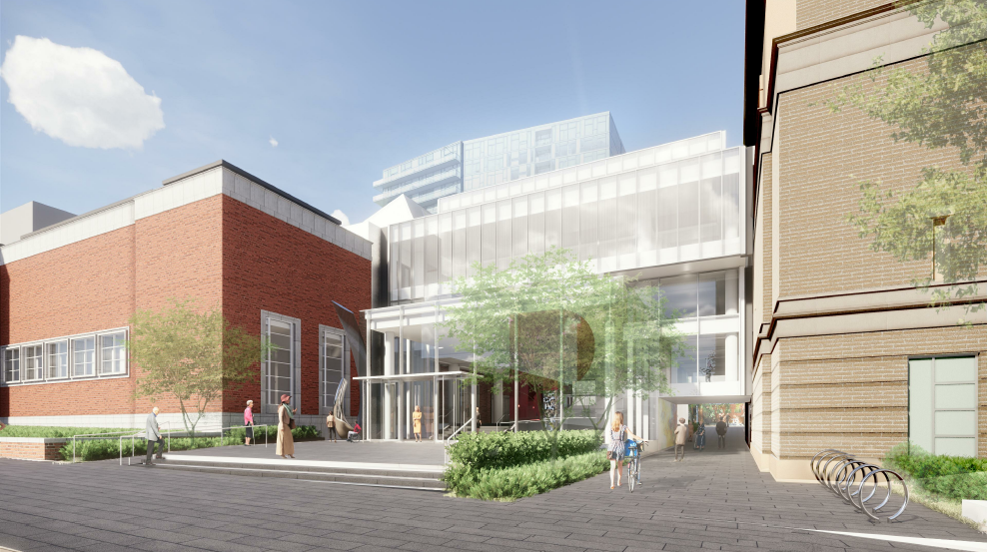
Response to City and Neighborhood Context
Transportation System
Modification #2 to allow distance greater than 50’ from bicycle parking to main entries

Slide 19
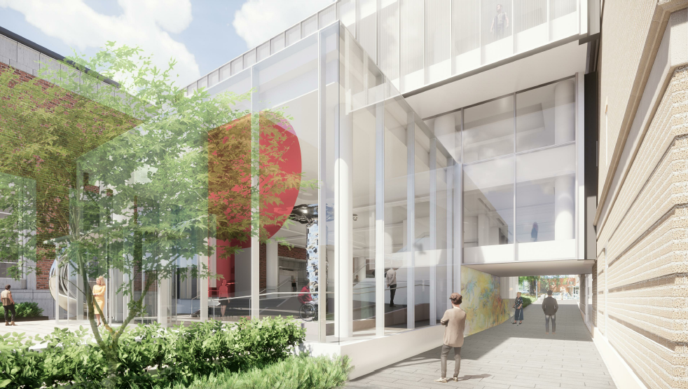
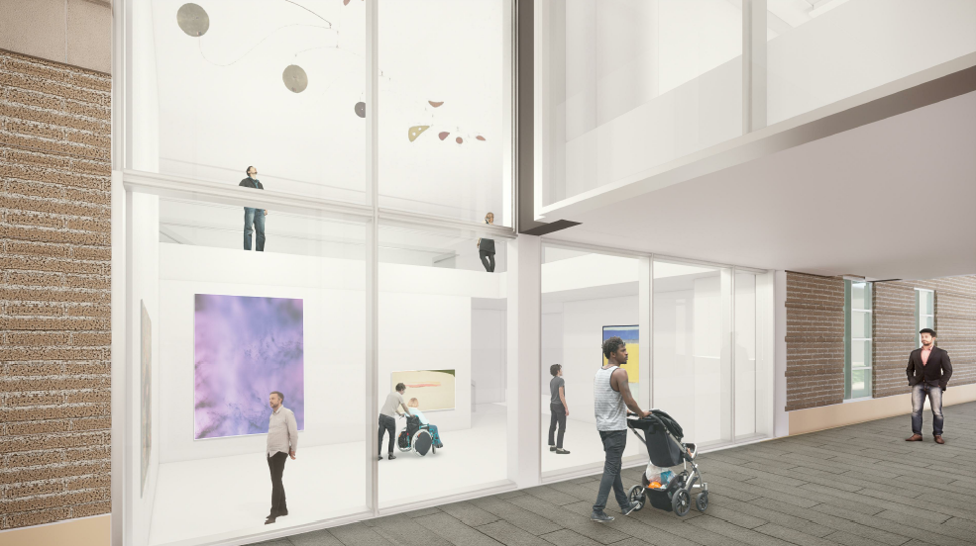
Response to City and Neighborhood Context
Cultural District

Slide 20
Loading and the Public Realm
Modification #1 to allow vehicle area between a building and a street
Modification #3 – to reduce the amount of landscaping between loading and the street
Adjustment #1 – to allow vehicular access on SW 10th
Adjustment #2 – to reduce number of loading spaces from 2 to 1 Standard A spaces

Slide 21
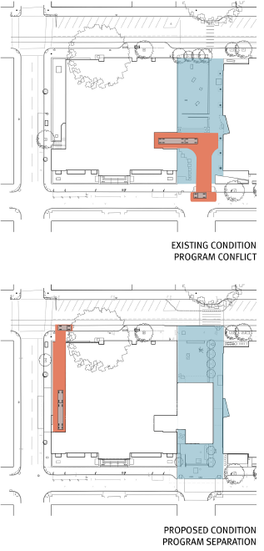
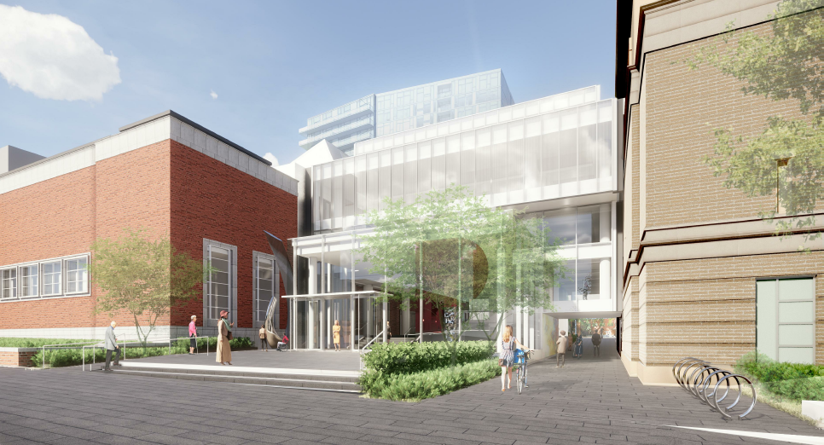
Site Organization

Slide 22
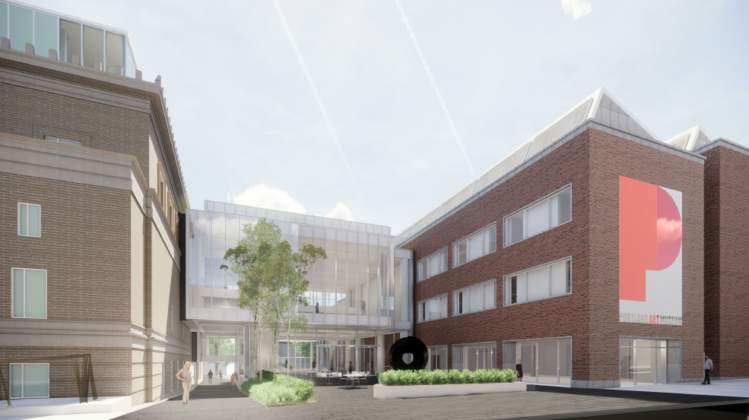
Major Remodel
Modification #4 to reduce the amount of required ground floor windows
Modification #5 to reduce the amount of required ground floor active use

Slide 23
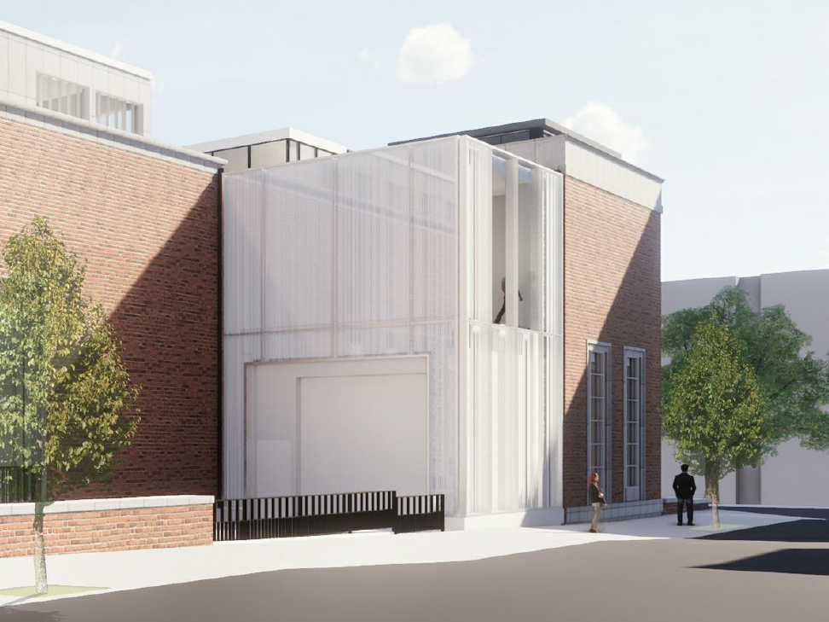
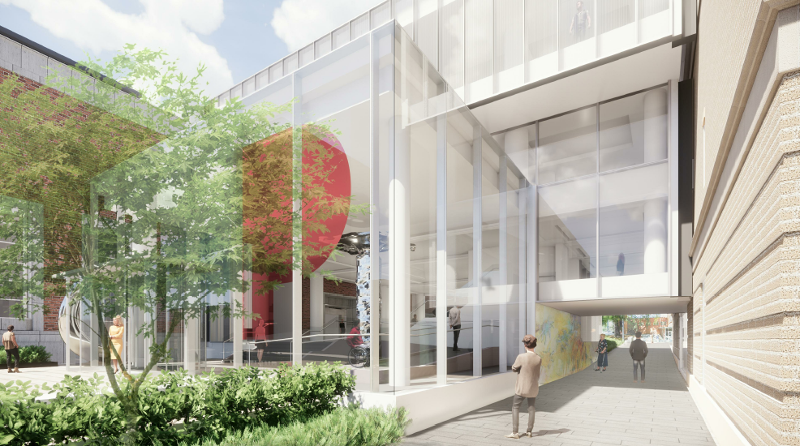
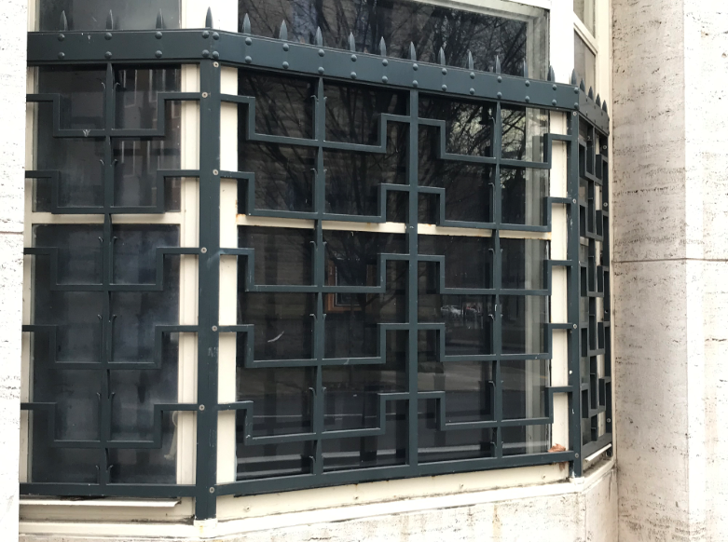
Additional Details

Slide 24
Staff Introduction
Applicant Presentation
Staff Discussion Topics
Public Comments
Commission Conversation

Slide 25
Public Comments
Robert Wright
Wendy Rahm
Tad Savinar
B. Story Swett
Diane Lowensohn
Katie Urey

Slide 26
Staff Introduction
Applicant Presentation
Staff Discussion Topics
Public Comments
Commission Conversation

