Slide 1



Proposed Street Vacation
for N Hunt Street
east of N Argyle Way

Slide 2
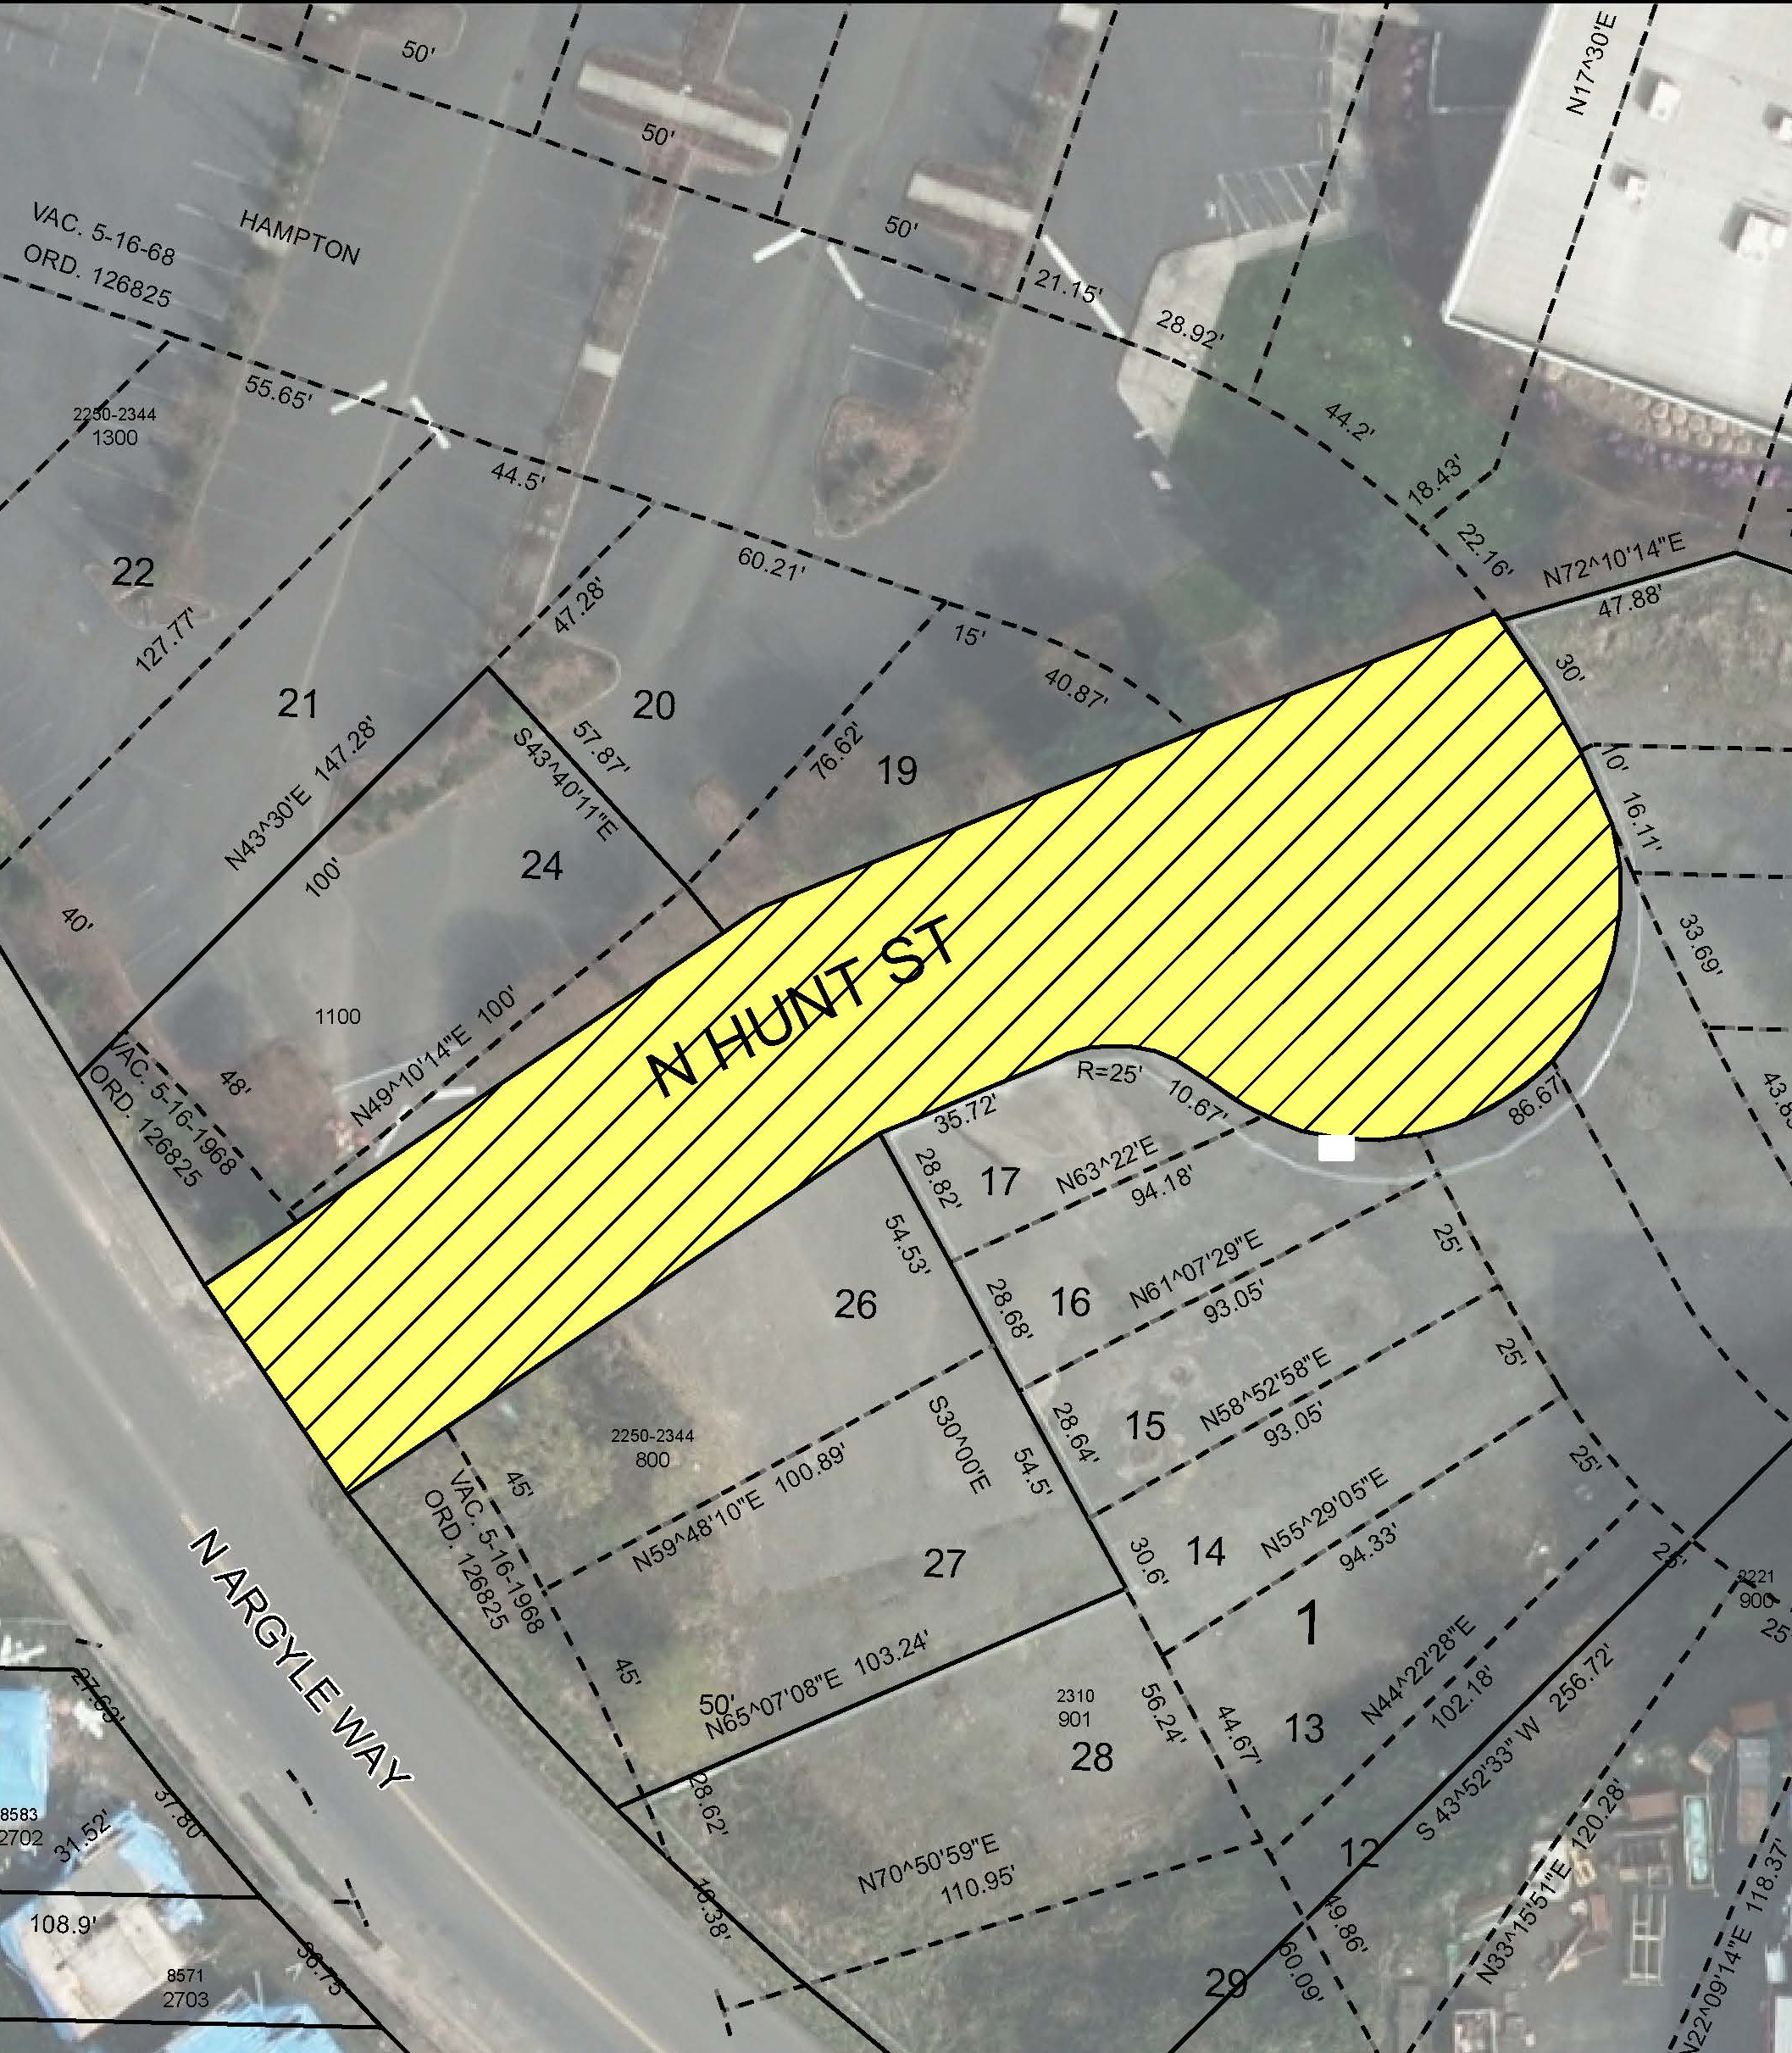
N. Hunt St.
Vacation Area

Slide 3
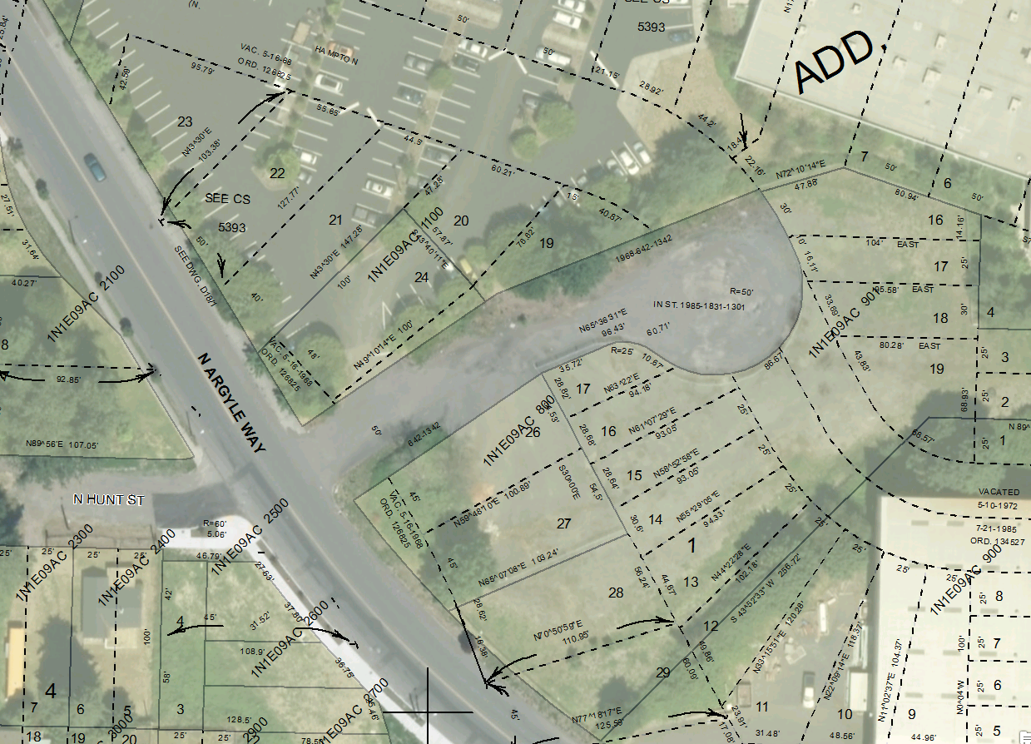
BES
Easement
(446 sq. ft.)

