Slide 1

State of Housing in Portland Winter 2018
December 19, 2018
Shannon Callahan, Housing Bureau Director
Matthew Tschabold, Interim Assistant Director

Slide 2
Summary Findings

Slide 3
Citywide
Portland continues to grow at an accelerated rate
Record numbers of market and affordable units, but more are needed to keep up with population trends
Increasing disparities require more resources and programs for lower income Portlanders
Notes:
2011-16 focus

Slide 4
Population
Portland grows in population, wealth, age, diversity
5th largest city on the West Coast (+1.5% annual growth)
27% of households making $100K annually
Population growth for Communities of Color
Wealth remains uneven across the board, disparities persist

Slide 5
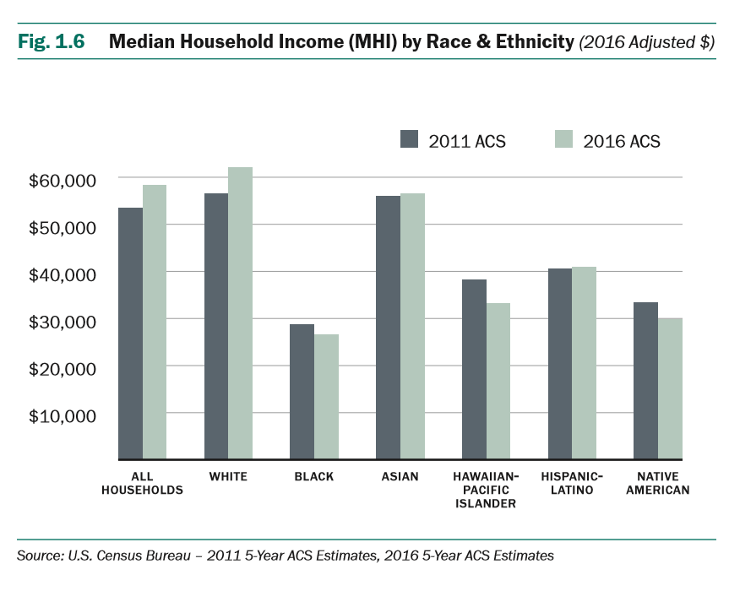
Income
More income inequality
By Housing Tenure
Renters: $36,883
Owners: $83,708
By Race
White and Asian: $59,349
Communities of Color: $32,685

Slide 6
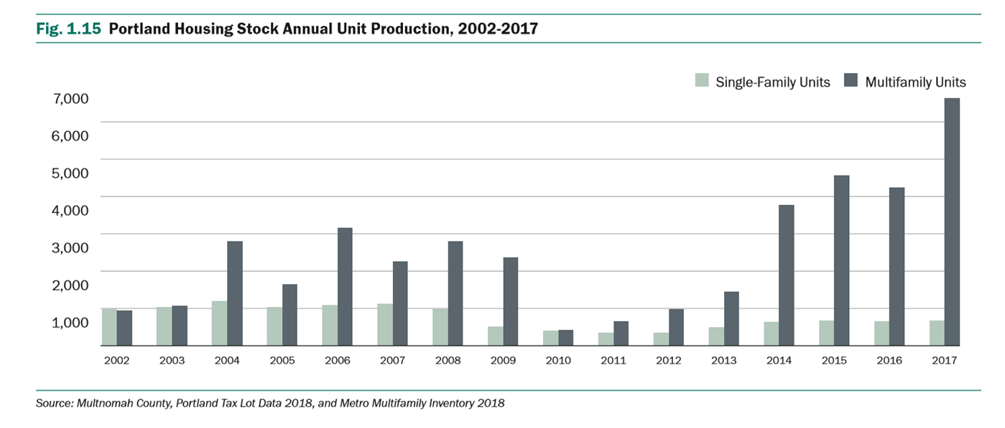
Housing Stock
2017 production at highest level in last 15 years (+7,300 new units)

Slide 7
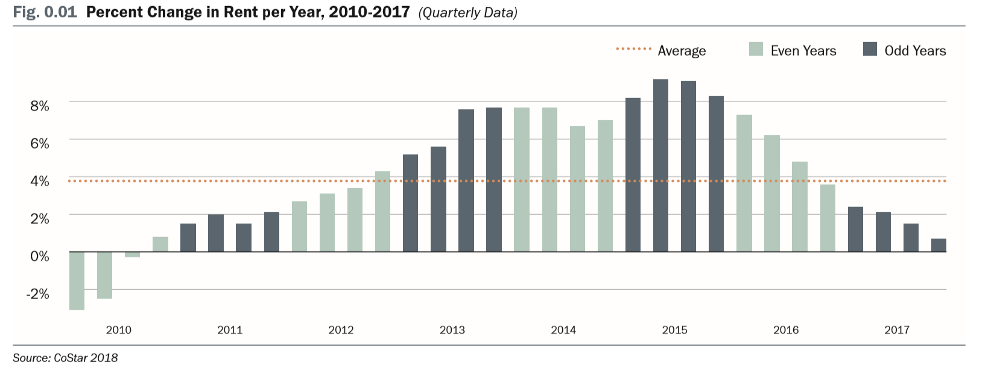
Rental Affordability
Rent growth is slowing with average rent in Portland at $1,430

Slide 8
Completely Priced Out
0-30% AMI Households
Single Mother Households
Black Households
Native American Households
Pacific Islander Households
On average, these households can’t afford rents anywhere in the city
Notes:
Native Americans Households
Studio in 122-Division
Pacific Islanders Households
Studio or 1bd in 122-Division
Studio in Raleigh Hills

Slide 9
Current Need
Non-Cost Burdened Renters
51%
Extremely Cost Burdened Renters
27%
Cost Burdened Renters
22%
Notes:
Non-cost burdened 30/50/80 – 7,730/2,220/10,085
Cost burdened 30/50/80 – 2,265/7,985/11,046
Extremely cost burdened 30/50/80 – 19,740/8,955/2,565

Slide 10
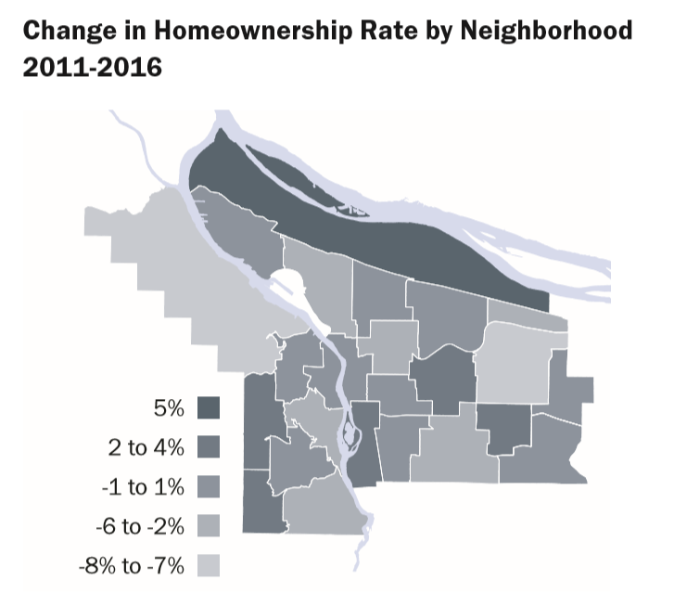
Homeownership Affordability
Most neighborhoods have median home sales prices over $400K
City median price is $406,192
+$148K increase in median city price from 2011 – 2017
Homeownership rates decreased over last 5 years
Notes:
Lents-Foster and 122-Division have seen steepest increase in median sales price 2011-17
LF= +113% ($153K -$327K)
122-D= +90% ($146K- $279K)

Slide 11
Housing Bureau
Strategic Initiatives

Slide 12
Portland Housing Bond

Slide 13
Portland Housing Bond
634
197
286
281
Total Units
Supportive Housing
Family-Sized Units
30% AMI
Units

Slide 14
N/NE Neighborhood Housing

Slide 15
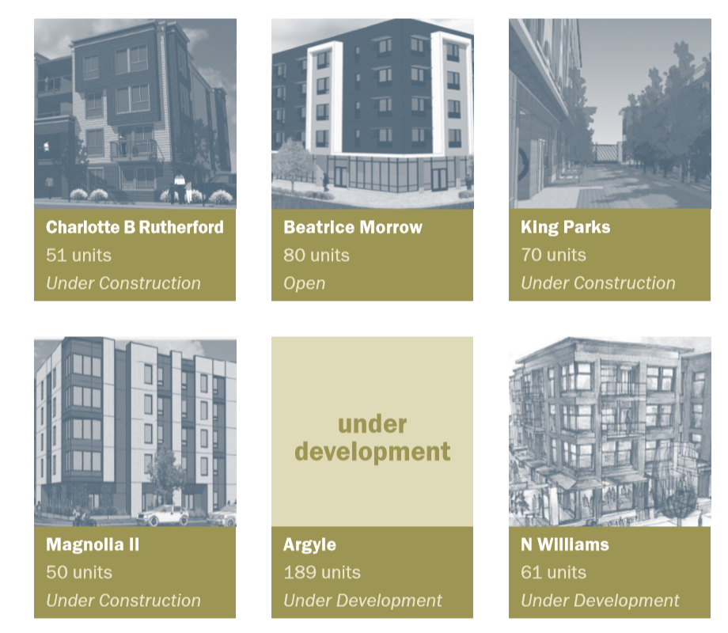
N/NE Neighborhood Housing
• 501 rental units in progress (121 units above the goal)
• 265 home repair grants
• 72 home repair loans
• On track to reach goal of 110 new homeowners by 2022

Slide 16
Inclusionary Housing

Slide 17
Inclusionary Housing

Slide 18
Supportive Housing

Slide 19
Supportive Housing
• 517 new supportive housing units in progress, 25% to the 10-year goal
• Unprecedented joint city-county-state NOFA for supportive housing projects

Slide 20
Rental Services Office

Slide 21
Rental Services Office
• Established Rental Services Office
• Adopted a permanent mandatory relocation assistance requirement
• Adopted a rental unit registration requirement
• Doubled the funding for legal assistance and education services

Slide 22
2018 Unit Production

Slide 23
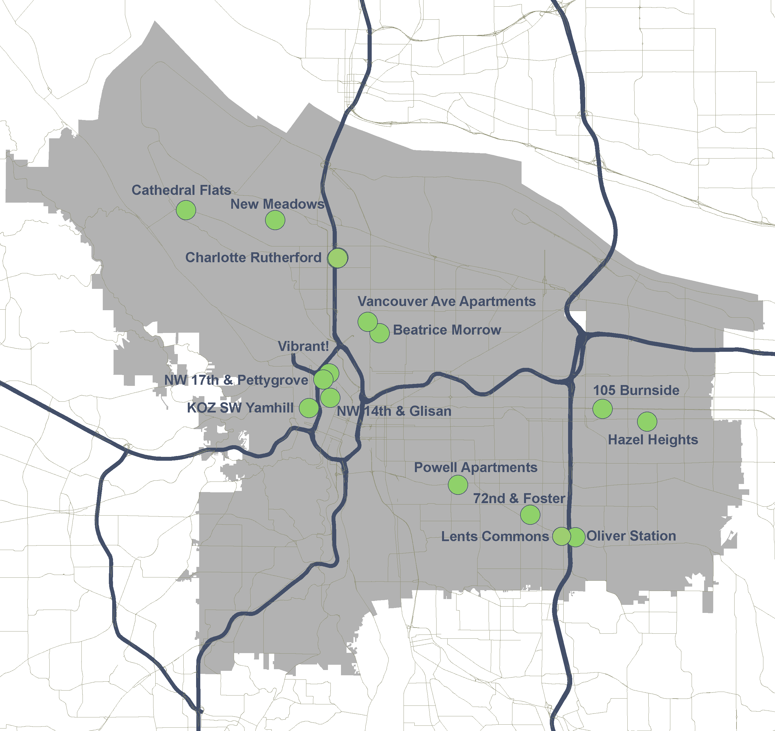
803 new units
183 rehabilitated units
1830+ people housed
2018 Completed Projects

Slide 24
105 Burnside
Charlotte B Rutherford
Beatrice Morrow
Lents Commons
Vibrant!
Oliver Station
Hazel Heights
Notes:
105 Burnside – 51 units
Charlotte Rutherford – 51 units
Beatrice Morrow – 80 units
Lents Commons – 16 affordable units (54 total units)
Oliver Station – 126 affordable units (145 total units)
Hazel Heights – 153 units
Vibrant! – 93 units

Slide 25
Update on Renter
Cost Burden

Slide 26
Cost Burdened Renters
As rent growth outpaces income growth, households in all income ranges are cost burdened.
Households paying percent of income towards rent:
30% - Cost Burdened
50% - Severely Cost Burdened
Cost Burdened (30% paid for rent)
Extremely Cost Burdened (50% paid for rent)

