Slide 1
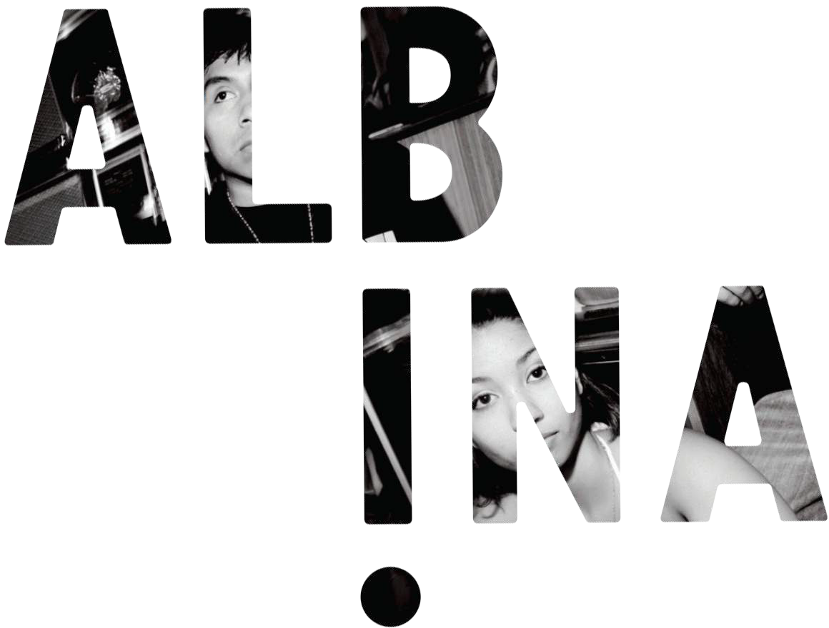

Slide 2
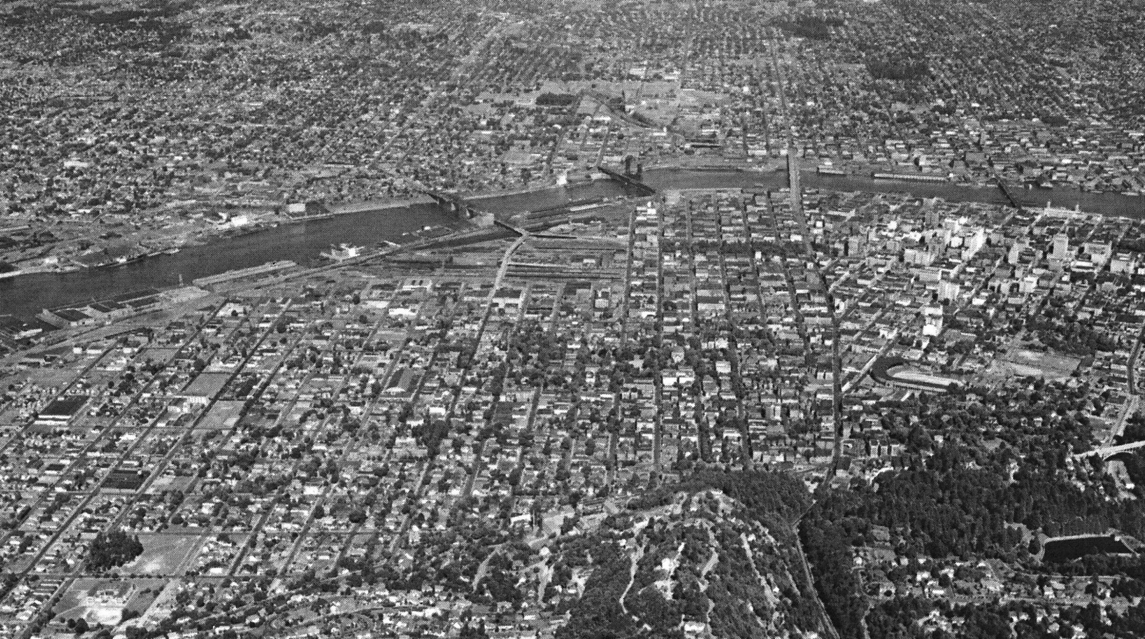
1940 PORTLAND LOOKING EAST

Slide 3
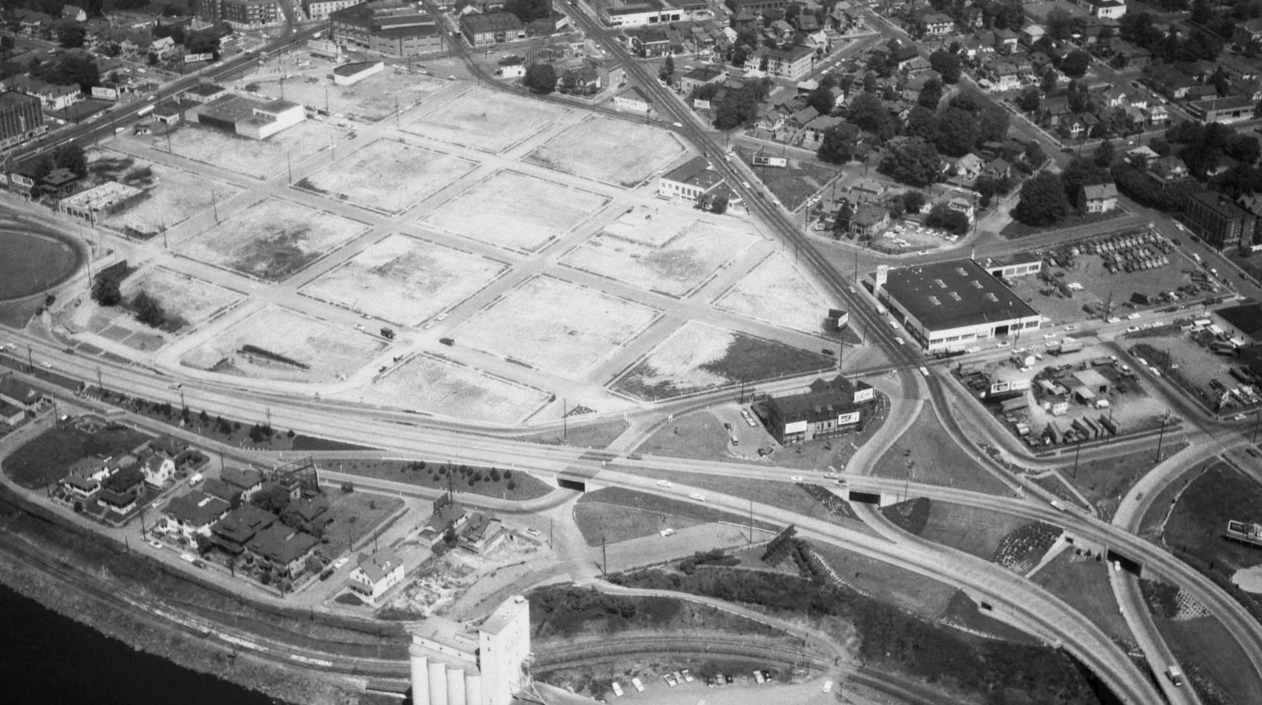
1958 SITE CLEARED FOR MEMORIAL COLISEUM

Slide 4
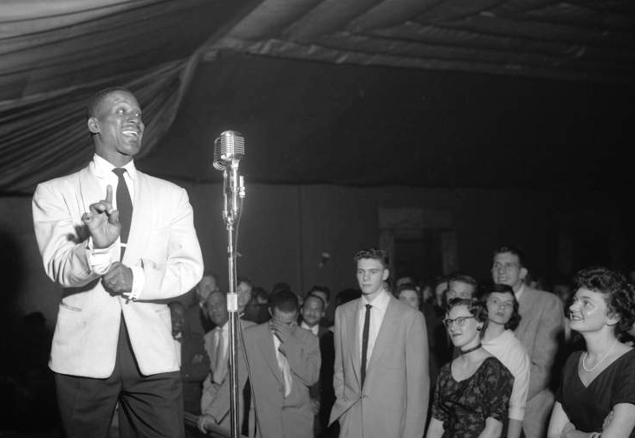
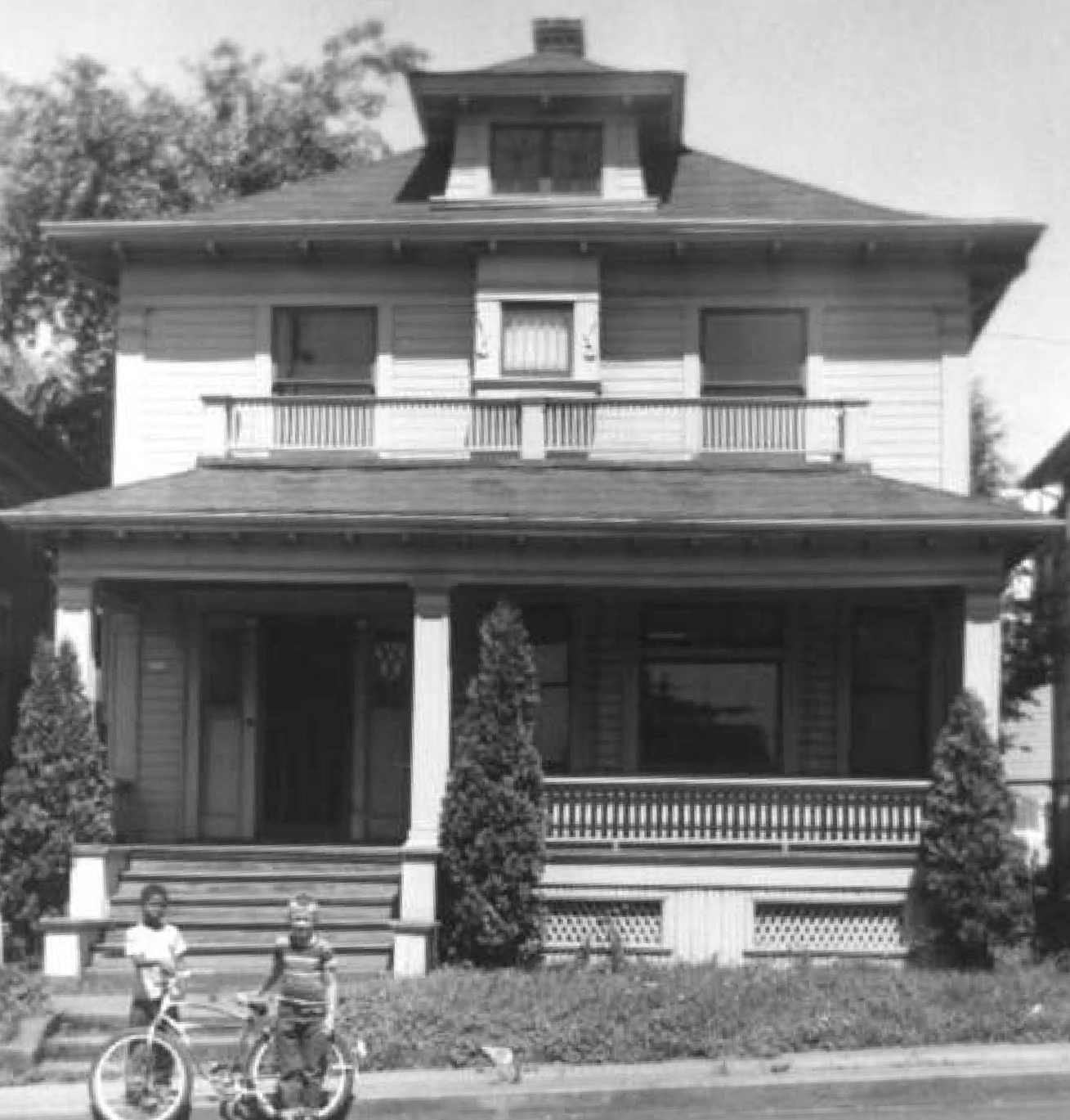
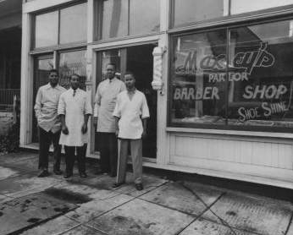
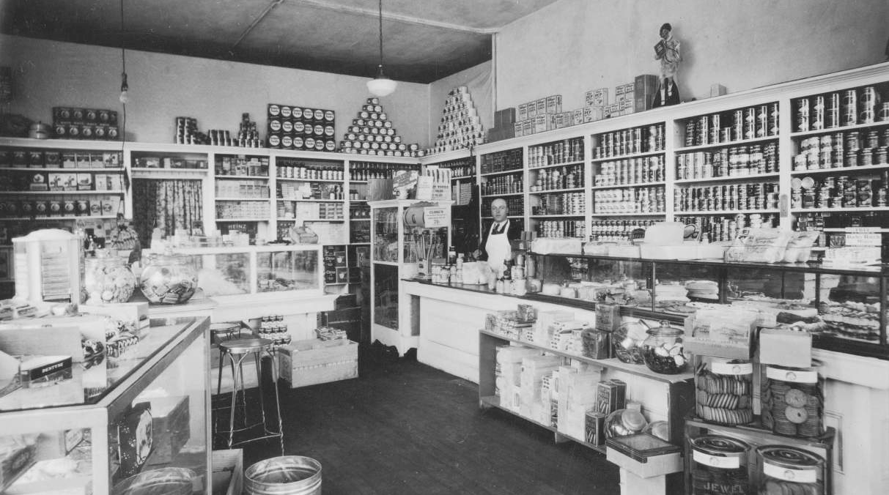
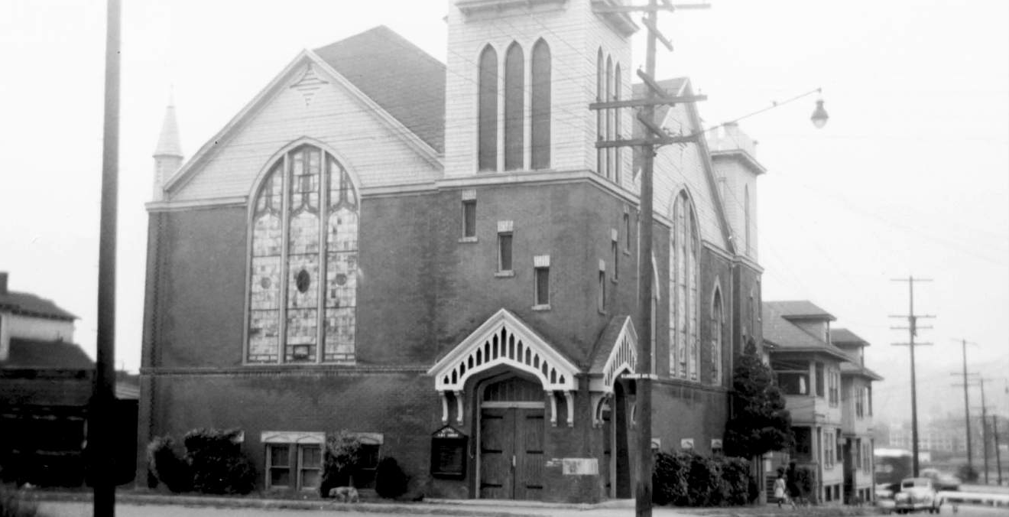
1957 N CHERRY ST.
1953 MAXEY’S PARLOR, NE WEIDLER
1931 SAM ATSEFF GROCERY, N LARRABEE
1957 BETHEL AFRICAN METHODIST EPISCOPAL CHURCH, N LARRABEE & N MCMILLEN

Slide 5
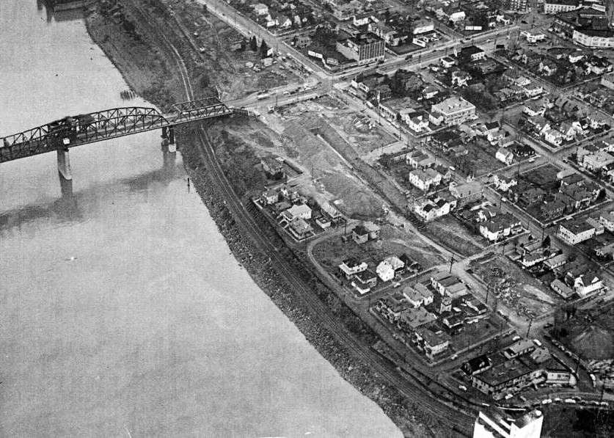
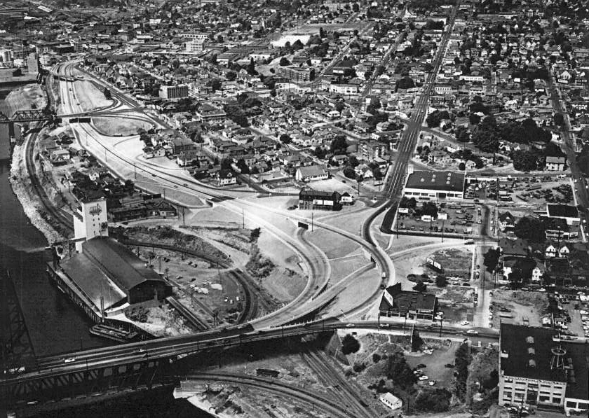
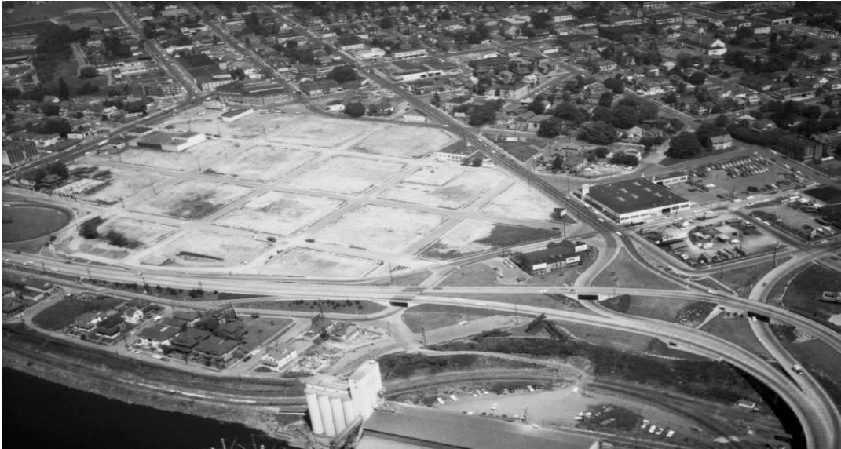
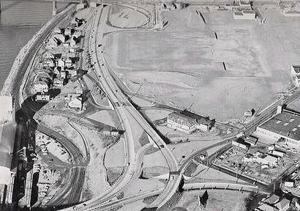
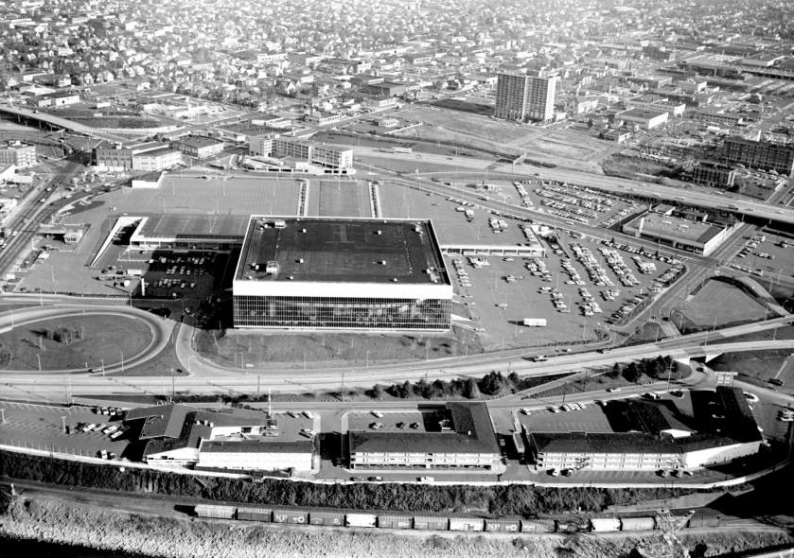
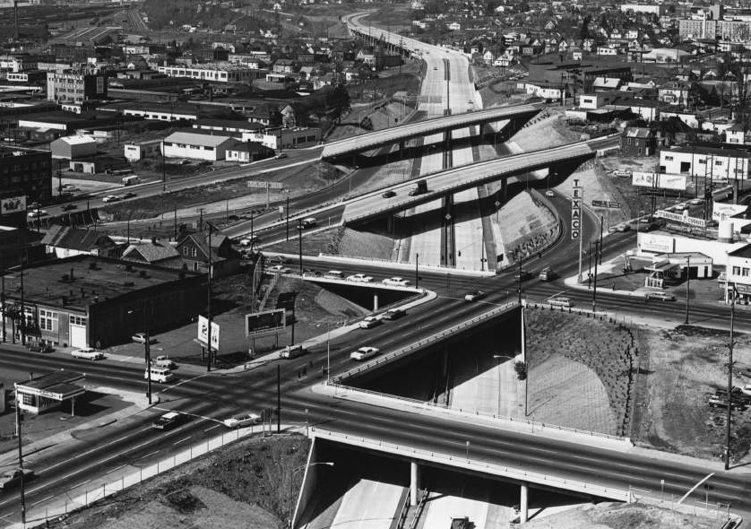
1949 CONSTRUCTION BEGINS ON INTERSTATE AVE
1952 INTERSTATE AVE AND JUNCTIONS COMPLETED
1958 SITE CLEARED FOR MEMORIAL COLISEUM
1958 SITE AREA REGRADED
1969 AERIAL VIEW OF MEMORIAL COLISEUM
1964 FREEWAY CONSTRUCTION

Slide 6
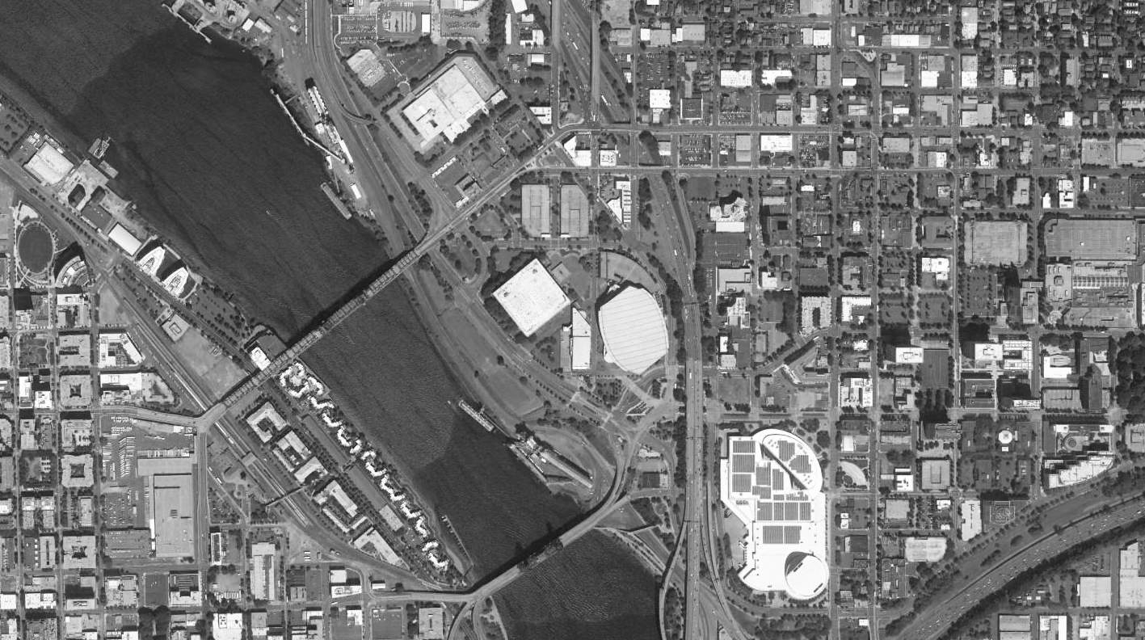
2016 CURRENT AERIAL OF THE ROSE QUARTER

Slide 7
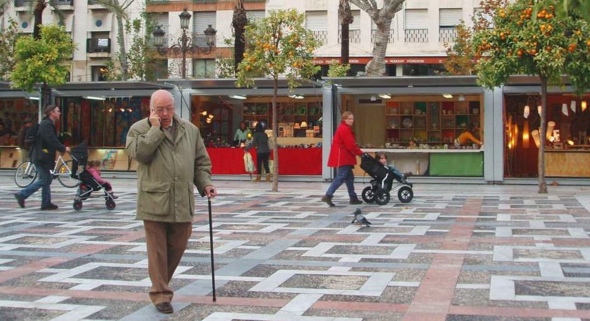
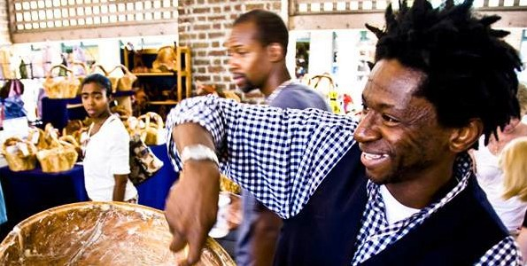
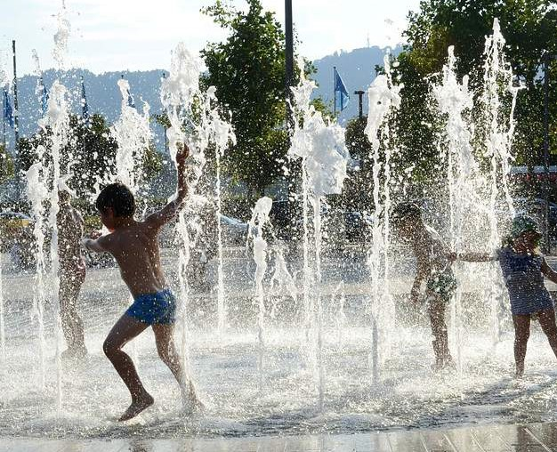
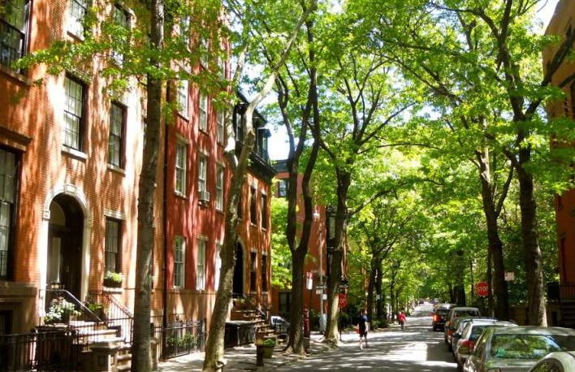
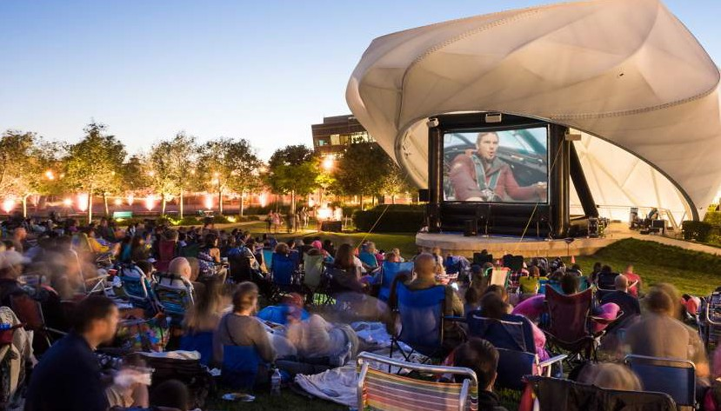
A PLACE TO LIVE, WORK, AND PLAY

Slide 8
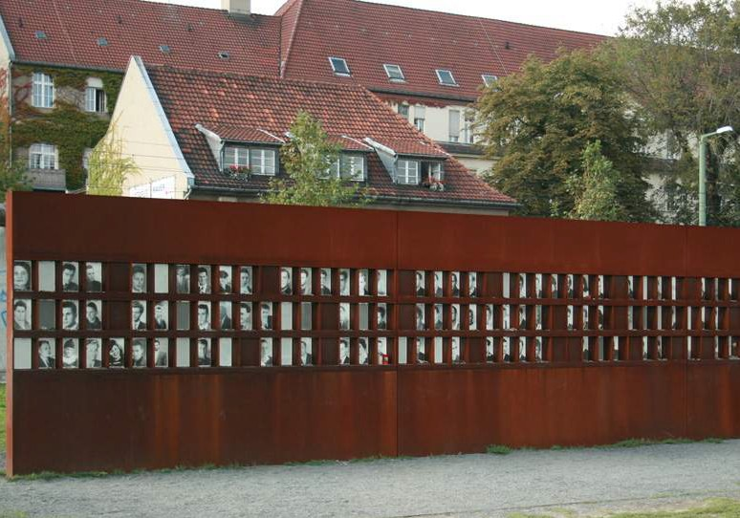
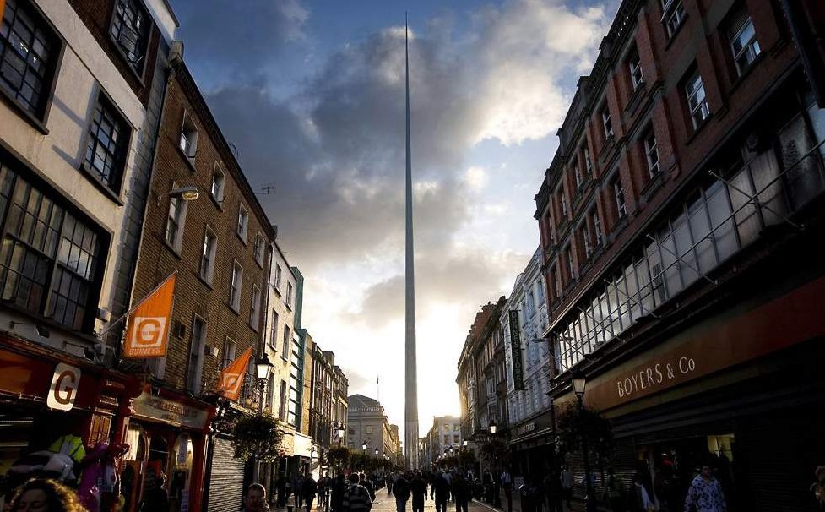
HEAL OURSELVES AND OUR COMMUNITIES
HONOR WHAT WAS, WHAT HAPPENED, AND WHAT COULD BE
BERLIN WALL MEMORIAL, BERLIN, GERMANY
SPIRE OF DUBLIN, DUBLIN, IRELAND

Slide 9
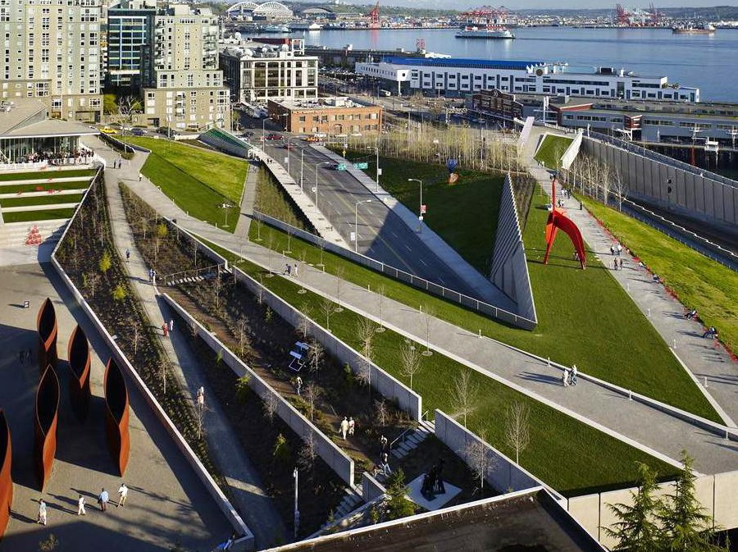
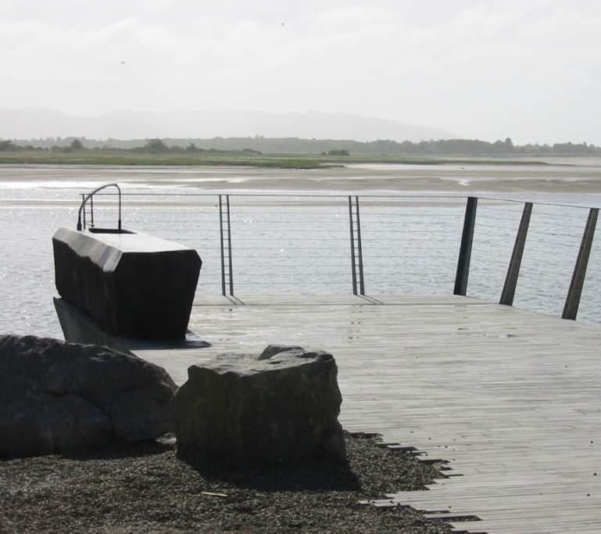
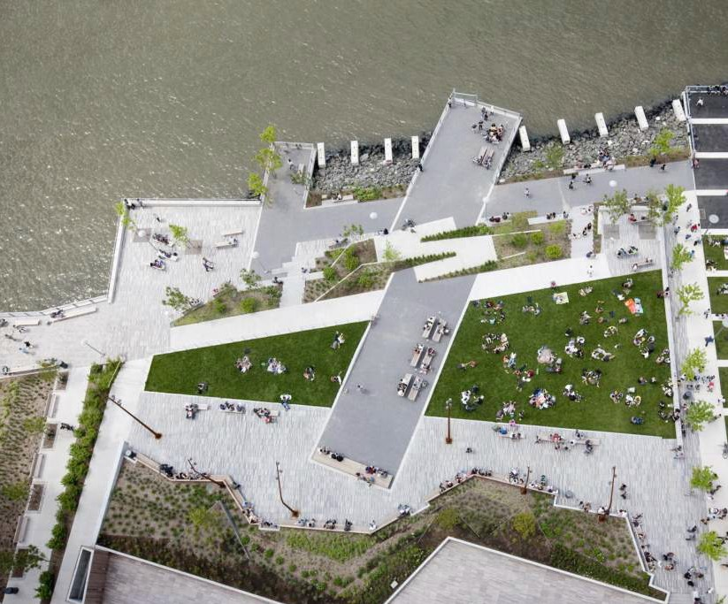
RECONNECT TO THE RIVER
OLYMPIC SCULPTURE PARK, SEATTLE, WASHINGTON
CONFLUENCE PROJECT, WASHINGTON
THE EDGE PARK, NYC, NEW YORK

Slide 10
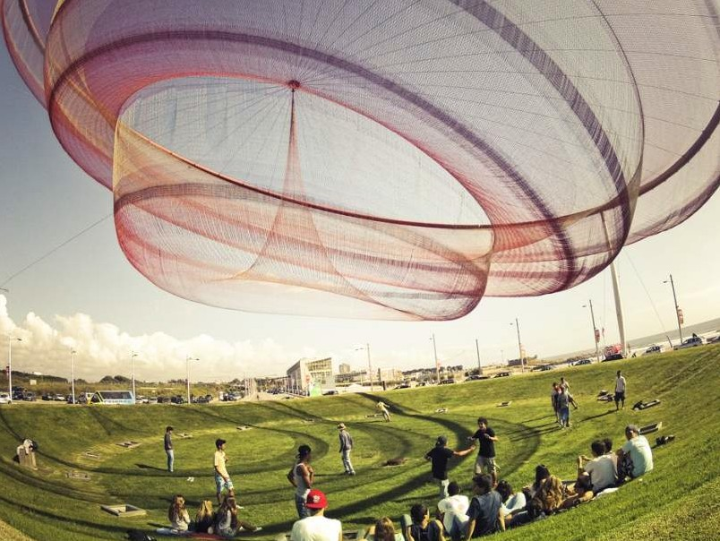
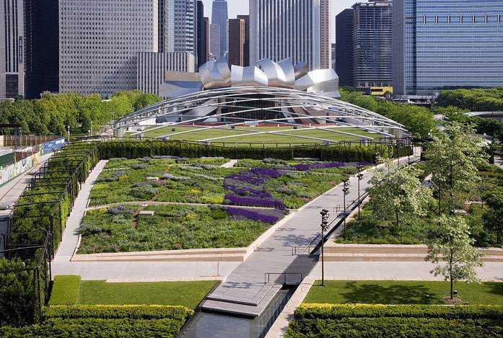
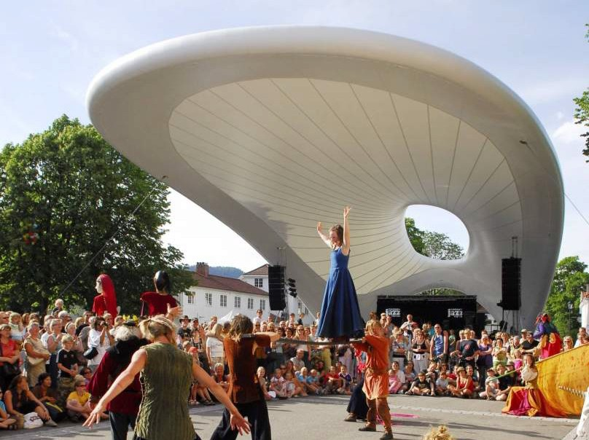
INTEGRATE THE ARTS IN THE PROCESS AND PRODUCT
PORTO, PORTUGAL
MILLENNIUM PARK, CHICAGO, ILLINOIS
KONGSBERG, NORWAY

Slide 11
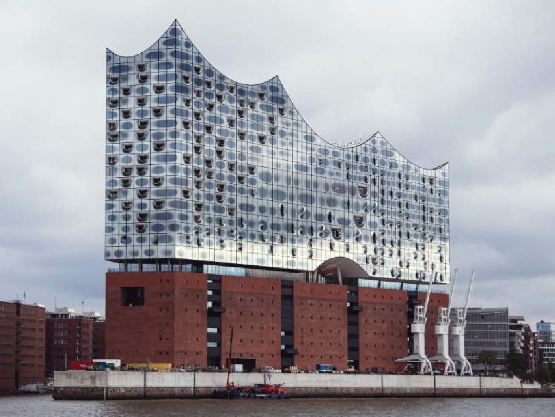
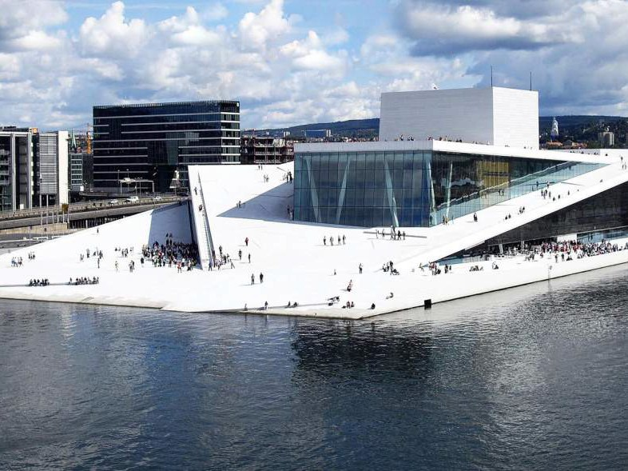
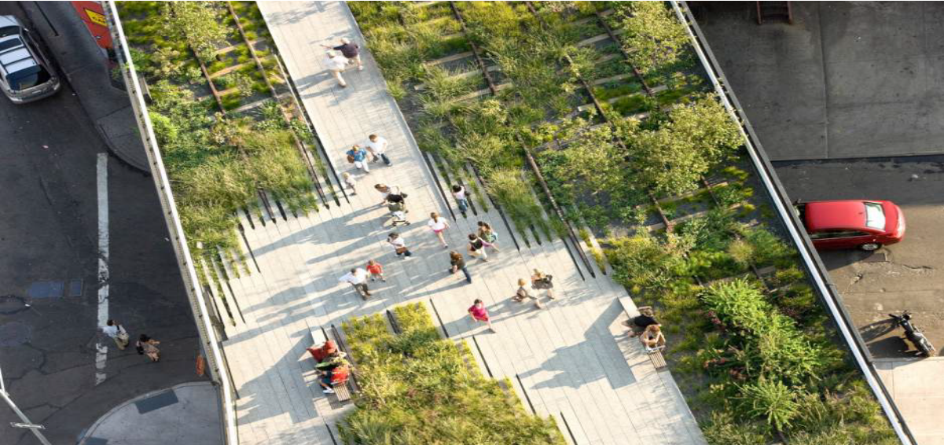
BE INTENTIONALLY REMARKABLE
PHILHARMONIC, HAMBURG, GERMANY
OSLO OPERA HOUSE INTERIOR, OSLO, NORWAY
HIGHLINE, NYC, NEW YORK

Slide 12



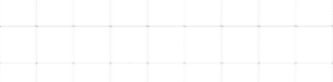
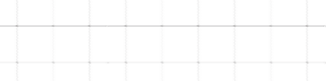
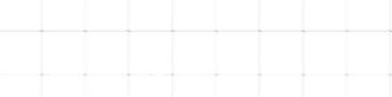
THROUGH THE 1950s
CURRENT
FUTURE

Slide 13
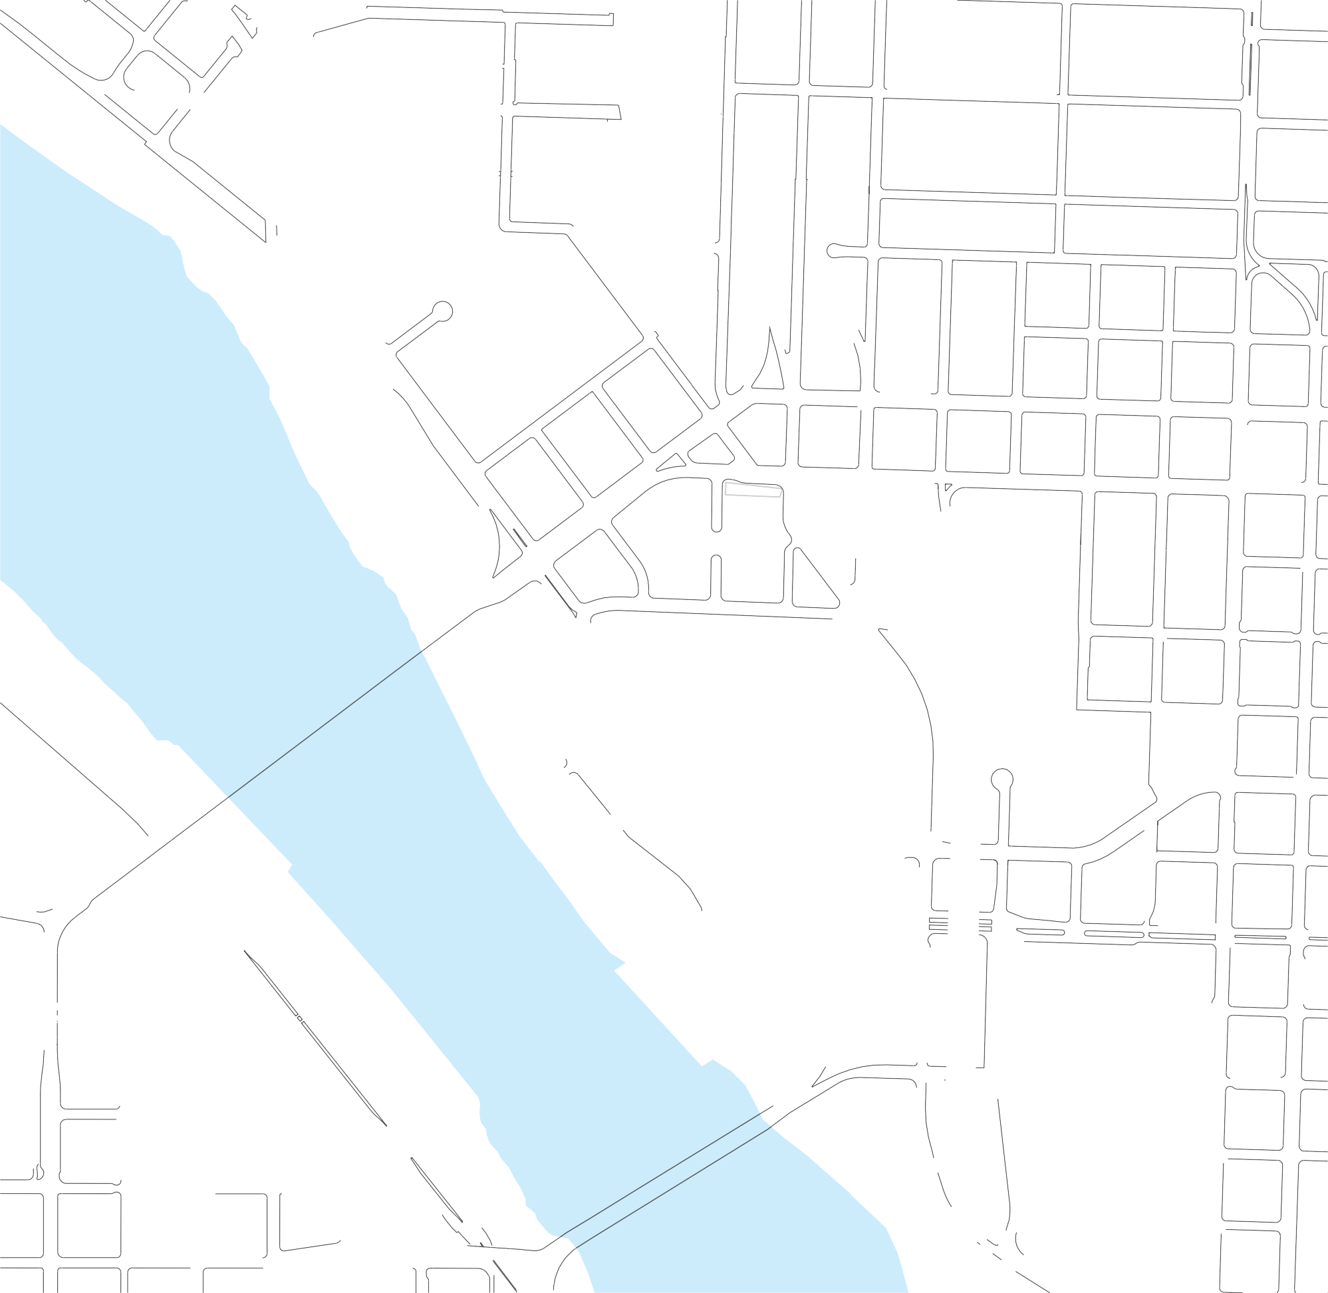
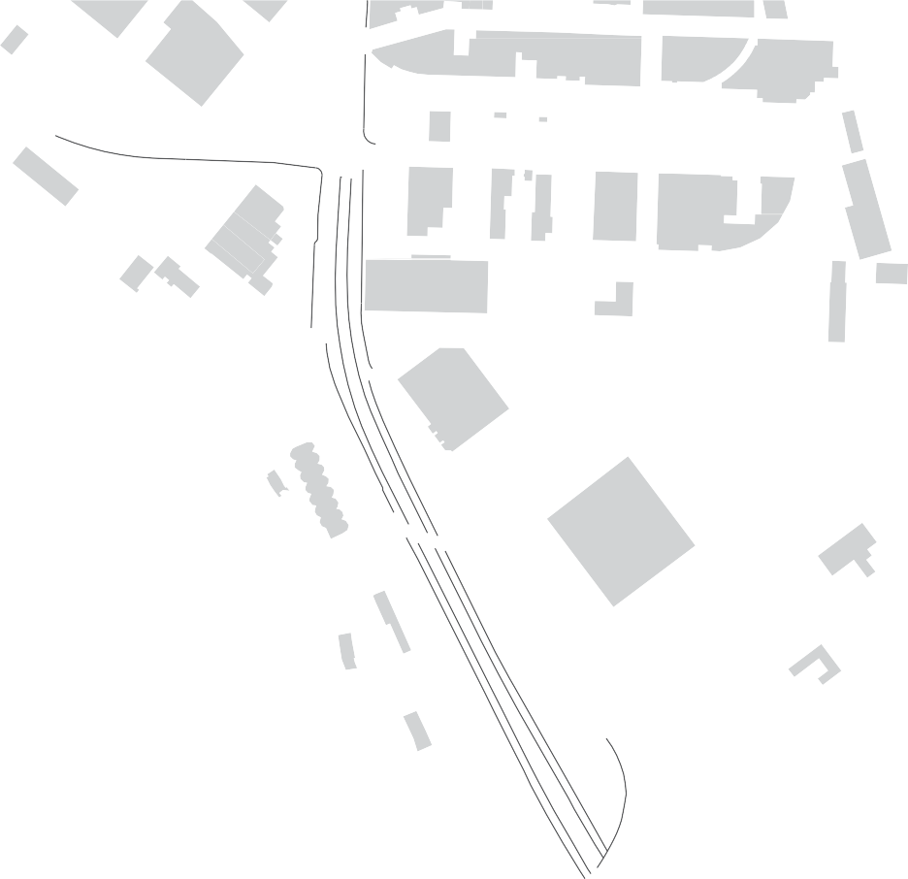
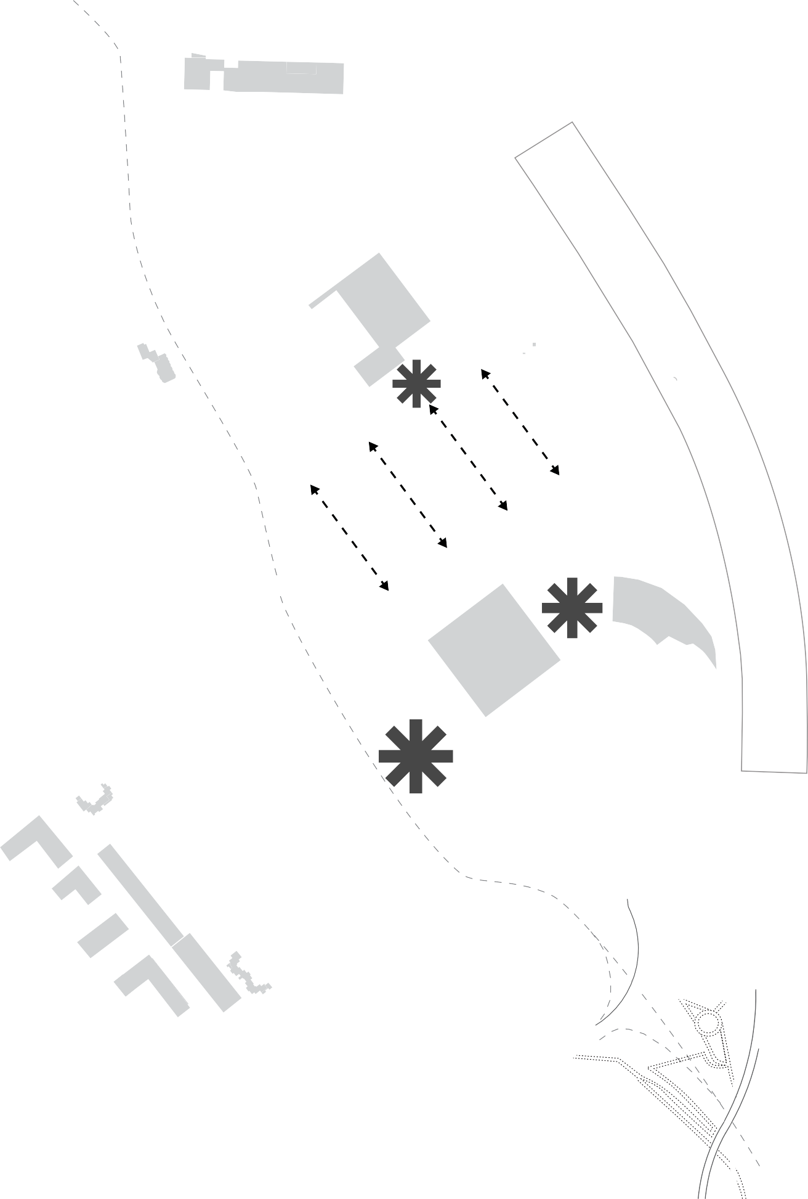


























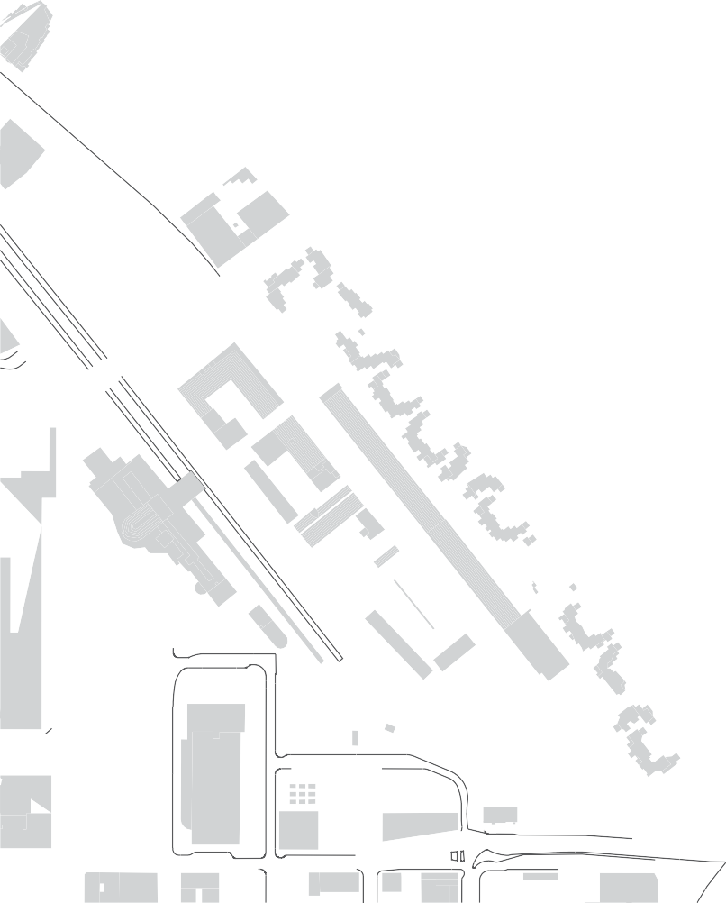









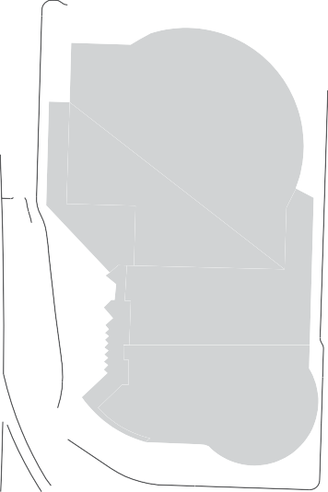






E
VANCOUVER
WILLIAMS
E
B
D
BROADWAY
C
WEIDLER
BROADWAY BRIDGE
B
VISION FRAMEWORK
Strategies for connecting and rebuilding
communities and neighborhoods.
A
MULTNOMAH
B
Connect to the Willamette River
Public cultural, event, and neighborhood spaces C Development spans Broadway
D Infill over freeway
E Connect to adjacent neighborhoods
HOLLADAY
STEEL BRIDGE
E
Existing Development
Public Open Space Organizes Community

Slide 14
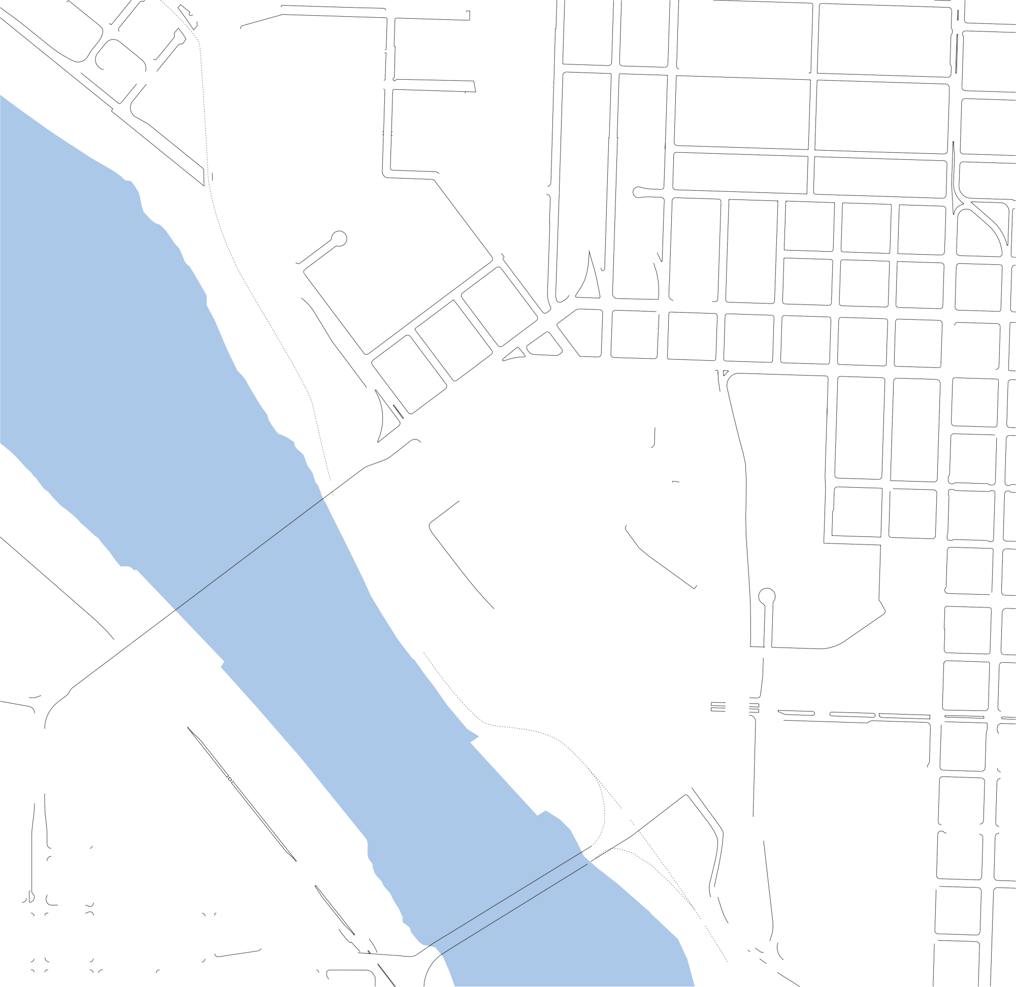
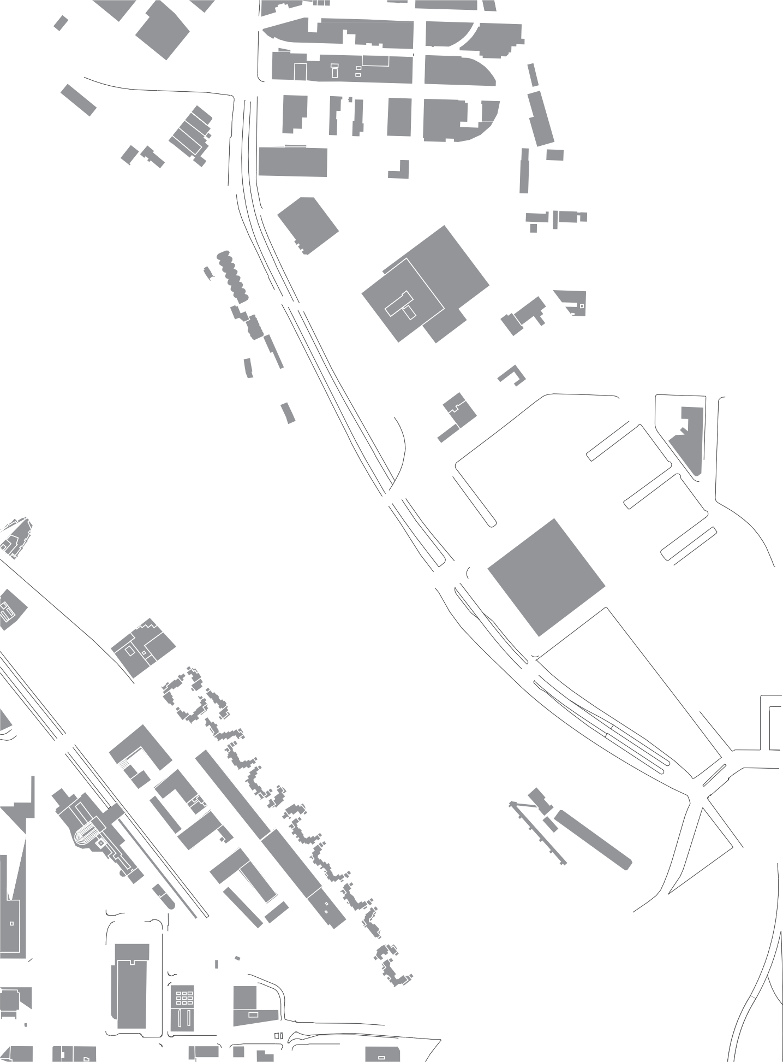






















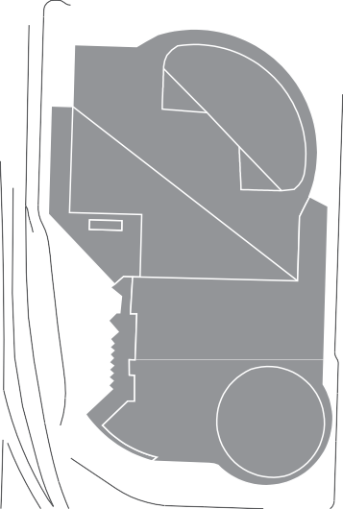



SHORT TERM DEVELOPMENT
Key infrastructure moves and world-class public open spaces re-set the district for development.
C
D
Waterfront Open Space
Public Plaza
Bridgehead Development D Public Plaza Development E Central Development
B
A
E
New Development Civic /Cultural Open Space
Cultural Heritage Installations
Bike / Pedestrian Routes Urban Development
Key Open Space
C

Slide 15
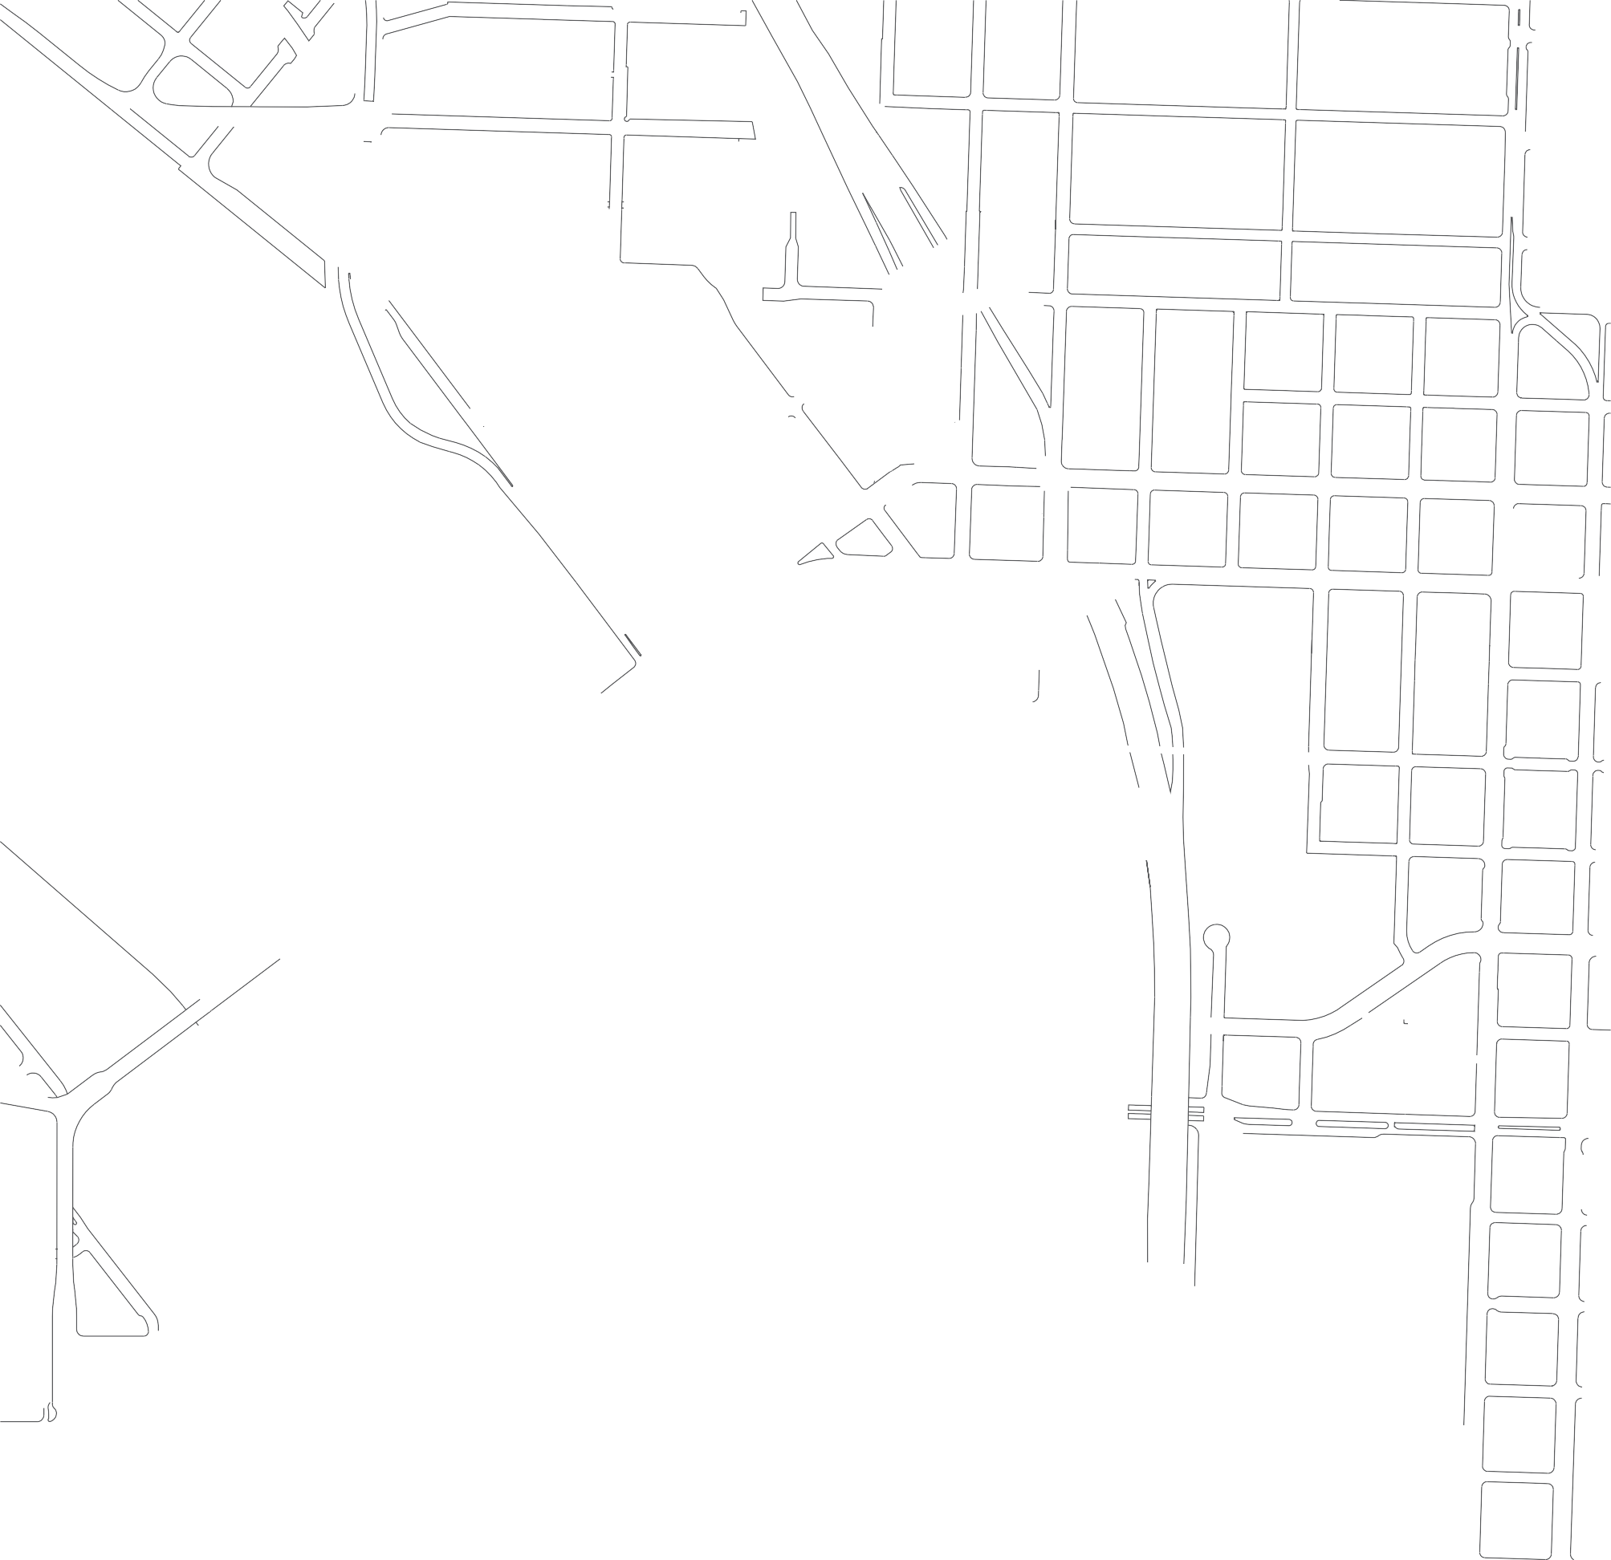
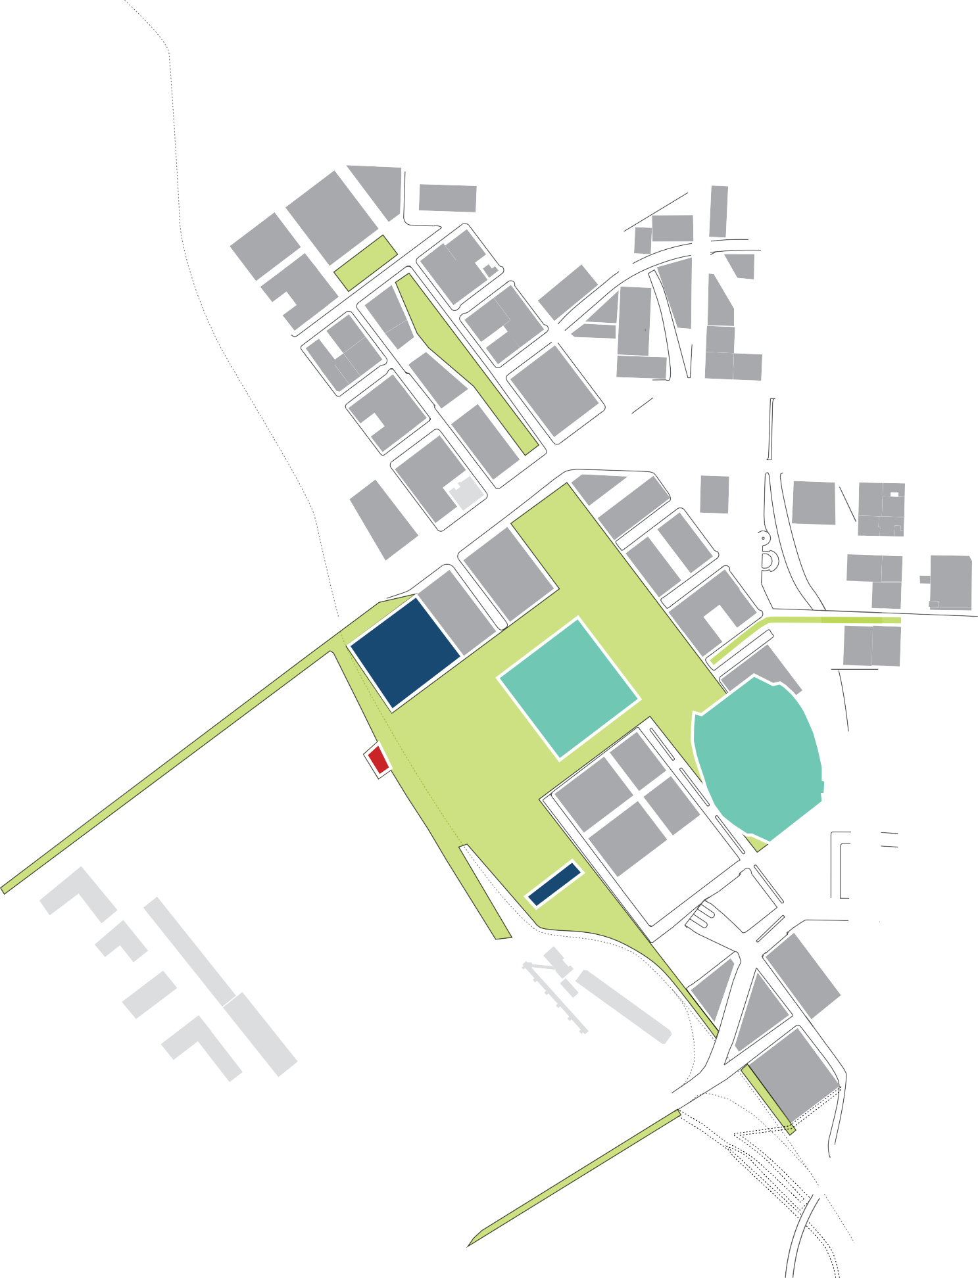



















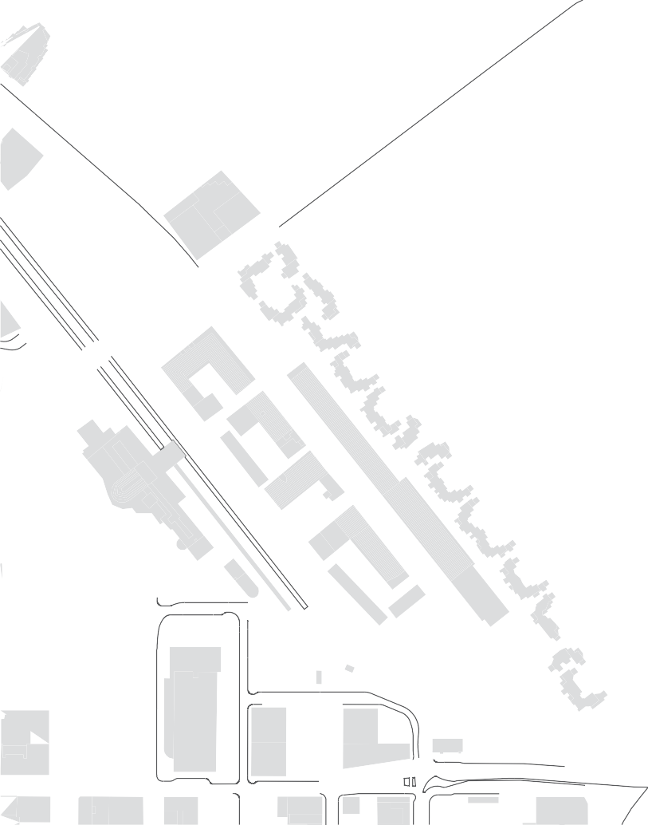






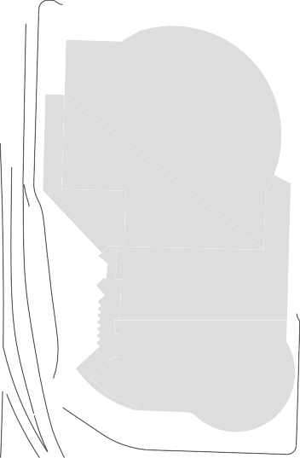







G
D
F
G
FUTURE VISION
Healing the district with intentional development that reverses displacement and honors The Great Migration.
E
Create a strong public connection to the Willamette River
Public waterfront park with cultural emphasis
Public plaza with local market and event emphasis D Public park blocks with neighborhood emphasis
E Inclusionary mixed development spans Broadway F Infill development bridges I-5
G Connect district to existing active eastside neighborhoods
C
BROADWAY BRIDGE
A
B
Existing Development New Development
Existing Civic/Cultural Buildings Aspirational Cultural Buildings
Monument to the Great Migration
Public Open Space Organizes Community
STEEL BRIDGE

Slide 16
























MEMORIAL COLISEUM
RIVER ACCESS!
INTERSTATE AVE
WATERFRONT PARK
RAIL LINE
85
65
40
20
WATERFRONT PLAZA SECTION
MODA CENTER
MEMORIAL COLISEUM
NE BROADWAY
PLAZA OPEN SPACE
PUBLIC PLAZA SECTION

Slide 17
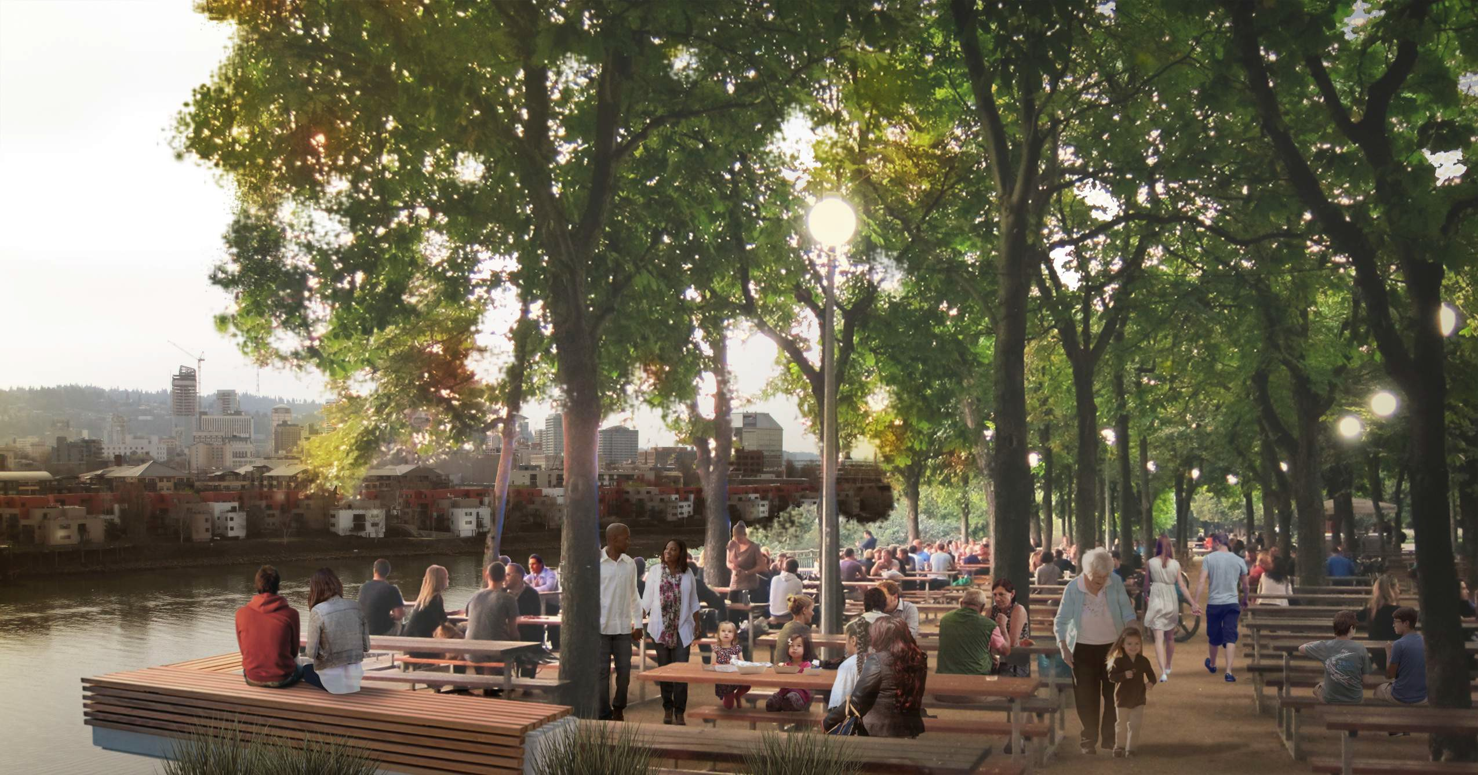

WATERFRONT, VIEW NORTH

Slide 18
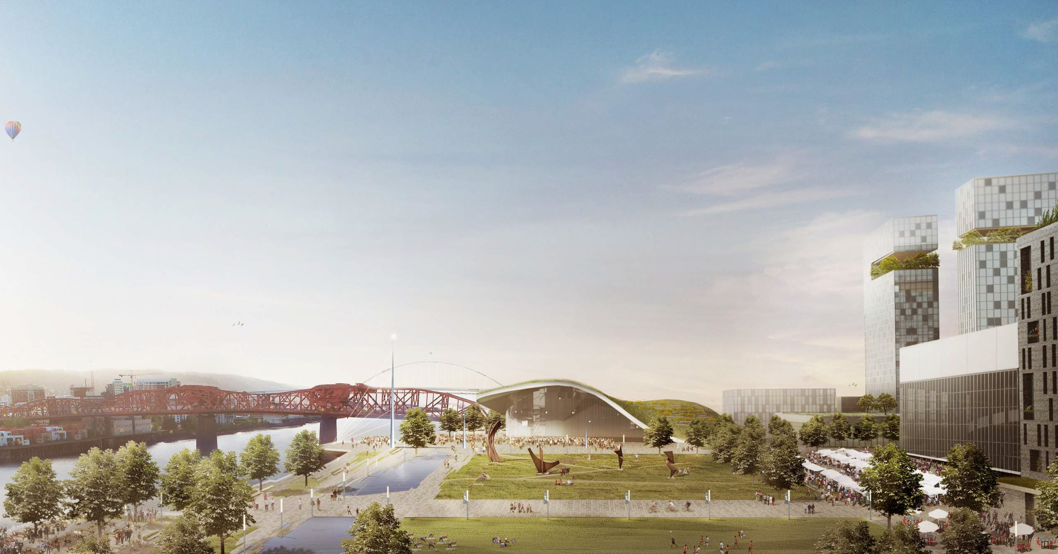
WATERFRONT, VIEW NORTH

Slide 19
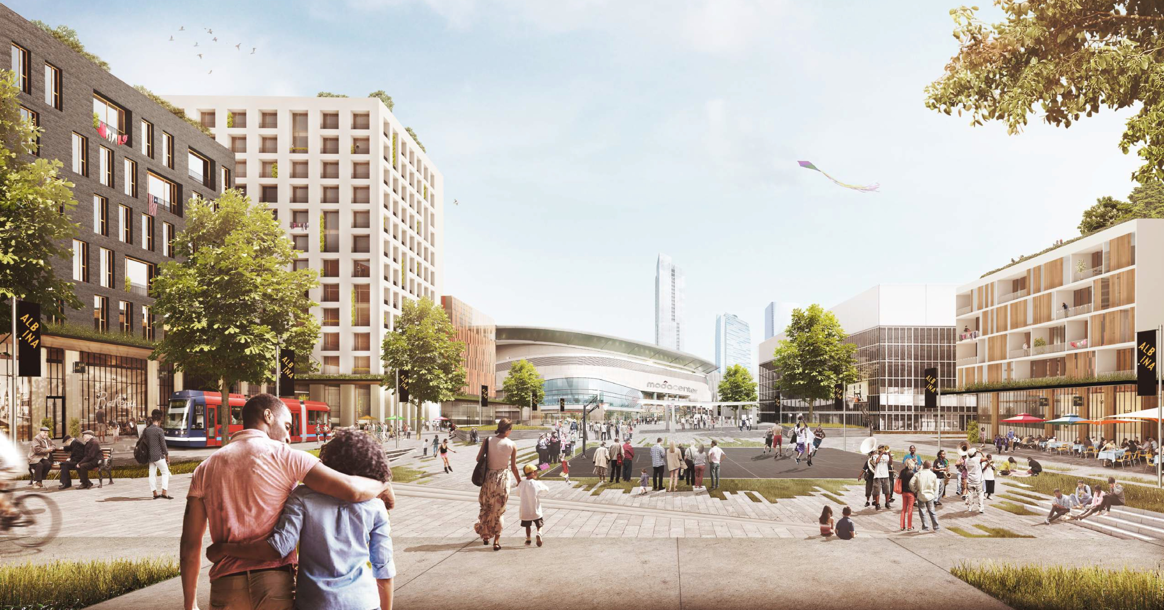
PLAZA, VIEW SOUTH FROM BROADWAY

Slide 20
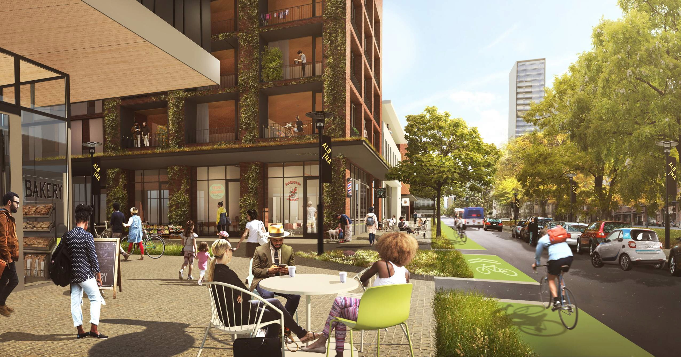
NEIGHBORHOOD STREET AND PARK BLOCKS, VIEW SOUTH

Slide 21

AERIAL, VIEW SOUTHWEST

