Slide 1

Inclusionary Housing Set Aside Rate Sunset Extension
Shannon Callahan, Housing Director
Matthew Tschabold, Assistant Housing Director
December 12, 2018

Slide 2
Inclusionary
Housing
Program
Program Options
Provide units on-site
Provide units off-site
Pay a fee rather than providing units
Building proposing 20 or more new units
99 years of affordability
Affordable for households earning 80% MFI or less
Outside Central City rate to increase January 1, 2019
Set-aside In Central City
20% of units affordable at 80% MFI
10% of units affordable at 60% MFI
Set-aside Outside Central City
15% of units affordable at 80% MFI
8% of units affordable at 60% MFI

Slide 3
Recommended Action
Extend the current sunset for the lowered inclusion rate outside the Central City for an additional 2 years from
  Program is working in the neighborhoods
  Market is adjusting
  Program refinements are needed before the full inclusion rate takes effect
3
Notes:
Extension changes from December 31, 2018 to December 31, 2020

Slide 4
Inclusionary Housing Program
Inclusionary Housing
Program
Key Highlights
8,578 units (buildings with 20+ units) have entered permitting, land use review, or pre-application/early assistance since IH went into effect
362 IH units (in projects with 2,269 total units) have permitted or are close to permitting
February 2017 – August 2018
4
Notes:
As of October 31, 9,346 units (buildings with 20+ units) have now entered the permitting, land use, or pre-application/early assistance since IH went in to effect.
8,294 units (buildings with 20+ units) from the pre-IH vested pipeline remain in a stage of permitting – (8,392 units as of October 31)
Multifamily permitting in 2017 set a historic high at over 6,000 permits
Market indicators are signaling a shift in the market cycle based on factors unrelated to the IH program

Slide 5
Inclusionary Housing
Program
February 2017 – August 2018
100 proposed buildings
8,578 total units
IH Set Aside Sunset Extension | 12/12/18 | Portland Housing Bureau

Slide 6
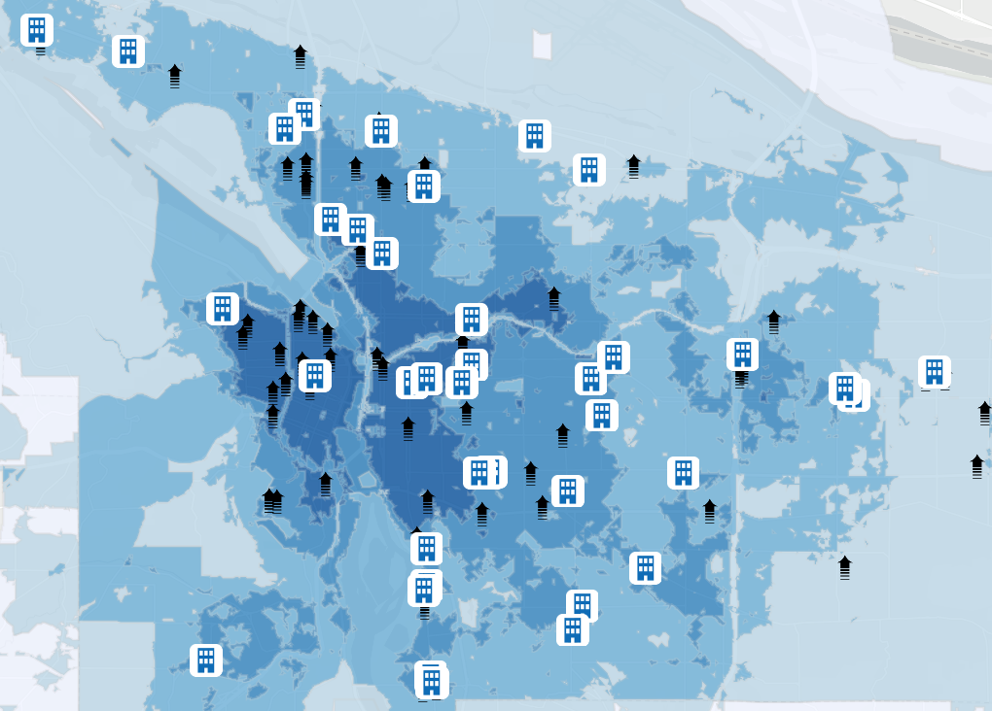
Inclusionary Housing
Program
Post Feb 1, 2017 Pipeline
100 applications
8,578 total units
43 in permitting
2,269 total units
57 in EA/pre-app
6,309 units
6

Slide 7
Inclusionary Housing
18-month review
Buildings under 20 units
Cycle of development is consistent since emerging from the recession
IH Set Aside Sunset Extension | 12/12/18 | Portland Housing Bureau

Slide 8
Actions Taken
March 2017: Council adoption of 5-year $15 million Multiple-Unit Limited Tax Exemption (MULTE) program cap
March 2018: Council adoption of Incentivizing the Pipeline MULTE program
June 2018: Council approval of technical change to IH fee-in-lieu and establishes that the fee applies only to residential portions of mixed use buildings
August 2018: Adoption of IH homeownership program requirements
Oct 2018: Council adoption of full 10-year property tax exemption for IH projects in the Central City built or zoned at 5:1+ FAR
Nov 2018: Council adoption of updated Incentivizing the Pipeline MULTE program
8

Slide 9
Upcoming Actions
Establish full 10-year property tax exemption for projects in specific geographies outside the Central City built at 5:1+ FAR
Review Central City bonus FAR to provide additional value offsets for projects subject to IH
Refine Build Off-Site and Designate Off-Site program options
9
Notes:
Dec 2018: Begin comment period, amended administrative rules addressing numerous technical issues
Dec 2018: Bring ordinance to extend lower inclusion rate for projects outside the Central City and Gateway Plan Districts by an additional 2 years

