Slide 1
Clean Air Construction Standard
Amendment to the City’s Sustainable Procurement Policy
Portland City Council Meeting December 13, 2018
Notes:
Stacey
Good afternoon Mayor Wheeler and City Commissioners. As Lester mentioned, my name is Stacey Foreman and I am here with Kyle Diesner to walk through the Resolution before you today to amend the Sustainable Procurement Policy to incorporate a City Clean Air Construction Standard.

Slide 2
Outline
Recap
Overview of the Clean Air Construction Standard and Developments Since September 20, 2018
Moving Forward: Commitments and Programming
Notes:
Stacey
As you may recall, in September Resolution 37387 directed Procurement Services and the bureau of Planning and Sustainability to continue to work with regional partners to finalize a clean air construction standard and develop a program framework for implementing the Standard.
Our presentation today will provide a brief recap of the issue and our work since September, and then we dive deeper into the Standard itself and proposed program framework.

Slide 3
Clean Air Construction - Recap
Regional Approach: Clean Air Construction Collaborative
Notes:
Stacey
As Lester mentioned in his opening remarks, the work on the Clean Air Construction Standard has been, and will continue to be, a regional effort with the agencies listed on this slide. Throughout the rest of our presentation, as we refer to our regional partners or agency workgroup, these are the agencies who are on this journey with us, and we are excited that additional agencies have expressed interest in joining this effort in the coming months.
I am now going to turn the presentation over to Kyle to continue recap and provide an update on our work over the past three months.

Slide 4
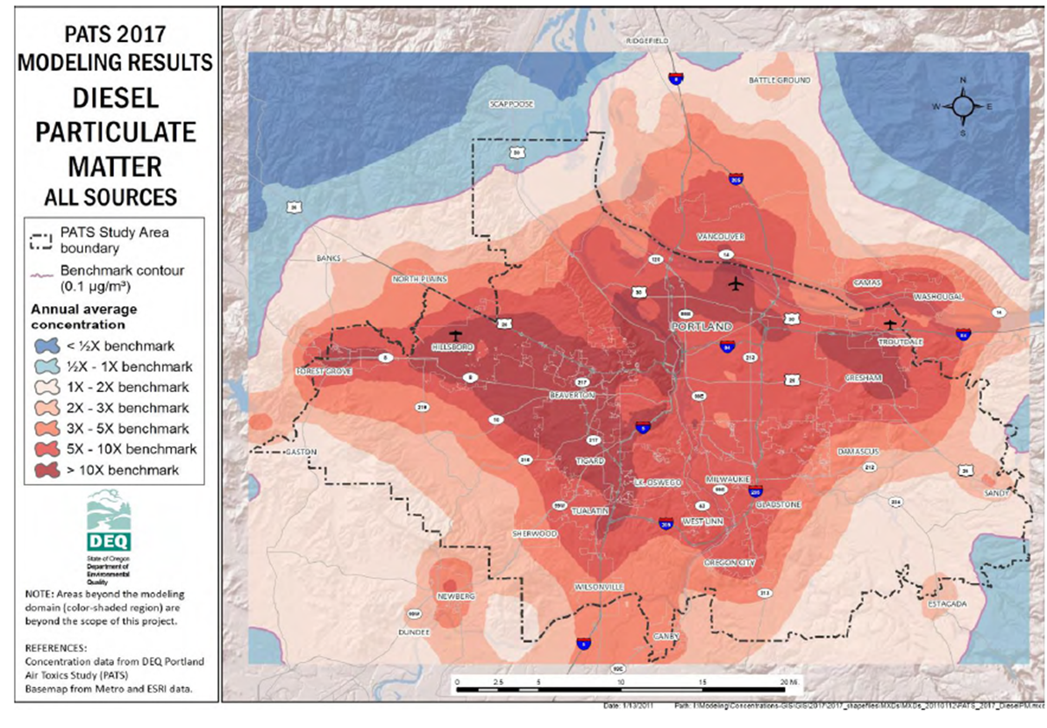
Issue: Clean Air Construction - Recap
Portland Air Toxics Study (PATS) 2017
average diesel particulate matter levels need to be reduced by 86 percent across the Portland Metro area to meet the State's adopted health benchmark.
65 percent of diesel particulate matter in the Portland-area is emitted from non-road equipment, such as construction equipment.
Notes:
Kyle
This chart shows Diesel Particulate Matter by Source for the Portland Metro area, 2017 PATS. Portland Air Toxics Assessment released in 2006 was the first-time data was published about diesel particulate matter in the Portland metro area. Since that time the problem has worsened with regional growth and increased economic activity. In fact, average diesel particulate matter levels across the Metro area exceed the State's adopted health benchmark. North Portland has the highest level of diesel particulate matter pollution in the state.
65% of diesel emissions in the Portland metro area come from non-road equipment. The on-road sector is already regulated through manufacturing standards. These emission standards have only more recently been applied to non-road equipment. New engines, electric equipment and exhaust controls can reduce diesel pollution up to 95% on our projects.
But why do we care about diesel particulate matter emissions? Diesel exhaust is 100 times more toxic than gasoline exhaust, and includes fine sooty particles layered in heavy metals and toxic gases. These particles move through the respiratory system like a gas…. Moving quickly from the lungs to the bloodstream and are then carried throughout the body leading to a wide range of health effects in the respiratory, cardiovascular and even the nervous system.
Diesel is a known human carcinogen as determined by the International Agency for Research on Cancer (IARC) typically expressed as lung and bladder cancers. Diesel particles are known to increase risk for heart attacks and are suspected as a causal factor in increasing risk for autism, impaired cognition and ALS, commonly known as Lou Gehrig’s disease.
Children and elderly are especially vulnerable. Asthma incidence is a concern for children and the elderly are especially vulnerable to heart disease from episodic and long-term exposure to diesel particulates.
Also, we know through work of Multnomah County Health Department that there is a disproportionate impact on African American and Latino populations in our city. They face up to 3 times higher exposure rates since those communities tend to live in proximity to high development and transportation hub activities.

Slide 5
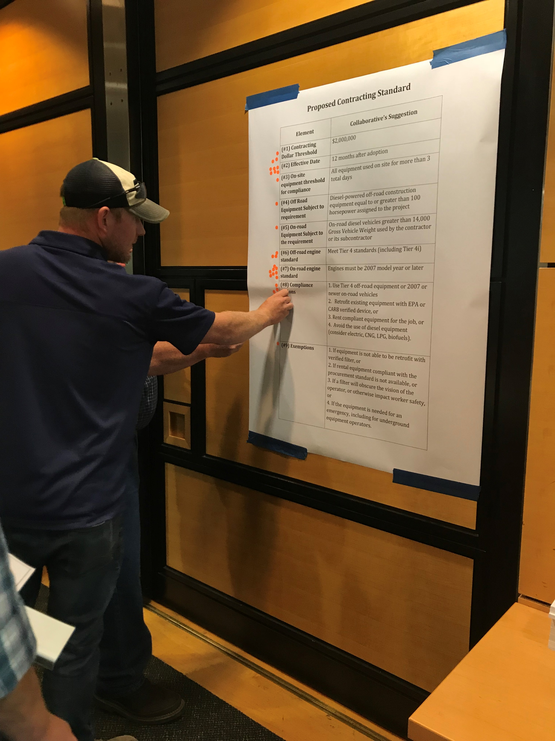
Clean Air Construction - Recap
Stakeholder Engagement
Ongoing since 2010
August 22nd Workshop
Individual presentations to various associations, contractor & neighborhood groups
Public comment period in November
Notes:
Kyle
Some stakeholders have claimed that we’re moving too fast. But we have actually worked on this issue strategically for over a decade. It was 2006 when the first PATS results were released, alerting us to the elevated health risk Portlanders face due to diesel pollution. Oregon Environmental Council reminded me that the former Sustainable Development Commission sent a letter to City Council in 2007 calling for the City to adopt contracting requirements to reduce diesel emissions from public projects.
At that time, we invested $2.3 million in federal funds to make upgrades to our own fleet. We also piloted and conducted stakeholder engagement for a similar contracting standard in 2009-2010.
Since that time, we have working to build a regional commitment to advance this work. Air pollution is not limited to the City and any policy on this front is far more effective if adopted my broadly by all regional jurisdictions.
In August we held a workshop with stakeholders, which helped us flush out the policy framework we shared at the Council hearing on September 20, 2018. Since that time, we have continued to collaborate with regional jurisdictions, City infrastructure bureaus, private sector contracting firms and associations, and neighborhood and environmental advocacy groups. We continue to hear the same feedback we’ve received over the last decade.
We also released a revised draft of the policy for public comment for two weeks in November.

Slide 6
Public Comment
138 Comments received
We heard from a variety of organizations including contractor industry associations, environmental advocacy and neighborhood groups.
98% supported; 2% opposed
Of those who support the rules, 57% support the rules as written and 40% supported the rules but wanted them to be stronger.
Notes:
Kyle
I’d like to spend a few minutes reviewing the results from the public comment period.
We received 138 Comments
We heard from a variety of organizations including contractor industry associations, environmental advocacy and neighborhood groups.
98% supported; 2% opposed
Of those who support the rules, 57% support the rules as written and 40% supported the rules but wanted them to be stronger.
The public feedback fell into 6 common themes, which I will share, along with the response from our regional workgroup.
#1 The horsepower threshold for non-road diesel powered equipment should be lowered from 100-hp to 25-hp.
The resolution before you today includes this lowered threshold, which is consistent with existing construction fleet requirements in California.
#2 The policy should incentivize the cleanest solutions, starting with replacement of diesel powered equipment with electric powered equipment.
This policy utilizes a Best Available Control Technology (BACT) methodology. The BACT requires the use of the technology that will have the greatest pollution reduction possible for a particular piece of equipment. The Policy explicitly mentions alternative fuels and electric powered equipment as alternative pathways for compliance.
#3 The phase-in timeline, 7 years, should be shortened.
The project team engaged in a two-year planning process to develop this policy. During technical program design, the team heard from California program administrators and emissions control experts who warned that program success would hinge on adequate time for outreach, implementation, contractor planning, and equipment market development. That coupled with the time needed to address critical elements such as VW settlement funds or Diesel Emissions Reduction Act funding for COBID firms, warrant an adequate phase-in timeline.
#4 The policy should use post-bid change orders or add an allowance item of a certain percentage of the overall contract budget to replace or retrofit diesel equipment to be used on the project, to be paid by the municipality.
This approach is not consistent with national best practices and would leave the entire cost of buying compliant equipment on public agencies. Of the 14-existing clean fleet construction contracting programs across the U.S. that we surveyed, in no case did any agency or university directly cover the cost of contractor equipment retrofits. Moreover, certain funding sources, such as utility and Highway Trust Fund dollars are restricted in their use.
#5 The program should identify a current baseline and measure and monitor progress toward improved air quality.
The City and the County do not currently have resources to monitor for particulate matter (PM) as a part of this project. Monitoring for PM is costly, time intensive, and does not always capture results associated with a construction project depending on the wind speed and direction, and other atmospheric factors. Instead, the program will rely on ambient monitoring data from the Oregon Department of Environmental Quality, and inventory data. In addition, the program will require that all pieces of equipment register and display a decal showing that the equipment has been checked for compliance on an annual basis.
#6 There has been insufficient opportunity to provide feedback.
The project team met individually with community groups and industry associations to discuss policy development. The project team then hosted a stakeholder workshop in August of 2018 to evaluate various program elements. In September of 2018 the Portland City Council and Multnomah County Board of Commissioners held public meetings to vet the project team’s policy recommendation and received public testimony. In November the project team had a two-week public comment process and received 138 responses.
Prior to the current effort, Multnomah County and the City of Portland held public meetings with contractors to pilot the policy in 2009-10. In 2016, project team members also participated in a 6-month stakeholder process convened by the Oregon Legislature and heard from both industry and the environmental community on this subject. Throughout the last decade, we have received consistent feedback from our stakeholders.
In short, given the long history of engagement on this issue, the fact that we have been forecasting our intent for over a decade, and the lack of policy solutions tried to date, the project team feels that moving forward at this time with policy adoption is the most prudent decision.

Slide 7
Clean Air Construction: Goals
Reduce Diesel Particulate Matter (PM) Emissions on City Construction Sites
Support Diverse Contractor Pool
Mitigate Cost and Administrative Impacts
Foster Regional Adoption to Further Reduce Diesel PM Pollution
Notes:
Kyle
Our goals for this policy are to first and foremost reduce diesel particulate matter (PM) emissions on city construction projects. Secondly, we are committed to supporting a Diverse Contractor Pool and want to ensure our approach doesn’t set back our efforts made to date. Third, we want to reduce cost and administrative impacts for contractors and our bureau construction managers. And lastly, we want to foster regional adoption to increase the effectiveness of this policy.

Slide 8
Clean Air Construction: Goals
At Full Program Implementation:
Idling reduction
Cleanest available (new) diesel nonroad equipment or cement mixers/dump trucks
Older diesel equipment/vehicles retrofitted with diesel particulate filter (DPF)*
Alternative fuel vehicles or equipment
*certified COBID firms may have equipment with grandfathered diesel oxidation catalyst (DOC) retrofit technology
electric-powered excavator
Notes:
Kyle
In all, the resolution and clean air construction standard before you today, strikes a fine balance between these goals. Ultimately, after full program implementation we will:
Reduce idling on our project sites
Utilize the cleanest available (new) diesel nonroad equipment or cement mixers and dump trucks
Increased use Alternative fuel and electric vehicles and equipment
And lastly, retrofit Older diesel equipment/vehicles with diesel particulate filters (DPF) such that we achieve reductions on the order of 95%. Certified COBID firms will be allowed to utilize lower cost control technologies that reduce emissions about 20%. We are committed to working with those firms to find ways to incentivize upgrades that achieve greater emission reductions.
I’m now going to hand this back to Stacey Foreman with Procurement Services to talk about the specifics of implementing this Clean Air Construction Standard.

Slide 9
Clean Air Construction Standard
Attachment 3 to Sustainable Procurement Policy
Effective Date: January 1, 2020
Idle reduction requirements begin 2020
Engine requirements phase-in period begins 2021
Applicability: Construction Contracts > $1 million
Engine Requirements Applicability:
Nonroad diesel equipment >25hp
On-road diesel cement mixers and dump trucks
Notes:
Stacey
Thank you Kyle
Over the next few slides I will be going through key content of the Standard, which this Resolution adopts as an attachment to the City’s Sustainable Procurement Policy
Standard has an effective date of January 1, 2020 and elements of the Standard are phased in over several years, which I will go into more detail over the next few slides
The Standard will be applicable to new City Construction contracts valued over $ 1 million dollars
And the Standard’s engine requirements will be applicable to nonroad equipment over 25 hp (as Kyle mentioned this is a change from 100hp referenced in the draft we presented in September)
And in terms of on-road vehicles, the Standard applies to cement mixers and dump trucks.

Slide 10
Clean Air Construction Standard
Idle Reduction Requirements
Nonroad equipment: shut down after five (5) minutes of inactivity
Nonroad equipment: anti-idling decals/prompts visible to operator
Job site: post “Five Minute Limit” signs
Job site: operator education/awareness
Notes:
Stacey
To begin with in 2020, the idle reduction requirements take effect
These requirements largely mimic the City’s idle reduction requirements for its own fleet with the addition of requirements around signage and operator awareness

Slide 11
Clean Air Construction Standard
Engine Requirements & the Compliance Options Protocol:
Individual equipment/vehicle focused
Maximizes emission reductions
Starts with the most stringent emission reduction technology option
(Best Available Technology approach)
Notes:
Stacey
Related to the engine requirements to reduce diesel emissions the Standard includes a Compliance Options Protocol, which you can find on page 3 of Exhibit A.
The Protocol reflects a point that Kyle highlighted earlier - that the Standard allows for multiple compliance options, such as alternative fuel or electric powered equipment –
AND that when it comes to retrofitting old equipment with emission control devices, there is not a one size fits all solution.
For example, the most effective emissions control devices include Diesel Particulate Filters (DPFs) which can achieve up to 95% particulate matter emission reductions .
But not all engines can accommodate DPFs, so in such cases, the Compliance Protocol requires an equipment owner to demonstrate that the next best option for a specific vehicle or piece of equipment is utilized.
This could mean that the best option for a particular piece of equipment is a diesel oxidation catalyst (DOC) with particulate matter reduction levels at about 20%.
If no emission control device works for a specific piece of equipment or vehicle, then the Protocol calls for the use of compliant rental equipment.

Slide 12
Clean Air Construction Standard
Engine Requirements
Effective Date of Diesel Engine Requirement | Nonroad Diesel (over 25hp) | On-Road Diesel (cement mixers and dump trucks)
January 1, 2020 | No Idling
January 1, 2021 | No tier 0 engines allowed¹
January 1, 2022 | No tier 1 engines allowed¹
January 1, 2023 | No tier 2 engines allowed¹
January 1, 2024 | No tier 3 engines allowed^{1,2} | No pre-2007 engines^{1,2}
January 1, 2025 | Tier 4 only^{1,2}
January 1, 2026 | Tier 4 only³ | No pre-2007 engines³
Notes:
Stacey
So, with that in mind, here is the Standard’s phase-in schedule.
As I mentioned earlier, in 2020, we start with the idle reduction requirements
Then in 2021, we begin the engine requirements, starting with excluding the dirtiest nonroad diesel engines, Tier 0, unless they are retrofitted with a DPF other control device per the Compliance Protocol.
Each year we exclude another nonroad engine Tier and then in 2024, we begin to limit the retrofit compliance options by not allowing any new DOCs (previously-approved DOC retrofitted engines are allowed until 2026). This retrofit limitation is another change from previous versions of the Standard, in response to concerns about DOC retrofitted equipment being used in perpetuity, thereby minimizing the effectiveness of the Standard in reducing diesel particulate matter emissions.
2024 is also the year we exclude any pre-2007 on-road diesel cement mixers and dump trucks unless they are retrofitted with a DPF emission control device.
By 2026, only Tier 4 diesel non-road and 2007 or newer on-road cement mixers and dump trucks will be allowed, unless an older engine was previously retrofitted with a DPF. Any previously approved equipment retrofitted with a DOC device will no longer be allowed on our construction sites unless that equipment is owned & operated by a COBID certified firm. (Certification Office for Business Inclusion and Diversity (COBID)
¹Diesel engine retrofits (emission control devices) allowed on older equipment/vehicles following the Compliance Options Protocol provided herein.
²No new DOC emission control devices allowed. Equipment retrofitted with DOC emission control devices prior to 2024 are allowed.
³No older equipment/vehicles allowed unless it was retrofitted with a DPF prior to 2026. Exemption: certified COBID firms may use equipment/vehicles retrofitted with a DPF or DOC prior to 2024 (for DOCs) and 2026 (for DPFs).

Slide 13
Clean Air Construction Standard
Exemptions
Equipment/vehicle is required for an emergency
A required emission control device would obscure operator lines of sight or otherwise impact worker safety and no compliant rental equipment is available within 100 miles of job site
Equipment is not able to be retrofit and no compliant rental equipment is available within 100 miles of job site
Special circumstance whereby compliance for a specific equipment/vehicle is not reasonable
Notes:
Stacey
The Standard does allow exemptions, which are listed on this slide. These exemptions are reflected in the compliance protocol mentioned earlier and is the process by which exemptions will be granted.

Slide 14
Clean Air Construction Standard
Compliance & Verification Key Elements
Single regional registration/compliance database
Regional equipment/vehicle decal for easy on-site verification
Notes:
Stacey
Regarding compliance, the Standard requires contractors to submit applicable equipment, vehicle and engine information for compliance verification.
Compliant equipment and vehicles will receive a decal to be displayed on the equipment or vehicle for easy identification by City staff.
To reduce submittal fatigue and make the compliance verification process more efficient, the regional workgroup recommends that we establish a single compliance database and decal program accessible to all participating regional agencies.
Which brings me to the last part of our presentation, the program framework for implementing the Standard

Slide 15
What’s Next
Regional Program Framework
Lead agency model
City as proposed lead agency: FY19-20 Direction to Develop and budget ask
Core Program Elements
Administration
Communications
Compliance/Enforcement
COBID certified firms- specific support
Continued stakeholder engagement in program development
Notes:
Stacey
So, as alluded to earlier, the recommended Program Framework takes a regional approach. Taking a regional and collaborative approach is intended to both make the compliance process more efficient for contractors by reducing redundancies, and also spread the cost impact of program administration among many agencies.
Yet, in this collaborative approach, one agency needs to take a lead role, and given the City’s large volume and variety of construction projects and Procurement Services’ history of serving as a regional leader in multi-agency programming, the clean air construction collaborative recommends the City serve as the lead agency.
Thus, the Resolution before you today also includes a directive for Procurement Services to submit in our FY19-20 budget request, funding needed to fulfill the role of lead agency for this regional programming approach.
Exhibit B to the Resolution provides the proposed program framework, which is comprised of the core programming elements the regional workgroup feels are needed for successful implementation of the Standard.
Yet, this Framework is just the beginning. It is a starting point and we will be working further with our regional partners to develop program details. As we do so, we are committed to engaging stakeholders – including City bureaus, the contractor community, and clean air advocates – many of whom are here today.

Slide 16
What’s Next
Return to Council
July 2019: Financial analysis on impact to affordable housing projects
Portland Housing Bureau projects currently exempt from Standard
October 2019: COBID compliance funding assistance proposal
Foster Standard Adoption by More Agencies
Notes:
Stacey
In addition to developing the Clean Air Construction program, next steps include returning to City Council in July 2019 with results from a financial impact analysis on applying the Standard to affordable housing projects.
And, returning in October 2019 with a proposal for financial and technical assistance support for COBID certified firms complying with the Standard. The October timeline reflects the need to take into account the results of the 2019 State Legislative session and the level of success in securing VW settlement funds for assisting COBID certified firms in upgrading or retrofitting old diesel equipment and vehicles.
Lastly, next steps include supporting more agencies to adopt the Clean Air Construction Standard, so we can maximize the potential for reducing harmful diesel particulate matter pollution in our neighborhoods.
And now I will turn it back over to Kyle for some closing remarks.

Slide 17
Closing Remarks
Notes:
Kyle
In closing I’d like to reiterate that we are bringing forward a solid regional approach to reduce emissions. This is based on national best practices and the phase-in schedule is based on lessons learned from California. In addition, we are utilizing a unique and proactive approach to addresses impacts to COBID firms. This is a step that was not taken by any of the other 14 programs we surveyed across the county. This demonstrates our strong commitment to equity and diverse business development.
We understand this policy includes significant cost uncertainty – both on impacts to contractors and on bureau construction costs. We are working to get better data with a survey of members of the Portland Building Development Group and the statewide inventory being conducted by DEQ. We have also committed to conduct a financial impact analysis to better understand how this policy impacts affordable housing projects.
This policy presents a careful balancing act between divergent stakeholder concerns - cost vs environmental/health benefits. We know from the U.S. EPA that every dollar invested in reducing diesel pollution has a $10 return on the investment. Even with cost uncertainty, we know the costs of inaction are greater than the costs of making these investments. Regardless, this is about our values. I think we can all agree, that when we can, it is our responsibility to help deliver on cleaner air for Portlanders.
In the absence of broader statewide regulation; clean air construction standards provide an opportunity to significantly reduce diesel emissions on our public projects. It benefits the health of agency employees, contactors, and nearby communities. This is an important leadership opportunity on a significant public health issue and now is the time to act.

