Slide 1
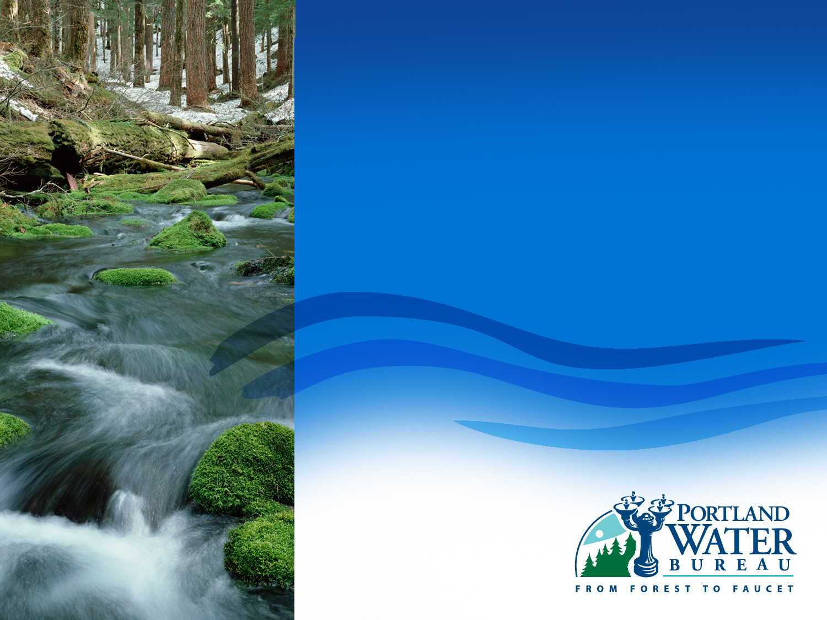
Portland City Council
Bull Run Filtration Project
December 12, 2018
Michael Stuhr, P.E. Administrator
Gabriel Solmer, Deputy Administrator
Teresa Elliott, P.E., Chief Engineer
David Peters, P.E., Principal Engineer
Notes:
1

Slide 2
Why are we here today?
Authorize the Water Bureau’s recommended alternatives for filtration capacity, location and technology.

Slide 3
Bull Run Filtration Project

Slide 4
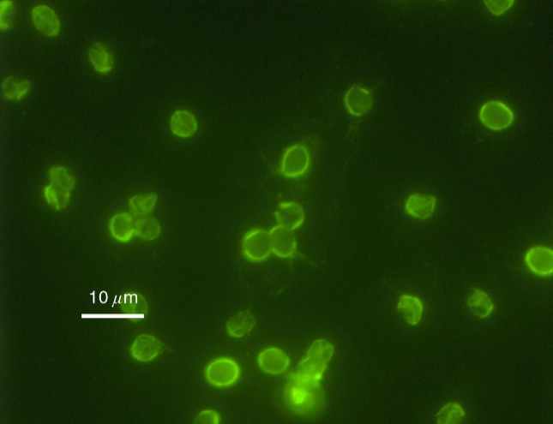
Why do we need filtration?
Filtration improves public health by removing Cryptosporidium (crypto) from the water
2006
2009 - 2016
2017
EPA passes a new regulation to protect against crypto.
Portland develops unique program to protect Portland’s water from sources of crypto, the program is successful for 5 years (2011 to 2016)
Low level detections show protecting Portland water at the source is no longer sufficient to keep crypto out of the water, OHA requires further treatment, Portland chooses the EPA approved Filtration.
The Bull Run Filtration Project continues the City’s commitment to serving the best possible water to Portland customers.

Slide 5
Filtration also provides other benefits
Makes Portland’s water safer by removing microorganisms
Makes our Bull Run supply more reliable
Allows Bull Run to be used after an emergency, such as a fire
May reduce the amount of chlorine needed for disinfection and the amount of disinfection byproducts.
Prepares us to respond to future regulations

Slide 6
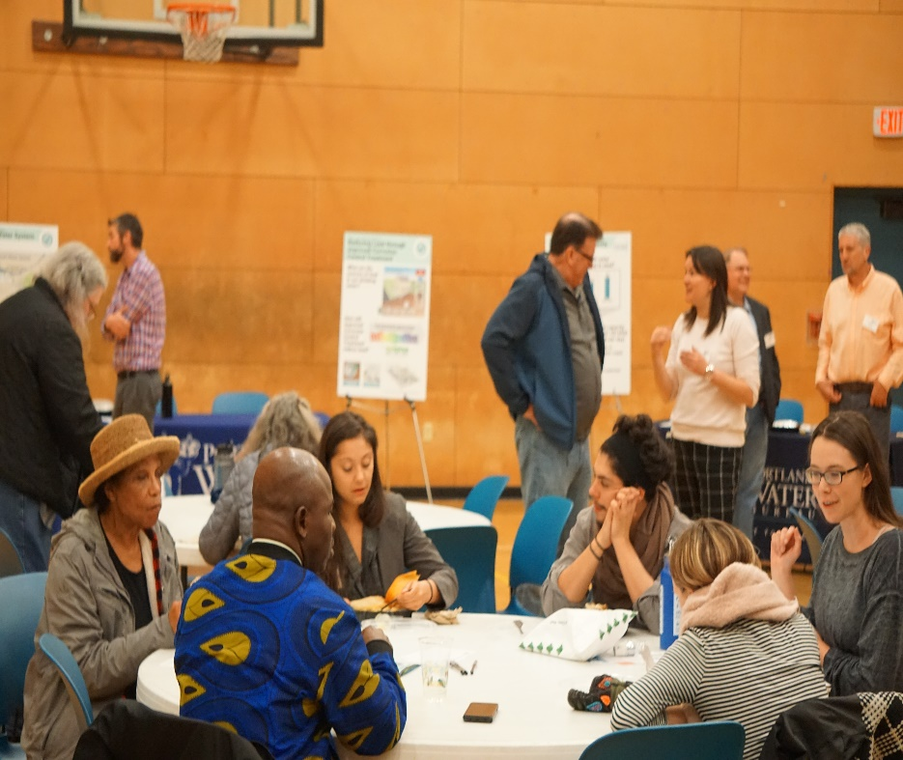
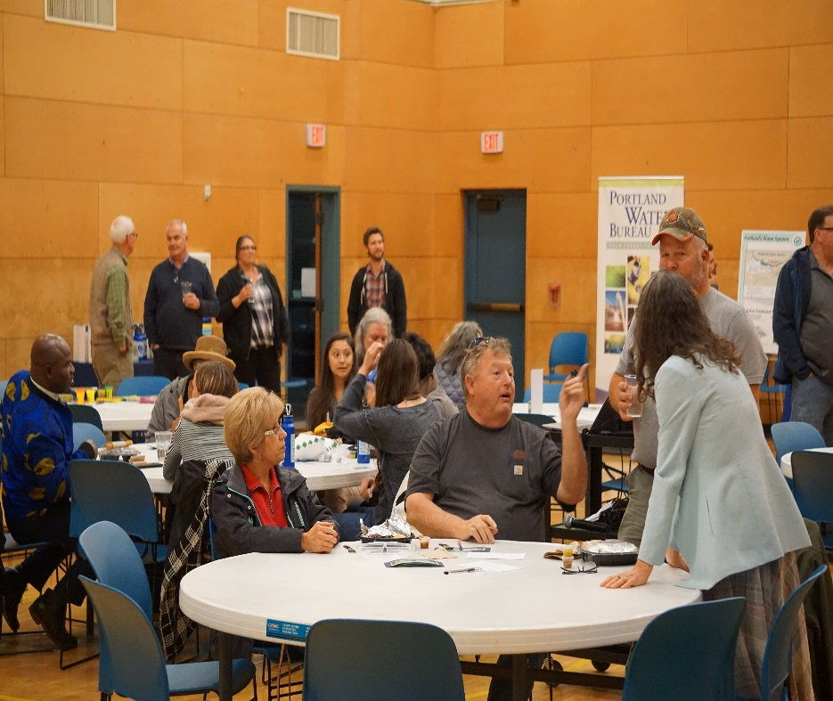
Community Conversations
  Prioritizing public outreach and communication to guide this work
  Online survey
  Digital/social media outreach
  Stakeholder interviews
  November 8th Community Forum
  Ongoing outreach with potential project neighbors

Slide 7




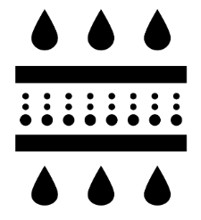
Initial decisions focus on four foundational elements
  Procurement Method
  City Council decision 8-29-18
  Filtration Plant Capacity
  Filtration Plant Location
  Filtration Plant Technology
Notes:
Add goal and delete next slide

Slide 8
Analysis:
Filtration Plant Capacity
    How much water are we going to need?
200MGD
145 - 160 MGD
115 MGD
Recommended capacity

Slide 9
Filtration Plant Capacity
Recommended capacity: 145 to 160 MGD
Continues Bull Run as Portland’s main water supply, meeting demands on most days in most years
Manages costs by matching filtration plant size to expected water use
Allows for future expansion if needed

Slide 10
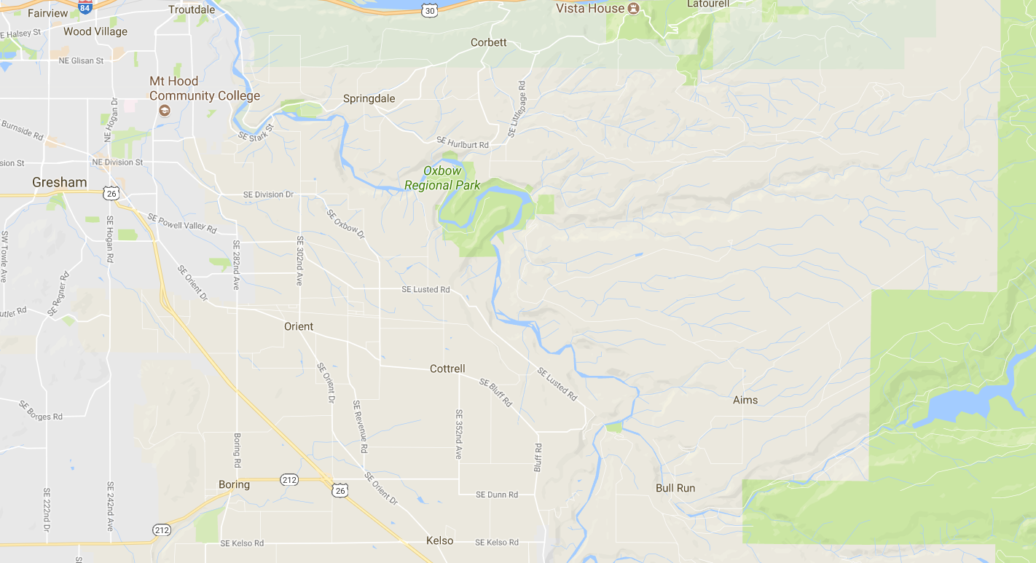

Analysis: Filtration Plant Location
Where should the filtration plant be located?
Powell Butte
Lusted Hill
Carpenter Lane
Headworks
Bull Run Watershed
Roslyn Lake
Larsen’s Ranch

Slide 11

Analysis: Filtration Plant Location
Site | HGL | Proximity to Conduits | Tax Lot Size | Slopes and Geologic Hazards | Schedule
Carpenter Lane | Pass | Pass | Pass | Pass | Pass
Headworks | Fail | Pass | Fail | Fail | Pass
Larson’s Ranch | Fail | Pass | Pass | Pass | Pass
Lusted Hill | Pass | Pass | Pass (with site expansion) | Pass | Pass
Powell Butte | Pass | Pass | Pass | Pass | Fail
Roslyn Lake | Fail | Pass | Pass | Pass | Pass

Slide 12
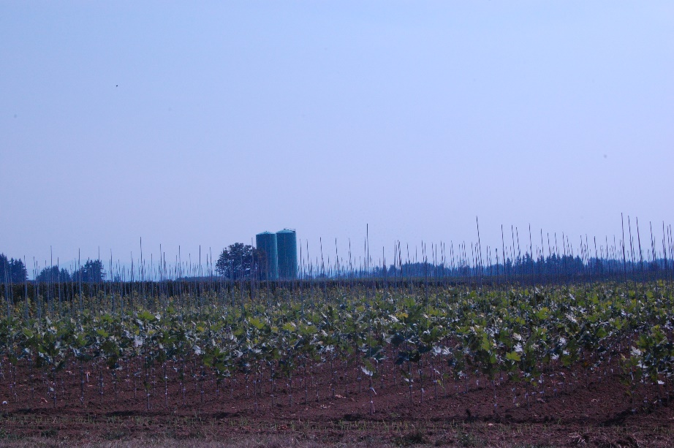
Filtration Plant Location
Recommended site: Carpenter Lane
Site is at the right elevation and location, so that less pumping is needed
Property is already owned by Portland Water Bureau so avoids the cost of purchasing a new property
Zoning allows a filtration facility
Site is large enough to provide a buffer between the facility and its neighbors
Carpenter Lane is a 95-acre property purchased by Portland for a future filtration facility

Slide 13
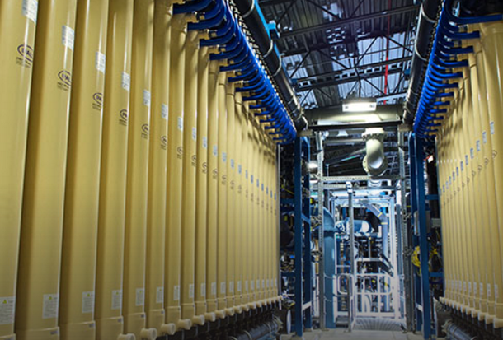
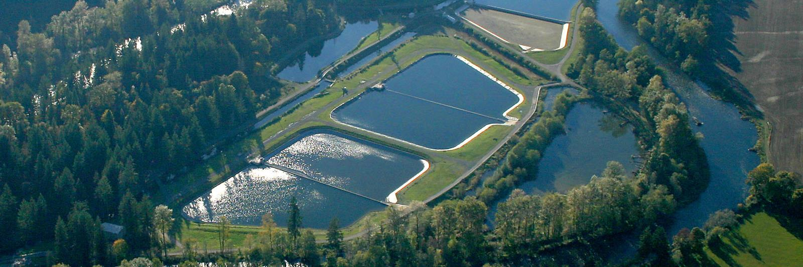
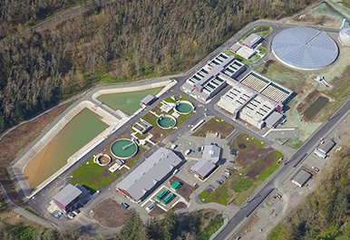
Analysis: Filtration Technology
Membrane
Slow Sand
Factors:
Water quality
Hydraulics
Regulatory requirements
Comparative costs
Other utility comparisons
Granular Media
Notes:
Better graphics that show the differences between options, 4 different slides (1 for each) with pros cons at high level

Slide 14
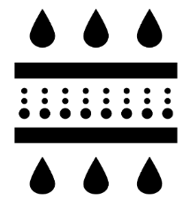
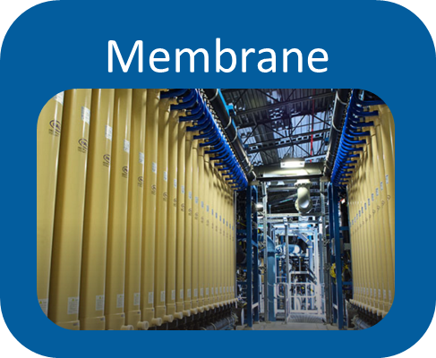
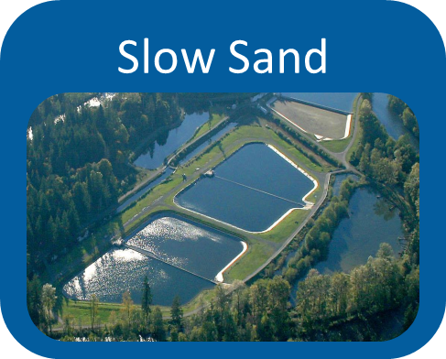

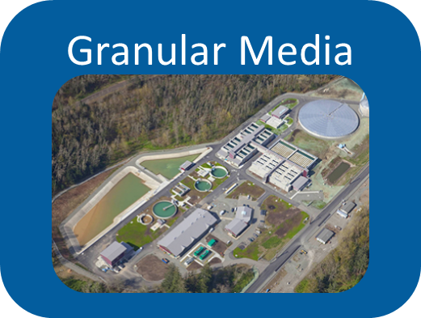
Analysis: Filtration Technology
Membranes
X High energy use
X High capital and operating costs
Slow Sand
X Significant size
X Comparative poor water quality
Granular Media
Best operating capabilities
Good water quality
Most flexibility
Notes:
Which one and why

Slide 15
Filtration Technology
Recommended filtration technology:
granular media filtration
Proven technology that produces excellent water quality
Lowest cost technology that can meet desired water quality
Very flexible – it can be adapted to different water conditions and new water quality requirements
Fits on the filtration plant site with room to grow in the future

Slide 16
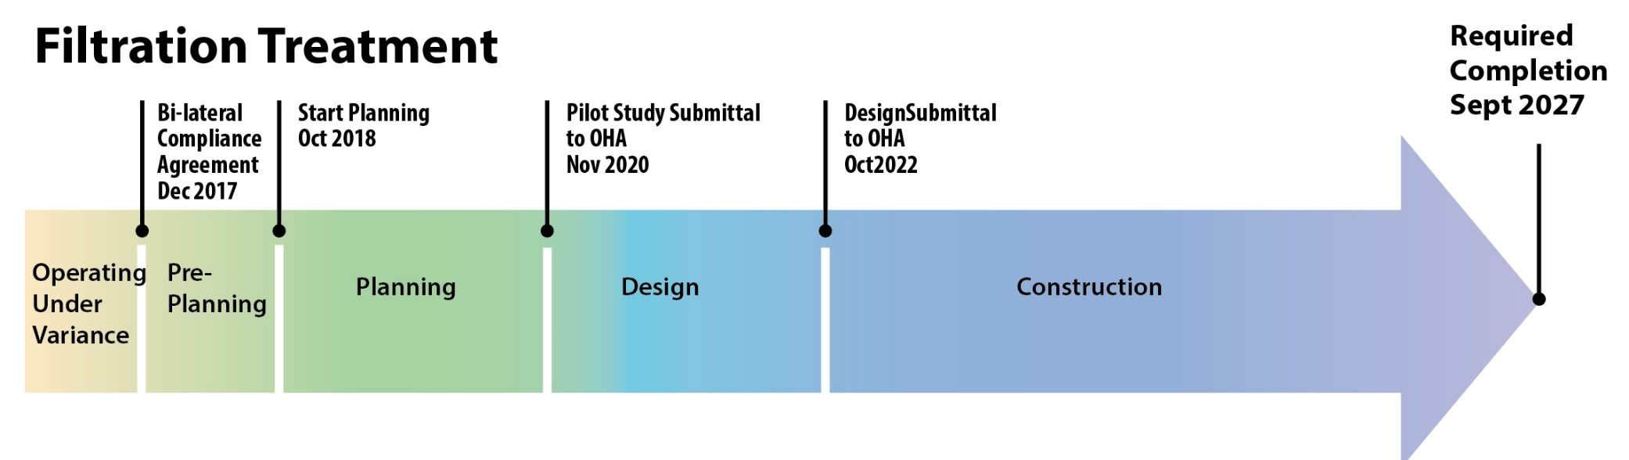
Bull Run Filtration will be in operation by 2027

Slide 17
Next Steps
For City Council
Authorize a design contract, summer 2019
Authorize a professional services contract with the Construction Manager/ General Contractor (CM/GC), end of 2019

Slide 18
Questions?

