Slide 1

The Henry Apartments
Sean Hubert, Chief Housing and Strategy Officer
December 5, 2018

Slide 2
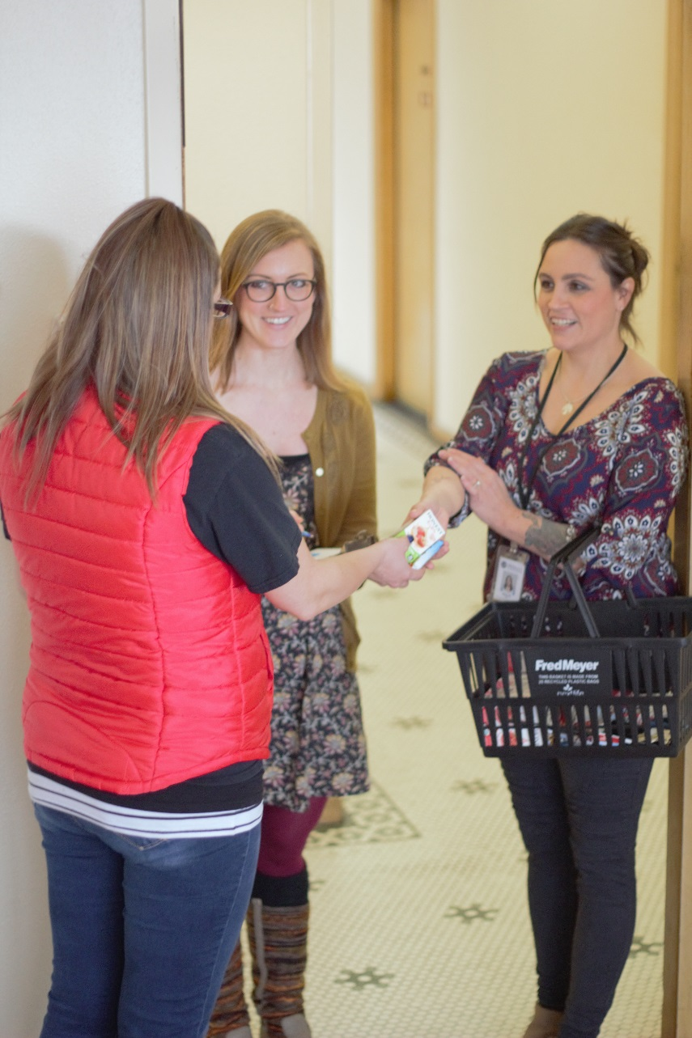
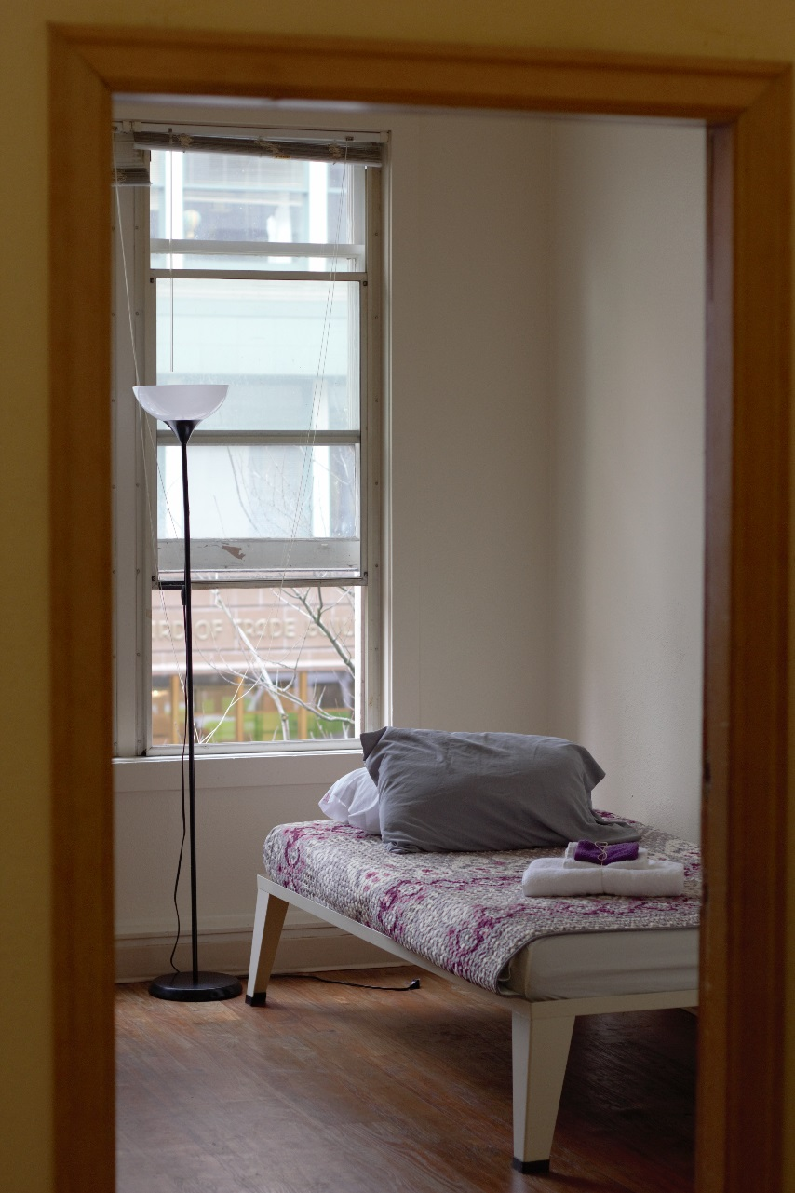
Resident Outcomes
769 Residents served per year on average
Avg Income at Move-In: $5,856/year
Avg Income at Move-Out: $13,104/year
Residents placed in stable / permanent housing upon exit: 82%

Slide 3
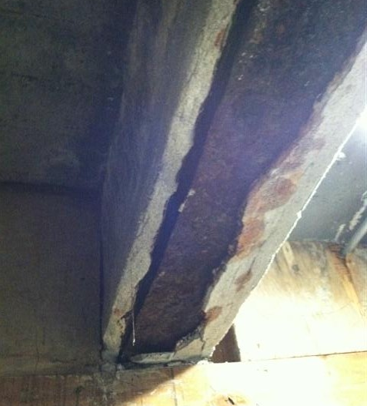
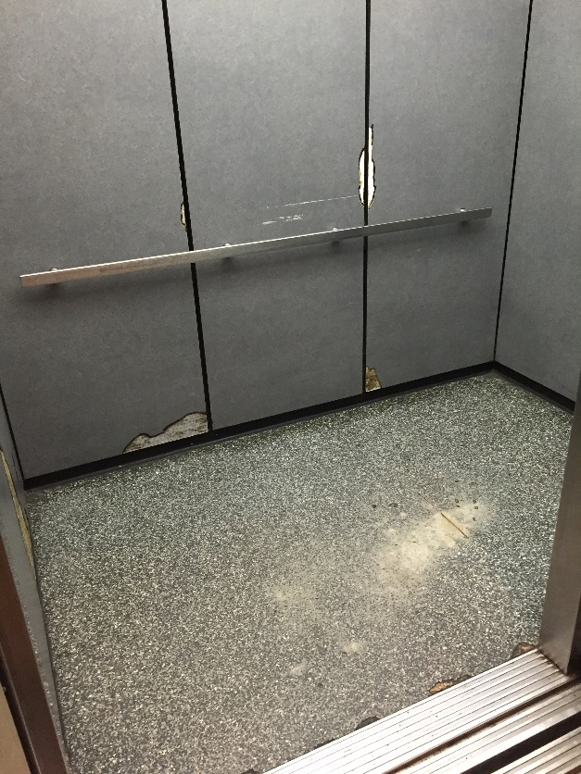
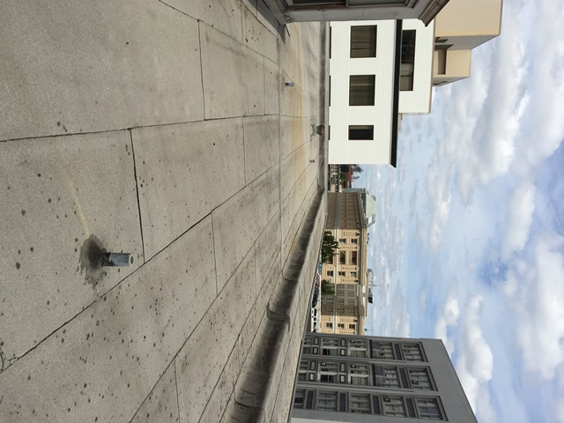
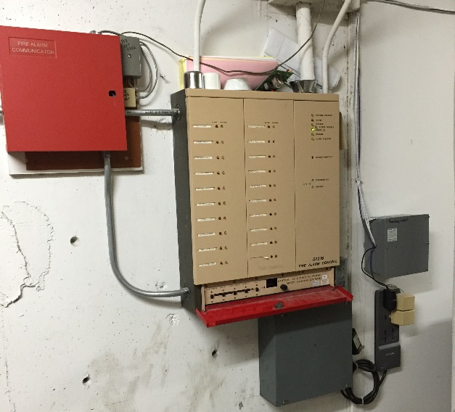
Existing Conditions
Water intrusion at sidewalk vault
Aging elevator and MEPF systems
Roof is beyond estimated useful life

Slide 4
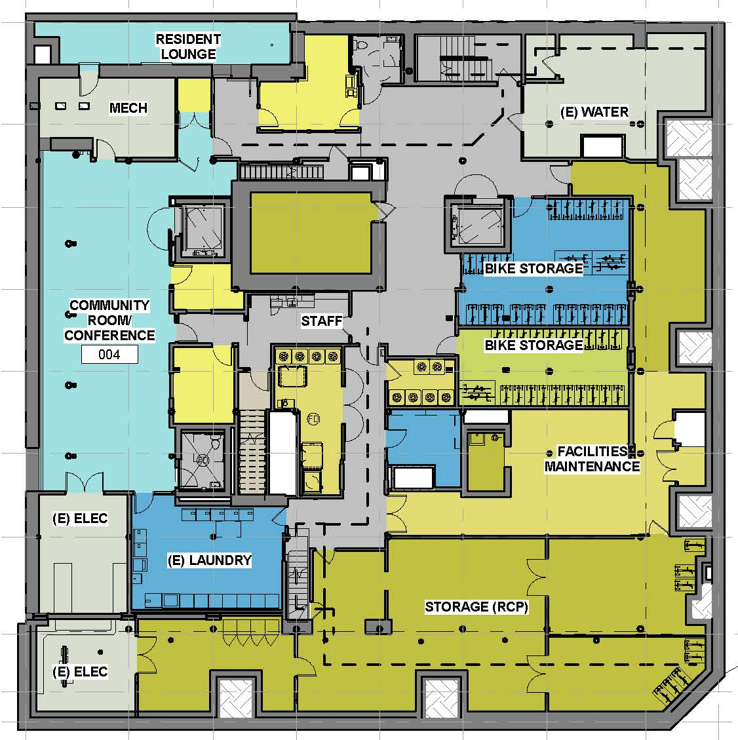
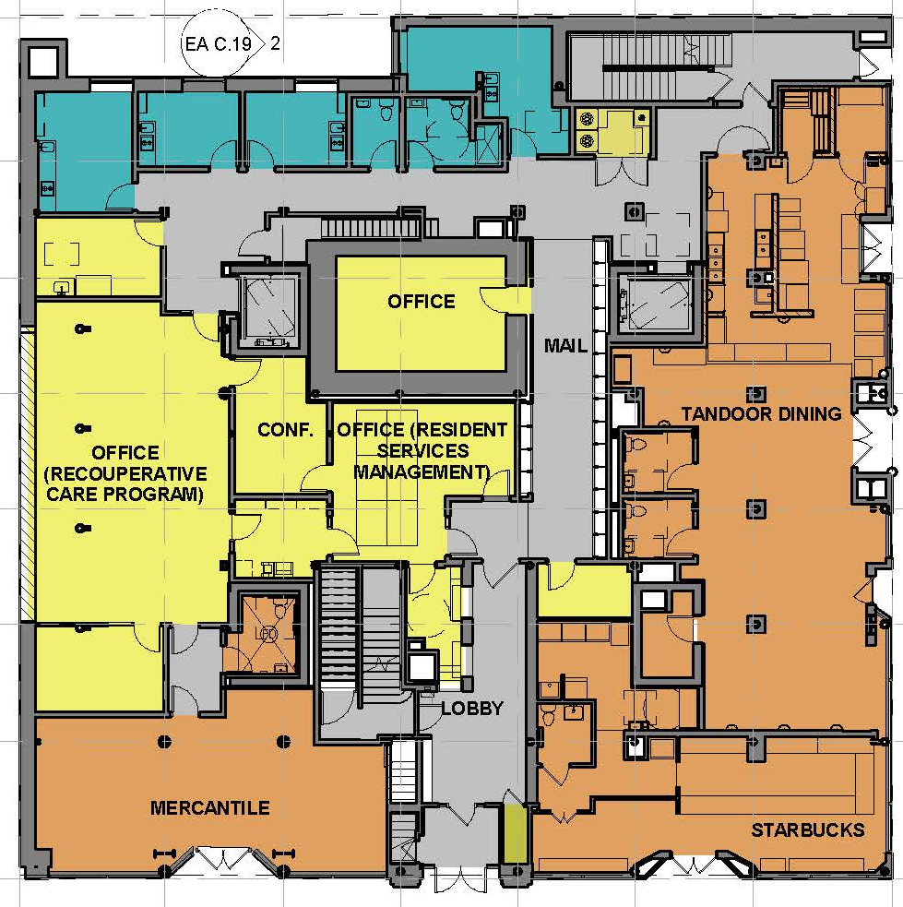
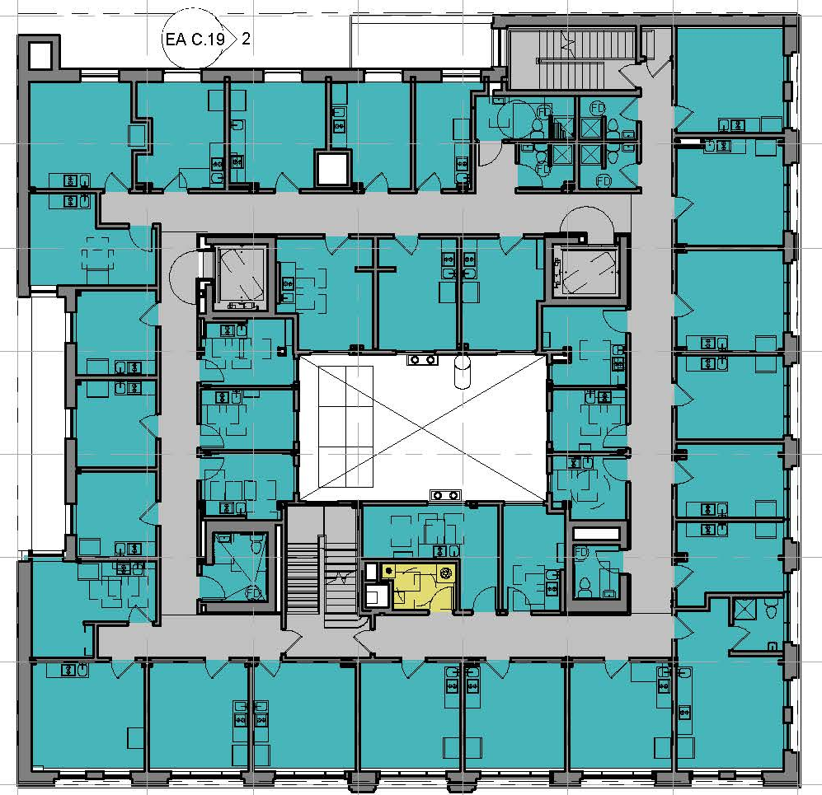
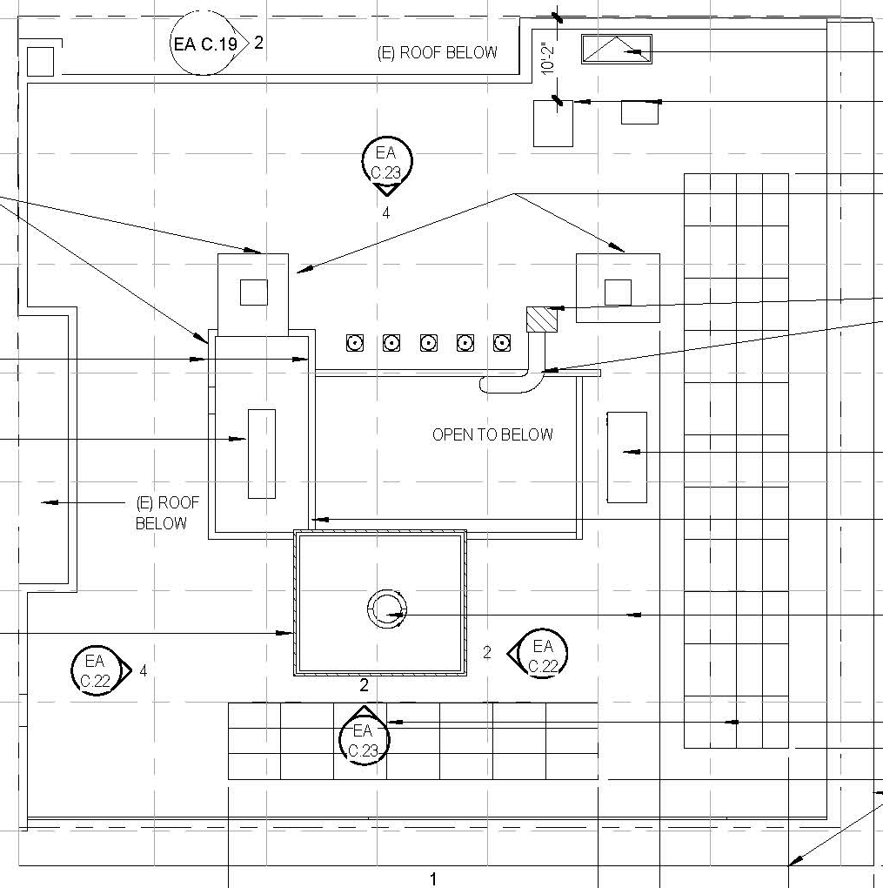
Proposed Improvements
20 New Units
2 New Elevators
Increased Community Space and Service Space
Energy/Water Efficiency Measures (e.g. Solar PV)
Updated infrastructure including MEPF, sidewalk and Roof replacement

