Slide 1

The Henry Apartments
Shannon Callahan, Housing Director
December 5, 2018

Slide 2
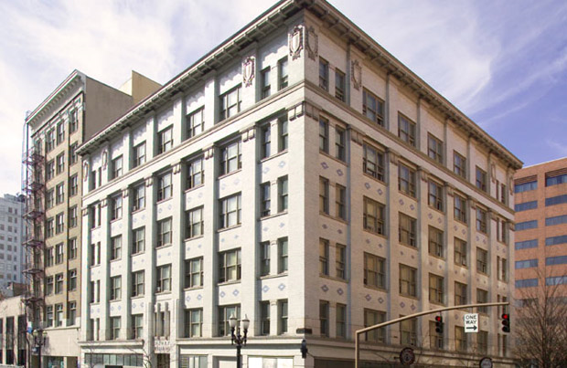
The Henry
Rehabilitation of existing historic Henry Building in downtown, SW 4th & Oak
173 extremely low barrier housing for very high needs population
Focused on homeless, supportive services, recuperative care and transitional housing
All units are SROs
Notes:
Rehabilitation of existing153-unit building on 4th & Oak and adds 20 new units. A 5 rating on Opportunity Score Area, needed for population
Thank partnership among many
CCC – Developer-Owner
PHB – Funder
Public Agencies for funding and services including
OHCS for 4% tax credits and preservations grants
Private Partners
Colas Construction-GC (MWESB certified)
US Bank in tax credit

Slide 3
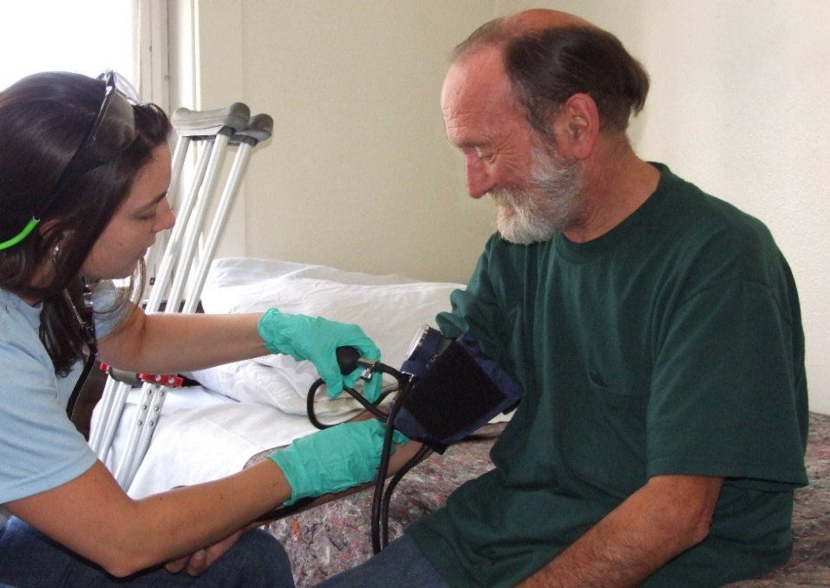
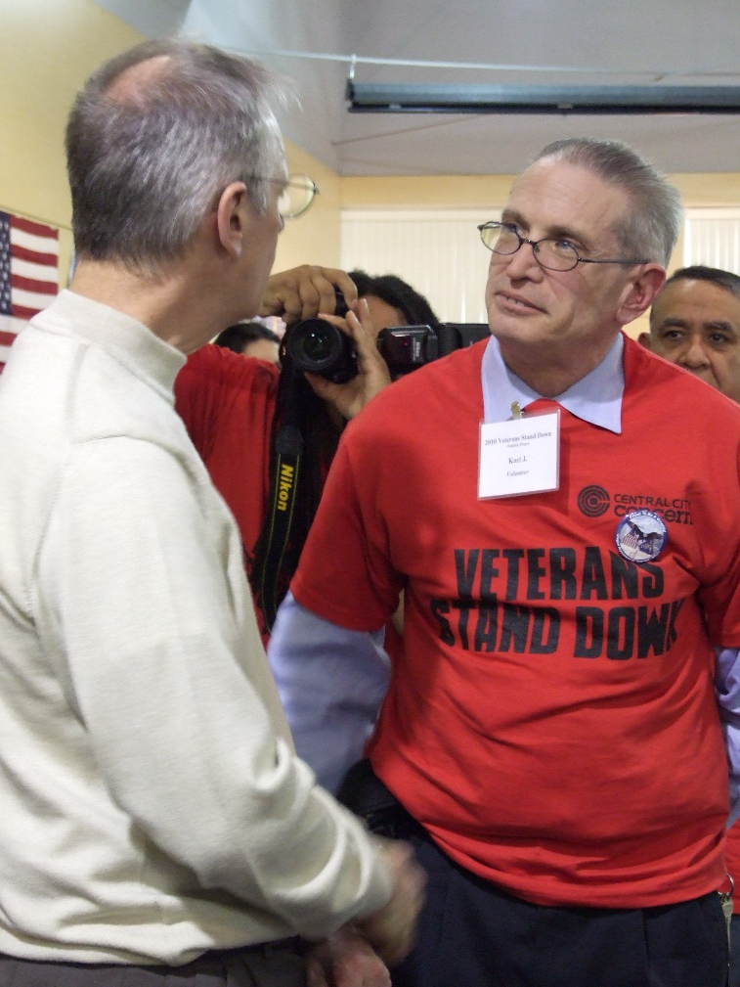
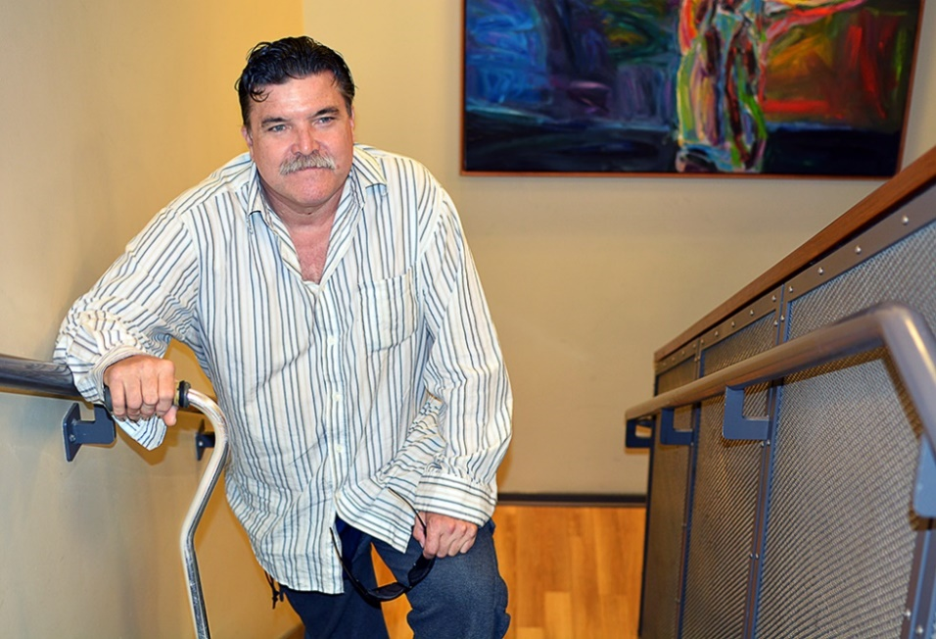
Public Benefits
All units at/below 60% AMI (net rents under $570/unit)
9 units at 30% AMI unsubsidized for very low income residents
All residents have supportive services (through City, County & Federal governments)
Exceeds City DMWESB contracting goals
Notes:
Total Affordability Breakdown (all SRO except Mgr. Unit)
9 @ 30% (unsubsidized)
163 @ 60% no PB S8 vouchers in the building
1 Unrestricted Mgr. unit
173 total
CCC leveraged services from
Veterans Administration
Recuperative Care (Care Oregon, Kaiser Permanente, Legacy, OHSU, etc),
Transition (Multnomah County Dept. of Justice, Dept of Community Justice),
Old Town Recovery Center
Expected MWESB is 24% compared to City target of 20% for hard costs construction (somewhat lower than new construction in King Parks due to rehab work)

Slide 4
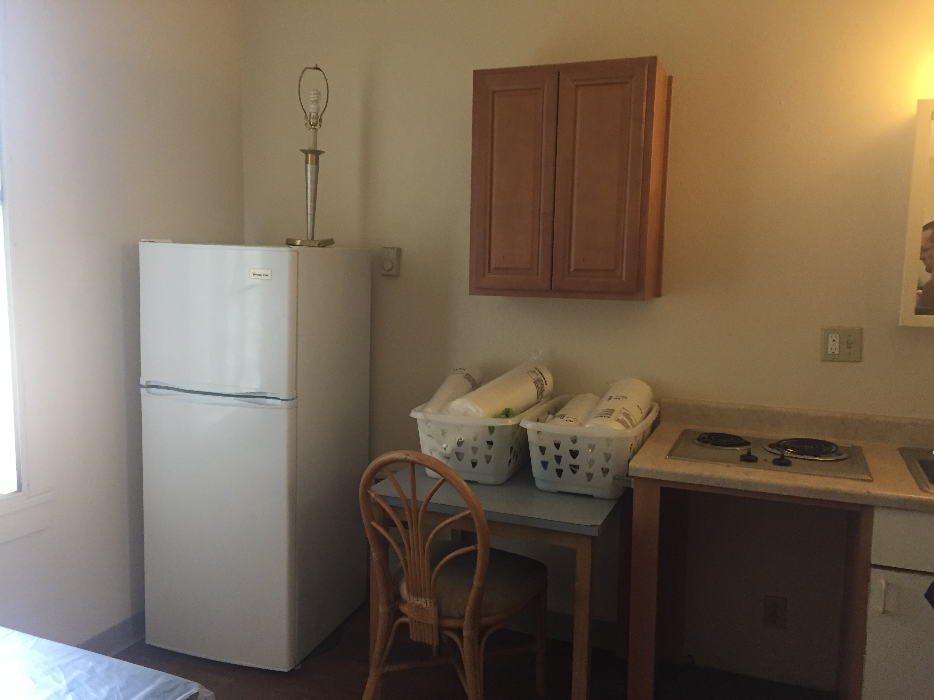
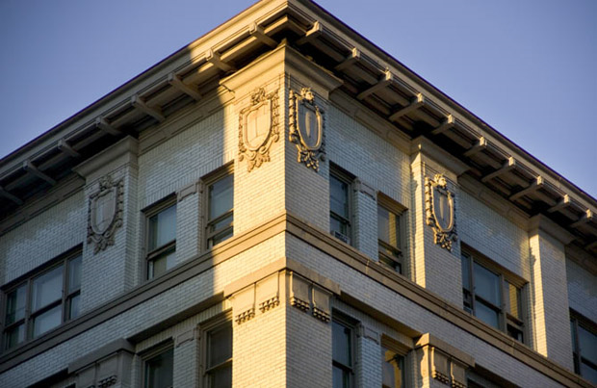
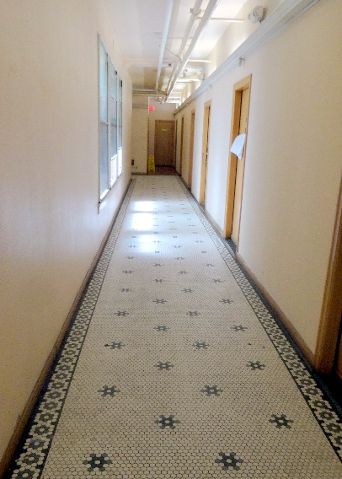
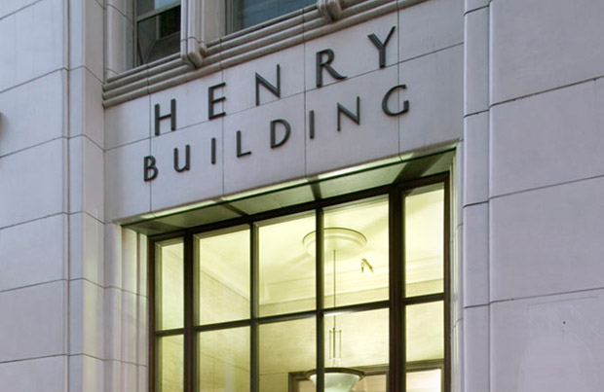
City Contribution
$12,977,742 construction and permanent loan
$80,000 SDC exemptions
Notes:
City Support works out to a little over $75k / unit for highly needed populations for which Sponsor CCC can leverage service funding
Leverages over 2x outside funding – low income housing and historic tax credit equity, grants and seller carry back – for each dollar of PHB funds

Slide 5
Recommended Action
  Approve $12,977,742 loan
  Execution of all necessary documentation for the Project by PHB Executive Director
4

