Slide 1

1222 *Approve findings to authorize an exemption to the competitive bidding requirements and authorize a competitive solicitation for the use of the alternative contracting method of Construction Manager / General Contractor for construction of the SW Capitol Highway: Multnomah Village – West Portland Transportation, Stormwater and Water Main project. (Ordinance)
City Council
December 5, 2018
Notes:
[Council Clerk reading of title]

Slide 2
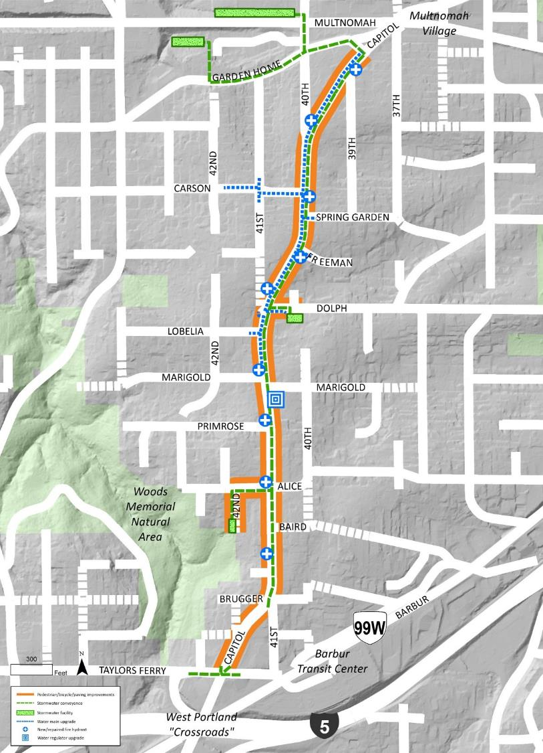
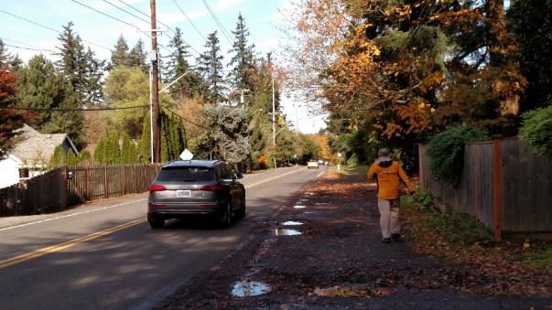

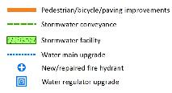
Project Location & History
Notes:
Chris: Good morning, Mayor and Commissioners. Chris Warner here, Interim PBOT Director, and alongside me are BES Director Michael Jordan, Water Bureau Chief Engineer Teresa Elliott, and Chief Procurement Officer Lester Spitler. We’re here today to recommend authorization of alternative contracting methods on a three-bureau partnership project on SW Capitol Hwy between Taylors Ferry & Garden Home Road, 9/10ths of a mile. We thought this would be a good opportunity to not just move through this milestone, but also to highlight the significant partnership and shared investment between our bureaus.
To say this project has a long history would be an understatement. At lower left is a snapshot of a letter from SWNI written by Marianne Fitzgerald in 1993 addressed to then Commissioner Earl Blumenauer. The letter states that SWNI’s highest priority for the 1994 capital improvement program is pedestrian & bicycle improvements along the entirety of Capitol Hwy, including the segment we’re discussing today. In the ensuing years, that particular segment was a tough nut to crack. The city moved forward with improvements to other areas of Capitol Hwy, but we were not able to secure adequate funding for this segment until recently. PBOT received federal planning funds in 2008 to develop a conceptual design, but there was still a major shortfall for construction. It wasn’t until 2016, with the voters’ approval of the Fixing Our Streets program, that we had the confidence to relaunch the project and reengage the public. That vote provided $3.3M in FOS dollars to the project, leveraging $5M in TSDCs already committed. Even then, it took an additional $2M commitment from the 2017 State Legislature and Governor Brown, and a $10.5M commitment from our gracious partners in Environmental Services to be able to fully fund the project, which has an estimated construction value of around $18M. That number puts us in a position to use alternative contracting methods to deliver the project, which we think will have tremendous benefits to the project.

Slide 3
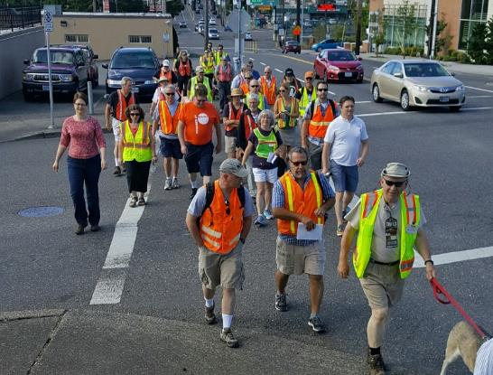
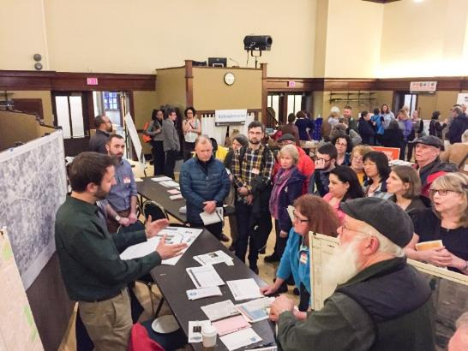
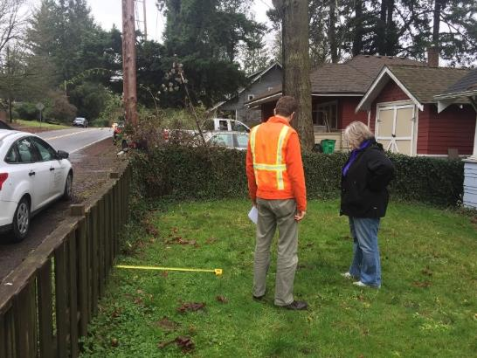
Public Involvement since 2016
7 Capitol Highway Subcommittee meetings
2 open houses
3 community walks
3 “office hours” sessions
55 property owner visits
3 newsletters mailed to 700+ addresses
10 e-bulletins to 800+ email/text accounts
5 Ped, Bike and Freight advisory committee meetings
Notes:
Chris: Before we describe the scope of the project, I’d also like to highlight the significant outreach that project staff and our community partners have accomplished. We’ve been working with a volunteer neighborhood group called the Capitol Highway Subcommittee that has been weighing in on project design details and impacts. Some of the members are here today, including chairman Chris Lyons who has been a fantastic with getting people engaged in the project. In addition to working with the Subcommittee, we’ve had 2 open houses, 3 community walks, 3 newsletters mailed to 700 addresses, 10 e-bulletins sent to 800 addresses, and have provided on-site consultations to more than 50 affected property owners along the corridor.

Slide 4
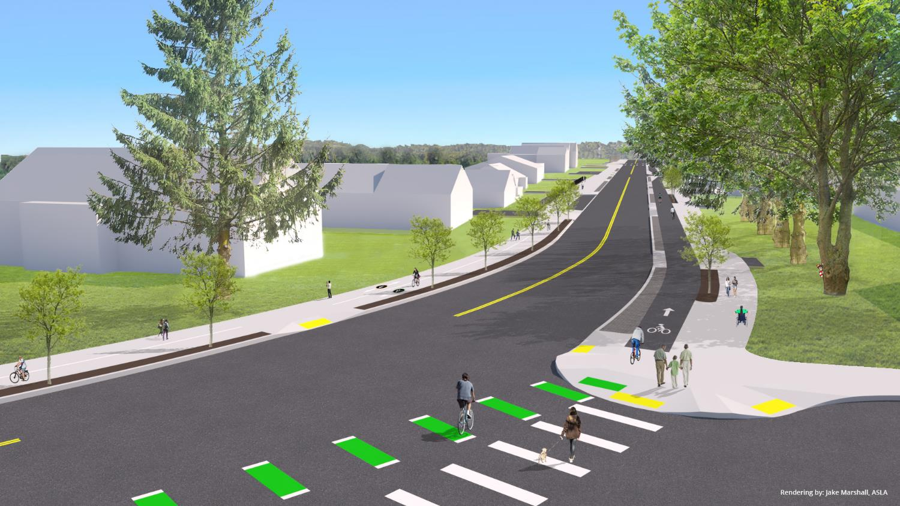
Transportation Scope
Notes:
Chris: The transportation scope of the project includes continuous sidewalk and protected bike lane on the east side of Capitol Hwy where today people walk on a narrow gravel path next to traffic that gets a bit muddy in the winter. The west side of the road will feature a combined multi-use path to reduce property impacts on this steeper side. 4 crossing improvements will line up with consolidated bus stop locations that we’ve coordinated with TriMet, and several side street improvements will be provided, including sidewalk on Dolph Court and paving a gravel section of 42nd Avenue.
In summary, we are excited to be moving forward with this project that has been decades in the making. We are particularly thrilled to have the partnership and the combined resources of BES and Water to make this a cohesive project that uses public funds efficiently, and to have our partners in Procurement Services help us with this alternative contracting process. With that I will hand it over to Mike Jordan at BES.

Slide 5
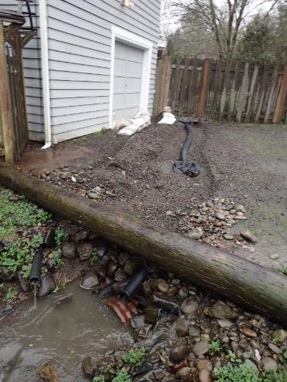
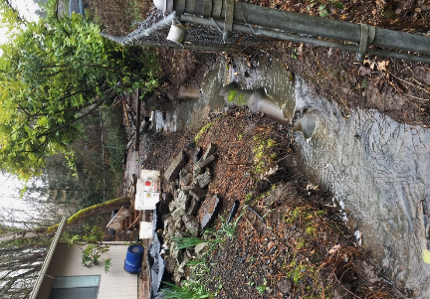
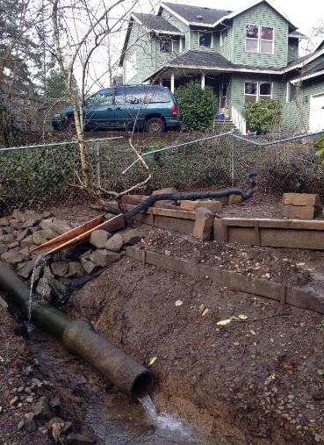
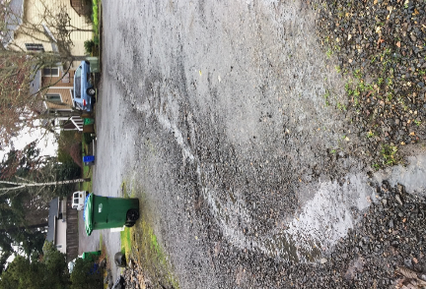
A Stormwater-Challenged Landscape
Notes:
Mike:
BES has been engaged with residents in this neighborhood for several years due to public and private stormwater issues that have developed, as this area with steep slopes and tight soils has urbanized.
Unlike older parts of our city that developed with curbs and storm drains in the late 19th and early 20th century, this area was a semi-rural landscape annexed by the city in the 1950s, 60s and 70s with no formalized stormwater infrastructure.
We see this project as an opportunity to collect and manage runoff from the new transportation system improvements, as well incorporating surrounding drainage areas as part of a regional strategy which will maximize the impact of the project’s proposed stormwater system improvements, thereby addressing both the project’s and the larger region’s stormwater management needs – in total, the stormwater system improvements will manage an area of nearly 50 acres, which includes the project footprint of about 6 acres.

Slide 6
Environmental Services Scope
Notes:
Mike:
The BES project scope includes a new stormwater collection and conveyance system in the roadway, totaling about 7,000 linear feet.
Flow from the new collection system will be distributed to four new regional-scale stormwater treatment and detention basins. These facilities will improve water quality in the three local streams to which they discharge: Woods, Tryon, and Vermont Creeks.
Two of the basins will be located along Multnomah Blvd west of 40th Ave; one on Dolph Court just east of Capitol Hwy, and one at the end of 42nd Avenue near Woods Memorial Natural Area
Stormwater management is a significant component of this project, which is why I have directed our Bureau to commit $10.5M to the project for design and construction of these facilities.
Now I’ll hand it over to Teresa to discuss the Water Bureau project scope.

Slide 7
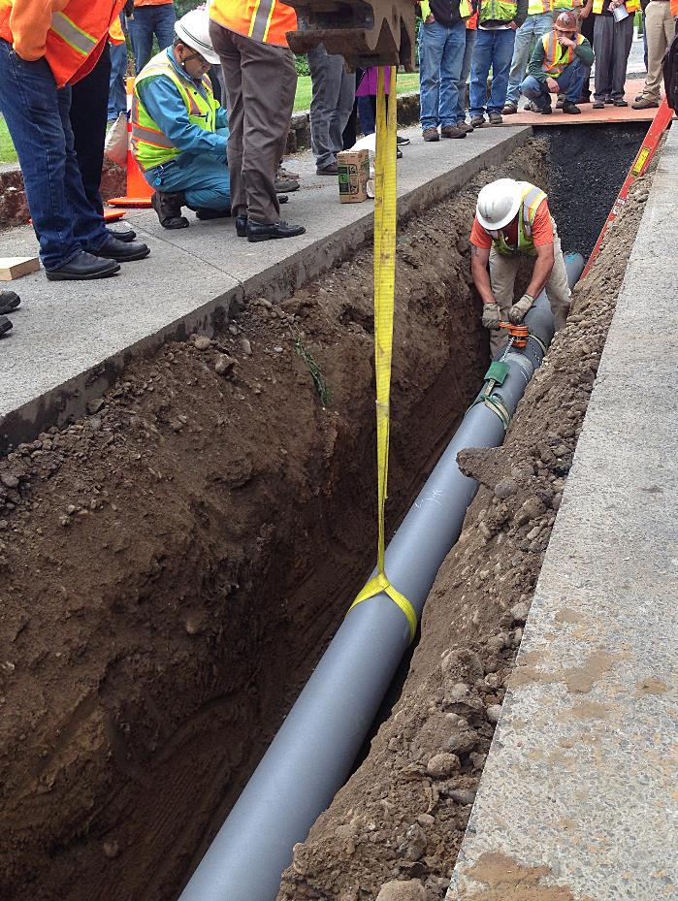
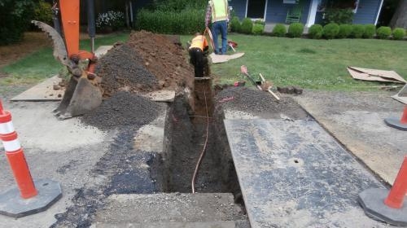
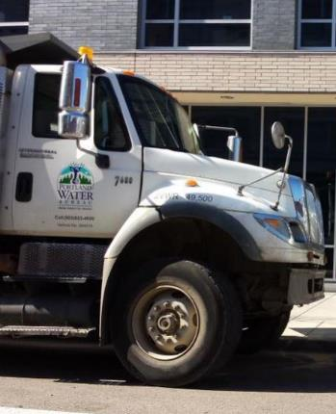

Water Bureau Scope
Notes:
Teresa: Thanks, Mike. It is standard practice for the city infrastructure bureaus to coordinate and identify capital improvement and maintenance needs at the outset of any major project. When our planning staff learned that PBOT and BES had a major project on this part of Capitol Hwy, we looked at our asset needs and decided to join the project. We will be upgrading over a half mile of water main from 6” cast iron to 8” ductile iron pipe, relocating or replacing 9 fire hydrants, upgrading one regulator device, and adjusting meters and service lines as needed. The replaced main will be more resilient to seismic events and its larger size will meet the needs of this growing community into the future. PWB is covering all costs associated with water asset upgrades, to the tune of about $1.5M. Having all 3 bureaus upgrade their infrastructure in the same area at the same time saves ratepayers and taxpayers money, and avoids redundant disruptions to the public.

Slide 8
Project Funding
$3.3M Fixing our Streets fuel tax
$4.9M Transportation System Development Charges
$2.0M Oregon Lottery funds
$10.5M Environmental Services funds
$1.5M Water Bureau Funds
______________________________________________
$22 million total
Notes:
Chris: Thanks Teresa. So thanks to these commitments from our partners at BES and Water, the advocacy of the SW Portland community and our state lawmakers, the voters who weighed in on Fixing Our Streets, and the ongoing contributions from development, we have a well-funded project of over $22 million.

Slide 9
Schedule Moving Forward
CM/GC RFP January 2019
Pre-construction services, final design, right-of-way through fall 2019
Pre-construction open house summer 2019
Begin construction fall 2019
Substantial completion fall 2020
Final paving spring 2021
Notes:
Chris: Here is our schedule moving forward. After today’s milestone, we aim to post an RFP shortly after the New Year. Pre-construction services and final design will take place through spring, summer and part of fall 2019, with construction beginning in fall 2019 and lasting around 12 months. The project should be substantially complete by the end of 2020, with a final pavement overlay during dry weather in the spring of 2021.
And now I’d like to hand it over to Lester Spitler, the City’s Chief Procurement Officer in Procurement Services.

Slide 10
Alternative Contracting
Project team examined 3 delivery options:
  Design-bid-build (“low bid”)
  Design-Build
  Construction Manager / General Contractor (CM/GC)
CM/GC benefits:
  Contractor participation in final design phase
  Constructability review
  Value engineering
  Early materials procurement
  Potential early work packages
  Qualifications-based selection
  Community Equity & Inclusion Plan
Notes:
Les: Thanks, Chris. The project team examined 3 project delivery models for this project and found CM/GC to have the greatest benefit…

Slide 11
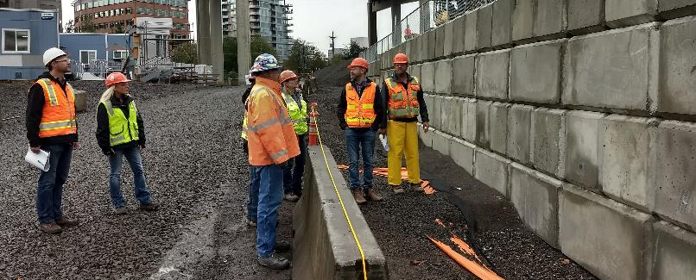
Exemption from Low Bid Findings
Use of CM/GC on the SW Capitol Hwy project will:
  Not diminish competition (competitive RFP will be posted)
  Facilitate cost savings due to value engineering
  Provide public benefits including:
    Schedule efficiency
    Increased workforce diversity through CEIP
    Improved neighborhood communication
    Specialized experience in tree protection, retaining wall construction in challenging soils
Notes:
Les: Findings are required for the exemption from competitive bidding, pursuant to state statute and city code. For this project we find that the use of CM/GC will…

Slide 12
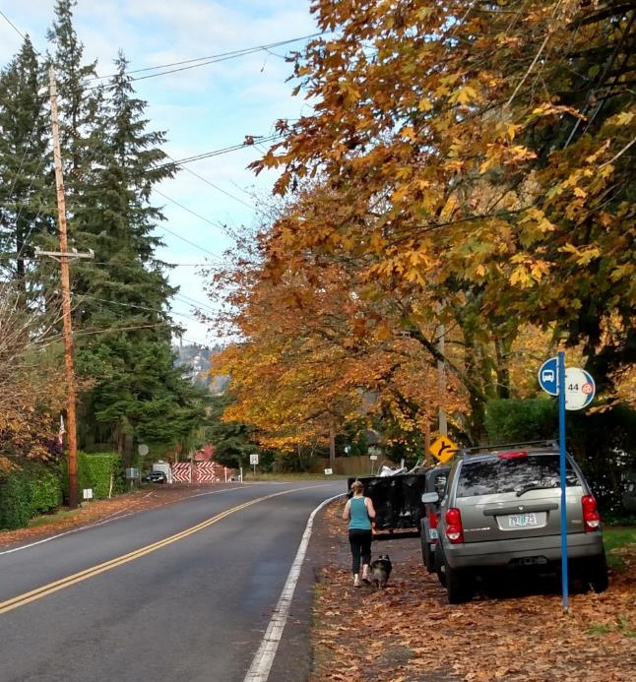
Recommendation:
Accept the findings
Authorize the project’s exemption from competitive bidding
Authorize a competitive solicitation for the use of CM/GC contracting
Notes:
Les: With that, our recommendation to Council is to accept the findings, authorize the project’s exemption from competitive bidding, and authorize a competitive solicitation for the CM/GC. We can now take any of your questions, including from project staff who are seated nearby.

