Slide 1

Westwind Apartments Acquisition
Portland’s Housing Bond
Portland Housing Bureau
Shannon Callahan, Director
November 14, 2018

Slide 2
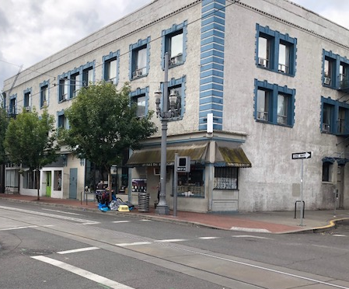

Presentation Panel
  Shannon Callahan
  Portland Housing Bureau
  Marc Jolin
  Joint Office of Homeless Services
  Andy Shaw and Dana Brandon
  Central City Concern
  Peter Beyer
  Home Forward

Slide 3
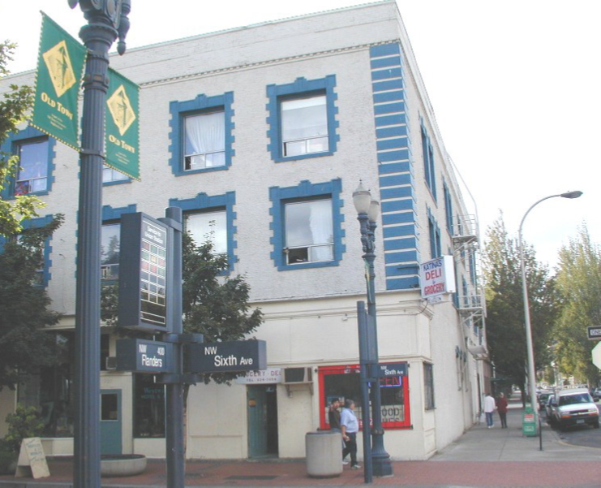
THE WESTWIND
A Portland Housing Bond and Multnomah County joint project
3

Slide 4
Westwind Property Profile
323-327 NW 6th Avenue
Purchase price: $3 M
Units: 70 Single-Room Occupancy (SRO)
0-30% AMI Units: 70
Supportive Housing Units: 70
Number of Persons Housed: (approx.) 70

Slide 5
Supportive Housing Goal – 2,000 units by 2028
2018-2021
5

Slide 6
Bond Progress Measures
1300 units
650 units
600 units
300 units
400 units

Slide 7
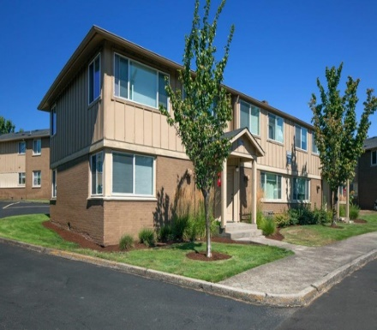
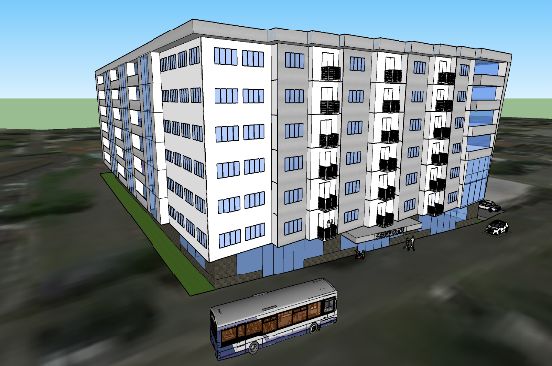
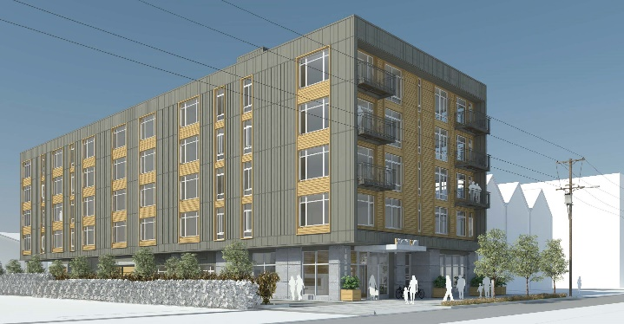
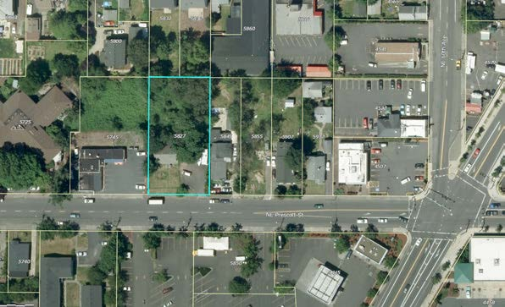



Current Bond Projects
The Ellington
Acquired February 2017
30th & Powell
Construction begins early 2020
105 Burnside
Leasing August 2018
NE Prescott
Pre-development
planning
Westwind
Expected Acquisition Fall 2018
263 units
~200 units
51 units
~50 units
~70 units
634
Total Units

Slide 8
Westwind Apartments
Next Steps

