Slide 1
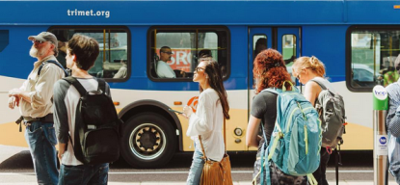
City of Portland Historic Landmarks Commission SECTION 106 HISTORIC RESOURCES OVERVIEW
November 19, 2018

Slide 2
Agenda
Division Transit Project (DTP) Overview
Consultation to Date
Section 106 Historic Resources
Section 106 Archaeological Resources
Landmarks Commission Comments/Questions

Slide 3
Project Background
Bus Rapid Transit (BRT)
Downtown Portland to downtown Gresham
Union Station to Cleveland Park & Ride
Mostly on SE/NW Division St
Uses Tilikum Crossing over Willamette River
42 stations

Slide 4
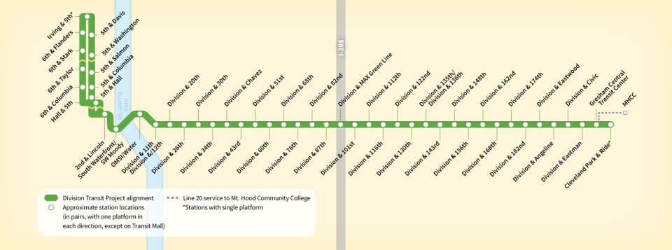
Project Route

Slide 5
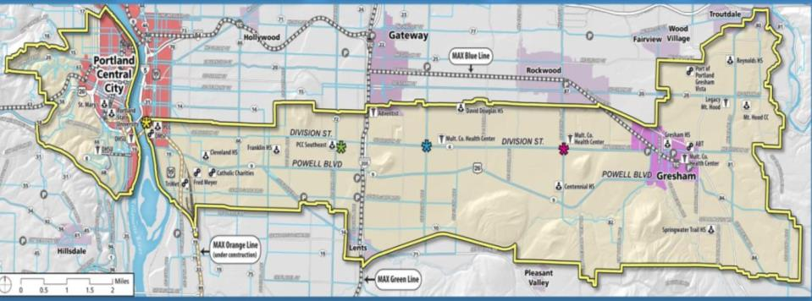
Division’s 4-line
BRT will replace current bus service
Quicker, more reliable trips
Higher level of Transit Signal Priority
Higher capacity vehicles with all-door boarding
Less stopping
Context sensitive approach
East Portland and east county have wider streets
More pedestrian improvements needed
Inner Division has frequent pass-ups, more bus capacity needs

Slide 6
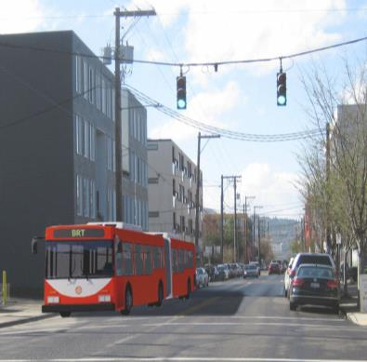
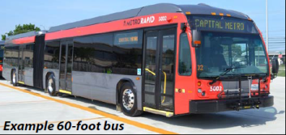
Transit Improvements
New 60-foot articulated buses
Widen lanes for Business Access and Transit (BAT)
Signal Improvements
More substantial stations with weather protection
ADA improvements
Improved street crossings
Service anticipated
Fall 2022

Slide 7
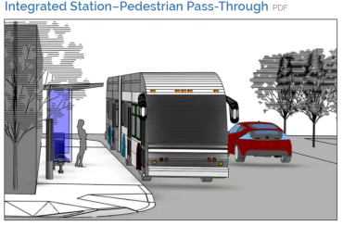
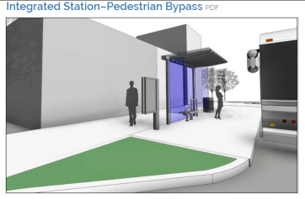
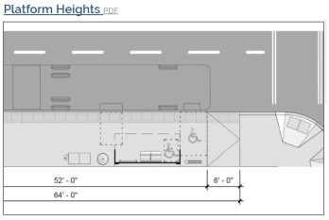
Station Rendering Examples

Slide 8
Section 106 Historic Resources Overview

Slide 9
Consultation To Date
APE letters – initial & revised (8/11/17, 9/22/17, 7/17/18)
SHPO Concurrence with APE (final 8/14/18)
Section 106 OR SHPO and Other Consulting Parties Meeting
10/9/18 and 10/12/18
Tribal Outreach
Siletz, Grand Ronde, Warm Springs, Cowlitz, CRITFC
Meetings with City of Portland (Landmarks Commission), City of Gresham, Multnomah County, TriMet Committees and Public Open Houses

Slide 10
Area of Potential Effect
Noncontiguous APE over the 15-mile project corridor
Dependent upon placement of Project facilities that are likely to affect historic properties
Includes areas with new stations, new ADA accessible pedestrian crossings/refuges, property acquisitions, construction easements, driveway closures/relocations, bikeway protection, etc.
Downtown area – new signage using existing infrastructure – not in APE

Slide 11
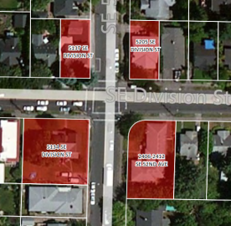
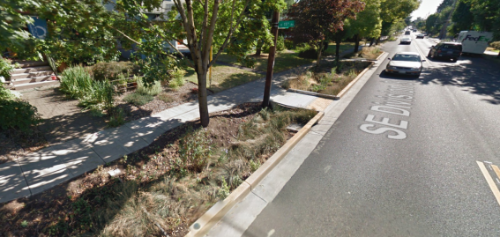
Previous Projects Approach
NE/SE 50s Bikeway Project, PBOT, ODOT, FHWA, 2012
Tacoma Link Expansion, SoundTransit, FTA, 2015
Division Street Reconstruction Project, SE 6th-SE39th Avenue, ODOT, FHWA, 2012
South Corridor, Portland-Milwaukie Light Rail Project, FTA, METRO, TriMet, 2010
NE/SE 50s Bikeways
Division St. Reconstruction Project (Ladd’s Addition)

Slide 12
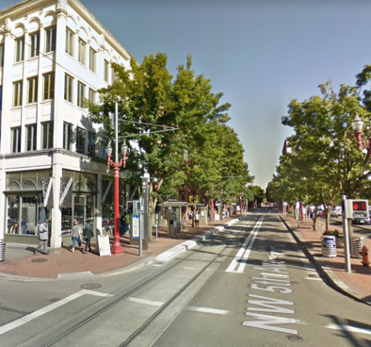
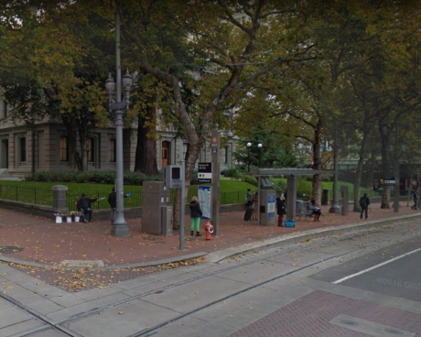
Previous Project Examples South Corridor / Portland Mall Light Rail Project
2004 Project Finding: No Adverse Effect
NW 5th and Couch
107, 115-117, 125-135 NW 5th Ave
SW 5th & Yamhill
Pioneer Courthouse

Slide 13
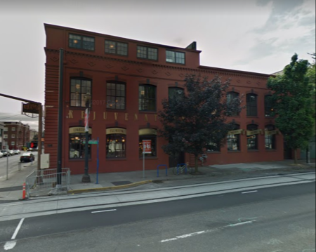
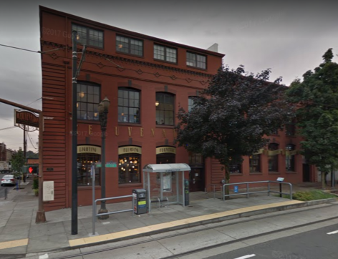
Previous Project Examples Streetcar Loop Project
2012 Project Finding: No Adverse Effect
Neustadter Building (1902): 1100 SE Grand
2011
2016

Slide 14
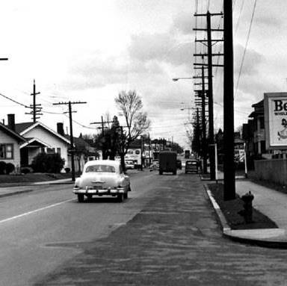
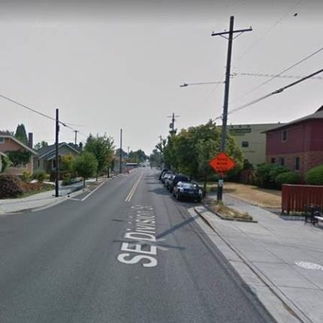
Division Streetscape Comparison
Note the differences in the utility poles.
SE Division St in 1956
SE Division St in 2017

Slide 15
Architectural Field Survey Recommendations to FTA
Built before 1975 (274)
Not Eligible/Demolished (223)
Potentially Eligible/Listed (51)
Minimal / No adverse effects (41)
No additional research
Intensive Effects Analysis (10)
Potential Adverse Effects (0)

Slide 16
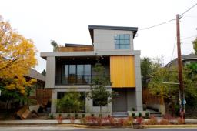
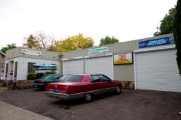
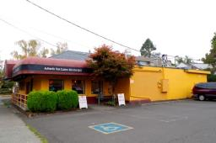
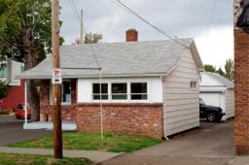
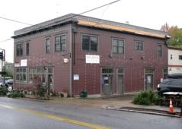
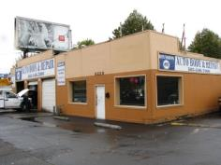
Examples of Properties Not Eligible for NRHP
3415 SE Division 3434 SE Division 3829 SE Division
4807 SE Division 5931 SE Division 8228 SE Division

Slide 17
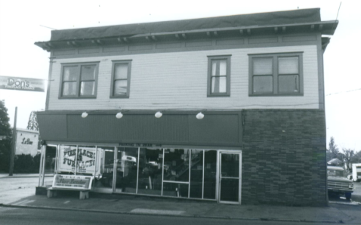
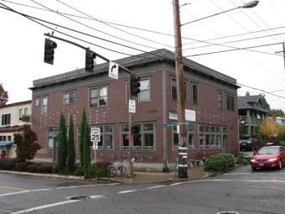
5931 SE Division (Not eligible for NRHP)
1980s
Early 20th century
2017

Slide 18
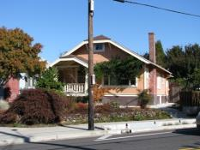
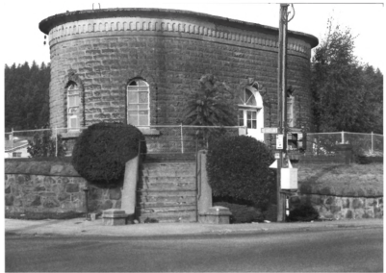
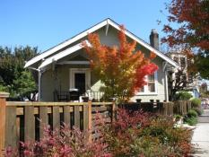
Properties Listed In NRHP
Ladd’s Addition Historic District
SE 12th- SE 20th & SE Division
Gatehouse (City Reservoir No. 2)
SE 60th & SE Division

Slide 19
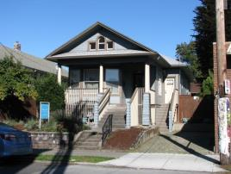
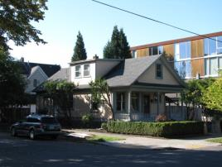
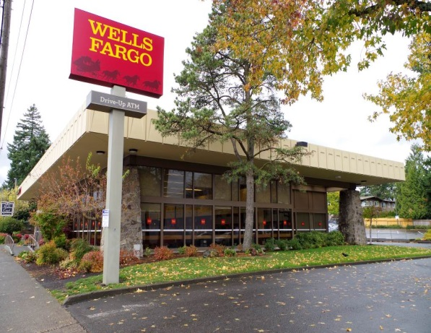
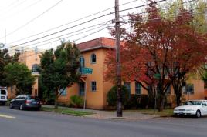
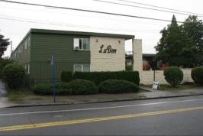
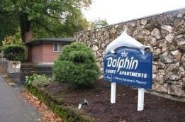
Examples of Properties Eligible for NRHP
2515 SE Division 2636 SE Division 12005 SE Division
5110 SE Division 5900 SE Division 6720 SE Division

Slide 20
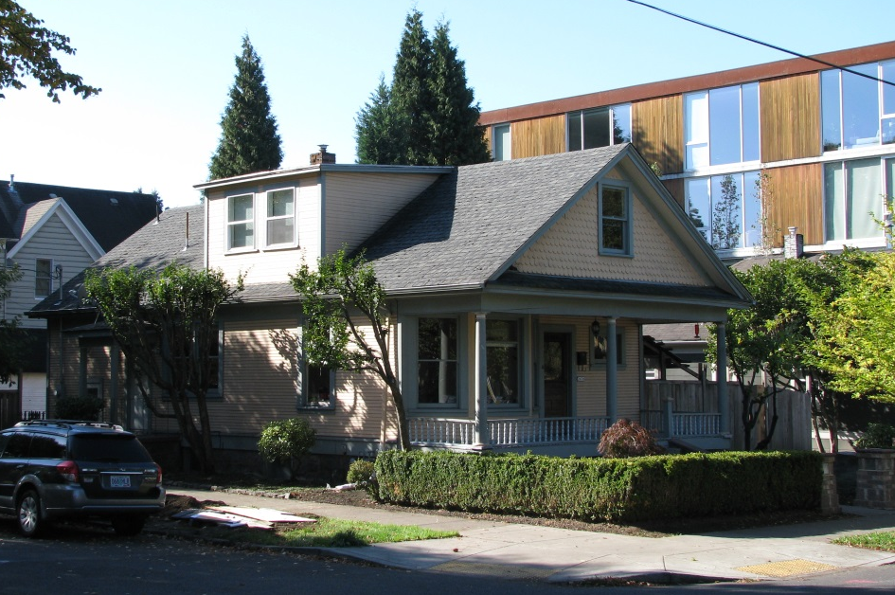
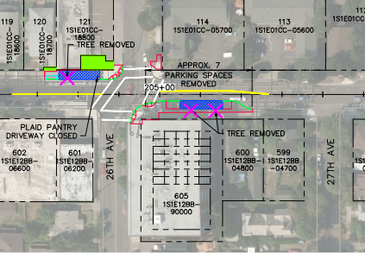
Effects Analysis 2636 SE Division St
Eligible (recommended)
No adverse effect (recommended)

Slide 21
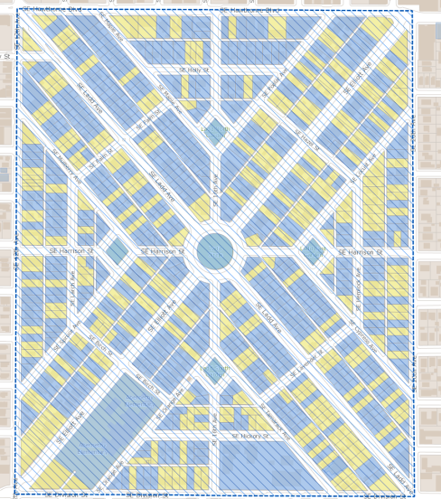
Effects Analysis Ladd’s Addition Historic District
SE 12th – SE 20th SE Hawthorne – SE Division
Listed in NRHP
No adverse effect (recommended)

Slide 22
Effects Analysis Ladd’s Addition Historic District
Ladd’s Addition in relation to station locations
One station within district, next to new construction
Two stations across the street
Station Location
Non-Contributing
Contributing
Notes:
Yellow = non-contributing
Blue = contributing

Slide 23
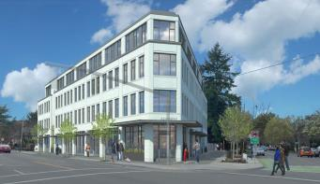
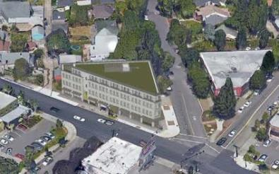
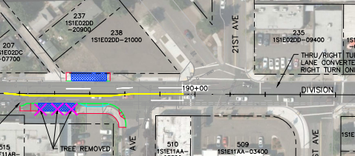
Effects Analysis Ladd’s Addition Historic District
Building images from NextPortland.com
Notes:
Ladd’s Addition: 20th/Division WB station is adjacent to brand new building (currently under construction as shown in aerial photo). Renderings show future building for context.

Slide 24
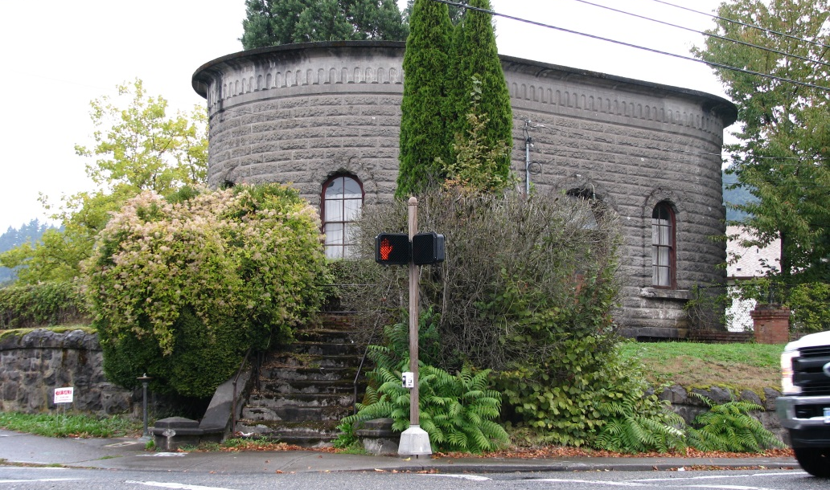
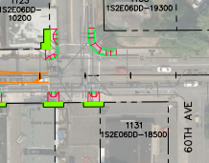
Effects Analysis Gatehouse (Reservoir No. 2)
2370 SE 60th Ave
Includes stairway and walls
Listed in NRHP
No Adverse Effect (recommended)
TriMet has modified project components to minimize effects to Gatehouse stairs and basalt retaining walls
Notes:
60th/Division

Slide 25
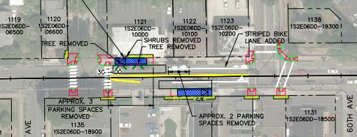
Planning to Minimize Effects Gatehouse (Reservoir No. 2)
Design Updates
avoid impacts
Oct 2018
Final 30% Plan
Dec 2017

Slide 26
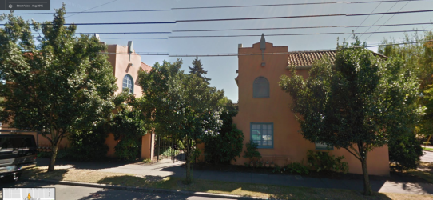
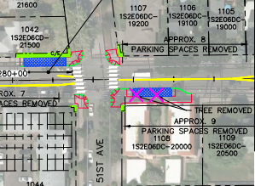
Effects Analysis Follis Court Apartments
5110 SE Division St
Eligible (recommended)
No adverse effect (recommended)
Construction easement for ADA improvements (~0.2% of total property area)
Tree removal (non-historic)
Change in setting – platform and shelter
Notes:
51st/Division

Slide 27
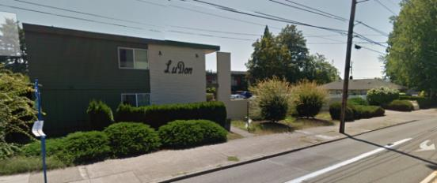
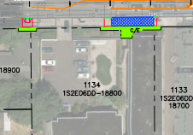
Effects Analysis LuDon Apartments
5900-5938 SE Division St
Eligible (recommended)
No adverse effect (recommended)
Construction easement for station construction and ADA ramp (~1.7% of the total property area)
Shelter and platform
Notes:
59th/Division

Slide 28
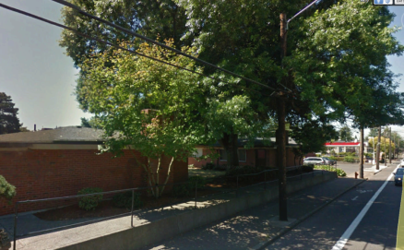
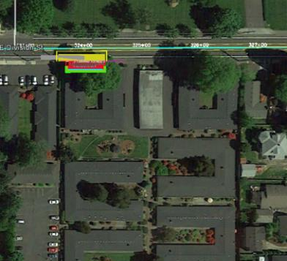
Effects Analysis DeLaine Court Apartments
6720-6922 SE Division St
Eligible (recommended)
No Adverse Effect (recommended)
Platform and shelter
Retaining wall to remain
Construction easement (~0.3% of total property)
Arborist and design team reviewed project to minimize potential for impacts to tree
Tree protection best practices during construction
Initial Design (2017)
Notes:
68th/Division

Slide 29
Planning to Minimize Effects DeLaine Court Apartments
Design Updates avoid impacts
Oct 2018
Final 30% Plan
Dec 2017

Slide 30
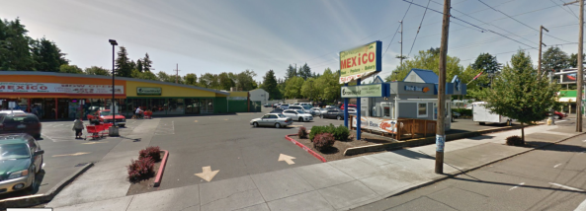
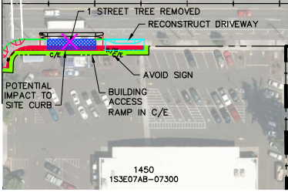
Effects Analysis Albertsons Food Center
17420 SE Division St
Eligible (recommended)
No adverse effect (recommended)
Platform and shelter
Acquisition of ~0.4% of total property
Construction easement ~1% of total property
Notes:
174th/Division

Slide 31
Archaeological Resources Literature Review
Within a 1-mile radius of the Project area 41 archaeological sites and 2 “noted” archaeological sites are identified on the SHPO GIS maps
No previously recorded archaeological resources are located in the APE
Property types: Historic cemetery, historic debris concentrations, structural remains and/or debris sites, possible Indian Camp

Slide 32
Archaeological Resources Potential For Effects
Archaeological APE = 108 ac. (spread over 15 miles)
DTP Ground Disturbance
Project elements would include minor ground disturbance (mostly less than 2 feet in depth)
Ramps, station platforms, work areas
Exceptions would include
Relocated utilities
Drywells
Signal poles (up to 24 feet deep)

Slide 33
Archaeological Resources Roads/Transportation
SE Division and SE 82nd, 1963
SE Division and SE 112th, 2017

Slide 34
Recent Projects (SE Division Reconstruction Project)
Image of Division Street Reconstruction Project, SE Division and 36th. Courtesy of KPFF Engineers

Slide 35
Archaeological Resources Streetcar lines
Potential historic streetcar lines (identified for avoidance)
Crossings at SE 11th, SE 12th, SE 50th
On Division St. between 11th and 13th and briefly at SE 60th

Slide 36
Archaeological Resources Recommendations
No Effects to NRHP-eligible Archaeological Resources are anticipated due to:
No previously recorded resources located in Archaeological APE
High degree of pre-existing surficial soil disturbance due to urban and suburban development and utilities in APE
Minimal project-related soil disturbance outside of existing ROW
Inadvertent Discovery Plan
Contact appropriate parties in the event of an inadvertent discovery of a cultural resource or human remains
Monitoring
Locations in close proximity to known or potential historic period cultural resources

Slide 37
Questions

Slide 38
Questions

