Slide 1

City of Portland
City Council Hearing
Staff Presentation of the
Hearings Officer Recommendation
Case File LU 18-112666 CP ZC
Strohecker’s Grocery Conditions

Slide 2
Summary of the Proposal
Comprehensive Plan Map and Zoning Map Amendments to amend conditions of approval from prior ‘zone change’ Ordinances at former Strohecker’s / Lamb’s Thriftway grocery store site in Portland Heights;
No change in zoning map proposed;
Same process required to revisit prior conditions of approval (new CP ZC);

Slide 3
Summary, continued
Ordinance conditions to remove include (partial list):
Limit use of site to a grocery store;
Prevent expansions or exterior changes;
Parking and loading restrictions beyond code;
Redundant applications of city code (e.g. Building Code, Stormwater, Fire Code); and
Rooftop and equipment screening, special setbacks, exterior signage limits, etc.)

Slide 4
Approval Criteria
33.810.050.A.1-4, Comp. Plan Amendments
Evaluation of proposal against relevant Comprehensive Plan Goals and Policies, “on balance”, has been found to be equally or more supportive of Comprehensive Plan as a whole than existing designation.
  Not a yes/no list of criteria, but rather a big picture look at the goals and policies overall
Analysis for both “old” and “new” (effective 5/24/18) Comprehensive Plan Goals and Policies
33.855.050.A-D, Zoning Map Amendments.
Adequacy of public services (Transportation, Water, Fire, Sanitary/Stormwater & Police services)

Slide 5
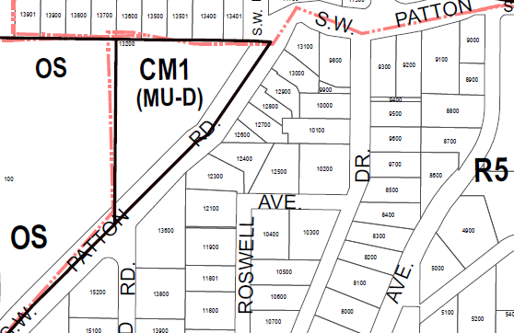
Zoning Map
Existing/Proposed Zoning: Neighborhood Commercial 2 (CN2)
New Zoning Map (5/24/18):
Commercial/Mixed-Use 1 (CM1)

Slide 6
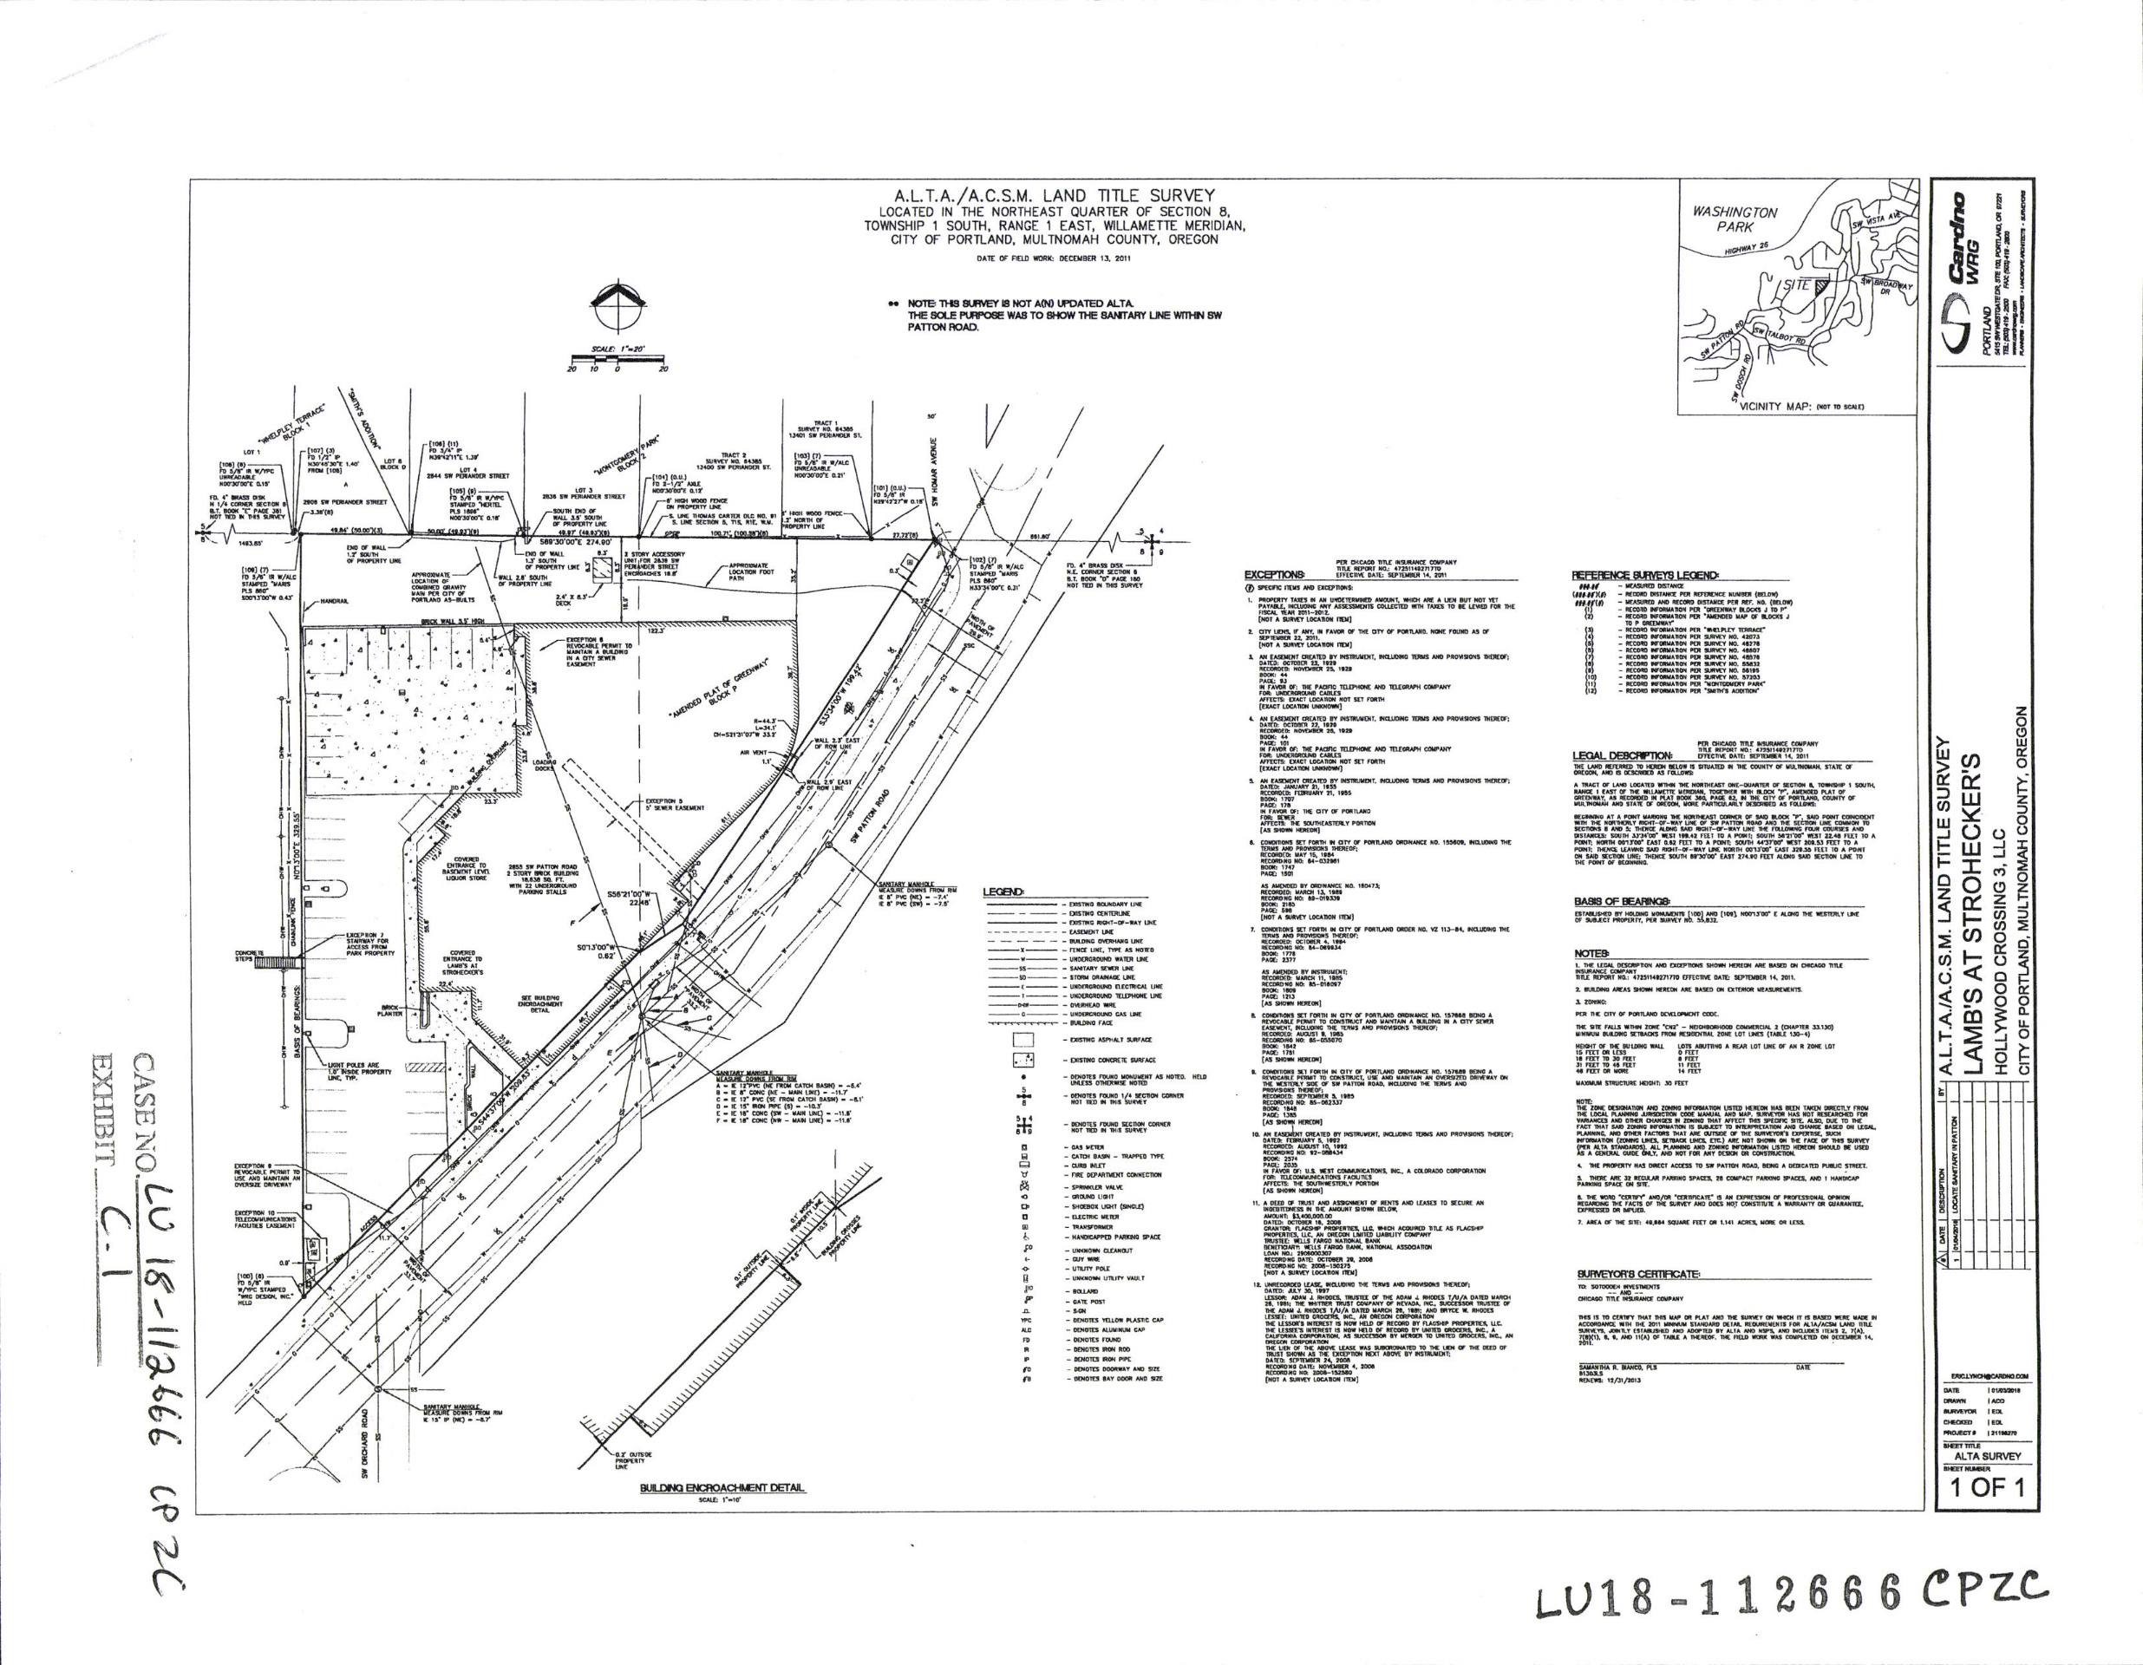
Exhibit C.1 – Utility/Site Plan

Slide 7
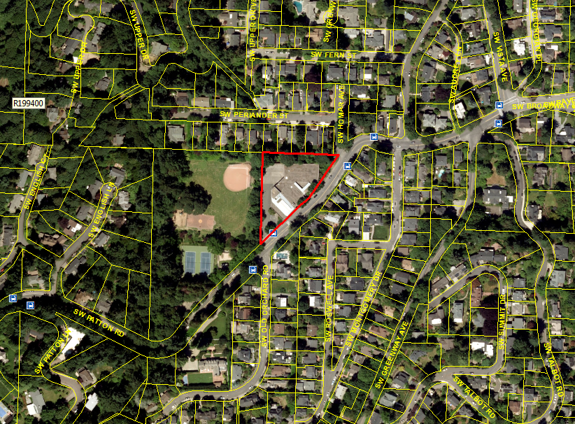
Aerial View

Slide 8
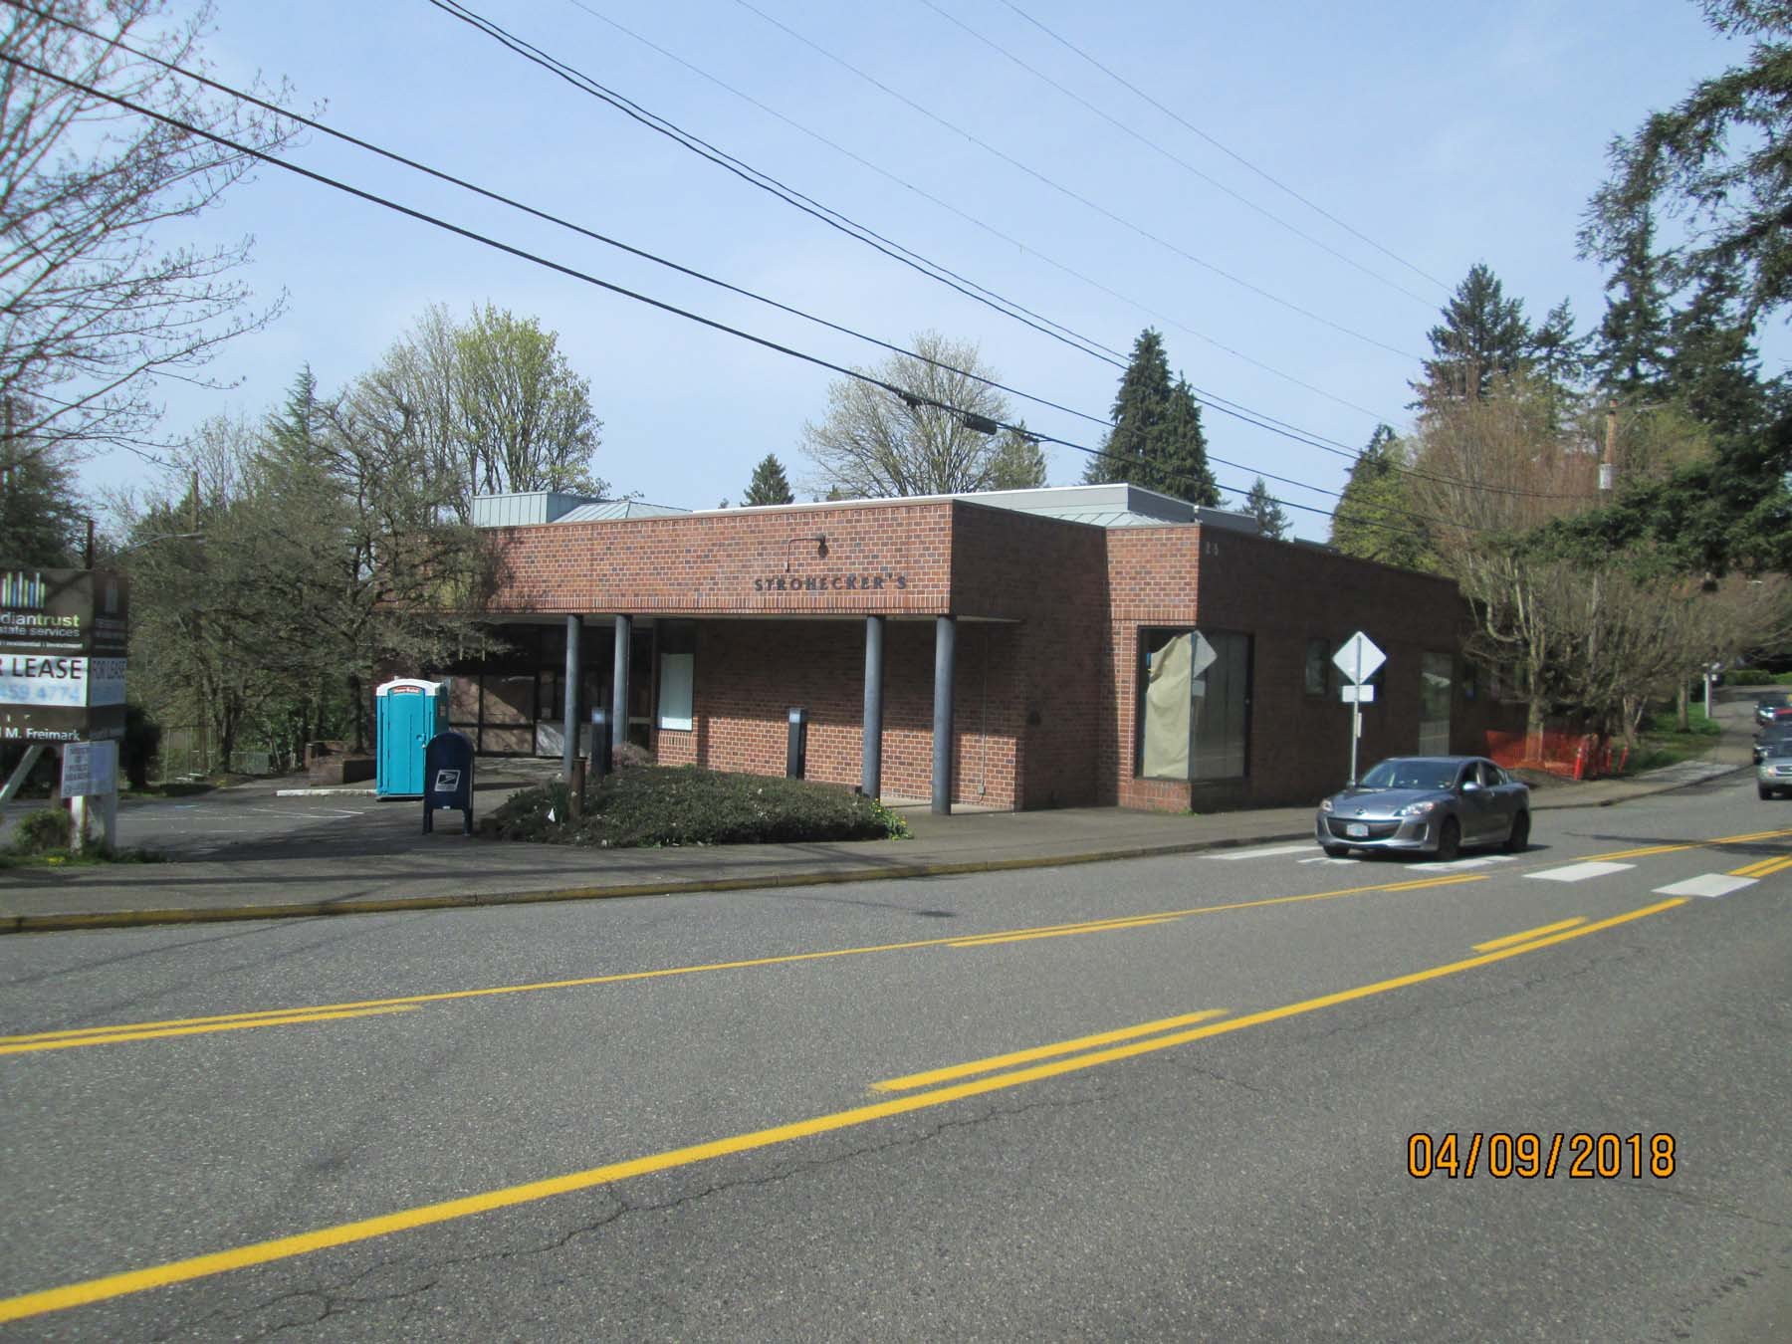

Slide 9
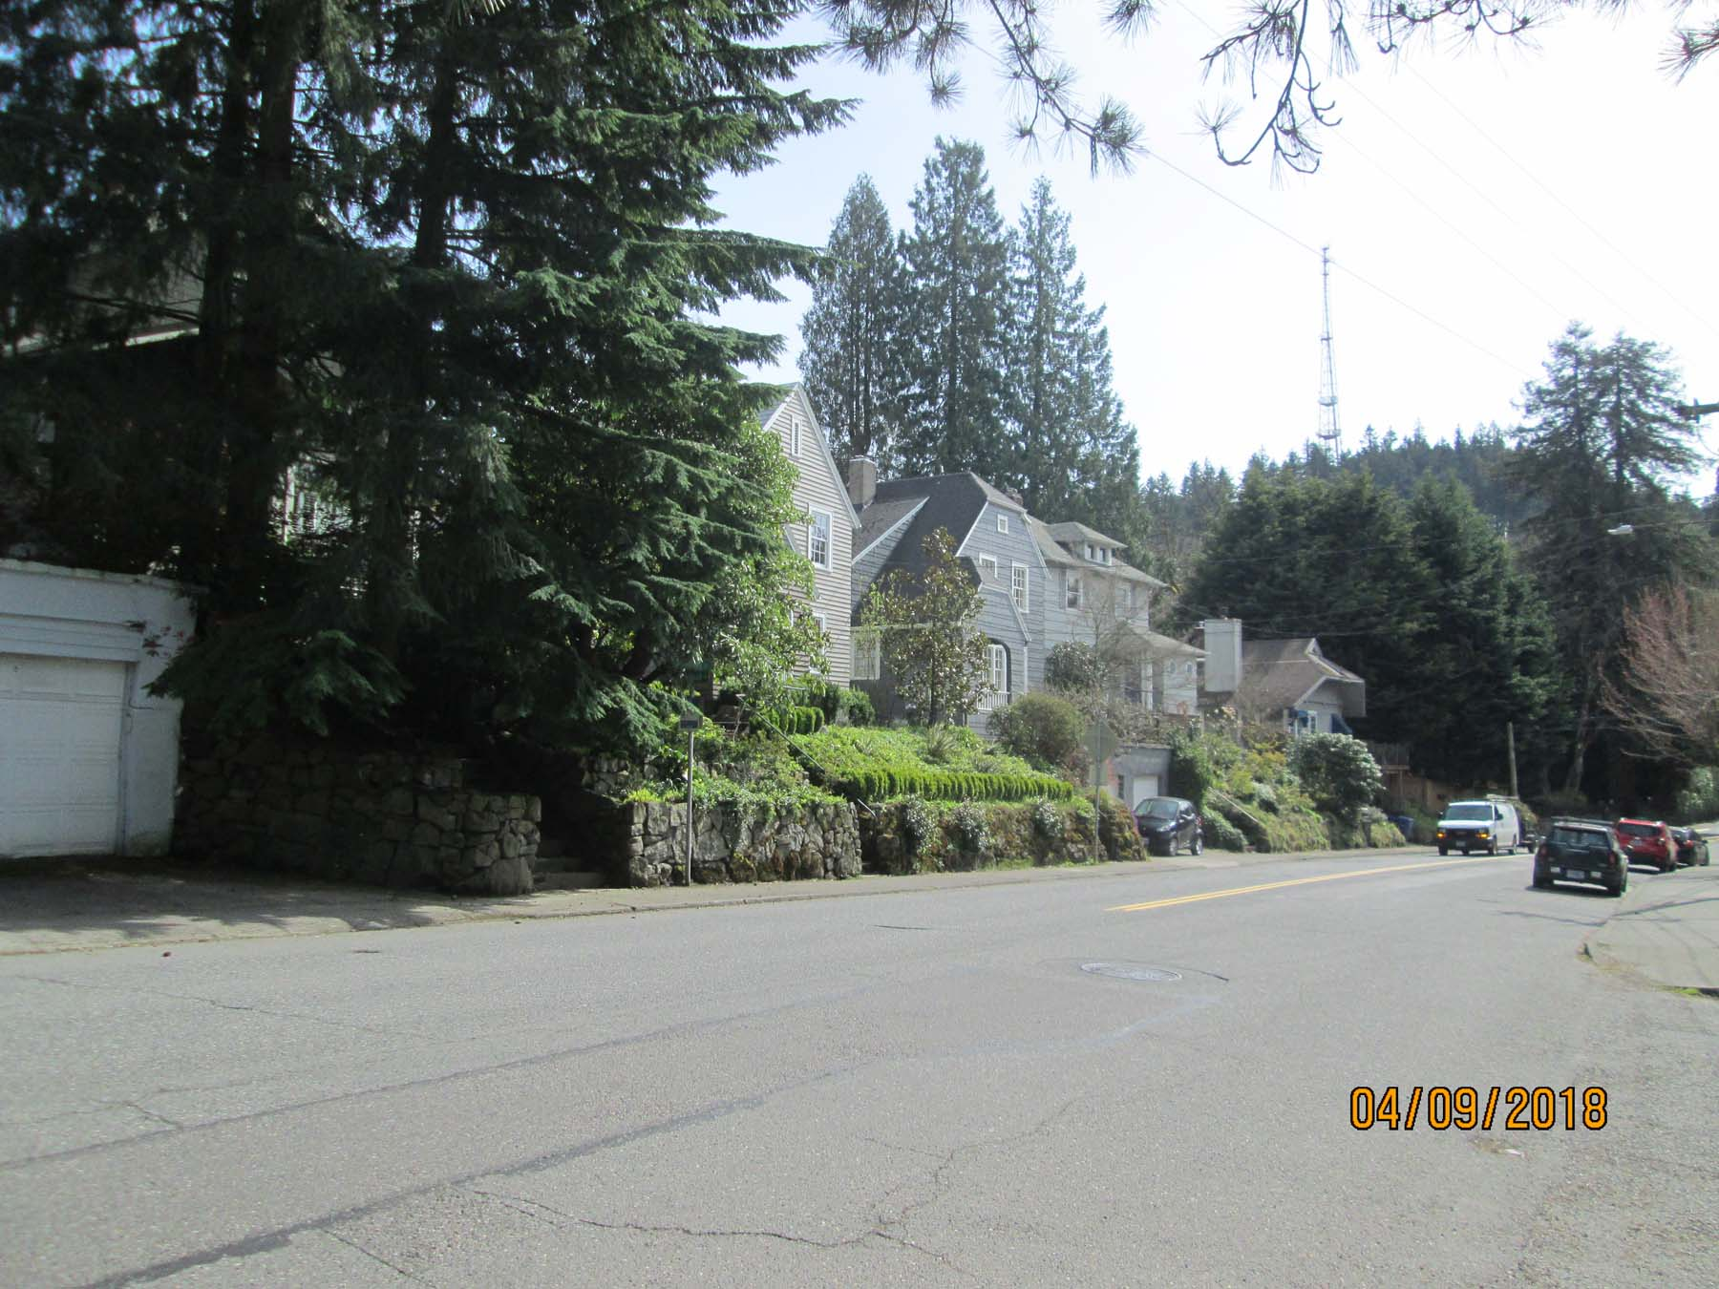

Slide 10
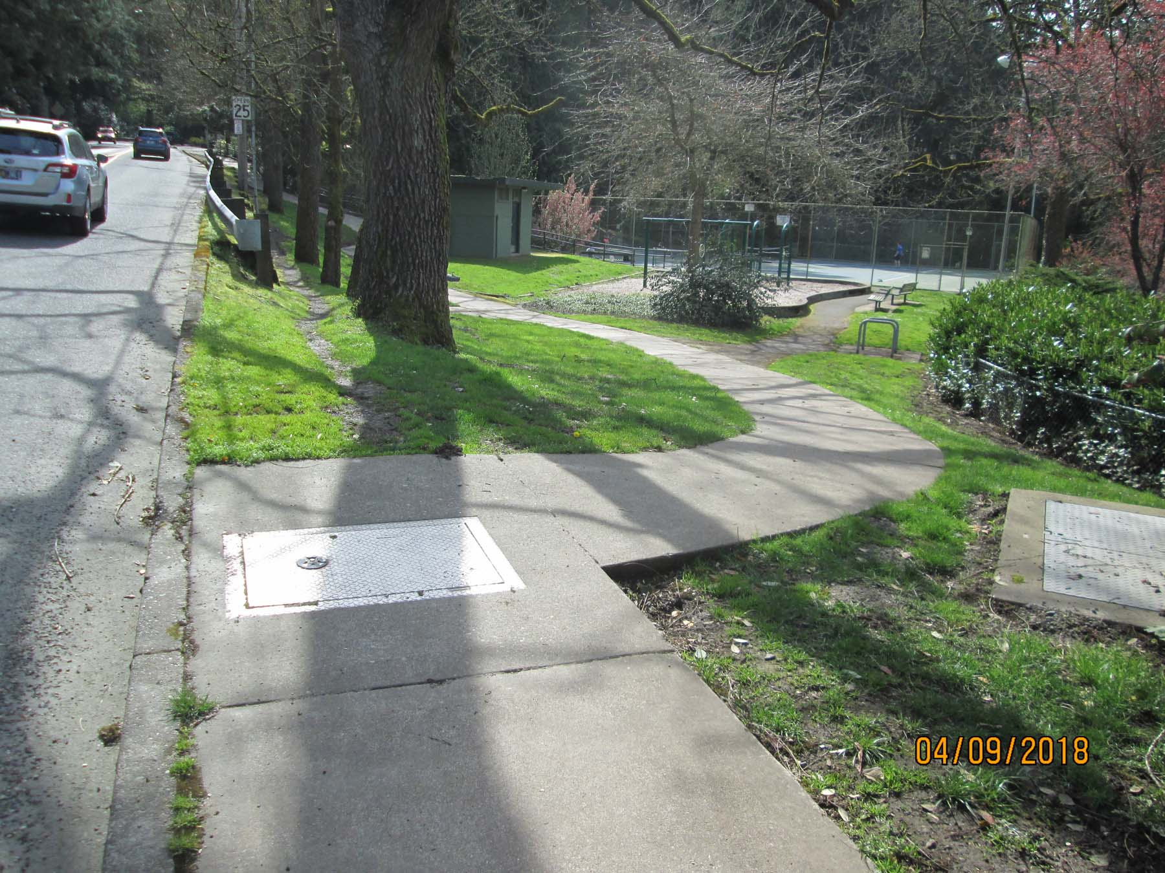

Slide 11
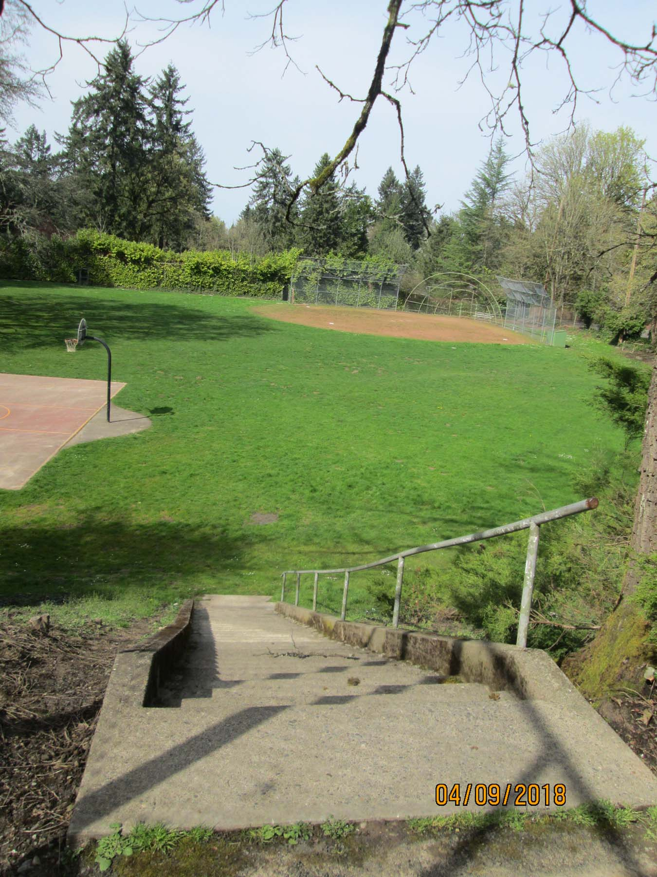

Slide 12
Neighborhood Comments
SWHRL wrote detailed letters addressing relevant CP goals and policies, seeks retention of all/most conditions with some use flexibility, seeks design parameters for future changes at the site, encourages denial of request;
Most letters objected to removing conditions, emphasizing neighborhood shopping needs, neighborhood character, distance to other groceries, surrounding residential/park context, public involvement in site development specifics, lack of public transportation to the site, questioning unviability of grocery lease, etc.; and
One neighbor wrote in support of the proposal, finding conditions burdensome, and writing in support of possibility for mixed-use development at the site.
Neighborhood retail critical to livability, residential-only problematic, neighborhood character/tradition, etc.

Slide 13
Hearings Officer Analysis
Comprehensive Plan Map Amendment
Based on the evidence, a grocery store is no longer viable as exclusive use on the site, even free rent did not entice tenants;
Conditions of approval are overly restrictive and inhibit use of the site for housing or other economic developments, contrary to many City goals and policies;
“On balance”, proposal would support City’s economic, livability and housing goals & policies by allowing redevelopment without grocery-only and other conditions;
No evidence that 2035 Plan legislative process intended to preserve conditions on the site, as suggested by neighbors;
With proposed Trip Cap condition, PBOT finds Goal 6 (Transportation) Policies are met; and
No issues with Statewide Planning Goals (33.810.050.A.2) or housing loss mitigation (33.810.050.A.3).

Slide 14
Hearings Officer Analysis, cont’d.
Zoning Map Amendment
Public services for Fire, Water and Police are capable of supporting the proposed use;
Sanitary Sewer and Stormwater Management Services are acceptable to BES with a condition regarding an existing public combination sewer running north-south through the site; and
Transportation System services are acceptable to Portland Transportation with a condition imposing a trip cap for future uses and developments at the site

Slide 15
Hearings Officer Recommendation
Approval of a Comprehensive Plan Map Amendment and Zoning Map Amendment for the site at 2855 SW Patton Road, Taxlot 13200 of Block P, Greenway Addition, to eliminate various conditions of approval from prior zone change-related Ordinances at the site, as follows:
Delete Ordinance No. 155609 Conditions c.1.a, c.1.b, c.1.c, c.1.d, c.1.e, c.1.f, c.1.g, c.1.h, c.1.k, c.1[sic], c.2.a, c.2.b, c.2.c, c.2.d, c.2.e, c.3.a, c.3.b, c.3.c, c.3.d, c.4.a, c.4.b, c.5, c.6, c.7, c.8.; and
Delete Ordinance No. 160473: item b (amending Ordinance No. 155609 Condition c.1.i), item c (amending Ordinance No. 155609 Condition c.1.j), item d.1 through d.10, and Section 2.
The above approvals are granted subject to the following conditions of approval:
A. As part of the future building permit applications at the site, any of the following development-related conditions (B through C) that are relevant to the project must be noted on each of the 4 required site plans or included as a sheet in the numbered set of plans. The sheet on which this information appears must be labeled "REQUIRED ZONING COMPLIANCE PAGE - Case File LU 18-112666 CP ZC." All requirements must be graphically represented on the site plan, landscape, or other required plan and must descriptive written notes documenting conformance with the conditions as necessary.
B. (Bureau of Environmental Services) Prior to issuance of any building permit that would result in an increase or modification of building area within existing City of Portland sewer easements, the proposed work must be evaluated by the Bureau of Environmental Services and any concerns related to the project must be addressed by the property owner to the satisfaction of the Bureau of Environmental Services, up to and including project modification to remain outside the easement areas, or re-routing the public sewer in a new easement so that the existing alignment and easements can be abandoned. This condition does not apply to tenant improvements within the existing building or to repair and maintenance of the existing building within the existing easement areas.
C. (Portland Bureau of Transportation) (Trip Cap Condition: meet objective limits in Table 1 or undergo Type II Transportation Impact Review to evaluate specific project against limits (2,168 daily trips OR 73 AM weekday peak hour trips OR 200 PM peak hour trips)

Slide 16
City Council Alternatives
Accept the Hearings Officer’s recommendation, with no changes
Accept the Hearings Officer’s recommendation with modified conditions and findings.
Reject the Hearings Officer’s recommendation and deny the proposal.

Slide 17
fin

