Slide 1
*Amend Inclusionary Housing Code to make technical corrections to the floor area ratio requirement for a tax exemption as designated in the Zoning Code (Ordinance; amend Code Section 30.01.120)
Shannon Callahan, Director
Matthew Tschabold, Assistant Director
October 17, 2017

Slide 2
Inclusionary Housing Program
Program Options
Provide units on-site
Provide units off-site
Pay a fee rather than providing units
Building proposing 20 or more new units
99 years of affordability
Affordable for households earning 80% MFI or less
Set-aside In Central City
20% of units affordable at 80% MFI
10% of units affordable at 60% MFI

Slide 3
Central City Incentives
Central City - 60% and 80% MFI
10 year property tax exemption on affordable units Tax exemption on all units if base zone is 5:1 FAR or greater
Construction Excise Tax exemption on affordable units
Exemption from parking requirements
Density bonus
Incentives are based on the level of affordability provided
Units with a deeper affordability are supported with greater subsidy
Central City – 60% MFI
SDC exemptions on affordable units

Slide 4
Proposed Change – Tax Exemption
Current Code – Central City:
Eligible for 10 year tax exemption on all residential units if:
Base zone FAR of 5:1 or greater
Applies to properties located within the Central City Plan District
Expands the criteria to qualify for a tax exemption on all units by including the FAR of the project as it will be built
Proposed Code – Central City:
Eligible for 10 year tax exemption on all residential units if:
Base zone FAR of 5:1 or greater; or
Built FAR of 5:1 or greater

Slide 5
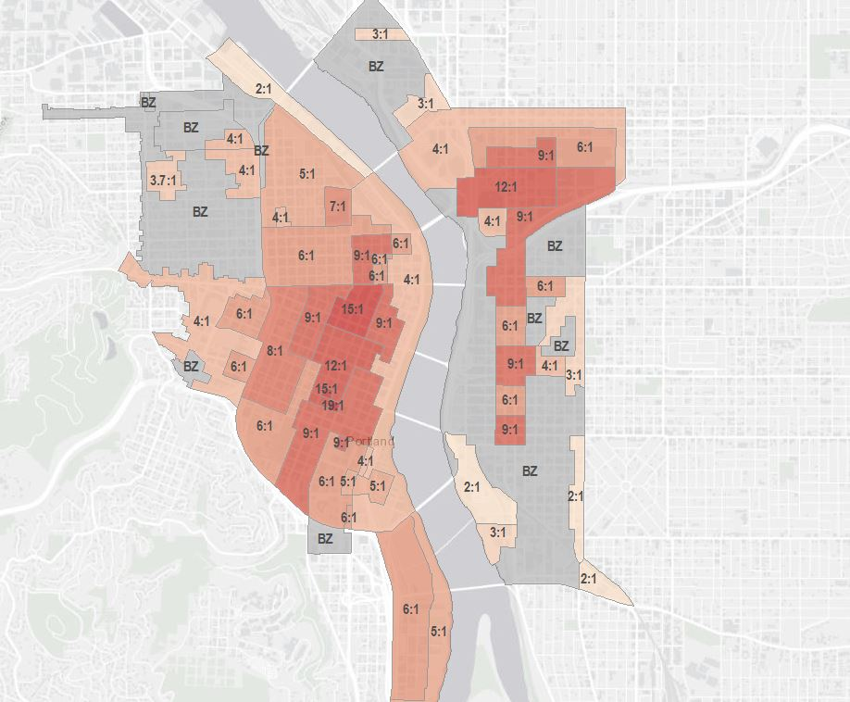
Central City Floor Area Ratios
Potentially expand eligibility to sites below 5:1 FAR including:
Several areas along SE 11th & 12th
Clinton Triangle
Westside Willamette River
Does not address other factors, such as industrial land protections, that could constrain ability to qualify

Slide 6
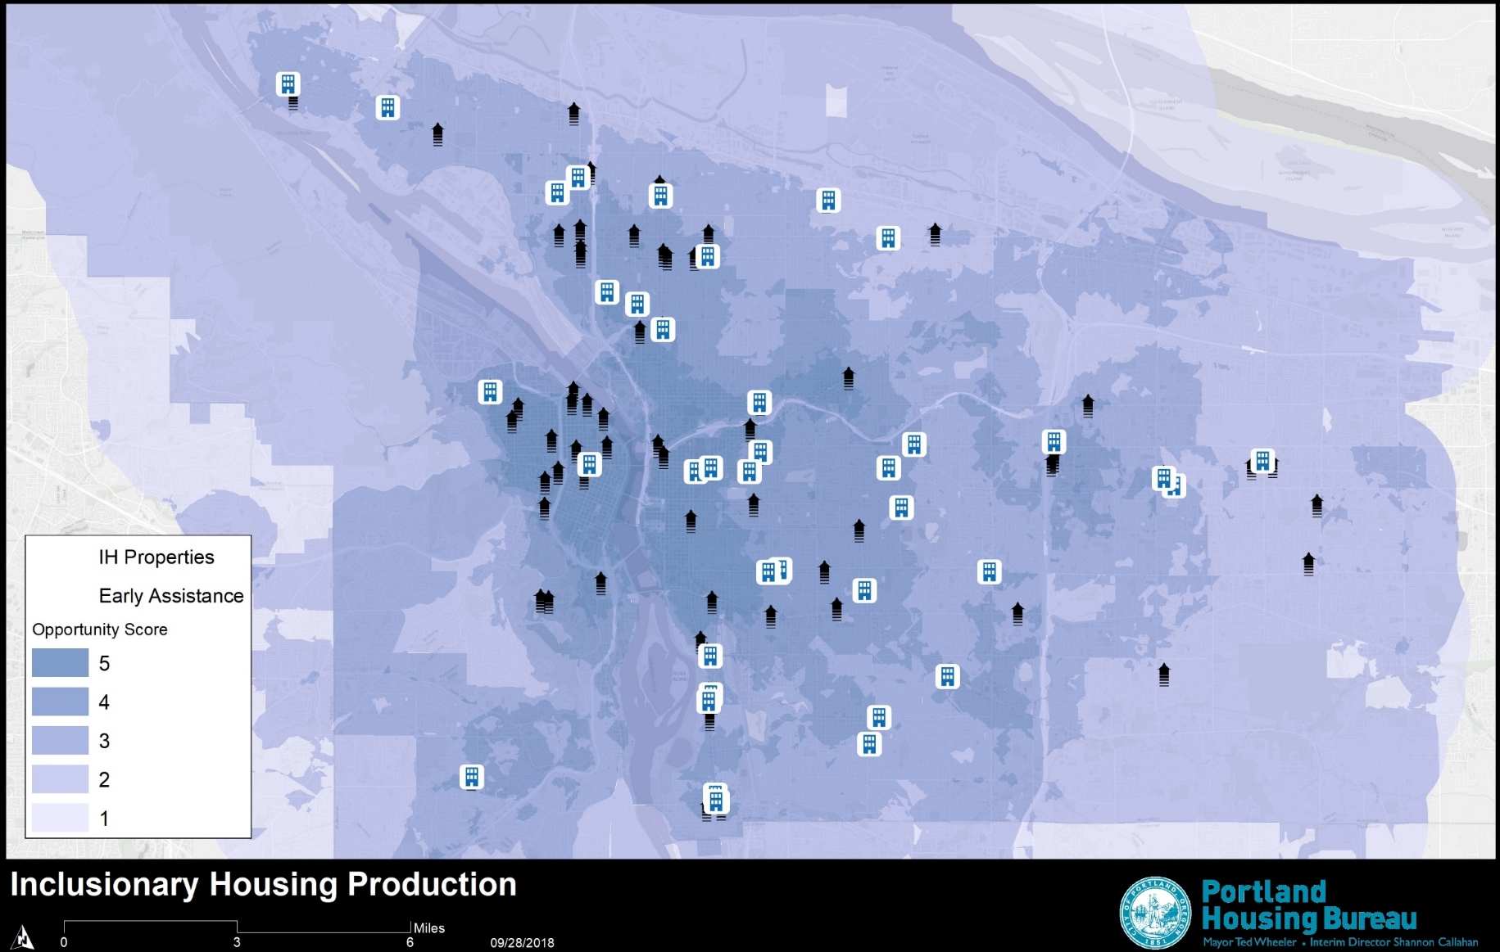
Opportunity Scores and IH Units Citywide
100 buildings in process:
57 early assistance with 6,309 units
43 in permitting with 2,269 units
Those in permitting stage, minimum 362 affordable units

Slide 7
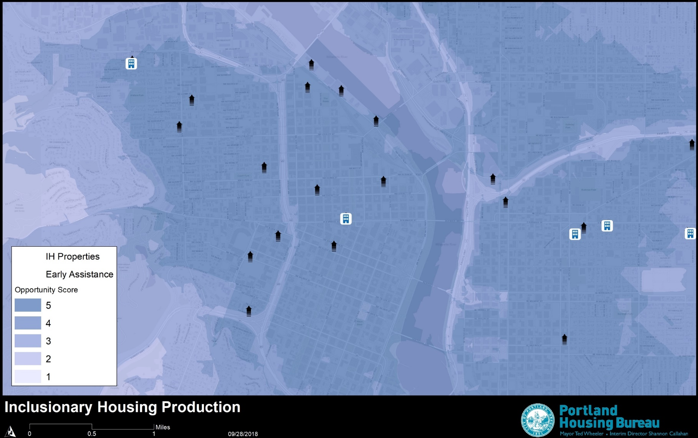
Opportunity Scores and IH Units Central City
15 buildings in process
14 early assistance with 2,460 units
1 in permitting with 144 units
261 potential IH units

