Slide 1
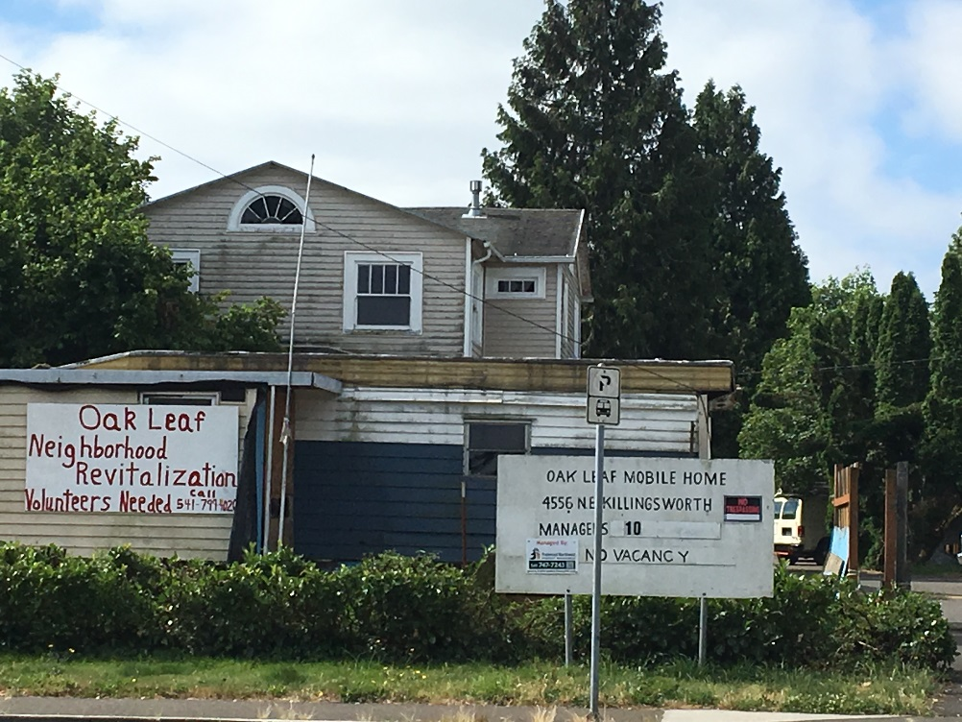
St.Vincent de Paul of Lane County, Inc.
Oak Leaf manufactured Home Park

Slide 2
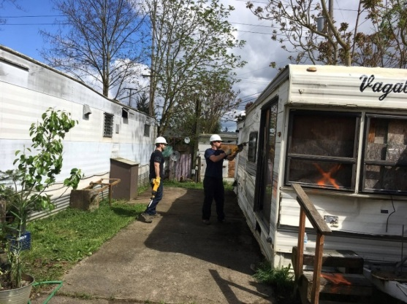
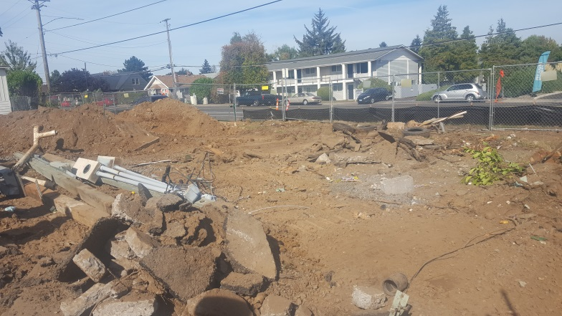
Project Overview: A Completely New Park
Acquisition & Rehabilitation: Preserving 22 Units of Affordable Housing
Acquired in 2017 to prevent park closure & displacement of residents
6-7 Months of Construction to scrape and re-build park
Post-Rehabilitation:
Affordability/unit mix:
16 new park-owned manufactured homes
1 existing park-owned double-wide
5 resident-owned units
All spaces restricted to 60% AMI
Resident Services:
On site computers and community gathering areas
Community Resource board and referrals
Homework clubs
Parenting, NA, AA & budgeting classes, etc.
Community Partnerships

Slide 3
Construction & Revitalization
Completely remove and replace infrastructure
Demolition & Abatement: Mobiles, House & accessory structures
Build a one-story community center with laundry facilities and on-site leasing and counseling offices
Install playground, secured entry
Replace uninhabitable housing with new 2-bd, 1 bath energy-efficient NEEM certified manufactured homes

Slide 4
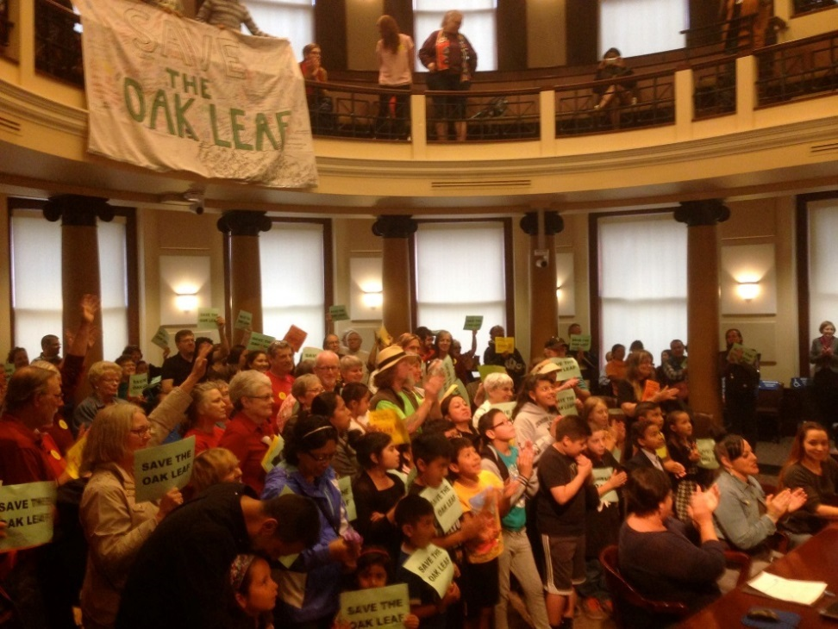
Project Costs & Funding Sources
Acquisition Costs: $1,289,431
Construction Costs: $3,035,067
Development Costs: $928,321
Total Project Costs: $5,252,819
CDBG Loan, Portland Housing Bureau: $3,213,319
OHCS GHAP Grant: $1,190,000
NOAH Permanent Loan: $313,000
Multnomah County Weatherization: $320,000
Energy Trust of Oregon: $160,000
Oregon Community Foundation Grant: $51,500
Bank of America Grant: $5,000
Total Sources: 5,252,819
*SDC Waivers: $16,766

Slide 5
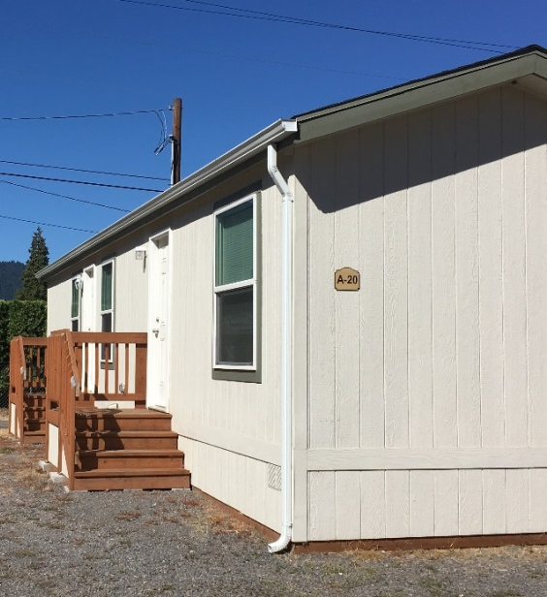
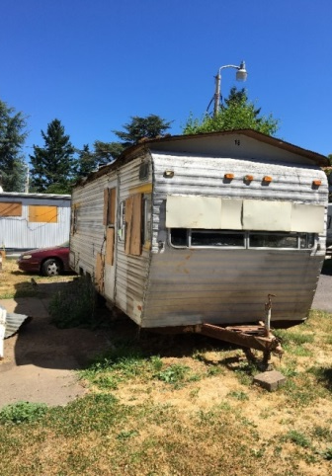
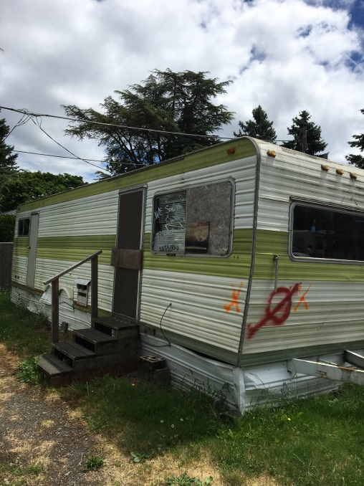
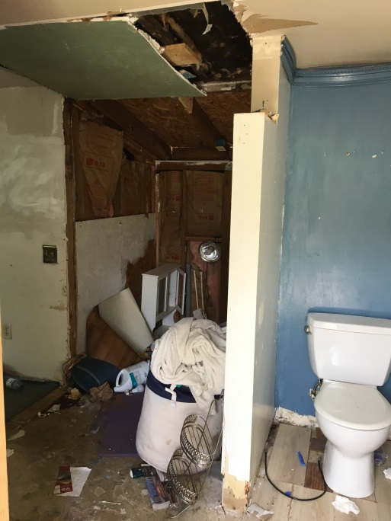
Mobile Home Replacement
Environmental/Heath Benefits:
Decommissioned, Pre-76 Units:
Hazardous materials (asbestos, mold)
Energy-inefficient/high utility burdens
Energy Star (NEEM 1.1) Manufactured Homes:
Built to higher energy-efficiency standards
Projected Energy Savings: $7,937 kWh per home
Costs:
16 New Home Purchase & Set-Up :
Purchase price/delivery per home: $35,780
Set-up costs per home: $10,000
Contingency: $20,000
Total Cost 16 Unit Purchase Delivery & Set-Up: $747,280

