Slide 1
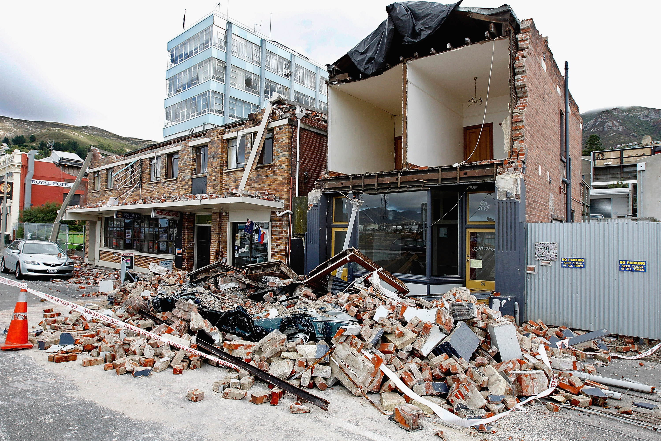

Slide 2
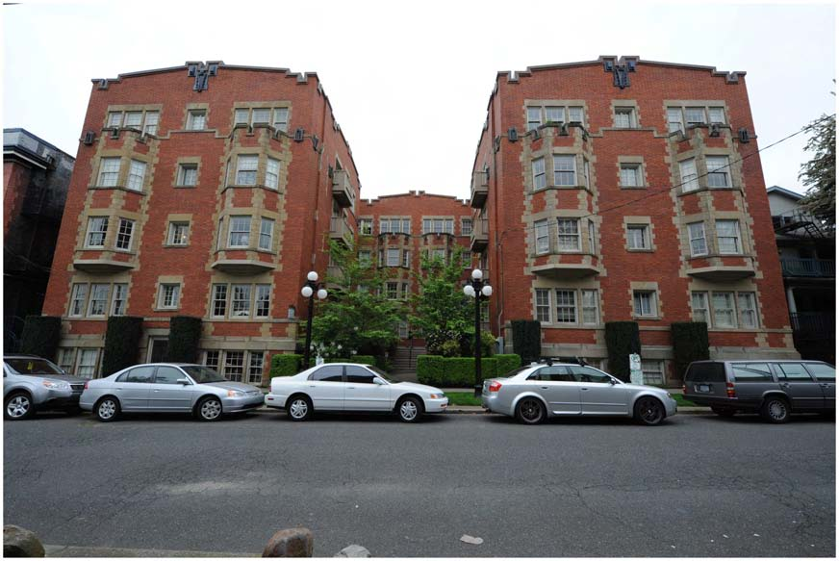
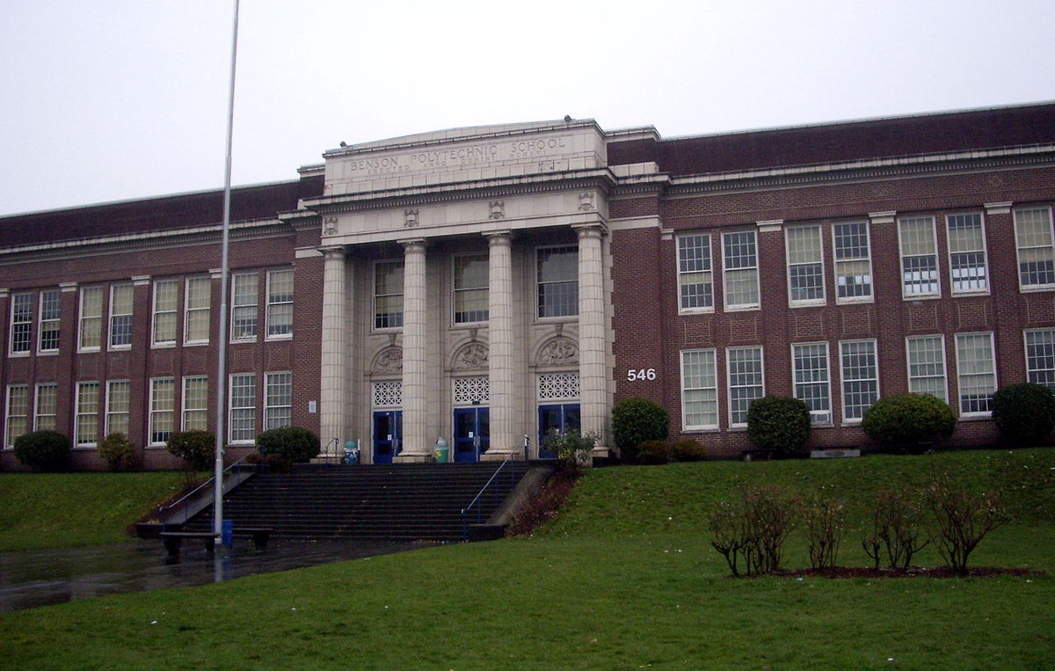
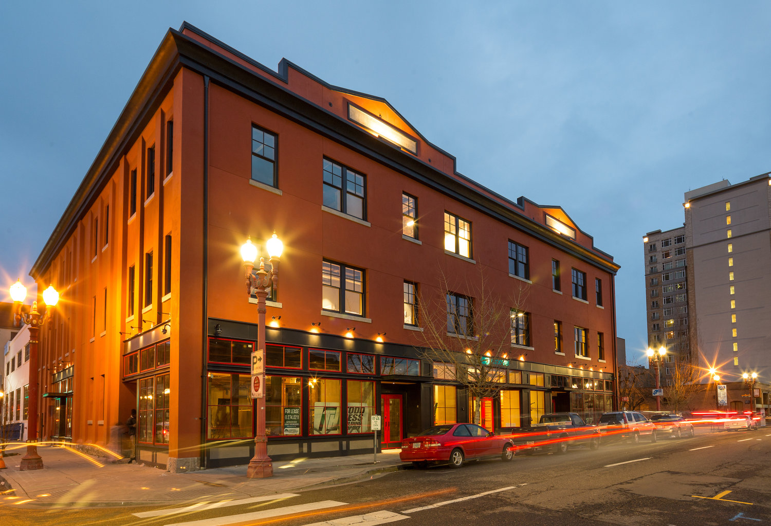
Unreinforced Masonry Building Placarding and Tenant Notification Ordinance
October 3, 2018
Notes:
Good Afternoon , Mr. Mayor and Commissioners.
My name is Amit Kumar and I am a Sr. Structural Engineer with Bureau of Development Services. I am here today to present on the proposed ordinance requiring Placarding and Tenant notifications for Unreinforced masonry Buildings.

Slide 3
City Council Resolution
In June 2018, the City Council passed Resolution No. 37364 directing City staff to draft an ordinance that would:
Require a placard on all URM buildings that have not been retrofitted to prevent collapse in the event of a “major earthquake”
Require URM building owners to notify tenants/renters through rental agreements that their building is an unreinforced masonry building.
Strengthen existing triggers in Title 24.85 requiring seismic retrofits of URM buildings
Notes:
Earlier this year in June, City Council directed City staff to return to council within 3 months that would 1) Require a placard on all URM buildings that have not been retrofitted to prevent collapse in the event of a “major earthquake”
2) Require URM building owners to notify tenants/renters through rental agreements that their building is an unreinforced masonry building.
and
3) Strengthen existing triggers in Title 24.85 requiring seismic retrofits of URM buildings

Slide 4
The Proposed Ordinance
PLACARDING REQUIREMENTS
An 8”x10” durable placard
Lettering in a 50-point bold font
Posted in a conspicuous location on the exterior at the main entrance with the following message:
Notes:
For item #1 which is placarding requirements. The ordinance would require a placard that is

Slide 5
Placard Wording
This Building is an Unreinforced Masonry Building. Unreinforced Masonry Buildings may be unsafe in an event of a Major Earthquake.
Notes:
The Placard would require the following wording :
SHOW EXAMPLE OF 8X 10 WITH 50 POINT Bold

Slide 6
The Proposed Ordinance
PLACARDING REQUIREMENTS
URM owners to post a placard according to the following timeline:
Publicly-owned buildings: On or before January 1, 2019
Non-profit buildings: On or before November 1, 2020
All other buildings: On or before March 1, 2019.
Notes:
The original resolution required URM buildings to be posted with a placard by March 1, 2019. However, Council felt that the City should lead by example so the requirement for placarding of Public building was preponed to January 1, 2019. In addition, based on outreach with various constituents and understanding , the unique nature of services provided by Non-profits including religious institutions , it was felt that these class of buildings be afforded additional time to place placards. They will now have to place placards on or before November 1, 2020

Slide 7
The Proposed Ordinance
TENANT NOTIFICATION REQUIREMENTS
Building owner must notify existing tenants and
Every new lease or rental agreement entered into or renewed must contain the statement that “This building is an Unreinforced Masonry Building. Unreinforced Masonry Buildings may be unsafe in an event of a Major Earthquake.
Timeline for notification into new lease or rental agreements is the same as for placarding
Notes:
The second component of the Ordinance is tenant notification. This requirement would require that building owners

Slide 8
The Proposed Ordinance
Placarding and Tenant Notification Requirements
Building owners must record an agreement not to remove the placard and acknowledgment of compliance with tenant notification requirements
Notes:
Owners would then be required to record an agreement with the county that they would maintain the placard and not remove it unless authorized by the city and also an acknowledgment that they have complied with the tenant notification requirements discussed previously.

Slide 9
The Proposed Ordinance
Exceptions to Placarding and Tenant Notification Requirements
Buildings that have been retrofitted to the following standards will not require a placard or tenant notification:
Collapse prevention standard for BSE-2 seismic hazards or life safety for BSE-1 seismic hazard as defined in American Society of Civil Engineers (ASCE) 41-17 or ASCE 41-13
Buildings that were retrofitted before January 1, 2018 are grandfathered in if they were retrofitted using either:
a. Life Safety standard using FEMA 178, FEMA 310, or ASCE 31; or
b. Oregon Structural Specialty Code 1993 edition or later
Notes:
Not all buildings will require placards or tenant notification:
The resolution required that buildings that have been fully retrofitted to prevent collapse in a major earthquake will not require placards. The ordinance defines what os meant by a Major earthquake and what collapse prevention means and lists the nationally recognized standards the retrofits need to meet
Essentially any URM that underwent a full seismic upgrade in the past (essentially 1995 onward) to the stanards in effect at that time has been grandfathered in and will not require a placard or tenant notification.

Slide 10
Implementation Plan
URM property owners will be notified by December 31, 2018 of the requirements
BDS will host a website where URM owners can upload the recorded agreement and pictures of the placard on the building.

Slide 11
Appeals
Owners may appeal notice and placarding requirements if they believe their building:
Was incorrectly classified as a URM
Has been retrofitted to meet the standards to be exempt from placarding.
Placarding and tenant notification will not be enforced until the appeal is resolved.

Slide 12
Enforcement
Portland Fire and Rescue will inspect the placement of placards as part of their regular commercial building inspection program, and work with BDS code enforcement in applying the requirements for placards.
BDS will use its existing code enforcement program and authority to enforce the requirements for placarding and tenant notification.

Slide 13
STRENGTHENING EXISTING SEISMIC TRIGGERS
Roof replacement – removal of greater than 50% of total roof area within a 5 15 year period requires wall anchorage for both in plane and out of plane forces and parapet bracing.
Costs of alterations or repair - When costs associated with building alterations or repair in a two five year time period or fifteen year time period exceeds the square-foot costs outlined in the ordinance, entire building must be improved to resist seismic forces to meet ASCE 31 41 criteria
Notes:
The third item in the ordinance is strengthening a couple of existing triggers for seismic upgrades.
Thank you. If there any questions I will be happy to answer them .

