Slide 1
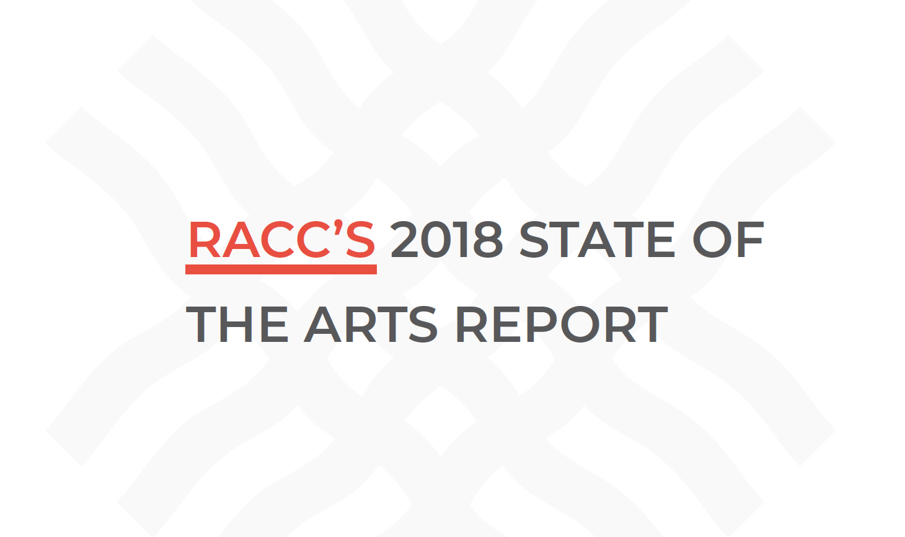

Slide 2
Mike Golub
RACC Board Chair, 2016-2018
Notes:
COMM. EUDALY introduces MIKE GOLUB, President of Business for the Portland Timbers and RACC’s board chair emeritus
MIKE GOLUB:
Thank you Commissioner, etc.
It’s been an honor to chair the Regional Arts & Culture Council for the past two years, an organization that continues to evolve and etc.
Most of today’s report will be presented by RACC’s new board chair, Linda McGeady, and our Interim Director, Jeff Hawthorne. But first I wanted to take a few moments to thank you all for helping make sure that Portland maintains a strong and vibrant arts community, and for putting your faith in RACC to be good stewards of your arts and culture investments. It’s a great organization that over its 23-year history has provided more than $50 million in grants for artists, nonprofit organizations and schools, and manages an internationally acclaimed public art program of more than 2,000 artworks. In the last twelve years, RACC has also raised more than $8.5 million for local arts organizations through workplace giving campaigns; and integrated the arts into the curriculum of other subjects for K-8 students in the region, serving more than 27,000 students per year. Over the last five years, RACC’s focus has been to expand its community engagement efforts and adapt its services to better serve communities of color and other underrepresented communities.

Slide 3

Notes:
MIKE (cont’d)
We are all looking forward to working with you, Commissioner Eudaly, as the new Arts Commissioner. And we’ll soon have a new Executive Director – Linda can tell you more but we may have an announcement as early as next week.
So let’s kick off today’s State of the Arts presentation with a special performance. We heard that Commissioner Fish attended a production of “Scarlet” at Portland Playhouse last year, which of course is funded in part by RACC, and Nick was so impressed with the show and one young performer in particular, and so we wanted to bring her here to perform for you today. We want to thank you, Commissioner Fish, for your leadership and support over the last six years, and we are grateful to know that you’ll remain a strong arts champion.

Slide 4
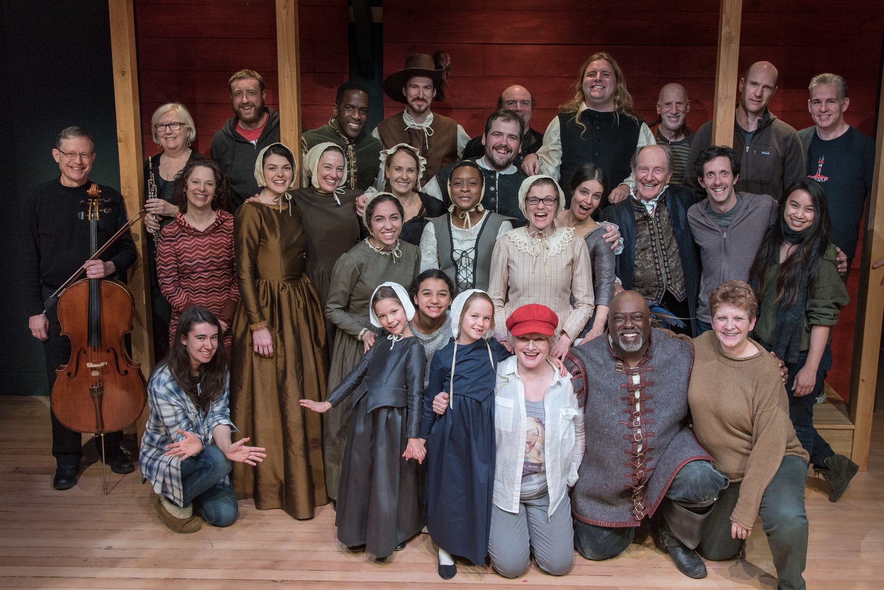
Notes:
MIKE:
Allow me to introduce to you all Rainbows, who will be singing “O' Papa” from the Portland Playhouse production of Scarlet.
(Mike can leave the table. Rainbows sings.)

Slide 5
Linda McGeady
RACC Board Chair
Jeff Hawthorne
Interim Director
Notes:
LINDA:
Thank you, Rainbows. That was wonderful.
Good afternoon, Mayor Wheeler and Commissioners. My name is Linda McGeady and I took the reins from Mike Golub as board chair in July.
I’m a first-generation American, born in Belfast, Northern Ireland. I emigrated here in the late ‘90s after eight years working in London as a lobbyist and policy advisor on energy conservation and climate change. I have now lived in Portland longer than anywhere else, and my kids were born here. I was introduced to RACC by former ED Eloise Damrosch about a year after we both joined the Art Committee of the Randall Children’s Hospital at Legacy Emanuel. I had previously served on the board of PICA for 6 years and then focused on school volunteering when my kids were little, and so I was delighted and honored - and not a little intimidated - to join the board of such a key arts organization.
Four years later I feel a little like the frog in the cold water: the Public Arts Committee led to the Leadership Development Cttee and the Executive Cttee, and then the first search cttee...It has been an honor and a stretch in the best way and I am endlessly challenged to think about the impact of this work on the city I love and the many communities it contains. The staff are a wellspring of knowledge, experience and creative thinking, and they and the new ED and the community volunteer board I chair are hungry to help showcase Portland as a city where art and culture are part of everyday life, are part of creative problem solving and are a revenue-generating attraction for residents and visitors alike.
JEFF:
And my name is Jeff Hawthorne and I am the Interim Executive Director. Good afternoon. As many of you know, we usually deliver our State of the Arts report in the spring, but I must say, it’s nice to have this talk when we aren’t in the middle of budget season, and, fortuitously, October is National Arts & Humanities Month, so it’s a great time to tell you about the things we are doing at the Regional Arts & Culture Council, and the challenges and opportunities we observe across Portland’s arts community.

Slide 6
Our Vision: An environment in which arts and culture flourish and prosper.
Our Mission: To enrich our communities through arts and culture.
Notes:
JEFF:
I wanted to start by reminding you of our mission, vision and values, which have basically remained the same since RACC was first spun off into an independent 501(c)(3) organization in 1995. RACC’s mission is broad -- “to enrich our communities through arts and culture” – which has allowed RACC to explore ways of using arts and culture not just as consumable products but as powerful tools for addressing a wide variety of community challenges and concerns.

Slide 7
Our Values:
We value freedom of artistic and cultural expression as a fundamental human right.
We value a diversity of artistic and cultural experiences.
We value a community in which everyone can participate in arts and culture.
We value a community that celebrates and supports its artists, and its arts and cultural organizations.
We value arts and culture as key elements in creating desirable places to live, work, learn and visit.
Notes:
JEFF:
I also want you to know that our staff and board have latched on to a very important value statement, which again has been in existence since 1995. We value a community in which everyone can participate in the arts, and has access to cultural experiences – this, I believe, represents the most important thing we are called to do as your local arts council.
We’ll return to this theme in a moment, but first we wanted to brief you quickly on some of the latest developments at RACC, starting with our search for a new Executive Director.

Slide 8
WHAT’S NEW
Executive Director Search
Audit Follow-Up
And so much more! Full report available online.
Notes:
LINDA:
As you know, this is phase II of an 18-month process: we offered the position to an outstanding candidate in May but that candidate’s family circumstances changed and they were not able to accept. The decision was made to continue the search, and last month we brought three strong new candidates to Portland for final interviews with board, staff and community, including Comms Eudaly and Fish, and Susan Gibson Harnett in the Office of Management and Finance. Almost everyone who participated in the phase I interviews returned to meet the new candidates, and we are grateful to the 20 stakeholders whose insightful and challenging questions put the candidates through their paces and were an invaluable part of the process.
I’m also grateful to the board, former board and community members who made up the first search committee, and to the current search committee who have all given countless hours to this process. The level of interest, participation and passion around this appointment speak to the art community’s expectations for the role RACC and its new leader will play in forging a new identity and place for the arts.
The search committee delivered its recommendation to the Board on Tuesday, which the board voted to accept. I am looking forward with great excitement to an announcement - hopefully - being made during the week of Oct 22nd.
***
In addition, we’ve been working through several of the issues that were raised in the auditor’s report earlier this year. Jeff has launched Phase One of RACC’s strategic planning process, working with a consultant to develop our planning goals, process and timeline. We suspect the entire process will take about a year to complete.
We’ve enjoyed our initial conversations with our new Arts Commissioner, Commissioner Eudaly, and we will be working together on a recommendation for how the city might go about updating its vision and strategic plan for arts and culture. Our community will surely benefit from such an exercise, and RACC stands ready to partner with you all on these important conversations that will help us prepare for Portland’s future.
We’ve also very much enjoyed working with Susan Gibson Hartnett in the Office of Management and Finance as we work to re-write the RACC contract, and we are looking forward to having a new relationship with the City Arts Project Manager that is soon to be hired. We have great confidence in the city’s process and we can already see how advantageous it will be to have this additional and dedicated relationship at the City. So thank you for making it happen.
***
So much else has happened since the last time we officially presented to you, but it’s all in the written report so I’ll leave it at that for now. Let’s have Jeff talk for a moment about RACC’s finances and services.

Slide 9
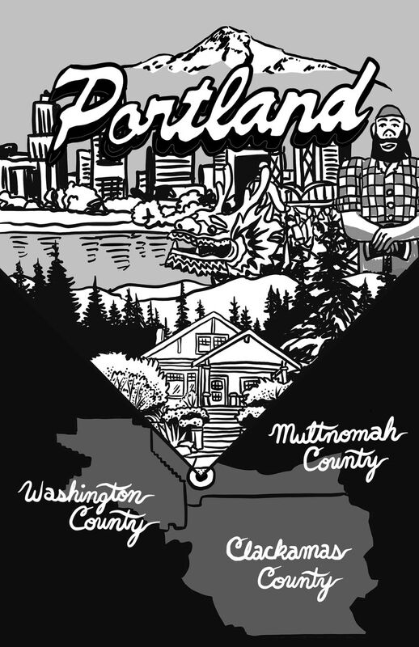
Who we serve:
Artists, nonprofit organizations and schools in the Portland tri-county area
Notes:
JEFF:
Thank you, Linda.
Throughout this presentation, you’ll see some wonderful illustrations by Alex Chiu, who has designed a State of the Arts zine for us, and he’ll be speaking a little later. Thank you, Alex!
RACC, by design, is a regional arts services agency that provides grants and services for artists, nonprofit organizations and schools in Clackamas, Multnomah and Washington County. Within this large metro area, it will come as no surprise for you to hear that the vast majority of arts activity happens in Multnomah County and, specifically, in Portland.

Slide 10
Total arts attendance in the region: 3.9M
In Portland and Multnomah County: 3.5M (90%)
Source: Arts & Economic Prosperity 5
Notes:
JEFF:
In fact, last year’s economic impact study that we conducted with the Americans for the Arts revealed that Portland accounts for 90% of the total attendance at nonprofit arts events in the tri-county area, and Portland businesses benefit from all the arts-related spending at restaurants, hotels, parking lots and retail stores. There’s much more detail as Appendix 1 in your report, but let’s FLAG that 90% of all arts activity is a remarkable percentage when you consider that Multnomah County accounts for only 45% of the region’s population and Portland funds only 68% of RACC’s budget.

Slide 11
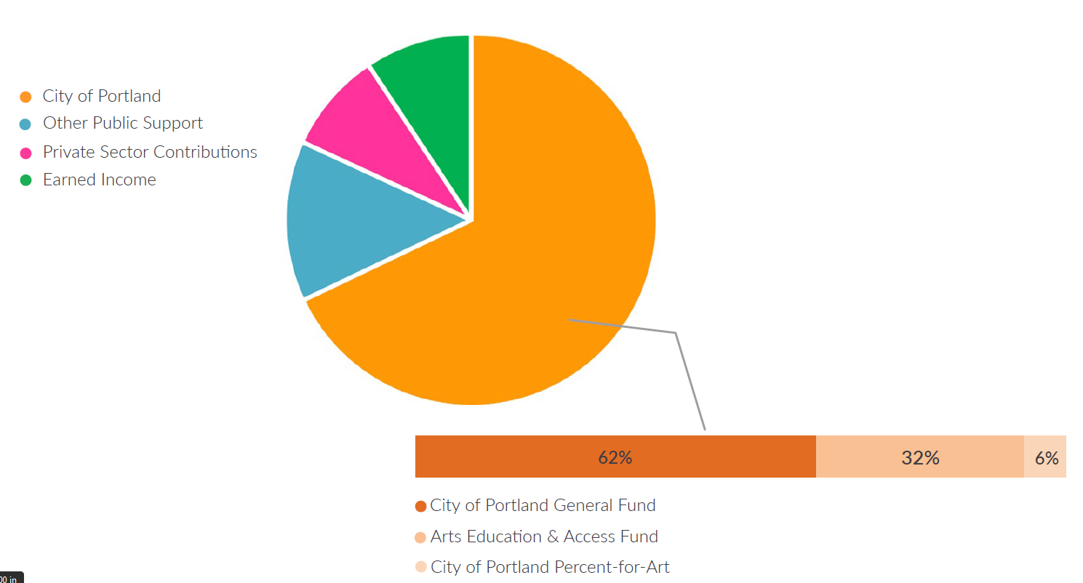
Total budget = $9.6 million
68% comes from the City of Portland
$6,531,319
Notes:
JEFF:
Indeed, the City of Portland is RACC’s largest source of revenue, and our service agreement with you is more comprehensive than any other contract we have.
You can see in this slide that 68% of our budget, a total of $6.5 million, comes from the City of Portland. Of that total, broken out in the rust-colored bar, you can see:
---Just over $4 million, or 62%, came from the General Fund
---$2.1 million, or 32% came from the Arts Tax
---$406,000, or 6% came through the 2%-for-art ordinance
I should note here that all of our fiscal year ‘18 financial statements are currently being reviewed by an independent firm, and we look forward to sharing our audited financial statements this winter -- as we do every year.
Also in this slide, you can see in teal that RACC earns 14% of our revenue through other local government agencies, including Multnomah County, Clackamas County, Washington County, and Metro. Those are revenue streams that we’re always working to grow, but it’s a challenging case to make when you see the disparity of the LOCATION of arts activity that I talked about in the last slide, and, frankly, many counties in the United States and here in the State of Oregon are simply not investing in the arts the way cities are.
The pink slice represents $843,000 that we raise every year in contributions from the private sector, and the green slice shows our earned income – almost $900,000 last year – mostly fees for services, including public art consultation services nationwide.

Slide 12
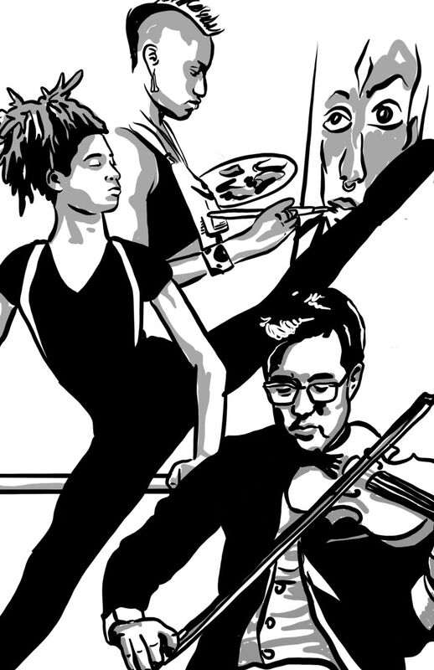
RACC provides grants and services for artists and arts organizations
$5.8 million
57% of RACC’s budget
Notes:
JEFF:
In terms of program delivery and expenses, we invested nearly $5.8 million or 57% of our budget in grants and services for artists and arts organizations. We’ll share some grantmaking highlights in a moment… (continued on next slide),,,,

Slide 13
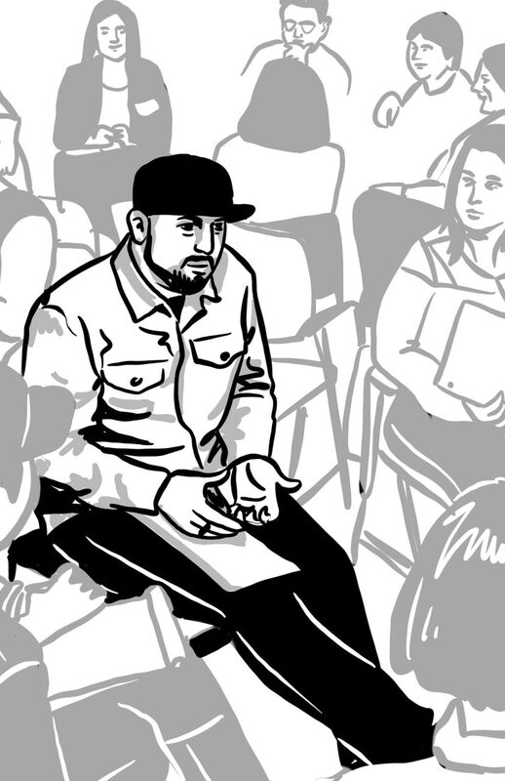
Some examples of our technical assistance services:
✓ a workshop on how to paint a mural
✓ assistance writing a grant
✓ a lesson in QuickBooks
✓ Art of Leadership
Notes:
JEFF:
…but just to give you some examples of the related technical assistance services we provide for artists and arts organizations… they include workshops on a wide variety of topics, personal assistance assembling an application, and “Art of Leadership”, a board training program.

Slide 14
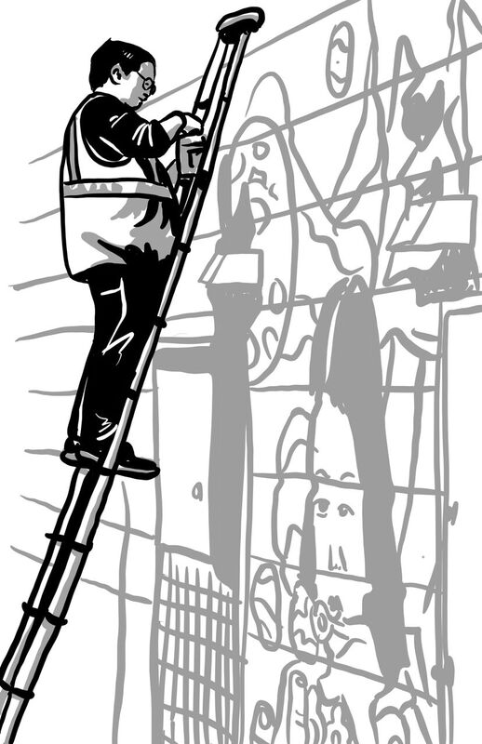
RACC commissions public art and maintains the city’s vast collection
$1.45 million
15% of RACC’s budget
Notes:
JEFF
15% of our total budget last year was spent on public art –RACC commissions and maintains a growing public art collection on behalf of the City of Portland and Multnomah County. There are now more than 2,200 artworks in the collection, thanks in large part to the City and County’s 2% for art ordinances.

Slide 15
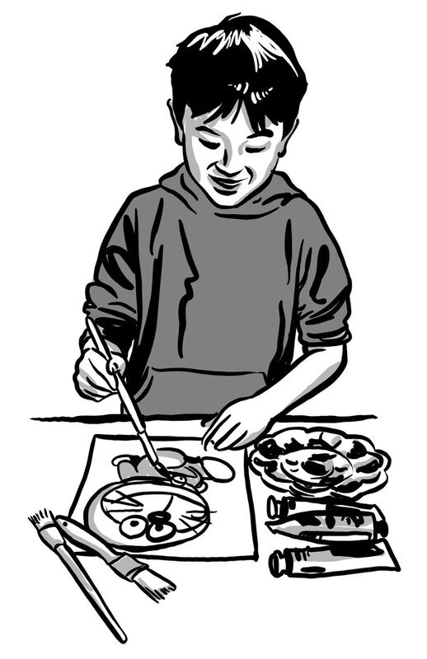
RACC ensures that every student has access to arts education
$1.2 million
12% of RACC’s budget
Notes:
JEFF
We all know that students do better in school when the arts are part of their curriculum, and RACC is working to ensure that every student in the region has access to arts education. We invested approximately 12% of our budget on these efforts last year.

Slide 16

RACC advocates for everyone to have access to the arts, and ways to express their creativity
$480,000
5% of RACC’s budget
Notes:
JEFF:
And we’ve discussed that it is incumbent upon us to ensure that everyone has access to the arts, and ways to express their creativity. Our advocacy and community engagement activities represent 5% of our budget, and there is still much work to do before we can confidently say that everyone in our community has access to the arts. We’ll talk more about our progress in a minute.

Slide 17
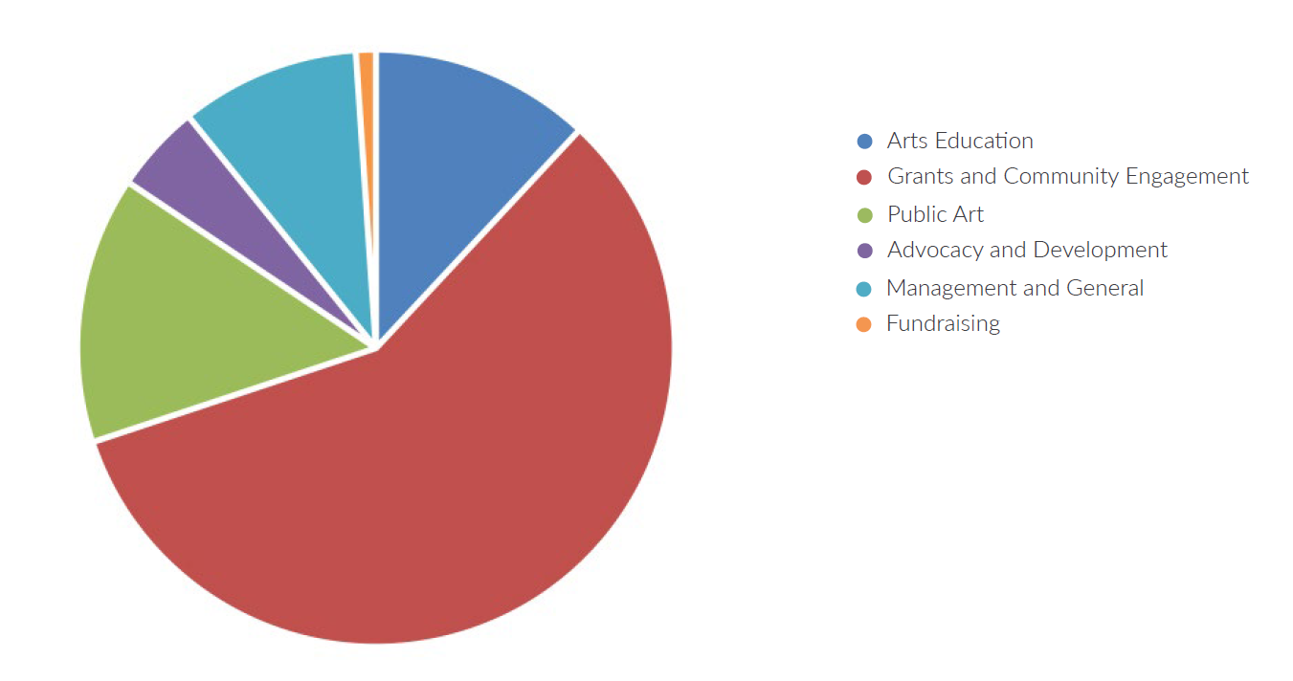
Expenses by program
Overhead = 11%
Notes:
JEFF:
So here’s a recap – RACC’s expenses broken out in red for grants, green for public art, the darker blue for arts education and purple for advocacy.
Note here that RACC’s overhead costs are 11%. The IRS defines “overhead” as management & general expenses, shown here in teal, plus fundraising expenses, shown in orange. RACC’s audited financial statements for the last ten years verify that our overhead costs have ranged between 9-12% every year -- an exceptional ratio by any definition.
We credit our Director of Operations, Cindy Knapp and her team, for both the commitment to low overhead costs, as well as keeping flawless financial records.

Slide 18
GRANTS
Notes:
LINDA:
Starting on page 28 of your report, you will see a complete list of every grant we awarded in the fiscal year that ended June 30, 2018 – more than $4.9 million overall. While every single grant has an impact on an artist or a community member, there a few examples that I’d like to highlight.

Slide 19
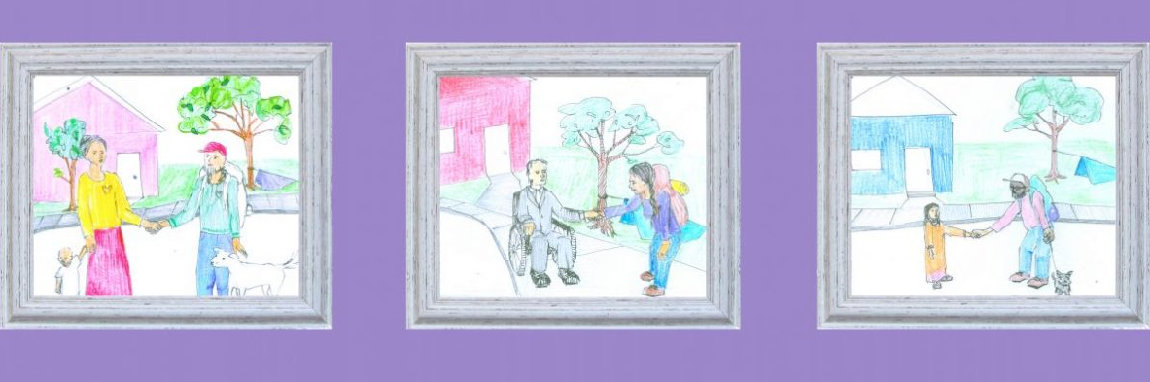
Notes:
LINDA:
RACC awarded $6,500 to Right 2 Survive for their Ambassador Project, hosting writing and art workshops for housed and houseless people to create together, culminating in the second annual Light the Hearth Festival.

Slide 20
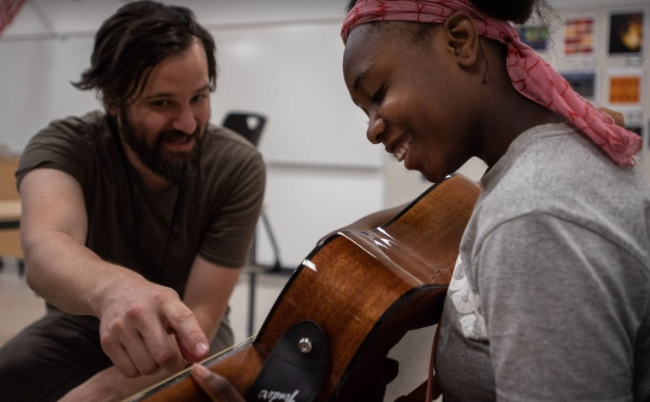
Notes:
LINDA:
The 2018 Immigrant and Refugee Youth Music Camp received $5,250 so that young people ages 13-17 could express themselves by creating original music, culminating in a live community performance at Franklin High School.

Slide 21
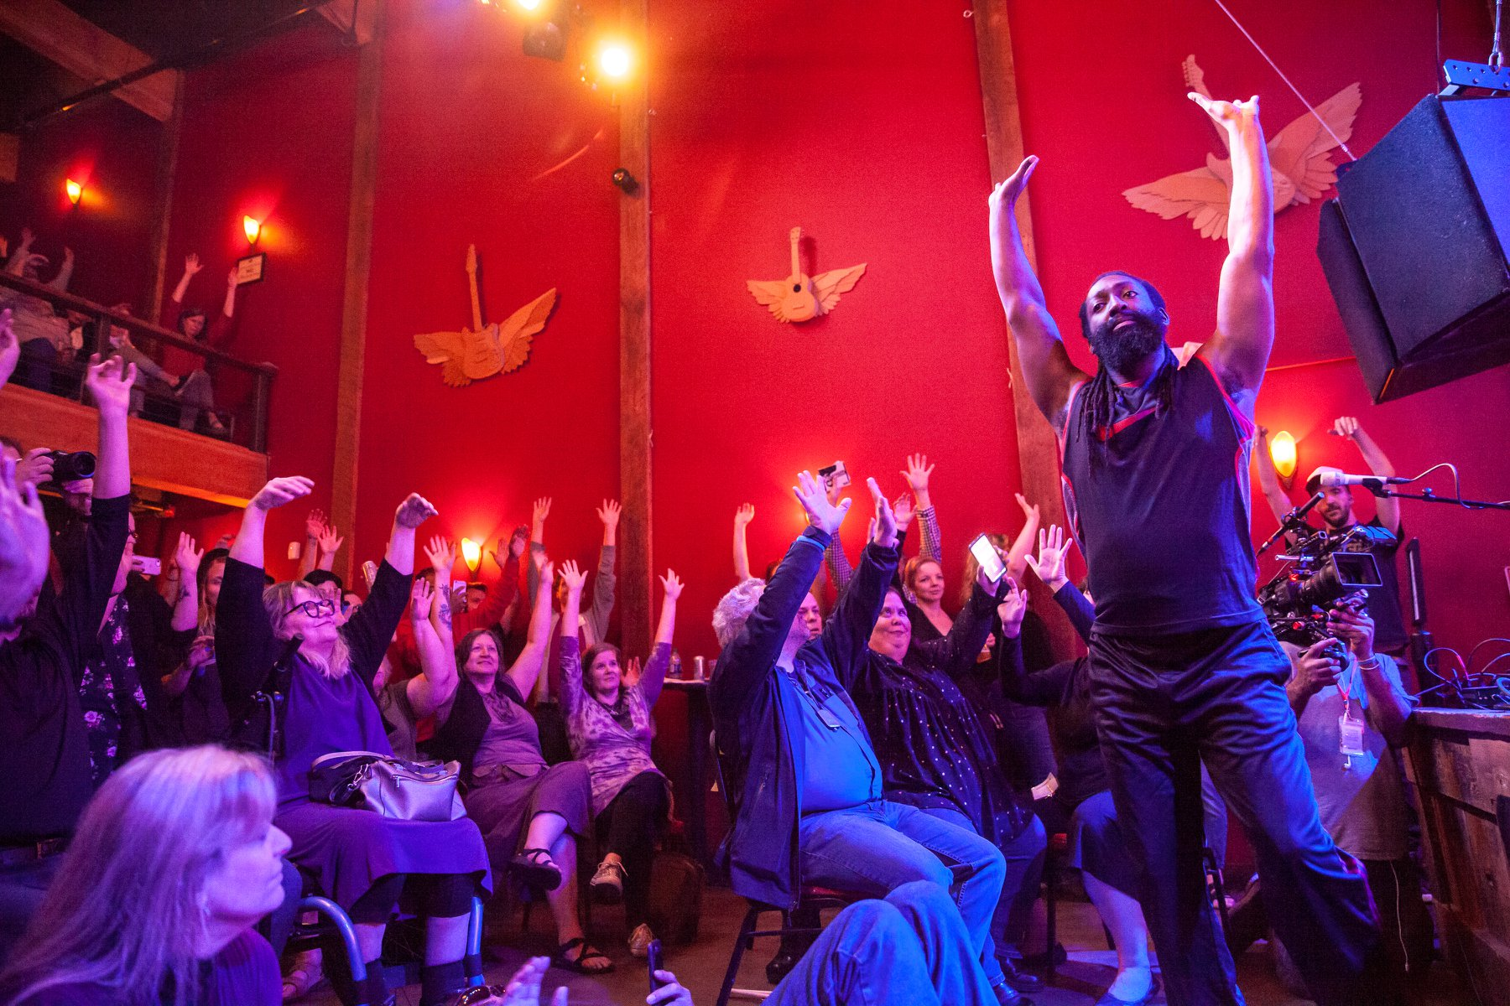
Notes:
LINDA:
And Myles de Bastion, founder and president of CYMA SPACE, received a project grant to support the NW Deaf Arts Festival, an inclusive and innovative experience for deaf and hearing allies at Mississippi Studios. Myles is here with us today, and I’d like to invite him up now to tell us more about his grant and the impact his festival had in the community.

Slide 22
Myles de Bastion
Artist and President of CymaSpace
Notes:
[Myles will have an ASL interpreter assist him with his remarks.]

Slide 23
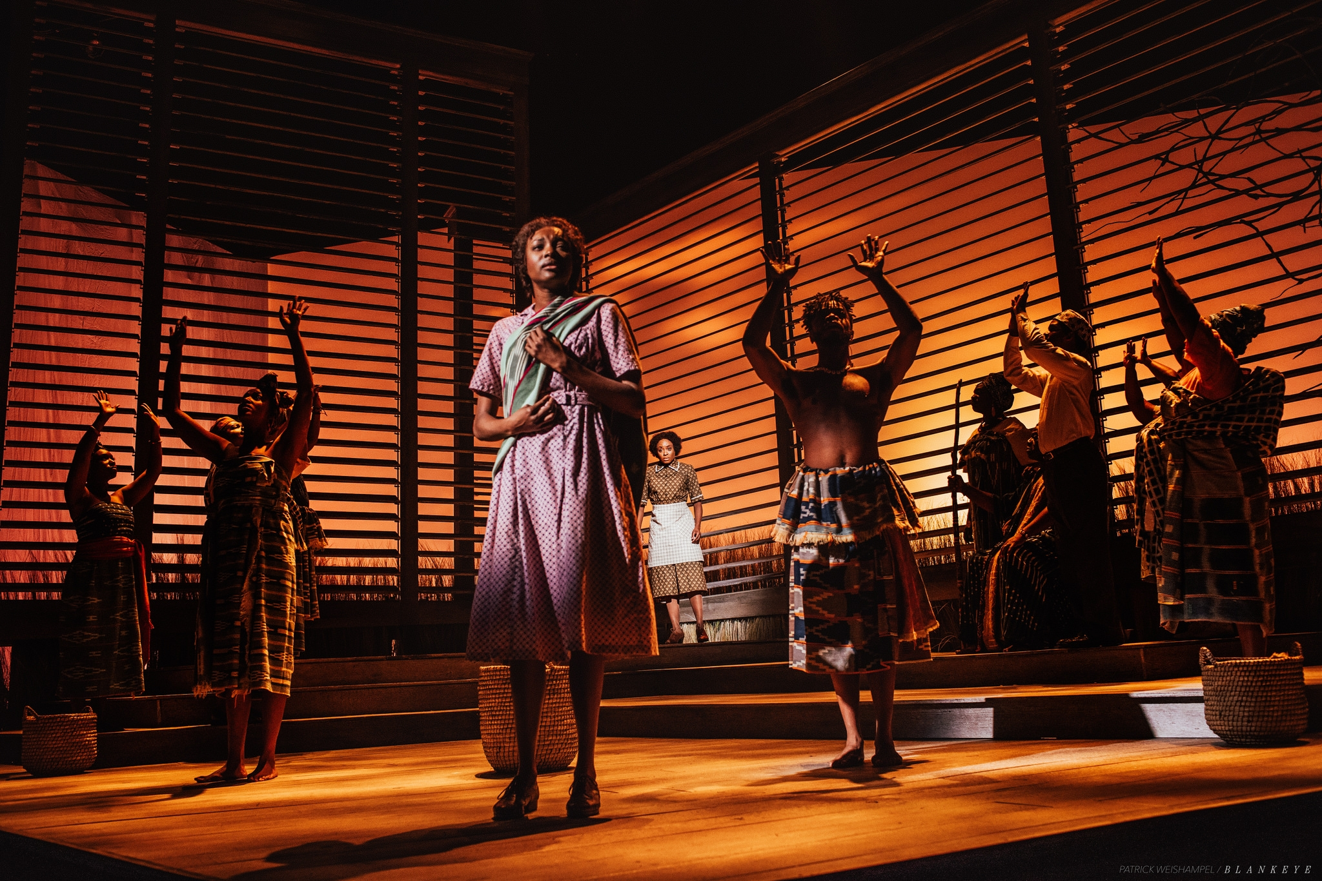
Notes:
JEFF:
Thank you, Myles.
Suffice it to say that RACC is changing the way we distribute funding to ensure that more culturally specific organizations, and other historically underserved residents throughout the city, ultimately benefit. Our grants team led by Helen Daltoso is doing excellent work to gather information about how other communities are addressing similar issues, and they are listening to and responding to the needs of our local community.
We continue to appreciate the many ways that large organizations contribute to our economy and our quality of life, including the distribution of more than 12,000 tickets at $5 each to low-income Oregonians through the Arts for All program. This is a photo of the current, excellent production of “The Color Purple” at Portland Center Stage.
We acknowledge that we don’t have enough resources to continue investing in the same groups at the same levels while also investing in all the smaller organizations and emerging artists in our city. That is why it is so important that we work with you to clearly understand and articulate the city’s priorities for arts and culture, and to collaborate on generating new revenue sources.

Slide 24
PUBLIC ART
Notes:
LINDA:
After 4 years of serving on the Public Art Committee I’m still learning about this fascinating and highest-visibility program. Public Art Director Kristin Calhoun and her team of specialists work miracles with a small budget to enhance the urban art landscape.

Slide 25
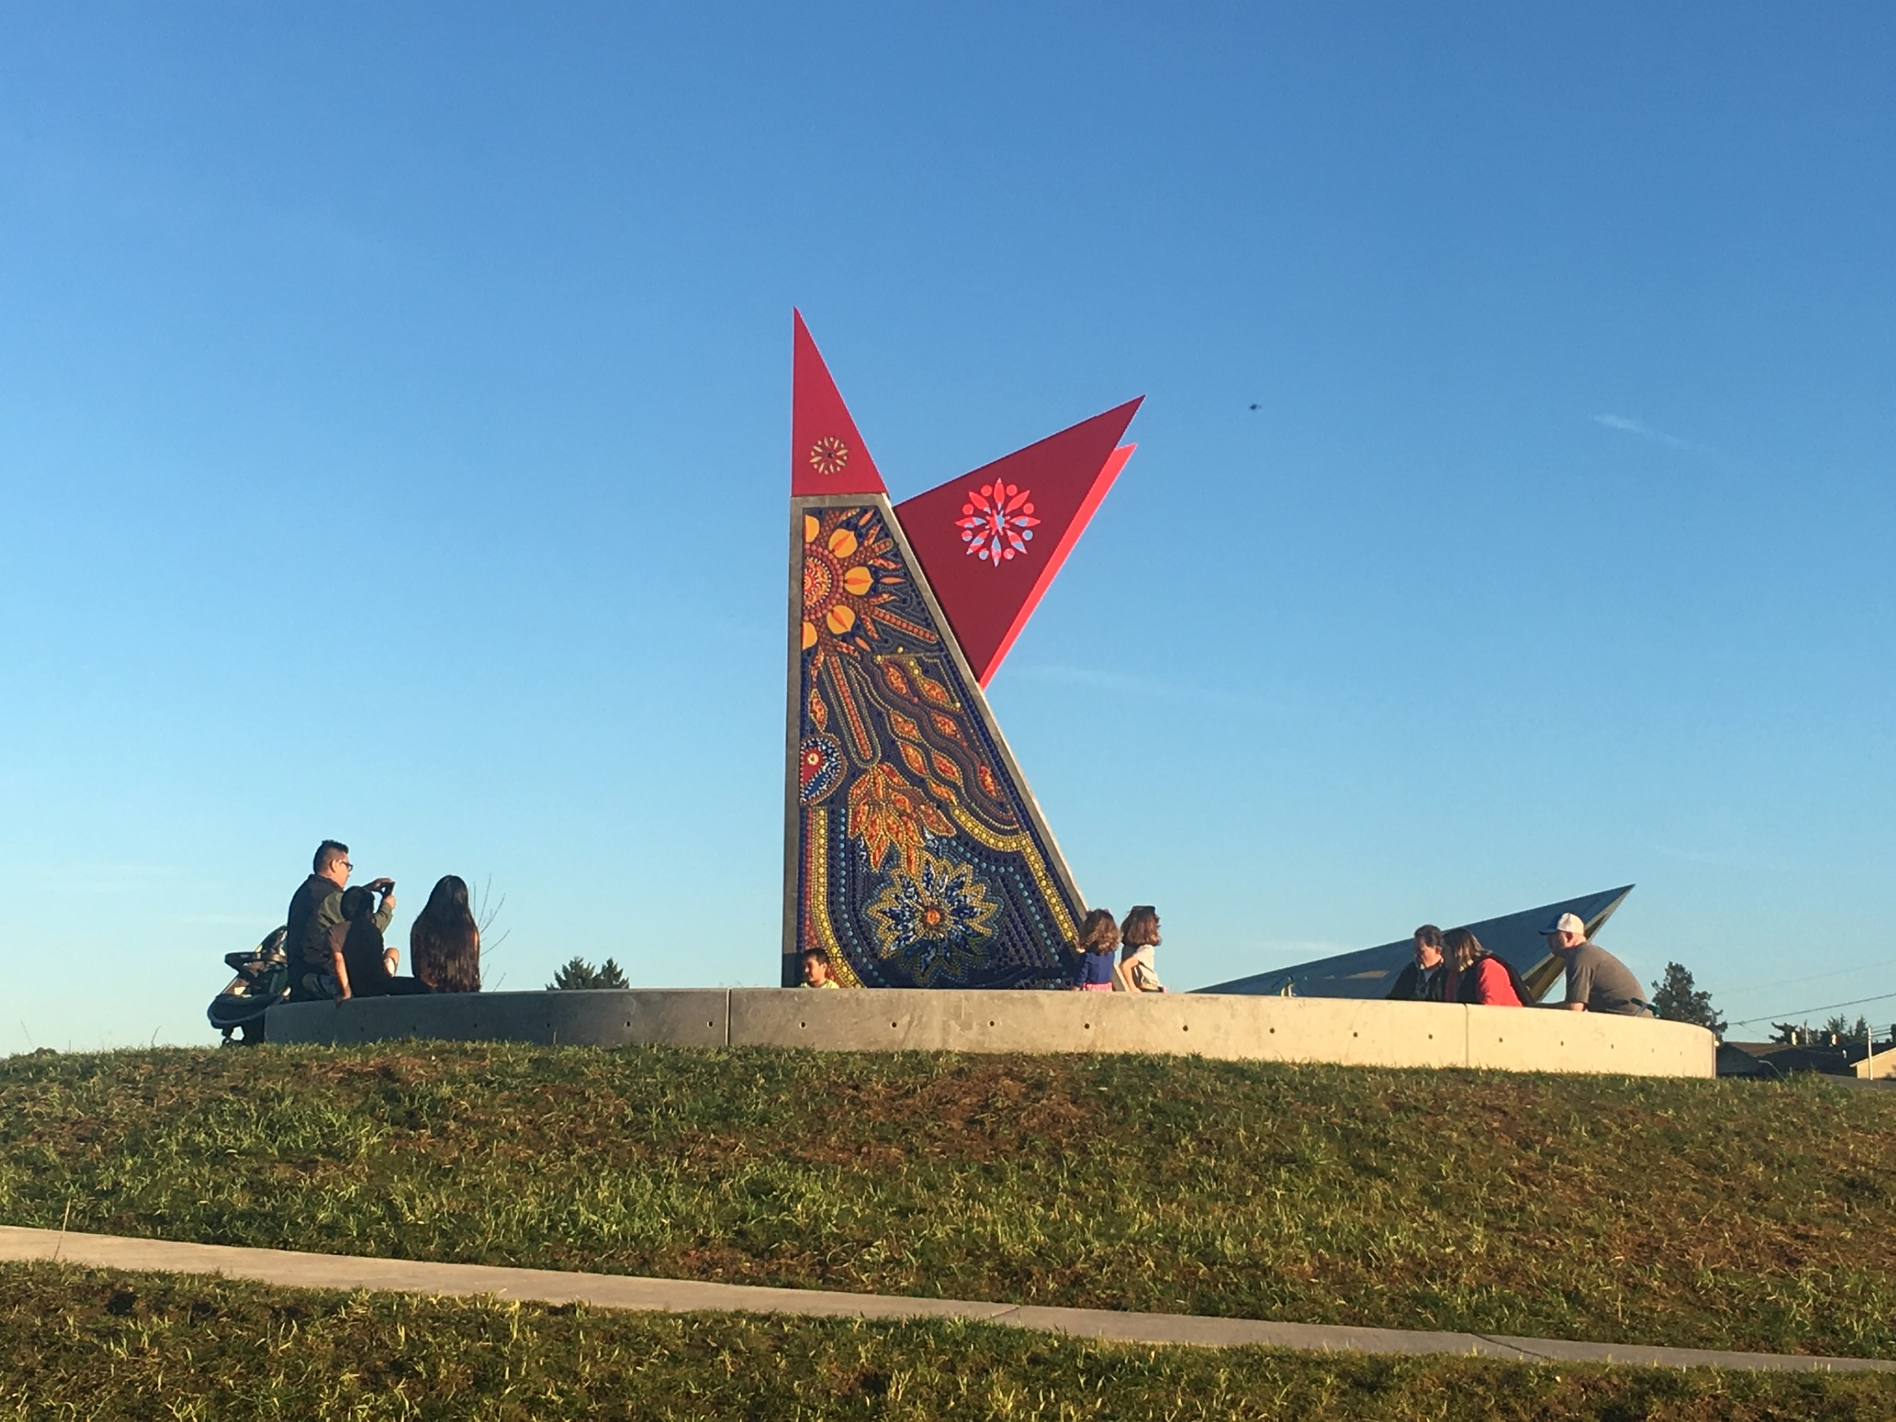
Notes:
LINDA:
Many of our parks are graced and enhanced by beautiful and quirky and humorous installations. We’ve been working closely with Portland Parks & Recreation and this year completed public art projects at Dawson, Luuwit View, Gateway Discovery Park and Spring Garden Park. This is Mauricio Robalino’s beautiful piece “Camero Bird” at Luuwitt View Park.
Thank you, Commissioner Fritz, for your tremendous support of these projects.

Slide 26
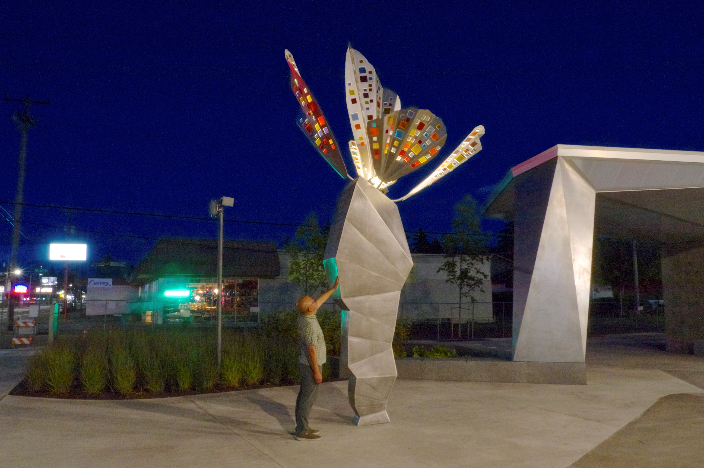
Notes:
LINDA:
RACC also maintains and when necessary repairs the public art collection, which now stands at over 2,200 pieces including large-scale sculptures; outdoor and indoor murals; smaller three-dimensional pieces and framed art in every size and medium.
This is Horatio Law’s new sculpture “The Fifth Wind” at Gateway Discovery Park. Horatio developed this artwork in part through butterfly folding workshops with the community at the park site before it was constructed.

Slide 27

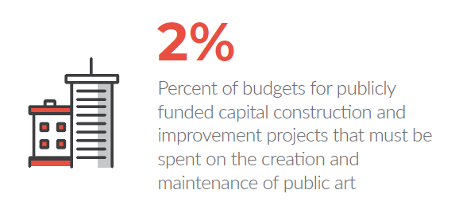
Notes:
LINDA:
We add to the collection every year, including 31 new artworks in this past year, mostly using funds generated by the city’s percent-for-art ordinance – where 2% of budgets for publicly funded capital construction and improvement projects must be spent on the purchase and maintenance of public art. Your report includes a complete list of all projects completed or underway in 2018.
In collaboration with the bureaus, this allocation can be spent on art not directly associated with the project, and we are preparing a report with recommendations on how we might direct more public art works to neighborhoods that have previously not benefited from them.

Slide 28
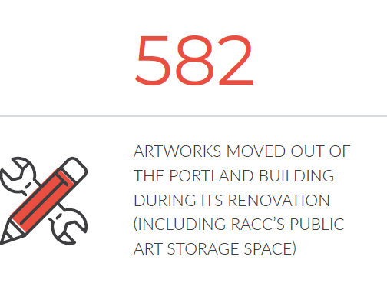
Notes:
LINDA:
Another high-profile project currently underway is the renovation of the Portland Building. 582 artworks, including RACC’s public art in storage, have been moved during the extensive renovations.

Slide 29
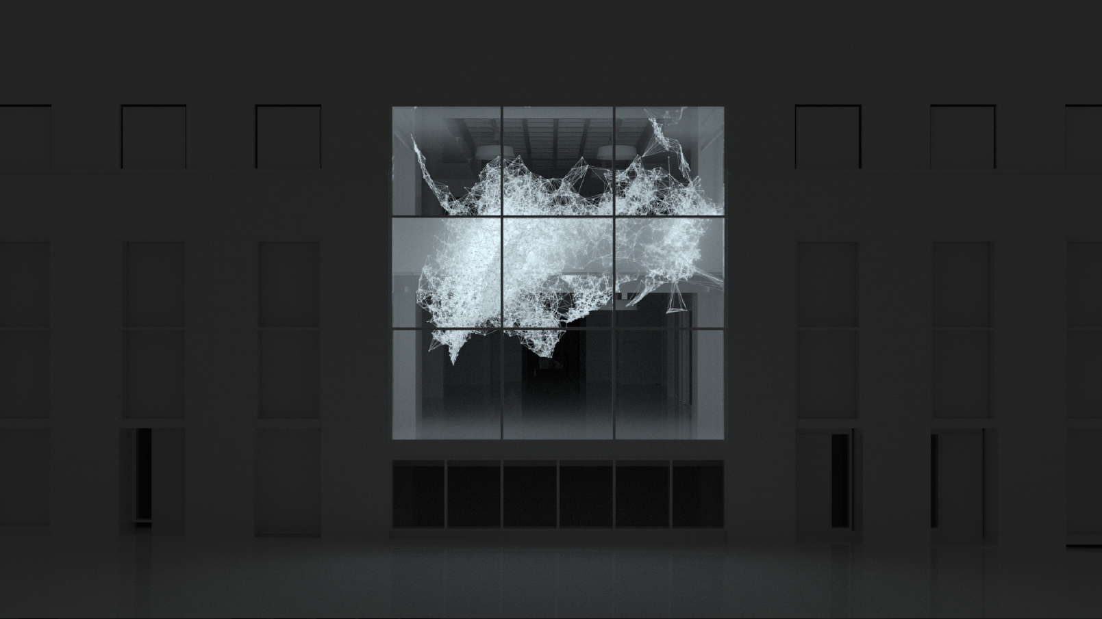
Notes:
LINDA:
Among many changes will be the creation of a large window looking onto 4th avenue where a garage entrance used to be. Refik Anadol will be creating a large, cutting-edge 3-D-printed artwork whose final shape will be determined by data collected from the city bureaus whose offices are in the building, along with data collected from the community, possible using social media. He is a media artist, director, and designer born in Istanbul, Turkey in 1985. Currently he lives and works in Los Angeles. In line with the spirit of innovation of the building, this piece will represent a new generation of cutting-edge creators. I hope you will all be there when the installation is dedicated.

Slide 30
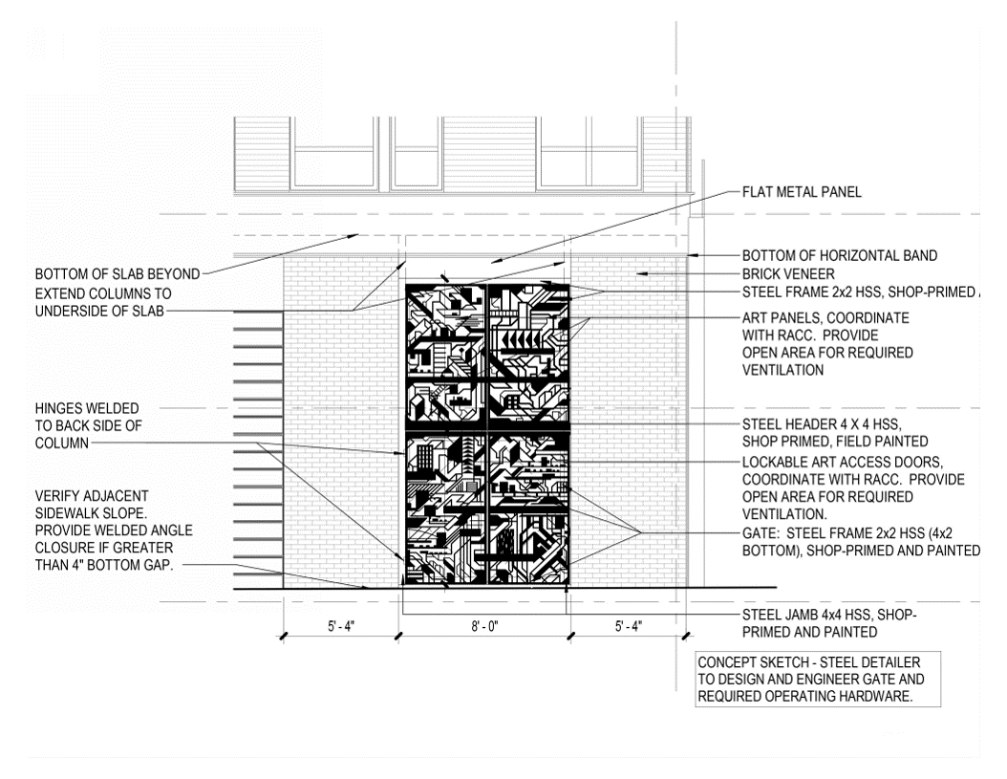
Notes:
LINDA:
Another important way in which the PAC works with the City is through the Design Review Process. A member of the volunteer Design Review Commission sits on the Public Art Cttee, and together we work with developers and artists to “embed” art in projects whose building does not conform to Zoning Code or Design Guidelines. In this case, it was a Ground Floor Window Mitigation and artist Damien Gilley is creating this beautiful gate to mask the utility meters of the new Broadstone Reveal apartments on NW 14th & Quimby.

Slide 31
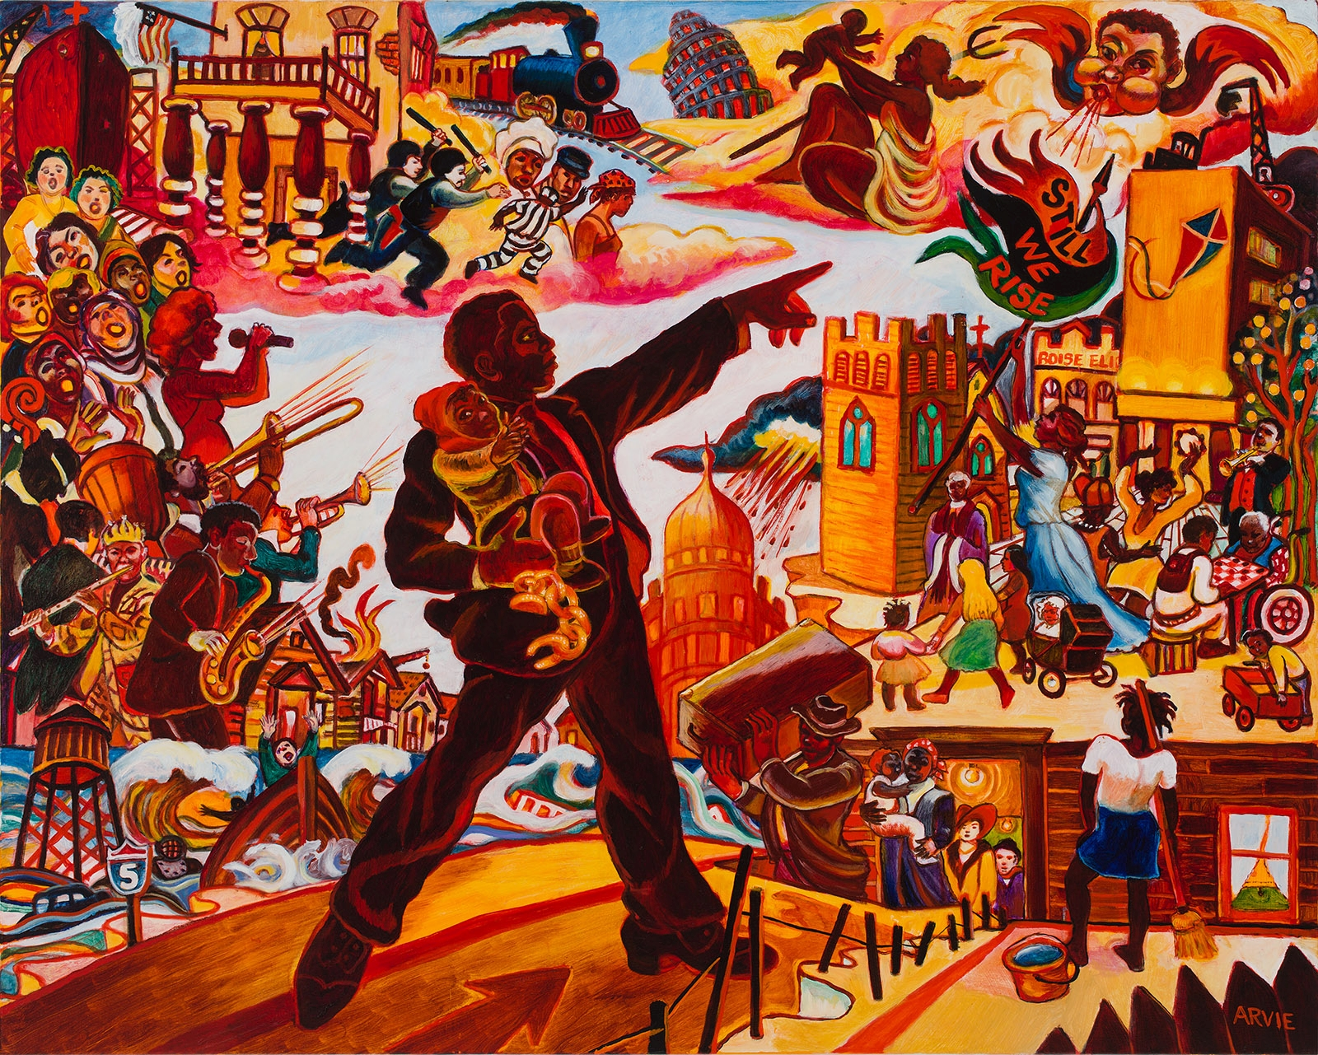
Notes:
LINDA:
Another Public Art Program dear to my heart is the murals program overseen by Peggy Kendellen. Portland has a spectacular range of stunning murals, and we have benefitted from the dedication and passion of internationally-renowned muralists and home-grown artists alike.
RACC collaborated with Prosper Portland to develop two new large scale murals at the Alberta Commons Development in the King Neighborhood. Artists Arvie Smith and Mehran Heard created two separate, vivid, community-inspired designs that honor the Northeast Portland community and its rich African American history.
This is Arvie Smith’s powerful work, “Still We Rise.”

Slide 32
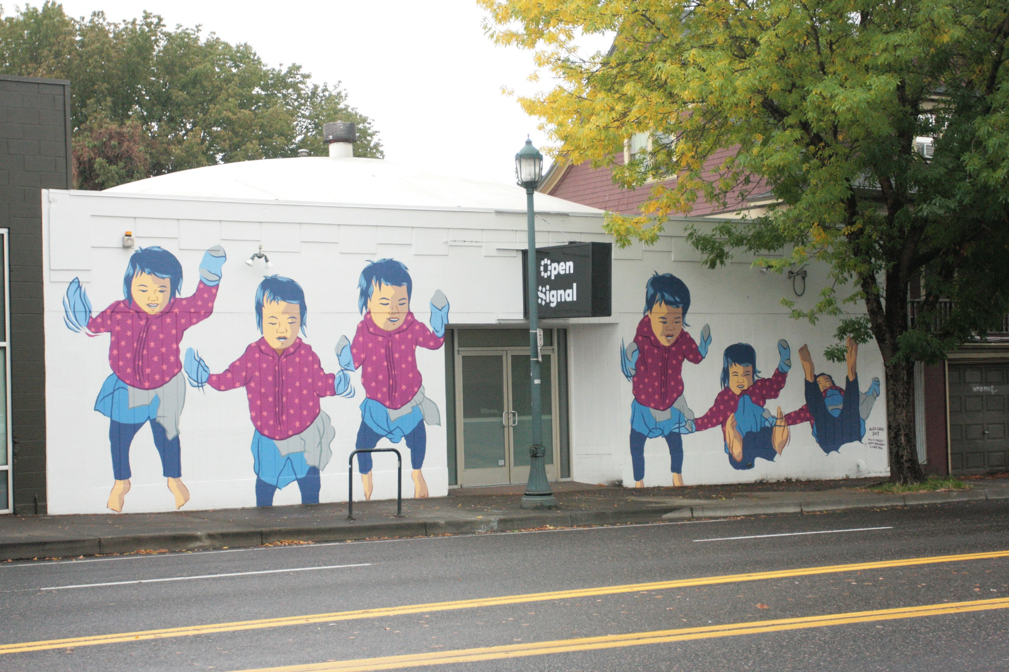
Notes:
LINDA:
Because mural art is such a growing and dynamic field, RACC established the Fresh Paint program specifically to nurture local talent and give artists the opportunity to learn how to work at such a large scale. In partnership with Open Signal, the walls of their media arts center on NE Martin Luther King Jr Blvd have become a gallery for new murals that stay up for 6 months and are then painted over for the next aspiring muralist. The first artist to participate in this program is here today, and this is his daughter bouncing on the bed, which brought a smile to my face every time. It’s my great pleasure to introduce Alex Chiu.

Slide 33
Alex Chiu
Artist
Notes:
[Alex Chiu speaks]

Slide 34
ARTS EDUCATION
Notes:
JEFF:
Thank you, Alex.
RACC is also working to bolster arts education in public schools by integrating the arts into the teaching practice of K-8 classroom teachers throughout the region, and by providing support and coordination services for the K-5 arts specialists in Portland who are funded by the city’s Arts Tax.

Slide 35
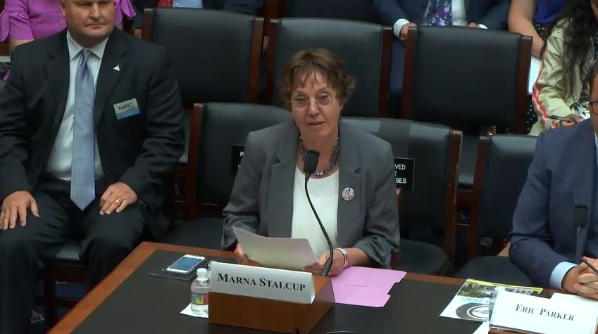
Notes:
JEFF:
Our arts education work is led by Marna Stalcup, who recently testified in front of a Congressional Committee on Education and the Workforce in Washington, D.C. at the invitation of congresswoman Suzanne Bonamici, a huge advocate for STEAM education – science, technology, engineering, ARTS and math. Under Marna’s leadership, The Right Brain Initiative has become a national model for addressing the nation’s education and workforce development challenges.

Slide 36
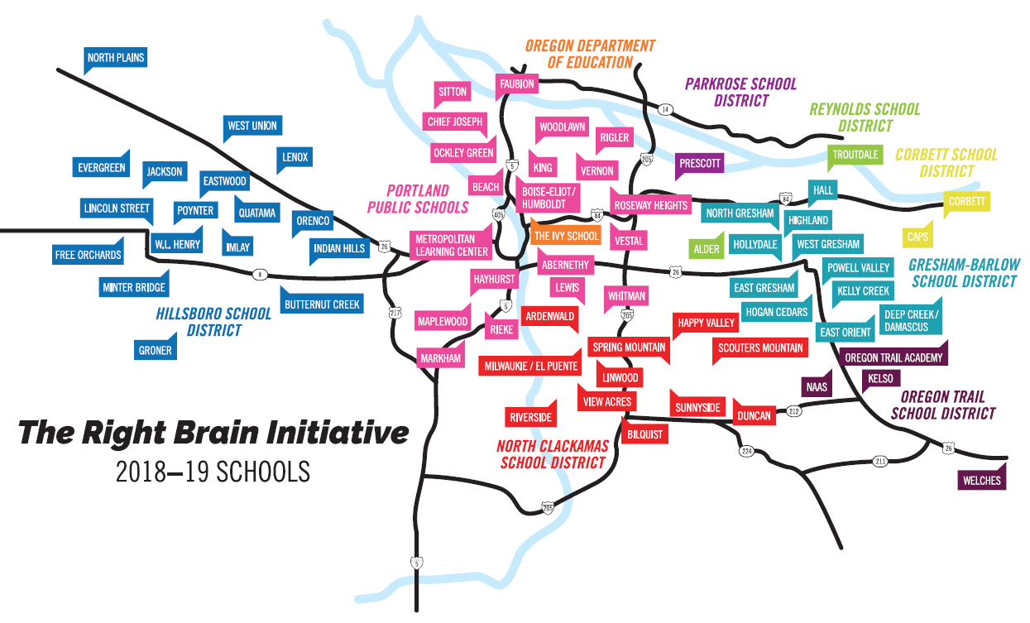
Notes:
JEFF:
Right Brain Initiative is now in its 11th year of integrating the arts into K-8 classrooms in the region’s elementary schools, improving student performance as a result. This year we are serving 29,716 students in eight school districts -- including Portland Public, Parkrose and Reynolds.

Slide 37
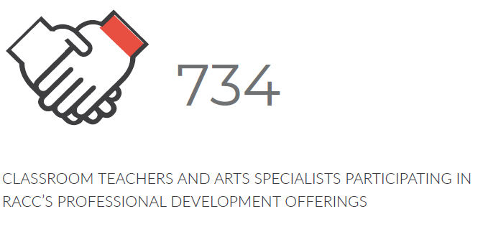
Notes:
JEFF:
RACC provided professional development offerings for 734 classroom teachers and arts specialists this past year -- including the 72 art, music and dance teachers funded by the Arts Tax.

Slide 38
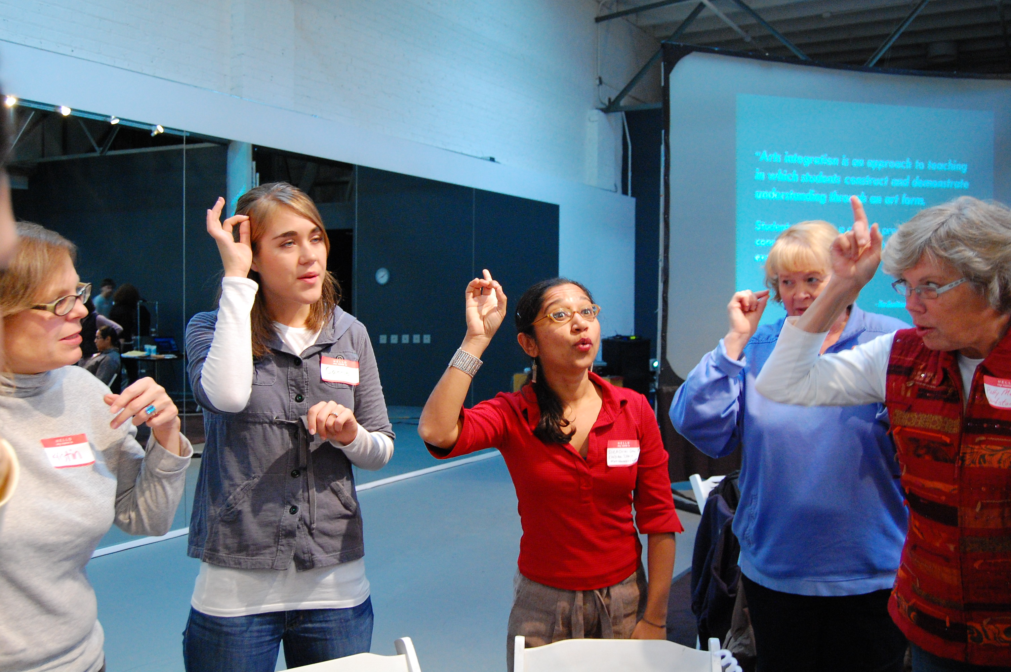
Notes:
JEFF:
As one example of the support we provide for teachers funded by the Arts Tax, RACC hosted a full-day professional development workshop on culturally responsive teaching with breakout sessions specifically designed for both visual and performing arts teachers.
We are also working with schools and arts organizations to map our collective arts education services and assess the gaps.
To tell us a little more about the ways that students benefit from a well-rounded education that includes the arts, it is my pleasure to introduce you to Michael Lopes, Superintendent of the Parkrose School District.
[MICHAEL LOPES SPEAKS]

Slide 39
Michael Lopes
Superintendent, Parkrose School District
Notes:
[MICHAEL LOPES SPEAKS for 3 minutes]

Slide 40

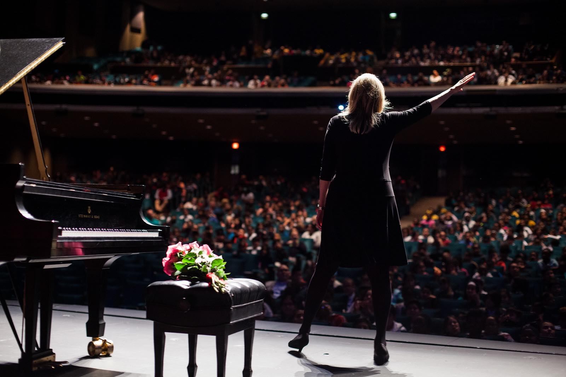
Notes:
JEFF:
Thank you, Michael.
One other quick education note: This fall we are collaborating with Portland Public Schools, Portland’s Centers for the Arts, the Oregon Jewish Museum and Portland Center Stage to bring the Willesden Reads Project to 2,400 6th through 12th graders, helping them learn the history and significance of the Holocaust through the inspiring true story of a young Jewish musician and her struggle for survival. This project has been completely funded by private donations to RACC.

Slide 41
Advocacy and Engagement
Notes:
JEFF:
RACC continues to build support for a strong arts and culture community, and our stellar community engagement duo, Humberto Marquez Mendez and Ella Marra Ketelaar, have developed a new plan to prioritize authentic engagements with marginalized communities by actively collaborating with some of the populations in Portland that have been underserved by RACC in the past.
Our “Art & Power” conversation series centers the experiences of artists from historically marginalized communities, touching on topics including cultural appropriation, code-switching, and art as activism, and more than 500 people attended Art Spark this past year – a quarterly networking event at rotating venues designed to help local artists and makers connect with each other.

Slide 42
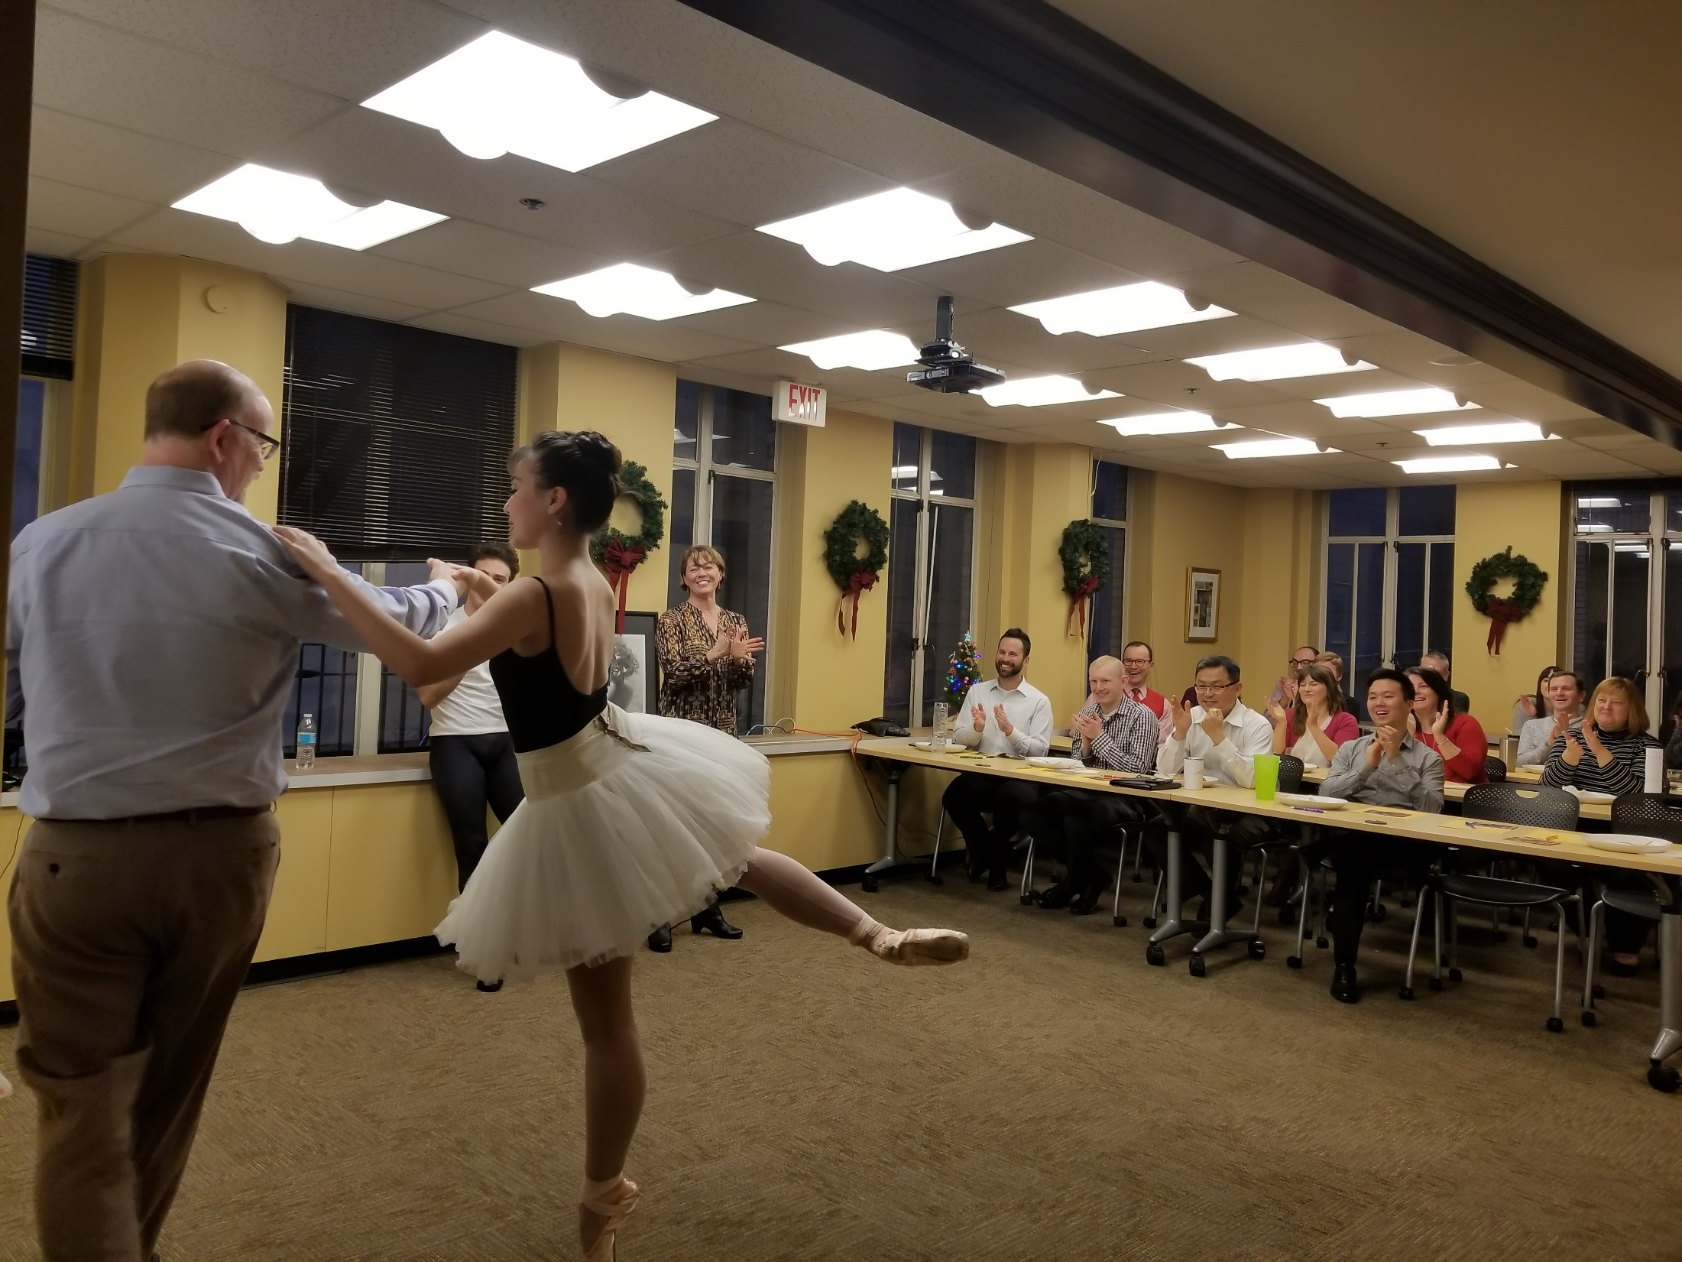
Notes:
JEFF:
RACC also conducts a workplace giving campaign and distributes the proceeds to more than 100 arts organizations in our community, including Oregon Ballet Theater, shown here engaging with employees at McDonald Jacobs Mark.

Slide 43
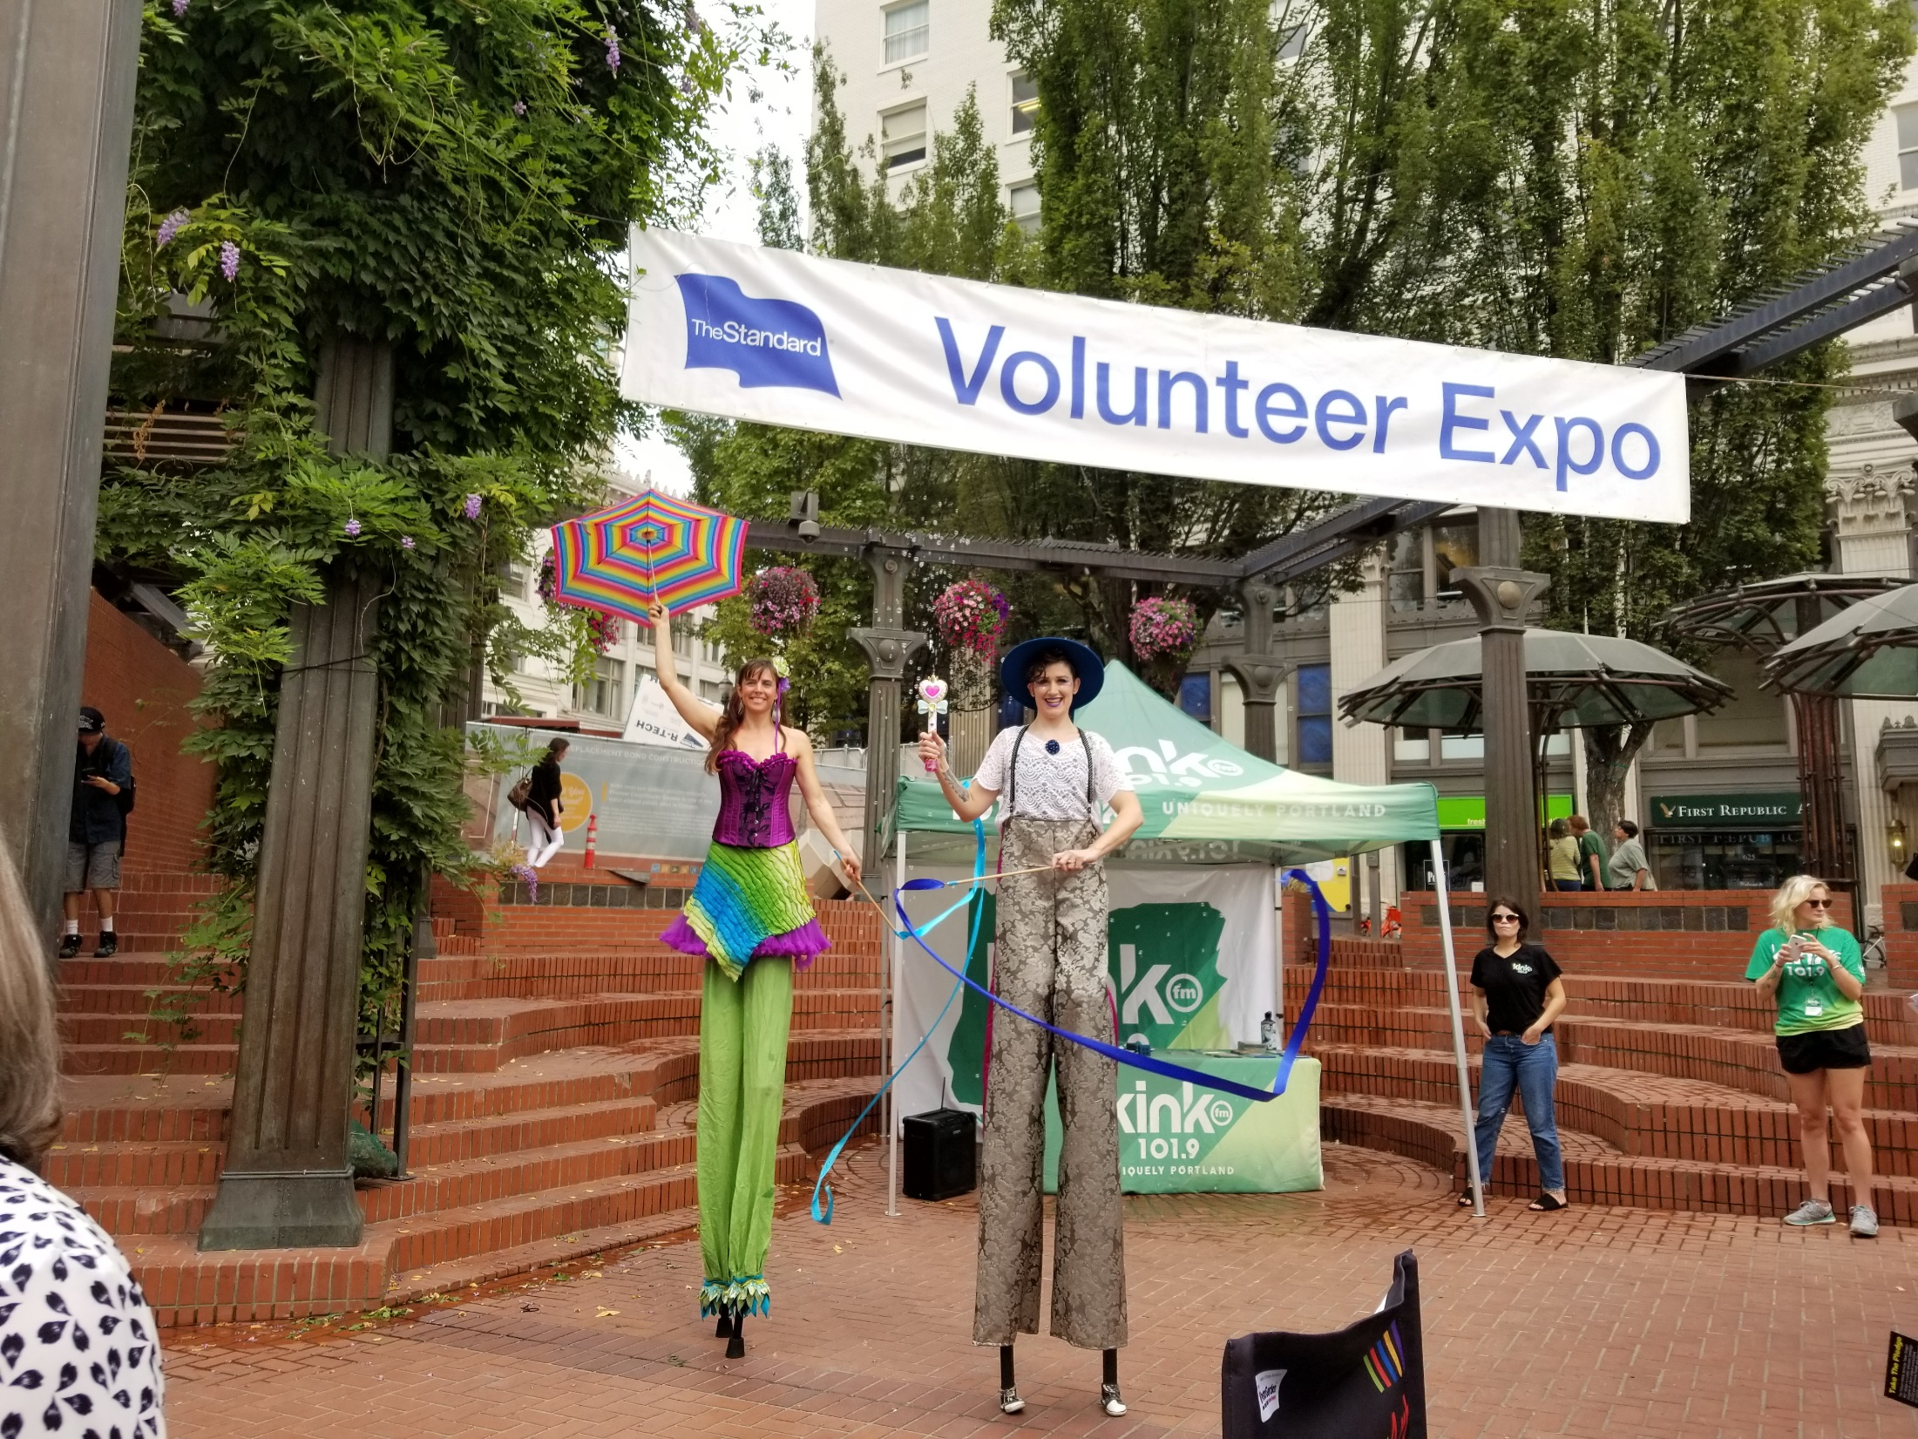
Notes:
JEFF:
Our top workplace giving campaign last year was at The Standard, a company that continues to make significant investments in our local arts community. In fact, just last week, The Standard received a national award from Americans for the Arts, honoring the company’s exceptional commitment to the arts through grants, local partnerships, volunteer programs, matching gifts, sponsorships, and board membership.
Remember all of those public artworks we told you had to be removed from the Portland Building? The Standard gave us a great deal on some temporary storage space, and is displaying Portlandia related items on its mezzanine across the street. We appreciate their partnership.

Slide 44
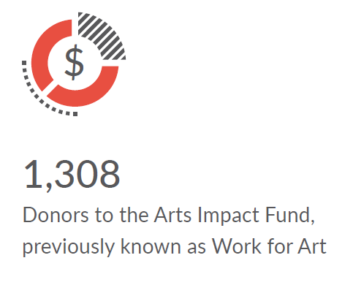
Notes:
JEFF:
1,308 donors participated in last year’s Work for Art campaign, contributing a total of $665,000. As you know, the City has eliminated its annual matching challenge incentive of $200,000 for this program, which will mean a smaller total next year, but we are working to regroup and reinvent the program.

Slide 45
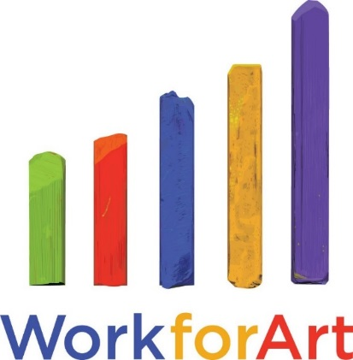
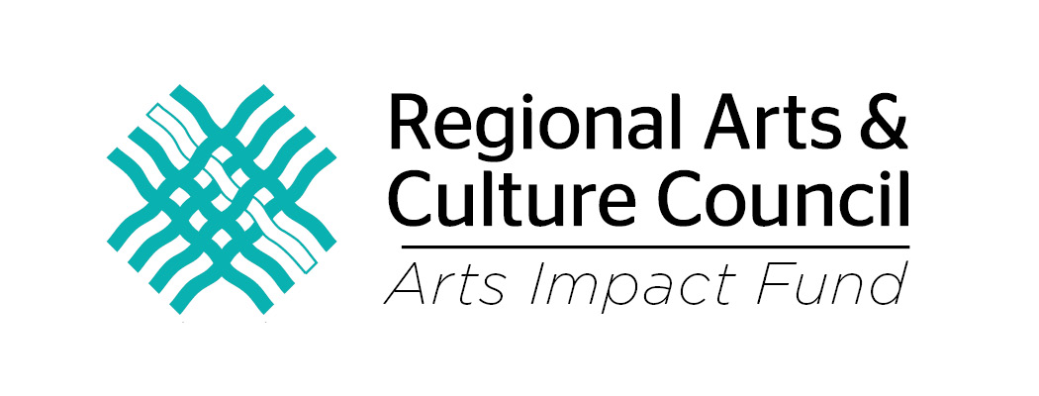
Notes:
JEFF:
In August, RACC retired the Work for Art brand and introduced the Arts Impact Fund, a broader appeal to donors beyond the workplace to support arts and culture organizations in our community.
We’d like to thank City employees for giving so generously to our campaign every year, and a special shout out to Alison Bailey and the advocacy team at RACC for all the great work that’s being done now to build strong support for the arts in the future.
[END. Linda speaks next.]

Slide 46
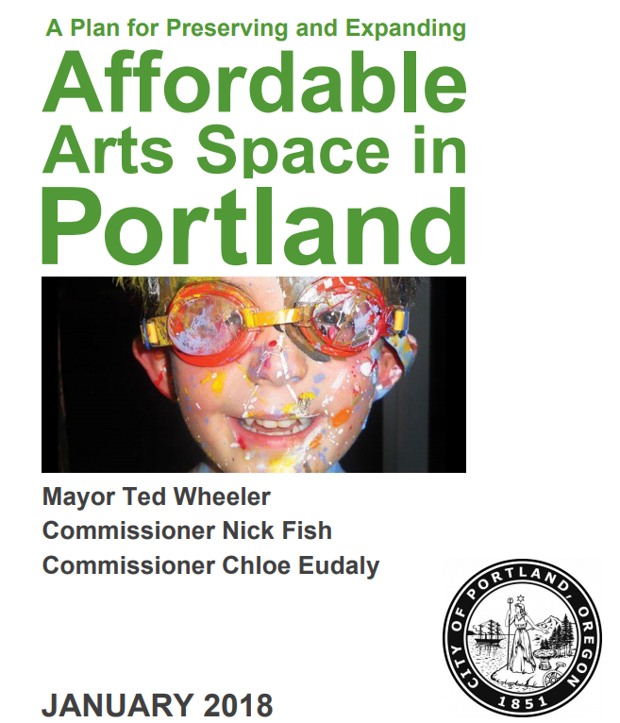
Notes:
LINDA:
Let’s talk for a moment about the challenges and opportunities that lie ahead.
Change is certainly afoot, with a new Arts Commissioner appointed last month and a new Executive Director starting very soon. All of us have our work cut out to tackle tough issues, including the persistent problem of rising costs, pricing many artists and arts organizations out of the city and potentially jeopardizing Portland’s reputation as a center of creativity.
Your written report includes an update on tasks assigned to RACC as part of the City’s Plan to Preserve and Expand Arts Space in Portland, and we’d love to get started on the mapping project in particular, if we can find a way to pay for it.

Slide 47
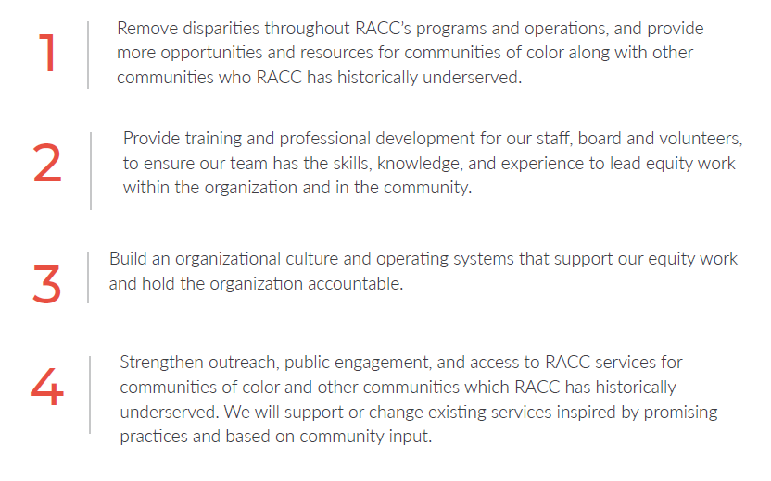
COMMITMENT TO EQUITY
Notes:
LINDA:
Equity, diversity and inclusion continues to be a priority for RACC, and we have developed 4 new goals in alignment with the City’s Office of Equity and Human Rights so that we can be more intentional in our work and more accountable for our progress.
Our focus remains on racial equity, partly because that’s what our contract performance measures are focused on, but we are also expanding our understanding of and engagements with other marginalized communities.
But when it comes to racial diversity at RACC, I am pleased to report that we have made progress over the last 8 years, and today 42% of the board and 37% of the staff identify as people of color. A full 50% of our grant panelists this past year, and 52% of our public art selection panelists, also identified as people of color.

Slide 48
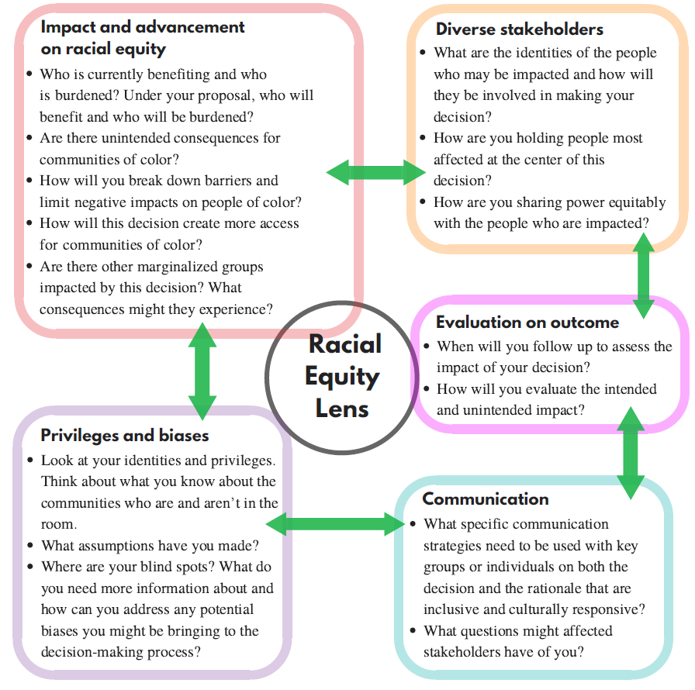
Notes:
LINDA:
This year we added a Racial Equity Lens, based on examples from other organizations that are leading the way. This lens helps guide the decisions we make as an organization. And while our equity work is not a closed process – there is no end point – we are committed to the continual improvement with help from our community partners.

Slide 49
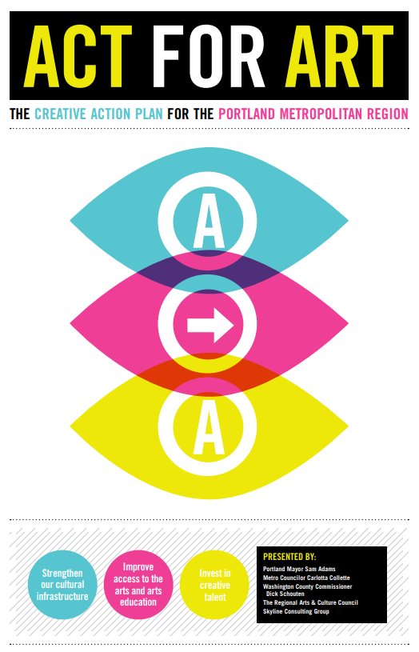
Notes:
JEFF:
Our written report concludes with a couple recommendations.
First and foremost, we want you to know that RACC is ready and eager to collaborate with the City to develop a clear vision and goals for arts and culture in Portland, as recommended by the Auditor. We’ve done this work before, with Act for Art in 2009, and we look forward to working with Commissioner Eudaly and the Mayor to determine the best approach for a new plan. Based on our experience and other examples from across the country, we estimate the cost to be between $10,000-$75,000 depending on how much research and public process are involved.

Slide 50
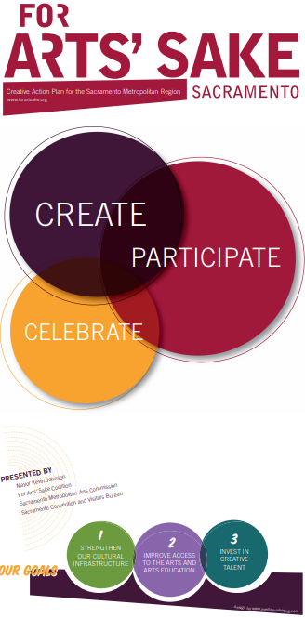
Notes:
JEFF:
By the way, so popular was our Creative Action Plan in 2009 that a year later parts of it were copied word for word by Sacramento Mayor Kevin Johnson. So you could say that RACC has done cultural planning in Portland AND Sacramento.

Slide 51
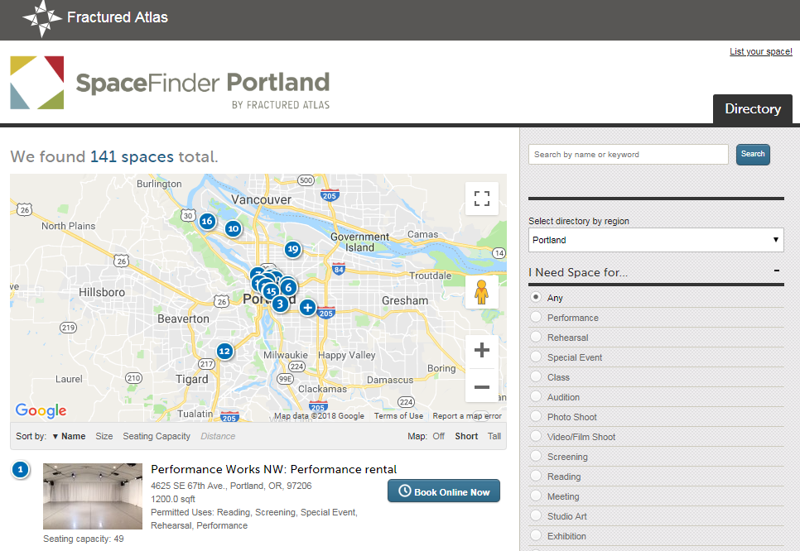
RECOMMENDATIONS
Image: Space Findeer Portland
Notes:
JEFF:
Recommendation #2 is that we build an online map and searchable database of the city’s arts venues and creative spaces. An investment of $30,000 would allow RACC to partner with Fractured Atlas in New York and a team of local artists and arts administrators to develop “Space Finder Portland,” using a platform that exists in other communities, including Seattle.
RACC assessed the mapping options with Commissioner Fish’s office last spring, and we believe this is the most cost effective and sustainable solution. We have already tested the resource to make sure it will work for us, but need additional funds to populate the database, to promote it to the community, and integrate it with other web-based mapping resources.
[END. Linda speaks next.]

Slide 52

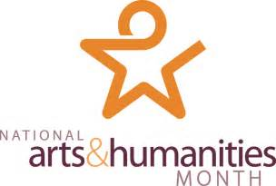
Notes:
LINDA:
As Jeff noted at the beginning, October is National Arts & Humanities Month, a coast-to-coast celebration of the importance of culture in America. We invite you, our elected officials, to come see us in galleries and theaters, community centers and parks across the city. There are so many amazing events to choose from, and we welcome your active participation in Portland’s vibrant arts community.
We are all committed to the idea that having an organization like RACC as a focal point for arts funding and support, is an essential element to maintaining a healthy arts ecosystem.
[Your closing thought.] [Use the word “catalyst” and/or “change”? This is not the same organization you joined 4 years ago? We are evolving, growing, etc.?]
Thank you.

Slide 53
Education
Notes:
JEFF: I too am grateful for your support. Not only for supporting the arts, but for understanding that culture, creativity and the arts are powerful TOOLS for addressing a wide variety of community issues. The arts are an essential part of our children’s education…

Slide 54
Public Health
Notes:
Artists and arts organizations are collaborating with doctors and scientists to improve people’s health and well-being;

Slide 55
Public Safety
Notes:
…The August Wilson Red Door Project and the Portland Police Bureau are tapping into the power of theater to make Portland a safer place for all of us…

Slide 56
The Economy
Notes:
…Cultural tourism and the arts are a driver of Portland’s economy, supporting more than 11,000 jobs in the region…

Slide 57
Social Justice
Notes:
And artists continue to play an extremely critical role in our pursuit of social justice.

Slide 58
Notes:
JEFF:
We are proud to be your regional arts and culture council, and we thank you for the opportunity to share our thoughts on the state of the arts in our community.
I want to thank the incredible staff at RACC, they are truly an amazing lot, and I am grateful to the board for their time and talent, as well as the opportunity to steward the organization during this interim period.
When we talk about the arts, we know that it’s important to hear from other voices as well.

Slide 59
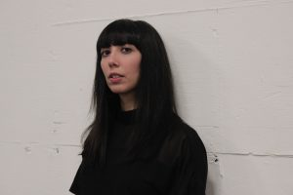
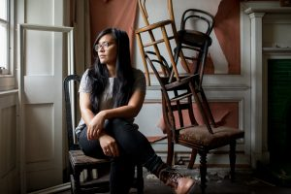
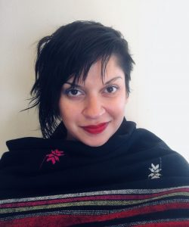
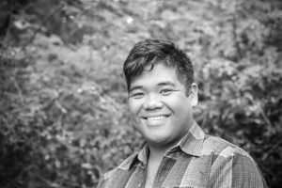
For more perspectives, visit racc.org
Roya Amirsoleymani | Celeste Noche | Roshani Thakore | Paul Susi
Notes:
JEFF:
We asked four artists, arts administrators, and creatives to share THEIR thoughts on the “state of the arts” in our changing city. I encourage you to visit racc.org to read their essays that we published just today, and to get a glimpse of the cultural landscape through their eyes.

Slide 60
Subashini Ganesan
Creative Laureate
Maya Vivas
Co-Owner, Ori Gallery
Victor Maldonado
Assistant Dean of Diversity and Inclusion at PNCA
Notes:
JEFF:
We’ve also assembled a panel of community representatives to briefly reflect on RACC’s report and share their observations with you today, and then Linda and I will be happy to answer your questions. Today’s testimonials are from…

Slide 61
Notes:
The end. Linda and Jeff field questions.

