Slide 1
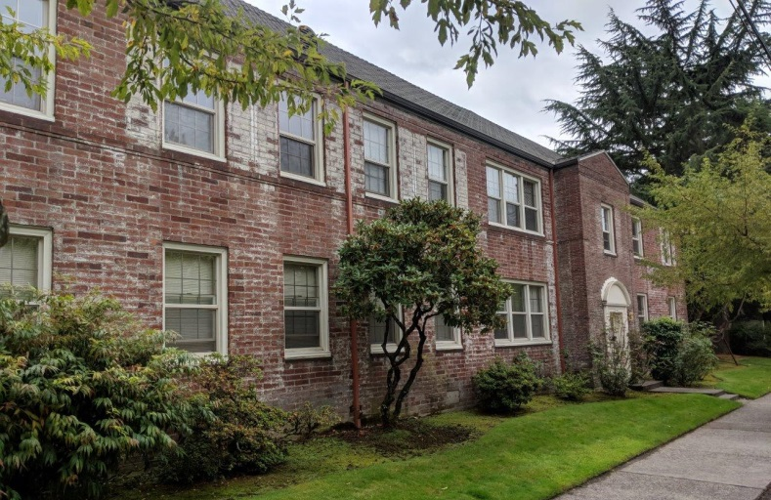
State of the City Preservation Report 2018
Portland Historic Landmarks Commission

Slide 2
WHO ARE WE?
Portland Historic Landmarks Commission 2018
Annie
Mahoney
Architect
Wendy
Chung
Attorney
Matthew
Roman
Designer
Vice-Chair
Kristen Minor
Planner / Architect
Chair
Kirk Ranzetta
Historian
Maya
Foty
Preservation
Architect
Ernestina
Fuenmayor
Historian/ Architect
With special thanks to: Hillary Adam, BDS staff to PHLC; BDS Design & Historic Review staff; and
Brandon Spencer-Hartle, BPS Historic Resources Program Manager

Slide 3
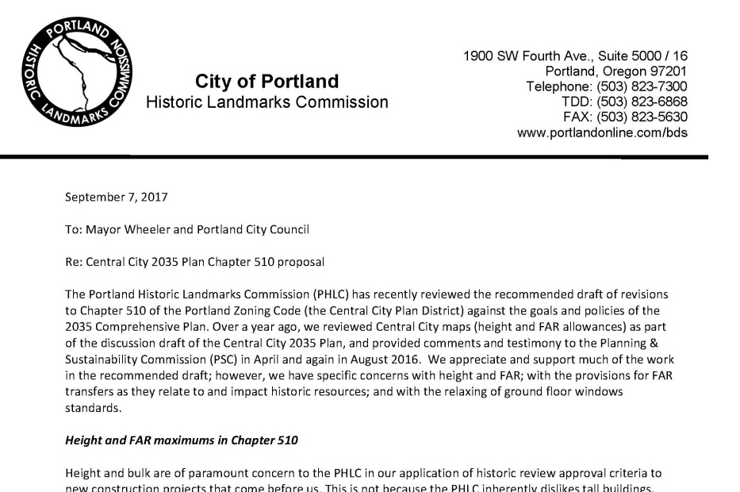
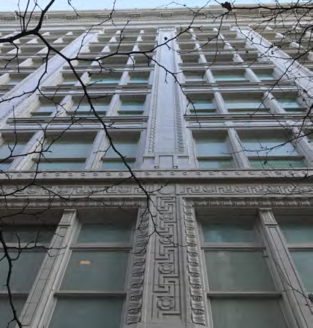
WHAT DO WE DO?
Make Land Use Decisions
-Type III Alterations, Demolitions, and New construction in Historic Districts
Make Recommendations to City Council
-Adoption of new Guidelines for Districts
-Type IV Demolition Reviews
Provide Advice on Historic Preservation Matters
-Design Commission
-Hearings Officer
-Planning & Sustainability Commission
-Portland Development Commission
-Portland City Council
-City Bureaus and other committees
Establish/Remove (or Recommend) Local Landmark Designations
Recommend the Establishment/Amendment of Historic Districts
Initiate and coordinate preservation and outreach programs within & outside of the City

Slide 4
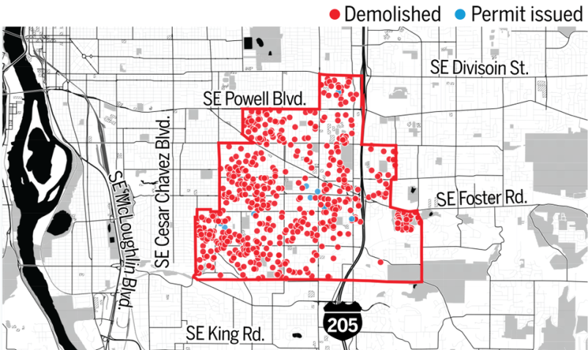
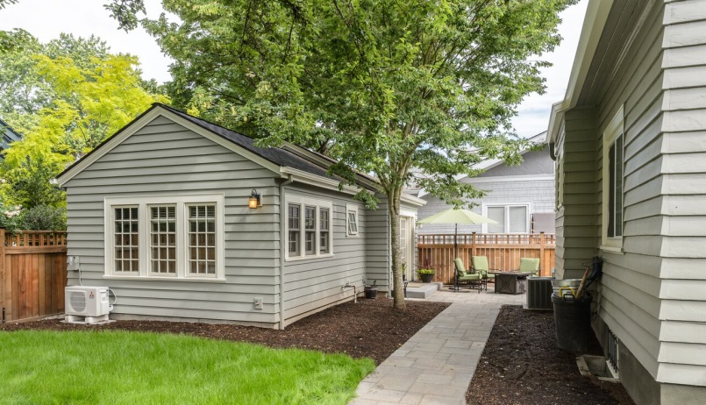
WHAT WE SEEK FROM CITY COUNCIL
LET THE PHLC BE PART OF THE SOLUTION
Preservation is not an enemy of increased density or affordable housing.
URM ORDINANCE
A mandatory requirement is important, but needs incentives, help for owners.
FUND THE HRI
Demolition continues. Help under-represented communities identify & preserve what’s important. Information is critical to assigning value.
SUPPORT PORTLAND’S UNIQUE PLACES
RIP and BHBD can and should allow for new development to reflect existing character. Encourage rehabilitation & adaptive reuse.
Notes:
Upper image: First Baptist Church, Portland (listed on current URM). Center image: July 21, 2018 article (Oregonian) showing top 25 areas for residential demolitions. This shows Lents-Foster, the #1 area with 4.45% of single-family homes demolished. No survey ever done in most of this area, like the #3 area (122nd-Division). Lower image: recent garage conversion project to ADU in Irvington HD.

Slide 5
A YEAR* OF PHLC ACCOMPLISHMENTS
Providing advocacy recommendations for the 2035 Comprehensive Plan, DOZA, RIP, Better Housing By Design, and other ongoing legislative work
Holding 21 public hearings (with assistance from staff) (7 Type III, 7 DARs, 2 NR nominations, 20 briefings, 1 retreat)
Staff performed (54 Type 1 Cases, 40 Type Ix, 93 Type II)
Participation in various subcommittees, including Historic Resources Project, DRAC, Semi-Quarterly Cross-Commission Chair Meetings, and RACC art murals
Collaboration with Design Commission in reviews, including Portland Art Museum DAR, Wells Fargo and PacWest
Providing advice and input on various bureau or agency projects, including the URM ordinance, SW Corridor Transit, PBOT Vertical Infrastructure in the ROW and Cellular Antennas, and Burnside Bridge project
Collaborating with U of O to create a studio for grad students in architecture examining the New Chinatown/Japantown Historic District
* (Approximately 10 months)

Slide 6
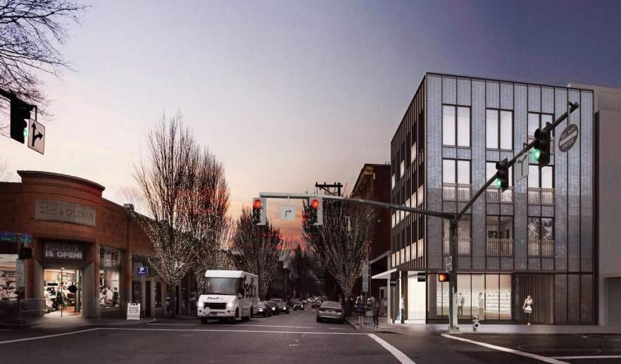
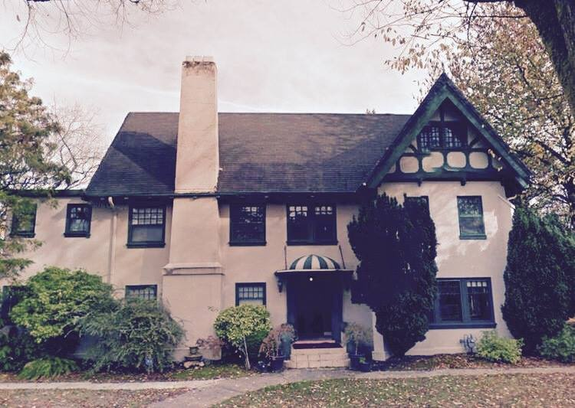
PROJECT HIGHLIGHTS
4 story mixed-use building by Allied Works (rendering by Allied Works) in the Historic Alphabet District
The 1913 Ocobock Mansion was saved from demolition in 2016 by a determined group of neighborhood activists who purchased the historic home and have been converting it for use as communal living. (Photo from the Facebook page, “Save the Historic Ocobock Mansion from Demolition.”)

Slide 7
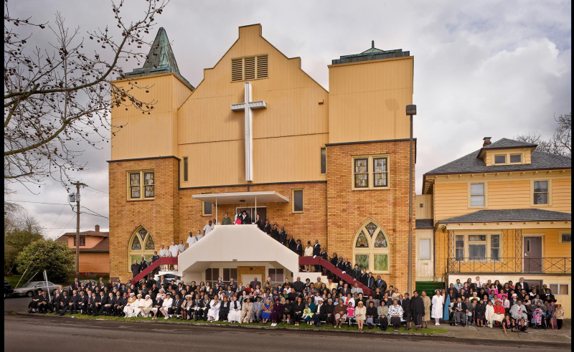
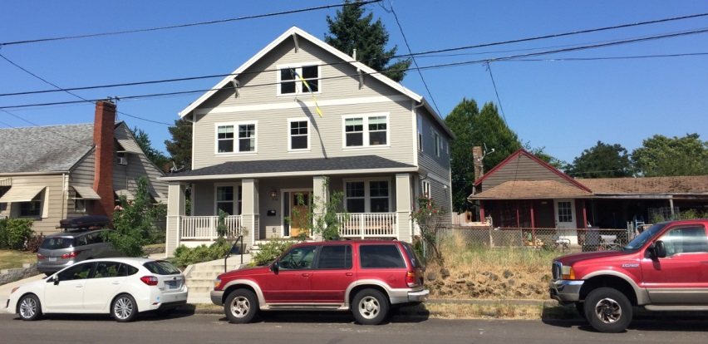
PRIORITIES AND GOALS for 2019
A
ENSURE HISTORIC PRESERVATION BENEFITS ALL CITIZENS
Recognize and protect important places
ENGAGE WITH OUR COMMUNITY
Reach out to listen and educate
ADVOCATE for LOCAL/ STATE INCENTIVES
Support rehabilitation & adaptive reuse
SUPPORT PORTLAND’S UNIQUE PLACES
Developer-driven and development-driven solutions by themselves are not working
B
C
D
Notes:
Photos: Vancouver Avenue First Baptist Church, added to the NR in 2016 by Raymond Burell.
An example of a new single-family house that replaced a much smaller single-family house.
Cultural festival in Eugene circa 2012.

Slide 8
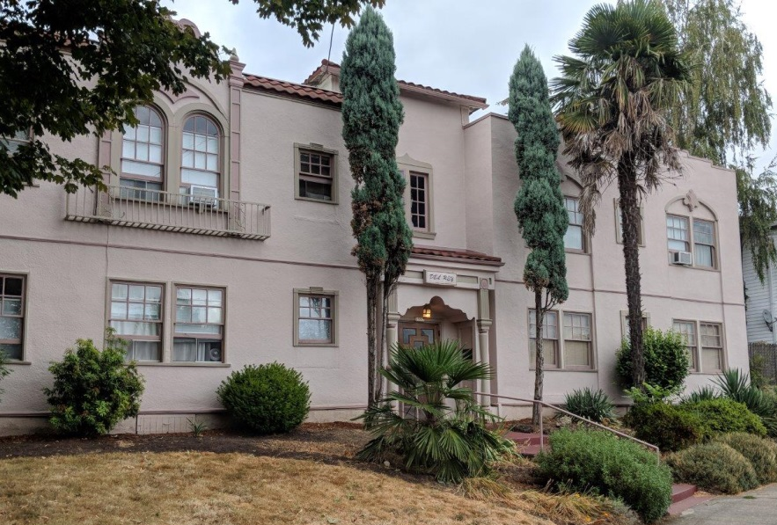
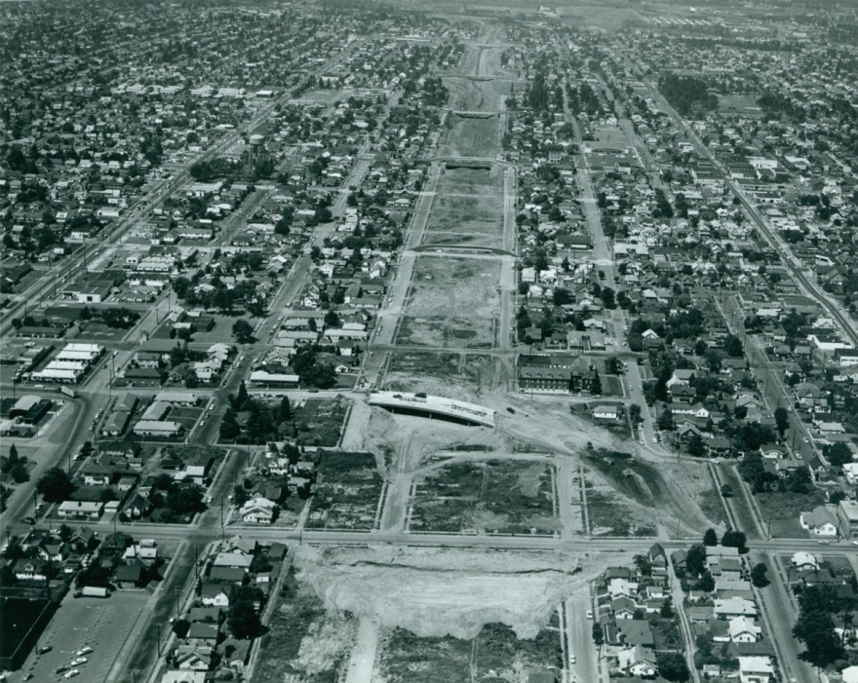
PROMOTE LIVIBILITY AND AFFORDABILITY
Preserving Historic Multifamily Housing
Sustainability
Affordability & economic diversity
Character and livability
Gentrification and Historic Preservation
Affordable = Vulnerable
Loss of cultural stories & places
Give communities a voice
Notes:
Lower: 1963 clearing for I-5

Slide 9
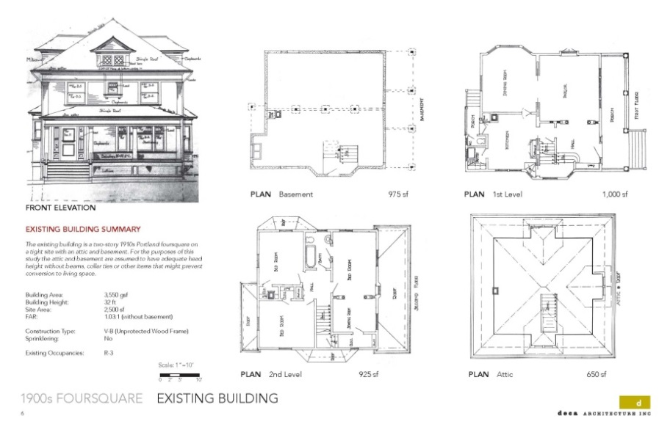
PROMOTE LIVIBILITY AND AFFORDABILITY
Equity and Inclusion
Support vulnerable populations
More “missing middle” housing
Identify culturally important places
Historic Preservation can Increase Density
Address code barriers
Incentivize conversions, not demo
New houses bigger, families smaller
Developers are profit-driven
Notes:
One of a series of maps done by City of Portland, 1936: “The Neighborhood Pattern of the City as defined by Foreign-Born and Racial Occupancy”. Lower image: a page from the 2016 internal conversions report (City of Portland) illustrating a typical 2.5-story Foursquare building type (this was shown divided into either 7 units or 4 units in the study). Avg house size has grown over 1000 SF from 1972 (first time data was avail- 1660 SF then)

Slide 10
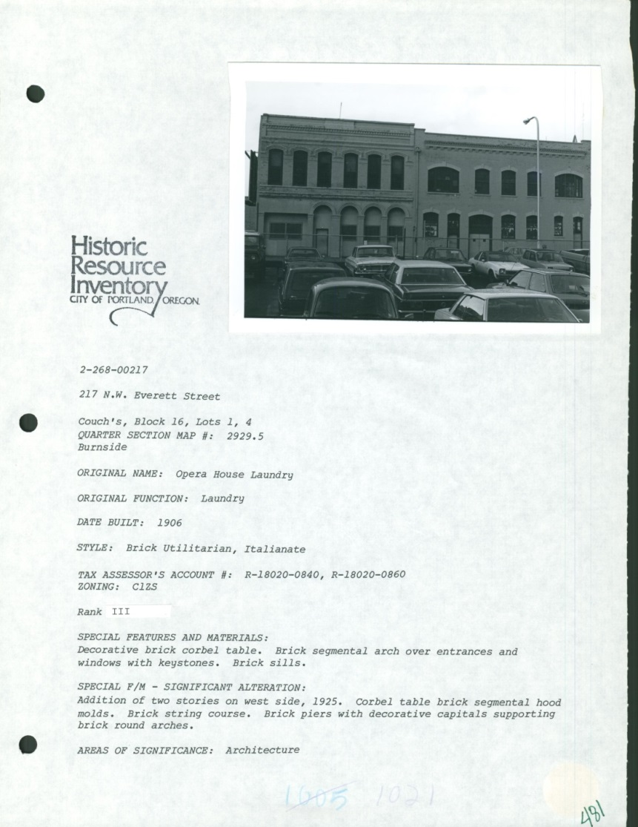
SEEKING SUPPORT IN 2019
Historic resource inventory update
$80K is a modest request
Comp Plan specifically supports
Critical for planning growth
Move towards preservation equity
Combat gentrification

Slide 11
Thank you
Questions?

