Slide 1
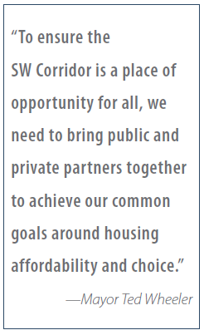
Southwest Corridor Equitable Housing Strategy
Portland City Council
October 4, 2018
Notes:
Eric
Thank you for considering today’s resolution to adopt a housing strategy for the SW Corridor.
This in an important step as we plan to expand the region’s transit system into this corridor. New transit is critical to bringing better access to more housing, education, and job opportunities.
However, we know displacement risk from the rising cost of living and lack of affordable housing threatens the existing economic and cultural diversity in the corridor. Displacement harms households and disrupts communities as well as creating obstacles to achieving the region’s long-range growth plans. If households who are most dependent on transit are displaced out of the corridor, they will be forced to buy cars, contributing to congestion and carbon emissions, and resulting in a loss of ridership for the transit system.
We want to get ahead of the predictable cycle of real estate speculation and market pressures to help ensure there are new housing choices available when the light rail comes.
In 2016 Council directed us to develop a housing strategy in relation to the light project. We teamed up with the City of Tigard to develop a unified, strategic approach to housing for the entire SW corridor.
At last month’s work session you heard about the corridors housing needs and the goals we are proposing. Today, you will hear how we will work with our partners to meet our goals

Slide 2
City Council Resolution:
Affirms City’s commitment to equitable growth
Adopts the housing strategy and goals for the Southwest Corridor
Directs bureau’s early actions to implement and report on progress
Notes:
Ryan
Today we are here to affirm the City’s commitment to equitable growth by adopting this housing strategy and directing City bureaus to begin implementation.
In doing so we should recognize how much of a team effort this will be….
Our community partners are here to share why this is the right approach and what role they will play in implementation.
The bureau’s taking a leadership role in implementation are here to describe the actions they will take.
You also will hear from our institutional partners who are here to describe how they are contributing to the solution.
Public testimony
Council Q&A/Discussion
Council Action

Slide 3
Broad Support
Winkler Development Corporation
Planning and Sustainability Commission
Notes:
Ryan
We worked with a lot of partners. An endorsement letter from our advisory group is included in the final strategy which you can find in your binders. I want to thank them for the many long work sessions and all the outreach they did to help develop this body of work
In addition, many other individual organizations and City commissions weighed in and submitted letters in support. These letters are included on the record today.
Now we’ll hear from a few of these community partners. I’ll introduce them as they come up to the table.
Allan Lazo – Executive Director of the Fair Housing Council of Oregon
Rachael Duke – Executive Director of the Community Partners for Affordable Housing
Pam Phan – Policy and Advocacy Director for the Community Alliance of Tenants
Amina Omar – tenant leader

Slide 4
Invited Community Partners
Allan Lazo –Fair Housing Council of Oregon
Rachael Duke –Community Partners for Affordable Housing
Pam Phan and Amina Omar– Community Alliance of Tenants
Notes:
Allan:
As a civil rights organization dedicated to eliminating discrimination in housing and promoting housing justice throughout Oregon, the Fair Housing Council of Oregon is strongly supportive of the SW Corridor Equitable Housing Strategy. This is a big opportunity to advance fair housing in the region and address past harms.
We are well aware of the history of racial discrimination and exclusion in and around the corridor; the areas in Southern Portland along the Barbur Boulevard were redlined in the 1930’s and 1940s while neighborhoods in the SW hills had private deed restrictions on properties that denied people of color the opportunity to own those properties. This history is still with us today when we look at the racial disparities in housing cost burden, homeownership, and income in the corridor and the region. The public investments now coming to this area must be made with the explicit goals of addressing this unjust history, eliminating these disparities, and thus creating better outcome for all people.
The opportunity to do the right thing is now. It is not too early to take action. Buying land for future affordable housing and purchasing existing apartment buildings along the corridor to preserve their affordability should be top priorities. These types of capital investments must be paired with new tenant protections and services. Specifically, we hope to see targeted education and enforcement of fair housing laws in the corridor as displacement pressures rise.
We commend your leadership and foresight on the issues of fair housing and transit equity. If you and your regional partners follow through on the commitments in the SW Corridor Equitable Housing Strategy you will set an example for the whole nation.
Rachael:
Community Partners for Affordable Housing is pleased to support the Housing Strategy. We participated on the advisory group that helped develop the housing strategy as well as the Community Advisory Committee who worked on the Locally Preferred Alternative for the light rail project. We see these two projects as inextricably linked.
This is a unique opportunity to meet the needs of the low-income families living in the corridor while also providing affordable housing for the thousands of families expected moving here in the next 10 years.
This strategy is particularly important to CPAH; we provide housing along the corridor- starting in Portland and ending with a senior housing community in Tigard. We know that there is great synergy between affordable housing and mass transit and we commit to ensuring all our housing communities have access to transit opportunities. CPAH and our community partners are ready to do our part.
We need leaders like yourself to stand with us and direct resources to the corridor. New funding and community partnerships are especially critical. We hope you will focus your early attention on a few key actions:
Tie up land and prioritize it for affordable housing.
Create an Urban Renewal Area along the Portland portion of the corridor with a large set-aside for affordable housing.
Fund the request from community based organizations active in the corridor to continue to engage low-income households and take an active role in implementing the housing strategy
It’s going to take all of us doing our part to make this strategy work so thank you again for your leadership.
Pam:
In 2018 CAT partnered with BPS to build tenant leadership in and around the area of the proposed SW Corridor transportation project.
As an organization, we also participated as members of the SW Corridor Equity and Housing Advisory Group, advancing our engagement approach that built skills and community among low-income tenants in SW Portland to help develop many of the anti-displacement strategies now included in the Housing Strategy.
In our experience, the strategy is the right menu of actions, and it is imperative that Council enact new regulations and bring new financial resources to bear to ensure the strategy’s success. It is our hope that a new model of Development-without-Displacement be used when initiating large scale public investments such as this, and that low- and moderate-income residents actually benefit from the improved public transportation and neighborhood revitalization, as opposed to being priced-out and excluded from local schools, parks, and services that benefit their lives.
We supported a cohort of tenant leaders, many of whom have lived for 15 or 20 years in the apartment buildings near the mosque in the West Portland Town Center.
Amina is here tell you a bit more about tenants’ priorities.
Amina:
We’ve raised their kids here and love our community. We want to stay and are concerned about the current housing crisis and what change will occur with the new MAX.
If we are giving TriMet and our local government public money, then the we want our communities to stay mixed-income, multi-cultural, and diverse
We ask that City Council make an early priority to prevent displacement by:
Buying some of the affordable apartment buildings in collaboration with local tenant leaders
Passing new tenant protection legislation: no-fault evictions, application fees returned, no discrimination, deposit regulations
Identifying new resources for anti-displacement services . Legal aid, emergency rental and utility assistance, and tenant organizing and education should be targeted to tenants along the corridor as light rail planning continues
We want to see our neighborhoods get better transit and safer sidewalks but first we want to be sure we will not get priced out.
Pass to Ryan, introduce Shannon Callahan, Eric Engstrom, and Kimberly Branam

Slide 5
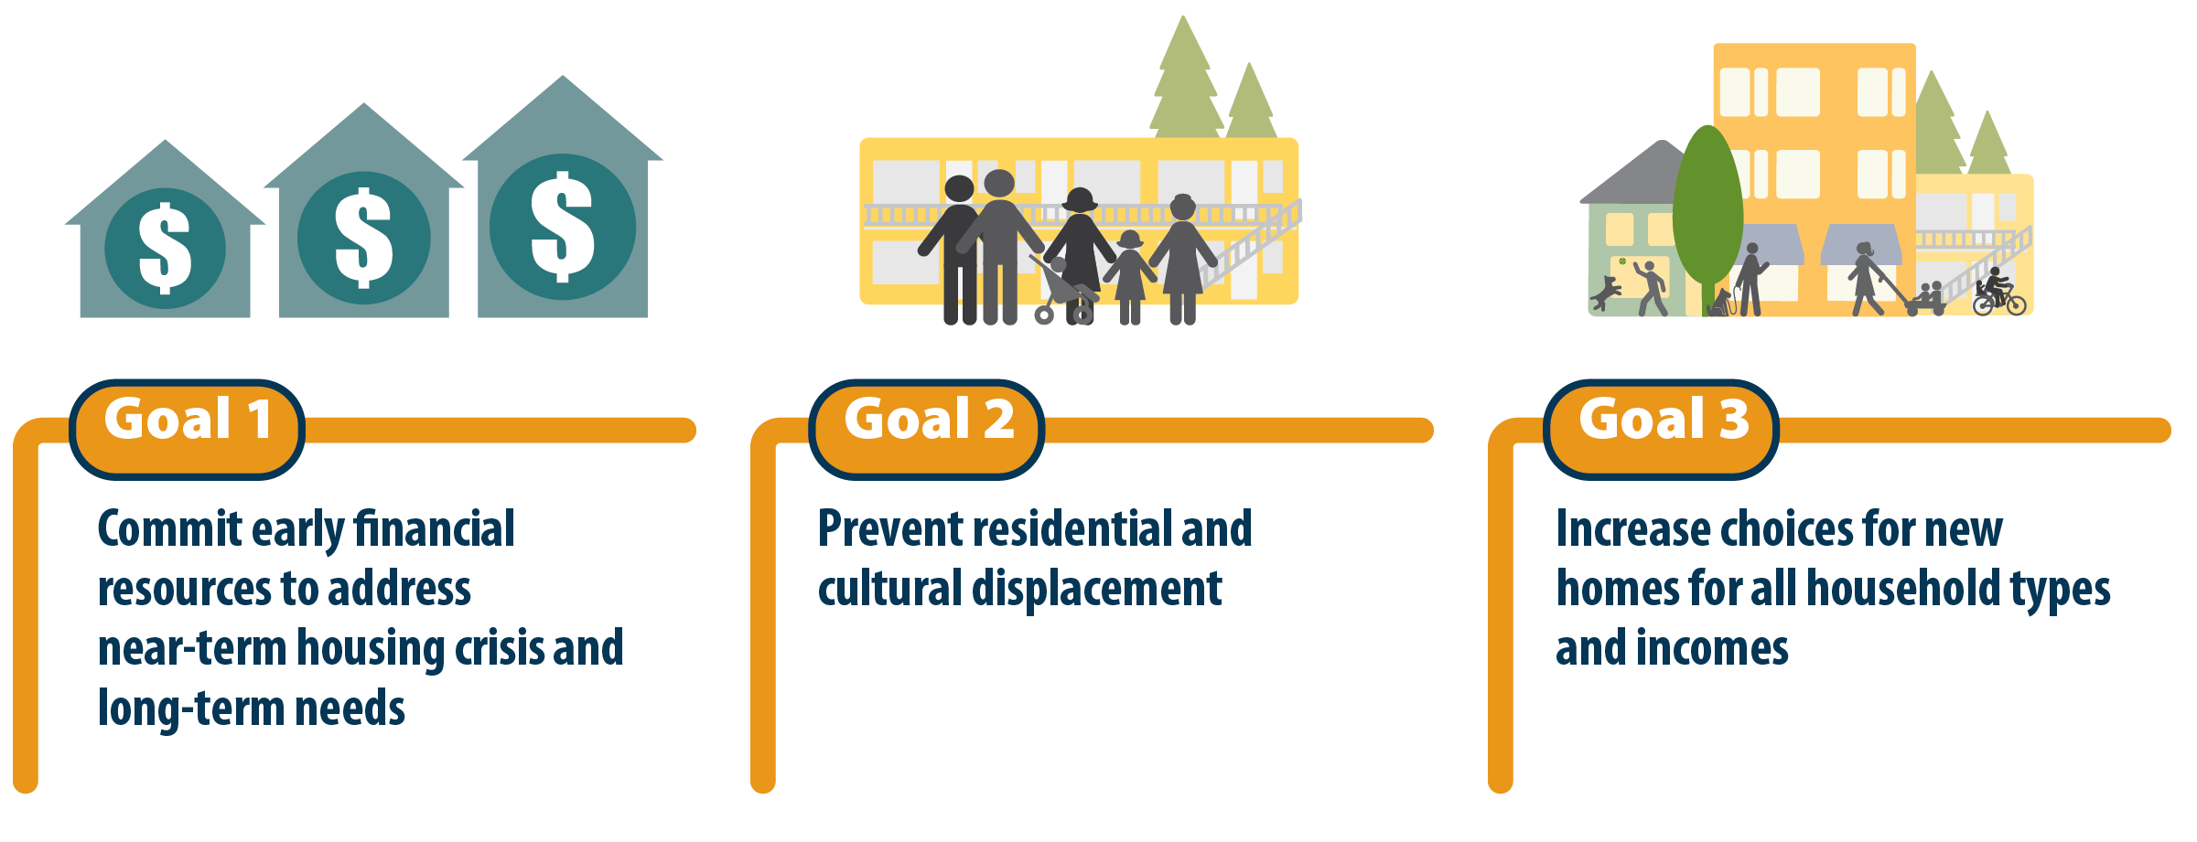
Major Goals
Notes:
Ryan
As a quick reminder from our work session, I want to briefly go over our charge and how we have responded.
Council asked us to develop a strategy that can work. This strategy before you today reflects the best thinking from local and national experts AND centers the priorities of those living in the corridor who are most impacted by today’s housing crisis.
It sets 3 major goals and provides a roadmap to achieve them over the next ten years:
Commit and grow new resources
Prevent displacement of vulnerable households
Increase housing choices
Our advisory group consistently asked “Are we going to do things different this time when new light rail comes?” and “Will what we do be enough?”
Their major indicators of whether we will do something different is whether we
1) capitalize the strategy with enough new resources and
2) whether we support community partners to continue to work with us in an accountable relationship
To answer the question of whether what we do is enough we analyzed the need and set targets to meet a portion of that need.
I want to acknowledge that we have more to do to capitalize the strategy. The strategy identifies potential sources of new resources, but many of those decisions are in the future, and some our in the control of partner agencies, or the voters – in the case of the regional housing bond. So this action today is really a blueprint for further work.

Slide 6
Notes:
Ryan
To set targets we first looked at the actual need; existing households paying more than 50% of their share on housing and future need based the estimated income distribution of future households
Then Portland and Tigard each set minimum housing targets based on current financial constraints and policies. They are a great start and will roughly double the corridor’s current inventory of regulated affordable housing: 775 currently to around 1,600.
The stretch housing targets are designed to achieve bigger policy goals; creating affordable choices at each station and preventing displacement.
That is how we developed the big 10 X 10 goal: One new regulated affordable building near each of the ten station that have residential zoning, and an equal number of building acquisitions where displacement risk is high.
Local partners will need to contribute resources to achieve this, and other sources can be leveraged …but the City of Portland will still need to make a significant investment.
Leadership from the bureaus are going to give more details on Portland’s targets and the work plan for moving this strategy into implementation

Slide 7
Affordable Housing Production Targets
 | Minimum Targets | Stretch Targets
Portland | 150 through inclusionary housing 150-200 acquired or converted Total: 300-350 homes Meets up to 14% of Portland’s need in the corridor | 550 constructed 150 through inclusionary zoning 350-700 acquired or converted Total: 1,050 – 1,400 homes Meets 39 to 53% of Portland’s need in the corridor
Notes:
Shannon
Reminder of the Portland specific minimum and stretch targets presented during the work session. The Housing Bureau has resources to achieve the minimum targets, the bureau does not have the resources to achieve the stretch targets.

Slide 8
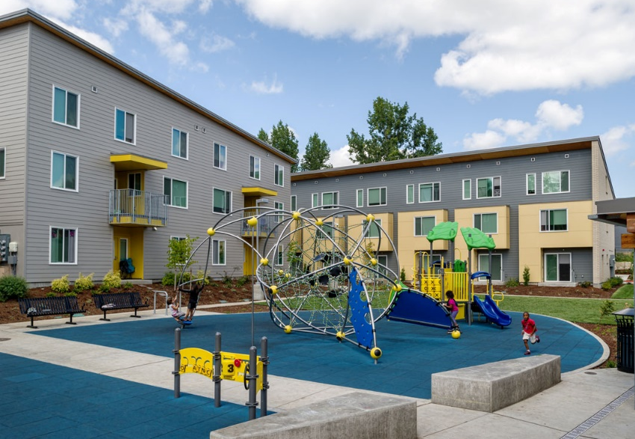
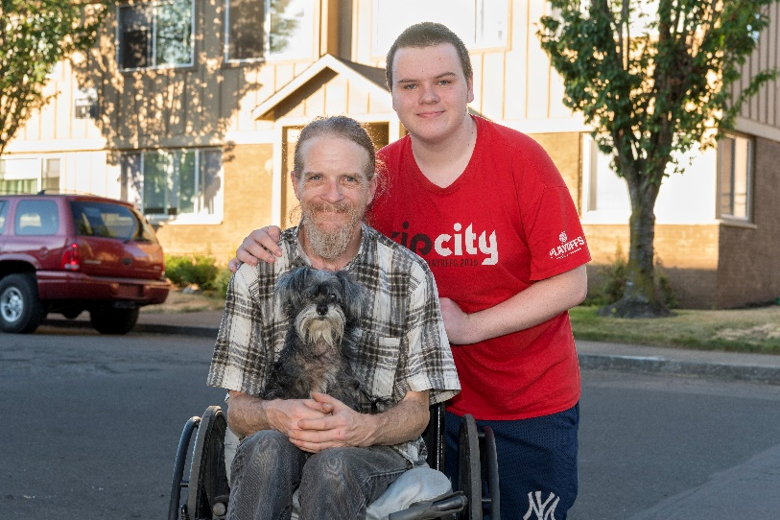
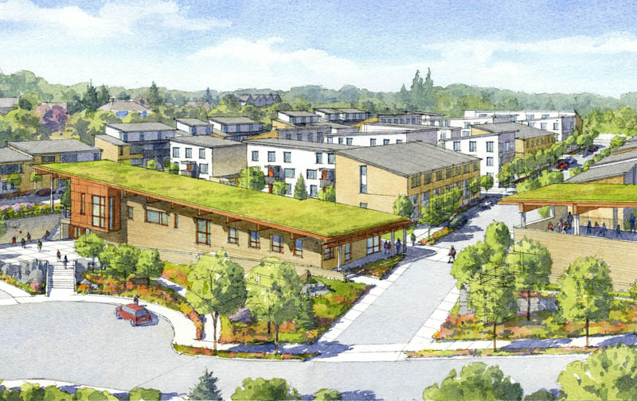
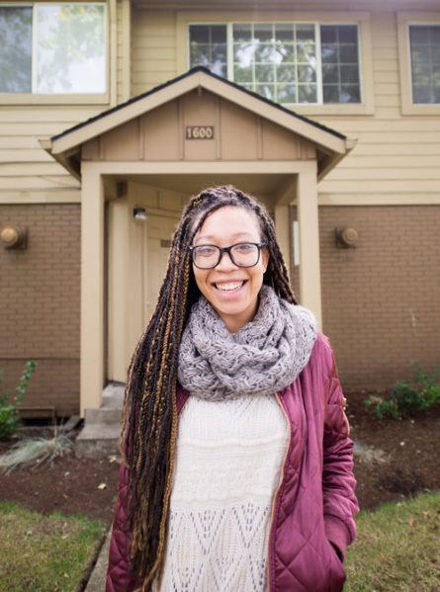
Implementing the Strategy Goal 1. Commit early financial resources to address the near-term housing crisis and long-term needs
Grow new resources for the long-term
Prioritize existing resources early
Strengthen partnerships
Notes:
Shannon
We are currently considering using the Portland Housing Bond funds, bond funds from the Metro referral if passed, and TIF resources from and urban renewal area.
Kimberly Branam will be speaking to a potential URA in a few minutes.
Eric Engstrom will also talk more about what strengthening partnerships looks like during implementation.

Slide 9
Implementing the Strategy Goal 2. Prevent residential and cultural displacement
Preserve existing unregulated affordable rental housing
Strengthen tenant protections and provide anti-displacement services
Notes:
Shannon
We are looking at the early acquisition of units through the capitalization of a land and property acquisition fund.
We are also looking at services packages that provide legal support, tenant counseling, landlord training, and financial services.

Slide 10
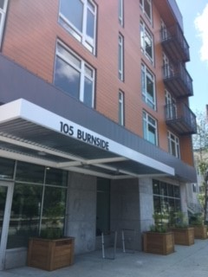
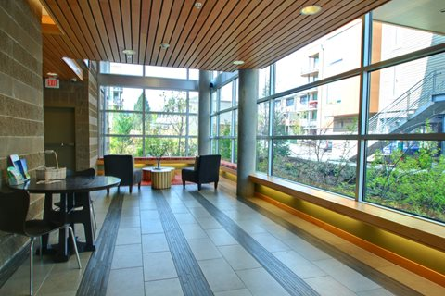
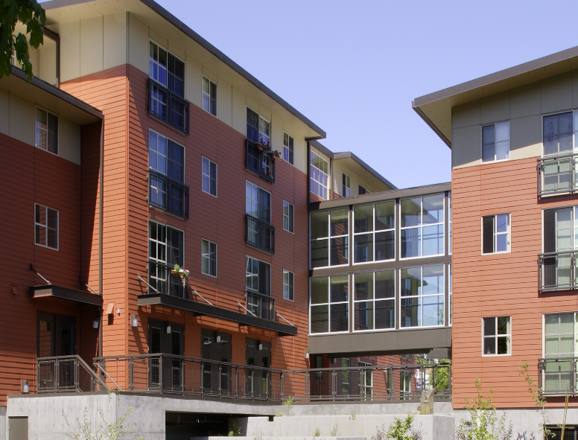
Implementing the Strategy Goal 3. Increase choices for new homes for all household types and incomes
Secure and develop opportunity sites for new construction of equitable transit-oriented development
Regulate land use and zoning to create affordable and market rate housing
Notes:
Shannon
We have preliminary agreement with TriMet on an MOU for acquiring remnant land parcels after the completion of the light rail project.
We are also working with BPS on station area planning for publicly owned sites in the corridor, Eric Engstrom will talk about this in a few minutes.

Slide 11
Early Implementation of Strategy: TriMet MOU
Conceptual agreement on the disposition of remnant SW Corridor land
TriMet will offer excess property to the Housing Bureau to accommodate 600 to 700 affordable housing units
These sites will sold at a discounted value
The City of Portland will also look to maximize development potential adjacent to other light rail lines.
Notes:
Shannon
Review conceptual agreement, the MOU language should be complete prior to the LPA vote next week.

Slide 12
Businesses, Employment and Wages
¼ MILE BUFFER
IMPACTED PARCELS
Size | Businesses | Employees | Wages | Businesses | Employees | Wages
1-4 | 644 | 896 | $46.4M | 183 | 308 | $13.9M
5-9 | 134 | 881 | $43.2M | 61 | 402 | $18.0M
10-19 | 93 | 1,233 | $51.7M | 35 | 469 | $18.2M
20-49 | 55 | 1,642 | $86.7M | 31 | 890 | $39.0M
50-99 | 28 | 1,918 | $69.2M | 15 | 990 | $32.0M
100-249 | 5 | 761 | $56.9M | 1 | 103 | $8.9M
250-499 | 2 | 557 | $38.5M | 1 | 259 | $7.0M
500-10,000+ | 3 | 18,758 | $1,490M | - | - | -
Source: Oregon Employment Department Quarterly Census of Employment and Wages (2016)
Notes:
Kimberly
Shannon has talked about the need for anti-displacement services for residents along the SW Corridor, we need to be equally mindful of the impacts on small, local businesses
As you’ll see from this slide, we estimate there are almost 1,000 businesses located within a ¼ mile of the corridor that stand to benefit from proximity to the transit improvements
Please also note that, using information from the Environmental Impact Statement, there are approximately 350 business whose property could be directly and negatively impacted by construction, almost 70 percent of which have fewer than 10 employees
As the City’s economic development agency, Prosper Portland is committed to creating affordability solutions for small businesses

Slide 13
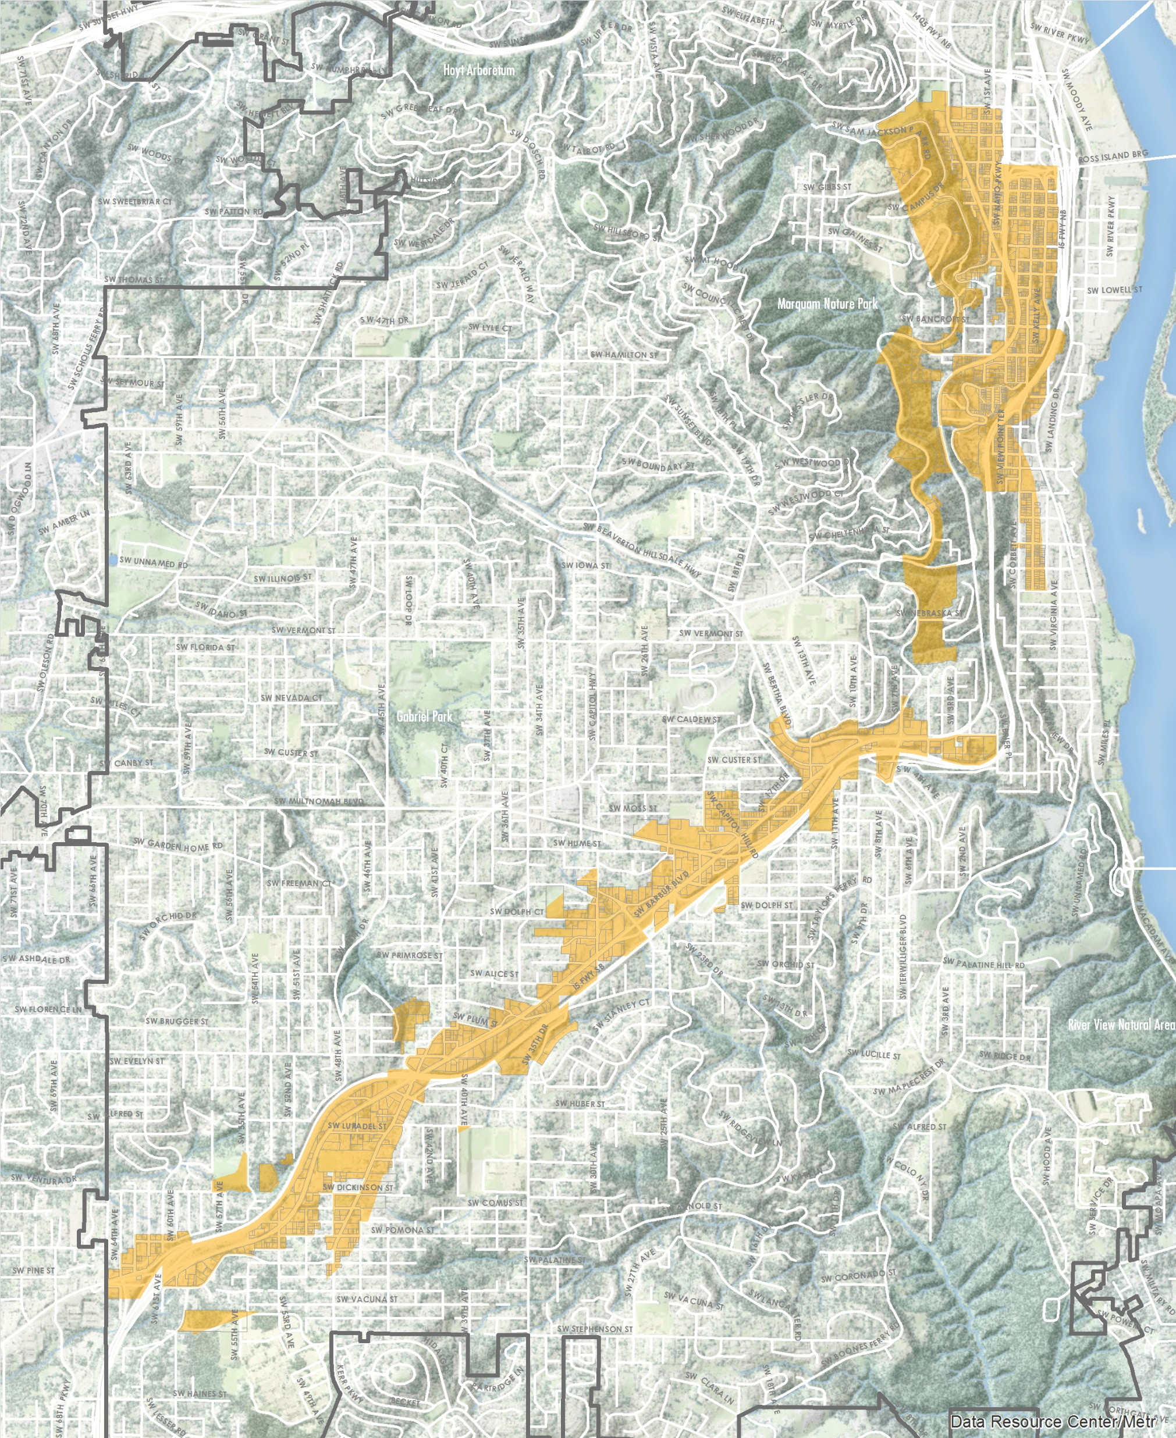
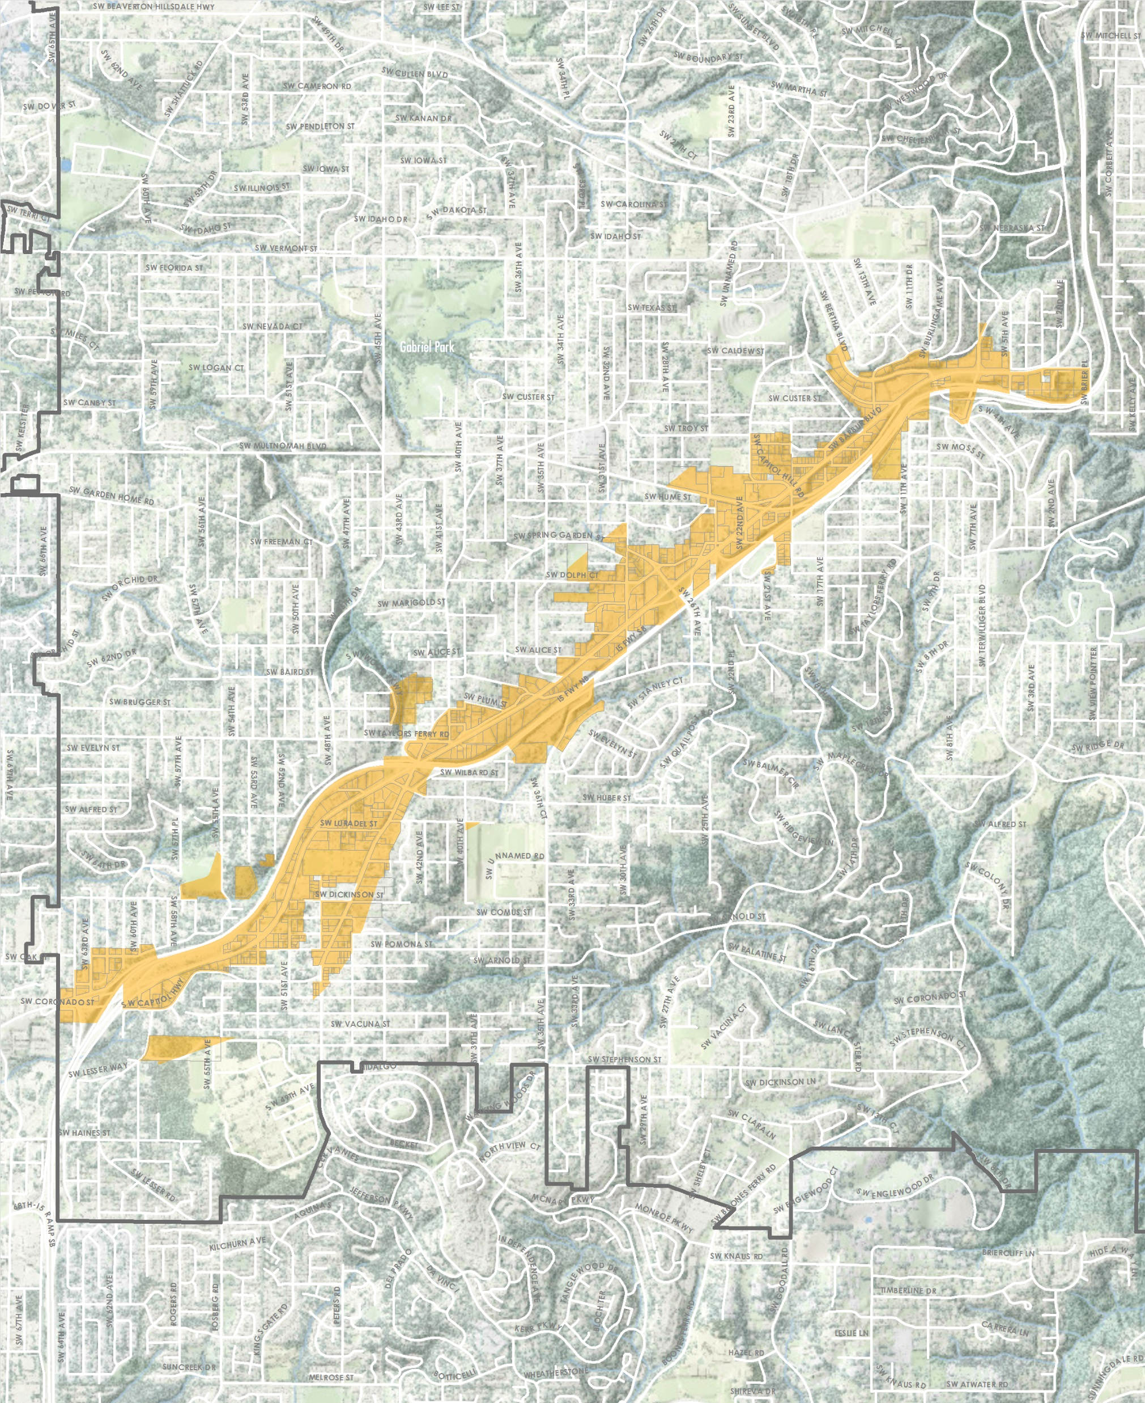
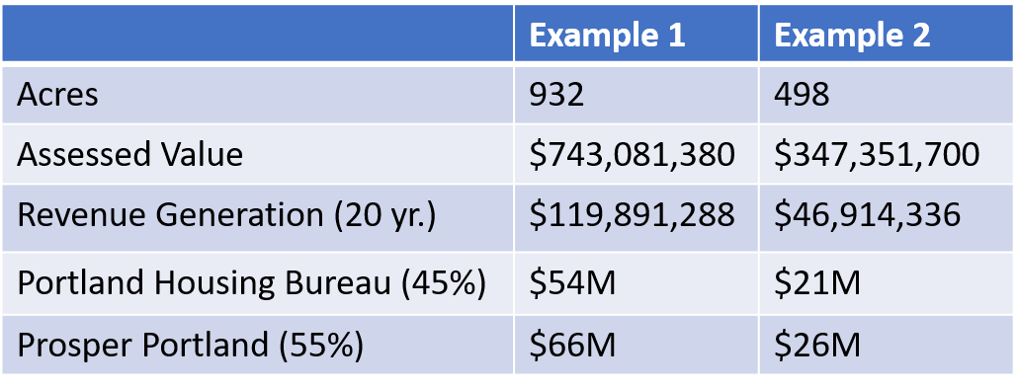
Early Implementation of Strategy: URA Modeling
Notes:
Kimberly
As you are aware, there is a 15% cap on the acres and assessed value within the City of Portland that can be within a tax increment finance district; as of today, there are 2,517 acres or $3.5 B in assessed value available within the City of Portland for new or expanded tax increment finance districts
We have modeled two potential tax increment finance districts – one at approximately 930 acres the other at approximately 500 acres
The larger district, as modeled, would yield approximately:
$54 M for Portland Housing Bureau investments, funding an estimated 240 affordable housing units, or 21 % of the stretch targets of 1,400 new and preserved units
Likewise, $66M for Prosper Portland would allow us to provide approximately 400 business loans and grants over 20 years
If 10% of the TIF resources were devoted to the City’s share of the local match for the transit project, that would yield approximately $12M
Please note that expected property acquisitions could remove approximately 20 percent of taxable properties off the rolls, which would adversely affect available TIF funding

Slide 14
SW Corridor – East Portland TIF District Scenarios
Total Available URA Acreage (2018)
2,517 acres
Reservation for Neighborhood Prosperity Network & East Portland
2,500 acres
Total Available URA Acreage (2020)
3,465 acres
SW Corridor Example 1
SW Corridor Example 2
932 acres
498 acres
Notes:
Kimberly
Of the currently available acreage City-wide, Prosper Portland intends to reserve these acres for new and expanded TIF districts in the Neighborhood Prosperity Network and East Portland
When debt in the Airport Way district will be paid off by June 2020, which will free up 885 acres for expanded or new TIF districts, including acreage for a potential SW corridor district

Slide 15
Early Implementation of Strategy: Station Area Planning & Public Land
Notes:
Eric
Getting the land uses around the stations right and prioritizing affordable housing on publicly owned land are critical to achieving our housing targets
With the help of a Metro 2040 grant BPS is gearing up to lead station area planning in the West Portland Town Center and in South Portland along Gibbs and Barbur station.
A few publicly owned properties have already been identified as having the potential for redevelopment. We will be exploring redevelopment scenarios through the station area planning
Ross Island Bridgehead sites. The Oregon Department of Transportation and the City of Portland owns the land under portions of the Ross Island Bridgehead. Should the bridgehead be reconfigured, an estimated 2-3 acres of land could be available for redevelopment. This land could support 300-450 units of housing under the current zoning regulations.
Barbur Transit Center. The Oregon Department of Transportation owns the Barbur Transit Center. If the transit center is redeveloped to include a light rail station and mixed-use building(s) then an estimated 100-200 units of housing could be built on a portion of the over five-acre site under the current zoning regulations.
Portland Community College Sylvania Campus. The Portland Community College Board of Directors is interested in the development of affordable housing on the Sylvania Campus just a short walk to the light rail station on 53rd Avenue.
Tigard Transit Center. The TriMet-owned Tigard Transit Center is a potential affordable housing redevelopment site when the bus transit center functions are relocated with a new light rail station in Downtown Tigard. Sean Farrelly from Tigard will tell you a little more about their work.

Slide 16
Next Steps: Ongoing Coordination Through MOU
Notes:
Eric
The local governments participating in developing this housing strategy acknowledge that past transit-related housing strategies were not successful in large part because they failed to enforce accountability measures or resource community organizations to play an active role in these measures during implementation. We are planning for this time to be different.
The organizations involved in the planning process are forming a Community Preservation Workgroup to focus on the anti-displacement measures in the strategy. With metro’s help BPS will resource this group to 1) expand efforts to engage low-income households and communities of color and 2) advise government partners to implement and report on progress. There is a budget proposal in fall BMP to match resources we have secured from Metro to do this work.
In addition, Portland, Tigard, Washington County, TriMet and Metro have agreed to form a staff level Equitable TOD Workgroup to coordinate the activities of the MOU like station area planning and planning for opportunity sites. This group will provide opportunities for regular input from the Community Preservation Workgroup
This will allow for greater coordination and accountability.
Pass to Ryan to introduce Sean, Malu, and Dave

Slide 17
Jurisdictional Partners
Sean Farrelly - City of Tigard Redevelopment Project Manager
Malu Wilkerson - Metro Investment Areas Manager
Dave Unsworth - TriMet Director of Project Development and Permitting
Notes:
Sean:
This strategy is important to Tigard
We’ve begun implementation (URA, SDC waiver, pre-dev on sites, etc…)
We are excited to work with community partners and other jurisdictions on the MOU.
Malu:
This housing strategy is an important part of the overall planning for the corridor. SWEDS continues to build on this housing strategy and expand planning to also include job creation, small business support, and workforce development
Metro is also continuing to play a role in equitable TOD through its TOD Program. We hope to play an active role in securing some properties near future light rail stations.
We also hope to expand our role in housing if the voters approve a regional housing bond. If it passes we will work with local jurisdictions to invest in their housing priorities like the SW Corridor Equitable Housing Strategy.
Dave:
1. TriMet supports the MOU - we want to be part of the effort to meet the corridor’s housing targets
2. This builds on what TriMet is doing today - 495 affordable units underdevelopment w 180 more anticipated.
3. Adoption of the low income fare

Slide 18
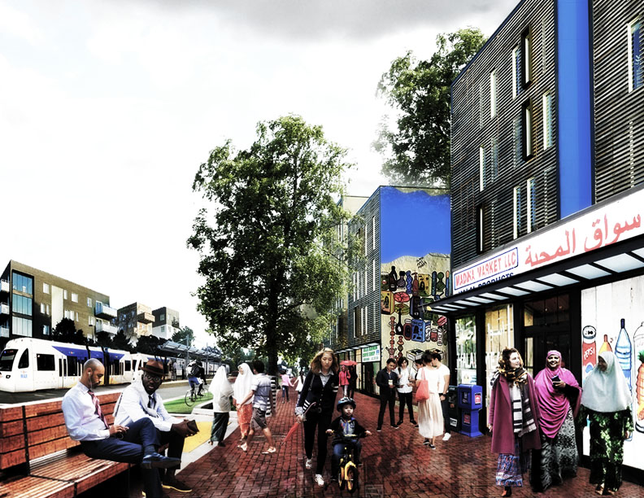
Discussion
Notes:
Ryan, just a reminder of what this resolution does:
Adopts the housing strategy as binding city policy
Directs City Bureaus to work with community-based organizations, to report to City Council before each budget cycle on the progress and near term priorities of the strategy
Directs City bureaus to bring a financing plan back to City Council
Directs BPS to conduct station area planning
Directs the City bureaus to advance racial equity through their work with Metro on SWEDS and a regional housing bond
Next is public testimony

Slide 19
Portland City Council
Due to technical difficulties the captioning system is no longer working – we apologize who rely on captioning.
Because we have lots of people her today in the chamber to make their presentations and give their public testimony we have decided to continue with the meeting.
We will make certain that all rebroadcasts of this meeting include captioning.
Rebroadcasts times will be posted on the Mayor’s website.

