Slide 1
E10941-Hillsdale Crest RDII Project Easement Acquisition – Agenda Item #923 Portland City Council | August 29, 2018
Bill Ryan, P.E.,
Chief Engineer
Henry Young, P.E.,
Project Manager
Notes:
Introductions:
Good morning Commissioners and Mayor….
My name is Henry Young. I’m the project manager for the Hillsdale Crest RDII Project.
With me… Bill Ryan, Chief Engineer for BES and John Deyo, R/W Agent III, PBOT.

Slide 2
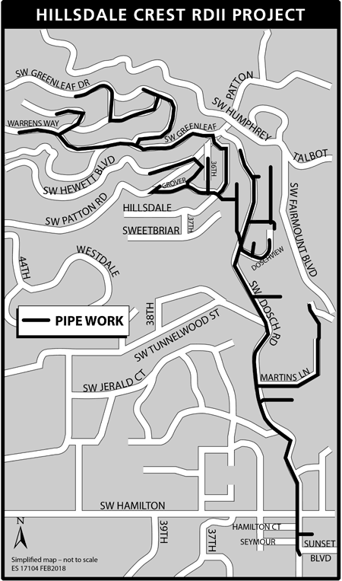
Hillsdale Crest RDII
The Hillsdale Crest RDII Project will reduce “Rainfall Derived Infiltration and inflow” into our sanitary sewer system in the northern portion of the Hillsdale Neighborhood of Southwest Portland by repairing and lining the public sanitary sewer pipes.
Notes:
This ordinance before you is to authorize the Bureau of Environmental Services to acquire sewer easements through the Eminent Domain Process for the Hillsdale Crest RDII Project. This project is the culmination of years of work completed so far by BES to control the Sanitary Sewer Overflow at the DeWitt Manhole.

Slide 3
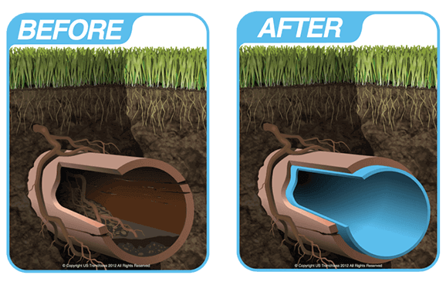
Hillsdale Crest RDII
Stormwater and groundwater (Rainfall Derived Inflow and Infiltration) leaches into aged sewer pipes designed to carry only sanitary sewage, causes sewer mains to overflow at low points which drain into ditches or nearby waterways.
The Hillsdale Crest Project will repair, using the Cured-in-Place Pipe lining (CIPP) methodology, line 18,500 lineal ft of 8-inch and 12-inch sanitary sewer mains and 226 public laterals.
Notes:
Our aged sanitary sewer system with cracks and joint separation, allow groundwater & stormwater seeps into the sewer pipes. At times, a large storm event, the sewer lines, through infiltration and inflow receives so much water that it overwhelms the capacity of our sanitary sewer system. The Hillsdale Crest Project will line 18,500 lineal feet of pipe to rehabilitate the internal of these sewer lines to a like new condition.

Slide 4
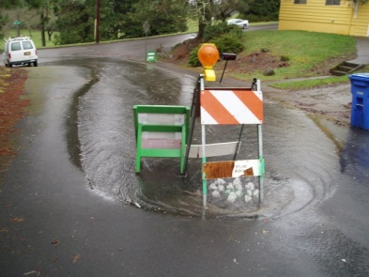
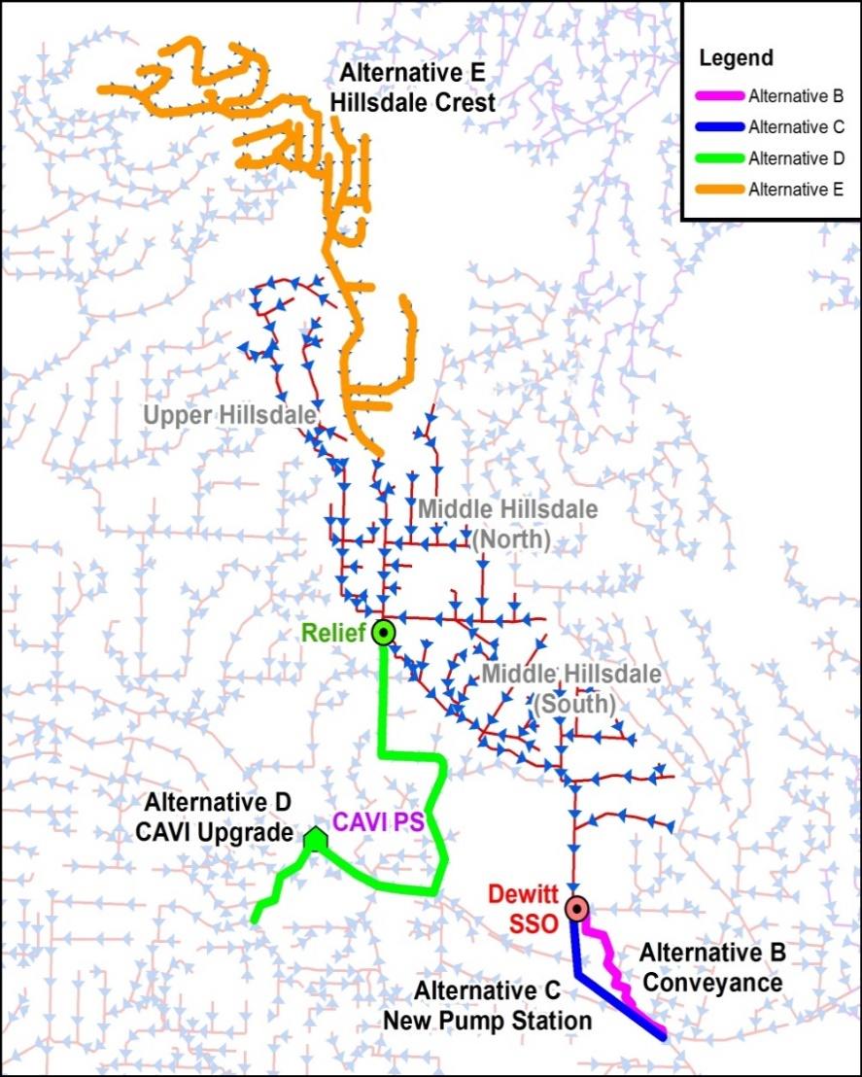
RDII Program Background and Status
Dewitt Manhole
BES entered in to a Mutual Agreement and Order (MAO) with DEQ in 2011 due to sanitary sewer overflows (SSO) in the Hillsdale Neighborhood.
Notes:
Because of repeated sanitary sewer overflow at the DeWitt Manhole, BES entered into a Mutual Agreement and Order with DEQ in 2011 to control the Sanitary Sewer Overflow in this Hillsdale Neighborhood/Burlingame Basin.

Slide 5
RDII Program Background and Status
The MAO with DEQ mandates a 40% reduction in infiltration and inflow
BES has undertaken four projects to reduce RDII and control sanitary sewer overflows (SSOs):
Upper Hillsdale (Public Pipes, Public & Private Laterals): Complete
Middle Hillsdale (Public Pipes): Complete
Middle Hillsdale (Public & Private Laterals): Under Construction
Hillsdale Crest (Public Pipes and Public Laterals): In design
In 2016, BES evaluated the effectiveness of the projects that had been completed at that time. This evaluation showed that repair and lining is very effective at controlling sewer overflows:
Mainlines, public and private laterals = 73% reduction
Mainlines Only = 57% reduction
Hillsdale Crest is the last project needed to control the SSO and comply with the DEQ MAO
Notes:
MAO goal reducing Infiltration and inflow by 40% by lining sewer mains and public laterals
Upper Hillsdale; mainline, public and private
laterals (2014)
Mainline = 9,300 ft, public laterals = 2,800 ft
Private laterals = 9,500 ft
Middle Hillsdale; mainline (2015)
Mainlines = 13,700 ft
Evaluate RDII effectiveness (2016)
Mainlines, public and private laterals = 73% reduction (Upper Hillsdale)
Mainlines = 57% reduction (Middle Hillsdale)
Develop final project (Hillsdale Crest) to achieve SSO control (2017)
Submitted predesign report and 30% design drawings to DEQ by June 30, 2017
DEQ closes MAO (July 5, 2017)
Middle Hillsdale; public and private laterals (currently in construction)
Public laterals = 4,500 ft, private laterals = 6,700 ft

Slide 6
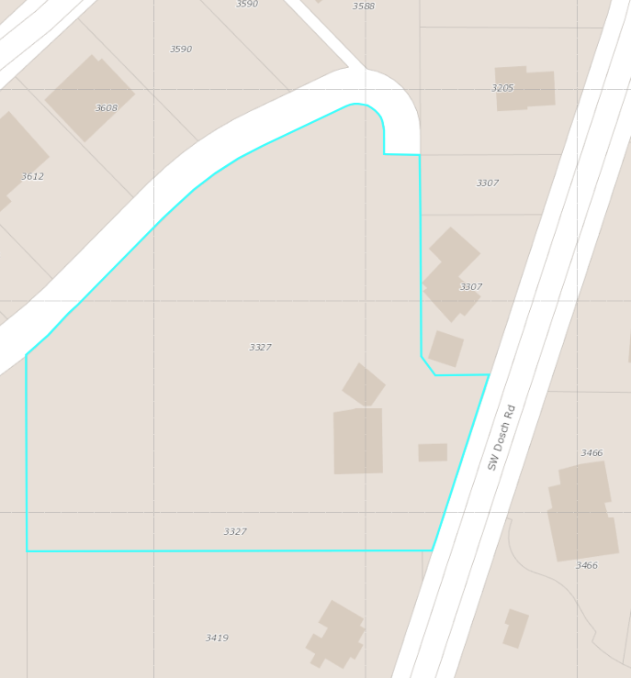
Easement Acquisition
SW Sweetbriar Drive was vacated by Multnomah County
BES has sewer assets running underneath the vacated Right of Way (ROW)
BES is seeking to acquire sewer easements on properties at 3327 and 3307 SW Dosch Road to gain access to repair the pipe as part of the Hillsdale Crest RDII project
SW Sweetbriar Drive
Vacated ROW
and Sewer Pipe
(approximate location)
Notes:
Area was in the unincorporated Multnomah County, sanitary sewer lines constructed in early 50s’. BES annexed the area, project research found that SW Sweetbriar Drive was vacated by Multnomah County, BES have sewer assets along the vacated area. There is a need to acquire sewer easements to gain access to repair the pipe.

Slide 7
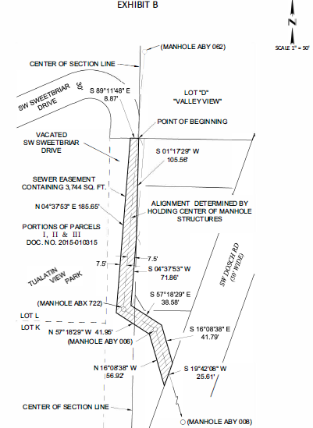
Easement Acquisition
BES has been in contact with both property owners to inform them of the effort to acquire the easements
Work will have low to moderate impact to two properties
Project funds are available -> WBS Element E10941.L65
Authorizing this ordinance would empower BES and PBOT Right of Way staff to begin negotiations on acquiring the easements with the property owners
Notes:
BES Public Involvement and PBOT ROW staff have contacted the two property owners regarding the easement needs. Would like Council (Mayor and Commissioners) to authorize ths ordinance to allow BES and PBOT RW staff to begin the negotiation with property owners to acquire the easements.

Slide 8
Questions?

