Slide 1





Lents
Stabilization and
Job Creation
Collaborative
Portland City Council
September 5, 2018

Slide 2
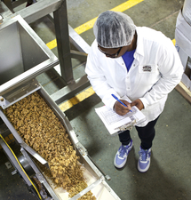
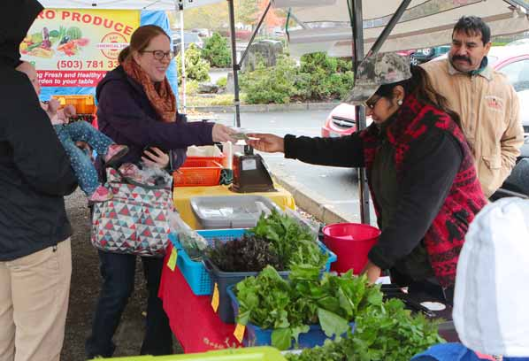
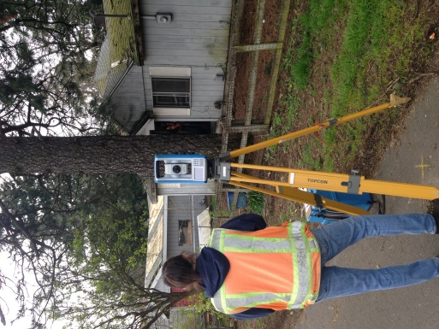
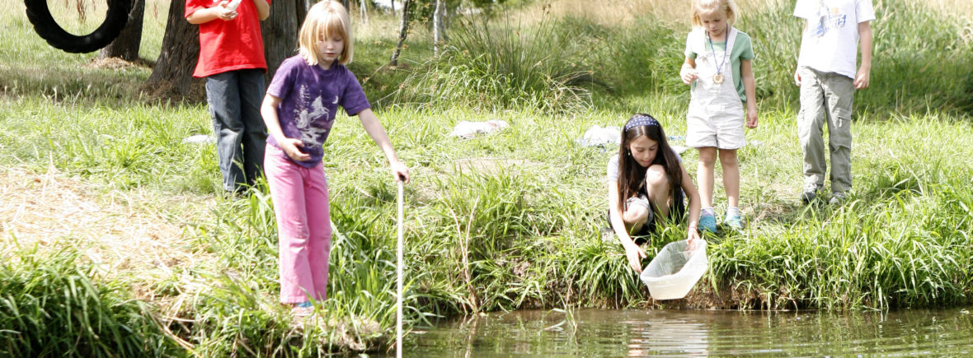
Lents Collaborative CHARGE
AN INTEGRATED APPROACH
Keep the neighborhood affordable and diverse
Support job growth and business investment
Mitigate flooding
Restore natural floodplain functions along Johnson Creek
Notes:
PURPOSE
WHEREAS, Governor Brown appointed State Rep. Jeff Reardon and City of Portland Planning and Sustainability Commissioner Michelle Rudd as the co-conveners of the Lents Collaborative to lead the multi-agency and stakeholder process to develop strategies and projects that work toward preserving existing housing, enhancing industrial lands for job growth, mitigating flooding and enhancing natural floodplain functions along Johnson Creek; and
Keep the neighborhood affordable and diverse.
Give homeowners the ability to stay in their homes and take control over their household finances by addressing the high and rapidly rising costs of flood insurance (which are driven by major disasters in other parts of the country)
Support job growth and business investment.
Create sensible floodplain regulations that provide more flexibility for development, while protecting the environment and preventing flood impacts elsewhere.
Restore Johnson Creek floodplain and wetlands.
Transform the Foster corridor from an area known for flooding to a neighborhood known for its abundant natural areas and restored salmon runs in Johnson Creek.

Slide 3
the Lents collaborative
Designated an Oregon Solutions project by
Governor Kate Brown
Oregon Solutions Co-conveners
Representative Jeff Reardon, Oregon Legislative District 48
Michelle Rudd, Land use attorney and Portland Planning and Sustainability Commission
PROJECT TEAM PARTNERS
City of Portland
  BES, PHB, Prosper Portland, OMF, BDS, BPS, OGR, PBEM, PBOT, PPR
State of Oregon
  DEQ, DLCD, DSL, ODOT, OEM, OHCS, Regional Solutions Team
Regional and Federal Agencies
  Metro Regional Government
  Federal Emergency Management Admin. U.S. Army Corps of Engineers
Educational Institutions
  Portland State University
  Reed College
  Wharton School of Risk Management
  Community Organizations and Reps
  Friends of Zenger Farm, Green Lents
  Johnson Creek Watershed Council
  Lents Neighborhood Association
  Lents Neighborhood Livability Association
  Powellhurst-Gilbert Neighborhood Association
  Freeway Lands/Jameson Partners
Notes:
PARTNERS
WHEREAS, the City of Portland participated on the Oregon Solutions Project Team, collectively known as the “Lents Collaborative,” with a wide range of stakeholders from City bureaus, state, regional, and federal agencies, community organizations, non-profits, university researchers and the private-sector to study the issues and for partners to develop solutions that work on advancing community goals (Exhibit X); and
WHEREAS, the Lents Collaborative was charged by Governor Brown with helping under-served residents, owners of under-utilized industrial land, and owners of businesses impacted by the flood hazard designation to build a foundation for improved community stability; and

Slide 4
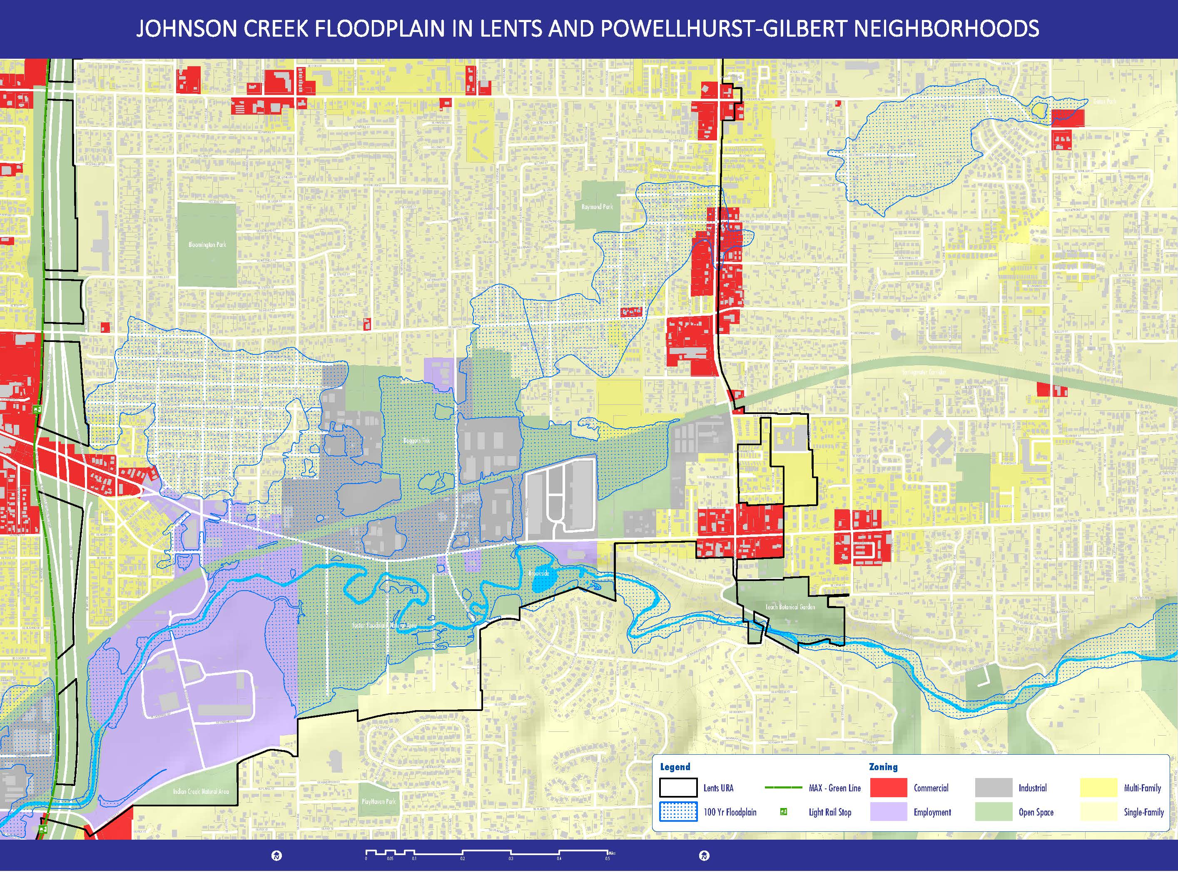
EAST FOSTER ROAD | ZONING AND FLOODPLAIN
SE 122nd Ave
Notes:
BACKGROUND
WHEREAS, the City of Portland received and accepted the Oregon Solutions project designation through Resolution No. 37227 on August 10, 2016 (Exhibit X), acknowledging that the flood hazard designation in the area imposes real and perceived impacts to development and job creation, area residents are significantly burdened by the rising costs of flood insurance, and that seasonal flooding of roads and development impacts the health of Johnson Creek, a regional fish-bearing tributary of the Willamette River, which is subject to requirements of the Endangered Species Act to restore and protect Chinook Salmon, steelhead trout and other indigenous fish species; and;
Effort focused on
Flat with high water table
Johnson Creek along southern edge, salmon and Willamette River
330 acres in floodplain – industrial/commercial and residential (mostly 1-family)
East of Lents Town Center, east of I-205 to ~122nd Ave, near southern city limits with Clackamas Co.
Springwater Corridor trail through the middle
Concentration of pick and pull car part lots and also “freeway lands” south of Foster
Floodplain sprawling up to ½ mile from Johnson Creek – ancient lake bed

Slide 5
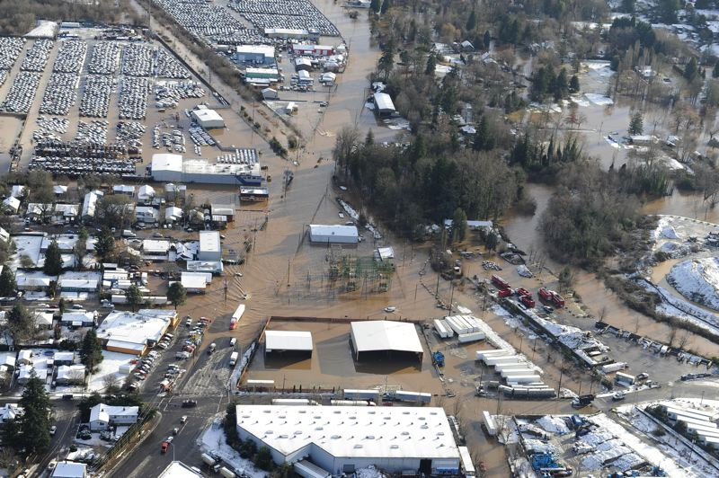
THE CALL FOR ACTION
COMMUNITY PLANNING
Johnson Creek Restoration Plan | 2001
Portland Plan | 2012
Foster-Lents Integration Partnership | 2013
Lents 5-Year Action Plan | 2014
Climate Action Plan | 2015
Lents Strong Action Plan community-led | 2016
2035 Comprehensive Plan | 2018
Notes:
PURPOSE
WHEREAS, the City of Portland received and accepted the Oregon Solutions project designation through Resolution No. 37227 on August 10, 2016 (Exhibit X), acknowledging that the flood hazard designation in the area imposes real and perceived impacts to development and job creation, area residents are significantly burdened by the rising costs of flood insurance, and that seasonal flooding of roads and development impacts the health of Johnson Creek, a regional fish-bearing tributary of the Willamette River, which is subject to requirements of the Endangered Species Act to restore and protect Chinook Salmon, steelhead trout and other indigenous fish species; and;

Slide 6
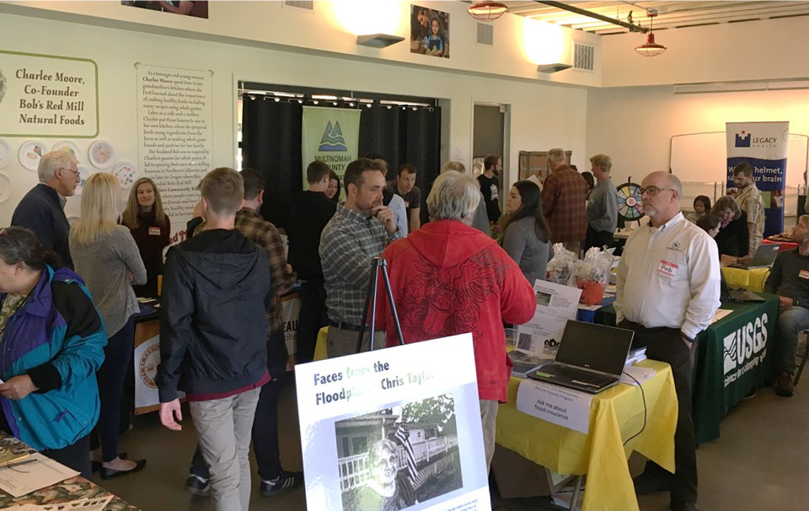
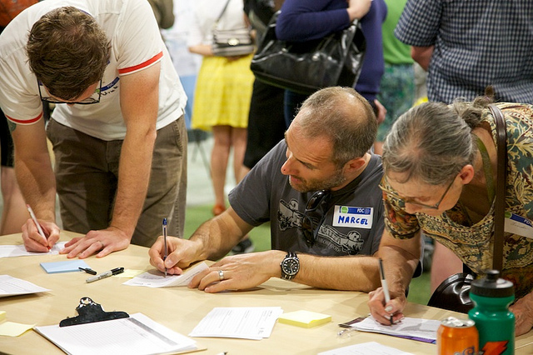
COMMUNITY PERSPECTIVES
Community-driven process to identify issues and options
Community workshops: Foster Lents Integration Partnership
Homeowner surveys and interviews: PSU/Green Lents
Life in the Floodplain Fairs
Multilingual outreach to all homeowners
Technical Advisory Committees
Flood insurance focus groups
Neighborhood meetings
Business interviews
Notes:
PROCESS
WHEREAS, the Lents Collaborative was charged by Governor Brown with helping under-served residents, owners of under-utilized industrial land, and owners of businesses impacted by the flood hazard designation to build a foundation for improved community stability; and
WHEREAS, the Lents Collaborative engaged hundreds of residents and business owners to share their knowledge and experiences, explain what they need to stay and be successful in the community, share their priorities and recommended actions and investments, and receive support and technical assistance to mitigate their flood insurance costs and flood risks; and

Slide 7
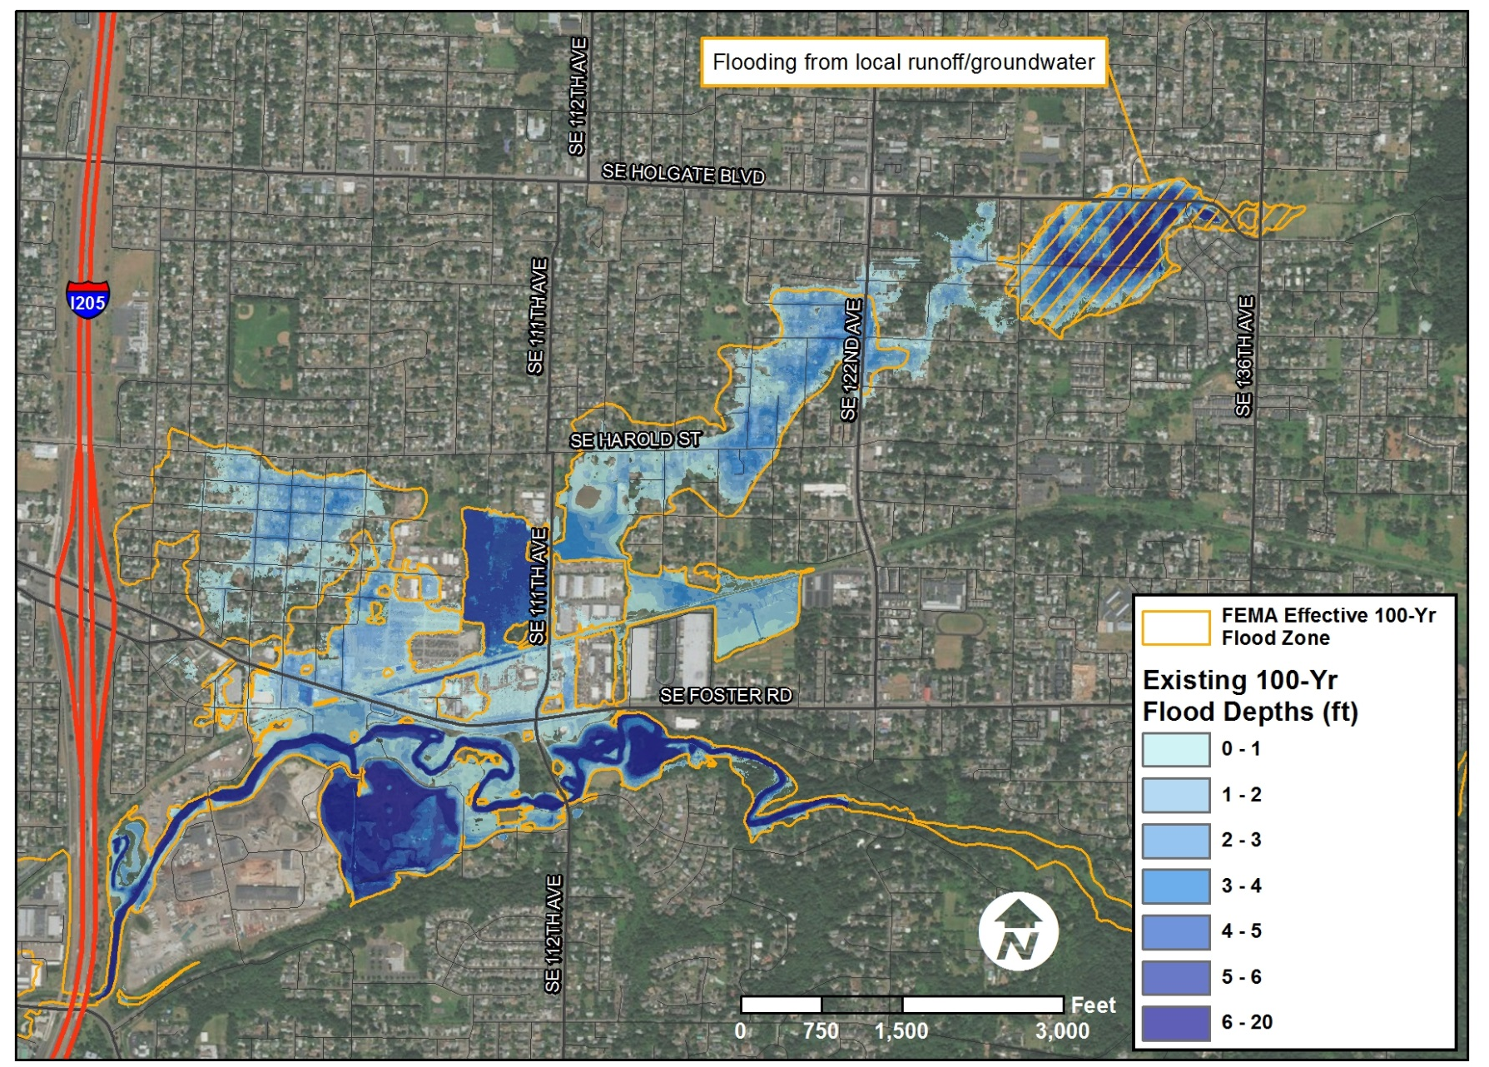
TECHNICAL ASSESSMENTS
  Studies and Analyses
  Housing opportunity and vulnerability analysis
  Insurance costs and claims
  Floodplain modeling and risks
  Feasibility and costs of flood mitigation project
  Employment and industrial readiness assessment
  Lived experiences of floodplain residents and business owners
Notes:
PROCESS

Slide 8
OUTCOMES AND FINDINGS
Evidence-based research
Homeowners say insurance costs are more of an issue than flooding
Three years of flood insurance premiums paid in the area roughly equal claims paid out over 40 years
Most businesses are well-adapted to flooding
Industrial lands are well-utilized with middle-wage jobs for East Portland
Community support for floodplain restoration projects
NFIP maps haven’t been updated in parts of the floodplain since 1999
A large-scale mitigation project is not resilient against larger floods
Notes:
PROCESS
Homeowners say insurance costs are more of an issue than flooding and NFIP premiums are increasing at annual rates of 5-25%
Three years of flood insurance premiums paid in the area roughly equal claims paid out over 40 years
Most businesses well-adapted to flooding
Industrial lands well-utilized, with middle-wage jobs for East Portland
Community support for floodplain restoration projects
NFIP maps haven’t been updated in parts of the floodplain since 1999 and current flood modeling suggests an update may be warranted
A large-scale mitigation project is not resilient against larger flood events that may be expected as a result of climate change

Slide 9
Major Accomplishments to Date
  HELP FOR FLOODPLAIN RESIDENTS & EMPLOYERS
  PHB Flood Insurance Savings Program
  Floodplain homeowner education
  Elevation certificates on PortlandMaps
  Assessment of market & development standards for business growth
  Meyer Memorial Trust grant to address displacement vulnerability
  New state requirements for additional NFIP training for insurance agents
  Coordination with federal policymakers
Notes:
PROCESS – IMMEDIATE ACTION AND ASSISTANCE
Immediate action, practical information, and pilot efforts

Slide 10
Project Team Priorities
Implementation
Reduce impacts from frequent floods
Improve community understanding of flood risks
Reduce financial stress and displacement pressure from rising flood insurance costs
Improve fairness and transparency of flood risks during real estate transactions
Promote sound floodplain management updating floodplain maps
Reduce complexity of floodplain regulations
Create interagency organizational capacity to effectively address complex resiliency issues
Notes:
LENTS COLLABORATIVE PRIORITIES
Advocate for FEMA to remap Johnson Creek as part of a pilot mapping program to test new floodplain mapping standards that emerged from the Biological Opinion on the National Flood Insurance Program in Oregon issued by the National Marine Fisheries Service in 2016.
Examine ways to improve safety for all users of Foster Road and explore capital and maintenance solutions that would increase flood resiliency and preserve emergency access on Foster Road during Johnson Creek flood events.
Evaluate the potential benefits of improving Portland’s ranking in Community Rating System, as resources are available.
Priorities of the multi-stakeholder Project Team, focused on immediate / near term action

Slide 11
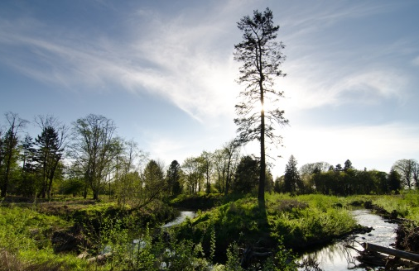

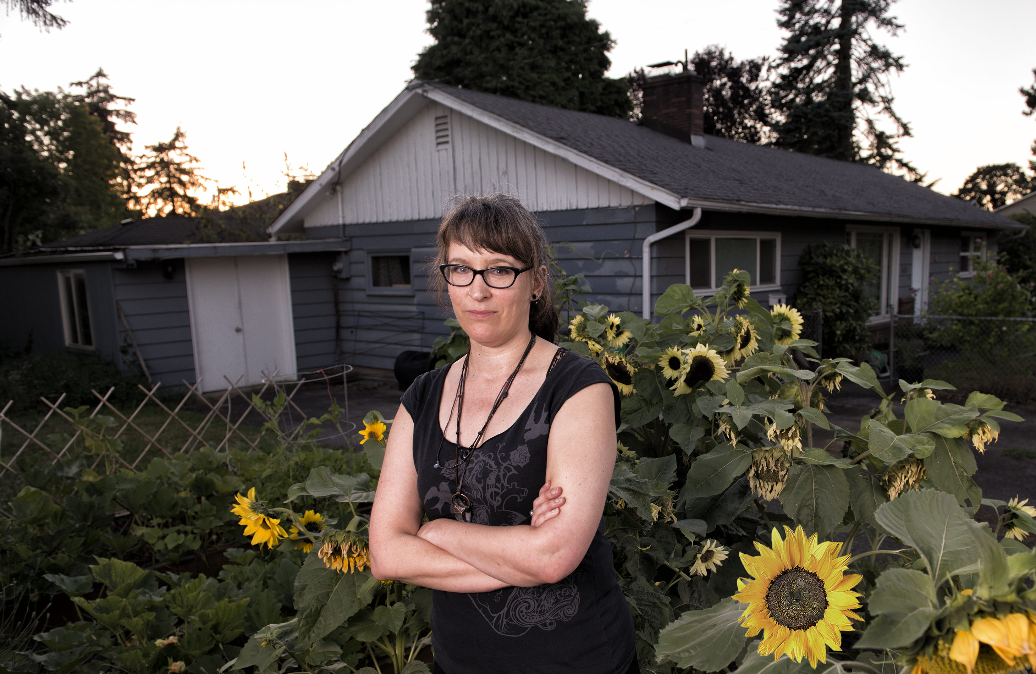
NEXT STEPS
CITY of PORTLAND COMMITMENTS
Construct the Springwater Wetlands Floodplain Restoration Project
Conduct community outreach to improve knowledge of flood risks and preparedness
Pursue updates to floodplain maps, potential as a FEMA pilot project
Update development regulations in compliance with the ESA
Explore tools to increase transparency in real estate transactions
Create opportunities for job retention and business investment
Notes:
CITY’S COMMITMENTS TO CARRY OUT PRIORITIES
WHEREAS, the Lents Collaborative prepared the Lents Stabilization and Job Creation Declaration of Cooperation that outlines their collective priorities for action and good faith commitments to further the community’s goals to protect and restore environmental resources, improve water quality of Johnson Creek, address the destabilizing impacts of rising flood insurance costs, support flood risk education and community resiliency in the floodplain area, and create opportunities for job retention, growth and reinvestment in the East Foster Commercial, Employment and Industrial Districts;

Slide 12
proposed COUNCIL resolution
Declaration of Cooperation
Direct staff to sign the Declaration of Cooperation as a partner in the Lents Collaborative
Direct bureaus to implement commitments and report back to Council
Notes:
RESOLUTION
NOW, THEREFORE, BE IT RESOLVED that the City of Portland hereby directs staff to enter into the City’s commitments, as substantially described in the Oregon Solutions Declaration of Cooperation (Exhibit X) and begin to implement their work; and
BE IT FURTHER RESOLVED that the City Council directs bureaus to report back to Council in 6 to 12 months on the status of the project and progress made toward the City’s commitments.

