Slide 1
Manufactured Dwelling Parks
City Council
August 22, 2018

Slide 2
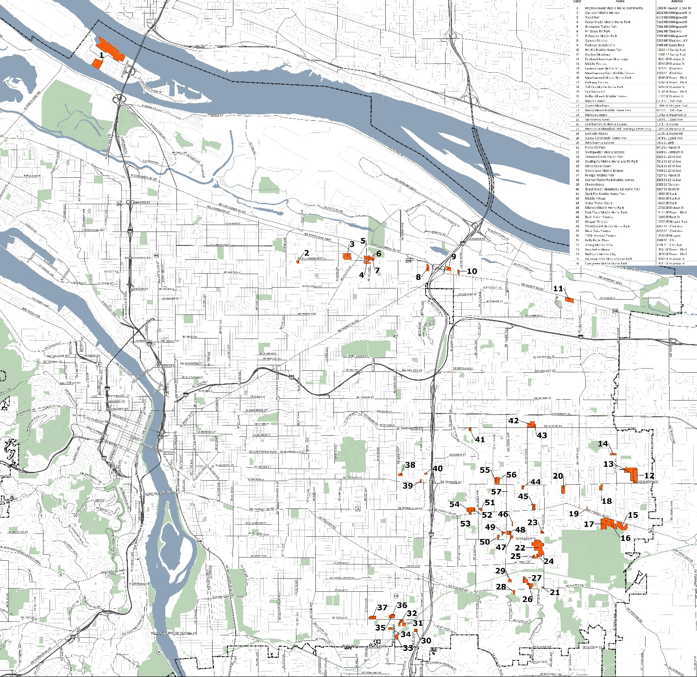
Map
Notes:
There are 56 MDPs with over 3,000 manufactured homes in Portland. Some residents own their manufactured dwelling and rent the space from a MDP owner. Some residents rent both the dwelling and the space from the MDP owner. Most (38) of the MDPs have R2 or R3 zoning, which are the only zones in which MDPs are currently an allowed use. The remaining 18 MDPs are non-conforming uses with a wide-range of residential (6), commercial (4) and employment (4) zoning.
There is one MDP, Fox Run, that is not rezoned as part of this project because it is a large (15 acres) park located in a Prime Industrial Area with General Employment (EG) zoning. This park is counted as part of Portland’s employment buildable land inventory (BLI). Therefore, changing the map designations would represent a significant reduction in Portland’s industrial land supply.

Slide 3
Proposed Changes
Comprehensive Plan Policy Amendments
Comprehensive Plan Map Amendments
Zoning Code Amendments
Zoning Map Changes
Notes:
This project proposes to establish a new residential multi-dwelling base zone specifically for manufactured dwelling parks. The proposal requires amendments to the Comprehensive Plan, Comprehensive Plan Map, Zoning Code (Title 33), Title 18 (Noise) and Title 32 (Signs). The proposed zoning changes will consolidate MDPs into one new base zone in the Multi-Dwelling Residential Chapter (33.120) to create consistent land use regulations for manufactured dwelling parks.

Slide 4
Zoning Code
A new base zone - RMP
The allowed housing type is manufactured dwellings in a manufactured dwelling park.
Recreational vehicle parks are allowed as Limited Retail Sales and Service use.
Institutional Categories (community service, schools, daycare) are allowed as Limited or Conditional Uses
Notes:
The allowed housing type is manufactured dwelling units. A manufactured dwelling park is defined as 4 or more manufactured dwellings on a site (see 33.910).

Slide 5
Incentives
RMP zone supports continued operation of MDPs:
Resolves nonconforming uses
Increased density to 1 space per 1,500sf
Expands density transfers to any other MDR site outside the Central City
Creates an affordable housing bonus
Allows for RV Parks as a limited use
Notes:
These amendments resolve nonconforming situations, increase density, and expand the ability to transfer unused density in ways that can support the continued operations of these parks, which can lead to park owners and home owners to reinvest and improve living conditions in these parks.
18 MDPs are non-conforming uses with a wide-range of residential (6), commercial (4) and employment (4) zoning
The increased maximum density standard will allow for 2,200 more spaces in MDPs than is allowed under the current zoning for the MDPs.
Current zoning only allows transfers on the same block or across the street. Current transfers for historic landmarks is to another site within 2 miles. So, this is a significant expansion that should provide a wider market for density transfers.
Affordable bonus is preserve 50% of units affordable at 60% AMI for 99 years. PHB will register and administer, similar to IH program.

Slide 6
Technical Amendments
#1 2035 Comprehensive Plan Policy 10.1 Land use designations
#2 RMP base zone description
Adjust maximum density to match zoning code.
#3 – Minimum Density (Table 120-3)
Adjust minimum density to be 80% of maximum density
Notes:
Need someone to move and second these amendments.

Slide 7
Technical Amendments
#4 - Planned Development Review (33.854)
Changes that are not necessary, this amendment is to not adopt the PSC recommended changes.
#5 Minimum space requirement (33.251.030)
Restore minimum space requirement of 30ft in width and 40 feet in depth.
#6 Substitute Exhibit A Findings of Fact as shown in document dated August 22,2018
Notes:
Need someone to move and second these amendments.

Slide 8
Supporting Documents
2016 State of Housing Report
2017 State of Housing Report
BPS memo on natural resources and hazards maps
PBOT memo on transportation modeling summary
MDP Zoning Map Quarter Sections
BDS 2018-19 Land Use Services Fee Schedule
David Douglas School District 2017-18 Enrollment
Notes:
State of Housing Reports provides information on housing costs and vacancy rates
NRI and Hazards maps show the MDPs that have resources/hazards and ezones.
PBOT memo shows these changes could result in minor traffic increases in already congested areas along outer Powell Blvd and 82nd/Killingsworth intersection. TSP identifies Refinement Plan that can address these issues.
Zoning Maps – detailed map changes
LUS fee schedule shows Nonconforming Situation Review fee is $7,500. Significant expense for improvements.
David Douglas SD enrollment shows K-5 enrollment is down 3.8% last year.

