Slide 1
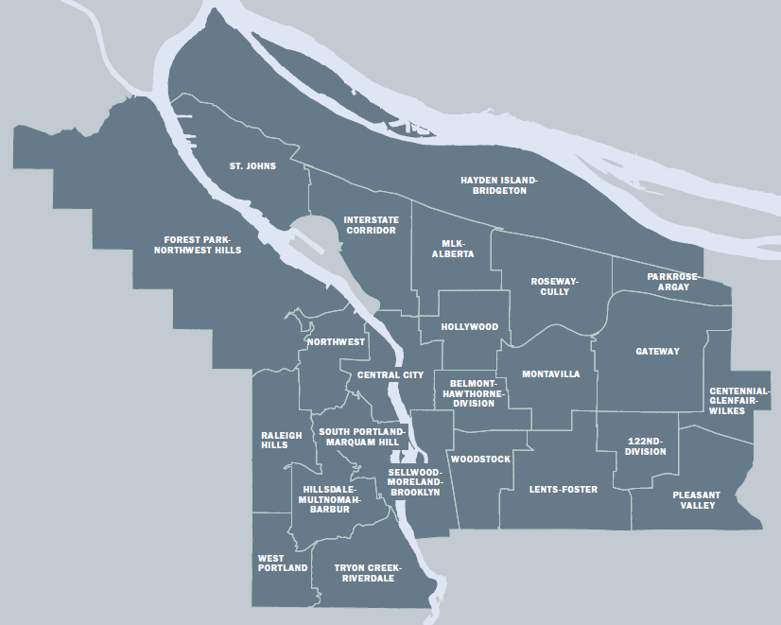
Homeownership in Portland
Market & Affordability
Median Home Price (2016): $381,108
+34% from 2011 - 2016
Homeownership Rate (2015): 52.9%
Monthly Mortgage for Household at 80% AMI: $1,247
~$250,000 home price

Slide 2
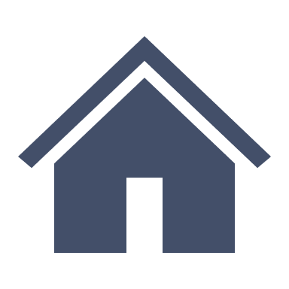
N. Carey Blvd. Property
Vision
Utilize N/NE Neighborhood Housing Strategy
Extension of community work to expand Interstate URA
Homeownership development for 50-70 households
Notes:
Community outreach to neighbors and neighborhood association to develop vision.
Less than 5% of current homes in neighborhood affordable at 80% AMI or below

