Slide 1

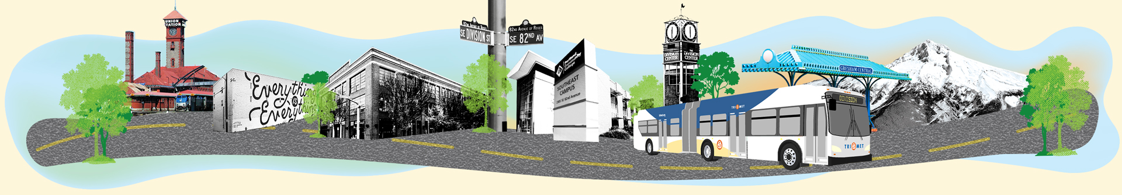
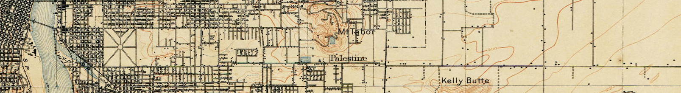
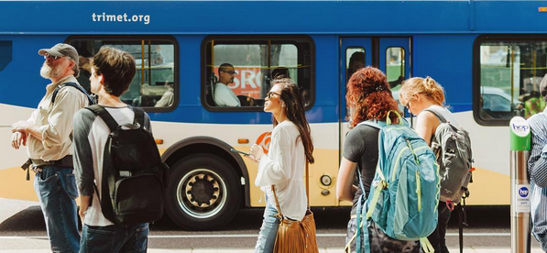

Portland City Council August 9, 2018
Teresa Boyle/April Bertelsen - PBOT

Slide 2
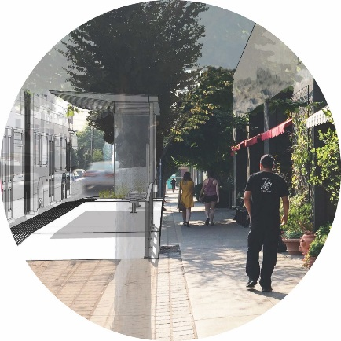

Today’s Agenda
Project Overview
Locally Preferred Alternative Conditions of Approval Status Report
Intergovernmental Agreement for funding
Notes:
Why we’re here today:
Re-affirm commitments to the LPA conditions
Provide faster, more reliable transit service with better stations.
We are helping a community to prosper and stabilize, including residents and businesses, so that they can remain, benefit from and grow with the transit project.
Affordability and Household cost bundling – How co-locating and coordinating transit and affordable housing investments can reduce cost of living for cost-burdened households.
The community asked us to take a holistic approach to address the needs of the community, not just build a transit project. This involves synchronized swimming by a team of bureaus and agencies. This project demonstrates what that looks like in action.

Slide 3
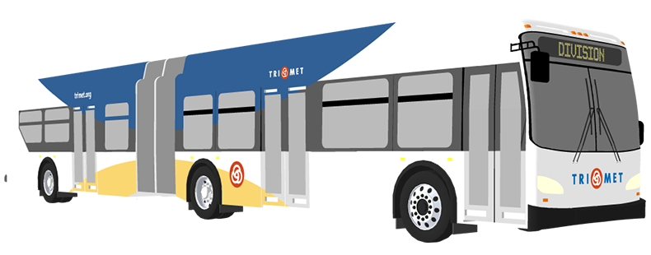
Project Overview
Better bus service - 15 miles
Replaces #4 - 10,000+ daily riders
Longer buses (60% more capacity)
3-door boarding
42 Stations (total) with weather protection
Consistently spaced stations based on demand, travel time, transit connections
Traffic signal upgrades with transit priority
Notes:
Won’t look like anything else in Portland. Our first “smart cities” transit corridor; We expect it won’t be the last.
Existing conditions: buses are crowded, full buses pass riders waiting at stops, and traffic congestion behind buses making frequent stops to pick up riders
42 stations (35 in ptld)= 69 platforms

Slide 4
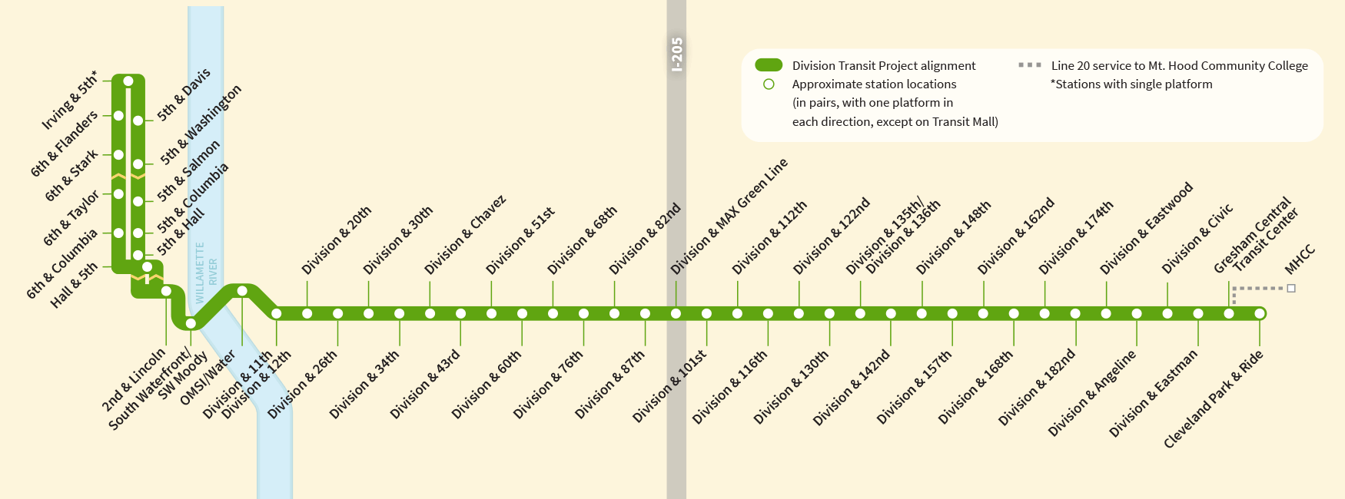
Project Overview
20 percent reduction in travel time
buses every 15 minutes; more frequent during peak
Notes:
Project will connect Downtown Portland and Gresham, traveling on SE Division Street through SE and East Portland to the Cleveland Park & Ride.
The new service will cross the Willamette River over the Tilikum Crossing, Bridge of the People, connecting the service with South Waterfront, OHSU, and PSU

Slide 5

Project Overview - Schedule
Currently at 30% design
Construction to start in late 2019
TriMet opens service in 2022
Notes:
As we complete design our ethic is
Reliability
Cost effective
Replicable in other corridors

Slide 6
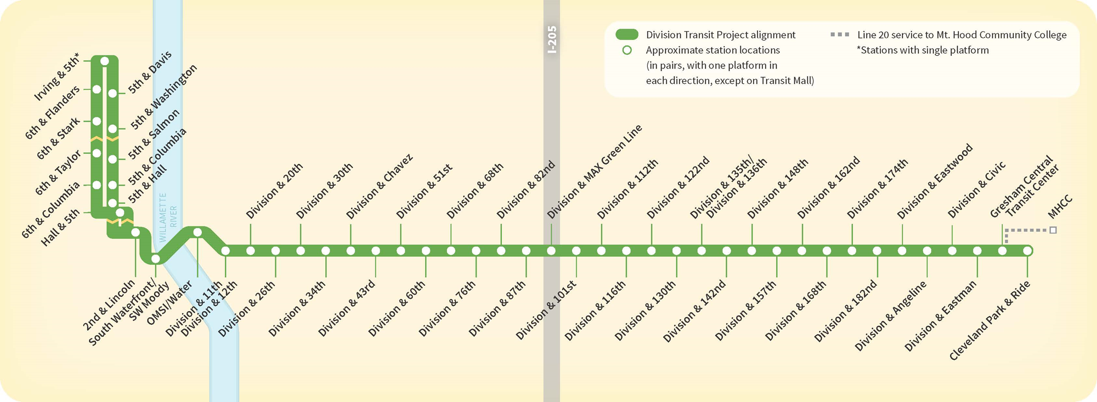

OMSI
PCC Climb Center
PCC East
Campus
Gresham
High School
PSU
Franklin
High School
Blue Line
OHSU
Green Line
David Douglas
High School
Orange Line
Notes:
15 miles, with 42 enhanced stations
Stations placed approximately 1/3 mile apart; meaning there are generally 3 stops per mile.
Each station includes 2 platforms; one eastbound, one westbound

Slide 7
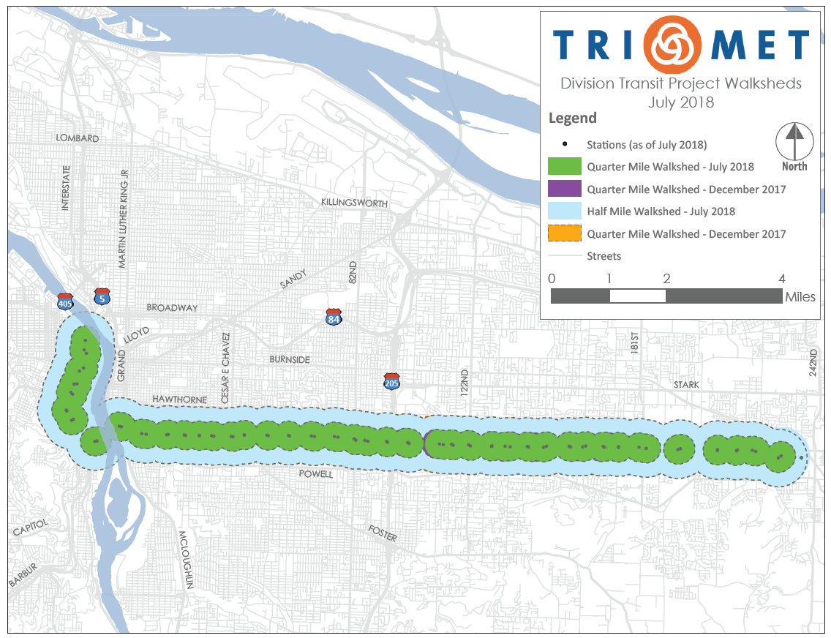
Stations
35 stations in Portland
More than 70% of transit users would have service near current stop
95% of existing riders would have service within 3 blocks of current stop
Notes:
The project has engaged an active Community Advisory Committee and held 3 sets of open houses over 18 months.
This included workshops with each of the Division project segment areas—inner and outer in Portland, and Gresham.
Project also met extensively with the Committee on Accessible Transit, and has ongoing active engagement with the city’s Bicycle Advisory committee, Pedestrian Advisory Committee and the Commission on Disability.
We listened and incorporated community feedback by refining station placement and our approach to station design., balancing access and travel time in the process.
Working with property owners, the project was able to shrink some of the station footprints to maintain access and minimize impacts.
Adding 116th station. Based on the removal of 109th from the LPA early in the project, we received community feedback about need for the station to be placed at 116th. This station was added in east Portland to provide better access to the project for people with limited mobility.

Slide 8
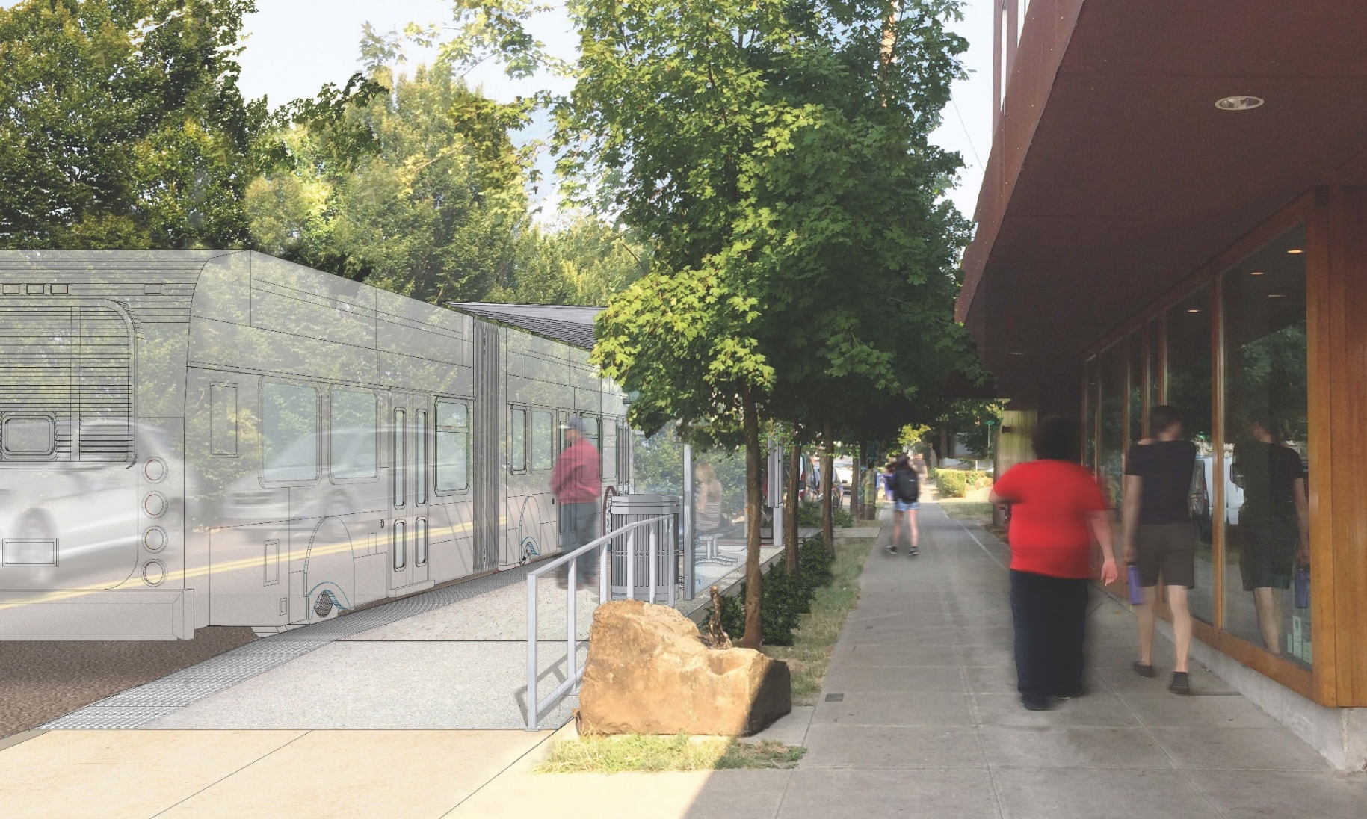
Stations and Amenities
Weather Protection
Lighting
Real-Time Information
Amenities (seating,
leaning rails,
trash receptacles,
bike racks, etc.)
Notes:
Context-based approach to station design with shelter size and the amenity package responding to individual station needs and context.

Slide 9
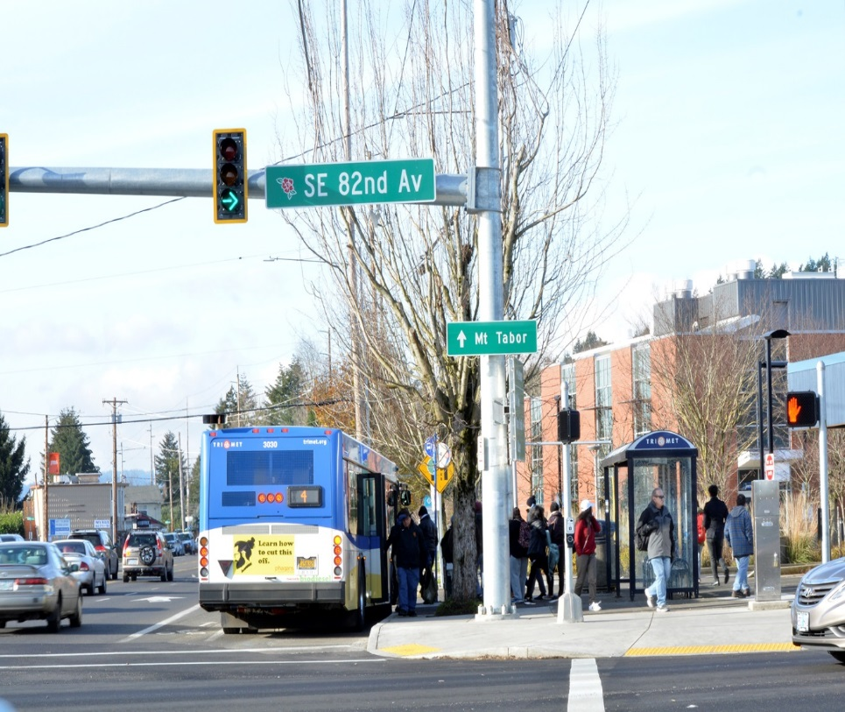
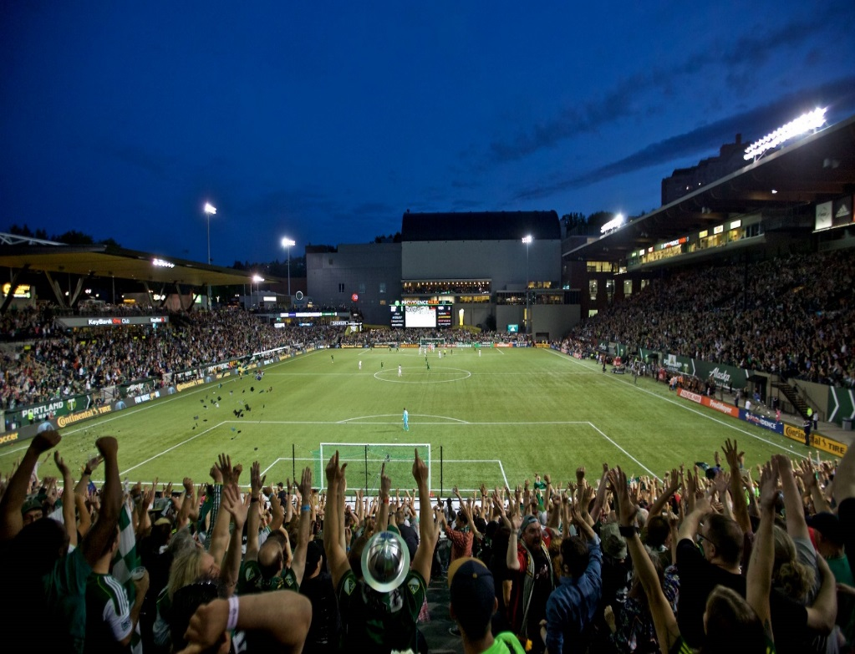
Meeting riders needs
High ridership
82nd and Division = 18,000 on/offs a week
Timbers’ soccer stadium = 20,400 capacity
New or improved sidewalks
59,000 sq ft in Portland = 25 basketball courts
Notes:
This corridor has among the highest ridership in our system, and it’s reliability is vital for TriMet and the region.

Slide 10
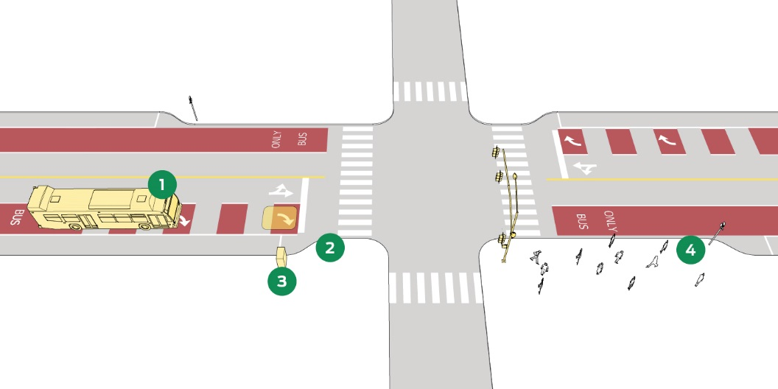
Transit Signal
Priority (TSP)
Connected signals
Connected buses
= Improved
performance
Notes:
Connected signals improves traffic flow, transit reliability, and facilitates the use of TSP
Signal priority contributes to overall transit performance
An enhanced network uses technological tools to help address congestion

Slide 11
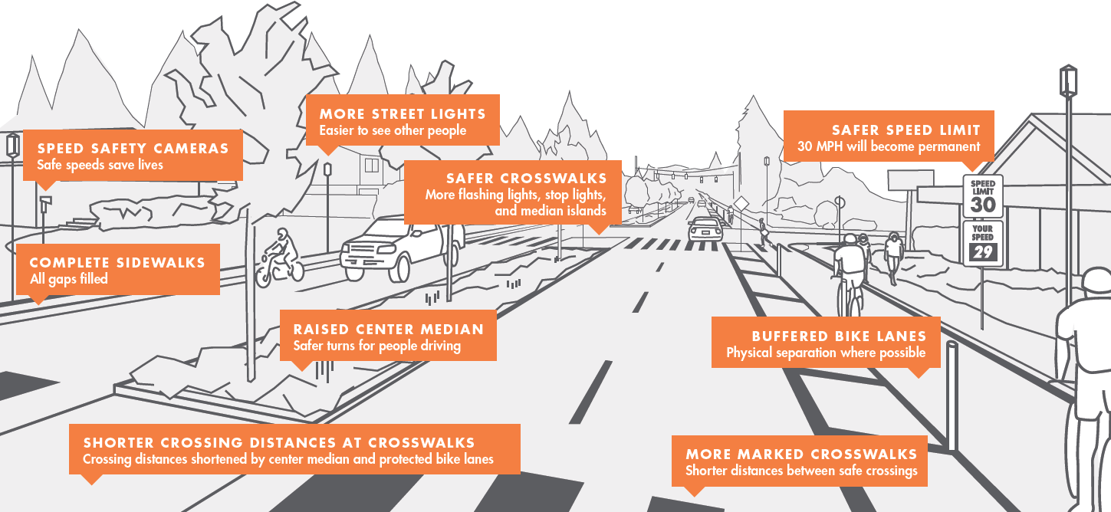
Building On Division Corridor Improvements
Notes:
DTP and Outer Division Multimodal Safety Project working together to deliver coordinated safety improvements
Elements of our project:
Protected bike lanes
Improved, safer pedestrian connections
Signalization
Traffic calming and lighting

Slide 12
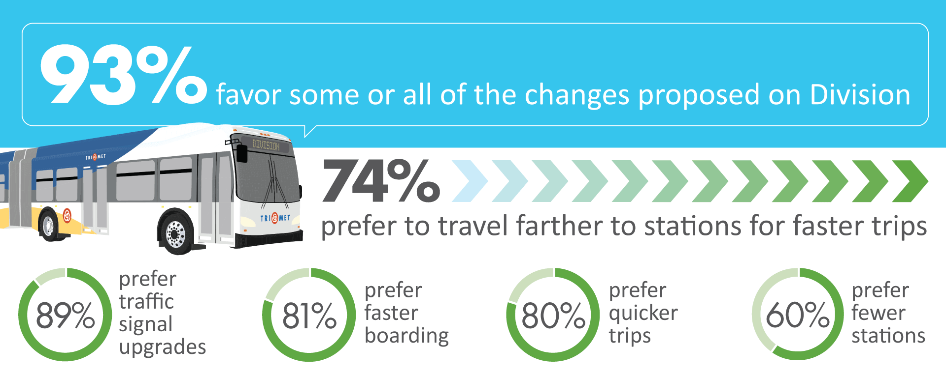
Transit Rider Support
Notes:
Survey had 3600+ respondents) and included direct outreach on Line 4 corridor, stops and buses
AND – our recent HB 2017 workshops around region consistently highlighted 3 key rider priorities:
Getting buses through traffic faster
On-street amenities
More frequency

Slide 13
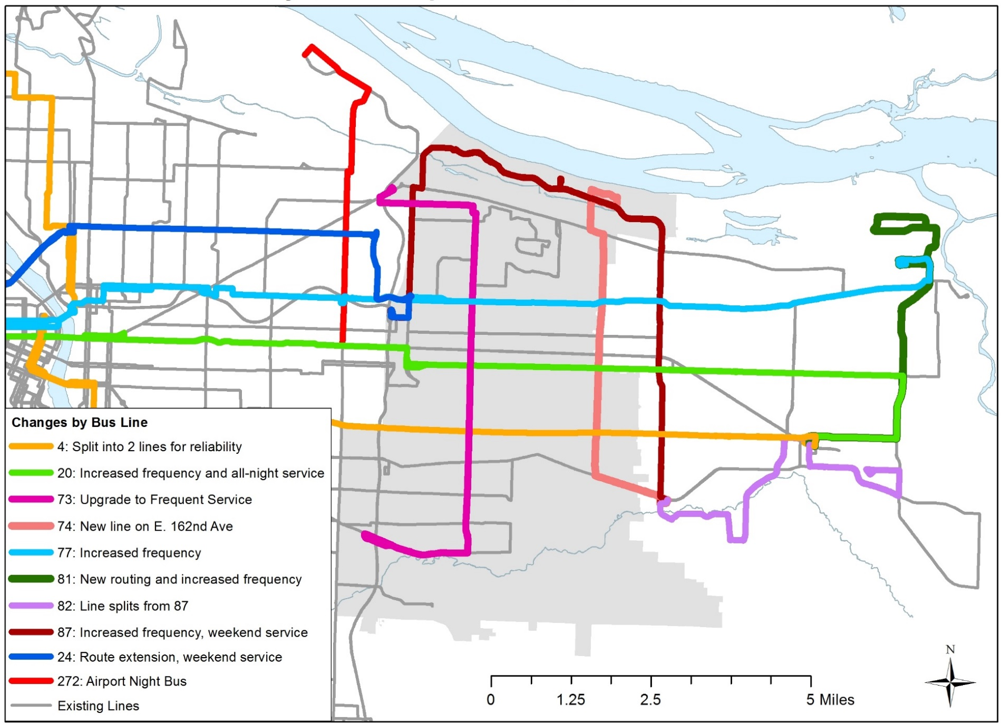
East County
Service
Improvements
FISCAL YEARS 2018–2019
Notes:
TriMet is making service improvements in advance of the Division Transit Project. They help make progress on one of the conditions of the LPA around transit service. The improvements align with the priorities we heard from community members in East Portland and East Multnomah County.
This year: new Line 74 on 162nd
Next year: Frequent Service on Line 73 on 122nd; 24-hour service on Line 20 on east Burnside/Stark
Reallocated 1,400 hours service hours from DTP will be distributed in East County
Low income fare is under way, which will benefit riders across the region

Slide 14
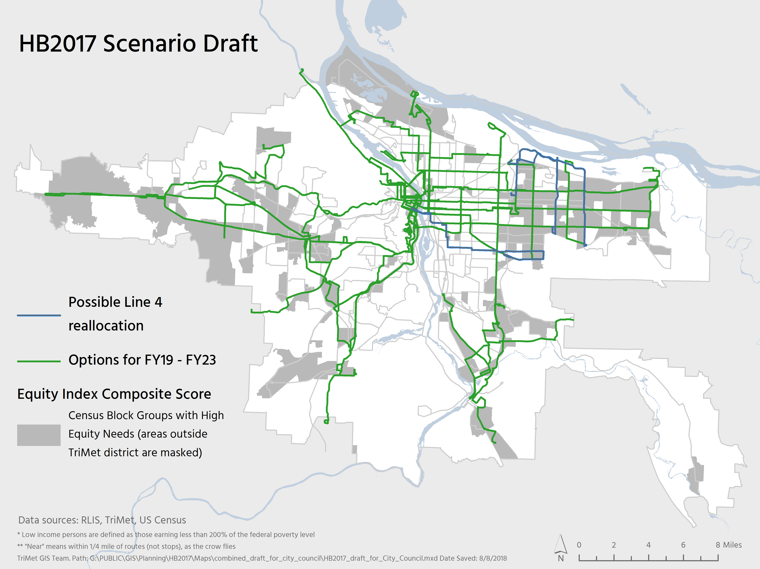

Slide 15
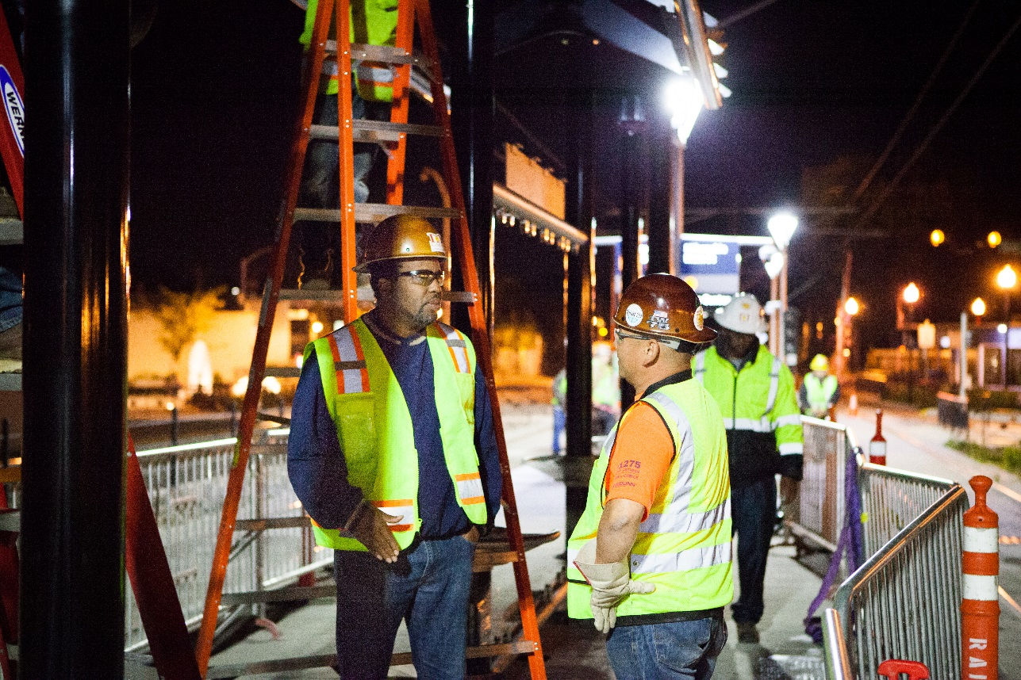
DTP General Contractor
Raimore Construction
Started as DBE on Interstate MAX project
Worked on Portland Mall,
Portland-Milwaukie, station rehab projects and for PBOT Fixing our Streets
Now the construction manager/general contractor for the Division Transit Project
Notes:
Bringing in Raimore helps fulfill one of the conditions of the LPA in regards to hiring DBE firms
And the effort continues
Bid documents will require DBE subcontracting plans, along with local supplier plans and workforce training plans.
Targeted apprenticeship outreach in the corridor

Slide 16
Locally Preferred Alternative – Status Report
Notes:
Speakers will include:
PBOT
BPS
Metro
PHB
Prosper Portland
TriMet

Slide 17
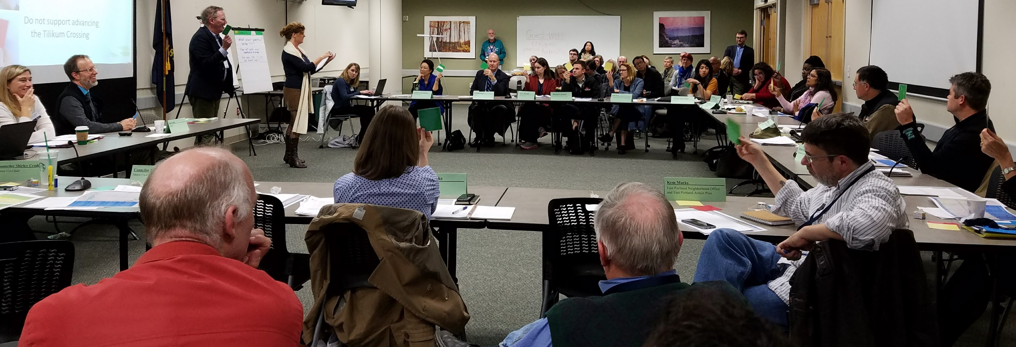
Locally Preferred Alternative (LPA) Conditions of Approval
  Adopted by City Council on December 7, 2016
  Address community stakeholder concerns to prevent displacement
  Critical to the continued support of community stakeholders

Slide 18
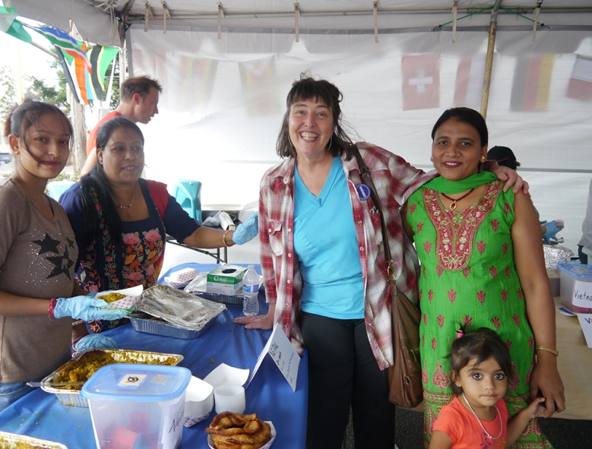
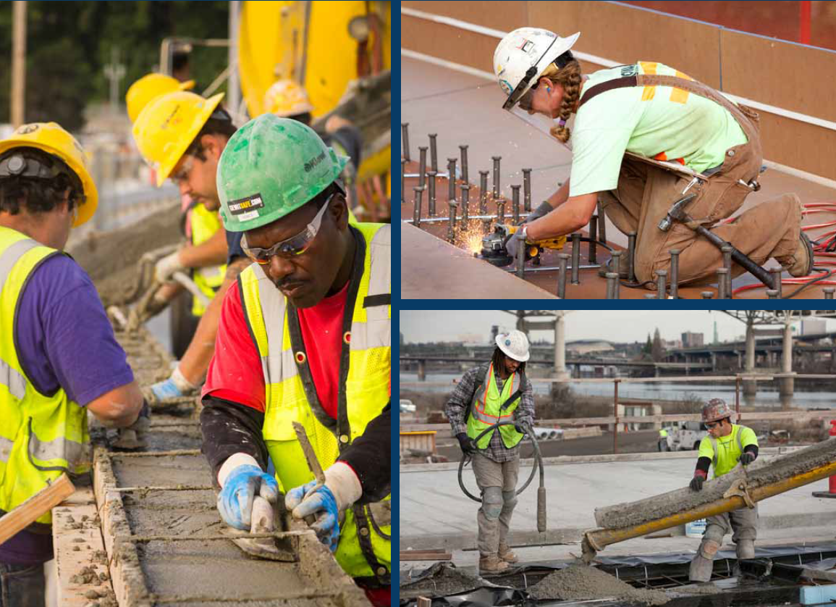
Main Categories of LPA Conditions of Approval
  Future Status Updates
  Community Engagement
  Affordable Housing Investment Strategy
  Economic Development and Business Mitigation
  Transit Service Enhancements
Notes:
5 main categories of conditions listed on slide.
The community asked us to take a holistic approach to address the needs of the community, not just build a transit project.
We are helping the existing community to prosper and stabilize, including residents and businesses, so that they can remain, benefit from and grow with the transit project.
This involves ‘synchronized swimming’ by a team of bureaus and agencies. This project demonstrates what that looks like in action.

Slide 19
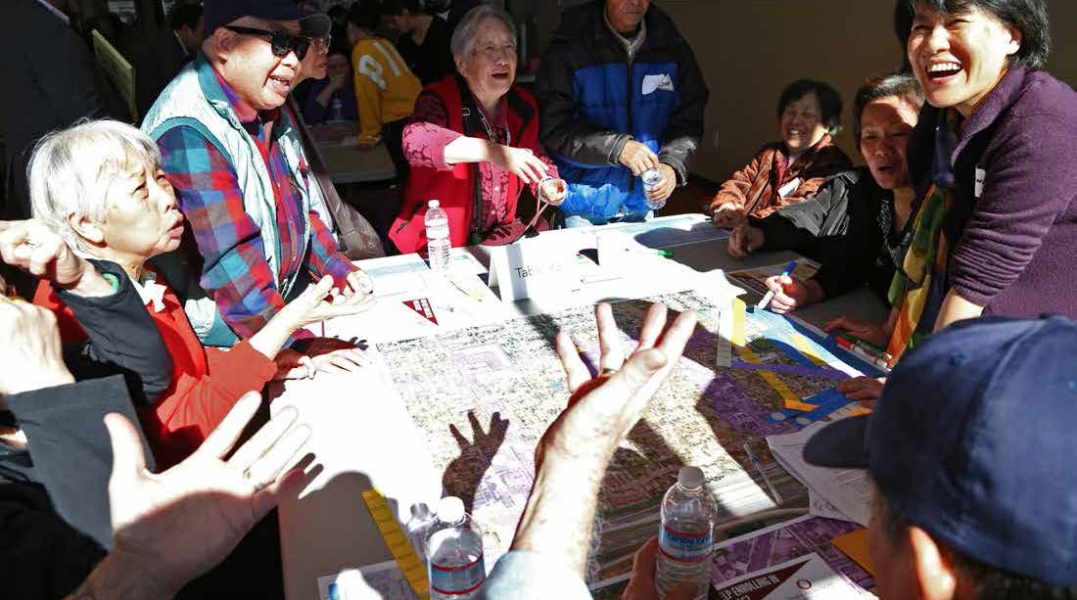
Origin of the LPA Conditions of Approval
  Powell-Division Transit and Development Project: Goals & Outcomes & Corridor-wide Strategy
  Portland Local Action Plan
  Portland 2035 Comprehensive Plan
Notes:
This could be a PBOT slide and BPS slide.
Adopted by the Steering Committee on June 23, 2014
PROJECT OUTCOMES
The Powell-Division Transit and Development Project will result in an actionable plan for key places
(future station areas) and improved mobility to address long-standing infrastructure and
investment issues along Powell-Division. The action plan will strive to:
1) Create a vision and development strategy for key places that promotes community-driven and
supported economic development and identifies tools and strategies that mitigate the impacts of
market pressures that cause involuntary displacement.
2) Identify a preferred near-term high capacity transit solution for the corridor that safely and
efficiently serves high ridership demand, improves access to transit, is coordinated with related
transportation investments, and recognizes limited capital and operational funding. The solution
will include mode, alignment and station locations with supporting transportation improvements.
PROJECT GOALS
Transportation: People have safe and convenient transportation options − including efficient and
frequent high capacity transit service that enhances current local transit service − that get them
where they want to go and improves the existing system.
Well-being: Future development and transit improvements create safe, healthy neighborhoods
and improve access to social, educational, environmental and economic opportunities.
Equity: Future development and transit improvements reduce existing disparities, benefit current
residents and businesses and enhance our diverse neighborhoods. There is a commitment to
prevent market-driven involuntary displacement of residents and businesses and to equitably
distribute the benefits and burdens of change.
Efficiency: A high capacity transit project is efficiently implemented and operated.

Slide 20
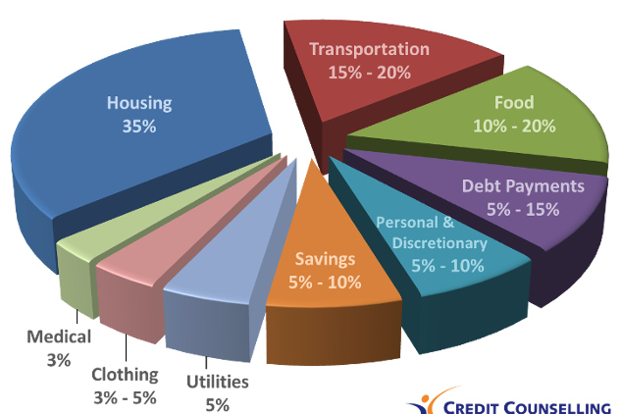
PORTLAND BUREAU OF TRANSPORTATION
Affordability and Household Cost of Living
Co-locating and coordinating transit and affordable housing investments can reduce cost of living for cost-burdened households.
Combined Household and Transportation costs range from 25% to 105% in the Portland metropolitan area.
Notes:
Affordability and Household cost bundling
Housing and transportation are typically a household’s 1st and 2nd largest expense.
The ideal combined cost for housing and transportation is 50% of household income.
For Portland metropolitan area, the combined cost ranges from 25% to 105% for the most cost-burdened households. The average is 52%.
The costs of owning and relying on automobiles, can add up to $12,213 for the average household.
Co-locating and coordinating transit and affordable housing investments can reduce cost of living for cost-burdened households.

Slide 21
PORTLAND BUREAU OF TRANSPORTATION
East Portland Funded Projects
Over $255 million allocated to East Portland in Motion (EPIM) and related projects, by PBOT and our agency partners.
Over $270 million when adding various paving projects.
Notes:
This doesn’t include funding for the Division Transit Project
This includes $130 M for Outer Powell
This includes newly funded projects, in 2018 (indicated in black on the map below):
PBOT allocated $15 M of additional TSDCs towards unfunded EPIM projects, with $5 M more in match leverage ($20 M total). We continue to seek more leverage funds.
Outer Stark funding from Build Portland, bringing the total to $20 M.
Lents Town Center, Phase 2 from Build Portland, $7 M.
Division Multi-modal Safety project, additional $2 M.
162nd Ave, $1 M
More in the works. Project Development funded for the following:
Connected Division-Midway
148th Ave Safety and Access to Transit
122nd Ave Safety, Access and Tranist

Slide 22
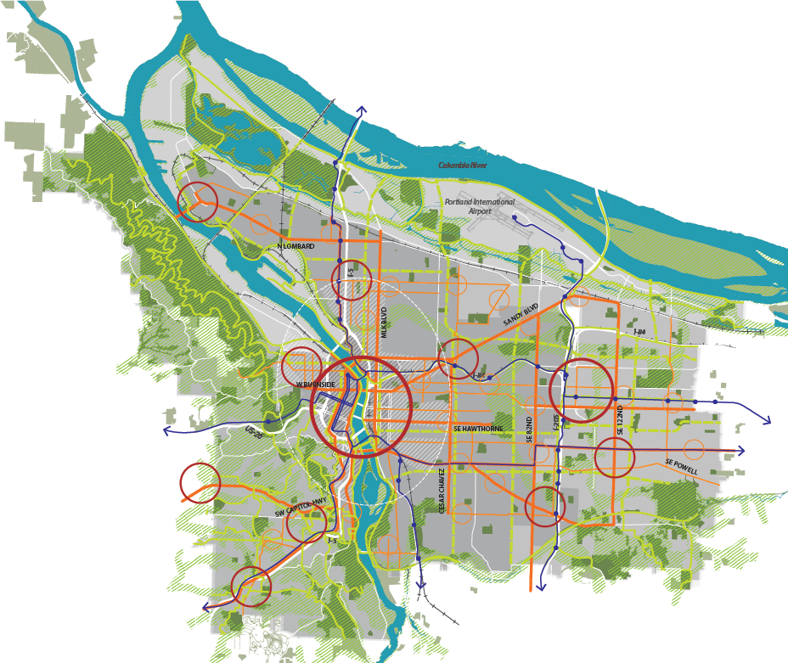
BUREAU OF PLANNING & SUSTAINABILITY
Notes:
Placeholder slide. Need to remove box around 82nd Ave.

Slide 23
BUREAU OF PLANNING & SUSTAINABILITY
Helping implement Portland 2035 Comprehensive Plan
Powell-Division Local Action Plan
Building Healthy Connected Communities
Start of an East Portland strategy

Slide 24
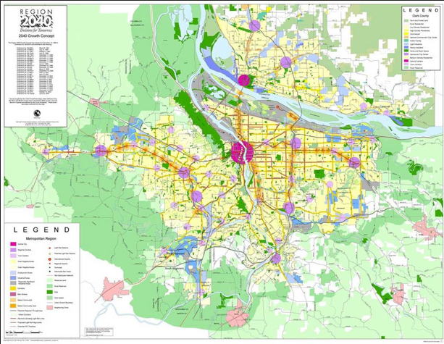
2040 Growth Concept
Notes:
MALU
This map is familiar to all of us
A lot of technical work went into developing our long term vision
The blueprint is still good – but we are halfway to 2040

Slide 25
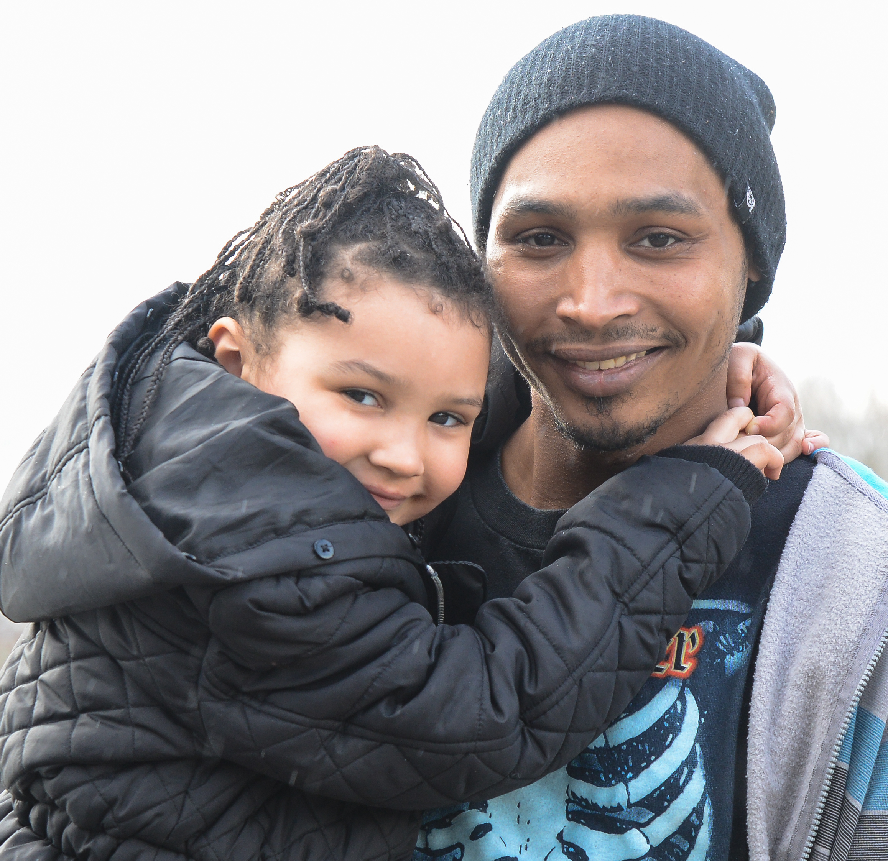
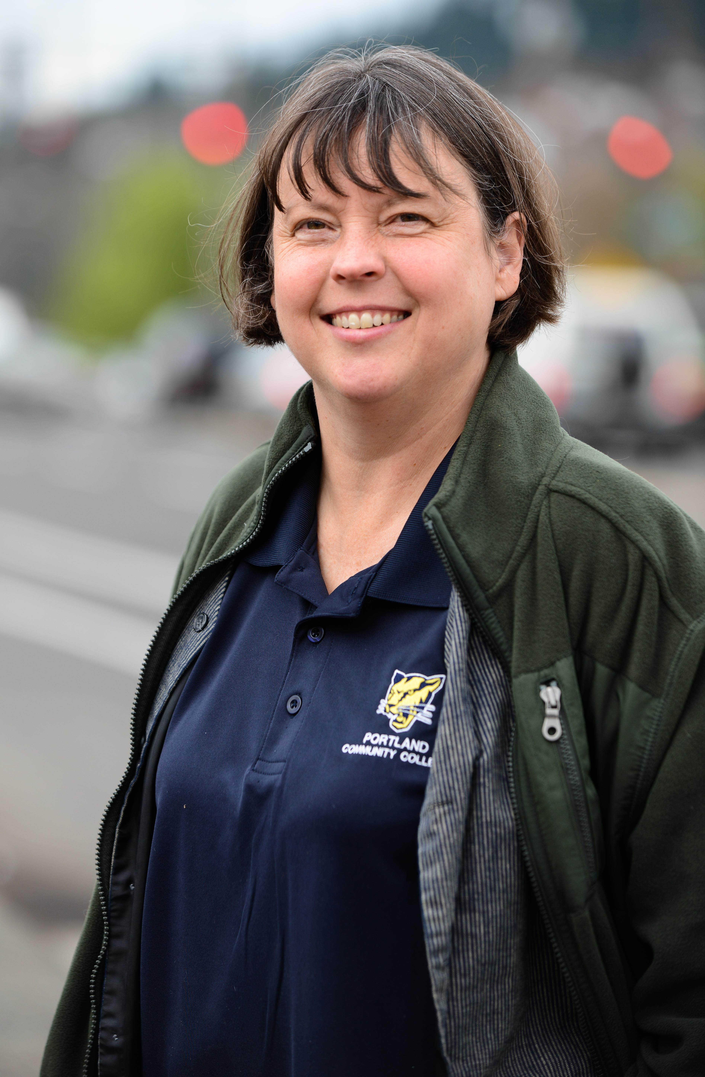
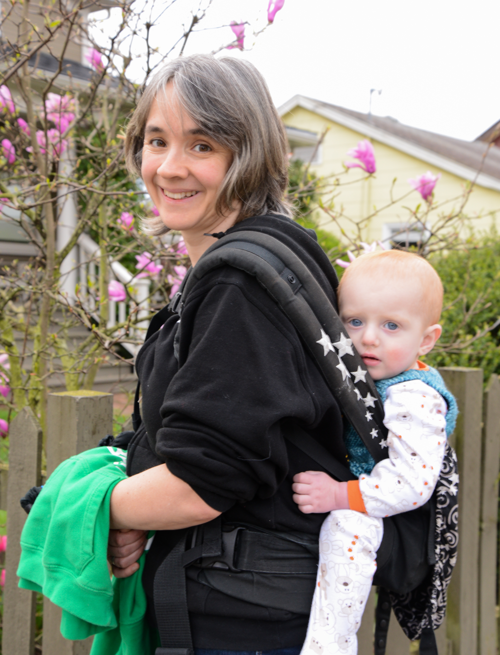
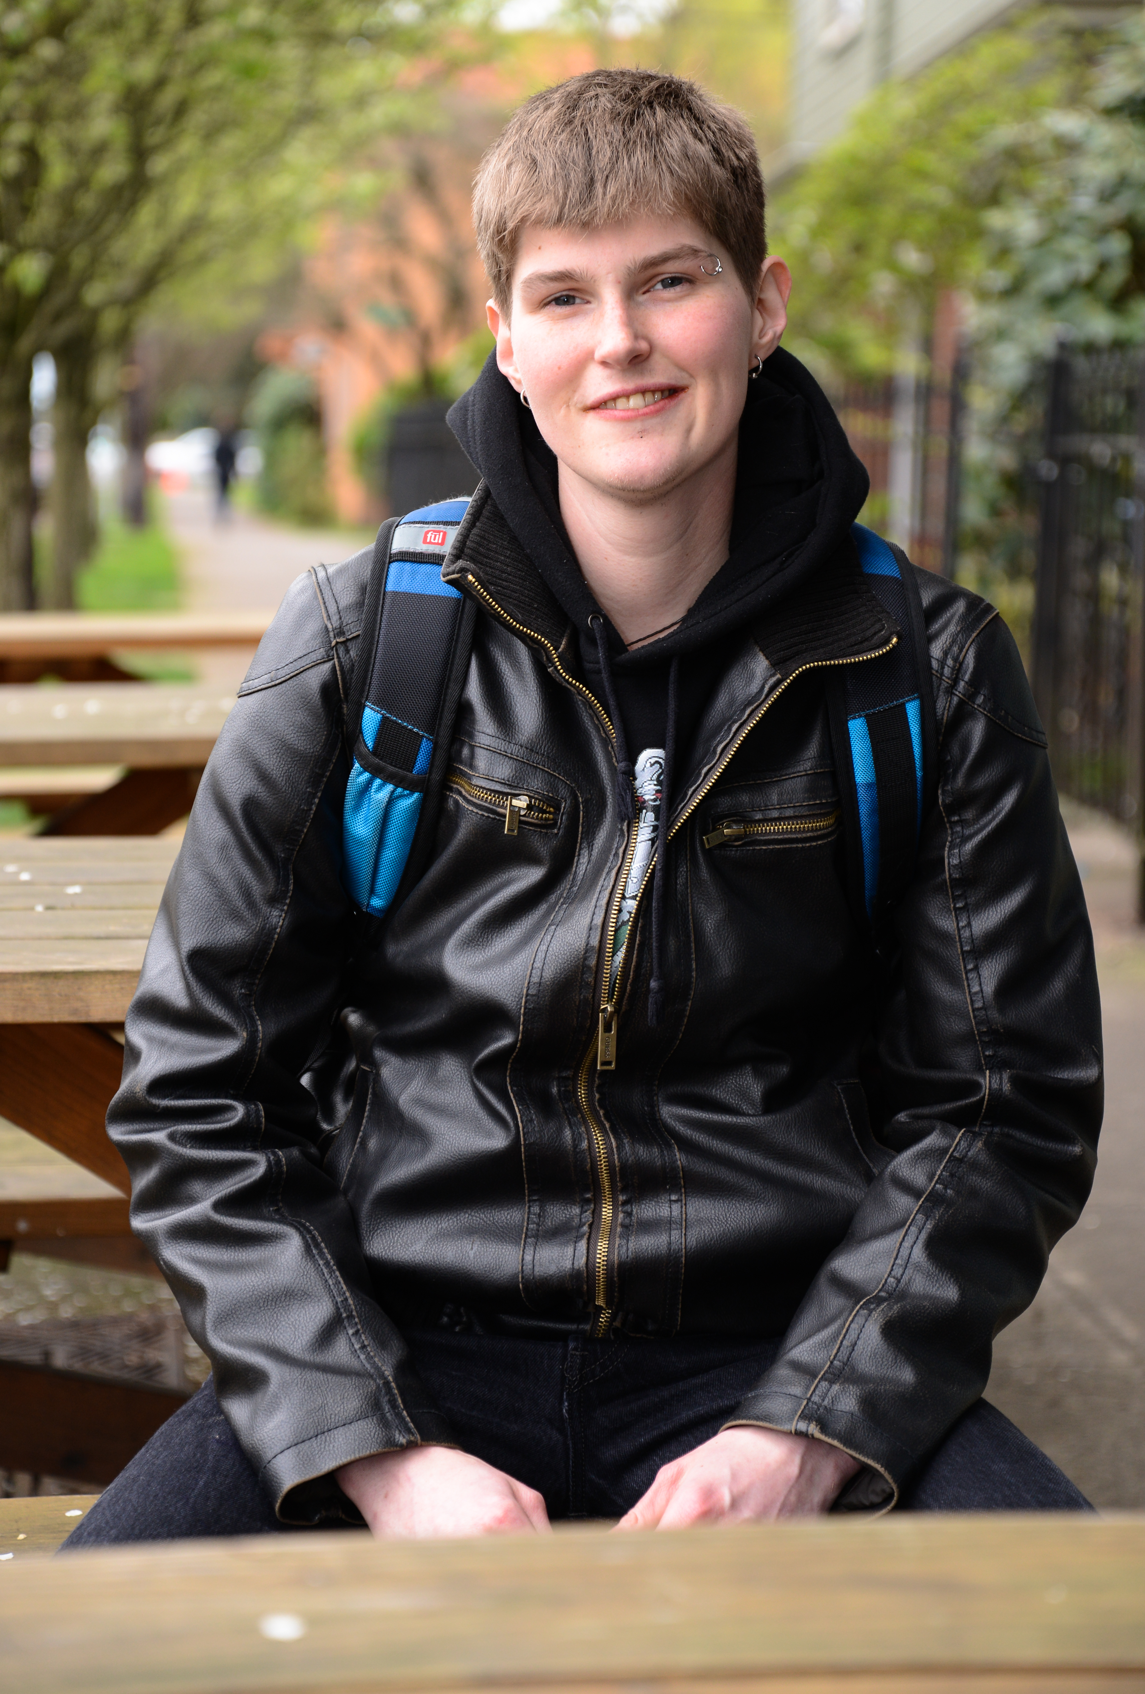
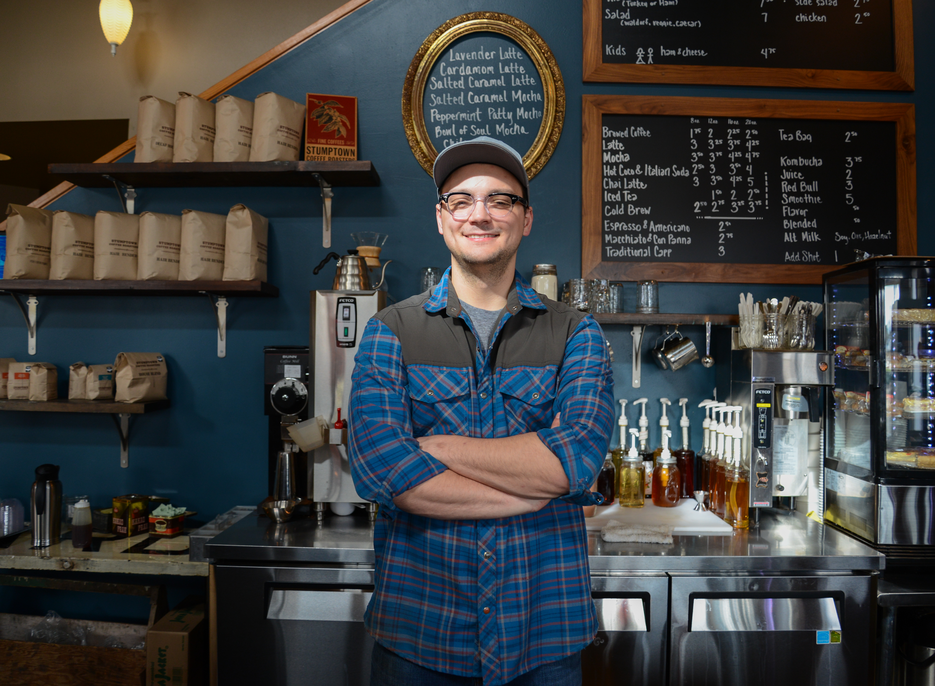
People
Notes:
We know that we are not planning to create the best maps or well written documents
We are planning for the people across the region, many of whom do not know that Metro or JPACT exists, most do not get themselves involved in local politics
They all care about how the place they choose to live allows them to do what they care about – whether it is working, playing, going to school, being a parent, taking care of a parent

Slide 26
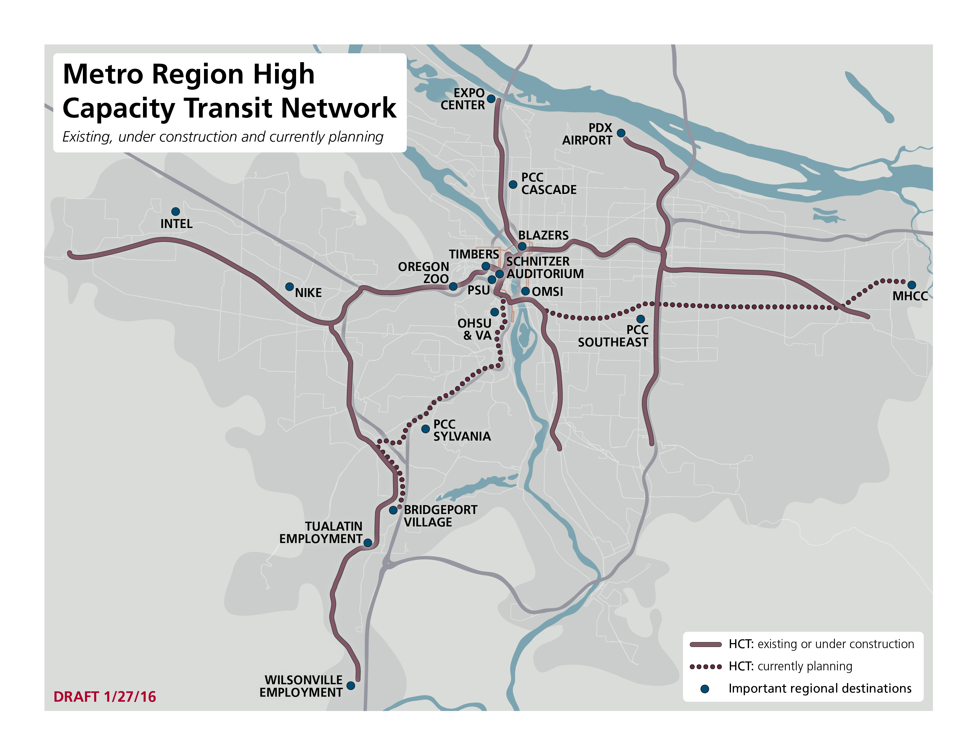
Notes:
People don’t care what city or county they live or work in when it comes to where they want to go
This map shows places – not cities – on the region’s high capacity transit network
Connecting people top the places they want to go and putting the tools, strategies and investments in place that make those places great is what we are aiming to do

Slide 27
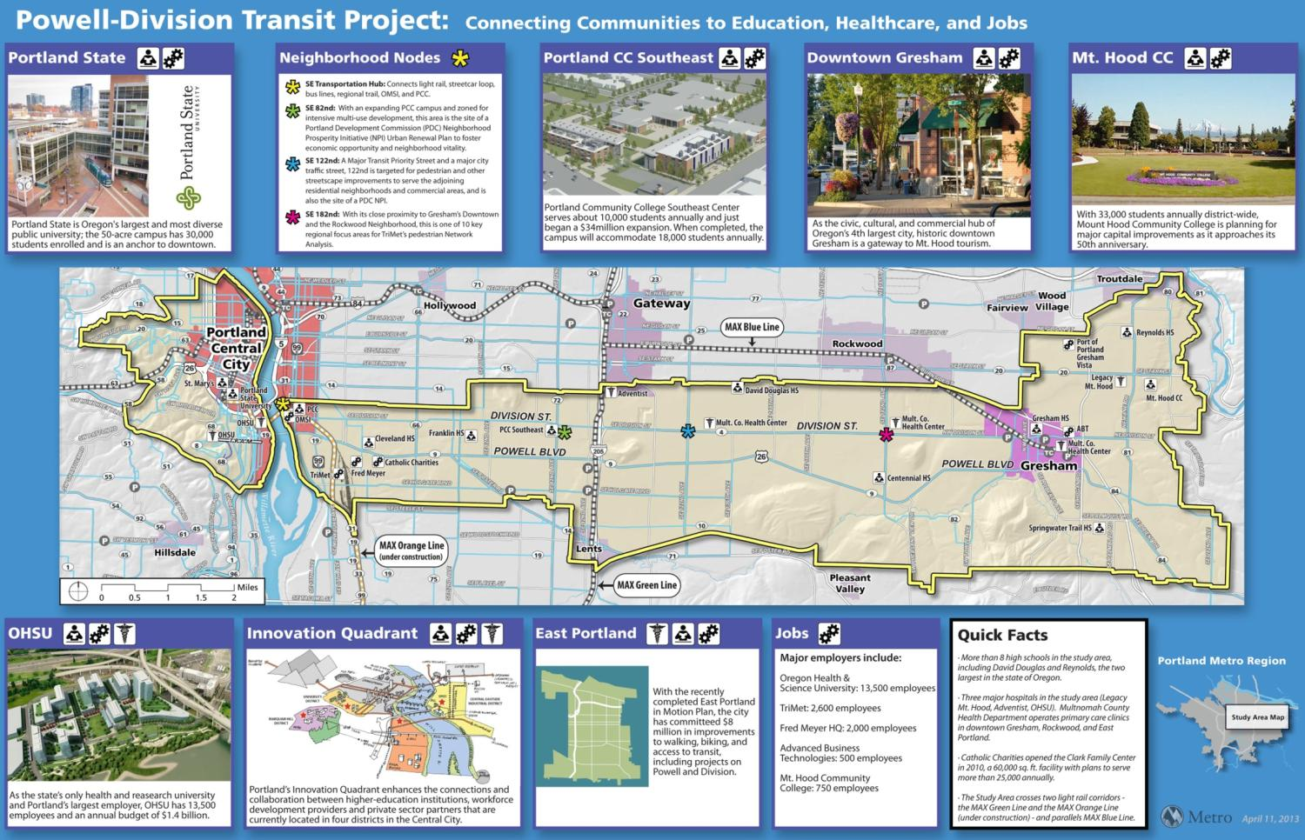
Powell-Division Transit and Development Project Overview
Notes:
Those lessons come together and allow us to continue to build on our tradition of innovation in planning and transportation in the Powell Division Corridor.
In this corridor we have brought in new public agency partners– community colleges, school districts,
But also have brought in community members in a new way– not just for input and engagement, but as part of decisions and governance

Slide 28
Project Outcomes and Goals
Goals:
Transportation
Well-being
Equity
Efficiency
Notes:
The LPA Conditions of Approval help the project meet the outcomes and goals adopted by the Steering Committee during the planning phase.
The goals are focused on transportation, well-being, Equity and Efficiency. They extend beyond building a transit project.
Adopted by the Steering Committee on June 23, 2014
PROJECT OUTCOMES
The Powell-Division Transit and Development Project will result in an actionable plan for key places
(future station areas) and improved mobility to address long-standing infrastructure and
investment issues along Powell-Division. The action plan will strive to:
1) Create a vision and development strategy for key places that promotes community-driven and
supported economic development and identifies tools and strategies that mitigate the impacts of
market pressures that cause involuntary displacement.
2) Identify a preferred near-term high capacity transit solution for the corridor that safely and
efficiently serves high ridership demand, improves access to transit, is coordinated with related
transportation investments, and recognizes limited capital and operational funding. The solution
will include mode, alignment and station locations with supporting transportation improvements.
PROJECT GOALS
Transportation: People have safe and convenient transportation options − including efficient and
frequent high capacity transit service that enhances current local transit service − that get them
where they want to go and improves the existing system.
Well-being: Future development and transit improvements create safe, healthy neighborhoods
and improve access to social, educational, environmental and economic opportunities.
Equity: Future development and transit improvements reduce existing disparities, benefit current
residents and businesses and enhance our diverse neighborhoods. There is a commitment to
prevent market-driven involuntary displacement of residents and businesses and to equitably
distribute the benefits and burdens of change.
Efficiency: A high capacity transit project is efficiently implemented and operated.

Slide 29
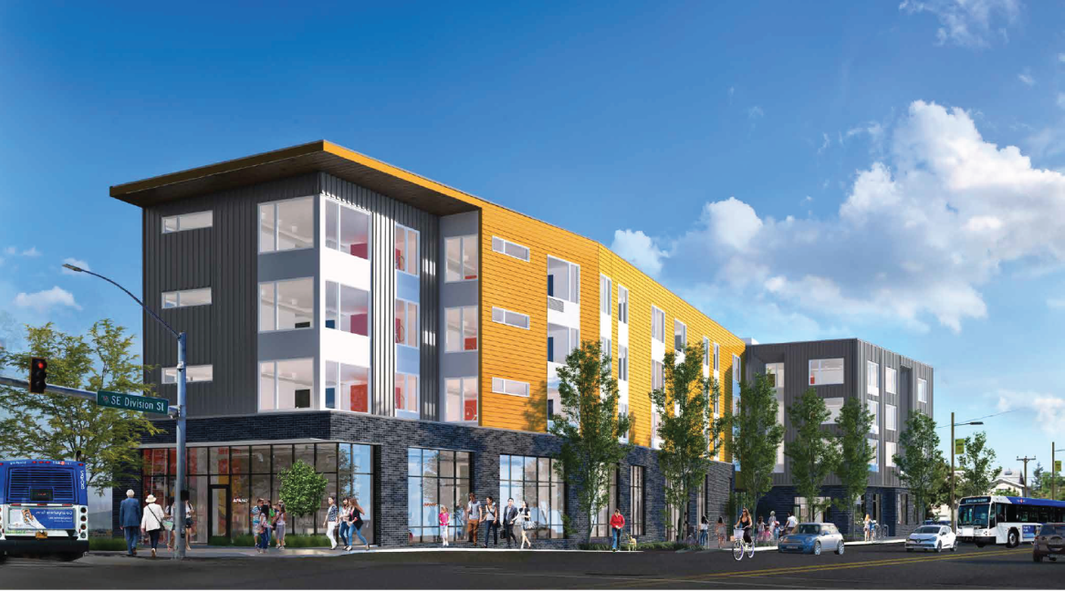
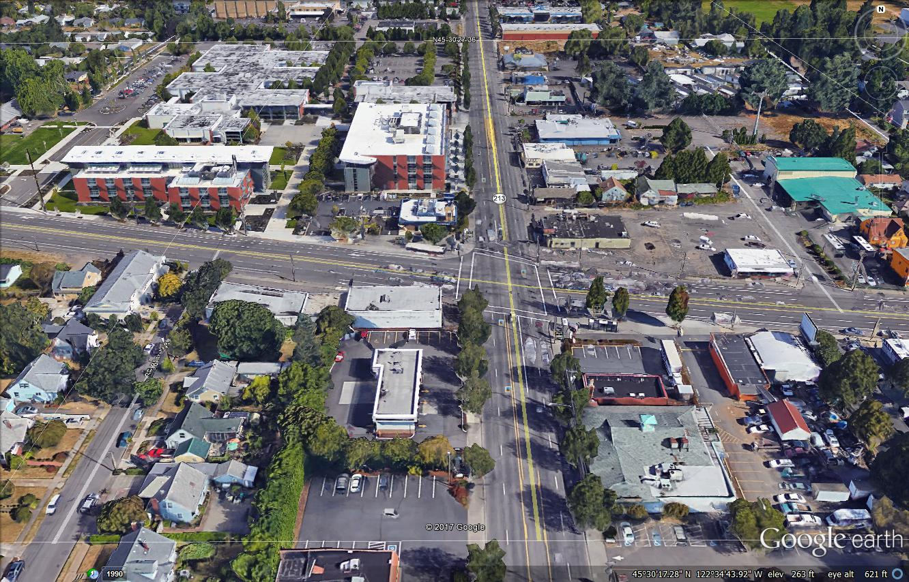
Jade Apartments Update
48 unit affordable housing project with rents affordable at 30% to 60% of area median income
4,800 square foot headquarters for APANO with event space
PCC Southeast Campus
#4 Division Street (FUTURE BRT)
Former Hung Far Lo- (Future Redevelopment)
Furniture Store Site
#72 – 82nd Avenue
Single Family Homes

Slide 30

Regional housing bond:
Overview of draft framework
$652.8 million general obligation bond
As many as 3,900 homes & 12,000 people
Building, buying homes and land for homes
Most investments through local partners
Emphasis on very-low-income and family-size units, opportunity throughout region, racial equity
Council referred to voters in June
More info & survey: oregonmetro.gov/housing
Notes:
Late last year, the Metro Council directed staff to work with partners and stakeholders around the region to develop a regional investment measure that could help address one of the region’s biggest shared challenges: Helping families, seniors, people with disabilities, communities of color and other vulnerable members of our community find stable, affordable homes – and all the opportunity it brings.
For the last several months, staff have worked closely with technical and stakeholder advisory tables representing many perspectives; listened to input from local jurisdictions, housing providers and elected leaders; funded community partner engagement; and conducted detailed technical analysis to create a framework of what we can accomplish together for these members of our community.
In late April staff released a draft framework with a hopeful vision: For an average cost to homeowners of less than $50 per year, we could create affordable homes for as many as 10,000 people. The framework envisions making investments primarily through local partners to build new homes, and buy and renovate existing housing that’s affordable but vulnerable to rent increases.
Metro would also reserve about 10% of the bond for a regional program to buy land for affordable housing near transit, as our existing TOD program already does.
The framework proposes an emphasis on very low income people, with 45% of units reserved for people making less than 30% AMI – that’s people on fixed incomes, seniors, people with disabilities. The framework also emphasizes family size units with half of the units targeted to be 2 bedrooms or larger.
In terms of where to invest, the framework proposes focusing both on creating housing in areas where there are significant communities of color and other vulnerable populations today, and also creating new housing opportunity in neighborhoods where housing opportunity has historically been limited. It includes a distribution approach that spreads homes all over the region’s three counties.
Racial equity is a core driving value for the measure, and has been a consistent priority voiced by partners
The framework is now being presented and discussed at the advisory tables, local partners and other interested stakeholders around the region. Metro also has a survey available for general public feedback.
A final recommendation to the Metro Council is expected in late May, with a council referral decision expected on June 7
Link for more info on the framework and a link to the survey there as well.

Slide 31
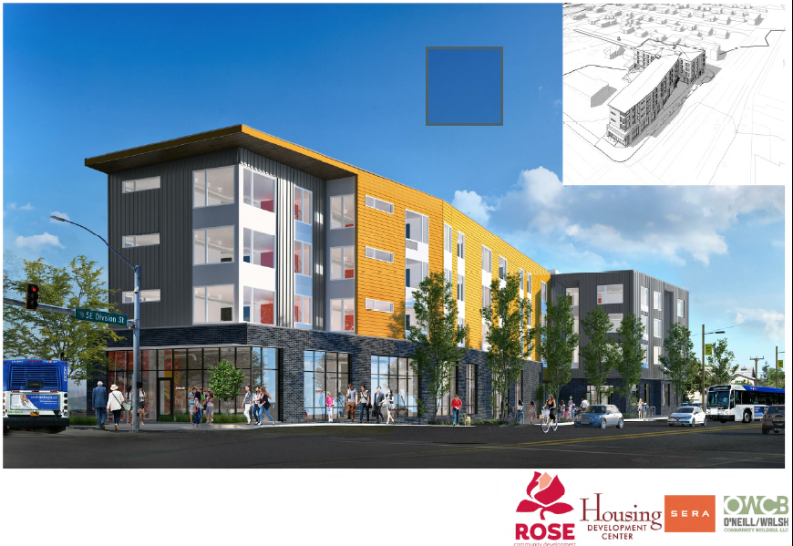
The Jade
2718 SE 82nd Avenue
Owner
Rose-Jade Housing L.P.
Developer
Rose CDC
Commercial Tenant
APANO
PHB funding = $1,857,307
+
9% LIHTC
+
Metro TOD land

Slide 32
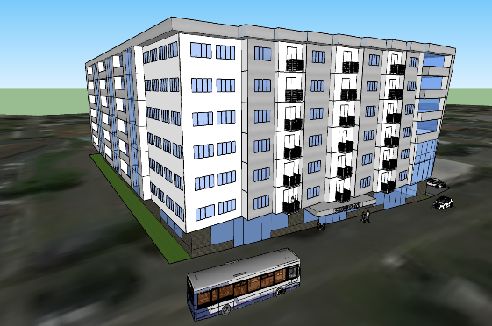
Portland Housing Bond
3000 SE Powell Blvd
October 2018: Architect contract signed, begin design work
November 2018: Community Design Charette
November 2018: CM/CG RFP issued
Fall 2019: Construction begins
Conceptual rendering

Slide 33
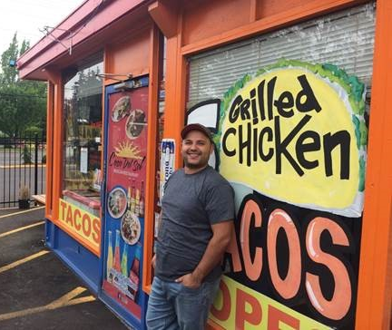
PROSPER PORTLAND
Workforce navigation and development services
Business Technical Assistance
Fall BMP add package: Division St. Business and Community Support

Slide 34
DTP – Intergovernmental Agreement - Local Match

Slide 35
City Local Match
$175M total budget
City of Portland $17.73M – in Transportation SDC revenue
Two installments:
  Start of construction (Oct 2019)
  1 year later
 | Historical Average | DTP
Total Federal | 58.6% | 50%
Total Local | 41.4% | 50%
Local breakdown:
State of Oregon | 11% | 0%
Regional Flex funds | 3% | 16%
Bonds/regional flex funds | 9% | 4%
Cities, Counties | 6% | 11%
Port, Metro | 2% | 1%
Private Contributions | 1% | 0%
TriMet | 8% | 19%
Property donations (not private) | 1% | 0%
 | 41% | 50%
Notes:
TERESA -
Standard process to have local match + federal dollars.
City has traditionally always participated in this way.
For this project, local match is from multiple sources (not just Portland)
TSDC funds for entire COP portion – payable contingent on CGA (50%) and then 1 year after (remaining 50%)

Slide 36
Project Finance Revenues
Project Finance Revenues
Federal Transit Administration Small Starts Grant | $87,341,000
ODOT | $600,000
Metro | $1,240,000
TriMet | $33,850,000
Portland - Construction | $16,730,000
Project Finance Revenues | $6,242,335
Regional Funds | $26,500,000
In Kind (Portland, Gresham, ODOT, Metro) | $2,200,000
Total Revenues | $174,703,335
Portland contribution | $17,730,000
TriMet contribution | $34,570,000
Notes:
You can see from this rundown of project contributions how important the project is for TriMet.

Slide 37
Value Received
Priority Portland elements:
  Protected bike lanes east of 82nd
  Enhanced pedestrian crossings
  Traffic signal upgrades
  Fiber communications for “smart city” transit priority
  Concrete bus pads
Notes:
TERESA - Innovation Quadrant link
Serves length of Mall

Slide 38
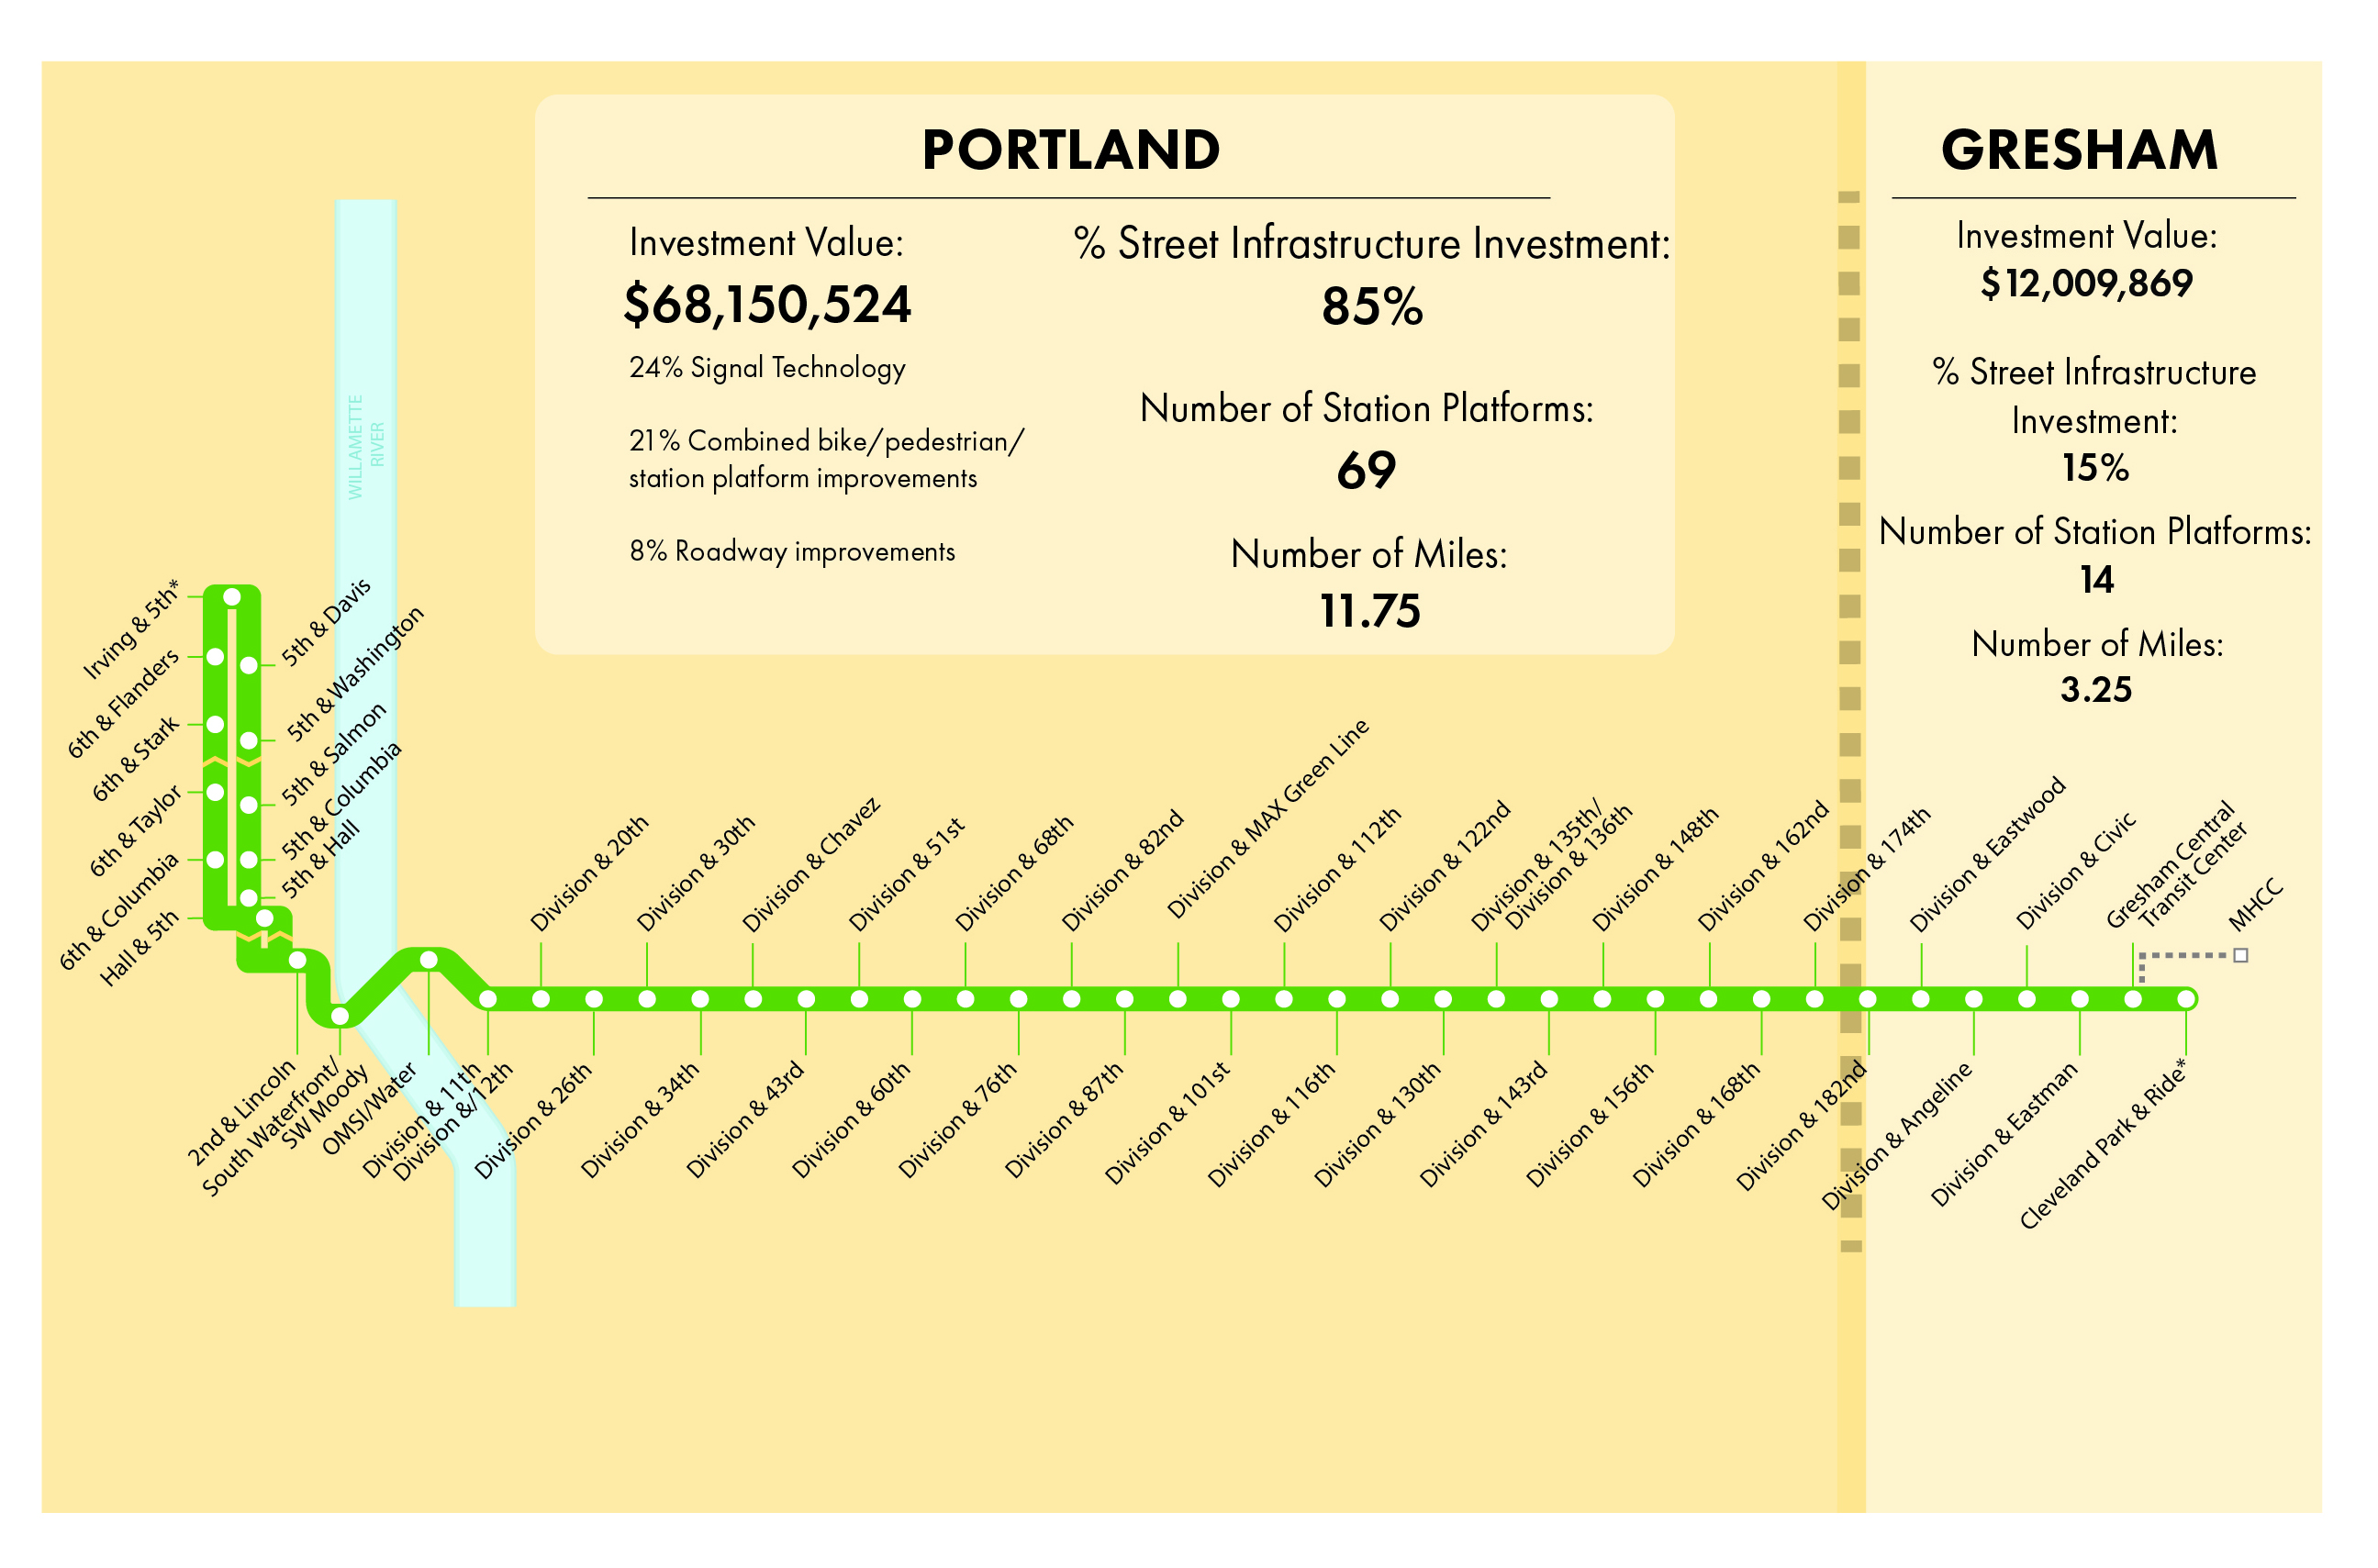
Notes:
Includes: Construction costs (Stations/Sitework/Traffic Systems) and Right-of-Way costs, including the associated contingency markups (allocated & unallocated) and escalation markups.
Excludes: Powell Garage, Cleveland Park & Ride and Cleveland Breakroom funding contributions, as well as Vehicles, Professional Services, and Financing costs.

Slide 39
Questions?

