Slide 1
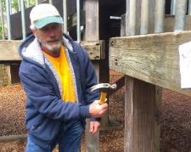
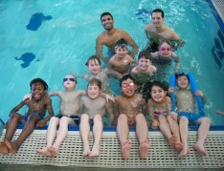
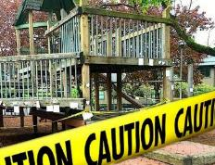
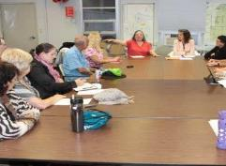

PARKS REPLACEMENT BOND
Annual Report
2017-2018
Wednesday – August 8, 2018
Commissioner Amanda Fritz | Interim Director Kia Selley
Notes:
Hello Mayor Wheeler and members of Council!
My name is Lauren McGuire, Asset & Development Division Manager for Portland Parks & Recreation. With me to day is Robin Laughlin, Bond Team Lead.
We are here today to thank the voters who supported the Parks Replacement Bond in 2014 and to present the Third Parks Replacement Bond Annual Report.
The purpose of this report is to summarize and share with you and the public the current status and challenges of the third year of this Parks Replacement Bond Program.

Slide 2
Bond Report Year 3
  BACKGROUND BOND YEAR 3
  PERFORMANCE
    Program Overview
    Scope
    Schedule
    Budget
  INVESTMENTS
  TRANSPARENCY
2014 Parks Replacement Bond $68 million for repairs and replacements
Notes:
On November 4, 2014, 74% of Portland voters approved Measure 26-159, the Parks Replacement Bond, which provides $68 million in funds for urgent repairs in parks, community centers, and facilities throughout the city. Portland Parks & Recreation’s Bond Program has completed its third year, a busy year summarized in this Year 3 report.
Today we will:
Provide a bit of background context for the Parks Replacement Bond
Discuss performance, report on the Bond projects’ scopes, schedules and budgets.
Review the investments that have been made to date and are projecting to make, and
Conclude with the program’s transparency efforts and public input processes

Slide 3
Background Year 3
  PROJECT DELIVERY
Notes:
The Bond Program is implementing 52 projects in two phases. In Phase 1, PP&R allocated $47.9 million of the $68 million Bond to 34 projects across the city. In Year 2 of the Bond, with input from the community, the Project Team developed the phase 2 project list to spend the remaining Bond funds on an additional 18 projects.
The first two years of the Bond firmly established the foundational structure for the Bond Program by establishing standards, implementing Phase 1 projects, and developing the Phase 2 list.
In Year 3, we focused primarily on project delivery as the Bond Team continued to carefully manage project scopes, schedules and budgets.
The program remained consistent with the Bond language throughout the year, with project work focused on the seven established themes of:
Playground replacement and repair
Trails & Bridges,
Pools
Protecting Workers
Pioneer Courthouse Square
Accessibility, and
Restrooms & other urgent repairs

Slide 4
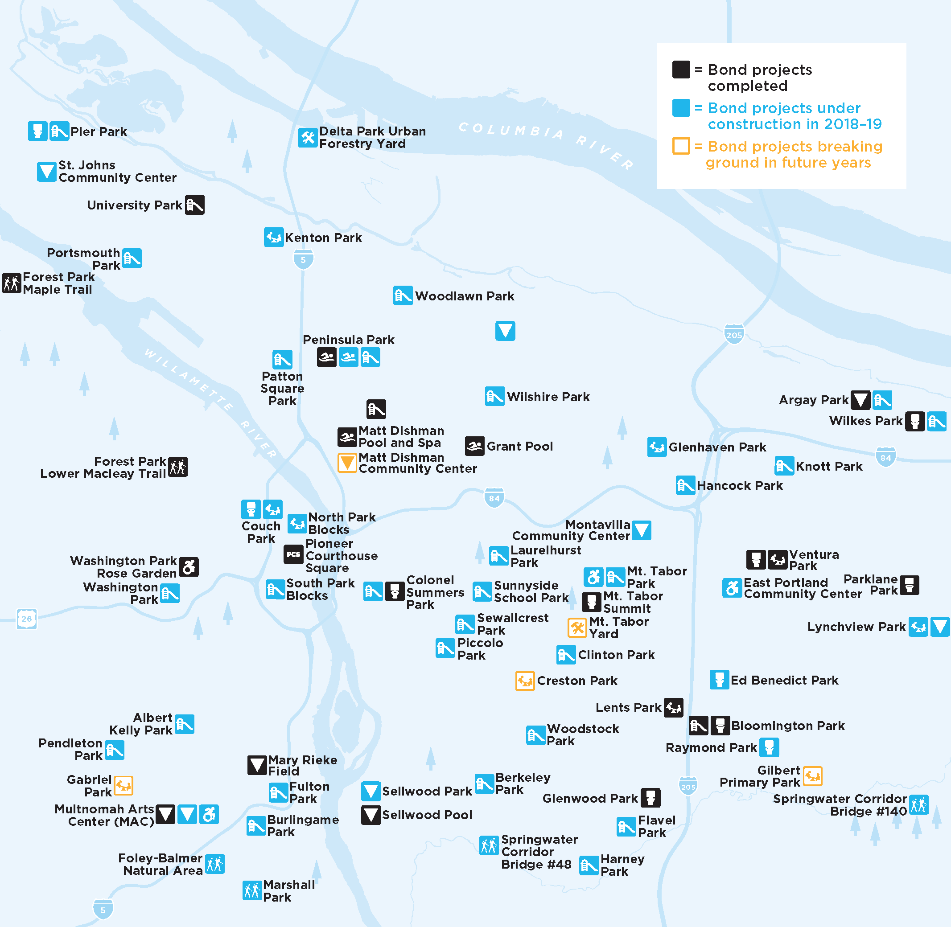
Bond & SDC Investments
Notes:
This map aggregates all 52 Bond projects representing the $68 million dollar investment. It is apparent here that the Bond is making significant improvements across the city to address a long back log list of critical repair projects.
Each project site is represented here by the black symbols for completed projects, blue indicating projects under construction this fiscal year, and orange, for projects going to construction after this fiscal year.
Despite all the repairs made through the Bond to date, PP&R estimates that the City has a $450 million funding gap for major maintenance needs for the next 10 years in our community’s parks, community centers, and other facilities.

Slide 5
Phases 1 & 2
Notes:
This map shows all the Bond projects, along with the projects for new Parks facilities funded by System Development Charges or other funding sources. These expansion projects (funded by SDCs) are not part of the Replacement Bond Program but sometimes the two projects overlap, creating and leveraging each funding source.
You can see that this is a very exciting and busy time for the Planning and Development Teams in Parks with over $100 million in SDC funds allocated to be invested over the next 5 years or so.

Slide 6
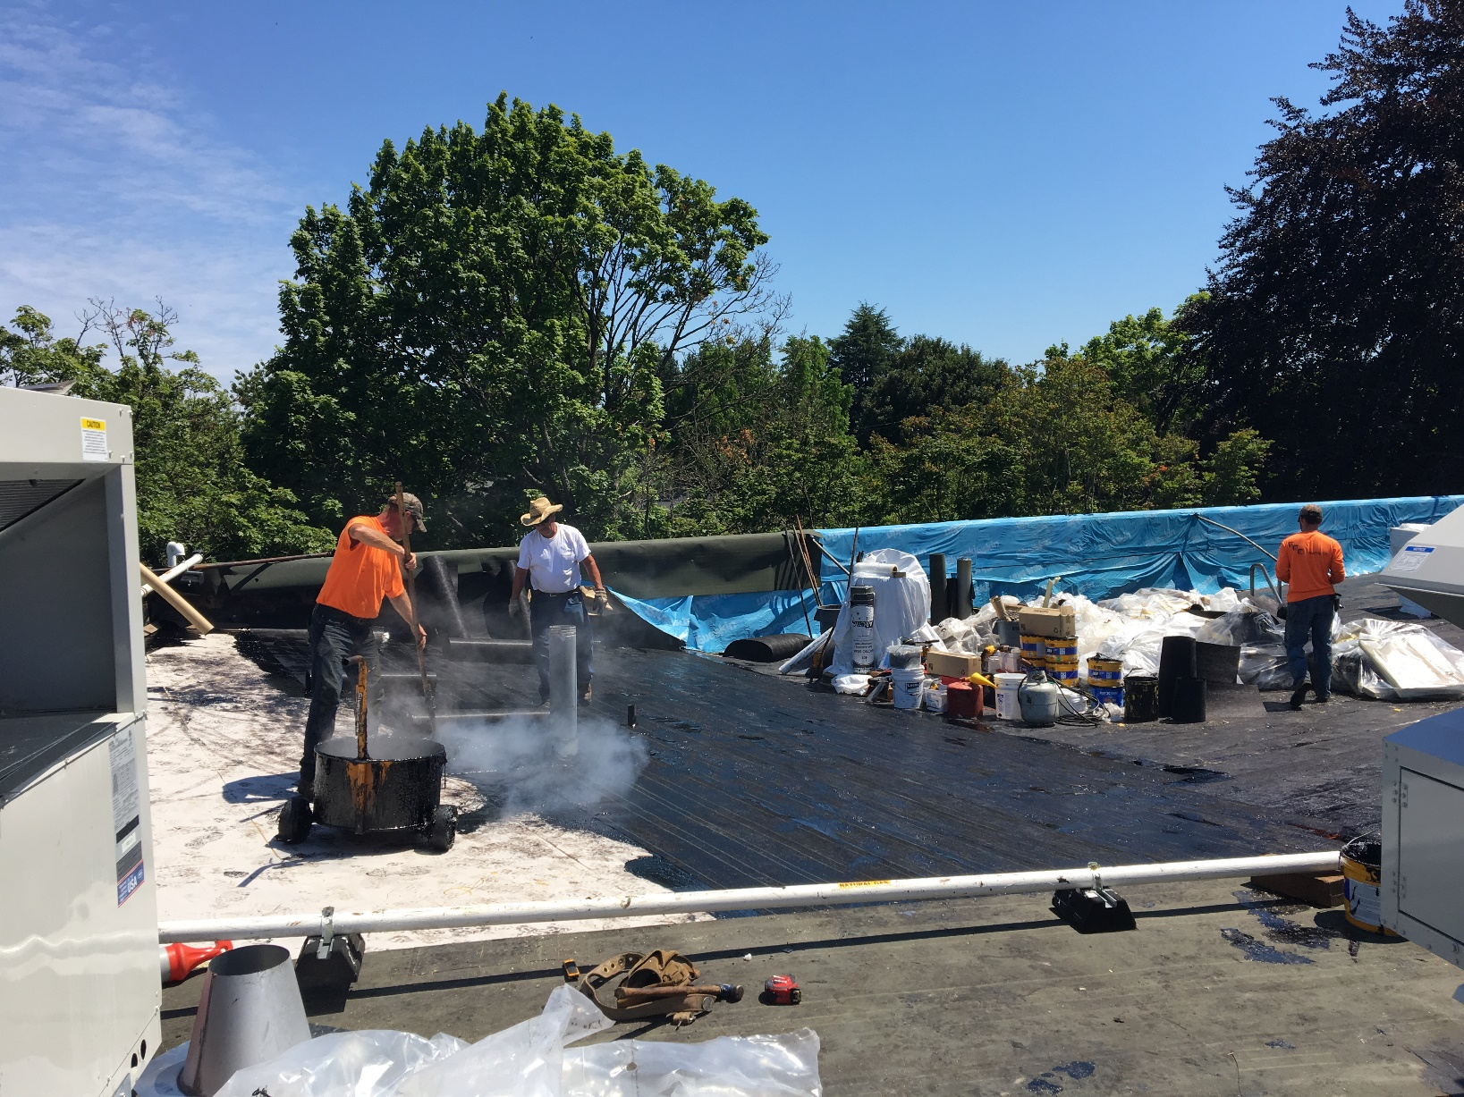
Performance Overview
St. Johns Community Center Roof
Notes:
In this third year of implementation, several projects have moved forward through various stages of design, construction and completion, while always maintaining consistency with the original Bond language and utilizing extensive tracking mechanisms for scope, schedule, and budget.
At this time, all 52 of the Bond projects are underway or complete:
31 projects are underway, including all 18 phase two projects.
21 Projects have been completed

Slide 7
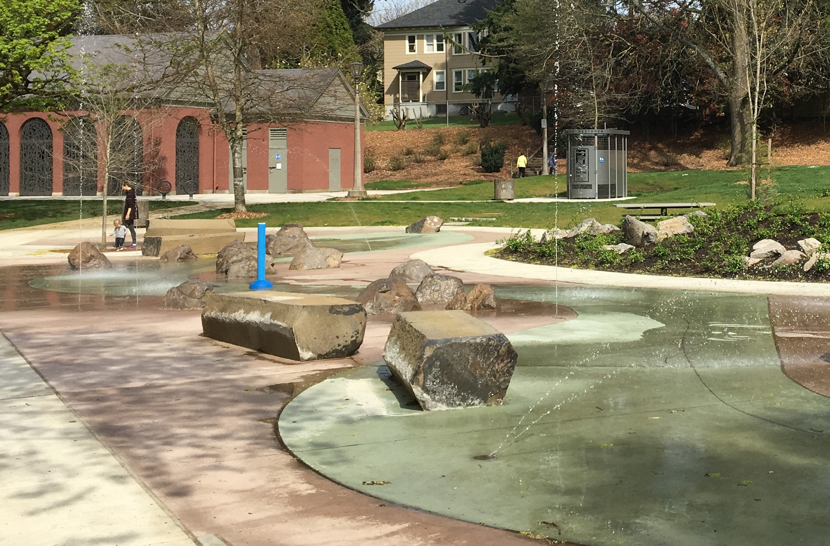
Performance - Scope
Colonel Summers Park Loo & Splashpad
Notes:
The majority of Bond projects continue to stay within the originally defined scope of simply fixing the most urgent problems. Currently five Bond projects have had scope expansions to leverage the Bond’s investments by capitalizing on efficiencies where private funding, System Development Charges funds, and major maintenance funding allow for improved service.
_________________________________________________________________________________________
If need data, should Councilors ask for details:
Colonel Summers – splash pad
St Johns Community Center - Major Maintenance $ for DDC $90,951
Couch – FOCP and Harpers, for inclusive play $500k
Peninsula – SCD, for shallowing, lights, lift $890,000
Gabriel – SDC, for destination inclusive play $2,500,000
NPK – expanded footprint, no additional funds, project efficiencies

Slide 8
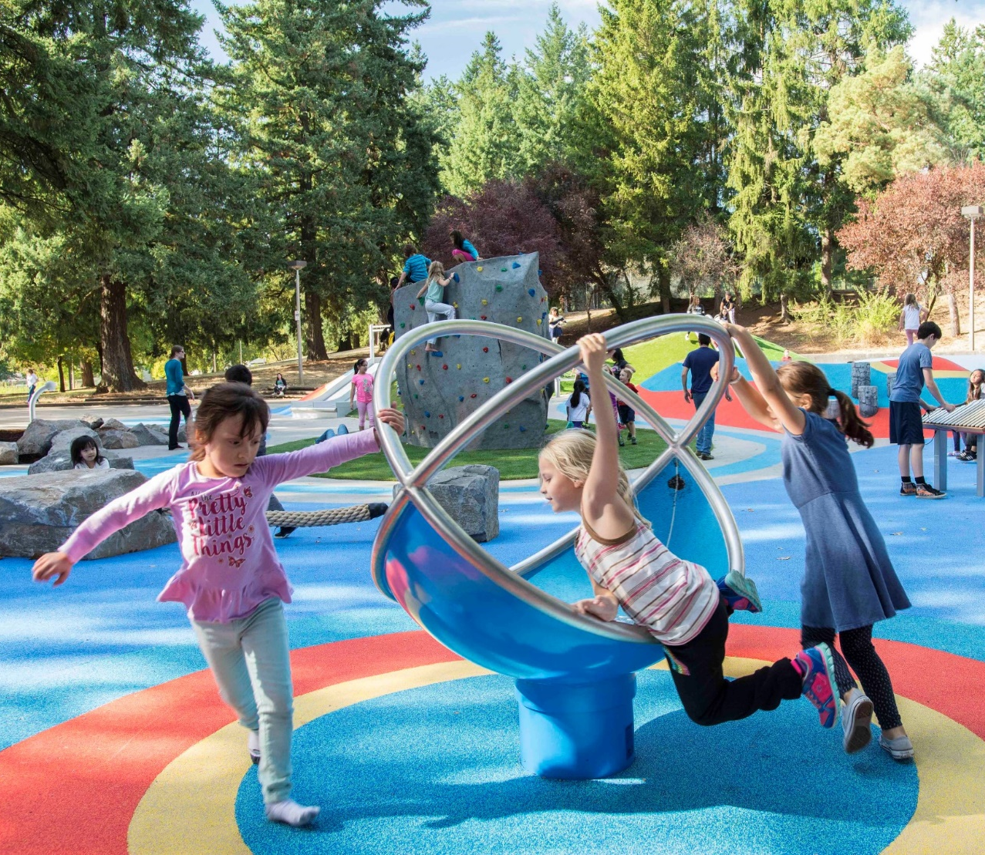
Performance - Schedule
Lents Park Playground
Notes:
Overall, the schedule metric is a positive one with 24 Bond projects on or ahead of schedule and 21 complete. In this last year the Bond team completed 13 projects! Seven projects have had schedule delays for various reasons including:
An increasingly challenging construction climate with contractors and subcontractors in demand, and bids coming in high or not at all.
Complex permitting and procurement requirements.
The desire to invest in increasing opportunities for mentoring disadvantaged, minority, and emerging small businesses as consultants and contractors.
The Bureau believes that investing time and effort in this work, although it may extend project schedules, results in broadening and diversifying the pool of contractors and building their capacity for future projects with the City.

Slide 9

Notes:
As of June 30, 2018, the program has spent 28.1 million dollars. Spending is still at a slower rate than originally anticipated, but that trend will change as more projects move into the construction phase.
All projects are currently within their Bond budgets, except for 2 projects
Grant Pool had higher than anticipated construction costs
Resulting in an overage of $565,957
This overage will be/has been addressed with a fund line transfer from other bond projects that came in under budget.
Due to an accounting error, the Parklane Park Loo project’s bond funding source was overcharged, however the overall project did not go over budget as this project included SDF funds.
Overcharge was $17,851
This graphic shows the overall progress of the bond. You’ll see that this year the Bond is expending proportionately more on construction and less on administrative costs and professional services.
One bit of excellent news is that administrative expenses continue to fall. Cumulative percentage of funds now at 5.1%

Slide 10
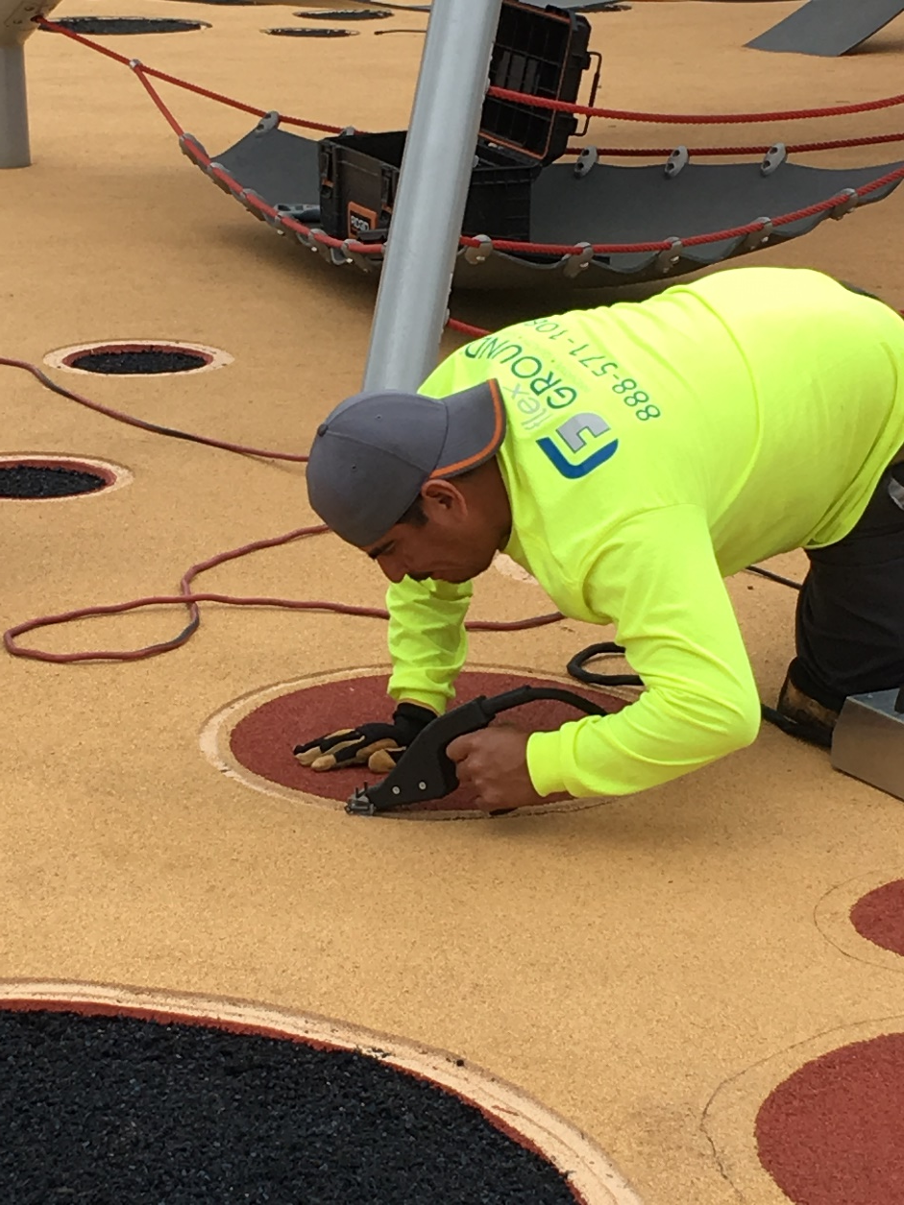
Investments
Ventura Park Playground
Notes:
Not only is the Bureau working hard to improve the Parks infrastructure, Bond funding is also being invested in the local greater Portland community to ensure that disadvantaged, minority, women, and emerging small businesses (known as D/M/W/ESB firms) have opportunities to design, bid on and construct Bond projects.
The success rate is laudable. To date:
31% of the value of all professional technical contracts for Bond work has been awarded to D/M/W/ESB firms, and
39% of the value of the Bond’s construction contracts has been awarded to D/M/W/ESB firms.
As a reminder, the City’s goals are 20%.

Slide 11
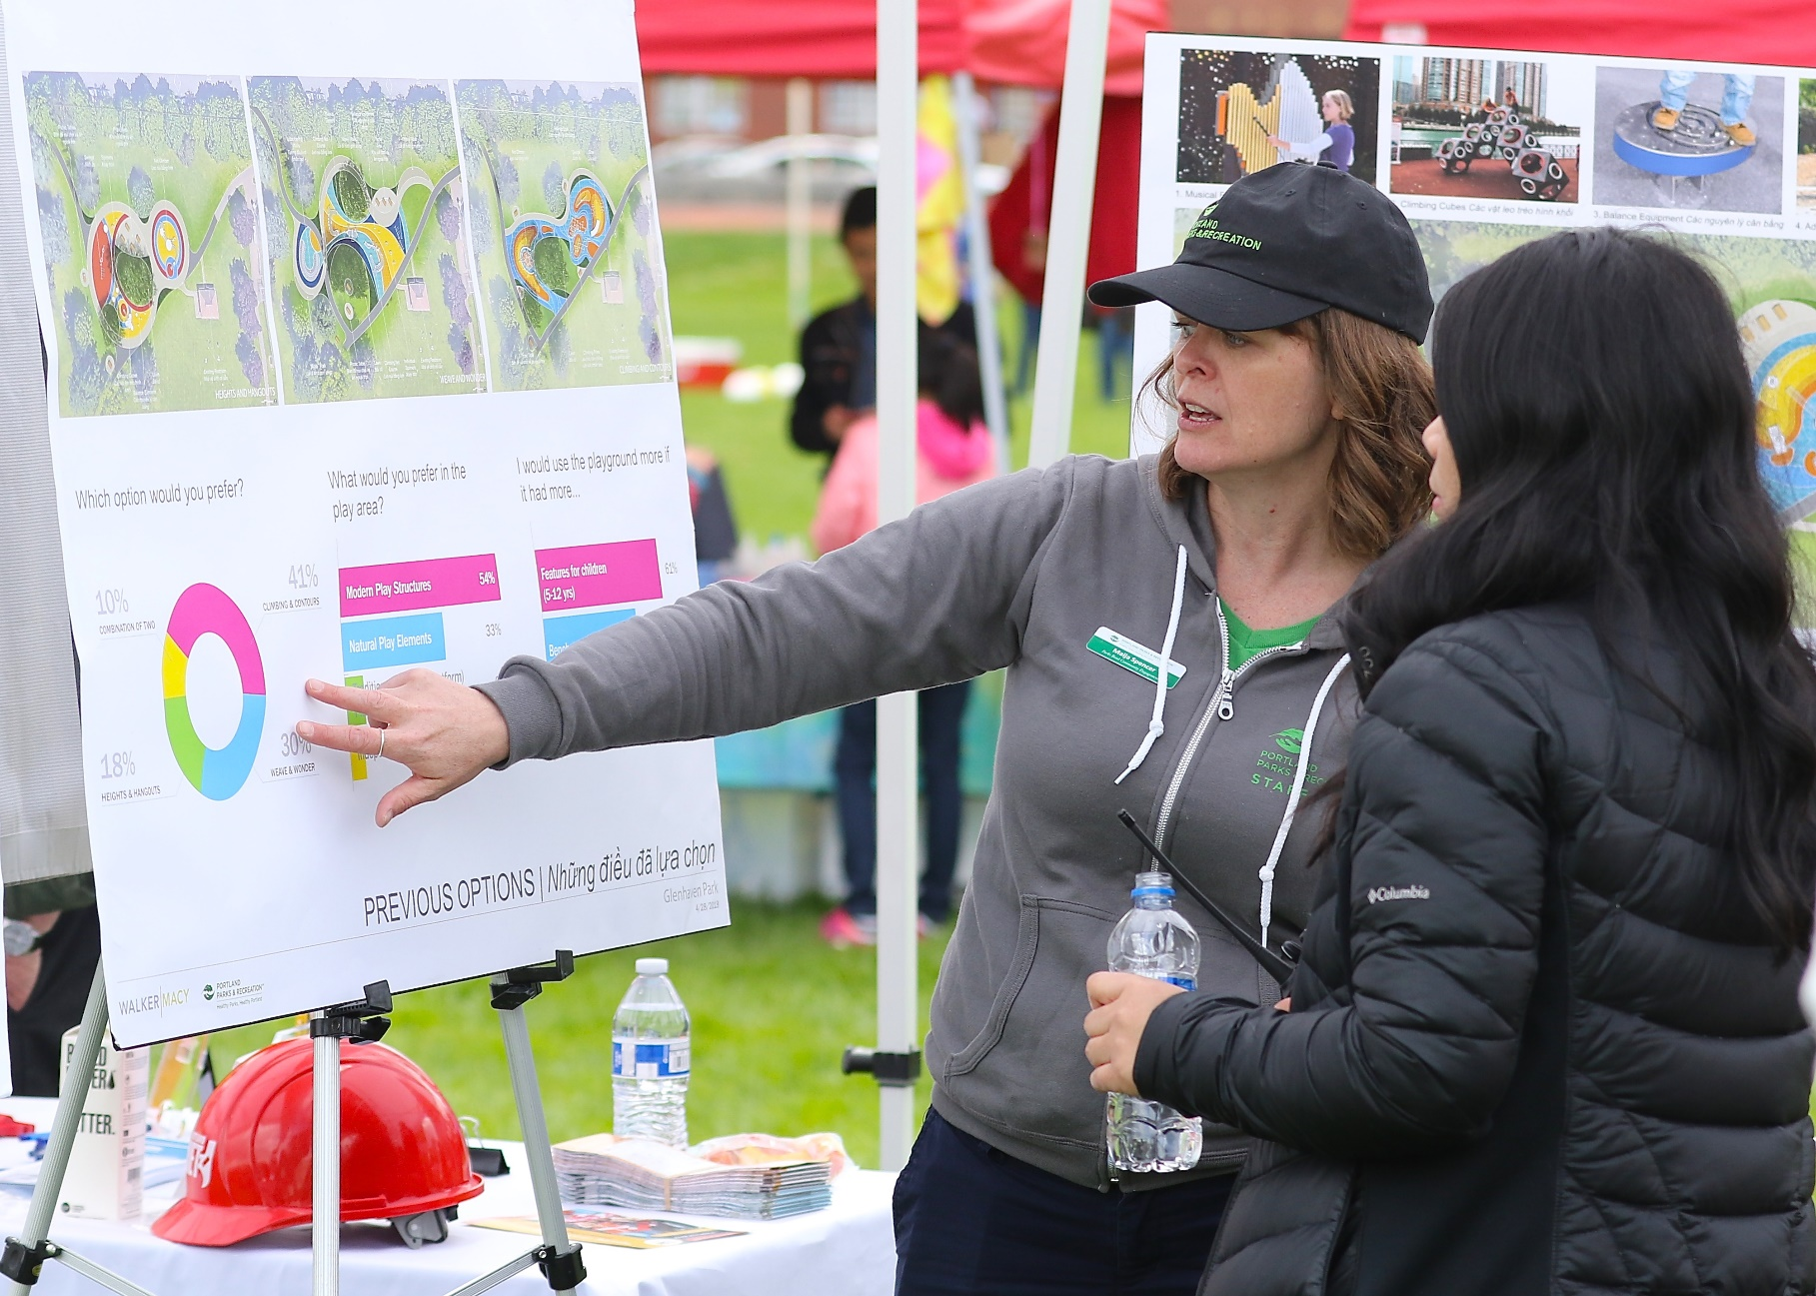
Transparency
  PUBLIC INVOLVEMENT
Notes:
The Bond Team is very proud and passionate about Portland’s park system.
With the initial Bond work, the extensive outreach process helped garner Bond support thanks in particular to Commissioner Fritz and Commissioner Fish. Building upon those efforts, the Bond Team has engaged in public outreach tailored to each of the Bond projects as the numbers on the screen indicate.
PP&R’s work around community engagement must reflect our increasingly diverse community’s needs and desires. To ensure that the voices of a broad spectrum of Portlanders are heard, PP&R’s Community Engagement staff have involved Community Engagement Liaisons, individuals with ties to Spanish speaking, Somali, Vietnamese, and Russian communities. These specialists have assisted with outreach and translation for playground renovation projects.
Project-specific outreach has also been targeted to low-income and disability communities, and open house meetings have been held in conjunction with cultural events, such as New Year in the Park and Summer Free For All events.

Slide 12
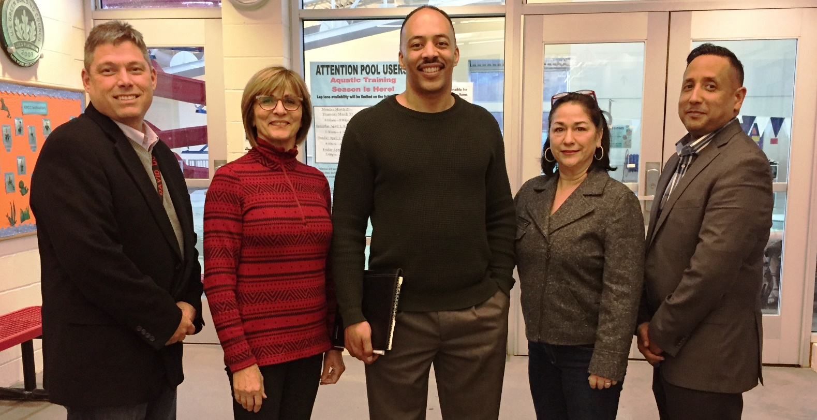
Transparency
  BOND OVERSIGHT COMMITTEE
      Demonstrate effectiveness of outreach efforts
Notes:
The Bond Oversight Committee continues to provide oversight to the Bond program. One member has changed in the last year, as chairperson Dion Jordan’s term ended and he has resigned from the Committee. A search for his replacement is underway. The current committee includes Jonath Colon, Karen Loper Tracy, Zari Santner, and Ken Richardson. This group has offered many significant and helpful suggestions to the Bond Program.
In their Annual Report last year, their recommendation was to:
Establish metrics that demonstrate the effectiveness of PP&R’s efforts to be transparent with the community and
Gauge if the public feels the process is open, transparent, and welcomes participation.
To address this suggestion, PP&R is developing a targeted survey to measure how well outreach and communications strategies have worked. A community survey will be available online from mid-August to September 2018 at www.parksreplacementbond.org.
The oversight committee will be evaluating the Bond performance and offering their opinion of Bond Program Year 3 this fall.

Slide 13
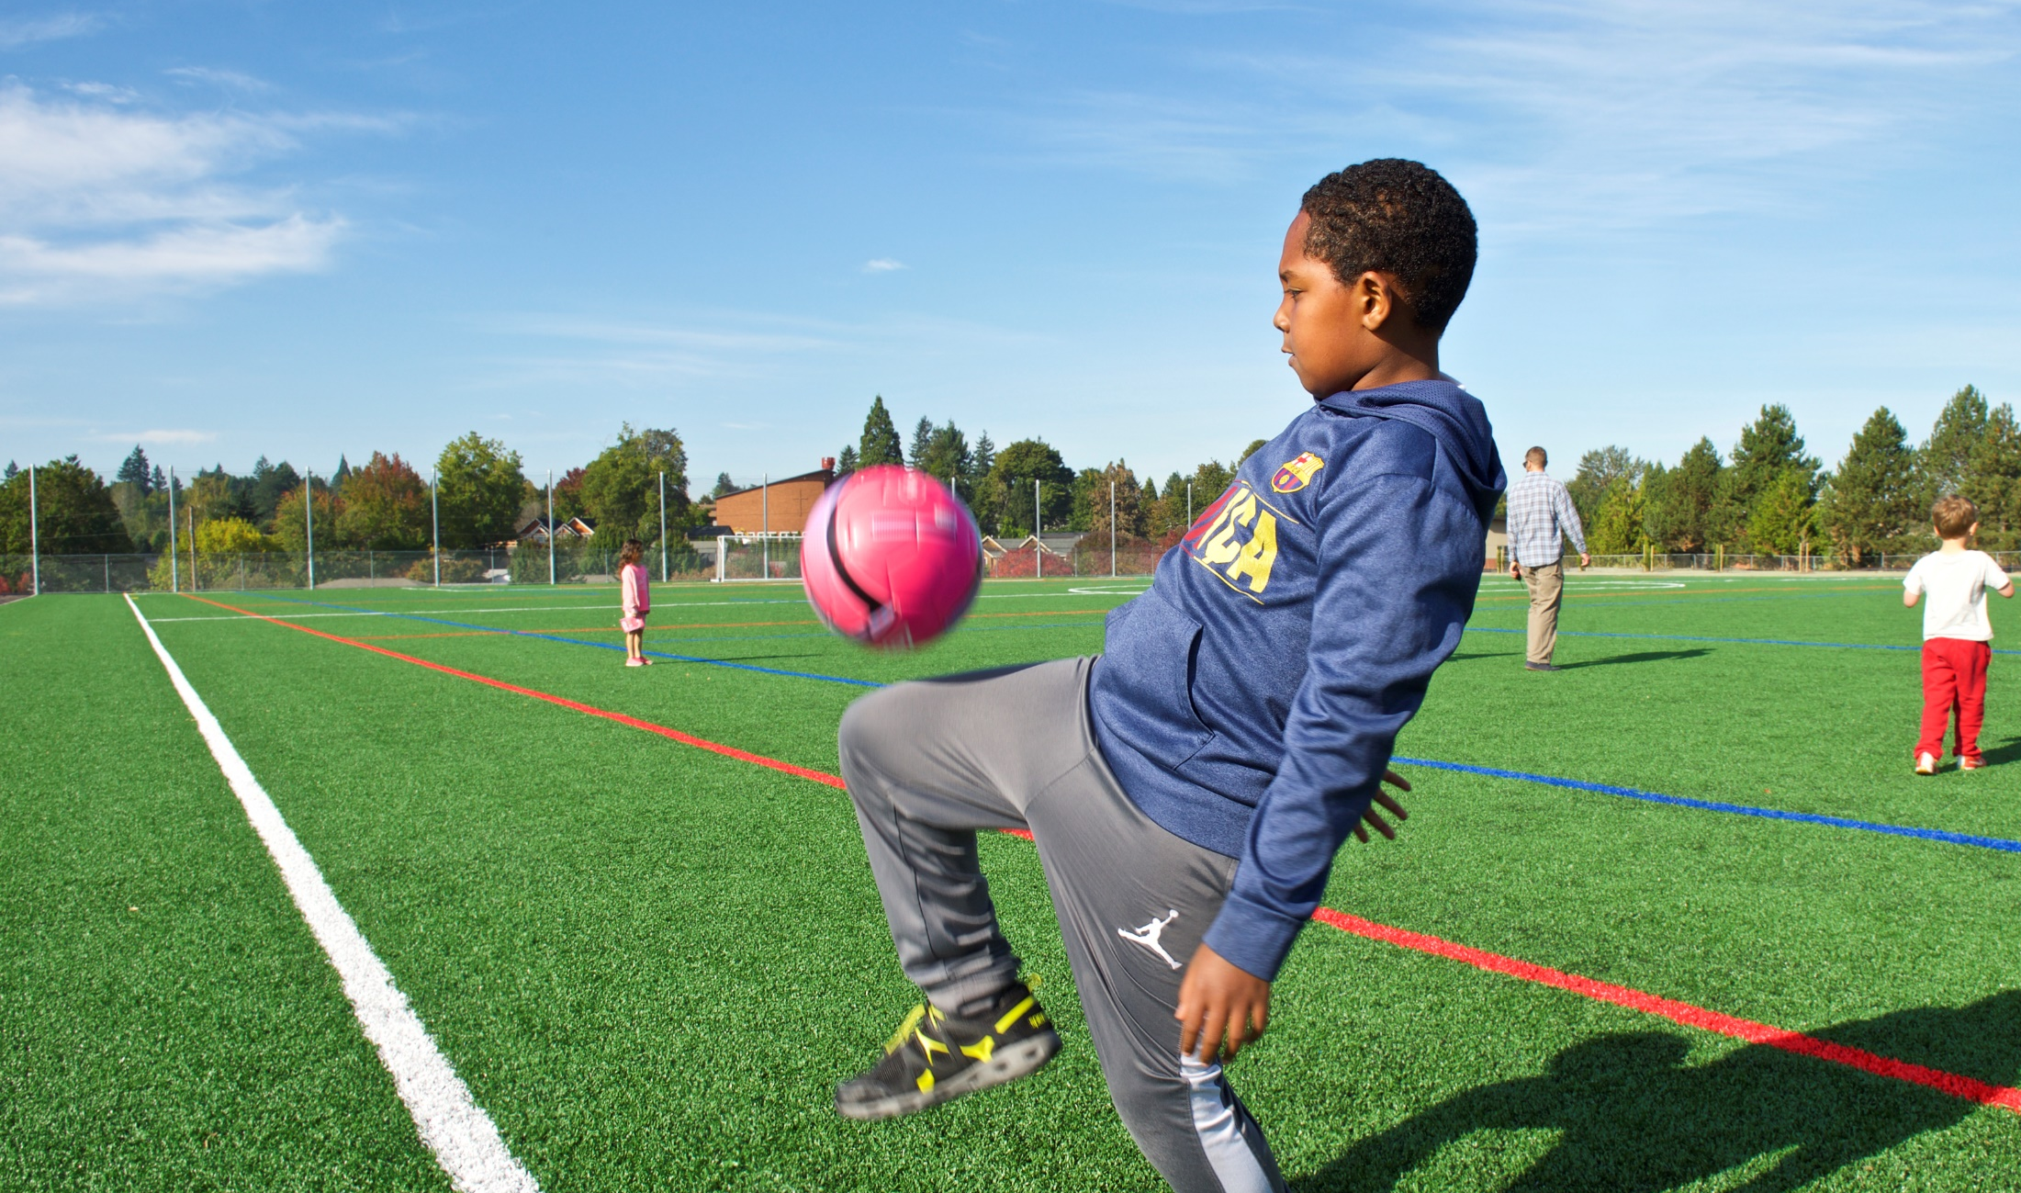
Audit
  AUDITS
      Performance
Mary Rieke Soccer Field
Notes:
Audits were required as part of the Bond measure to ensure fiscal accountability. To meet this obligation, we have hired an independent firm to provide a performance audit of Bond activities.
This performance audit will serve as a progress check on how the Bond Program is operating and as a guide for future work to ensure the efficient delivery of the Identified Bond Projects.
The audit is currently underway and scheduled to conclude this fall.
Harvey M Rose is the Audit Consultant.
------------------------------------------------------------------------------------------------------
Data if needed, Harvey M Rose contract value $56,670

Slide 14
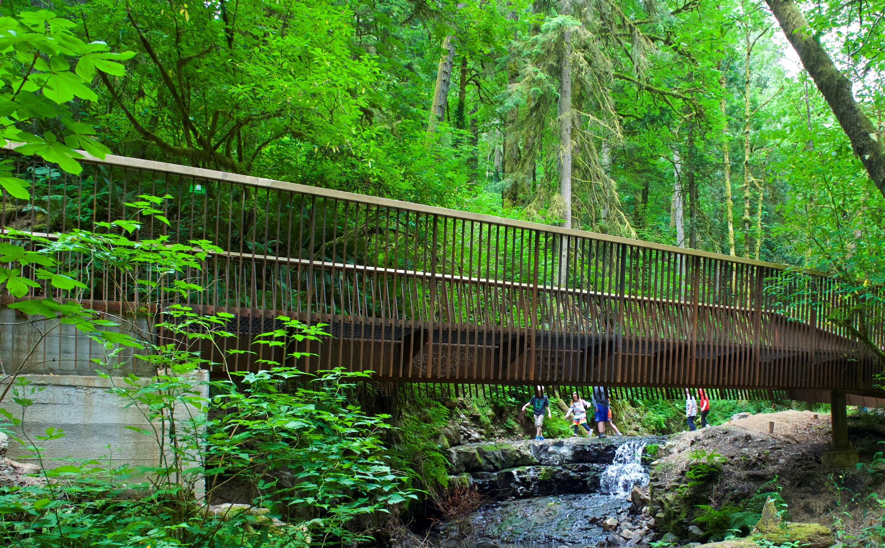
Going Well
Projects well received
Exceeding D/M/W/ESB Utilization
Majority on schedule/scope
On budget except for Grant Pool
Tracking tools well utilized
High performing team
Forest Park: Lower Macleay Trail
Notes:
The Bond projects have been received, with support from three main stakeholder groups that that are involved in the projects - the public, the contracting community, and the City Council.
Goals for utilization of DMWESB consultant and contracting services have been exceeded.
The majority of projects are on schedule and consistent with promised scopes and in budget.

Slide 15
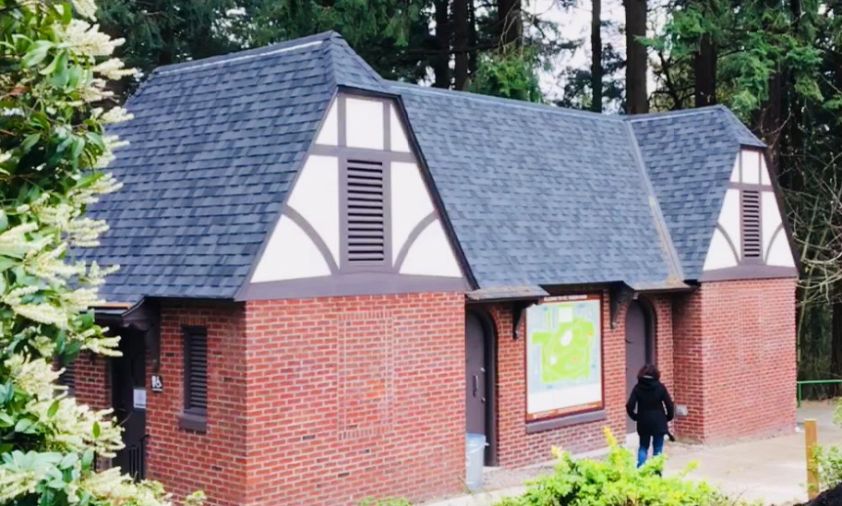
Project Highlights
Mt. Tabor Park
Argay Park
Bloomington Park
Glenwood Park
Mt. Tabor Park Summit Restroom
Notes:
All the bond projects bring quality, revived services to our community. We’d like to share a few of those projects with you today.
The Summit Restroom at Mount Tabor, pictured here, opened to the public after many years of closures. Visitors to this park can now make use of two all-user restrooms, as well as a new map that shows the park’s trail and road systems.
Argay Park – This Bond project was focused on resurfacing outer East Portland's only tennis court, which had been virtually unplayable. The project also corrected barriers to access with renovated pathways.
Bloomington and Glenwood Parks received restroom renovations that provided much needed modernization and increased accessibility.

Slide 16
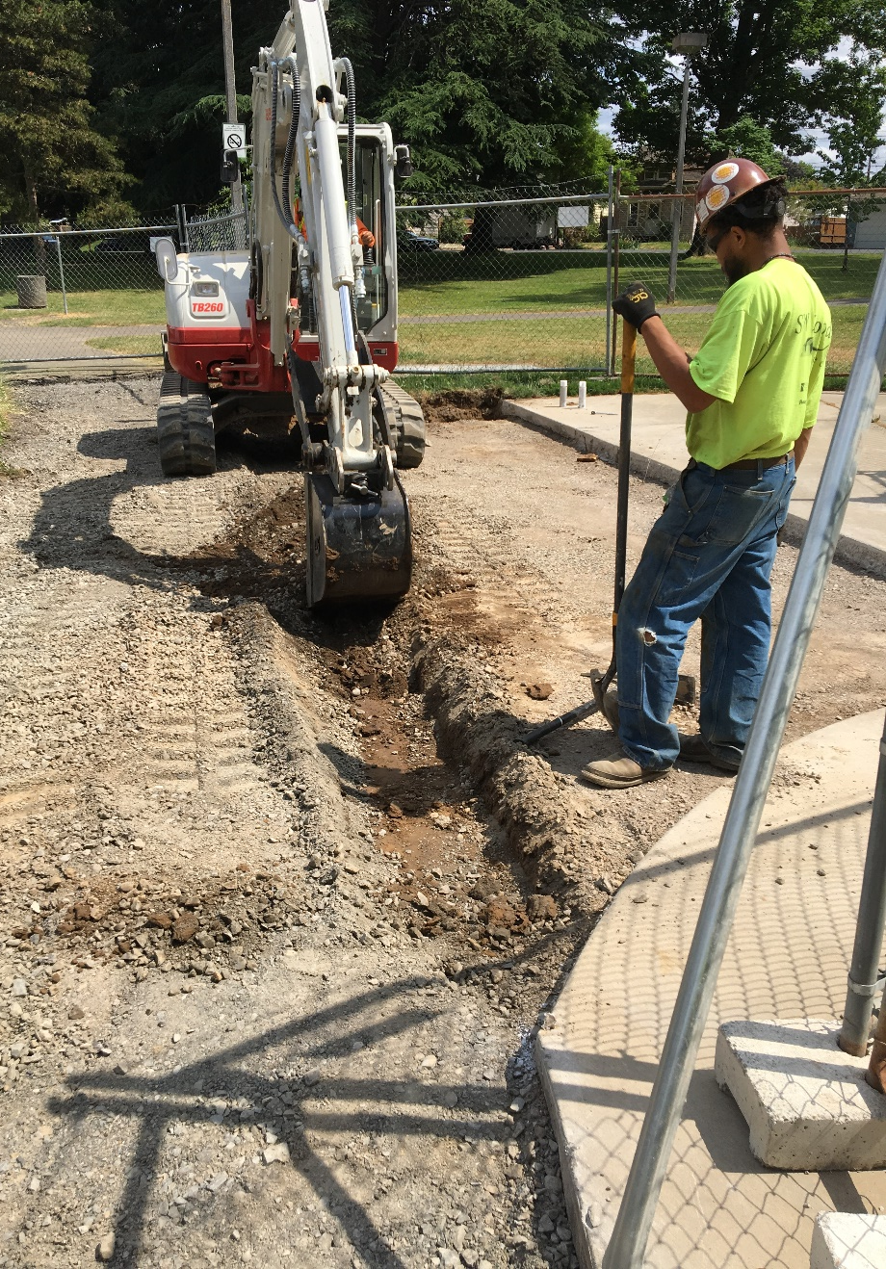
Project Highlights
Kenton Park
Rieke Field
Couch Park
Kenton Park Playground
Notes:
Kenton Park, pictured here, is currently under construction and will have a fully renovated playground this fall. This project will also increase accessibility for park visitors with new pathways leading to the playground.
The renovation of Mary Rieke field was completed in Fall 2018. This project allows for safer play, expanded accessibility, and an extended useful life of the surfacing.
Our partnerships with the community have allowed us to leverage bond funds and create a new inclusive playground at Couch Park, which is currently under construction and due for completion this coming winter. This project also includes a new Portland Loo and will make accessibility improvements to the plaza space.

Slide 17
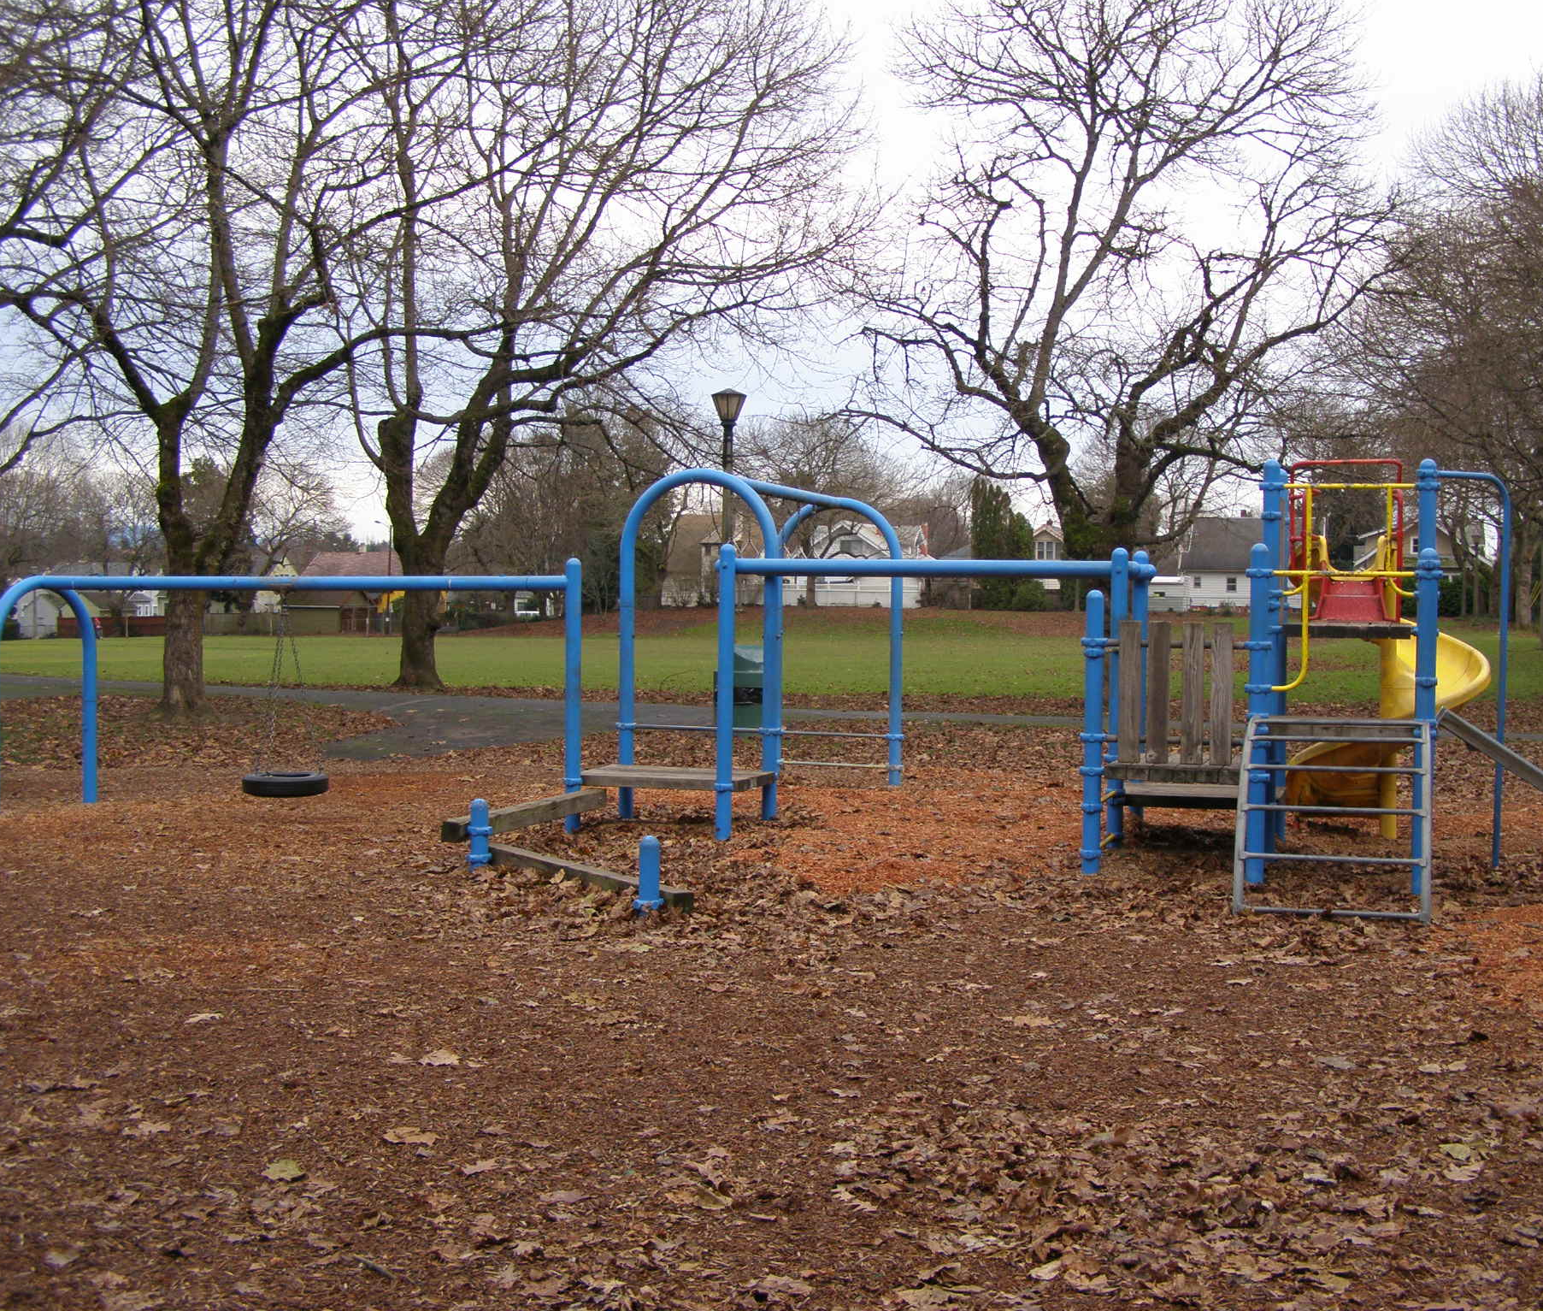
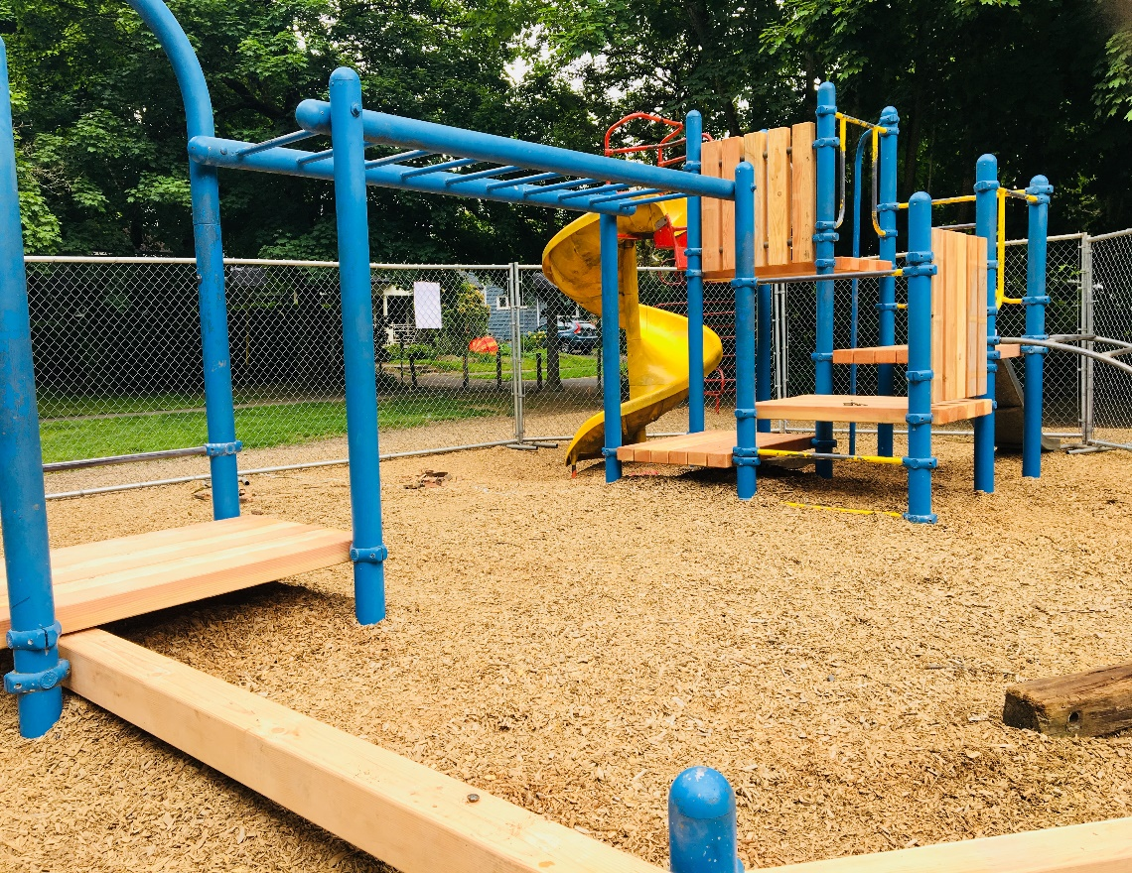
Project Highlights
  Irving Park Play Piece Renovation
Notes:
One of the first Bond Phase 2 projects, called the Playground Parts & Pieces project, touches 30 parks throughout our system by replacing aging playground structures, making drainage improvements, and making accessibility upgrades. As part of this project, Irving Park, shown here, has already received all new decking on the play structure.

Slide 18
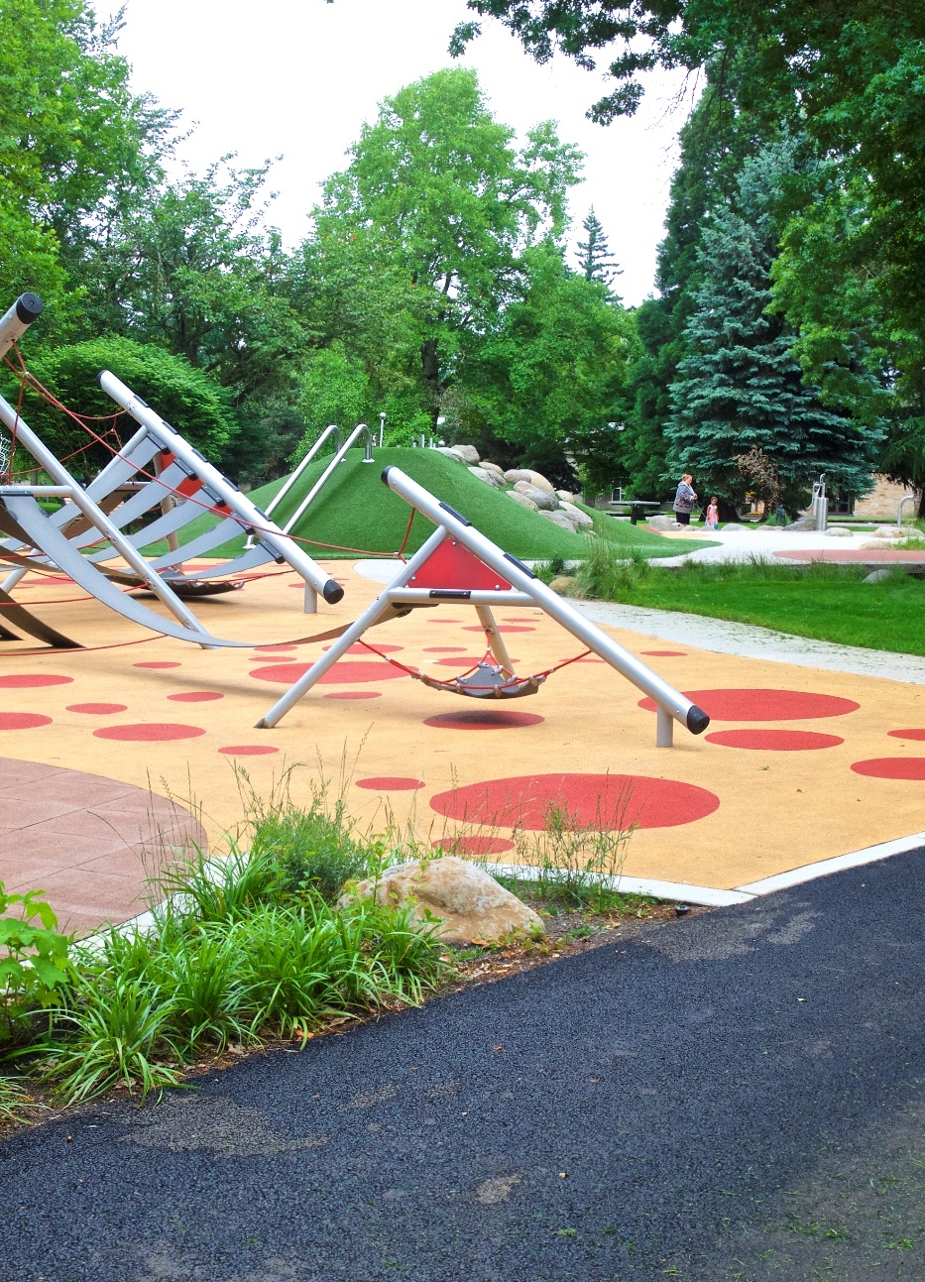
Looking Ahead
Couch Park Loo
Couch Park Playground
Ed Benedict Park Restroom
Fernhill Park Water Supply
Kenton Park Playground
Mt. Tabor Park Handrails
North Park Blocks Playground
Raymond Park Loo
Sellwood Park Kitchen Roof
Peninsula Park Pool
Ventura Park Playground
Notes:
Looking ahead, 10 Bond Projects are scheduled for completion over the next year, so more excitement and diligent work is to come. Our team is excited to be reaching the halfway point in delivering these important reinvestments in our Parks infrastructure to Portlanders.

Slide 19
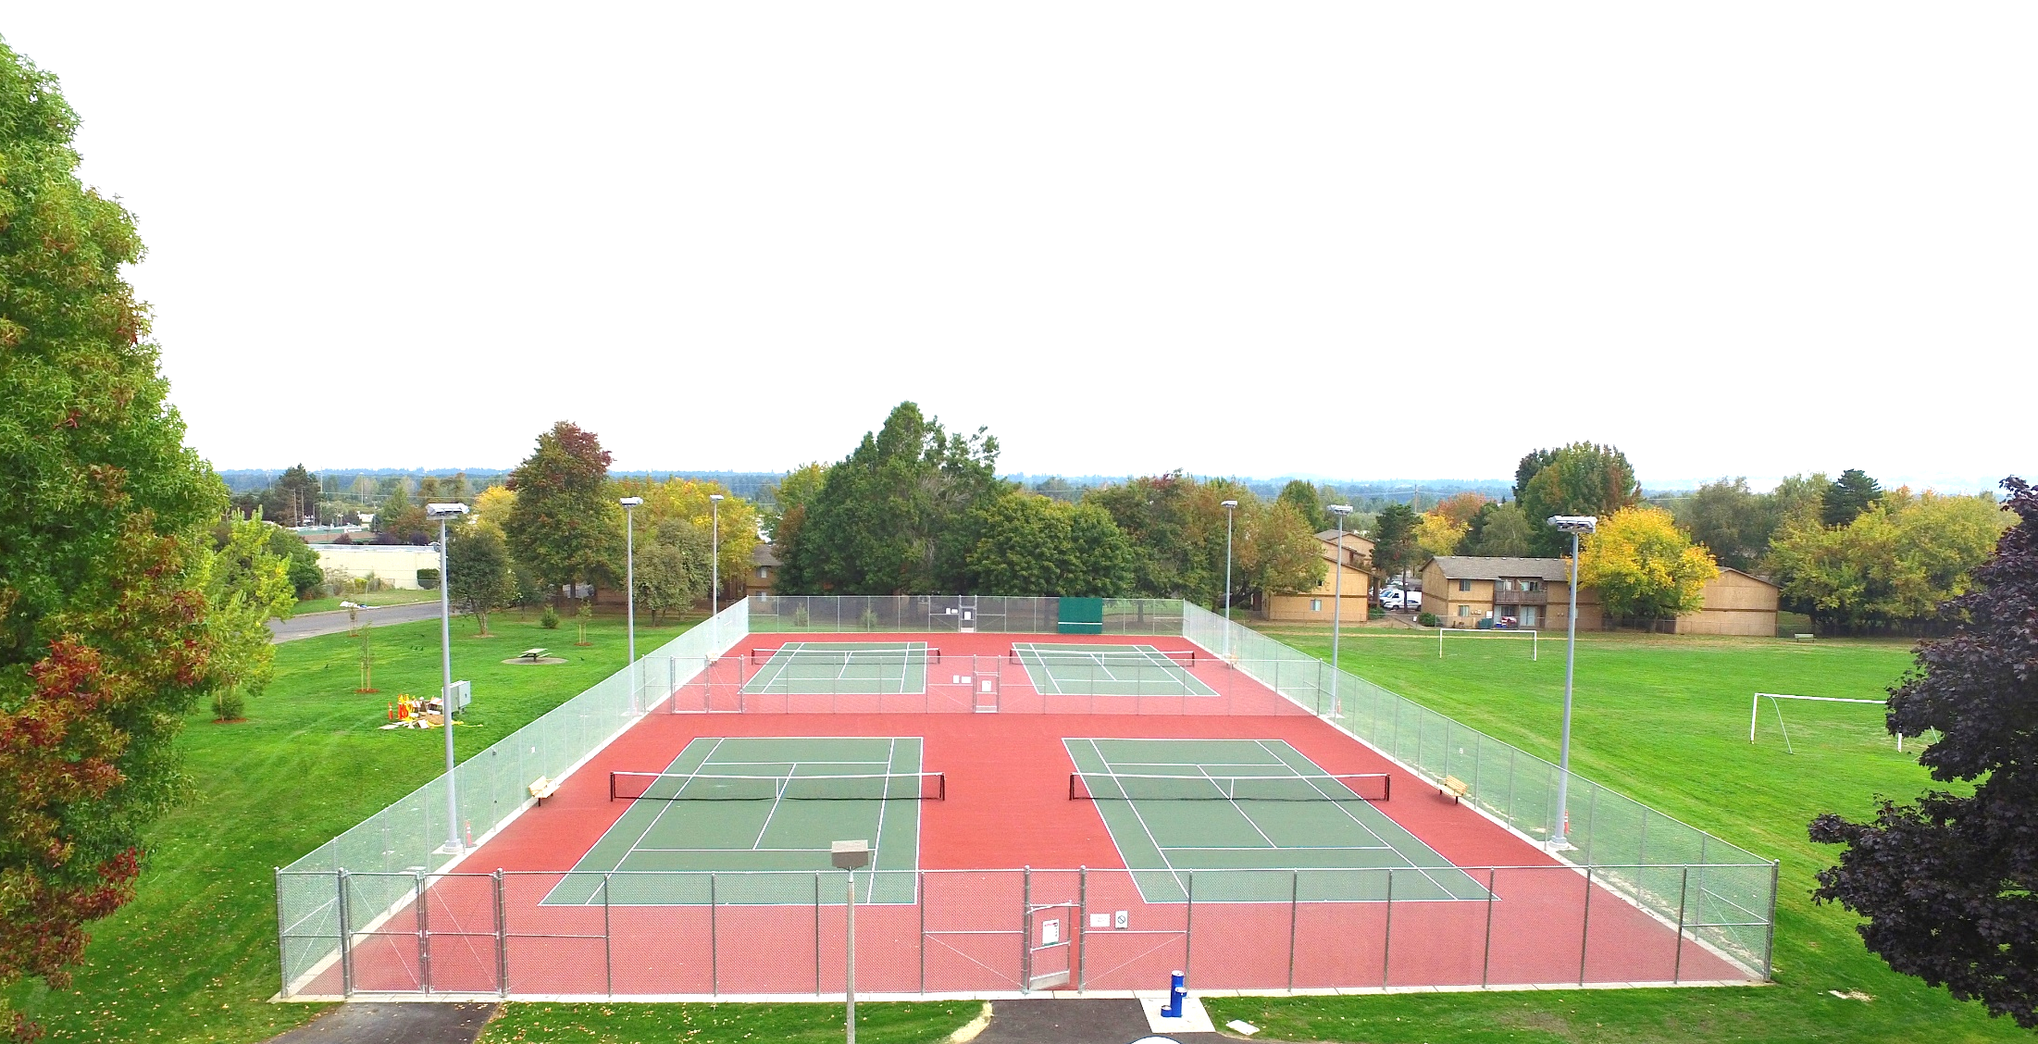
THANK YOU!
  Robin Laughlin
  Lauren McGuire
  Assets & Development Division
  City of Portland
  Robin Laughlin 971.940.5567
  Robin.Laughlin@PortlandOregon.gov
Argay Park Tennis Courts
Notes:
With that, we are happy to present you with the long form of the Annual Bond Year 3 Report, which will be shared with the press and neighborhood coalitions and will be available on the Parks web site.
The information presented here today can be found in that report. It is intended to be completely transparent and honest not only about what’s gone well but also about where the program challenges lie.
The short version will be widely distributed through Portland Parks’ community centers and parks events throughout the summer. It is available in English and has also been translated into Spanish.
In summary, we anticipate that we will be able to deliver the Phase 1 and 2 Bond Projects promised within the $68 million bond with maximum accountability and transparency.
We are happy to take any questions at this time. Thank you!

