Slide 1
PARKING MANAGEMENT MANUAL
July 25th, 2018

Slide 2
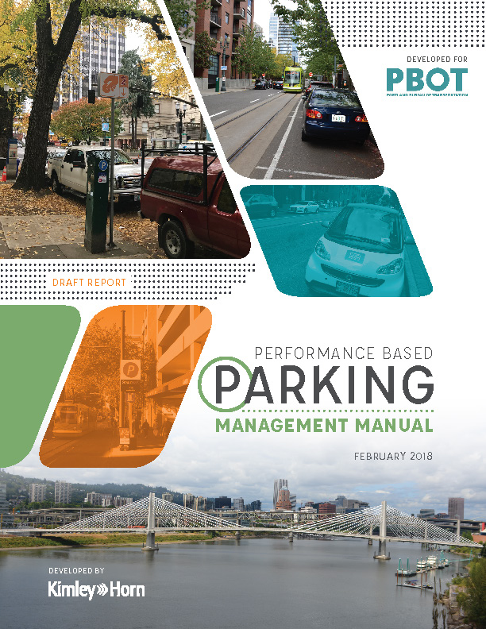
Items today
Adopt new parking management policies in Parking Management Manual (Resolution)
Adopt new Parking Meter Rate Policy
  Rescind outdated policy (Ordinance)
  Adopt new performance-based parking management pricing policy for meter areas and event districts (Ordinance)
Notes:
Why are we here?
To rescind outdated policy governing parking management and to adopt new policy guiding PBOT on managing parking that is:
Data-driven
Transparent
Responsive to changing environments

Slide 3
Overview of Topics Covered
Introduction
Parking Management Districts
Time Limits
Pricing
Event Districts
Truck Loading Zones
Notes:
Presentation Outline
Each Chapter provides clear guidelines on each topic to serve as a resource manual, helping to add clarity and consistency to parking management questions that PBOT gets asked on a daily basis. Each chapter was developed with input from the Stakeholder Advisory Committee, and is based on a performance-based process that uses data and best management practices to inform parking management citywide.
_____________________________
FAQ: APP and Permit Surcharge?
These items are not included within this document.
FAQ: Use of Net Meter Revenue?
The use of Net Meter Revenue will continue to be spent per existing City Policy, covered in TRN 3.102 (1996)

Slide 4
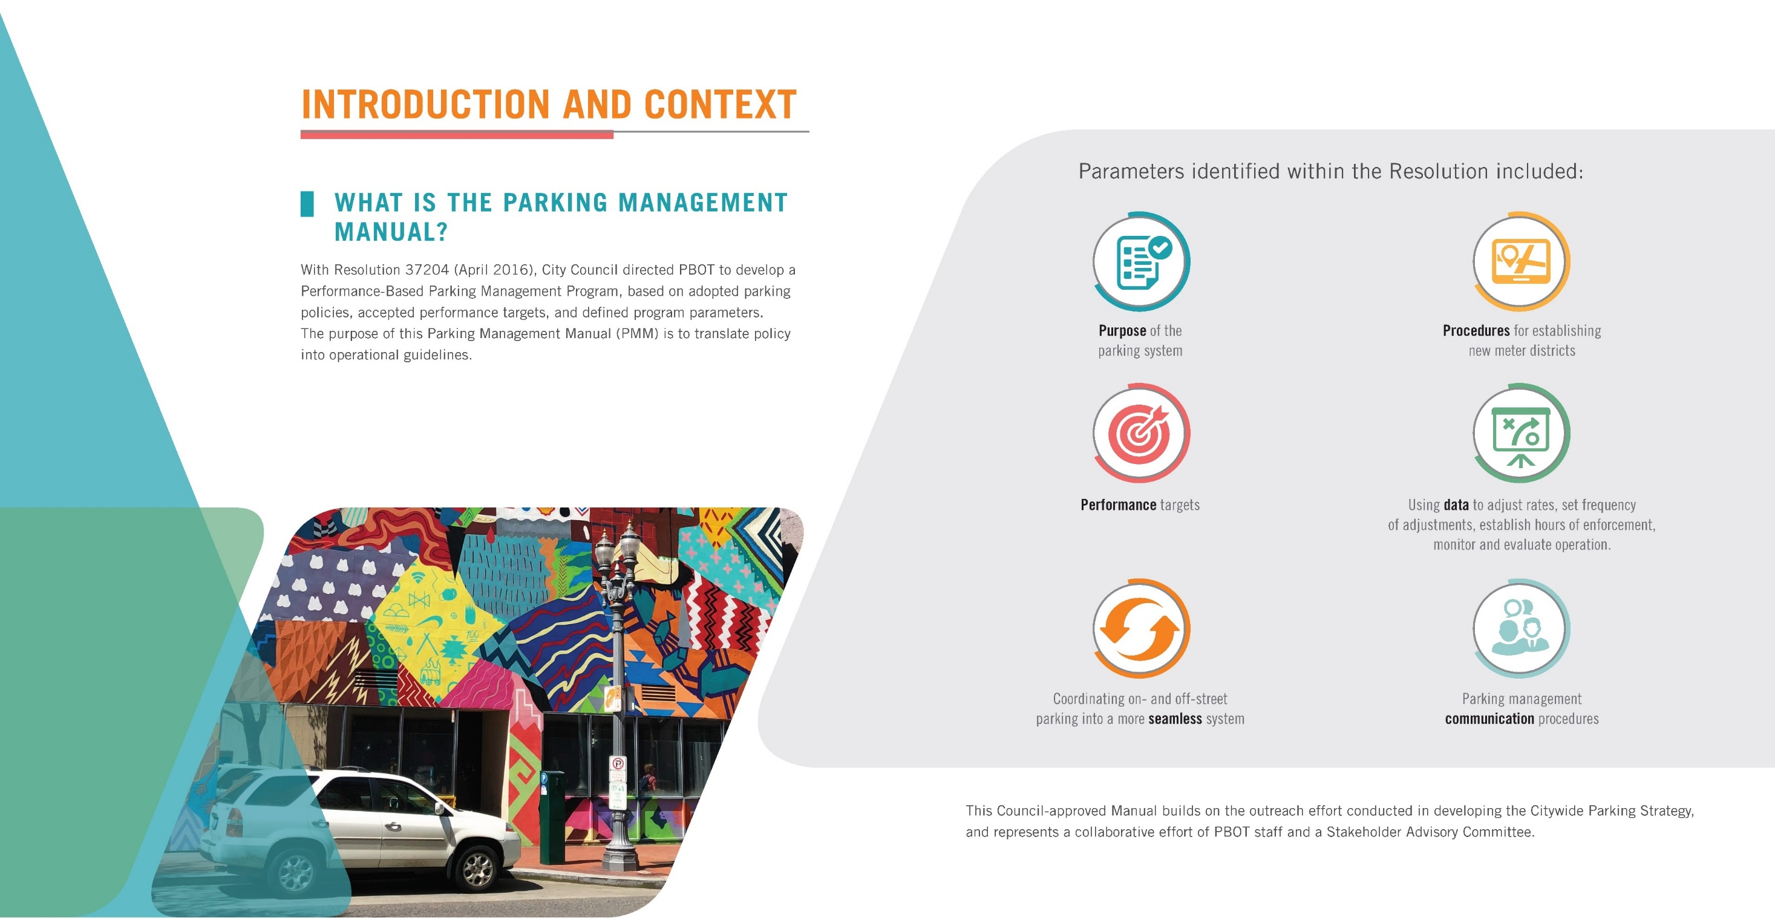
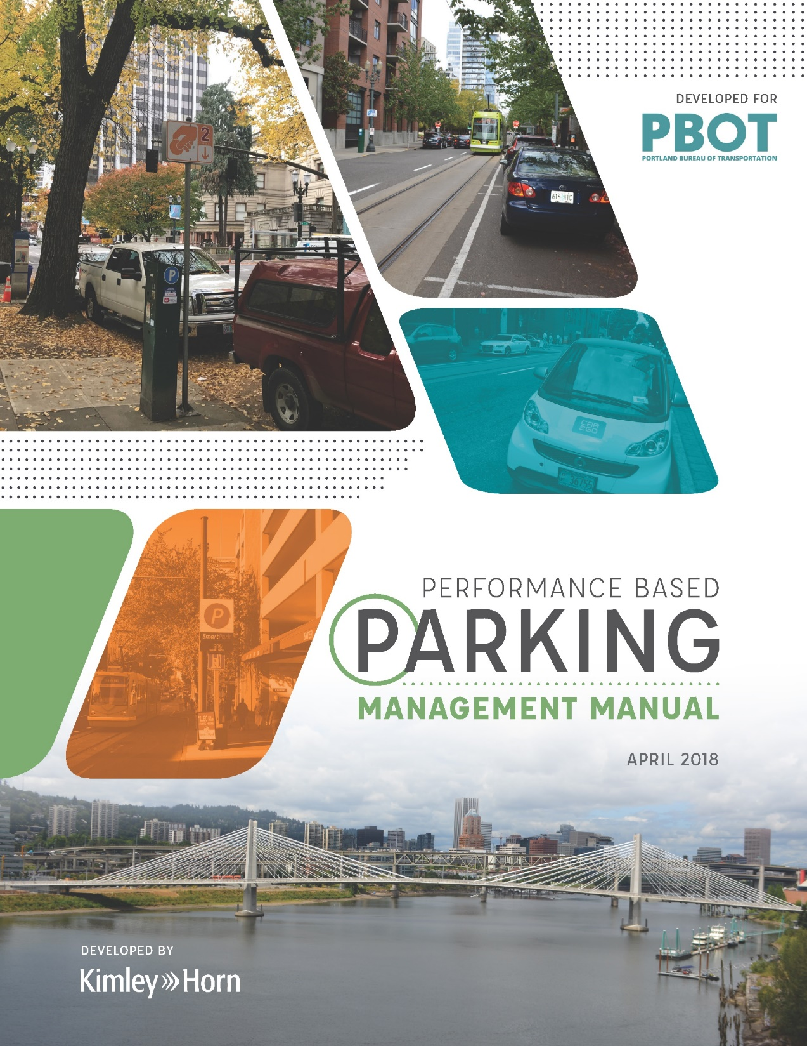
Background – Resolution 37204
Planning & Engagement to Date
2035 Comprehensive Plan
Transportation System Plan
Citywide Parking Strategy
Central City 2035 Plan
Mixed Use Zones Project
Centers and Corridors Parking Toolkit
Performance-Based Parking Management Stakeholder Advisory Committee
Notes:
Thank You
Introductions
The direction to develop a Performance-Based process for managing parking was initiated more than three years ago as a key recommendation that emerged from the outreach process in developing the 2015 Citywide Parking Strategy. That extensive public outreach process included communication with close to 1,000 people and more than 50 briefings, meetings, and public events throughout the City. A consistent theme that emerging was the desire to manage parking using a transparent, data-driven approach, referred to a performance-based parking management.
(Advance)
With Resolution 37204 in April 2016, City Council directed PBOT to develop a Performance-Based Parking Management Program that establishes operational guidelines to implement City policy.
The resulting Parking Management Manual (PMM) developed over the last 18-months outlines standardized guidelines, performance measures, and exception processes to consistently manage Portland’s public parking system based on data. The program relies on parking management best practices to support the economic vitality of commercial districts with the primary goal of ensuring equitable, efficient access for all users.

Slide 5
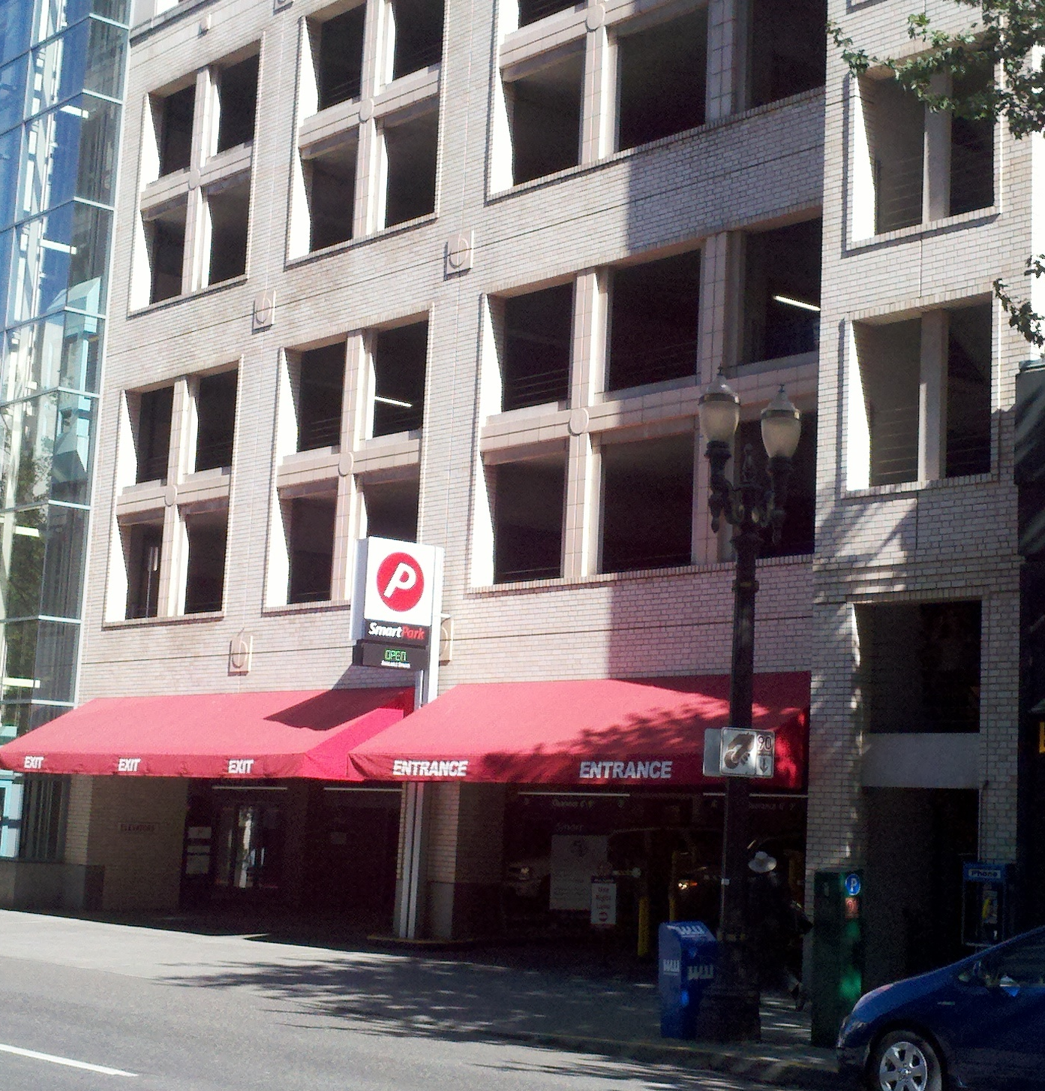
Better use of
existing parking
Existing parking assets are often underutilized for much of the day
Redefining the role and function of parking in the curb zone
Manage parking to achieve highest and best use

Slide 6
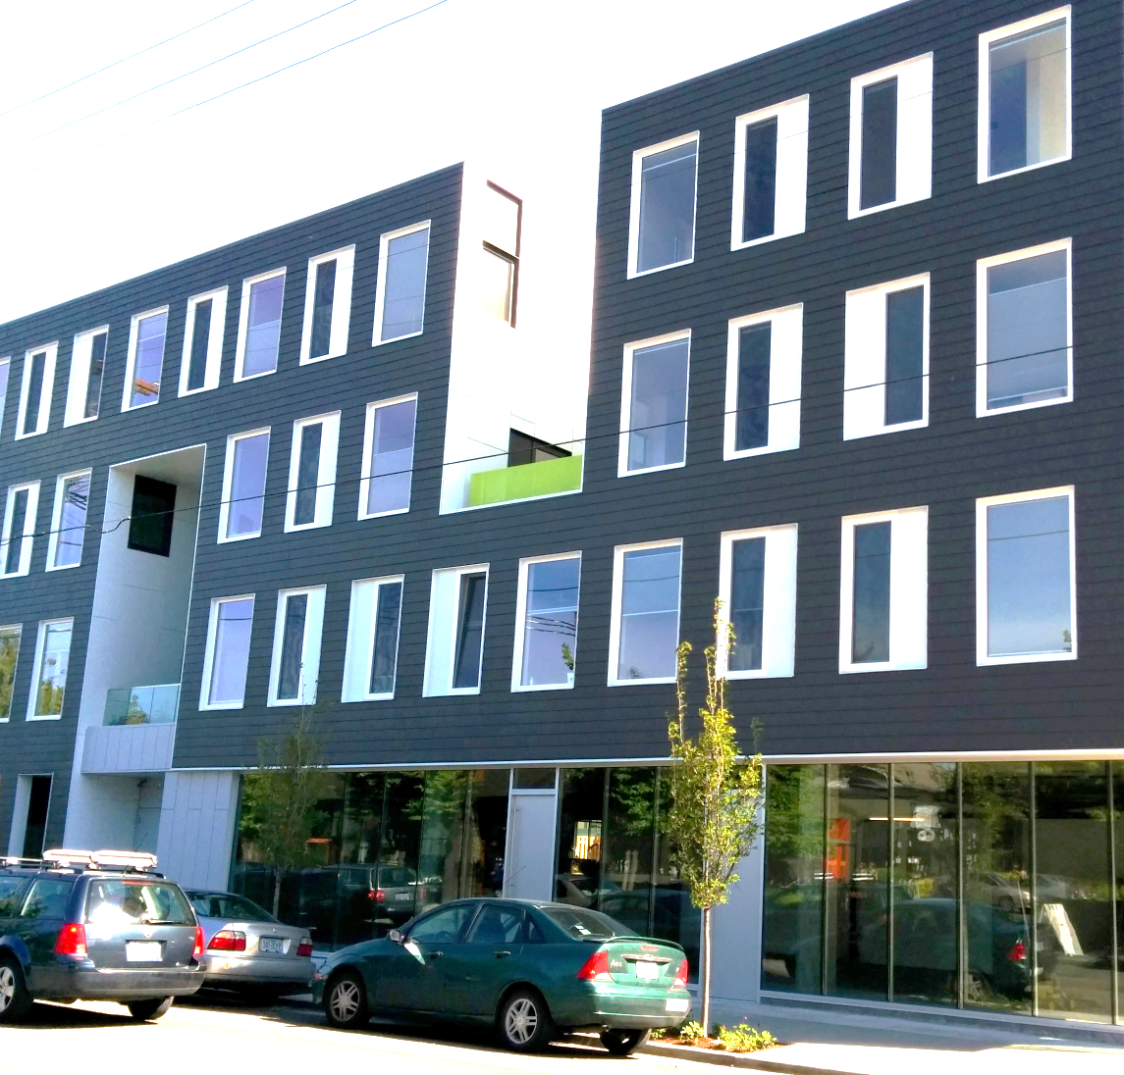


Better on-street management
Parking supply is getting tighter as commercial districts redevelop and demand for limited parking spaces increase

Slide 7
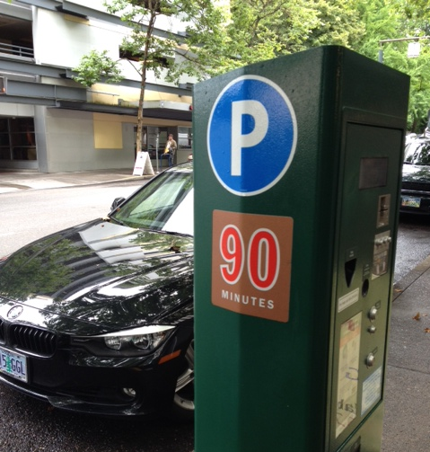
More demand-responsive
management
It is challenging to adjust parking rates and initiate parking management plans
New technologies and practices allow for more responsive management

Slide 8
Background – Resolution 37204
PERFORMANCE BASED
PARKING MANAGEMENT MANUAL
(Per Resolution 37204 –April 2016)
Purpose of the parking system
Performance targets
Procedures for establishing new meter districts
Using data to adjust rates, set frequency of adjustments, establish hours of enforcement, monitor and evaluate operations
Communication procedures for parking management
Coordinating on- and off-street parking into a more seamless system
Notes:
Thank You
Introductions
The direction to develop a Performance-Based process for managing parking was initiated more than three years ago as a key recommendation that emerged from the outreach process in developing the 2015 Citywide Parking Strategy. That extensive public outreach process included communication with close to 1,000 people and more than 50 briefings, meetings, and public events throughout the City. A consistent theme that emerging was the desire to manage parking using a transparent, data-driven approach, referred to a performance-based parking management.
(Advance)
With Resolution 37204 in April 2016, City Council directed PBOT to develop a Performance-Based Parking Management Program that establishes operational guidelines to implement City policy.
The resulting Parking Management Manual (PMM) developed over the last 18-months outlines standardized guidelines, performance measures, and exception processes to consistently manage Portland’s public parking system based on data. The program relies on parking management best practices to support the economic vitality of commercial districts with the primary goal of ensuring equitable, efficient access for all users.

Slide 9
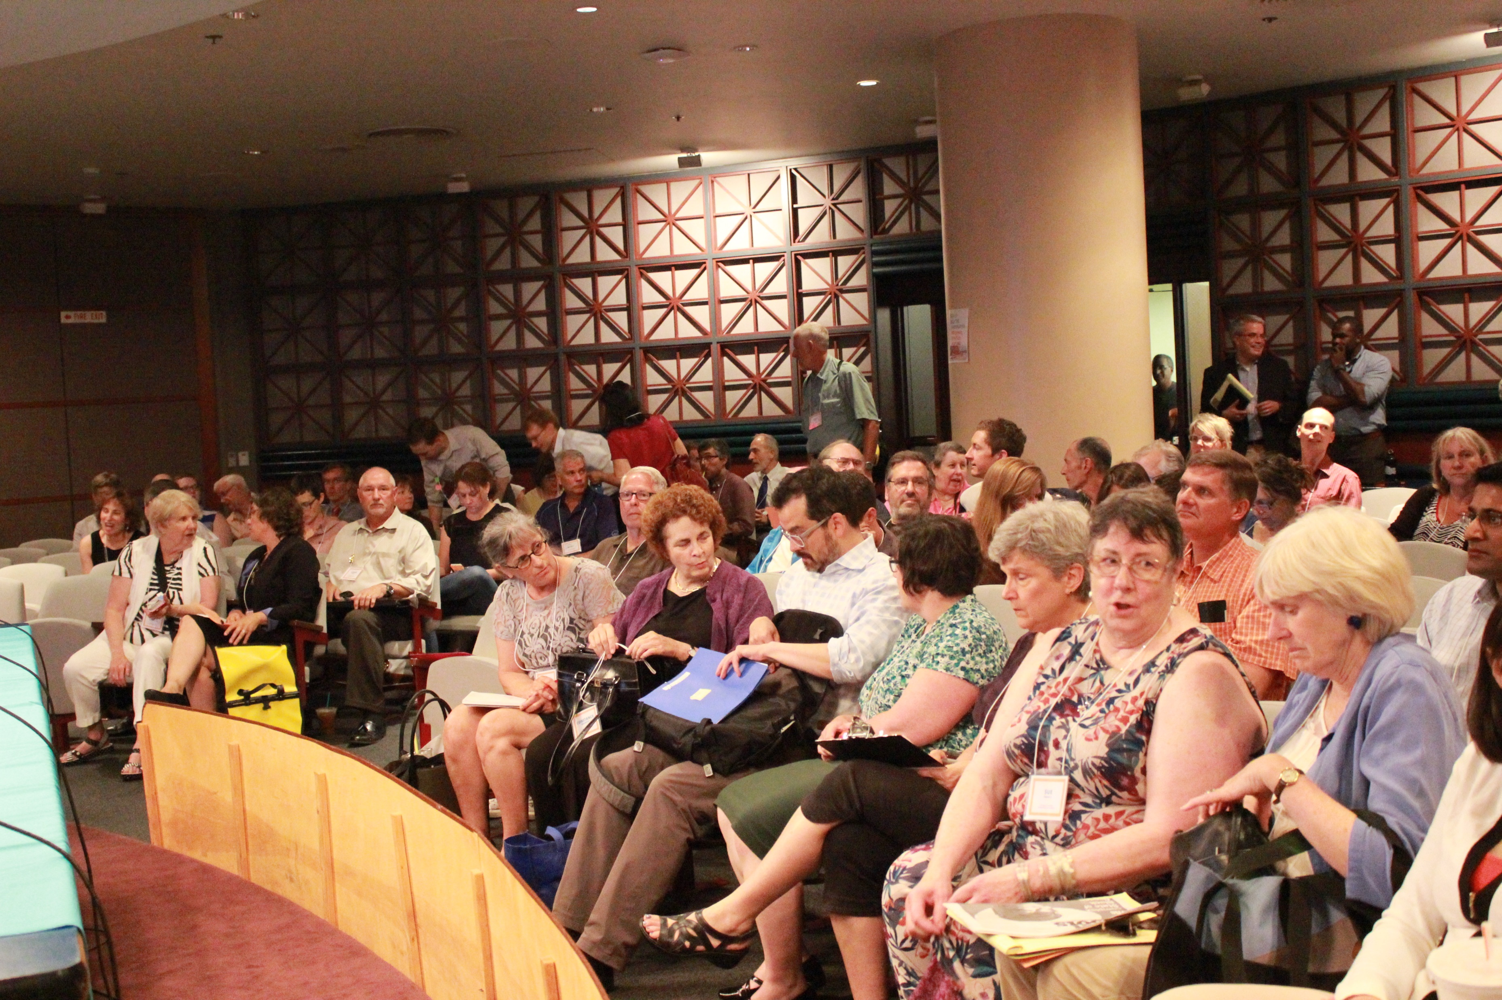
Public Support
Citywide Parking Strategy Process
Communication with close to 1,000 people
Support for data-driven management
Centers and Corridors Parking Project SAC
Endorsed the Parking Management Toolkit
Central City Parking Policy Update SAC
Recommended that staff develop a performance-based parking management program
2016 Downtown Meter Rate Adjustment Subcommittee
Recommended to transition from existing process to PBPM

Slide 10
Adopt the
Parking management manual
(Resolution)

Slide 11
Overview of Topics Covered
Introduction
Parking Management Districts
Time Limits
Pricing
Event Districts
Truck Loading Zones
Notes:
Presentation Outline
Each Chapter provides clear guidelines on each topic to serve as a resource manual, helping to add clarity and consistency to parking management questions that PBOT gets asked on a daily basis. Each chapter was developed with input from the Stakeholder Advisory Committee, and is based on a performance-based process that uses data and best management practices to inform parking management citywide.
_____________________________
FAQ: APP and Permit Surcharge?
These items are not included within this document.
FAQ: Use of Net Meter Revenue?
The use of Net Meter Revenue will continue to be spent per existing City Policy, covered in TRN 3.102 (1996)

Slide 12
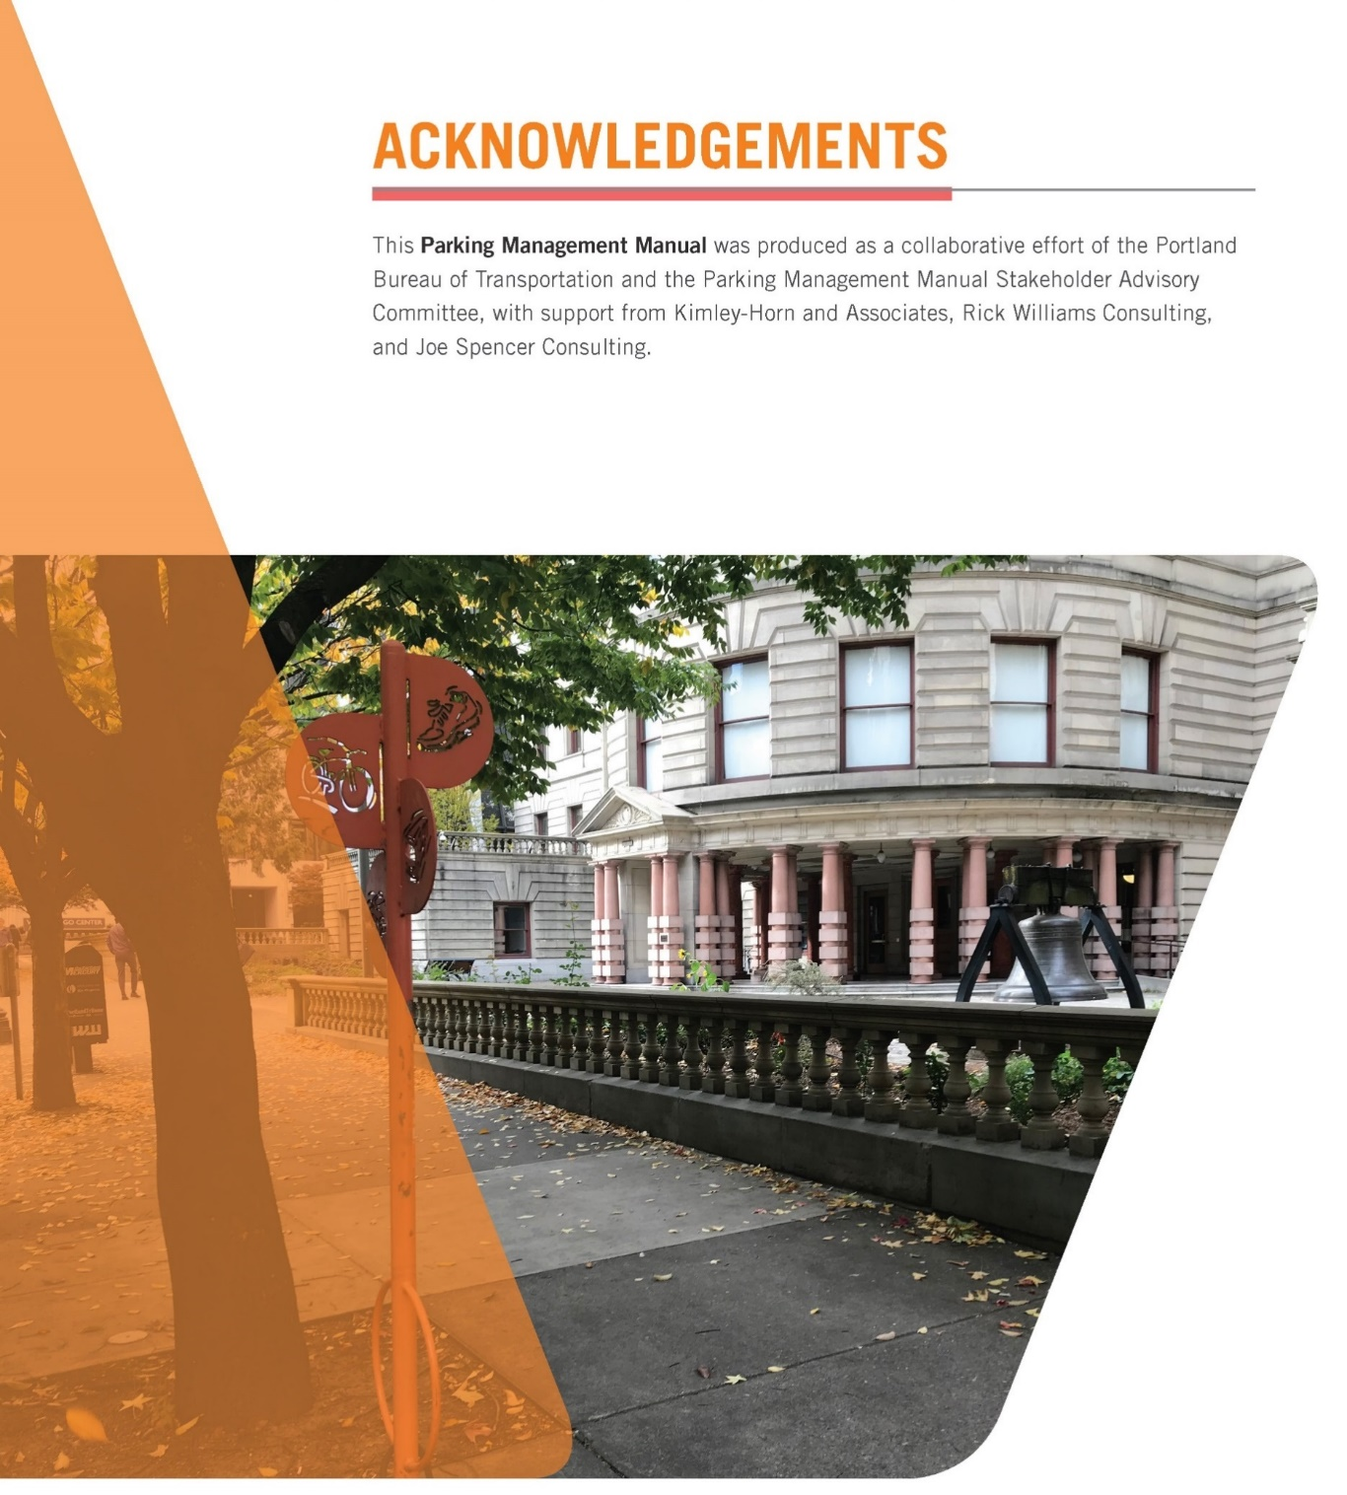
Partners
Notes:
As discussed in the Introductory Chapter, the manual is the result of a 12-month collaboration between PBOT and a 10-member Stakeholder Advisory Committee with representatives from:
The Pearl District Neighborhood Association
The Portland Business Alliance
Venture Portland
The Oregon College of Oriental Medicine
Portlanders for Parking Reform
The Central Eastside Industrial Council
The Northwest District
Go Lloyd
The Portland Freight Committee, and
The Portland Downtown Neighborhood Association

Slide 13
Public Outreach
“I'm very excited to see data & performance be used to set parking policy…”
Parking Management Manual Online Open House
  Available in 10 languages online (February 2018)
  Multiple comments in support of using data to set rates.
Letters of Support
  Individuals
  Go Lloyd
  Portland Business Alliance
  Portland Freight Committee
  Bureau of Planning and Sustainability
“I think a data‐driven approach is the best way to set parking management policy”
“I like that hourly parking prices will be adjusted to meet demand.”
“Bravo! I encourage the Commissioners to approve it… because studied, data‐based policymaking is what we need.”
Notes:
Adopt Parking Management Manual to establish guidelines for managing public parking in the City of Portland (Ordinance)
NOW, THEREFORE, the Council directs:
The City Council adopts the Parking Management Manual to guide management of the public parking system and directs the Bureau of Transportation to implement the guidelines contained in the Manual.
This ordinance is binding City policy.

Slide 14
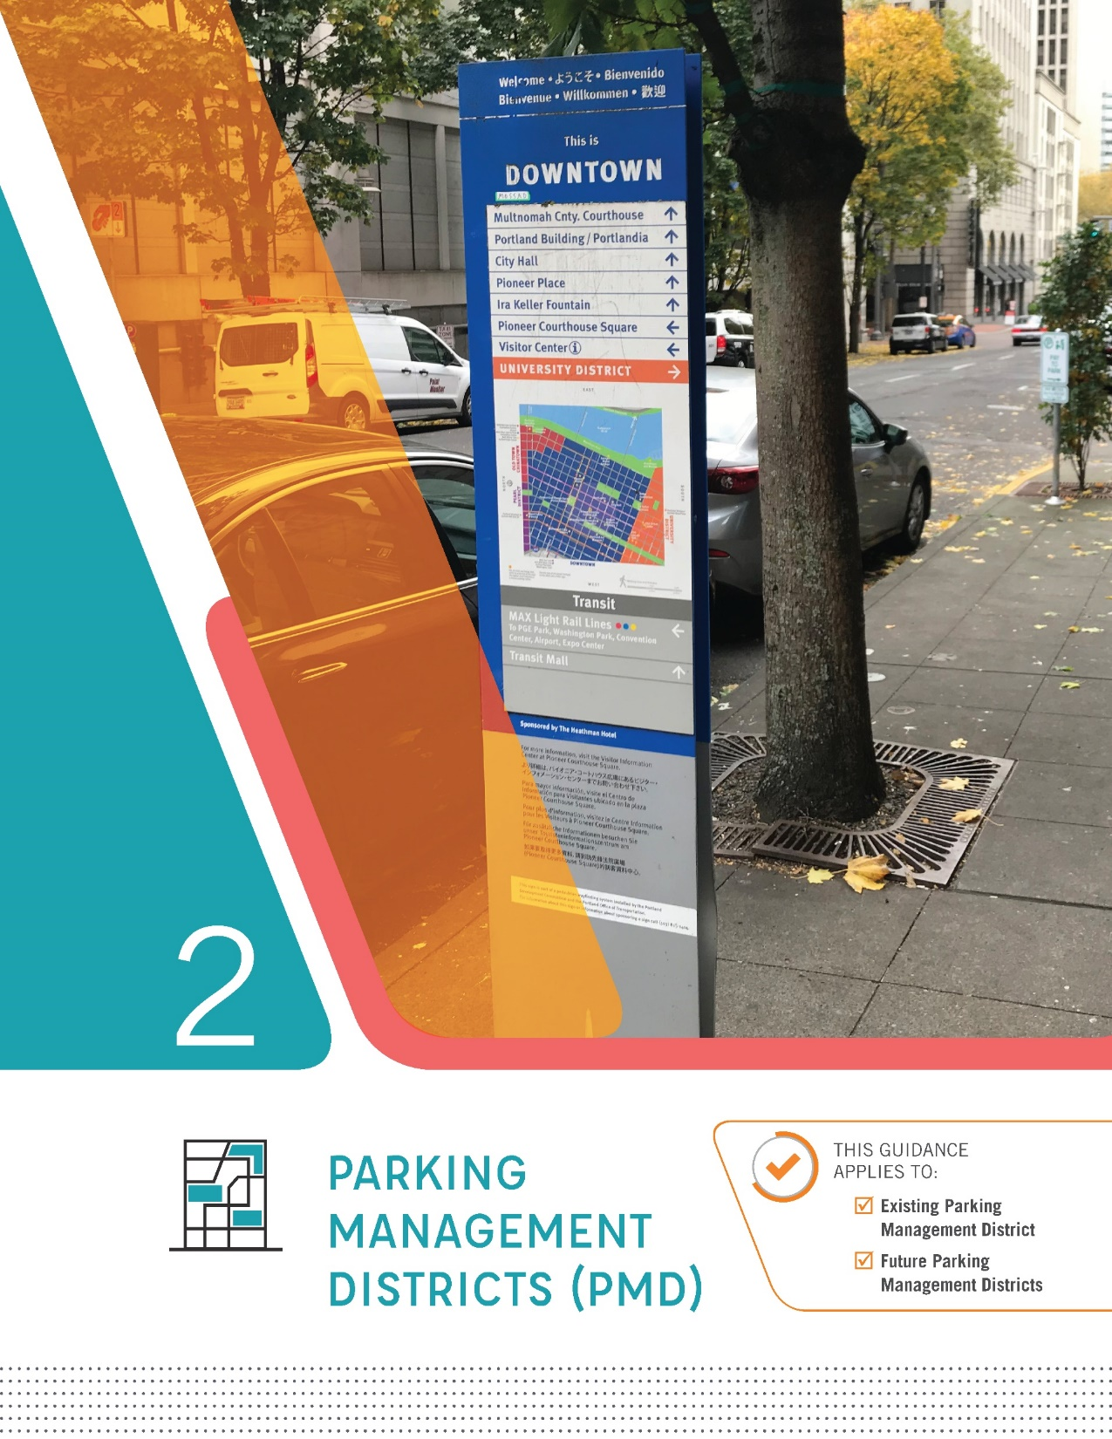
Guidelines Included:
Establishing New Parking Management Districts
  8-Step Process
  Outreach to Surrounding Communities
Notes:
Establishing New Parking Management Districts: There are currently no guidelines for establishing new Parking Management Districts in commercial corridors. The PMM provides clear guidance for establishing a workgroup of business representatives and district residents responsible for recommending parking management strategies and monitoring performance. The process includes outreach to surrounding communities, including nearby historically underserved communities of color to insure any potential impacts from parking management in the commercial corridor are mitigated.
Implementing On-Street Paid Parking: The PMM clarifies existing policy and establishes a series of requirements that must be met to implement a new meter district within a Parking Management District. As noted in the Parking Management Toolbox (approved in February), meters should only be used as a tool to manage demand in commercial corridors after time limits with consistent enforcement do not achieve the stated performance goals.
_________________________________________
FAQ: Will PBOT Begin to Impose New Parking Management Practices?
Parking Management remains community-driven and PBOT will continue to respond to requests for new or revised local parking management strategies. The Manual helps document PBOT’s parking management practices, providing additional consistency, clarity, and transparency in the implementation of existing City policy.

Slide 15
Amendment language
Added language in Resolution about the composition of a workgroup or Parking Committees for new Parking Management Districts (PMD)
  Should include ten (10) stakeholders consisting of:
    3 business owners
    5 residents
    2 employees of the proposed PMD who live outside of the area
Added language that Parking Committee should consider the equity implications of the changes to the parking system in their PMD
This language will be incorporated into the Final Parking Management Manual
Notes:
Presentation Outline
Each Chapter provides clear guidelines on each topic to serve as a resource manual, helping to add clarity and consistency to parking management questions that PBOT gets asked on a daily basis. Each chapter was developed with input from the Stakeholder Advisory Committee, and is based on a performance-based process that uses data and best management practices to inform parking management citywide.
_____________________________
FAQ: APP and Permit Surcharge?
These items are not included within this document.
FAQ: Use of Net Meter Revenue?
The use of Net Meter Revenue will continue to be spent per existing City Policy, covered in TRN 3.102 (1996)

Slide 16
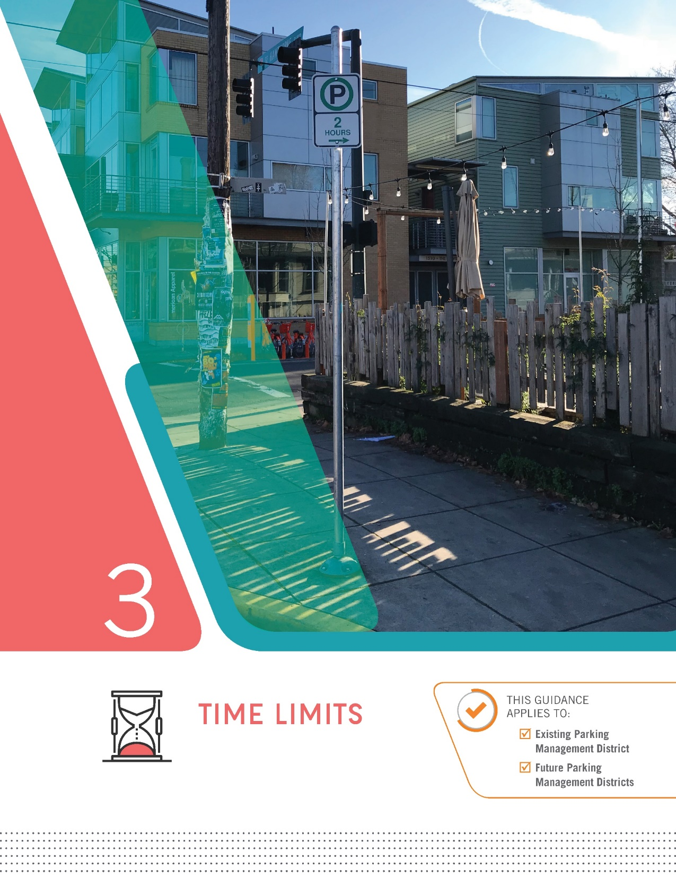
Guidelines Included:
Standardized Time Limits
  15-Minutes or 30-Minutes
  2 Hours
  4 Hours
For New Parking Management Districts in Commercial Corridors:
  Default Time Limit: 2 Hours
Notes:
Standardized Time Limits: The PMM simplifies existing time limit implementation to help ensure that Portland’s on-street parking system is easy to understand and navigate, better allowing visitors to quickly find parking that meets their needs.
Default Guidelines for Time Limits in New Parking Management Districts: 2-hours will serve as the default time limit, starting at 10am. Adjustments to default enforcement hours to be based on data.
__________________________________________________
FAQ: Enforcement Hours in Existing Meter Districts/Existing PMDs
Any changes to enforcement hours in existing districts would be based on data, and would come before Council for approval
FAQ: Prepay for Parking for the Next Day
Current parking meter technology in Portland does not allow users to prepay for the next morning. Later enforcement hours (where applicable) would help to support Action Item I.2 in the Vision Zero Action Plan, which calls for implementing measures to encourage impaired drivers to leave their cars overnight without concern of getting a parking ticket for being towed.

Slide 17
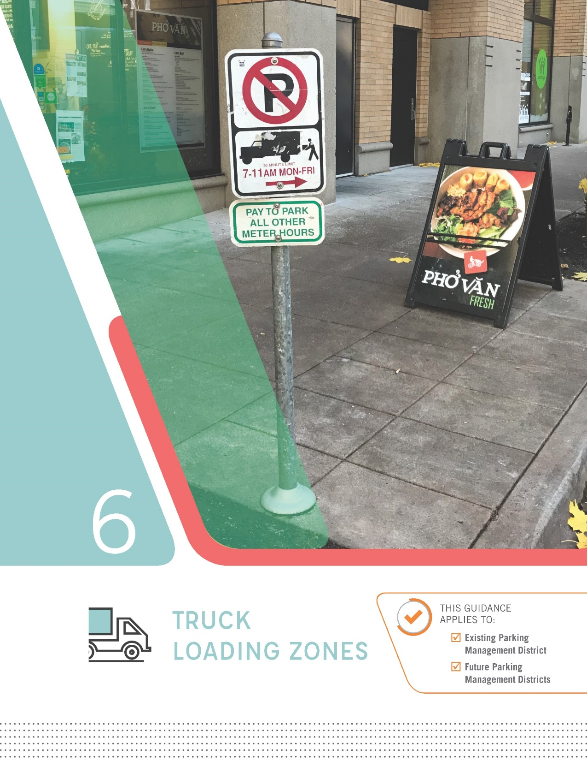
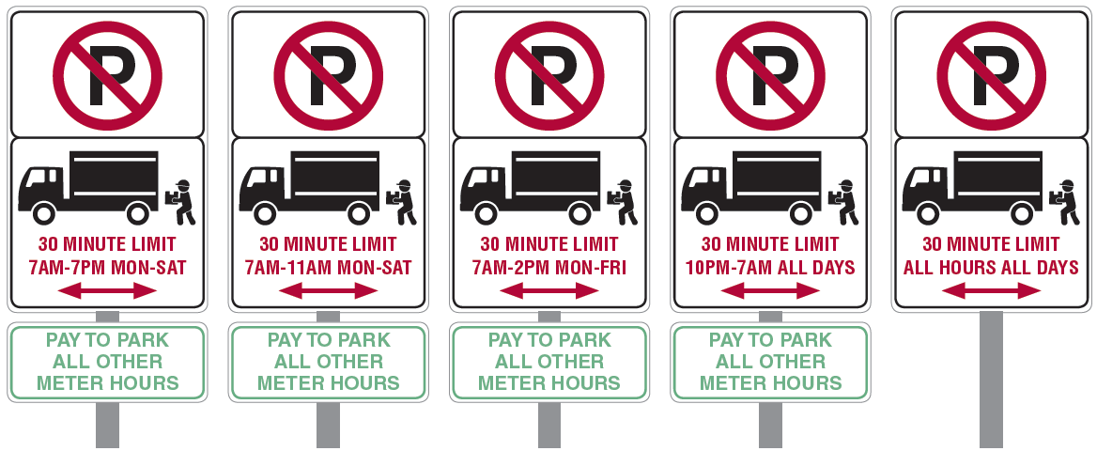
Guidelines Included:
Consistent Approach to Loading Zone Management
Support Business Needs while Providing Access for All Users
Proposed guidelines supported by the Portland Freight Committee
Notes:
Consistent Loading Zone Management: The PMM establishes five standard loading zone options (reduced from 44) to improve consistency and allow both freight operators and visitors to easily find available parking. The Portland Freight Committee supports the proposed guidelines, which continue to support businesses with on-street delivery needs while allowing for equitable access for all users.

Slide 18
Rescind Trn 3.102 Meter District Policy
(Ordinance)

Slide 19
Updates to TRN-3.102
TRN-3.102 – Parking Meter District Policy
REVISED:
Parking Meter Rate Setting
NO CHANGES:
Parking Meter Revenue Allocation Policy
1996
2018
(New Ordinance)
(New Ordinance)

Slide 20
Adopt new parking and event district policy
(Ordinance)

Slide 21
Overview of Topics Covered
Introduction
Parking Management Districts
Time Limits
Pricing
Event Districts
Truck Loading Zones
Notes:
Presentation Outline
Each Chapter provides clear guidelines on each topic to serve as a resource manual, helping to add clarity and consistency to parking management questions that PBOT gets asked on a daily basis. Each chapter was developed with input from the Stakeholder Advisory Committee, and is based on a performance-based process that uses data and best management practices to inform parking management citywide.
_____________________________
FAQ: APP and Permit Surcharge?
These items are not included within this document.
FAQ: Use of Net Meter Revenue?
The use of Net Meter Revenue will continue to be spent per existing City Policy, covered in TRN 3.102 (1996)

Slide 22
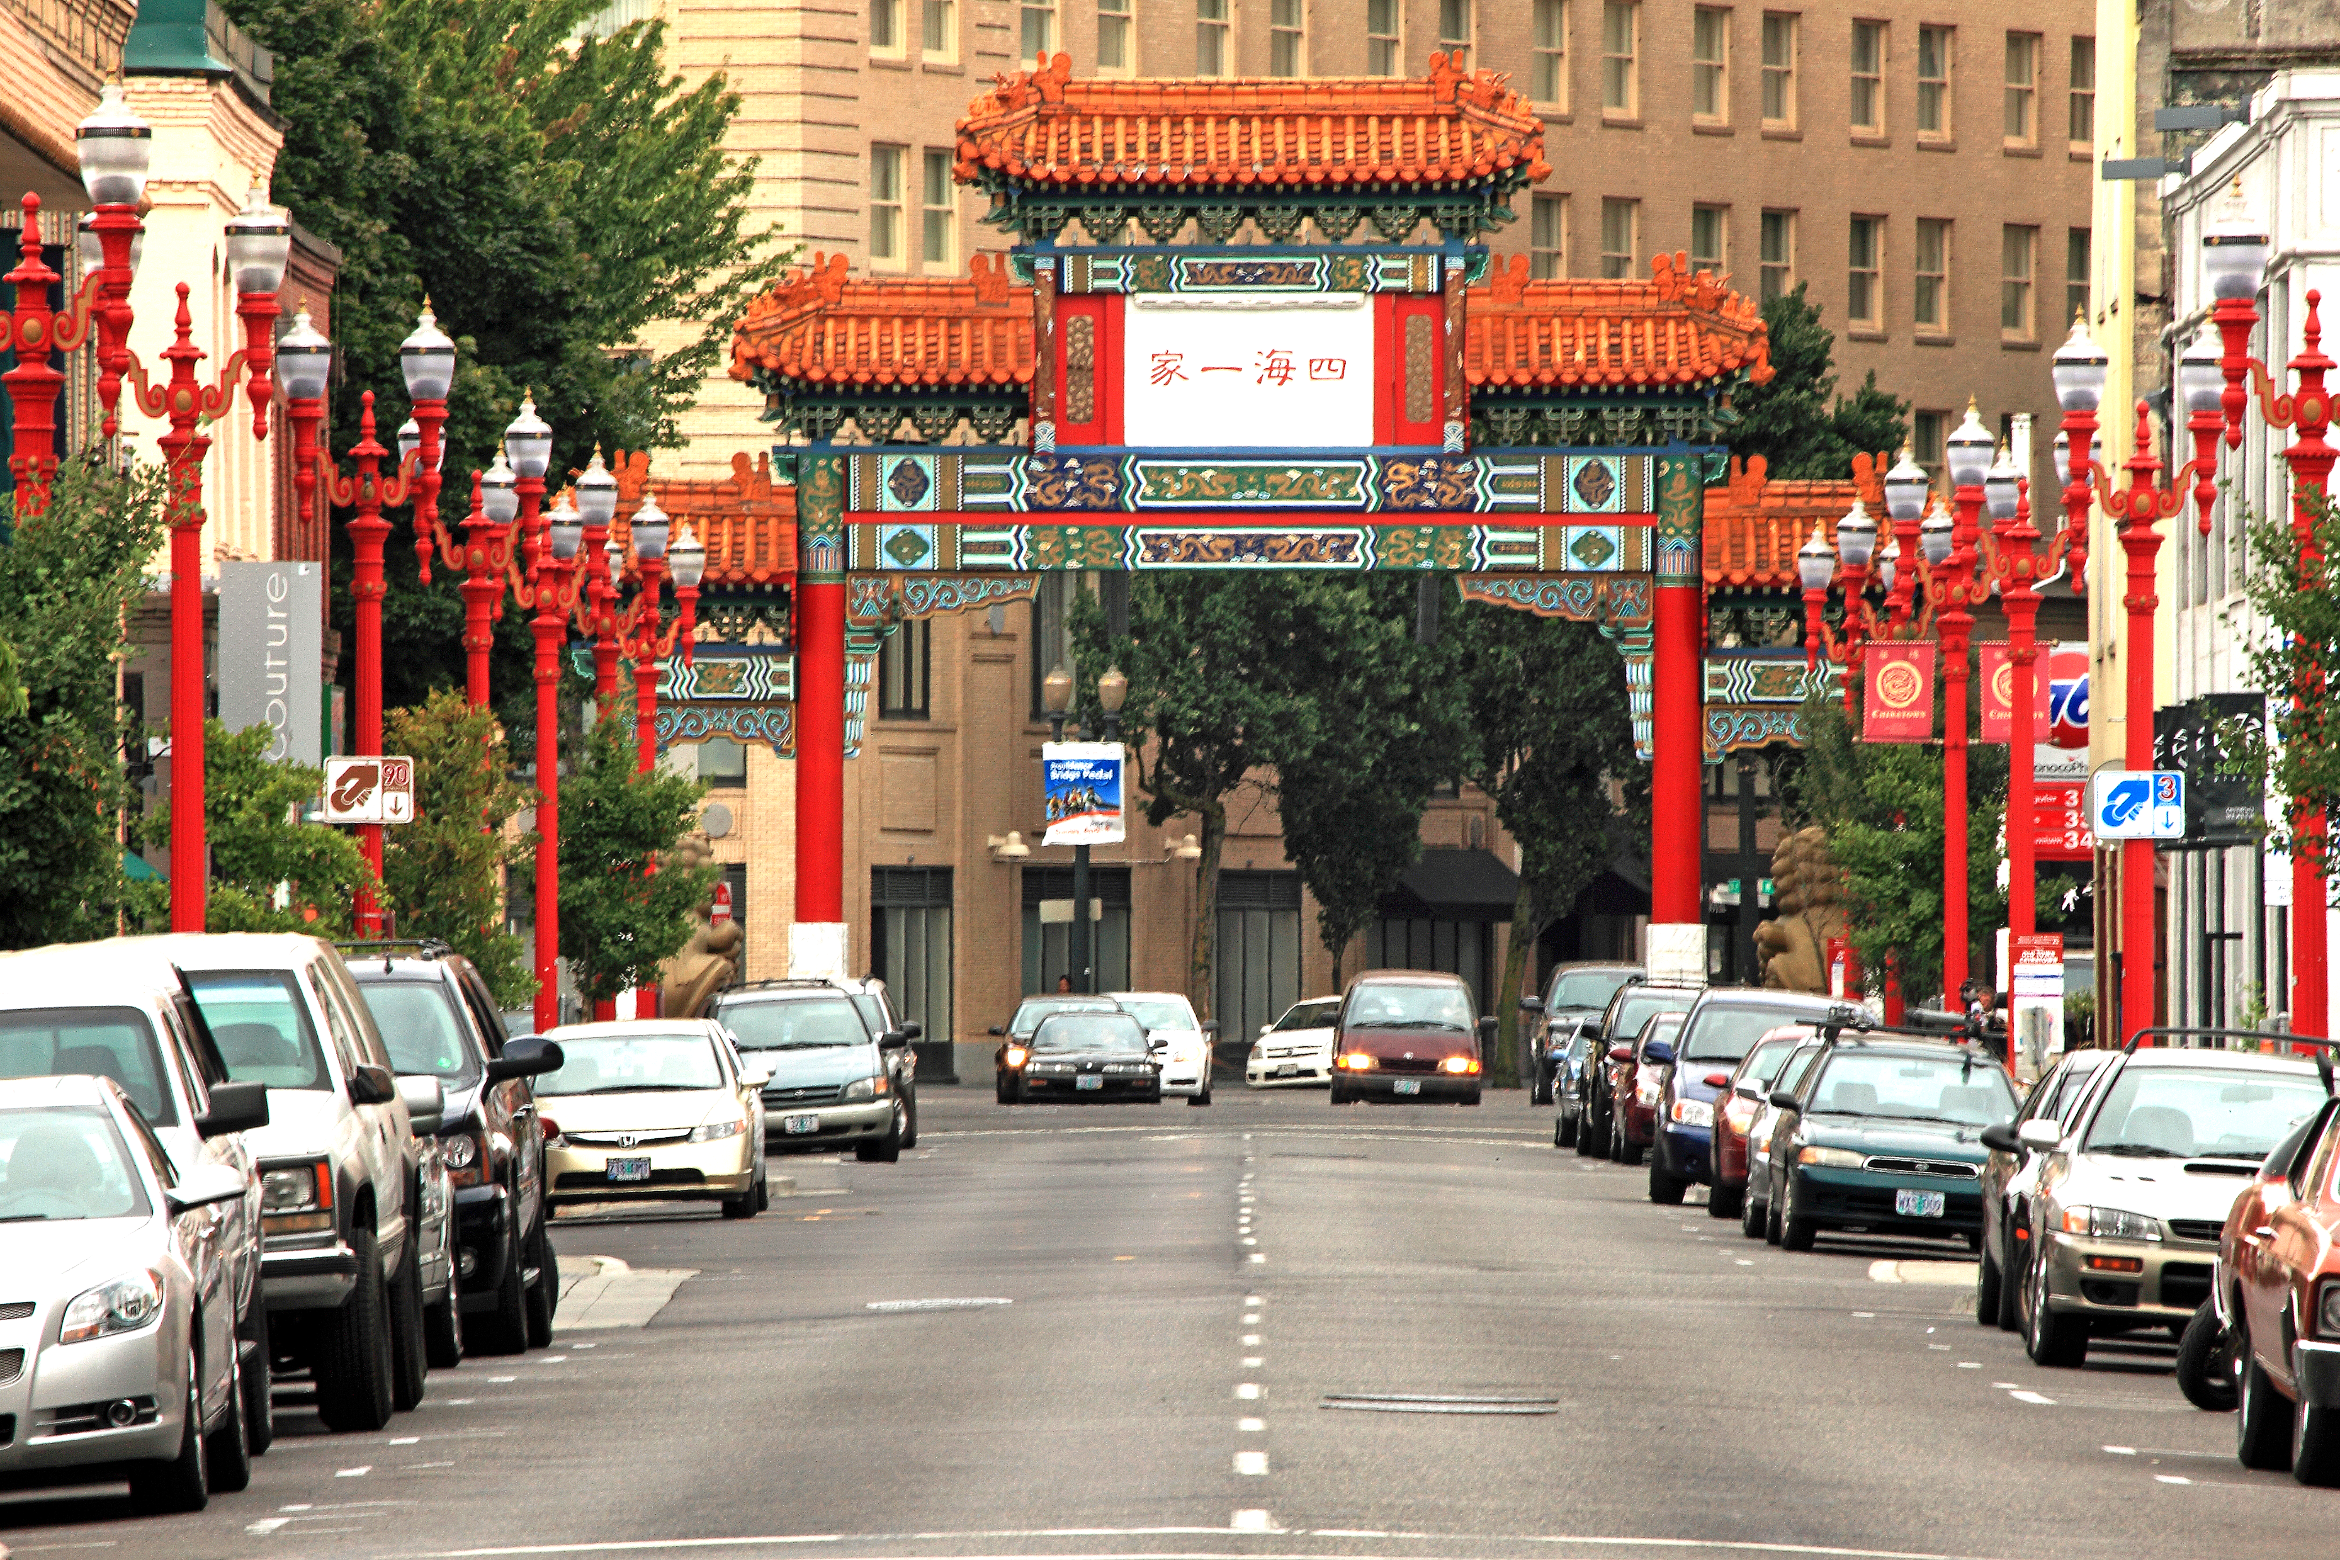
PERFORMANCE-BASED PARKING MANAGEMENT
(PBPM)
Notes:
The Portland Bureau of Transportation is in the process of developing a Citywide Parking Strategy. We are here today to present our work to date and to get feedback from you on our general direction before we finalize our recommendations.
The development of a Citywide Parking Strategy will include:
Recommended changes to policies and practices related to parking;
Recommended changes to the City’s zoning code Title 33 related to parking;
Recommended changes to Title 16 related to management of parking resources in the Central City.
The two main projects we will present on today are the Centers and corridors parking project, and the Central City Parking Policy Update. The study areas are called out in the image.

Slide 23
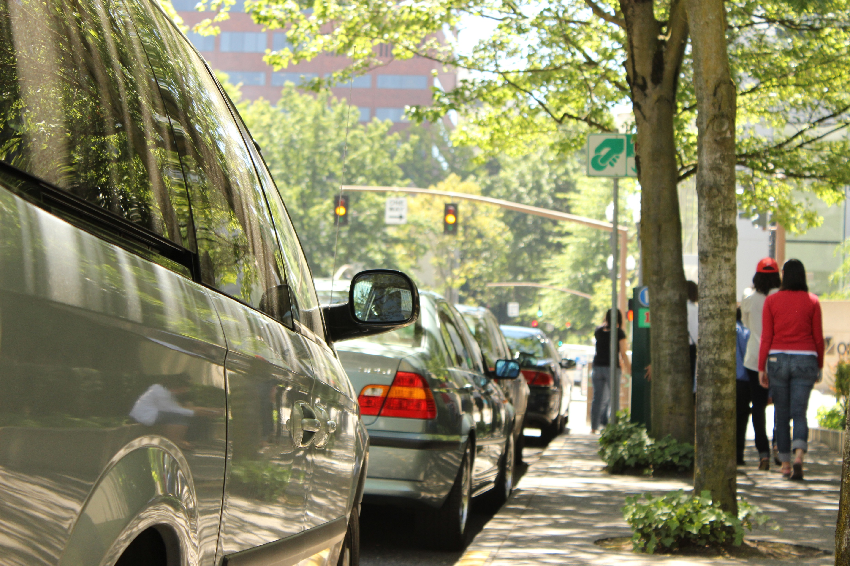
What is PBPM?
Is data-driven, clear and transparent
Relies on performance metrics
Maximizes customer experience
and efficiency of parking system
Is not driven by revenue
Improves reliability of transportation system and overall livability of places
Includes industry best practices for parking management
Notes:
Basic goals of any demand-based pricing program, if done right…
“Good government” program – “the care of human life and happiness and not their destruction is the only legitimate object of good government” (Jefferson)
Uses transparent methods and sound data collection to justify policy changes
When done correctly, is revenue-neutral – this is NOT a program to raise money, it is a program to utilize market principles for the betterment of all transportation system users
Better yet, it maximizes the customer experience of the parking system – this is where messaging is key, in concert with the fact that it is revenue-neutral – transportation system users, like any customer, like to be treated well. Signage, clear policies, easy to use meters are all part of this experience.
The system makes parking function better as a piece of the transportation puzzle. Making it easier for drivers to find parking spaces reduces the amount of circling people do to look for parking spaces that just aren’t there in high-demand areas. Fewer people distractedly circling for parkign spaces or double parking means faster transit, safer crosswalks/bike lanes, and happier customers/businesses.

Slide 24
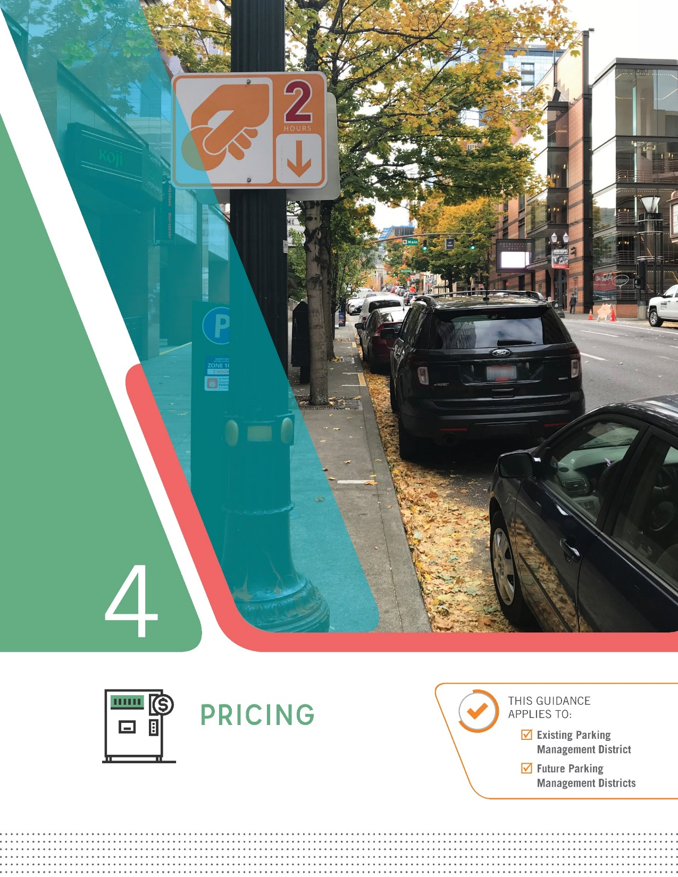
Guidelines Included:
Performance-Based Process
  Performance Target: 65% - 85% occupied during peak period
A predetermined rate range
  From $1 up to $5 an hour
Standardized Annual Review Process
  Either no change, or adjust up or down by increments of $0.20, $0.40, or $0.60 (maximum) based on data
  Final rates approved by Council
Enforcement hours for both and new and existing meter districts have to be approved by Council
Notes:
Performance-Based Process: The PMM establishes performance targets (specifically a goal occupancy range 65% - 85% during peak periods) and provides guidelines for adjusting hourly parking rates annually (if needed) based on data. The primary goal to support economic vitality by allowing visitors to quickly and easily find convenient parking, even during peak hours.
Standardized Annual Review Process: Tiered rate adjustments are established to allow for a clear, transparent, data-driven process. All proposed rate adjustments emerging from this process will come before Council each year. Other cities that have implemented performance-based pricing, such as San Francisco, Seattle, and Washington DC, have found it to be an effective method to adjust rates based on data and therefore balance demands.
More Parking Options for All Users: Allows for rate reductions in lower demand areas, providing more opportunities for individuals to find on-street parking at a more affordable rate. Off street rates will continue to provide a lower cost option. Additionally, SmartPark garages offer a discounted monthly pass for low income employees.
__________________________________________________
FAQ: Is This Surge Pricing?
Not surge pricing; it is simply a standardized, data-driven annual rate review process.
FAQ: Is This Simply a Method to Increase Meter Revenues?
Peer cities have found the change in revenue to be largely negligible (0 to 3% change). The goal of the process is to balance system demands and improve each of access.

Slide 25
Annual Rate Review Process
PBOT collects data and recommends rate adjustment based on parking occupancy/demand every year
City Council considers recommendation and adopts yearly rates as part of budget process rate fee schedule
↑ Rate Increase
Measured Occupancy
No Rate Change
↓ Rate Decrease

Slide 26
Annual Rate Review Process
↑ Rate Increase
Measured Occupancy
$2.00
No Rate Change
↓ Rate Decrease

Slide 27
Annual Rate Review Process
$5.00 Max.
↑ Rate Increase
$2.60
$2.40
$2.20
Measured Occupancy
$2.00
No Rate Change
$1.80
$1.60
↓ Rate Decrease
$1.40
$1.00 Min.

Slide 28
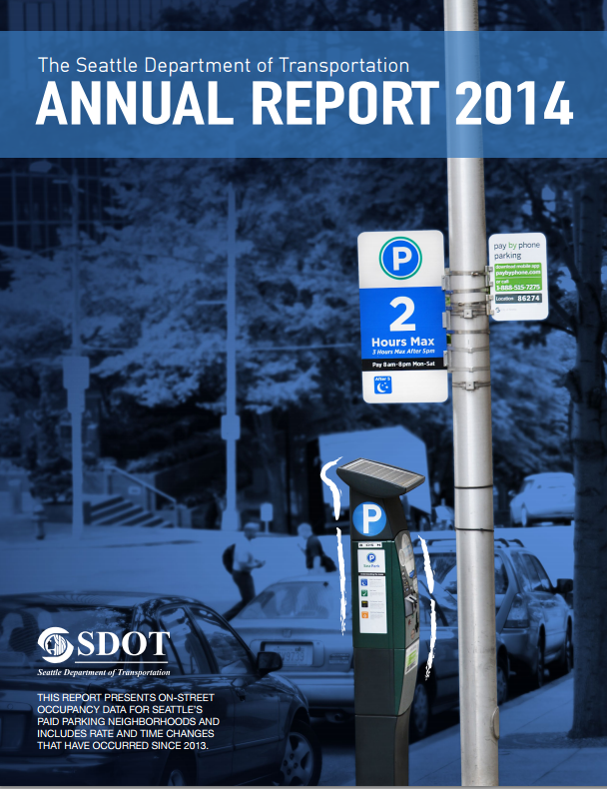
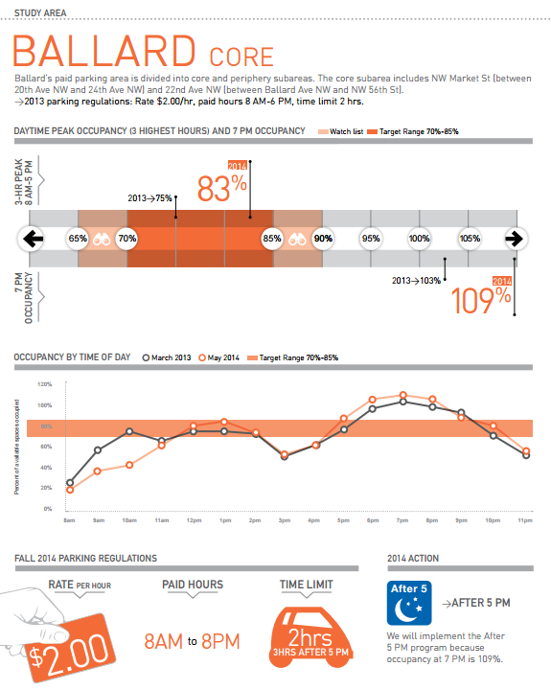
Seattle example: REPORTING
EXAMPLE: Seattle Department of Transportation (SDOT) 2014 Annual Paid Parking Report
Notes:
Example is of type of detailed analysis completed to performance-based pricing
Seattle has collected performance data for non-metered areas to inform decision-making on establishment of new metered areas, and Residential Permit Parking Zones.
Performance-analysis has led to innovative management, including:
Extended meter hours (to 8 pm), with extended time limits after 5pm in areas where “occupancy at 7 pm exceeds target”
Establishment of 10-hour time limit in South Lake Union (where on-street occupancy was low in some areas, but lower pricing was not expected to increase utilization).
Public signage and education (new “Best Value” directional signs) to direct people driving to the least expensive (and generally most available) parking in any given paid parking area – usually at the edge of the business district, or a block or two away from the primary arterial.
Establishment of seasonal rates (variation of rate by season) to account for variation in demand in places such as the Ballard Locks – a prime tourist destination in the summer months.
Kevin

Slide 29
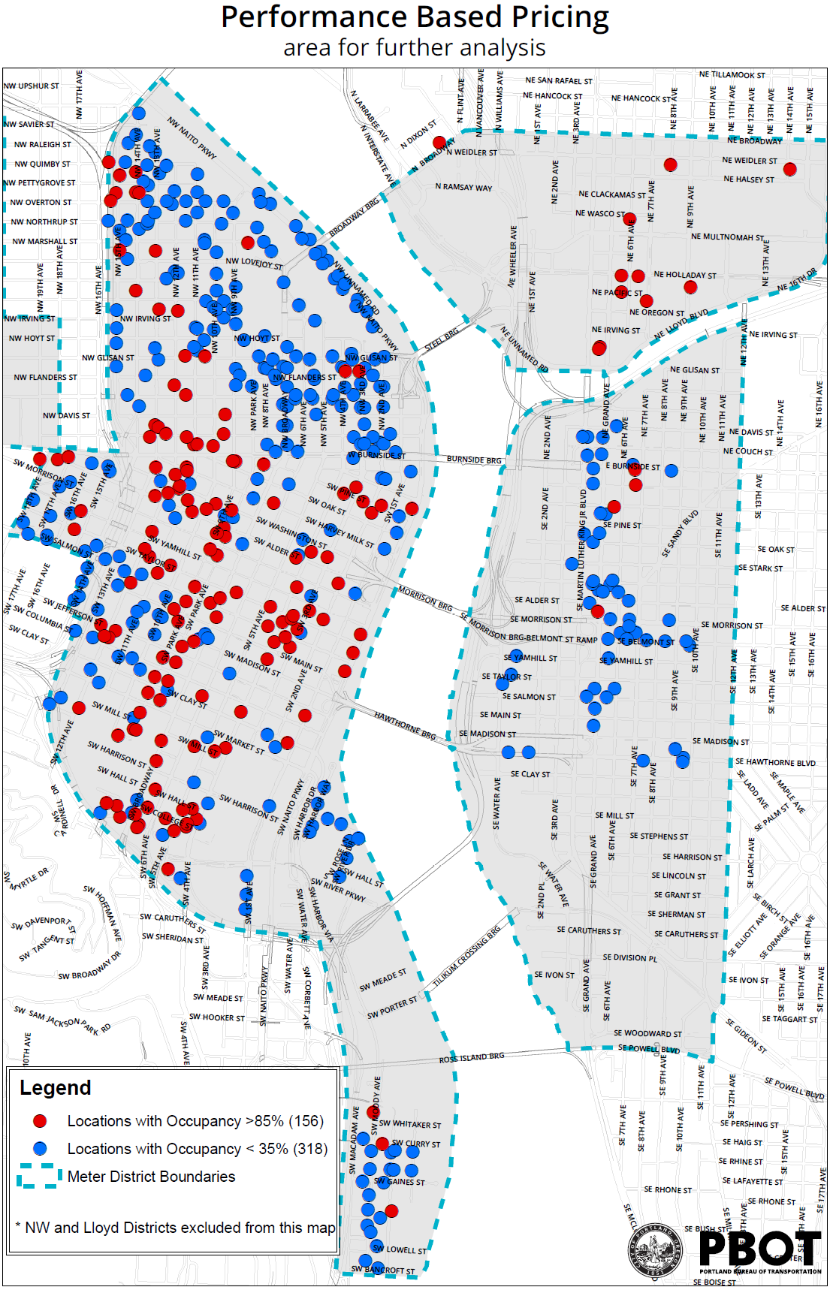
Data-Driven
Management
PBOT receives very few comments that rates are too high, but frequently hears that finding on-street parking is very difficult in some parts of the City.

Slide 30
Who uses public parking
PBOT 2015 Downtown
Meter Rate Intercept Survey
By policy, most public parking along commercial corridors is managed for short-term uses, not commuting
Notes:
During the last meter rate increase, the equity considerations were considered and examined. PBOT staff conducted an intercept survey of evening on-street parkers on the purpose of their visit that day. Only 25% of the respondents were headed to work, of those only 1/3 of them were headed to work in the service industry (health, restaurants, janitorial, etc.).

Slide 31
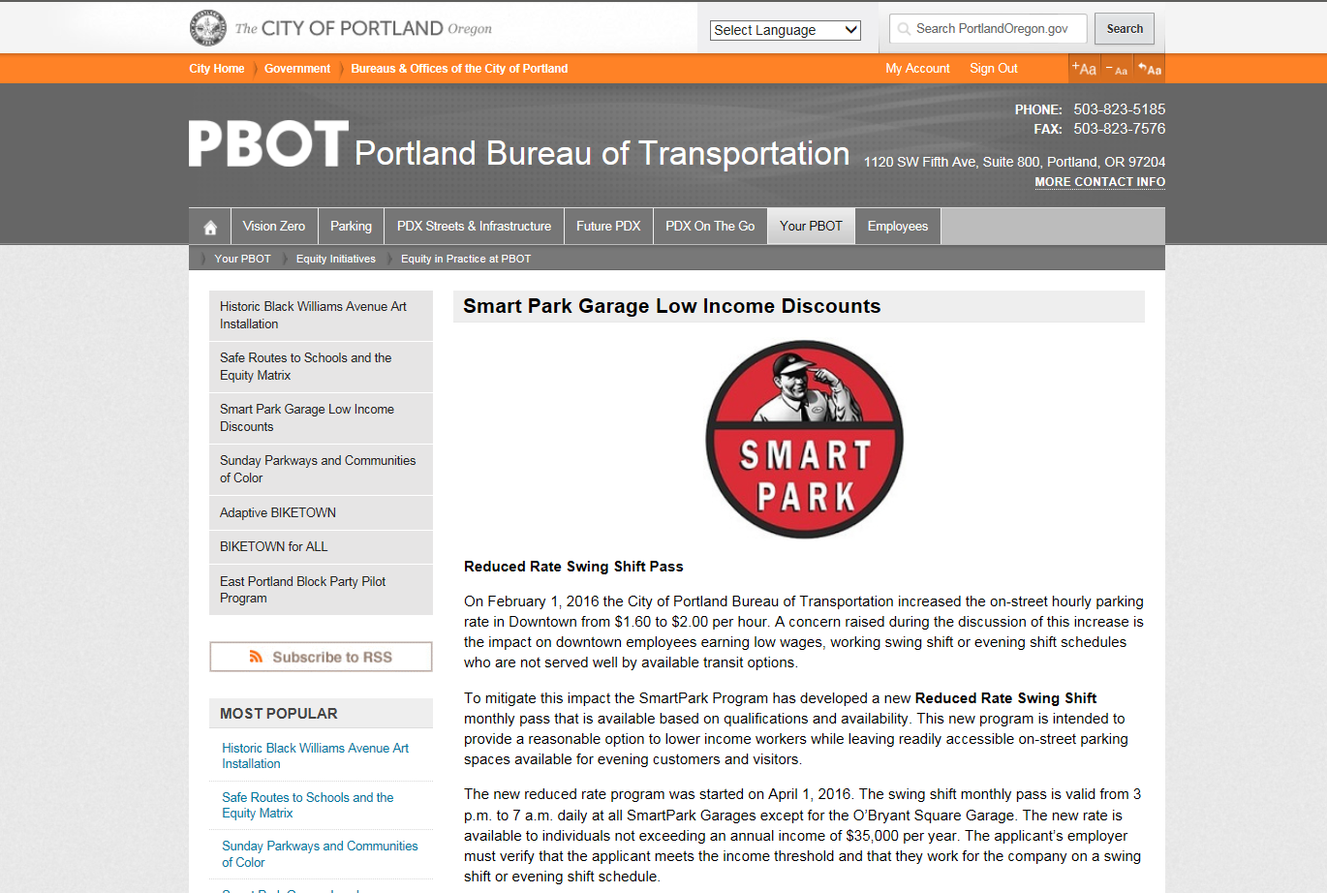

Slide 32
Event districts

Slide 33
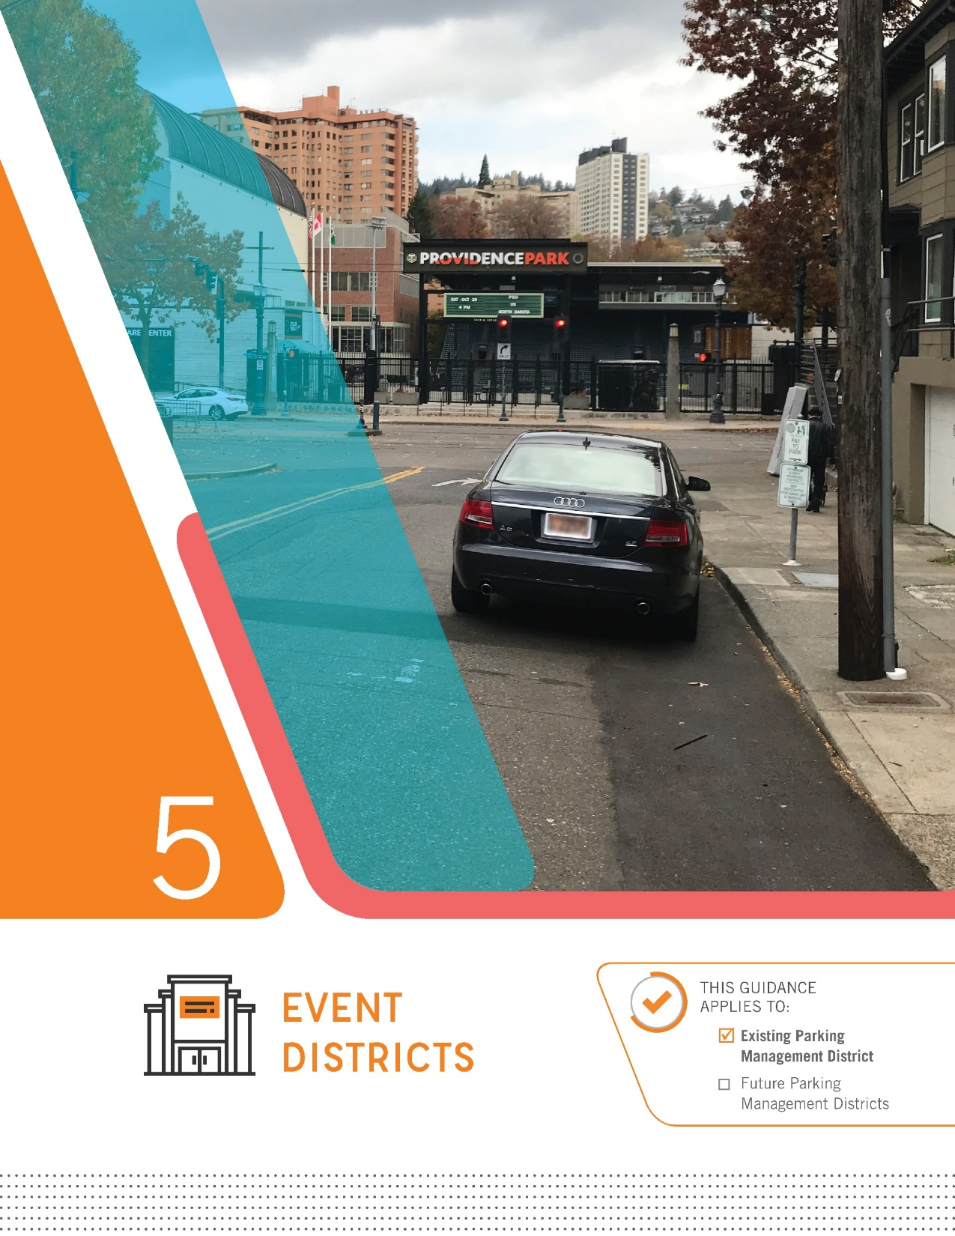
Guidelines Included:
Establishing Event Districts
  Providence Park (Existing)
  Rose Quarter
  Convention Center
Standardized Annual Review Process
  Adjust rates based on data to incentivize the use of alternative modes
  Predetermined rate range
Enforcement hours for both and new and existing meter districts have to be approved by Council
Proposed guidelines supported by the Oregon Convention Center and the Rose Quarter
Notes:
There are currently no guidelines for establishing new Event Districts around large venues (which is to say venues with a capacity of 10,000 or more). The PMM establishes a process for managing on-street public parking during events, with the goal of encouraging the use of alternative modes, reducing congestion, and minimizing impacts on surrounding neighborhoods. The process is supported by the Oregon Convention Center and the Rose Quarter.
__________________________________________________
FAQ: Specific Venues, Special Events, etc.
The proposed process, when used, will only be applicable around Providence Park, the Rose Quarter, and the Convention Center. No changes to standard on-street pricing will be used for events or around smaller venues.

Slide 34
Event District Rate Review Process
PBOT collects data and recommends rate adjustment based on parking occupancy/demand every year
City Council considers recommendation and adopts yearly rates as part of budget process rate fee schedule
↑ Rate Increase
Measured Occupancy
No Rate Change
↓ Rate Decrease

Slide 35
Event District Rate Review Process
$10.00 Max.
$6.00
↑ Rate Increase
$5.00
Measured Occupancy
$4.00
No Rate Change
$3.00
↓ Rate Decrease
$3.00 Min.

Slide 36
Thank you
(Resolution) Adopt new parking management policies in Parking Management Manual
Adopt new Parking Meter Rate Policy
  (Ordinance) Rescind outdated policy (and maintain meter rate allocation policy with new number)
  (Ordinance) Adopt new performance-based parking management pricing policy
Notes:
Why are we here?
To rescind outdated policy governing parking management and to adopt new policy guiding PBOT on managing parking that is:
Data-driven
Transparent
Responsive to changing environments

Slide 37
Additional Slides

Slide 38
Parking then and now
1938
1,336 parking meters installed between SW 3rd, SW 10th, SW Salmon and
SW Oak Streets
Notes:
These other parking projects will be brought to Council for discussion sometime early next year.

Slide 39
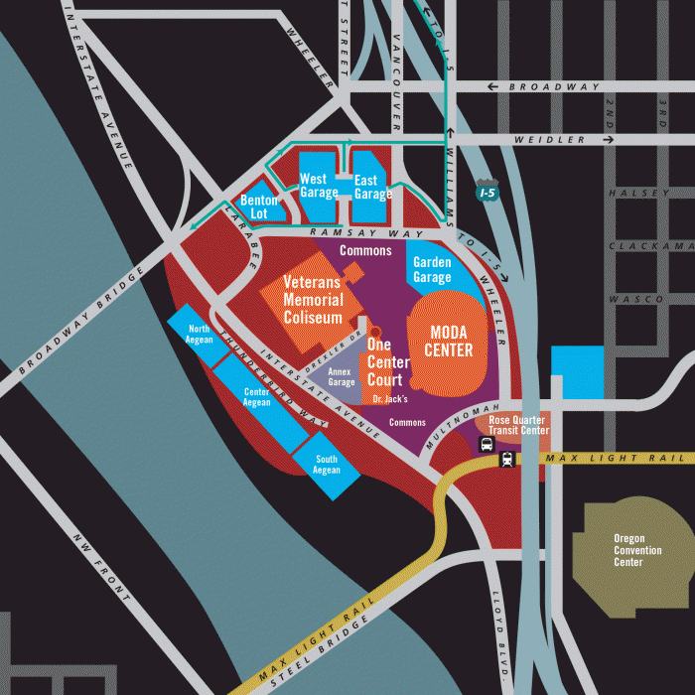
Example Transportation Costs for Event in Rose Quarter
2 People, Stay of 4 hours
 | Cost
Off-Street Event Parking | $26.00
Transit | $10.00
Biketown | $9.60*
On-Street Parking (@ $1.00/hr) | $4.00
*Assuming a 30-minute ride each way

Slide 40
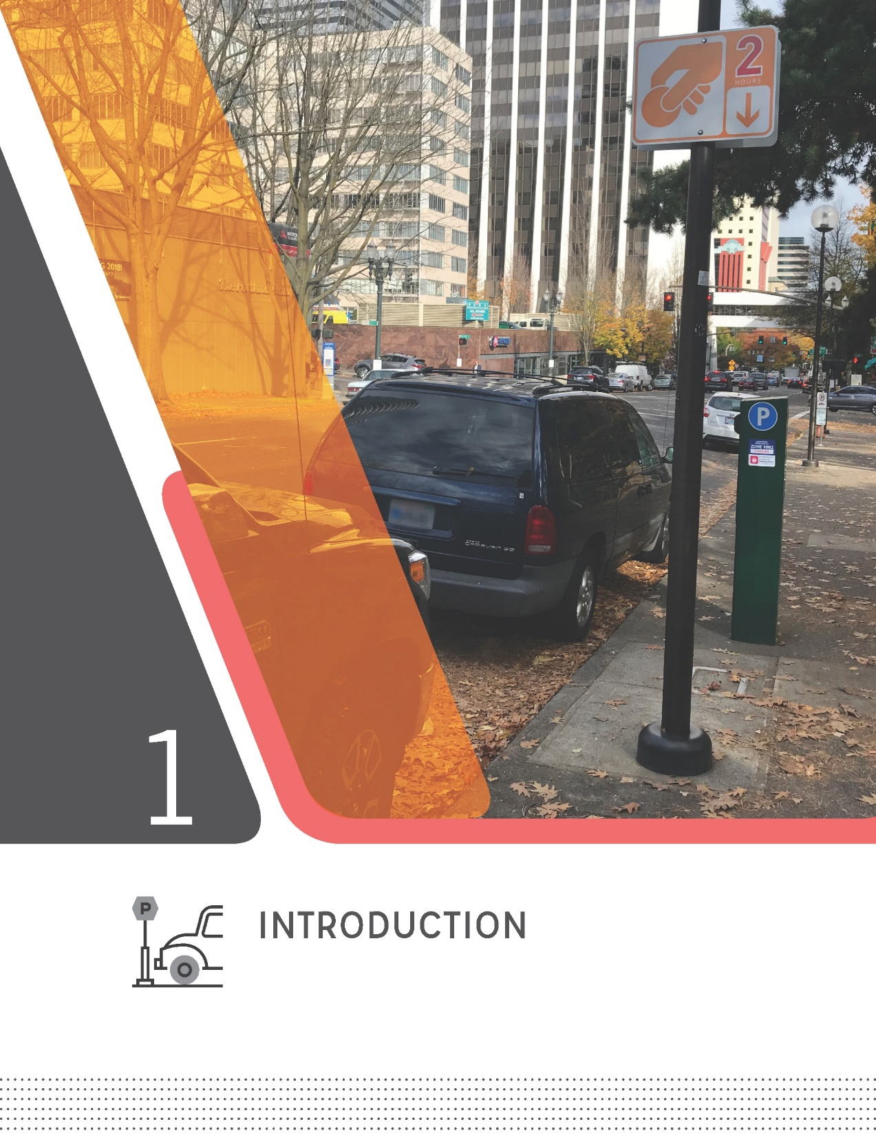
Overview of Topics Covered
Introduction
Parking Management Districts
Time Limits
Pricing
Event Districts
Truck Loading Zones
Notes:
Presentation Outline
Each Chapter provides clear guidelines on each topic to serve as a resource manual, helping to add clarity and consistency to parking management questions that PBOT gets asked on a daily basis. Each chapter was developed with input from the Stakeholder Advisory Committee, and is based on a performance-based process that uses data and best management practices to inform parking management citywide.
_____________________________
FAQ: APP and Permit Surcharge?
These items are not included within this document.
FAQ: Use of Net Meter Revenue?
The use of Net Meter Revenue will continue to be spent per existing City Policy, covered in TRN 3.102 (1996)

Slide 41
Partners
Notes:
As discussed in the Introductory Chapter, the manual is the result of a 12-month collaboration between PBOT and a 10-member Stakeholder Advisory Committee with representatives from:
The Pearl District Neighborhood Association
The Portland Business Alliance
Venture Portland
The Oregon College of Oriental Medicine
Portlanders for Parking Reform
The Central Eastside Industrial Council
The Northwest District
Go Lloyd
The Portland Freight Committee, and
The Portland Downtown Neighborhood Association

Slide 42
Guidelines Included:
Establishing New Parking Management Districts
  8-Step Process
  Outreach to Surrounding Communities
Implementing On-Street Paid Parking
  5 Minimum Requirements
Notes:
Establishing New Parking Management Districts: There are currently no guidelines for establishing new Parking Management Districts in commercial corridors. The PMM provides clear guidance for establishing a workgroup of business representatives and district residents responsible for recommending parking management strategies and monitoring performance. The process includes outreach to surrounding communities, including nearby historically underserved communities of color to insure any potential impacts from parking management in the commercial corridor are mitigated.
Implementing On-Street Paid Parking: The PMM clarifies existing policy and establishes a series of requirements that must be met to implement a new meter district within a Parking Management District. As noted in the Parking Management Toolbox (approved in February), meters should only be used as a tool to manage demand in commercial corridors after time limits with consistent enforcement do not achieve the stated performance goals.
_________________________________________
FAQ: Will PBOT Begin to Impose New Parking Management Practices?
Parking Management remains community-driven and PBOT will continue to respond to requests for new or revised local parking management strategies. The Manual helps document PBOT’s parking management practices, providing additional consistency, clarity, and transparency in the implementation of existing City policy.

Slide 43
Guidelines Included:
Standardized Time Limits
  15-Minutes or 30-Minutes
  2 Hours
  4 Hours
For New Parking Management Districts in Commercial Corridors:
  Default Time Limit: 2 Hours
  Default Start Time: 10 am
Notes:
Standardized Time Limits: The PMM simplifies existing time limit implementation to help ensure that Portland’s on-street parking system is easy to understand and navigate, better allowing visitors to quickly find parking that meets their needs.
Default Guidelines for Time Limits in New Parking Management Districts: 2-hours will serve as the default time limit, starting at 10am. Adjustments to default enforcement hours to be based on data.
__________________________________________________
FAQ: Enforcement Hours in Existing Meter Districts/Existing PMDs
Any changes to enforcement hours in existing districts would be based on data, and would come before Council for approval
FAQ: Prepay for Parking for the Next Day
Current parking meter technology in Portland does not allow users to prepay for the next morning. Later enforcement hours (where applicable) would help to support Action Item I.2 in the Vision Zero Action Plan, which calls for implementing measures to encourage impaired drivers to leave their cars overnight without concern of getting a parking ticket for being towed.

Slide 44
Guidelines Included:
Performance-Based Process
  Performance Target: 65% - 85% occupied during peak period
Standardized Annual Review Process
  Either no change, or adjust up or down by $0.20, $0.40, or $0.60 based on data
Over Time, More Options within Each Meter District
  Targeted rate increases only in very high demand areas
  Reduced priced options in SmartPark garages and in areas with lower demand
Notes:
Performance-Based Process: The PMM establishes performance targets (specifically a goal occupancy range 65% - 85% during peak periods) and provides guidelines for adjusting hourly parking rates annually (if needed) based on data. The primary goal to support economic vitality by allowing visitors to quickly and easily find convenient parking, even during peak hours.
Standardized Annual Review Process: Tiered rate adjustments are established to allow for a clear, transparent, data-driven process. All proposed rate adjustments emerging from this process will come before Council each year. Other cities that have implemented performance-based pricing, such as San Francisco, Seattle, and Washington DC, have found it to be an effective method to adjust rates based on data and therefore balance demands.
More Parking Options for All Users: Allows for rate reductions in lower demand areas, providing more opportunities for individuals to find on-street parking at a more affordable rate. Off street rates will continue to provide a lower cost option. Additionally, SmartPark garages offer a discounted monthly pass for low income employees.
__________________________________________________
FAQ: Is This Surge Pricing?
Not surge pricing; it is simply a standardized, data-driven annual rate review process.
FAQ: Is This Simply a Method to Increase Meter Revenues?
Peer cities have found the change in revenue to be largely negligible (0 to 3% change). The goal of the process is to balance system demands and improve each of access.

Slide 45
Guidelines Included:
Establishing Event Districts
  Providence Park (Existing)
  Rose Quarter
  Convention Center
Standardized Annual Review Process
  Adjust rates based on data to incentivize the use of alternative modes
Proposed guidelines supported by the Oregon Convention Center and the Rose Quarter
Notes:
There are currently no guidelines for establishing new Event Districts around large venues (which is to say venues with a capacity of 10,000 or more). The PMM establishes a process for managing on-street public parking during events, with the goal of encouraging the use of alternative modes, reducing congestion, and minimizing impacts on surrounding neighborhoods. The process is supported by the Oregon Convention Center and the Rose Quarter.
__________________________________________________
FAQ: Specific Venues, Special Events, etc.
The proposed process, when used, will only be applicable around Providence Park, the Rose Quarter, and the Convention Center. No changes to standard on-street pricing will be used for events or around smaller venues.

Slide 46
Guidelines Included:
Consistent Approach to Loading Zone Management
Support Business Needs while Providing Access for All Users
Proposed guidelines supported by the Portland Freight Committee
Notes:
Consistent Loading Zone Management: The PMM establishes five standard loading zone options (reduced from 44) to improve consistency and allow both freight operators and visitors to easily find available parking. The Portland Freight Committee supports the proposed guidelines, which continue to support businesses with on-street delivery needs while allowing for equitable access for all users.

Slide 47
Wrap Up
Introduction
Parking Management Districts
Time Limits
Pricing
Event Districts
Truck Loading Zones
Notes:
Adopt Parking Management Manual to establish guidelines for managing public parking in the City of Portland (Ordinance)
NOW, THEREFORE, the Council directs:
The City Council adopts the Parking Management Manual to guide management of the public parking system and directs the Bureau of Transportation to implement the guidelines contained in the Manual.
This ordinance is binding City policy.

Slide 48
Rate Adjustment Process
 | Meter Districts | Event Districts
Maximum Hourly Rate | $5.00 | $10.00
If Greater Than 85% Occupied | +0.20, +$0.40, or +$0.60 | +1.00, +$2.00, or +$3.00
If Between 65% and 85% Occupied | No Rate Change | No Rate Change
If Less than 65% Occupied | -0.20, -$0.40, or -$0.60 | -1.00, -$2.00, or -$3.00
Minimum Hourly Rate | $1.00 | $3.00

Slide 49
Performance-Based Pricing Comparison
 | Seattle | SF Park | Portland
Price Range | $0.50 - $5.00 | $0.25 - $6.00 | $1.00 - $5.00
Adjustment | $0.50 | $0.25 | +/- $0.20, $0.40, $0.60
Guidance | > 90%: Increase > 85%: Watch for 1 Year < 70%: Watch for 1 Year < 65%: Decrease | > 80%: Increase < 60%: Decrease < 30%: Decrease ($0.50) | > 85%: Increase < 65%: Decrease
Period | 12 Months | 2 Months | 12 Months
Time Limits | 2 Hours 3 Hours (after 5pm) 4 Hours 10 Hours | 4 Hours No Limit | 15/30 Minutes 2 Hours 4 Hours

Slide 50
Citywide Parking Strategy
Comprehensive Plan
Parking Policies
9.54-9.60
Public Parking (on and off street)
Performance-Based Parking Management
Private parking
(existing and new development)
Title 16 (Vehicles + Traffic)
Parking Management
Permits
Meter Policy
Title 33 (Zoning)
510.261 Central City Plan District
510.266 Parking and Loading
510.260 TDM
510.808 Central City Parking Review
Administrative Rules

Slide 51
Maintain Net Meter Revenue Policy
51% of revenue stays in Parking Meter District that it’s generated in

Slide 52
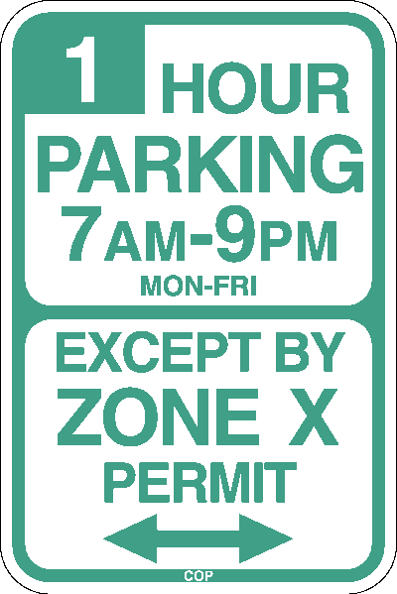
Resolution 37204 in April 2016
PBPM Program Parameters
Purpose and priority of the parking system
Performance targets and other trigger conditions
Coordinating on- and off-street parking into a more seamless system
Criteria and procedures for establishing new meter districts and subdistricts
Parameters for adjusting rates and frequency of adjustments, hours of enforcement, monitoring, evaluation and enforcement protocols
Communication procedures to inform the public of changes in parking management in particular areas

