Slide 1
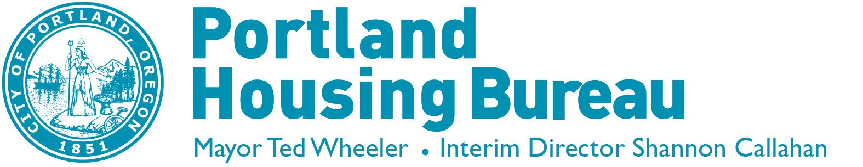
5827 NE Prescott Acquisition
Portland’s Housing Bond
Portland Housing Bureau
Shannon Callahan, Interim Director
July 18, 2018

Slide 2
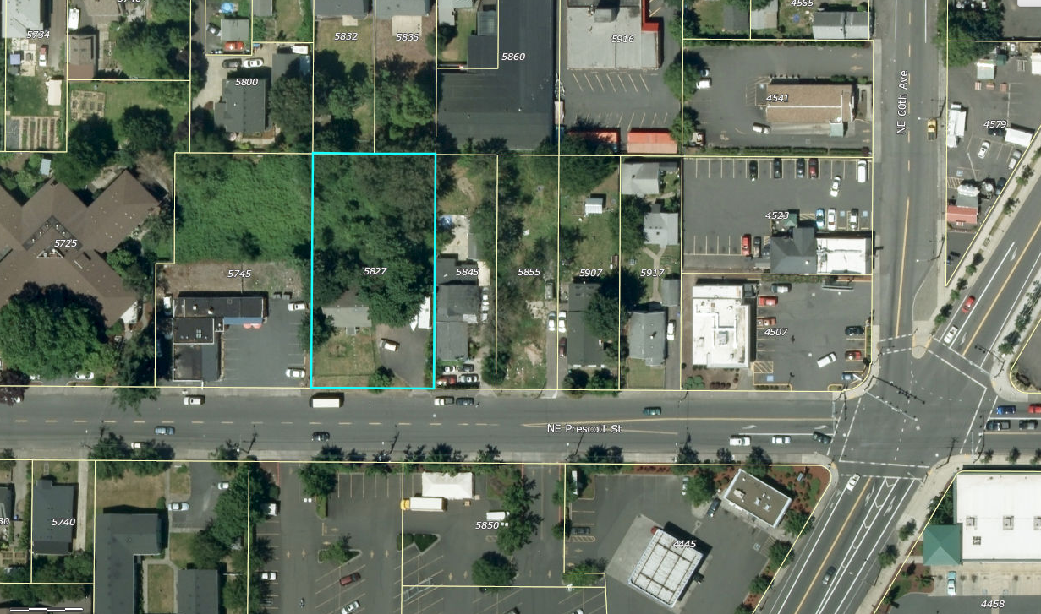

Presentation Panel
  Shannon Callahan
  Portland Housing Bureau
  Todd Struble
  Bond Oversight Committee
  Cameron Herrington
  Living Cully

Slide 3



Bond Production Goals
Overview
600
Units at 0-30% AMI
Units at 31-60% AMI
Supportive Housing units
Family sized units
$258.4
Million
To purchase land for development and existing buildings for new affordable housing
Units affordable at or below 60% of Area Median Income (AMI)
700
300
1,300
Units
650

Slide 4
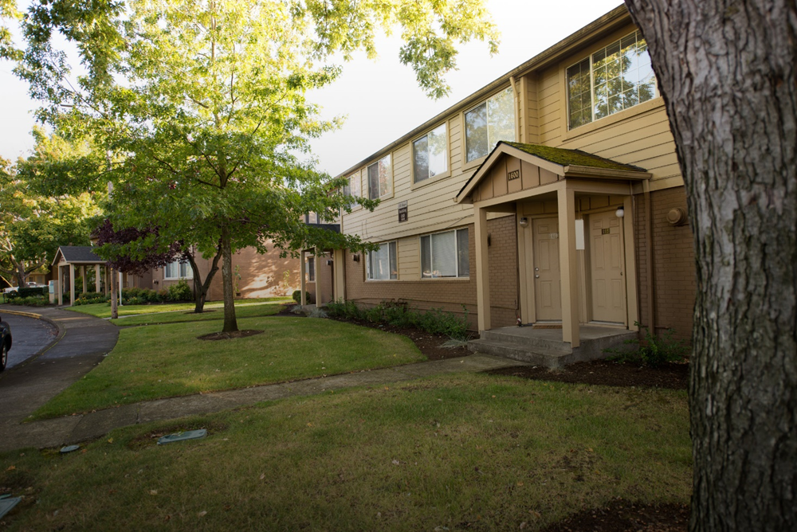
Policy Framework
  Create new housing and prevent displacement
  Prioritize communities of color, families, and households facing homelessness or displacement
  Invest citywide, in areas of high opportunity or at high risk of gentrification

Slide 5
5827 NE Prescott St.
Property Profile
Purchase price: $500,000
Vulnerability Score: 16 (out of 20)
Opportunity Score: 2 (out of 5)
Potential Units: up to 75 (100% affordable)
Potential Supportive Housing Units: up to 13
Potential Persons Housed: (approx.) up to 200
NE Prescott St.
NE Cully Blvd.

Slide 6

Property Assessment: Bond Framework
Meetings aimed at working toward consensus
Standing Committee Members:
  Director
  Assistant Director
  Business Operations Manager
  Finance and Accounting Manager
  Housing Investment & Preservation Programs Manager
  Data Manager
  Representative of Home Forward
  Two representatives of the Bond Oversight Committee
Location, Units, Zoning, Pricing
Site visit to assess property/building condition, surrounding characteristics
Opportunity and vulnerability map scores

Slide 7
Timeline
5827 NE Prescott Street
December 2017: Property submitted to PHB through Bond process
January 2018: Bond Property Review Committee approval
February 2018: Purchase and Sale agreement signed
January 2020: Potential construction start
NE Prescott St
NE Cully Blvd.

Slide 8
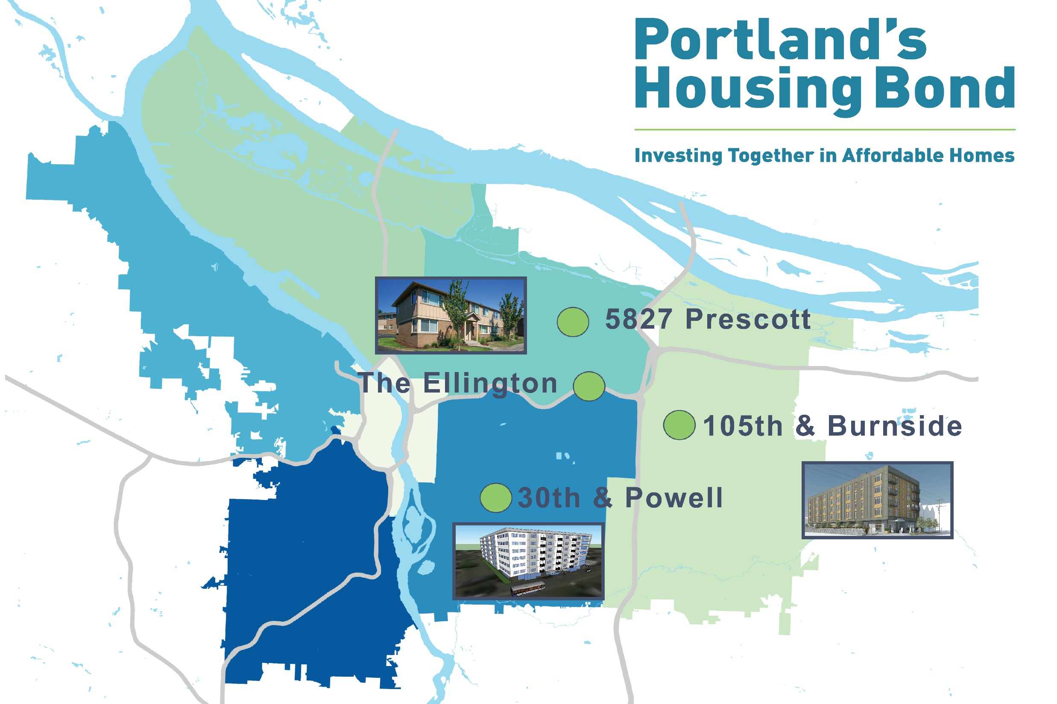
Presentation Title Option One A
Presentation Subtitle.
One to two lines maximum.
Presenter Name, Job Title October 3, 2017

Slide 9

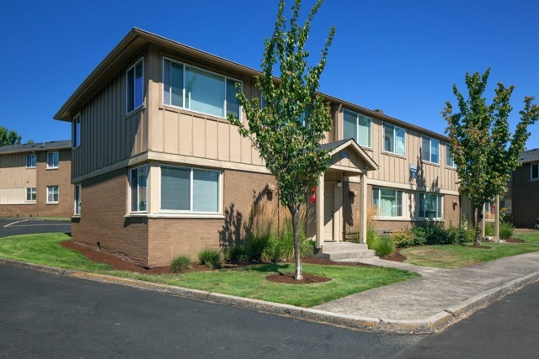
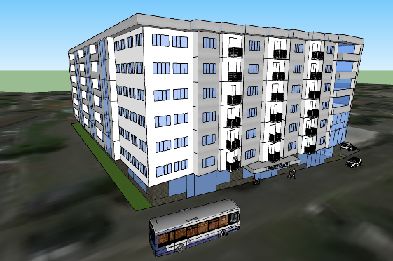
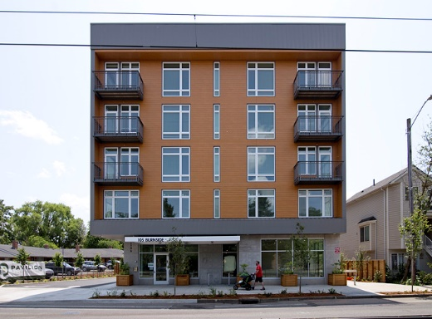

Current Bond Projects
Total Units
514
The Ellington
Acquired February 2017
30th & Powell
Construction early 2019
105th & Burnside
Leasing July 2018
263 units
~200 units
51 units
Est. People
1,623
1106 people
~350 people
167 people

