Slide 1
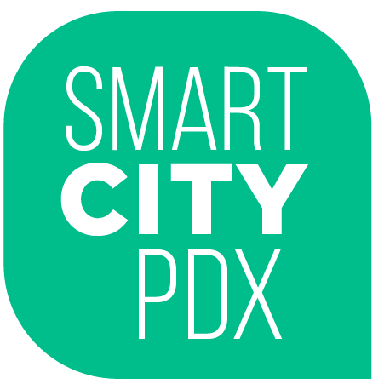
Smart City PDX
Priorities Framework
www.smartcitypdx.com
smartcitypdx@portlandoregon.gov
Notes:
KEVIN

Slide 2
Goal
The City of Portland’s Smart City PDX Initiative goal is to address inequities and disparities using data and investing in technology-driven projects that improve people’s lives.
Notes:
KEVIN

Slide 3
This Priorities Framework is:
How we will lead with equity
Silo-busting, cross-agency, nationally-recognized work
An acknowledgement that resources are limited
Us trying to learn from the past
A starting point for a community conversation
Notes:
KEVIN

Slide 4
This Priorities Framework is not:
Applicable to everything we do with data & technology
An implementation or engagement strategy
Marketing of technology, PR
Notes:
KEVIN

Slide 5
An equity focus tailored to data, information, and technology.
Notes:
Smart City PDX Initiative is focused on learning how data, information, and technology can better support our City goals.
Portland Plan, Comp Plan, Digital Equity Action Plan, Racial Equity Toolkit, etc. clearly establish our commitment to equity and implementation of strategies to address disparities.
The Priorities Framework uses language and values from these plans to set a goal, process, and criteria for centering and upholding equity in the Smart City PDX Initiative tailored to data, information and technology strategies.

Slide 6
The City will:
1. Engage under-served & under-represented populations to:
inform data collection design;
lead identification of needs, priorities and solutions; and
participate in implementation of solutions & iterative assessment.
2. Design data collection to uncover and learn about the barriers that create inequities and disparities and to identify solutions to overcoming those barriers;
3. Use data to understand how solutions benefit and/or further burden underserved communities; specifically consider the balance between collecting information to implement solutions and protecting privacy.
4. Leverage and/or invest city resources in these data-driven solutions.
Notes:
Section 1 describes a process to guide how data, integrated with community engagement, will be collected and used for decision-making within Smart City PDX projects and to determine investments in Smart City PDX projects

Slide 7
Under-served +
Under-represented
When we design policies, programs and practices that center solutions that work for the most marginalized communities, all communities benefit
An explicit and intentional focus on communities of color and communities with disabilities
Notes:
The most persistent and detrimental disparities are starkest when we look at race and disability
Defined underserved and underrepresented as an explicit focus on race and disabilities—as the Mayor stated, when the City designs policies, programs and practices that work for the most marginalized communities, all communities benefit

Slide 8
To receive City support:
Address
Address an inequity/disparity (supported by data and/or information identified by under-served communities).
Acknowledge
Acknowledge that one size does not fit all.
Solve
Solve a problem and define who may be burdened and who benefits (e.g. understand what unintended consequences may occur in order to identify mitigation strategies).
Use
Use data from/about under-served communities in the design of the policy/plan/project.
Identify
Identify indicators/metrics of success that have been developed based on input from under-served communities.
Establish
Establish tools/techniques that allow for ongoing, iterative engagement and evaluation by under-served communities, tools/techniques that account for diversity of backgrounds and needs.
Provide
Provide detailed information about how data is being used and privacy is being protected.
Support
Support a Smart City PDX Focus Area.
Notes:
For vetting and evaluating Smart City PDX projects, plans, policies. If a community partner, private sector, and/or academic partner proposes a project that does not meet these criteria the project will not be pursued as Smart City PDX project.
These criteria will help us vet multiple (and often competing) opportunities, better allocate resources, coordinate and standardize our values into decision-making processes and now gives us a clear starting place for evaluating projects in this initiative.
The framework helps us filter through the various emerging opportunities to focus on our equity goals and be thoughtful about how we use resources.

Slide 9
Focus Areas
Economic Prosperity
Public Safety
Human Health
Environmental Health
Transportation/ Mobility
Education
Housing
Resiliency
Notes:
We have identified 8 focus areas based on our existing citywide plans.
Currently working on a strategy map to help broaden our Smart City PDX work beyond transportation, make connections between existing and upcoming projects across multiple bureaus and offices and identify gaps between projects and community identified needs, issues, and solutions.

Slide 10
Endorsement
The Smart Cities Steering Committee (SCSC) endorses the goal, processes, criteria and focus areas in the Smart City PDX Initiative Priorities Framework.
Notes:
If adopted, framework creates a city-wide coordinated approach for deciding how and if to engage in work.
Implements equity values and strategies across an entire initiative, not as something separate or an overlay.
We think imbedding this thought process from the very beginning can spur more innovative approaches to projects and result in increased, measurable community benefits.

Slide 11
Priorities Framework Build Out
Apply to existing Smart City PDX projects
Use to identify and prioritize future Smart City PDX projects, policies, plans
Work with community partners to implement and evaluate success in meeting the Framework’s Criteria
Notes:
Adopting the Priorities Framework is only the first step.
Next we need to work with our community partners to implement and evaluate our success in meeting the Framework’s Criteria
Example of old project- City IQ sensors, how we share data and involve community. Open data too
Currently exploring strategies for community partnership and means to support community involvement in Smart City PDX. One potential option is to create an Equity Advisory Committee which could help us evaluate how well we are doing centering and upholding equity.
We are also looking for other types of innovative community engagement that would allow us to create true partnerships and not only transactional engagement interactions and strategies to be agile and responsive to the iterative nature of technology and experimentation.

