Slide 1
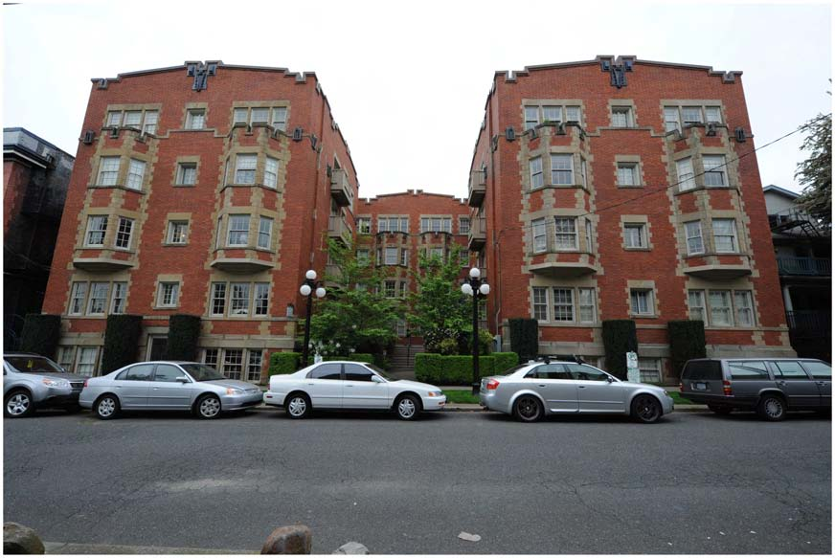
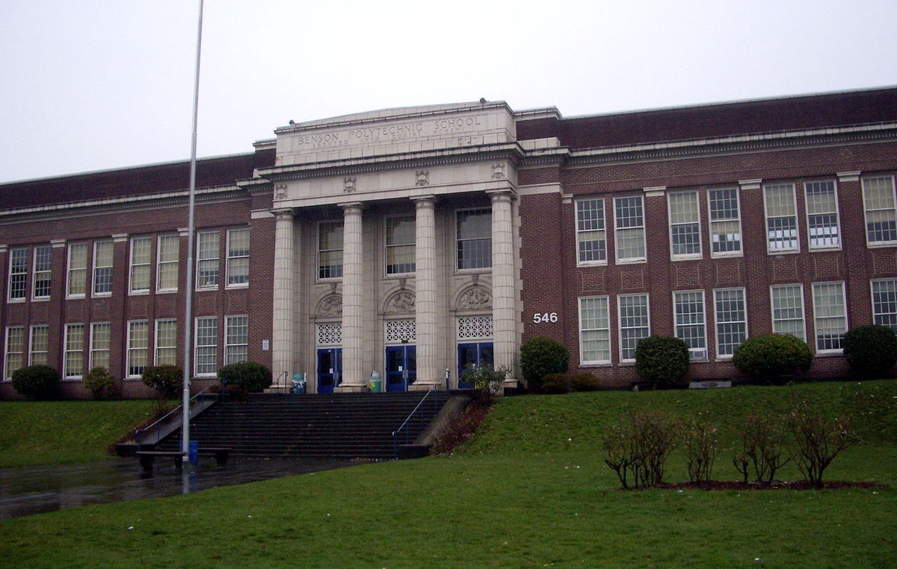
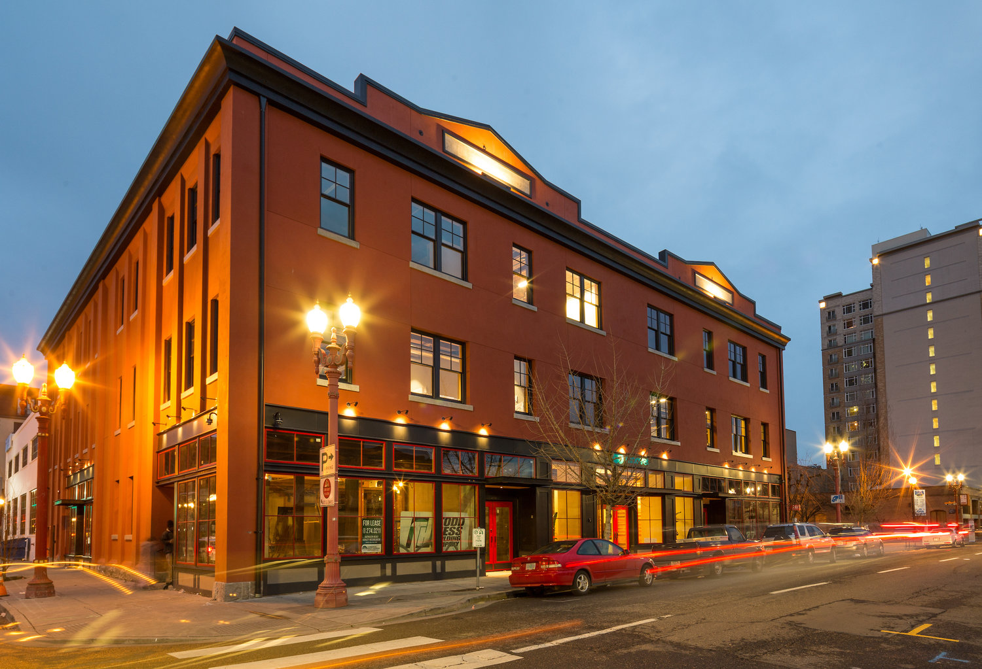
Unreinforced Masonry Building Seismic Retrofit Policy
Jonna Papaefthimiou, PBEM | Amit Kumar, BDS | Shelly Haack, Prosper Portland
June 13, 2018

Slide 2
Resolution before Council
Return to Council within a year with a mandatory retrofit program as described in the URM final report:
Stronger triggers in existing code.
New code to implement mandatory seismic retrofits:
Critical buildings to immediate occupancy in 10 years.
Schools and community centers to damage control in 20 years.
Most commercial buildings to collapse risk reduction in 15 years:
Brace parapets, tie roof to walls, strengthen roof diaphragm,
Tie walls to floors.
Small buildings brace parapets in 10 years.
Notes:
Remind them this is a resolution to bring back implementation language; NOT final language.

Slide 3
Resolution before Council
Return to Council within a year with proposed financial supports including:
Property tax exemption program to offset retrofit costs
Proposal to capitalize and administer a pool of funds (revolving loan)
Program of staff assistance at BDS and Prosper Portland
Legislative agenda for state tax credits:
Seismic tax credit
Historic tax credit.

Slide 4
Resolution before Council
Next Steps
Return to Council within a year with:
Assessment of City-owned URM buildings

Slide 5
Resolution before Council
Next Steps
Return to Council within a year with:
Ordinance for placarding of non-residential URM buildings not retrofitted to prevent collapse:
Ordinance requiring URM building owners to disclose URM status to renters, for buildings not retrofitted to prevent collapse.

Slide 6
Amendments to the Resolution

Slide 7
Proposed Amendment
Add whereas clause to the resolution:
WHEREAS, the City of Portland is experiencing a housing crisis, and therefore has an interest in ensuring that all options to preserve affordability have been explored, especially in URM buildings where public dollars have been invested to guarantee long-term affordable housing. [FISH 1]

Slide 8
Proposed Amendment
Next Steps
Return to Council within a year with:
Assessment of City-owned URM buildings
A financial plan to bring City-owned buildings into compliance with the adopted mandatory seismic retrofitting standards based on the assessed costs. [FRITZ]

Slide 9
Proposed Amendment
Next Steps
Return to Council within a year with a mandatory retrofit program as described in the URM final report:
Stronger triggers in existing code.
New code to implement mandatory seismic retrofits:
Critical buildings to immediate occupancy in 10 years.
Schools and community centers to damage control in 20 years.
Most commercial buildings to collapse risk reduction in 15 years:
Brace parapets, tie roof to walls, strengthen roof diaphragm,
Tie walls to floors.
Class 4 (small) buildings brace parapets in 10 years.
20 years:
20 years.

Slide 10
Proposed Amendment
Add a resolution to form another committee:
City Council directs City staff from the Bureau of Development Services, Prosper Portland, and Bureau of Emergency Management, to formulate a working group comprised of URM building owners, URM building tenants, and other subject matter experts, charged with further evaluating reasonable seismic retrofit requirements, support, incentives, and timelines, for Class 3 and Class 4 URM buildings, and return to Council within a year to report on their findings. This includes identifying specific strategies to achieve wall-floor ties including incentives, financing options, tax strategies, and hardship options. This also includes an evaluation of the impacts on insurances rates for seismically retrofitted buildings, including wall-floor ties. [WHEELER 1]

Slide 11
Proposed Amendment
Add a resolution to shape the committee:
The working group shall be subject to the boards and commissions reforms adopted on November 8, 2017 via resolution no. 37328, including mandatory conflict of interest disclosure. [FISH 3]

Slide 13
Resolution before Council
Next Steps
Ordinance effective March 1, 2019:
Ordinance for placarding of non-residential URM buildings not retrofitted to prevent collapse:
8 x 10 sign with 30-point font.
Reads: This is an unreinforced masonry building. Unreinforced masonry buildings may be unsafe in the event of a major earthquake.
Ordinance requiring URM building owners to disclose URM status to renters, for buildings not retrofitted to prevent collapse.
Reads: This building, which you are renting or leasing, is an unreinforced masonry building. Unreinforced masonry buildings have proven to be unsafe in the event of an earthquake.
This is binding City policy.

Slide 14
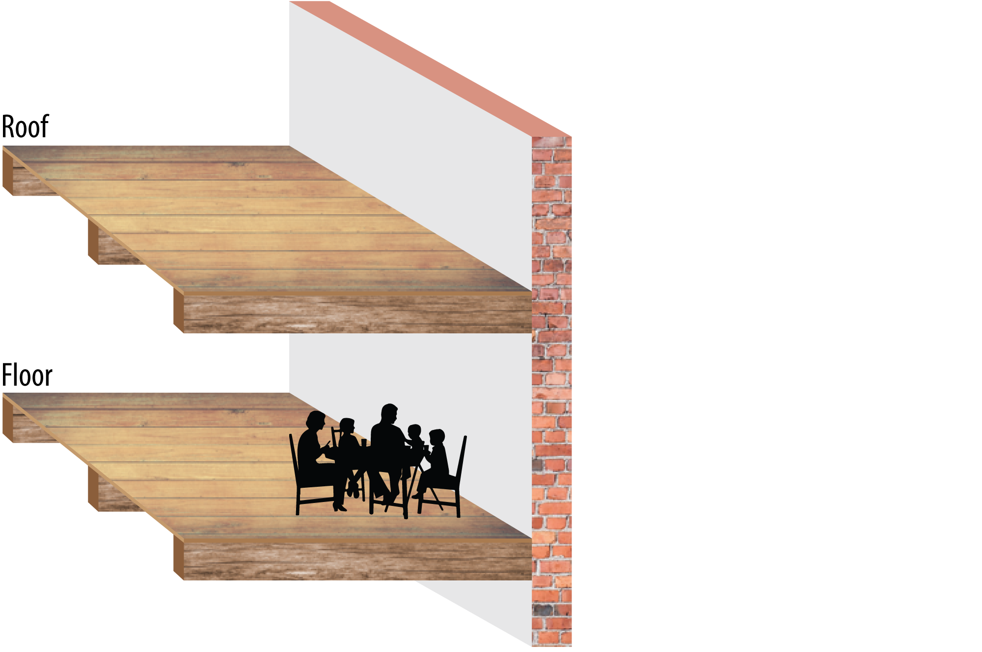
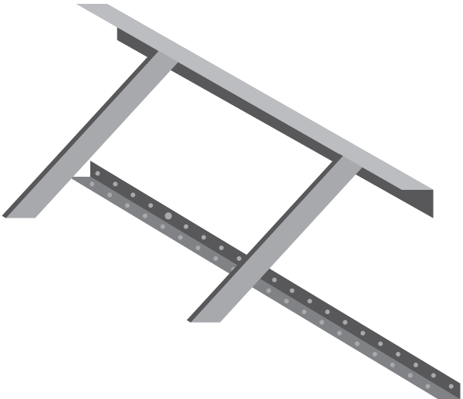
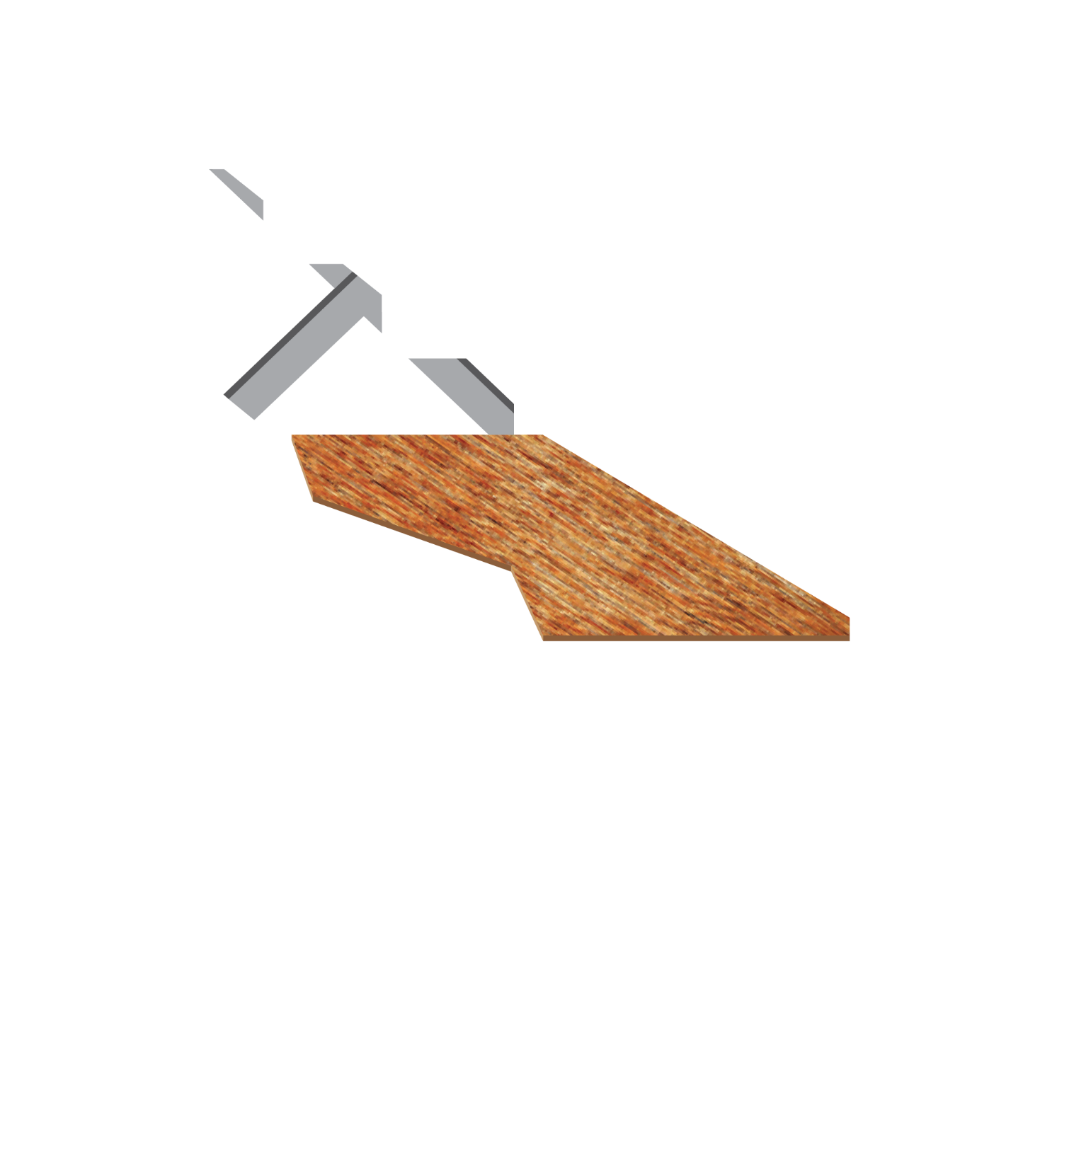
Key Elements of a URM Retrofit
A Brace parapets
B Attach wall to roof
C In-plane shear attachments and roof sheathing, ties and cross ties
D Attach wall to floor
E Out-of-plane wall bracing
F Other upgrades as required

Slide 15
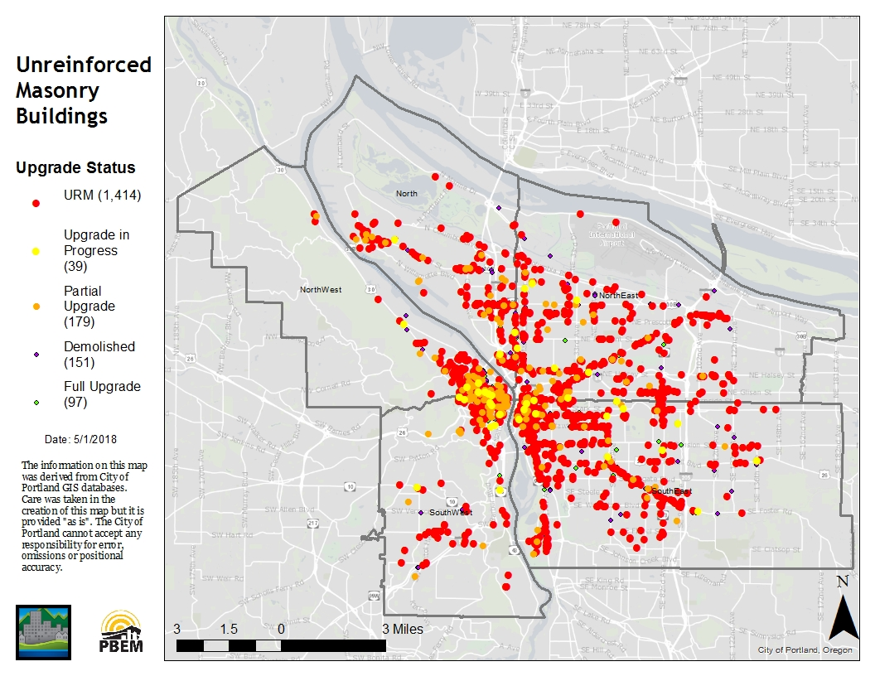
Portland’s URM Buildings
Inventory
Notes:
1,650 citywide, 9% of our building stock.
FEMA says they are most dangerous buildings in an earthquake.
82% of them are commercial buildings, 14% are residential (7,200 residential units).
9% partially retrofitted and 5% fully retrofitted since 1990s

Slide 16
Critical buildings, schools + community centers
Proposed Standard
Class 1 critical buildings achieve immediate occupancy:
10 years to complete all steps
Class 2 schools and community centers achieve damage control
10 years for parapets
20 years for all steps
Notes:
Class 1 estimated cost: Est. cost $70 - $110 SF. There are 6 critical URMs. This IS an engineered standard from American Society of Civil Engineers.
Class 2 estimated cost: Est. cost $48 - 81 SF. There are 44 schools and 13 other public assembly spaces like community centers.

Slide 17
Most commercial buildings (class 3)
Proposed Standard
Collapse risk reduction for 85% of buildings
10 Years for A, B, C
15 Years for D
A Brace parapets
B Attach wall to roof
C In-plane shear attachments and roof sheathing, ties and cross ties
D Attach wall to floor
Notes:
NOT an engineered standard – not from American Society of Civil Engineers

Slide 18
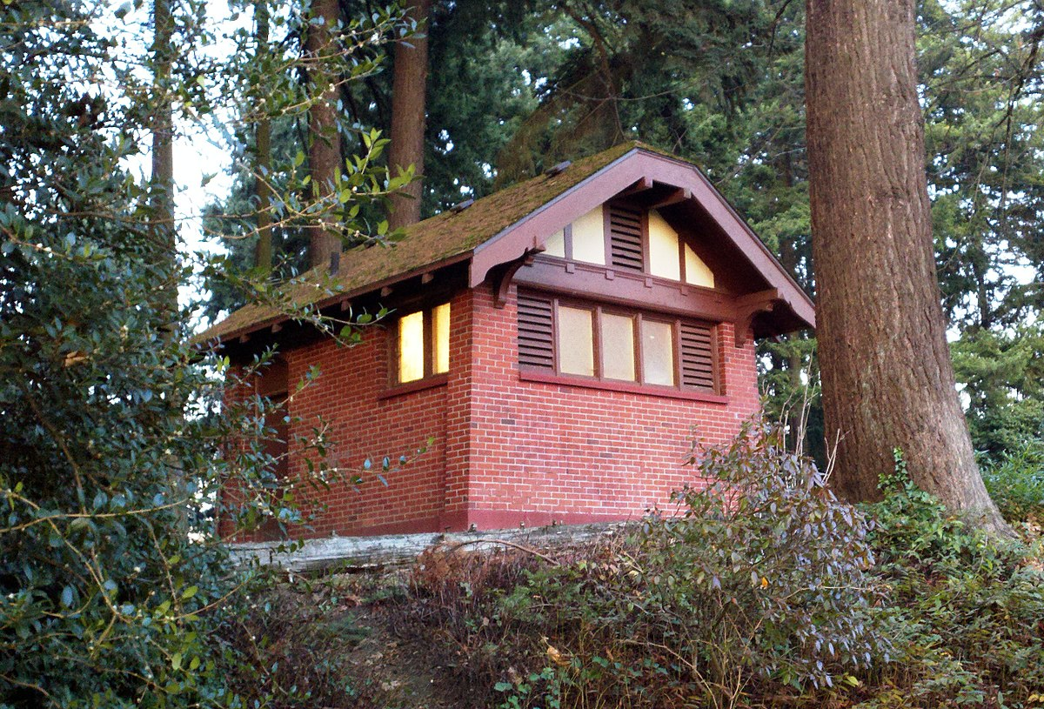
Small buildings, under 10 occupants
Proposed Standard
Brace parapets and tie roof to walls (current code).
10 years to complete.
Notes:
There are 200 buildings in this category

Slide 19
Strengthen existing triggers
Proposed Standard
Triggers in existing seismic regulations (Title 24.85):
Roof replacement – removal of greater than 50% of total roof area within a 5 15 year period requires wall anchorage for both in plane and out of plane forces and parapet bracing.
Costs of alterations or repair - When costs associated with building alterations or repair in a two five year time period or fifteen year time period exceeds, entire building shall be improved to resist seismic forces to meet ASCE 31 41 criteria.

Slide 20
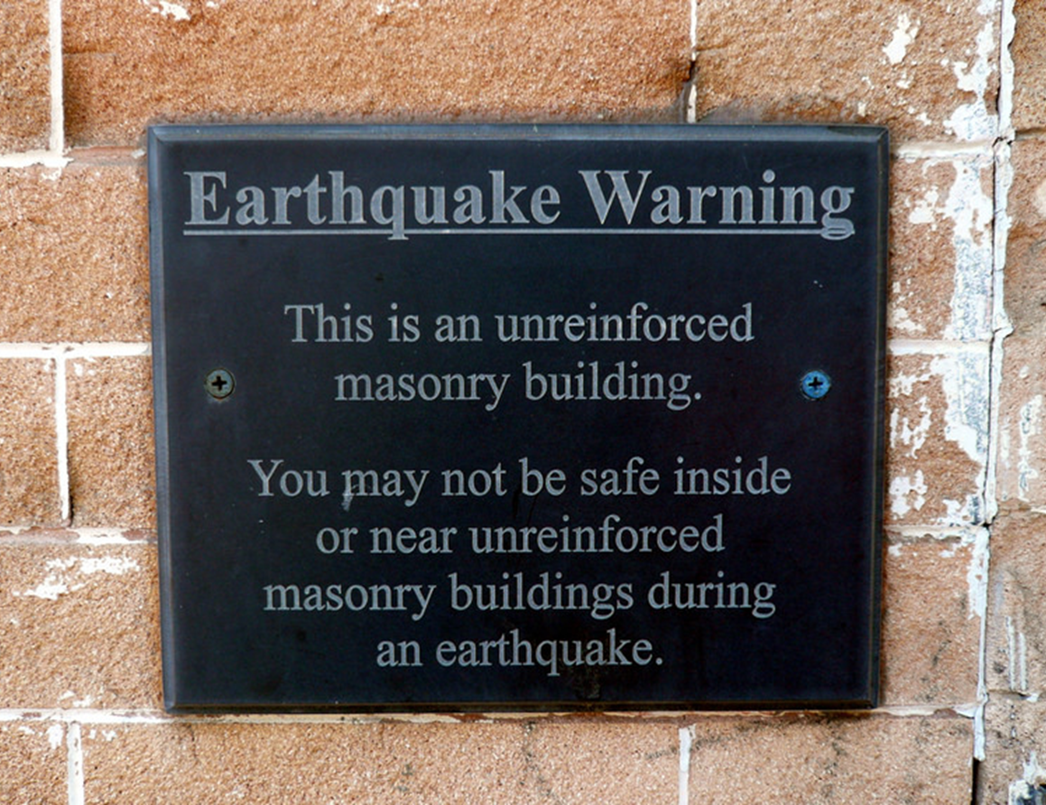
Public Notification
Proposed Policy
Placard non-residential URM buildings not retrofitted to Collapse Prevention.
Notify renters in the lease agreement if a URM is not retrofitted to Collapse Prevention.
Notes:
MENTION THIS IS STAFF RECOMMENDATION

Slide 21
Support for URM Building Owners
Proposed Support
Existing:
Property Fit (Seismic C-PACE)
Authorized:
Property Tax Exemption (SB 311)
Proposed:
State historic tax credit
State seismic tax credit
Capital pool to provide financial assistance
City staff as advocates at BDS and Prosper Portland

